Slide 1
Ecological Threat Report 2025

Slide 2
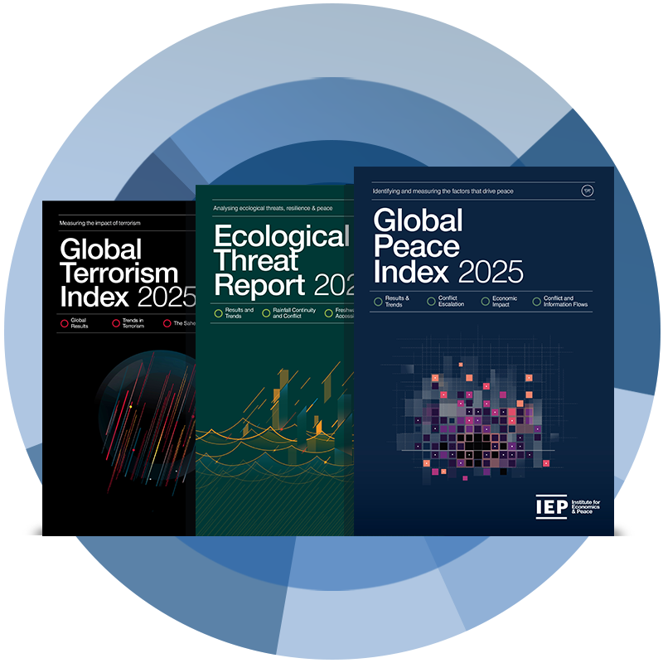
ABOUT US
Making the case for peace with data and research
The Institute for Economics and Peace (IEP) is an independent, not-for-profit think tank dedicated to building a greater understanding of the key drivers of peace and the economic benefits that increased peacefulness can deliver.
Founded in 2008, IEP is headquartered in Sydney, Australia, with offices in Brussels, New York, and Nairobi.

Slide 3
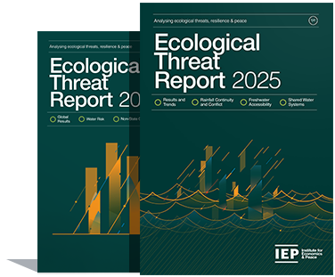
Ecological Threat Report
Ranks
Includes
Covers
>99%
of the world’s population
172
3,125
countries and territories
local administrative areas
Assesses
Scores
Examines
2019-2024
4
➔ Water Risk
➔ Food Insecurity
➔ Impact of Natural Events ➔ Demographic Pressure
risk domains on a 1-5 scale

Slide 4
Results and Trends

Slide 5
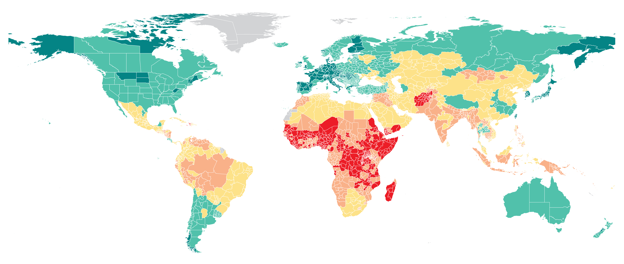
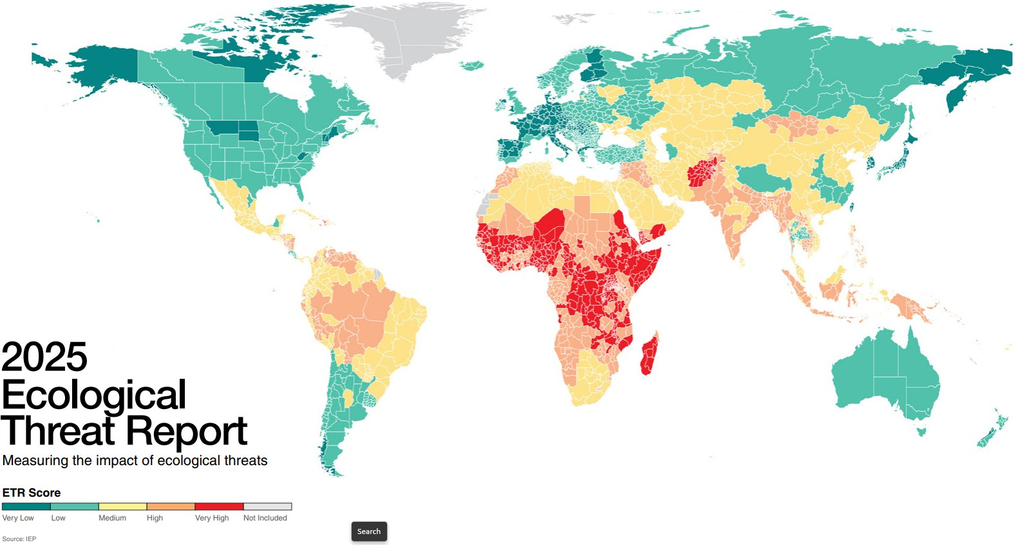
Global ETR scores, 2024

Slide 6
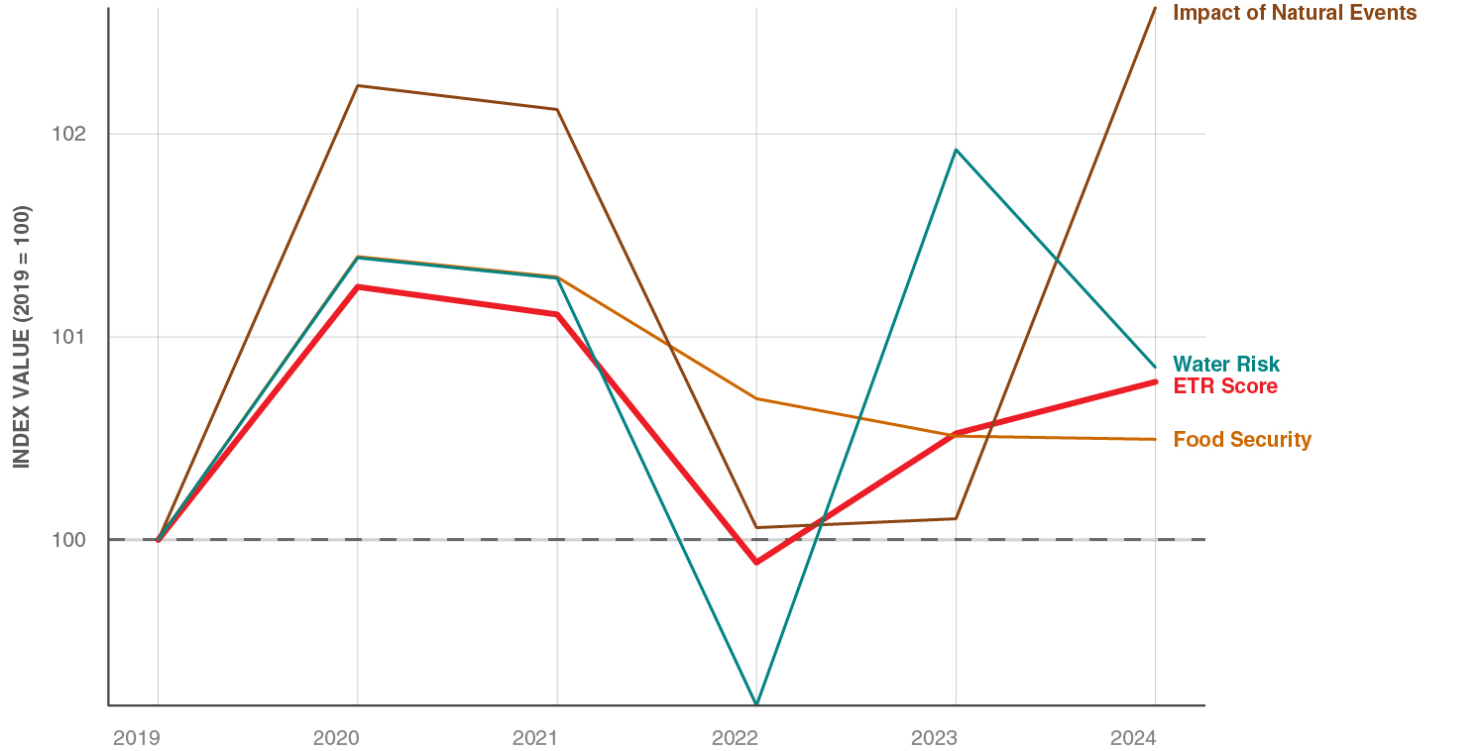
Changes since 2019
Indexed trend in global ETR indicator scores, 2019–2024
The average global ETR score rose 0.8% since 2019.
96 countries deteriorated; 74 improved.
Water risk and the impact of natural events show the most year-on-year volatility, as they are grounded in climate dynamics.
Food insecurity spiked in 2020 as a result of COVID-19, and it has slowly been improving since.
Demographic pressure is forward-looking and is the only indicator with no time series data.

Slide 7
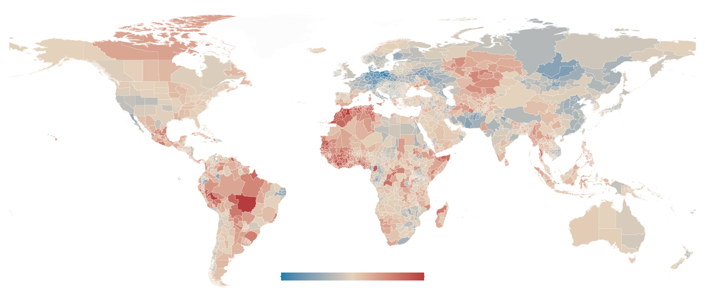
Changes since 2019
Northwest and West Africa: sharpest deteriorations since 2019.
Tunisia, Algeria and Morocco saw largest overall rises in water risk.
Western-Central Brazil had the second largest subnational deterioration in the world, owing to extreme wildfires in 2024.
Central and Western Europe: largest improvements.
The improvements in Europe largely represent a reversion to normal following anomalously dry condition in 2019.
Changes in global ETR scores, 2019-2024
Most improved Most deteriorated

Slide 8
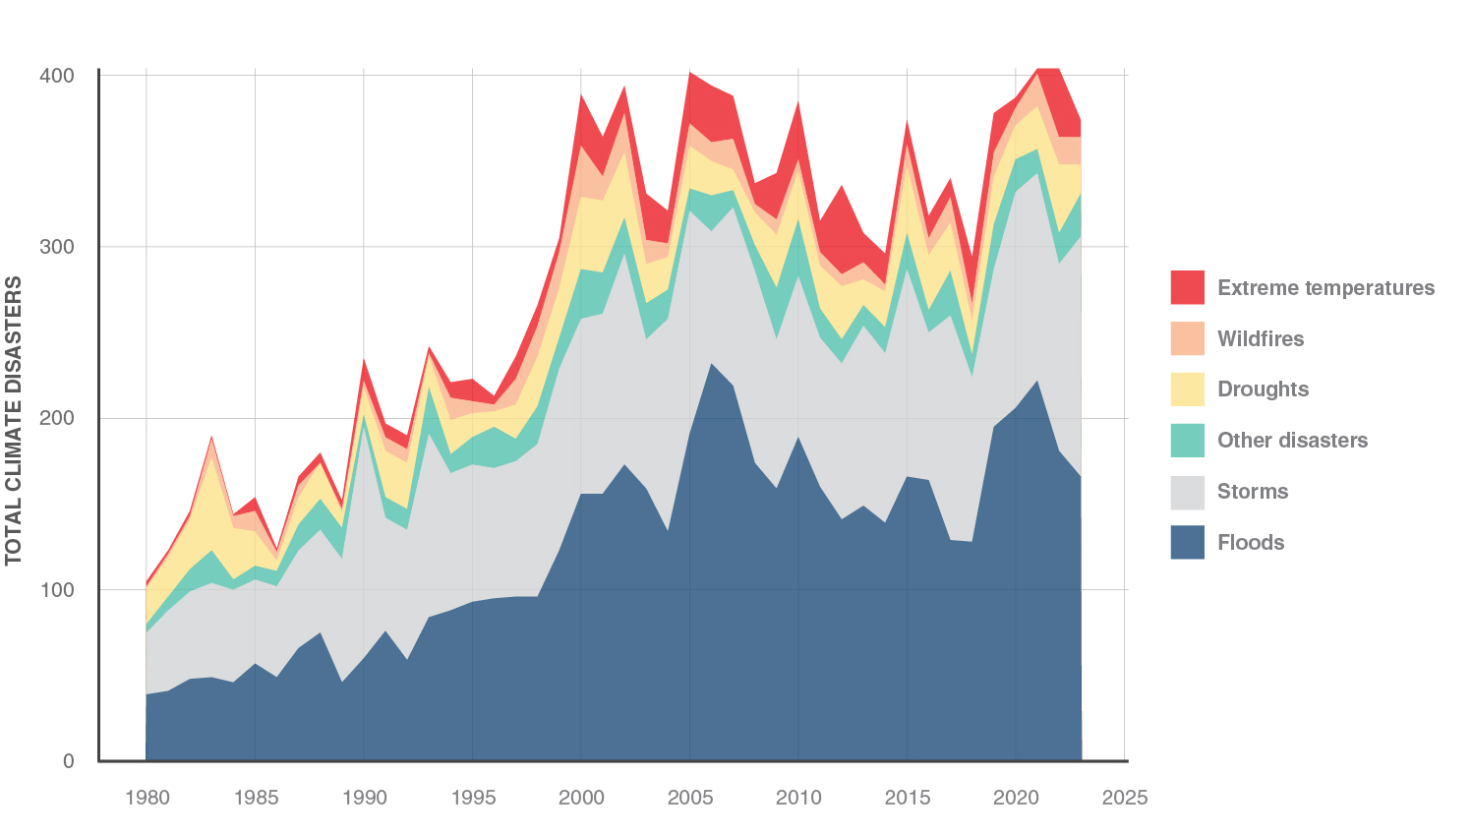
Impact of Natural Events
This indicator measures how dangerous climate-related disasters – such as floods, storms, or heatwaves – are likely to be for populations.
2024 saw 45 million climate-related displacements, the most on record. Most displacements came from storms/floods.
These displacements affect high-, middle-, and low-income countries, but the impacts are longest lasting in the poorest places.
Annual recorded climate-related disasters have more than doubled since the 1980s.
However, better infrastructure, warning, and response systems have reduced deaths per event more than 50-fold in the past century.
Climate-related disasters, 1980–2023

Slide 9
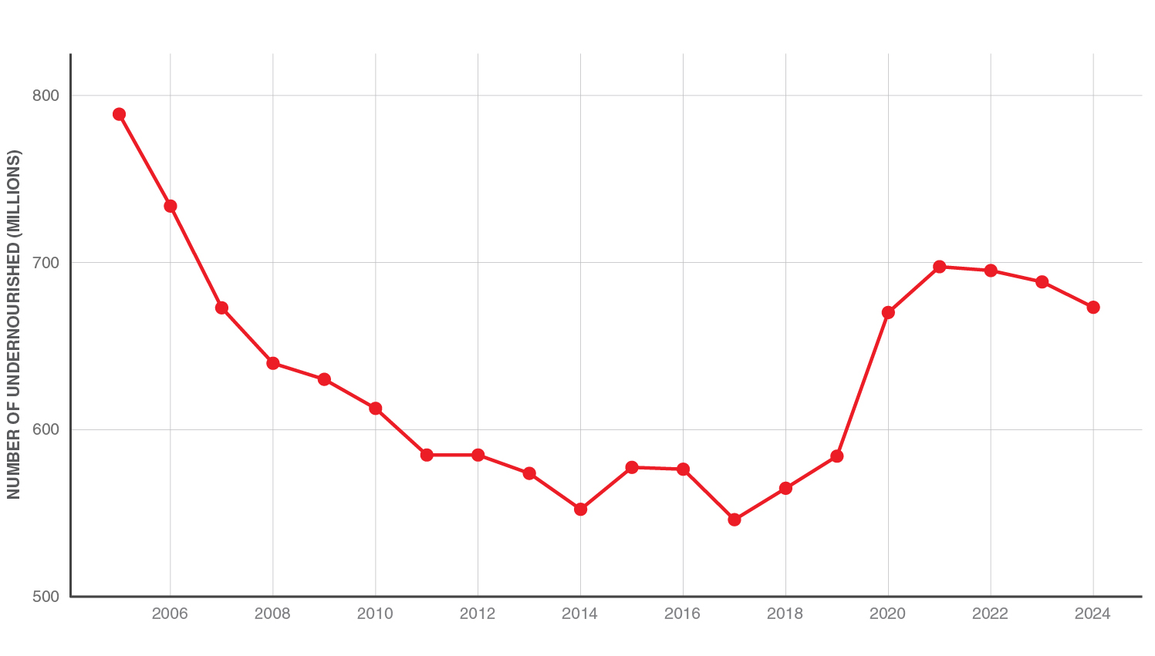
Food Insecurity
The ETR food insecurity indicator measures the likelihood that people will have sufficient food.
It considers availability, accessibility, affordability, and the risks posed by conflict and violence to supply chains.
Food insecurity spiked with the onset of the COVID-19 pandemic.
Between 2019 and 2021, the number of food insecure people rose by 300 million, to a total of 2.3 billion.
There have been modest improvements since, but food insecurity will likely not return to its pre-pandemic levels until around 2029.
Number of undernourished people, 2005-2025

Slide 10
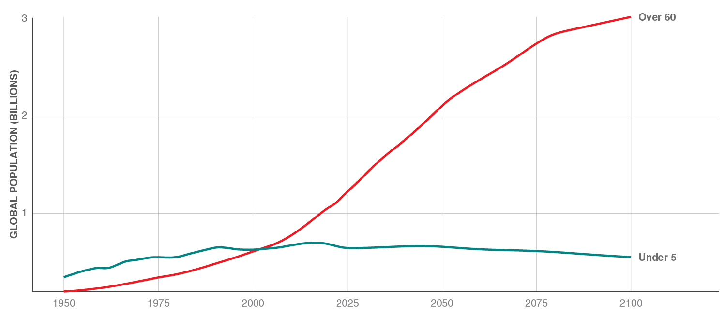
Demographic Pressure
The ETR demographic pressure indicator measures projected population growth rates to 2050.
Sub-Saharan Africa is expected to experience the most rapid growth in next 25 years, potentially expanding by 70 per cent.
Niger, Uganda, and Malawi are projected to grow the most.
However, global population growth estimates have repeatedly been revised downward in recent years.
Many countries will see plateauing or shrinking populations, particularly in Europe and East Asia.
This will result in an increasingly ageing population, which will present other, non-ecological challenges.
Number of people over 60 and under 5, 1950–2100

Slide 11
Water Risk and Freshwater Availability

Slide 12
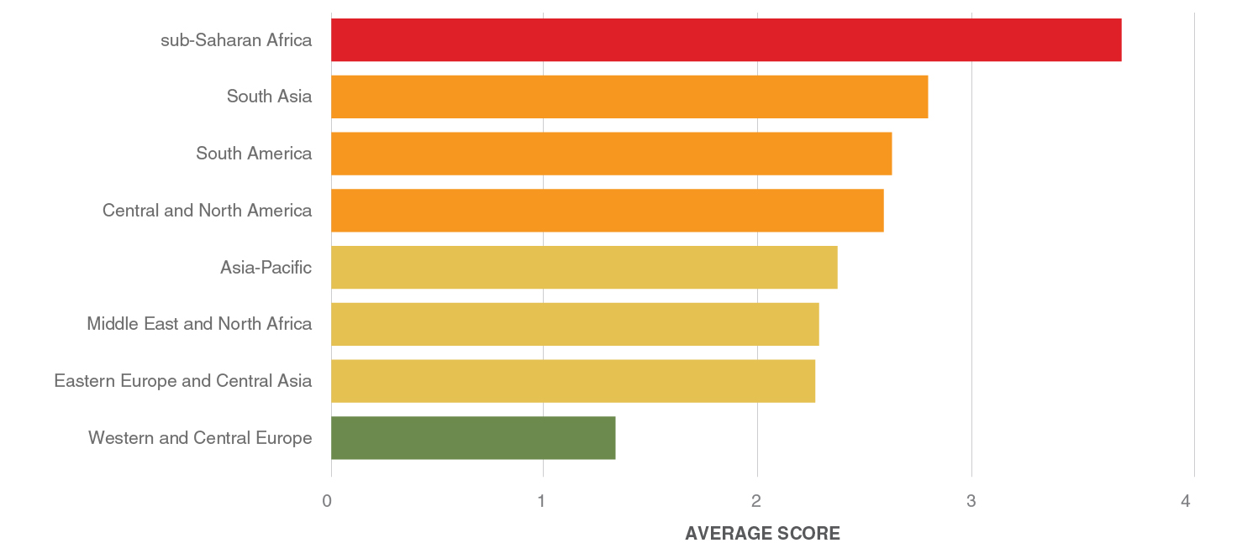
Water Risk
The ETR water risk indicator measures the reliability of access to safe drinking water.
It combines two measures: the proportion of the population with access to clean water and the frequency of extreme monthly rainfall deficits compared with historical averages.
Sub-Saharan Africa has the highest average levels of threat in this indicator, followed by South Asia and South America.
Between 2019 and 2024, South America experienced the greatest increase in threat levels.
Western and Central Europe, the region with the lowest overall levels of threat, experienced the largest improvement since 2019.
Regional water risk scores, 2024

Slide 13
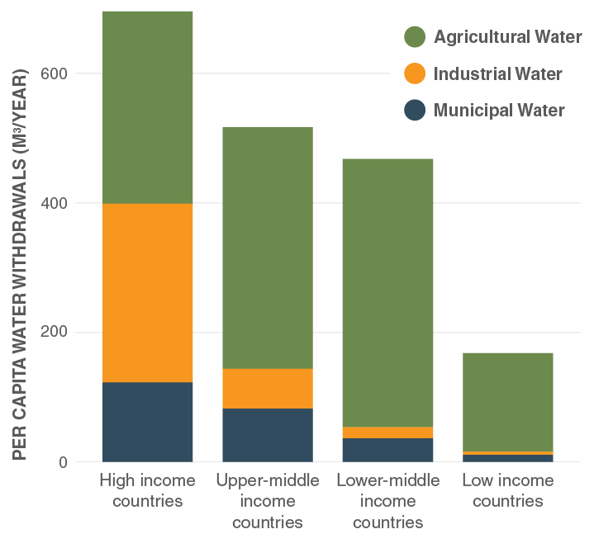
Freshwater availability
Per capita water withdrawals by sector and country income groups, 2022
Total renewable flows of freshwater are about 44,000 cubic kilometres per year, which has been relatively stable over the decades.
But with population growth, the amount of freshwater per person has fallen from about 18,000 cubic metres in 1950 to about 5,000 today.
On a per capita basis, high-income countries withdraw the most freshwater, while low-income countries withdraw the least.
More than 70% of global water withdrawals go to agriculture.
In wealthy countries, greater amounts are used for industrial and household/municipal use.

Slide 14
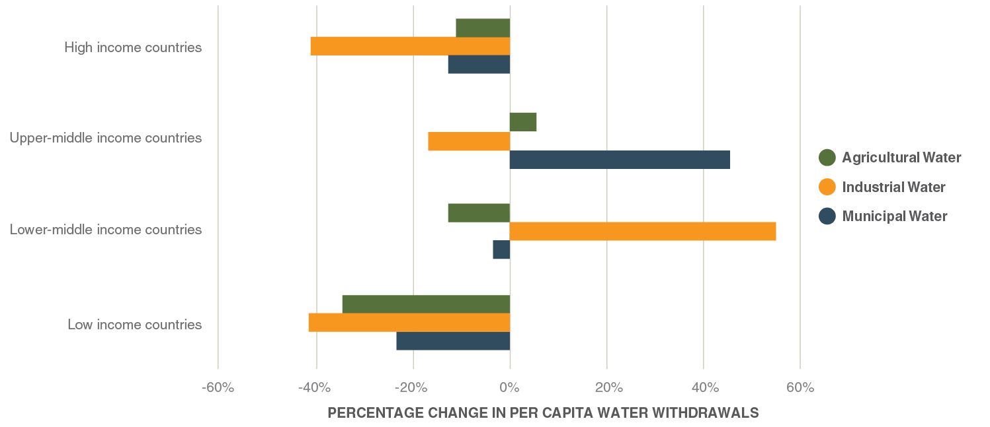
Trends in freshwater withdrawals
Per-capita withdrawals peaked in 2008 and have fallen about 14% since.
Total water withdrawals appear to have peaked in 2019.
Much of these improvements seem to be the result of more efficient use in high-income countries.
Improvements in wealthy countries are highly impactful owing to their disproportionate water use.
Middle-income countries show mixed trends.
While low-income countries are withdrawing more water than ever, population growth has resulted declines in water use on a per capita basis.
This means that water is increasingly scarce in such settings.
Changes in per capita water withdrawals by sector and country income groups, 2000-2022

Slide 15
Rainfall Continuity and Conflict

Slide 16
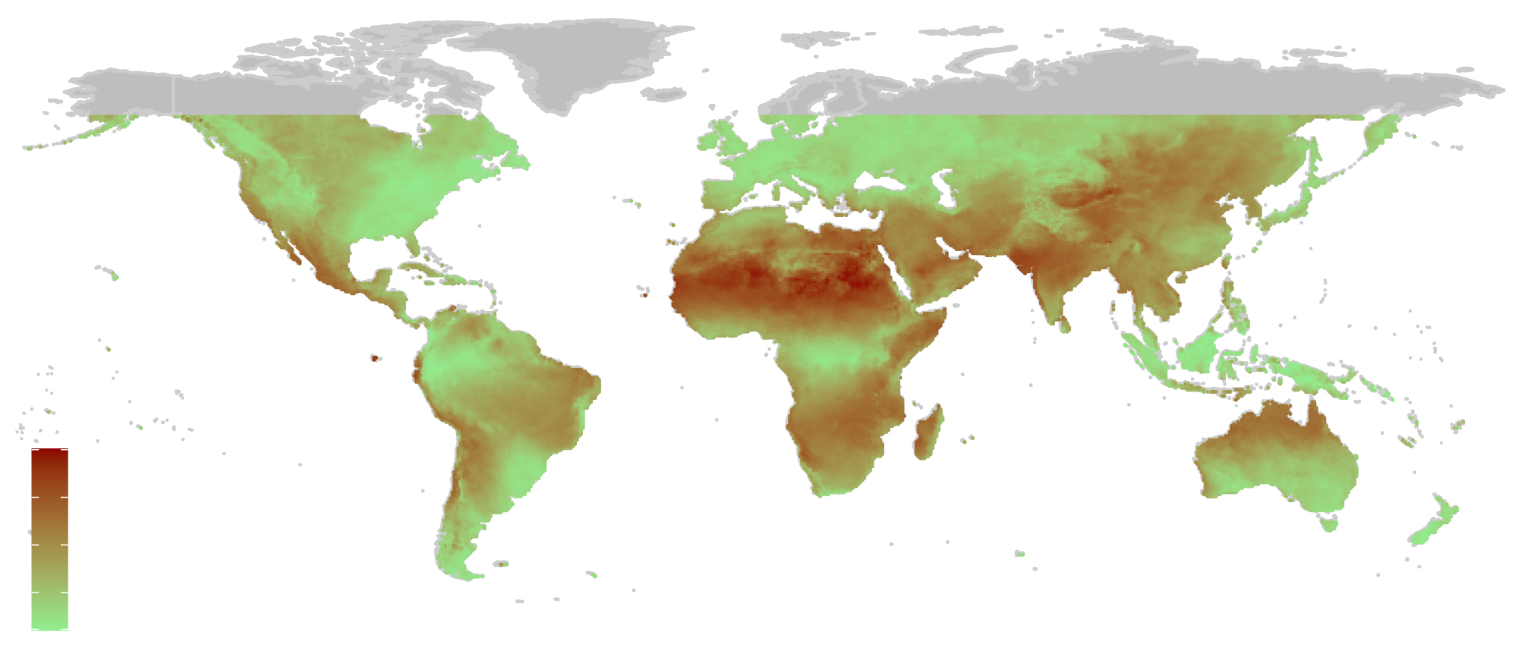
Rainfall seasonality
Rainfall variability refers to how much rainfall fluctuates over time – either from year to year or within a given season.
A related concept is rainfall seasonality, which describes the degree to which rainfall is concentrated in a few months throughout the year.
Seasonality tends to be highest in highly arid areas, where rainfall is generally uncommon, but which occasionally receive bursts of rain.
Rainfall seasonality index, 2005-2025
High seasonality
Low seasonality

Slide 17
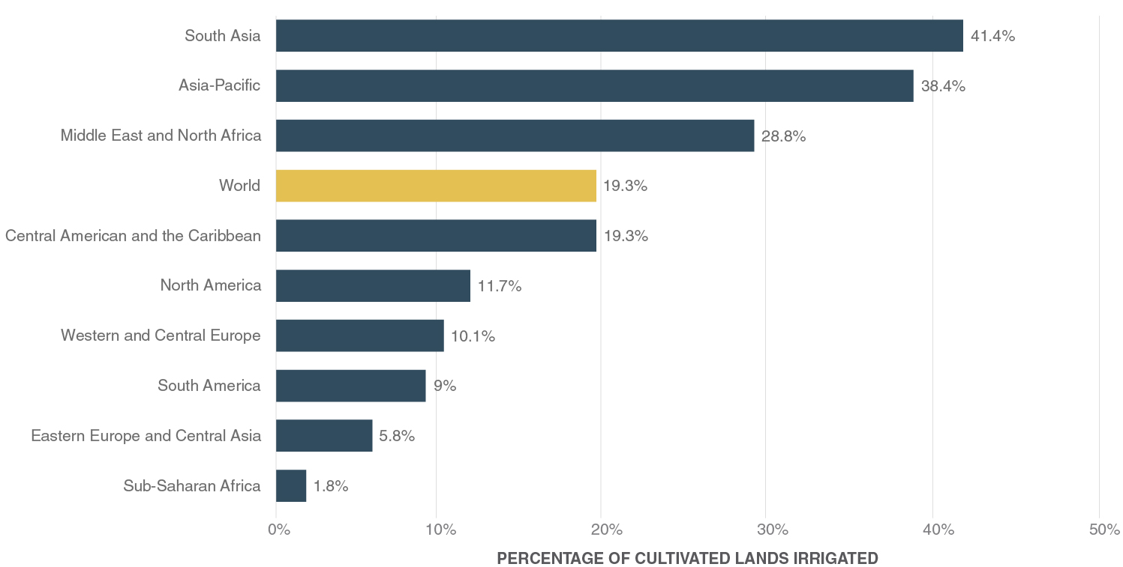
Rainfall dependence
Most food production around the world is highly dependent on rainfall.
Communities across the globe have developed intricate knowledge systems around local rainfall regimes.
These patterns govern when to plant, when to harvest, and when to migrate livestock.
Less than 20% of the world’s cropland is irrigated (though it produces 40% of the world’s food).
Sub-Saharan Africa has the lowest irrigation rates in the world.
Prevalence of irrigation by region, 2021

Slide 18
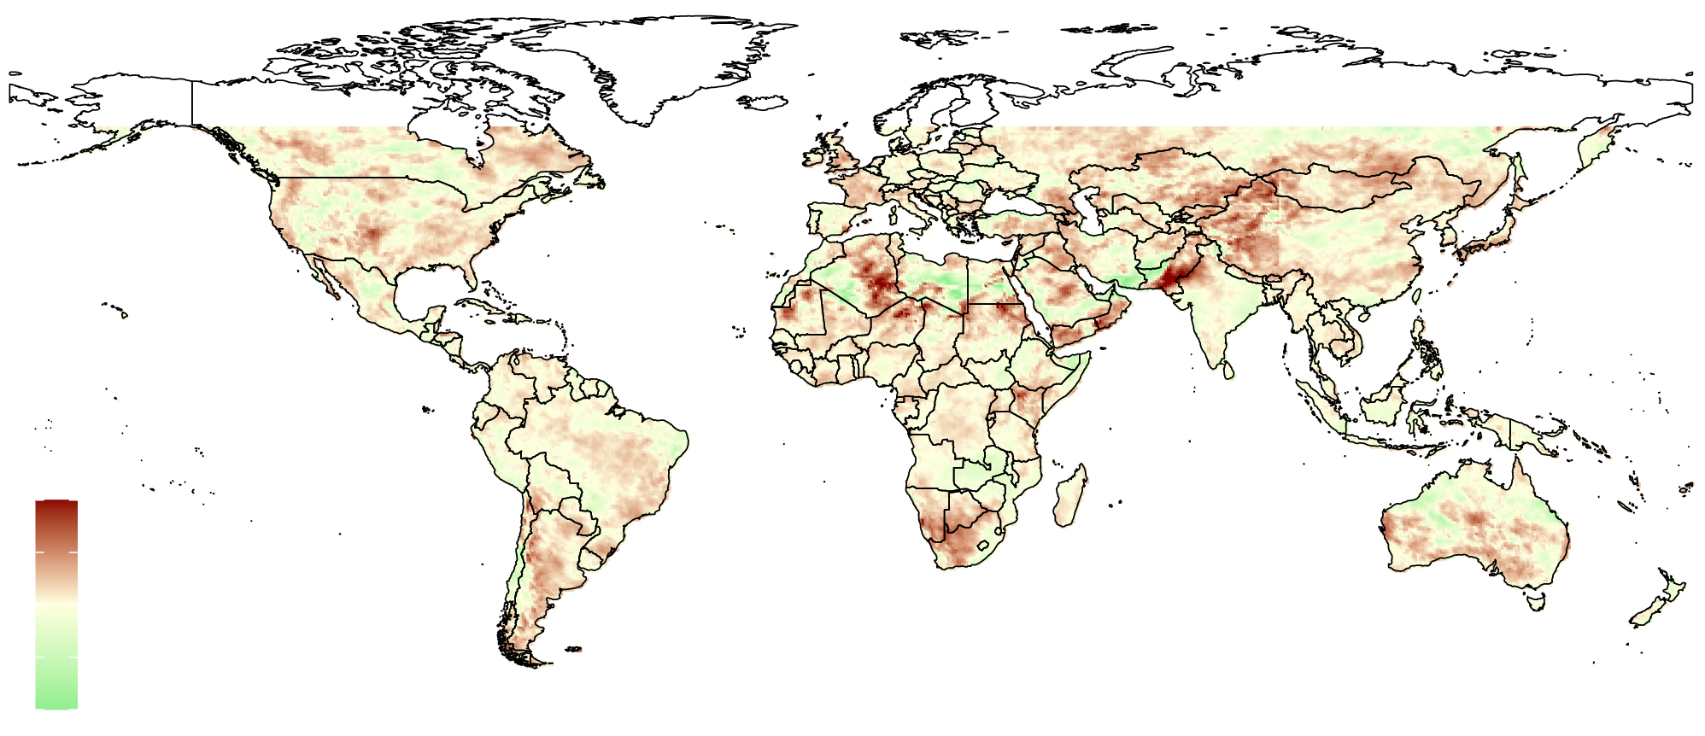
Increasing seasonality
Rising rainfall seasonality represents a critical disruption for food production and many agrarian economies.
More than 60% of the world has seen rainfall seasonality increase over the past two decades.
In most areas, these increases have been marginal, but in others they have been moderate or severe.
Unpredictability, not just scarcity, is the critical risk.
Change in rainfall seasonality, 2020-2025 vs 2005-2010
Increasing seasonality
Decreasing seasonality

Slide 19
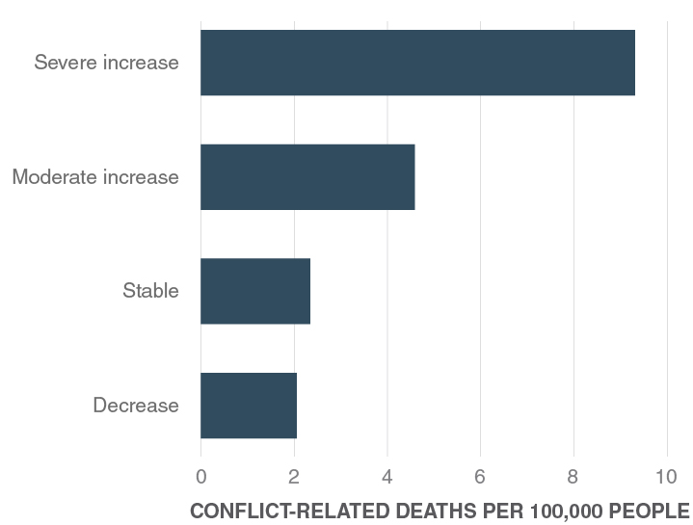
Seasonality changes and conflict
Average subnational conflict fatality rates, by seasonality trend
The world has registered more than 1.7 million conflict-related fatalities since 2018.
This equates to a global annual rate of about 2.8 conflict deaths per 100,000 people.
Globally, subnational areas where rainfall seasonality has decreased or remained stable average 2.1-2.4 conflict deaths per 100,000 people per year.
In areas of moderate seasonality increase, the average is 4.6 deaths per 100,000 people.
In areas of severe increases, it is 9.4 deaths.

Slide 20
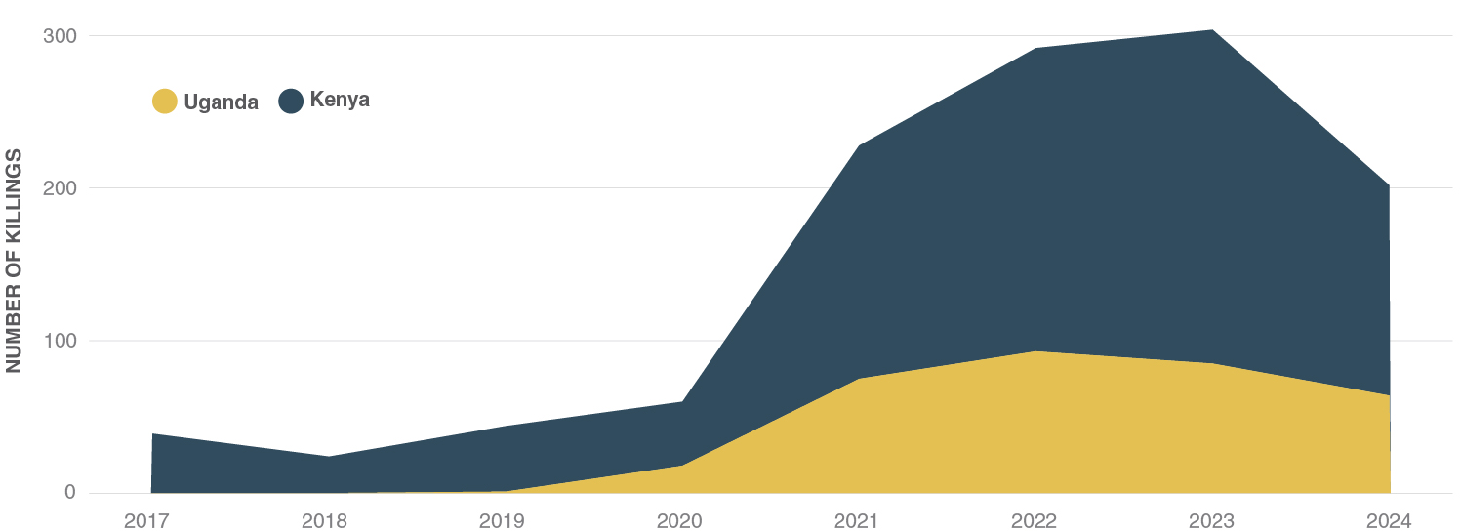
East Africa’s Karamoja Cluster
The 2025 ETR includes an in-depth profile of a region called the Karamoja Cluster in East Africa.
The region is known for cross-border agropastoralism, and it has a history of cattle raiding and pastoral violence.
Among the non-desert regions of sub-Saharan Africa, the Karamoja Cluster has experienced the greatest increases in rainfall seasonality in the past two decades.
After a period of relative peace in the 2010s, pastoralist violence in Karamoja has recently been on the rise, amid increasing water pressures.
Killings attributed to pastoralist groups, Kenya and Uganda, 2017–2024

Slide 21
Shared Water Systems:
Cooperation, Co-Existence and Conflict

Slide 22
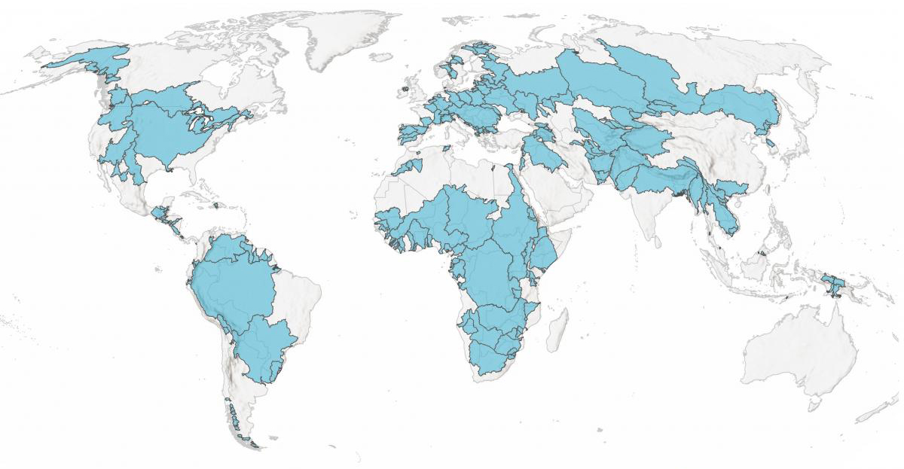
Transboundary river systems
There are over 300 transboundary river and lake basin systems around the world.
More than 150 countries share a system with at least one other country.
Billions of people depend on these systems for food, energy, and water.
Shared dependencies on rivers like the Nile, the Mekong, and the Indus can raise the stakes for interstate relations.
But they can also incentivise cooperation.
Shared river basins around the world

Slide 23
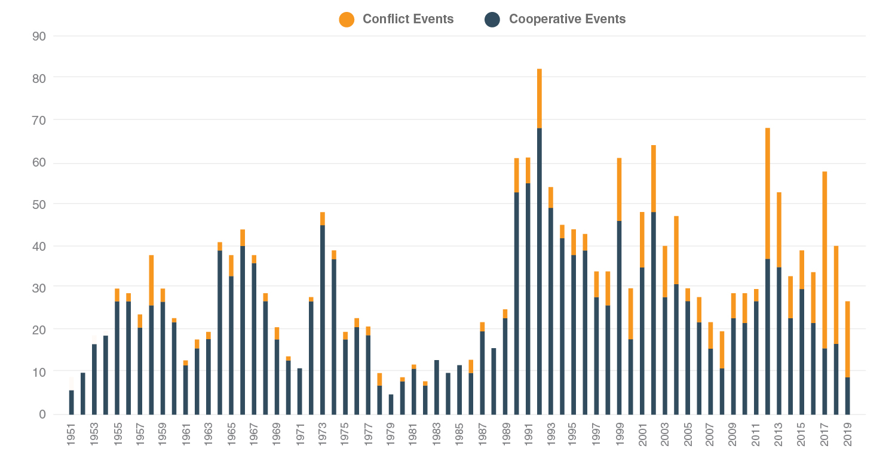
Water conflict and cooperation
Popular narratives have warned of looming “water wars”, especially in transboundary river and lake basins.
However, interstate wars fought exclusively over water have not occurred in the modern era.
In fact, since the 1950s, recorded water cooperation events have been far more common than conflict events.
But since 2013, conflict events have been on the rise.
This makes the lessons from successful river sharing arrangements critical to understand and replicate.
Water-related conflict and cooperation events, 1951–2019

Slide 24
Key Takeaways
Water risk is the system’s keystone
Water risk underpins every other ecological pressure, shaping risks related food insecurity, natural disasters, and population stress.
Variability drives instability
It’s not just overall scarcity, but the timing and predictability of rain and other water sources that drive risk.
Cooperation outweighs conflict
Shared river systems like the Nile, Mekong, and Indus link billions of people. Interdependence both raises stakes and incentivises collaboration.
Targeted investments can bend risk curves
Smart investment in storage, small-scale irrigation, and water governance reduces both food and disaster risks.

