Slide 1
Global Terrorism Index 2025
Measuring the impact of terrorism

Slide 2
Mission & About Us
“
The Institute for Economics & Peace aims to create a paradigm shift in the way the world thinks about peace.
We are an independent, not-for-profit think tank dedicated to building a greater understanding of the key drivers of peace, as well as identifying the economic benefits that increased peacefulness can deliver.

Slide 3
Our international office
New York
Brussels
The Hague
Sydney Head Office
Mexico City
Nairobi

Slide 4
Implementing Partners
Lloyds Foundation
Global Partnership for the Prevention of Armed Conflict
Philippine Government
State of Jalisco Government Mexico
Peace by Chocolate

Slide 5
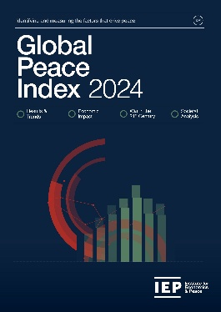
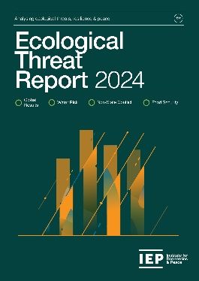
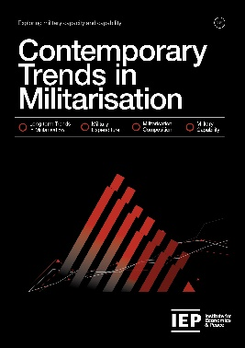
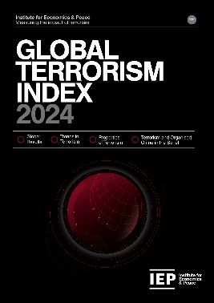
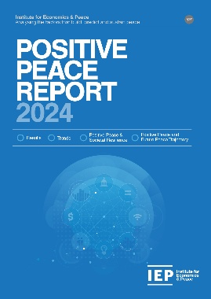
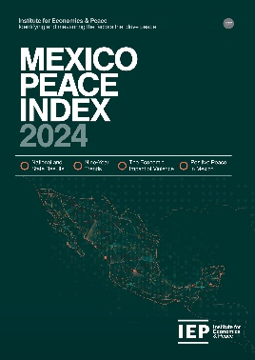
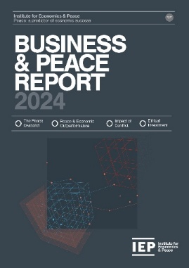
Our major reports
IEP Research
IEP produced 6 major reports each year and up to six minor reports
IEP also produces many specialised reports including coverage of the Ukraine, COVID and the Sahel and the effects on peace

Slide 6
Institute for Economics & Peace
Research used extensively by organisations, including the OECD, Commonwealth Secretariat, World Bank and the United Nations
44BN
1.5BN
170
MEDIA REACH
SOCIAL REACH
COUNTRY REACH
Work is included in thousands of university courses
Over 350,000 downloads of IEP reports
10
3000
2M
PUBLISHED REPORTS
BOOK REFERENCES
UNIQUE VISITORS

Slide 7
What is Global Terrorism Index?
01.

Slide 8
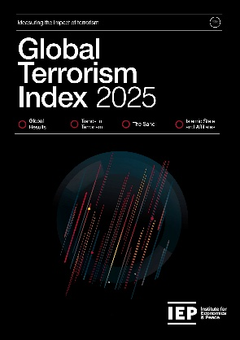
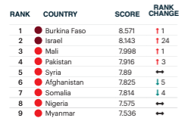
Global Terrorism Index: Methodology
Definition of terrorism: the systematic threat or use of violence, by non-state actors, whether for or in opposition to established authority, with the intention of communicating a political, religious or ideological message to a group larger than the victim group, by generating fear and so altering (or attempting to alter) the behaviour of the larger group.
Over 5 years to measure long term impact
Indicator | Weight
Incidents | 1
Injuries | 0.5
Deaths | 3
Hostages | 0.5
Year | Year minus 1 | Year minus 2 | Year minus 3 | Year minus 4
52% | 26% | 13% | 6% | 3%
Socio-economic indicators
Logarithmic banding scores (1-10)

Slide 9
GTI 2025 Results
02.

Slide 10
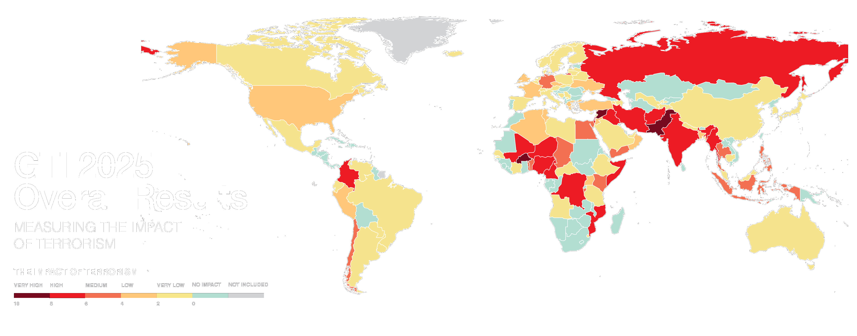
Notes:
Needs map

Slide 11
Key Findings 2025
Deaths from terrorism constant at 7,555 in 2024, after deducting Hamas Oct 7th attack.
Attacks decreased to 3,492, a 3% fall.
The number of countries with a recorded terrorist incident increased from 58 to 66 countries in 2024.
Forty-five countries deteriorated, while 34 improved when compared to 2023.
98% of terrorist deaths occur in a conflict one.
More conflicts than at any time since the end of WWII – 69.

Slide 12
Key Findings 2025…con’t
The four deadliest terrorist groups killed 11% more people in 2024.
TTP in Pakistan fastest growing terrorist organisation – deaths up by 90% to 558 deaths.
Seven Western countries in worst 50 countries.
93% of all deaths in the west caused by lone actors.
Lone actors 3 times more likely to be successful than group.
Islamic State and its affiliates remained the world’s deadliest terrorist group in 2024, and is active in 22 countries, one more than in 2023.

Slide 13
Key Findings 2025…con’t
The Sahel is the most affected region globally, accounting for over half of all deaths from terrorism.
Western and African influence waning.
Burkina Faso remains the most impacted country despite a 57% drop in attacks and 21% in deaths.
A fifth of all terrorism deaths globally were in Burkina Faso, followed by Pakistan and Syria.
Niger and Pakistan had the largest increases in deaths from terrorism, with increases of 94% and 45% respectively.

Slide 14
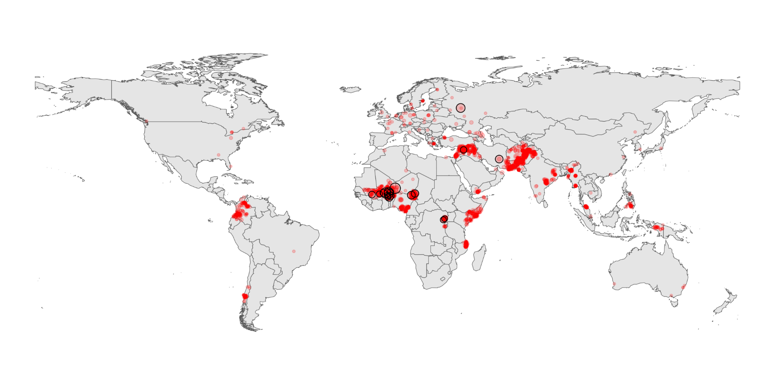
Terrorist Attacks in 2024
Source: TerrorismTracker, IEP Calculations

Slide 15
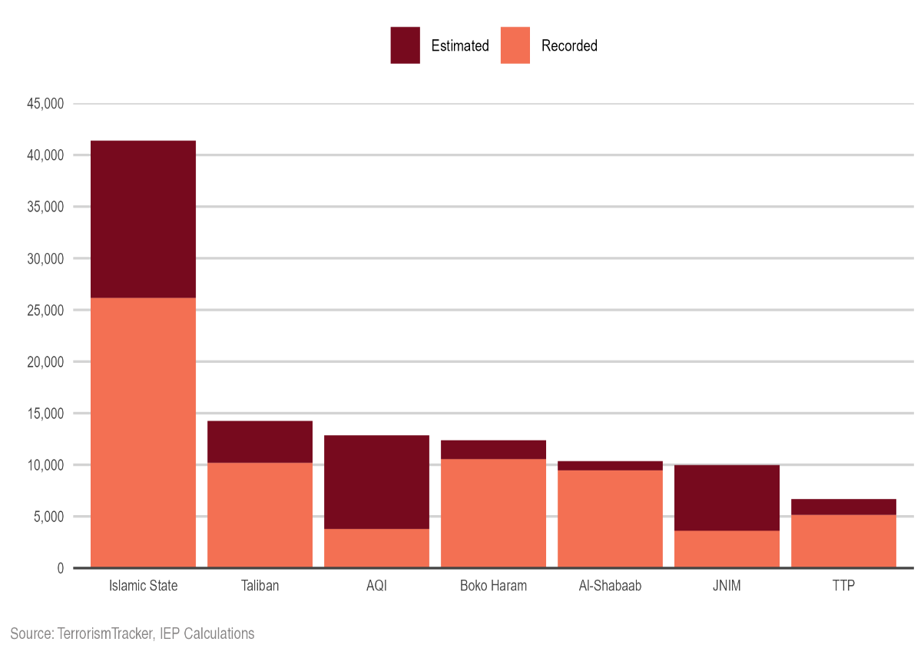
Methodological Issues
Fundamental considerations:
Taliban no longer classified as terrorist organisation, leading to large drop in deaths in Afghanistan
Fall in the number of active groups and an increase in unattributed attacks.
Using Machine Learning, unattributed deaths can be attributed to existing groups.
Over the period 2007-2024, IS deaths would have been 58% higher (26,000 deaths attributed -> 41,000 deaths estimated)

Slide 16
The Countries Most Impacted by Terrorism, 2025
Burkina Faso recorded the highest impact of terrorism for the second consecutive year.
1
BURKINA FASO
Rank change:
6
Nigeria
Rank change: 2
2
PAKISTAN
Rank change: 2
7
SOMALIA
Rank change:
3
SYRIA
Rank change: 2
8
ISRAEL
Rank change: 6
4
Mali
Rank change: 1
9
AFGHANISTAN
Rank change: 3
5
Niger
Rank change: 5
10
CAMERON
Rank change: 2

Slide 17
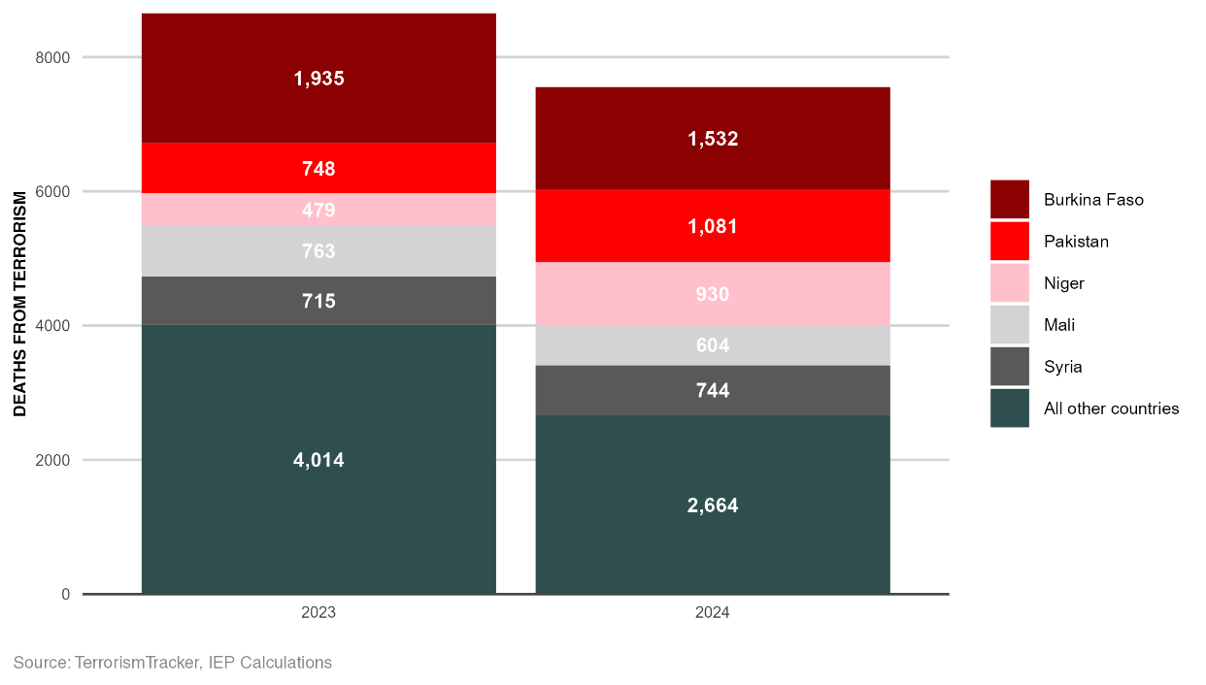
Five Countries Account for Bulk of Terrorism
Deaths in 5 most impacted countries increased by 5%
Deaths fall 34% for all other countries
Terrorism activity remains
highly concentrated

Slide 18
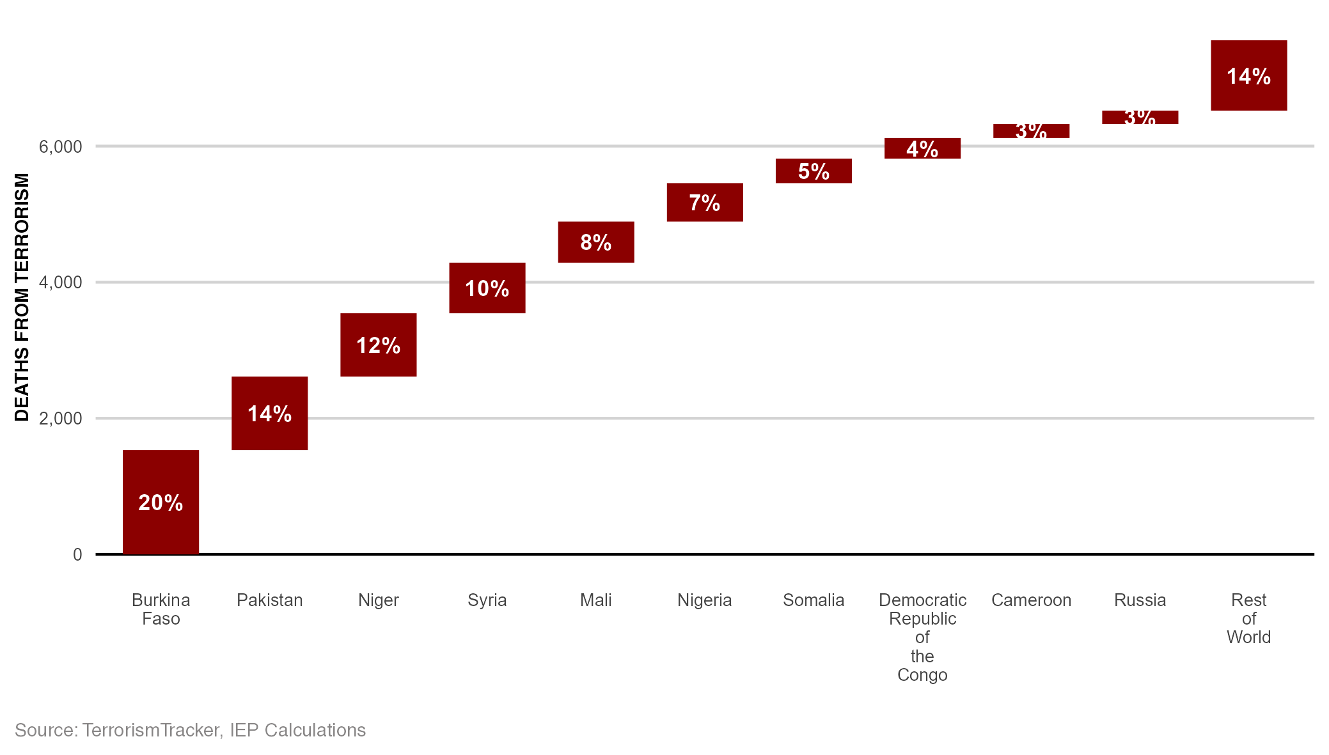
Deaths from Terrorism by Country, 2024
Ten countries accounted for 86% of all deaths from terrorism in 2024.

Slide 19
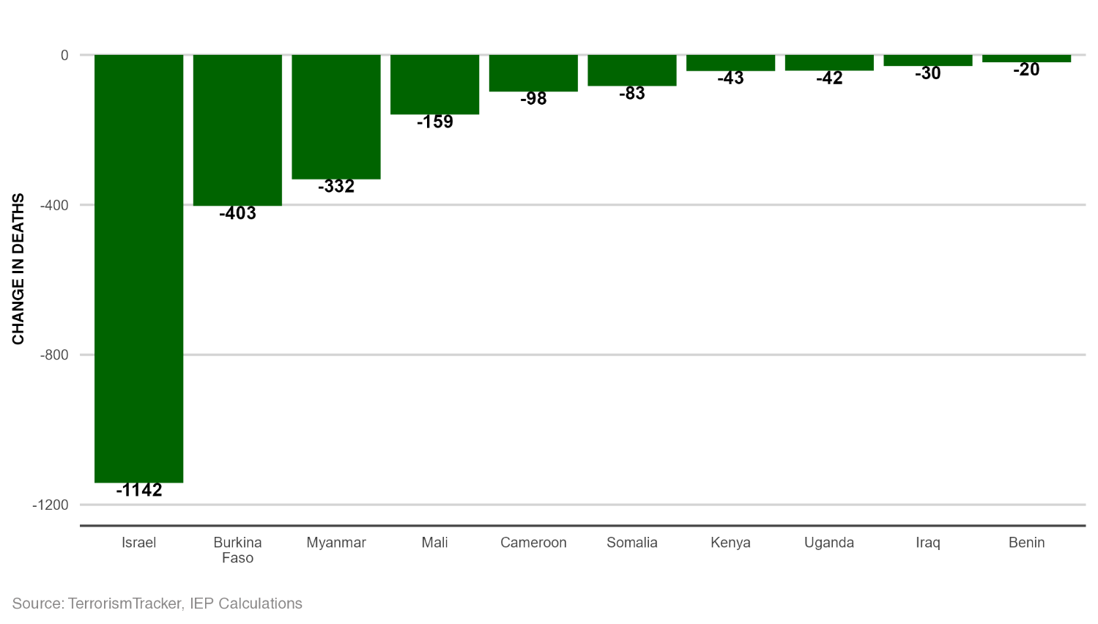
Decreases, Deaths from Terrorism, 2023 - 2024
Israel had the largest decrease in the number of deaths from terrorism since 2023.

Slide 20
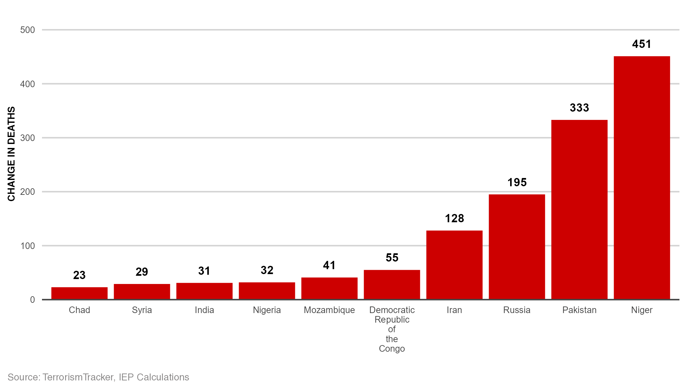
Increases, Deaths from Terrorism, 2023 - 2024
Niger had the largest increase in deaths from terrorism between 2023 and 2024.

Slide 21
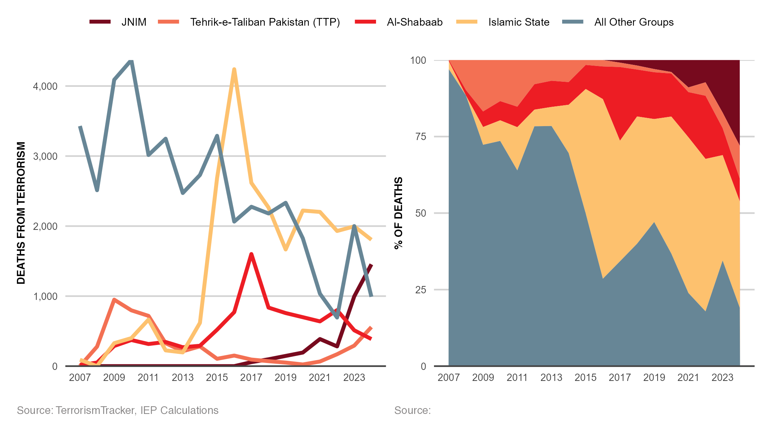
Attributed Deaths by Terrorist Groups, 2007 - 2024
Islamic State was the deadliest terrorist group of 2024.

Slide 22
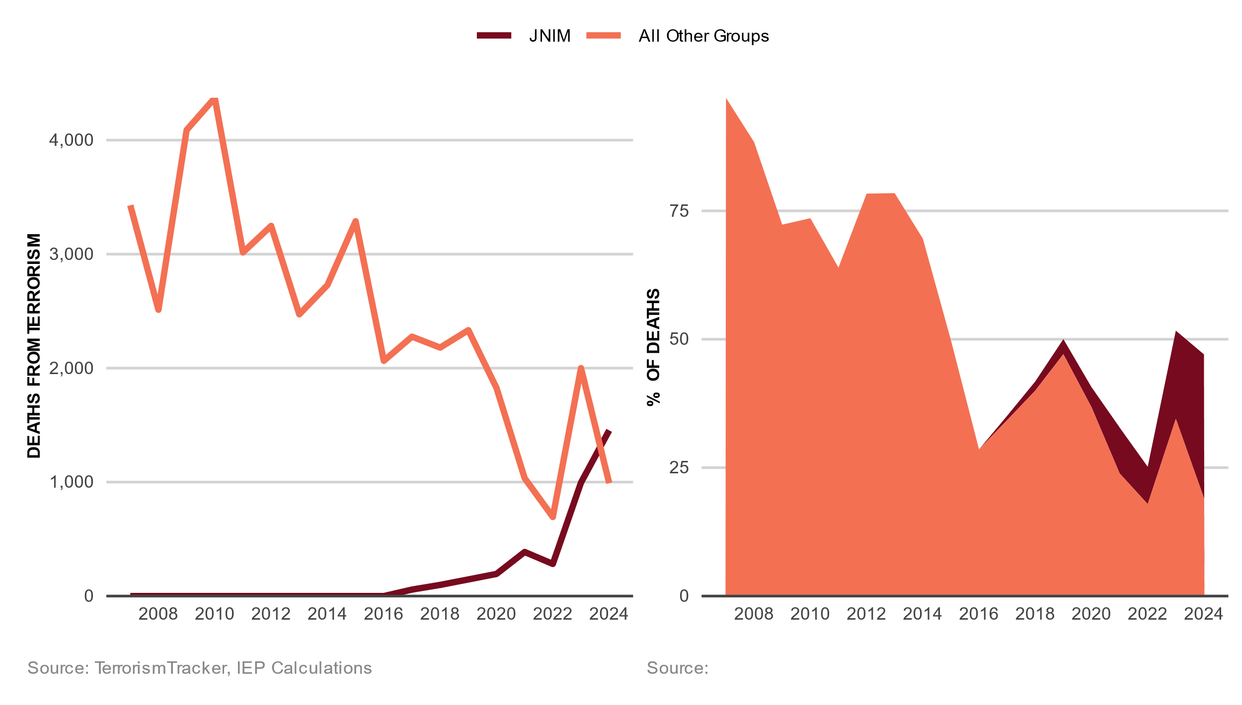
JNIM Attributed Deaths, 2007 - 2024
JNIM was the deadliest terrorist group of 2024.

Slide 23
Trends in Terrorism
03.

Slide 24
Trends in Terrorism
Since 2018, deaths from terrorism have fluctuated in a narrow band, between 6,824 and 7,484.
Since 2018 were in Burkina Faso, Niger and Pakistan largest declines.
Since 2018 the largest improvements were in Afghanistan, Iraq and Somalia.
In the West, attacks peaked in 2017 and fell every year to 2024 when increased by 40% to 52.
Antisemitic and Islamophobic incidents surged since Gaza war in Europe, Australia, and the US.
In the two months since start of Gaza war in US both antisemitic and Islamophobia incidents up over 270%

Slide 25
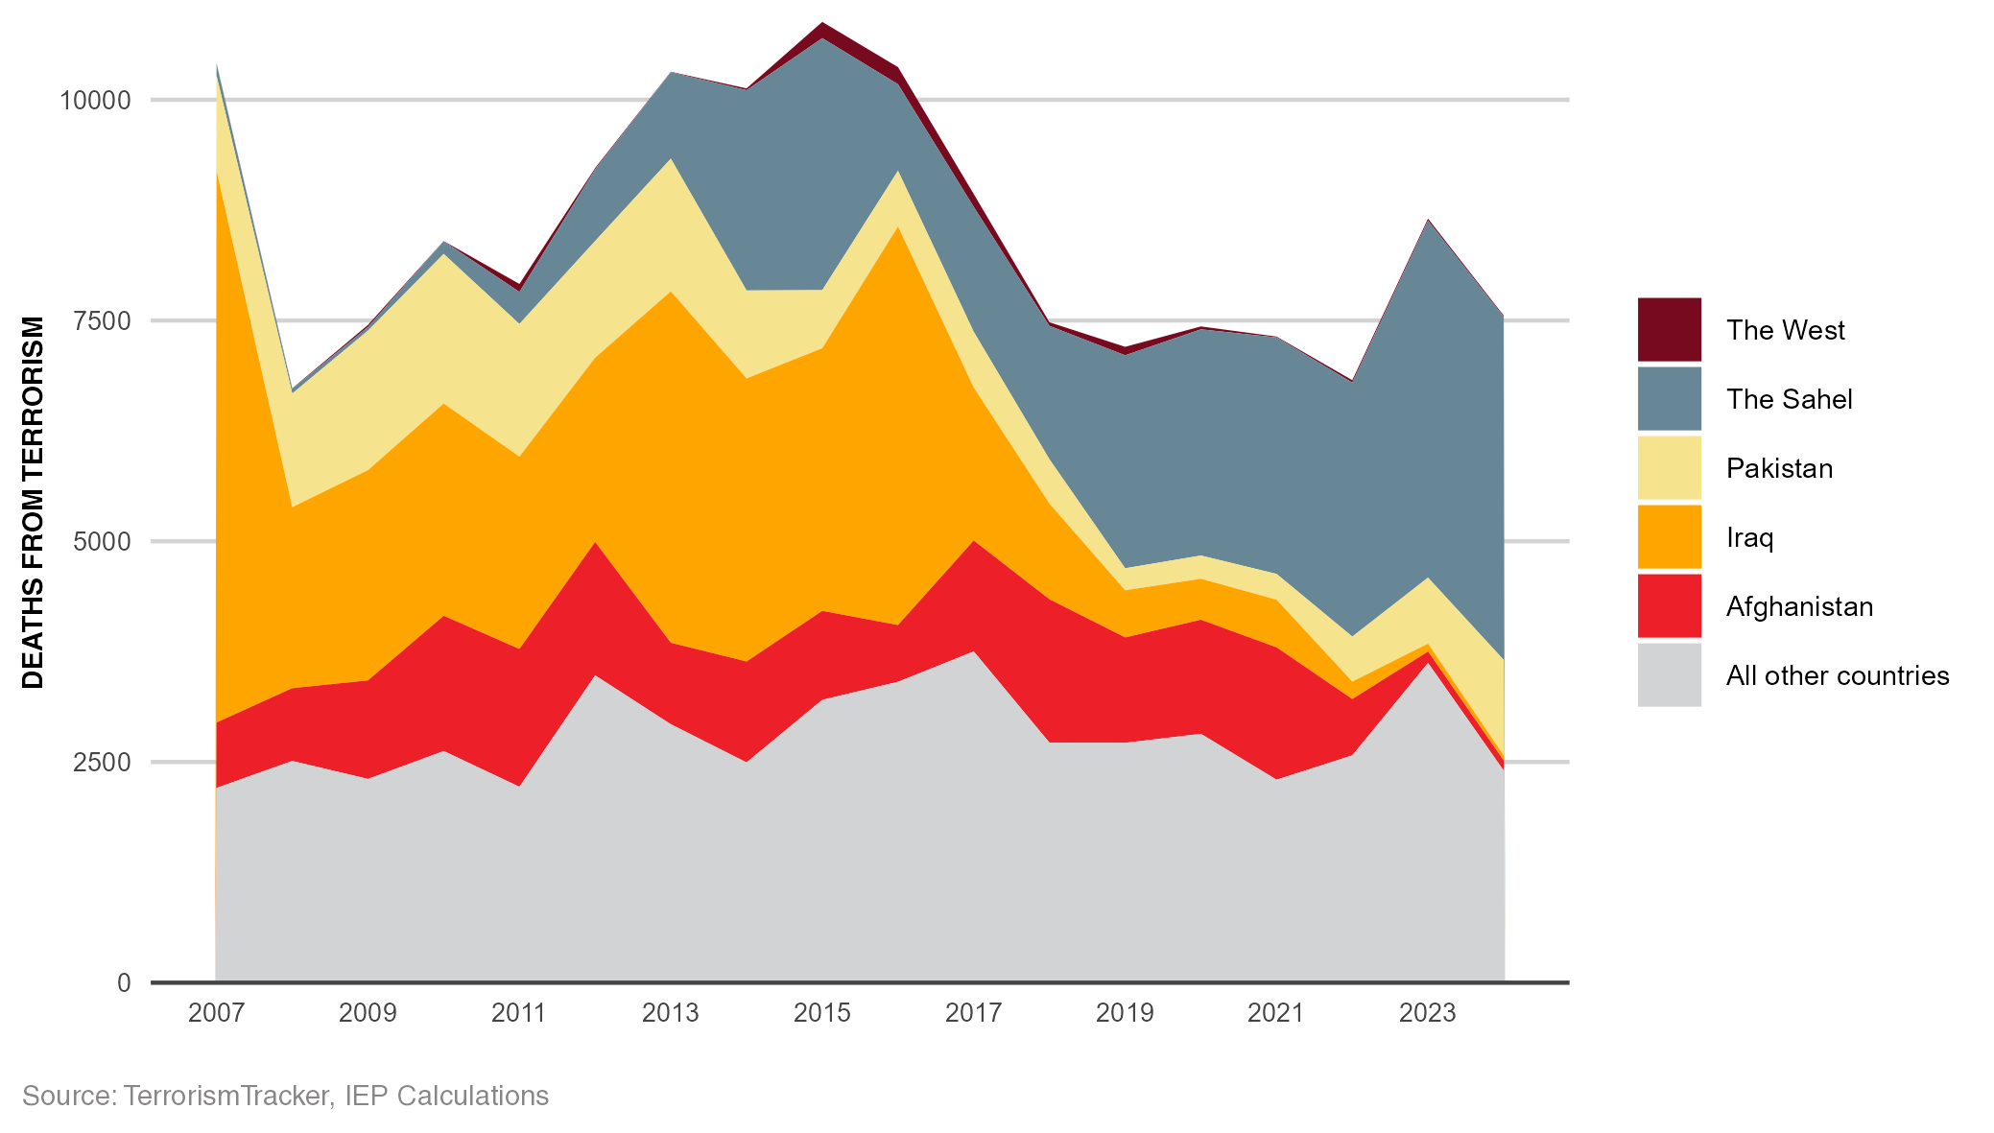
Deaths from Terrorism, 2007-2024
After seven years of improvement deaths are on the increase again.

Slide 26
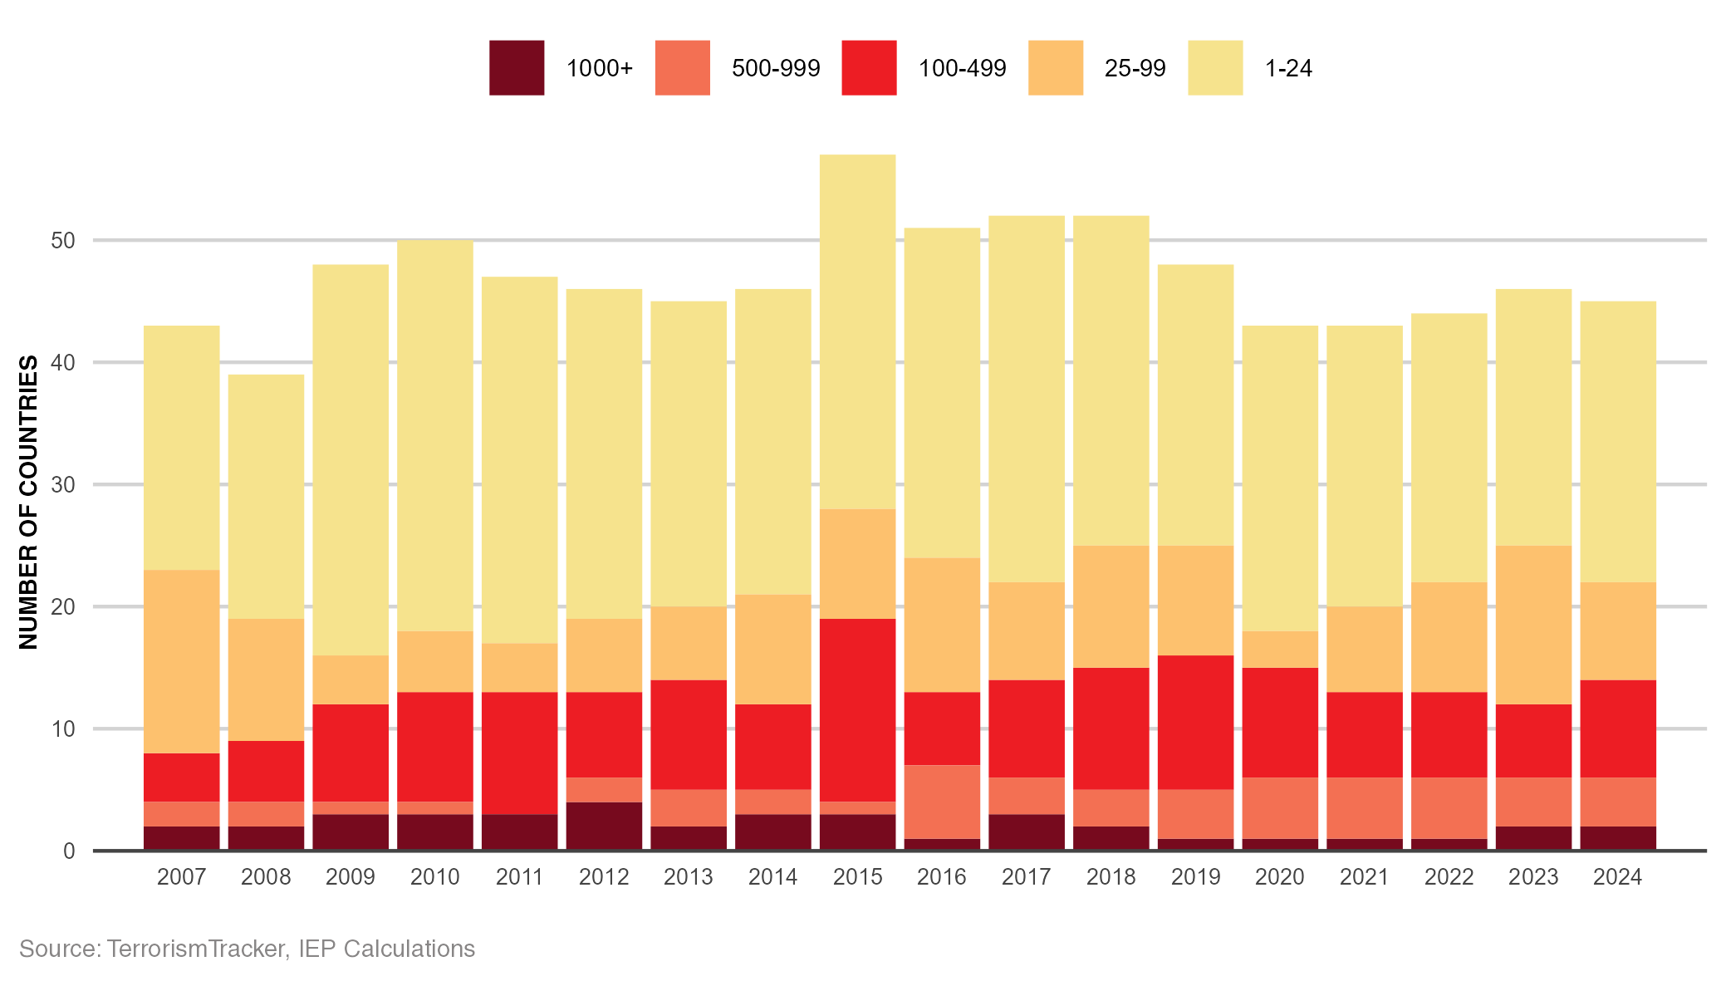
Distribution of Deaths from Terrorism, 2007-2024
45 countries recorded at least one death from terrorism in 2024.

Slide 27
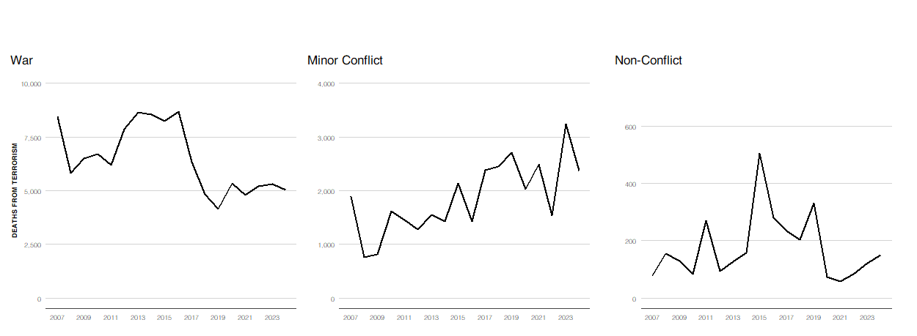
Deaths from Terrorism by Conflict Type, 2007-2024
98% of deaths from terrorism in 2024 occurred in countries currently experiencing conflict.
Source: TerrorismTracker, UCDP, IEP Calculations

Slide 28
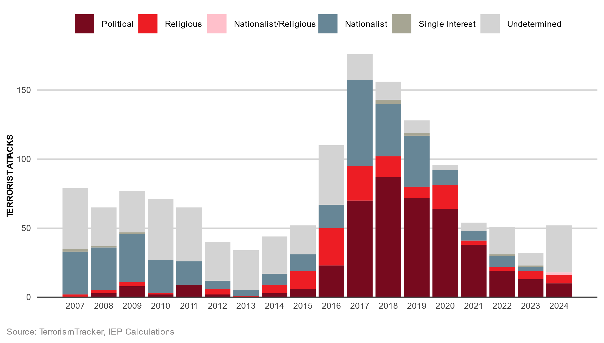
Terror Attacks in the West by Motivation, 2007-2024
Both politically and religiously motivated attacks have fallen since 2017.

Slide 29
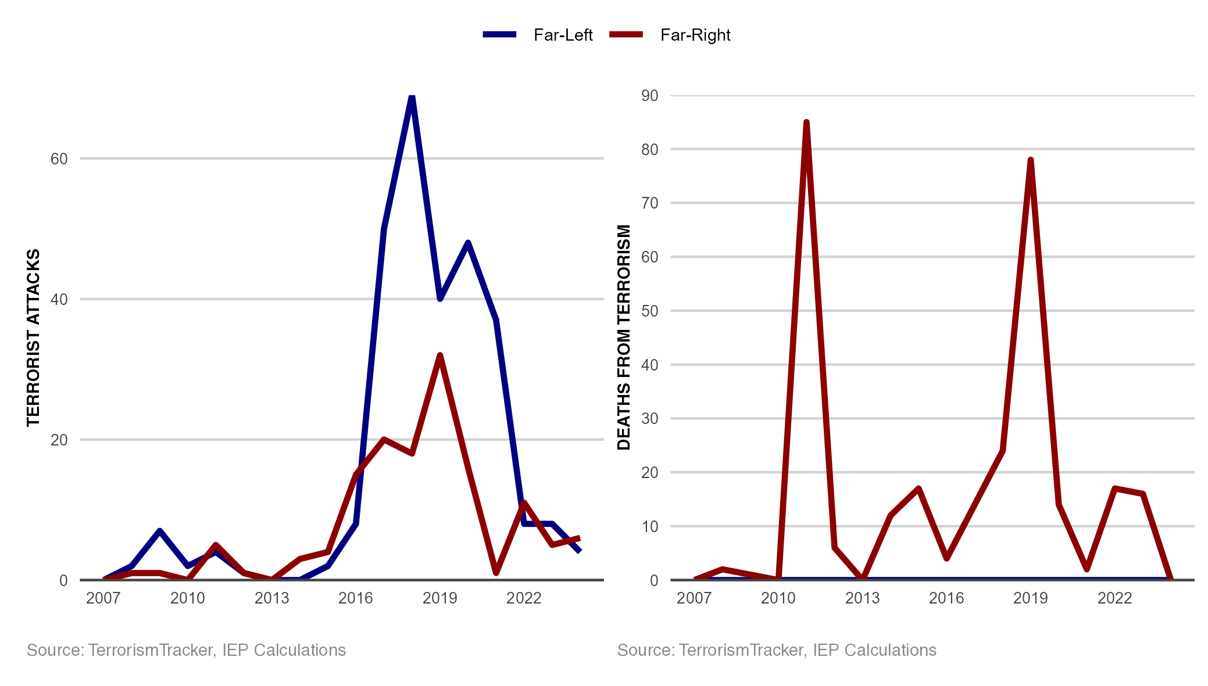
Far-Left and Far-Right Terrorism in the West, 2007-2024
While far-left groups have recorded more attacks, far-right groups have recorded more deaths.

Slide 30
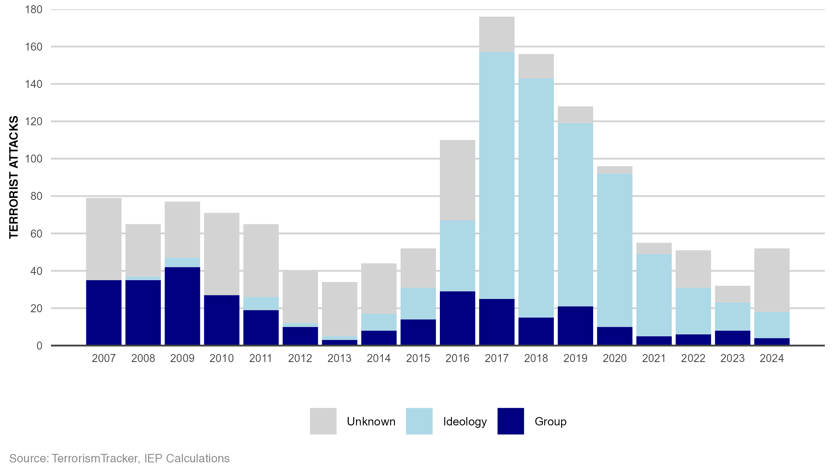
Responsibility for Terrorist Attacks in the West, 2007-2024
The percentage of attacks that could not be attributed to a group rose from 55 per cent to 92 per cent.

Slide 31
Home Grown, Lone Wolf Terrorism
04.

Slide 32
Lone Wolf Terrorism
Only 8% of attacks in West carried out by a group.
Radicalisation more rapid – 2002 16 months, 2015 10 months, today can be weeks.
Reasons – Isolated, dislike society, mental health, meaning and purpose, grievances, lack of opportunity.
Opportunities to self-radicalise are diverse – social media, gaming platforms, fringe forums, encrypted apps, dark web.
Number of attackers under 18 increasing – 42% in UK and 1 in 5 in Europe.
Difficult for intelligence agencies to uncover – minimal footprint, radicalize alone, short timeline, no financing.

Slide 33
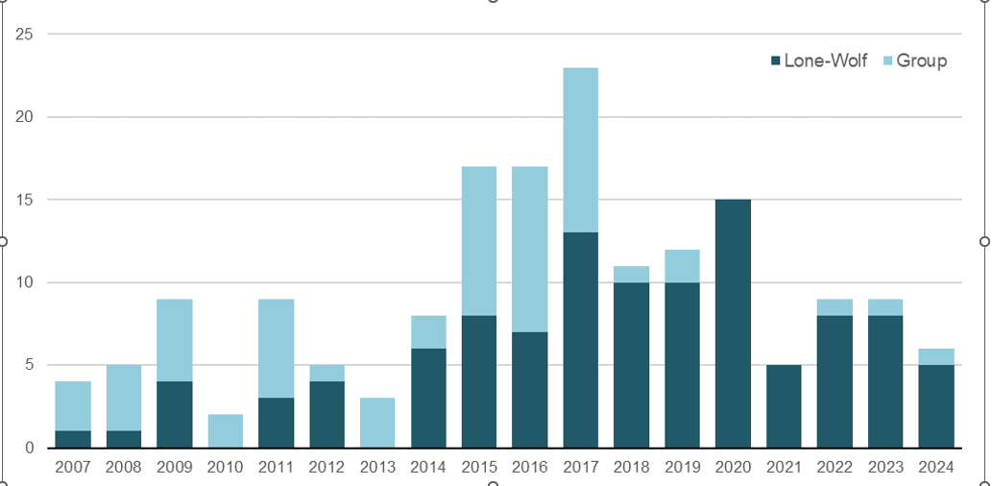
Fatal Lone Wolf Terrorism Attacks as a Percentage of Total Attacks in the West, 2014-2024
The majority of fatal terrorist attacks in the West since 2017 have been lone wolf attacks.
Source: TerrorismTracker, IEP Calculations

Slide 34
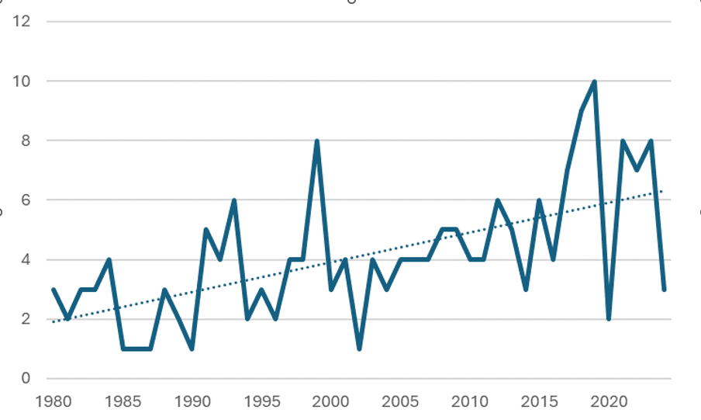
Mass Shootings in the US, 1980-2024
Mass shootings have been trending upwards since the turn of the century.
Source:

Slide 35
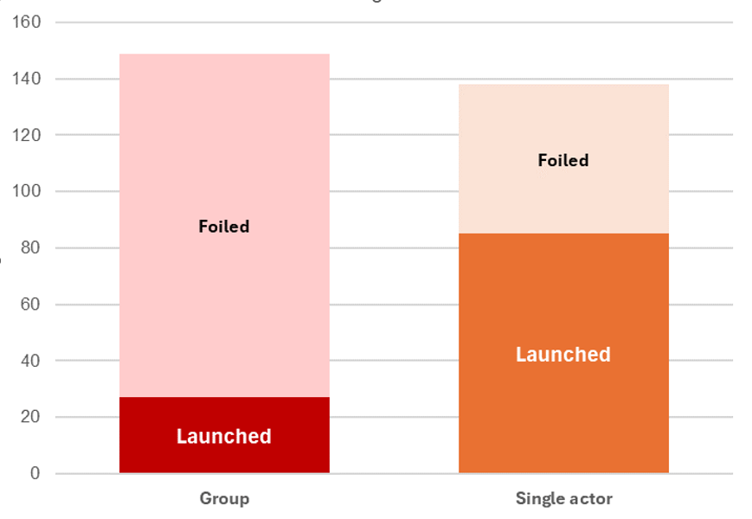
Foiled and Launched Jihadist Plots in Europe by Group Size, 1994-2021
Lone wolf Jihadist plots were much more likely to be successfully carried out than a group plots.
Source: Jihadist Plots in Europe Dataset (JPED), IEP Calculations

Slide 36
The Sahel
05.

Slide 37
Terrorism in the Sahel
The Sahel accounted for 51% of global terrorism deaths in 2024.
Western and African influence declining Russia and China growing.
Sahil part of a broader conflict – 25,000 deaths, with 4,794 being terrorism.
Complex issues – poor governance, pastoralist conflicts, ecological degradation, economic issues, security abuses, jihadists, transnational interests.
Massive gold vein running though Mali, Burkina Faso and Niger. Niger 7% of Uranium world supply, 25% for Europe. Attacks on gold mines up 300% since 2020.
Terrorism deaths up 10 times since 2019.
JNIM dominant group, ISWA on the decline – deaths down 46% in 2024.
Jihadists spreading to West Africa – Togo 52 people killed by terrorism in 2024, highest ever.

Slide 38
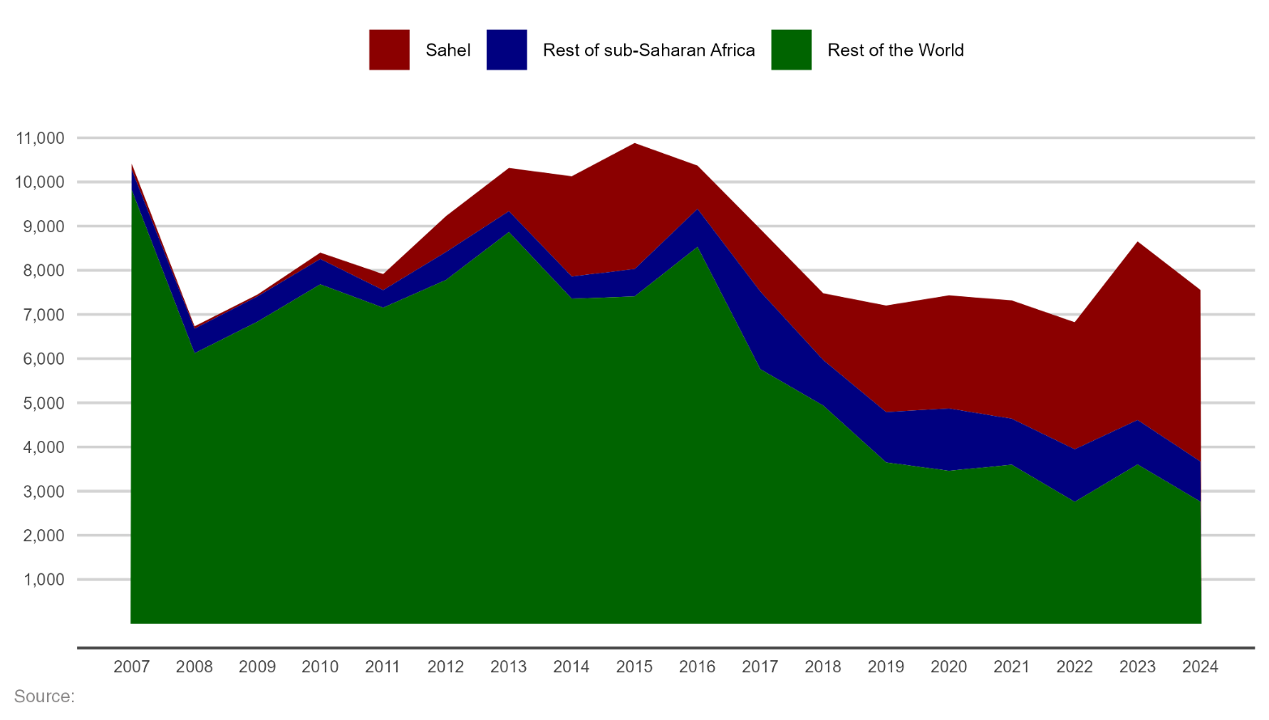
Deaths from Terrorism in Sahel, 2007-2024
Deaths in the Sahel have exceeded both sub-Saharan Africa and global totals since 2022.
Source: TerrorismTracker, IEP Calculations

Slide 39
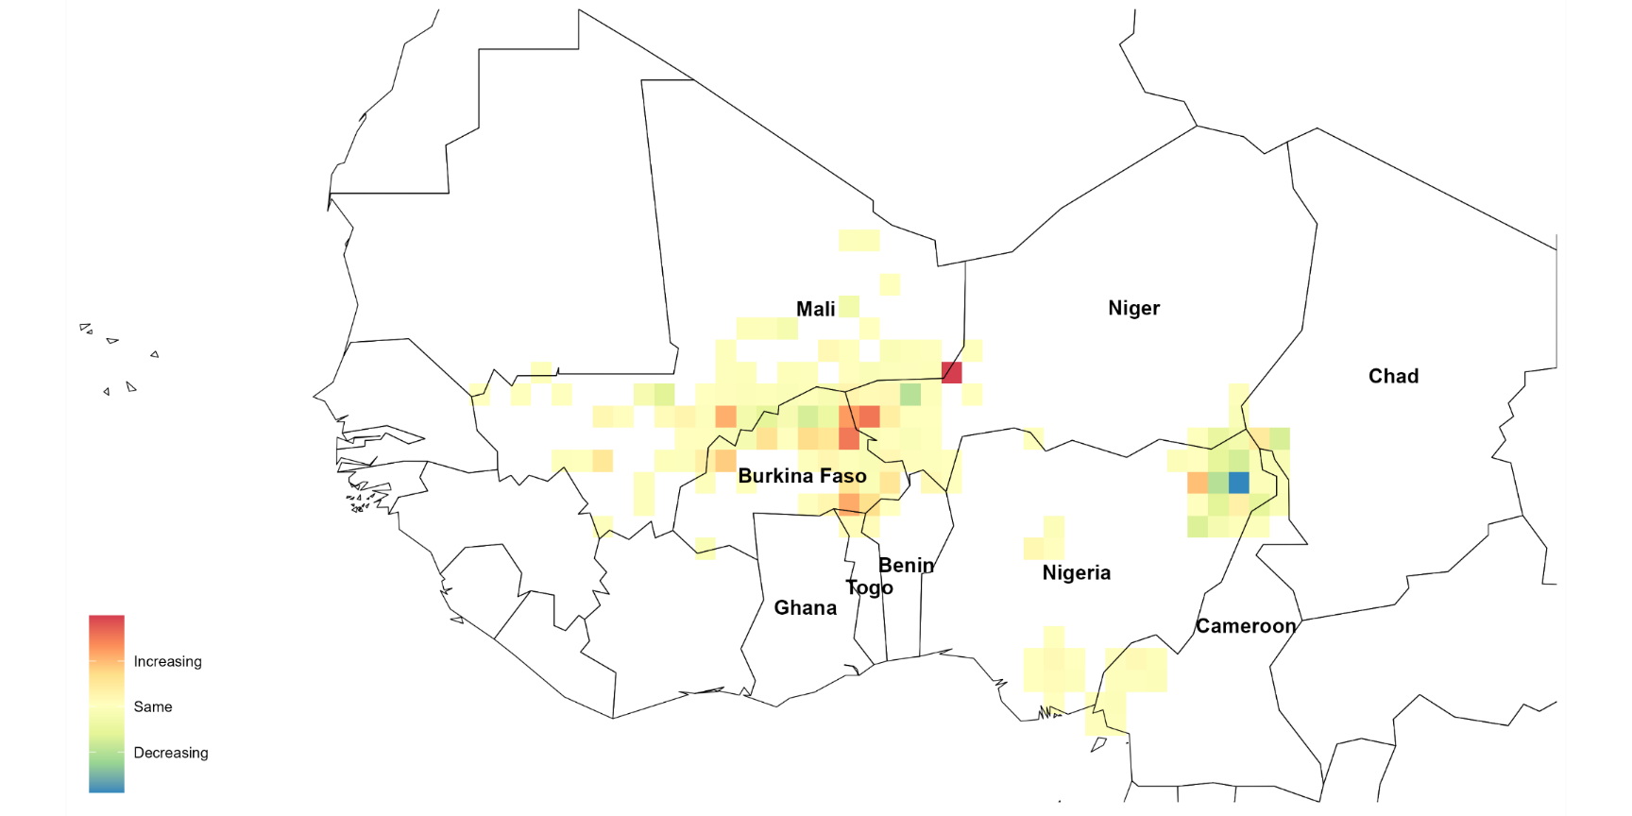
Intensity of Deaths in the Sahel, 2020-2024
Deaths across the Sahel have increasingly intensified in the tri-border areas of Mali, Burkina Faso and Niger.
Source: TerrorismTracker, IEP Calculations

Slide 40
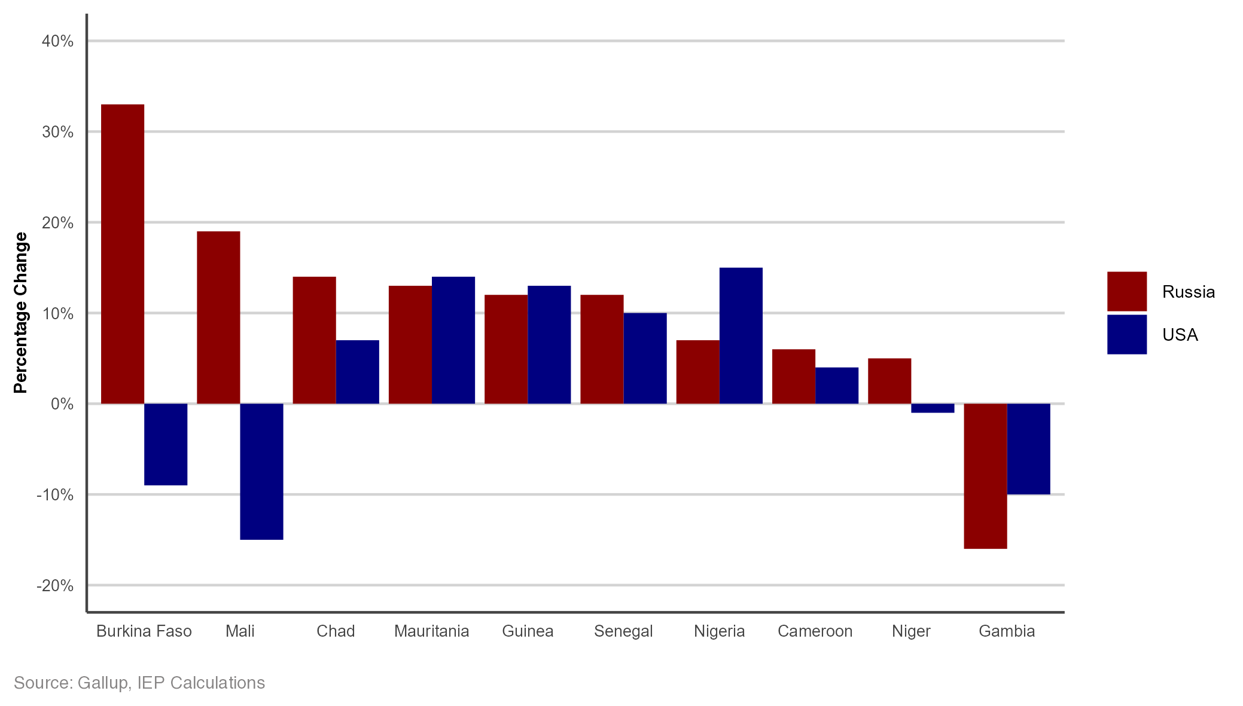
Changes in the Approval of the US and Russia in the Sahel
Changes in approval rates of Russia and the US have significantly improved overall since 2019.

Slide 41
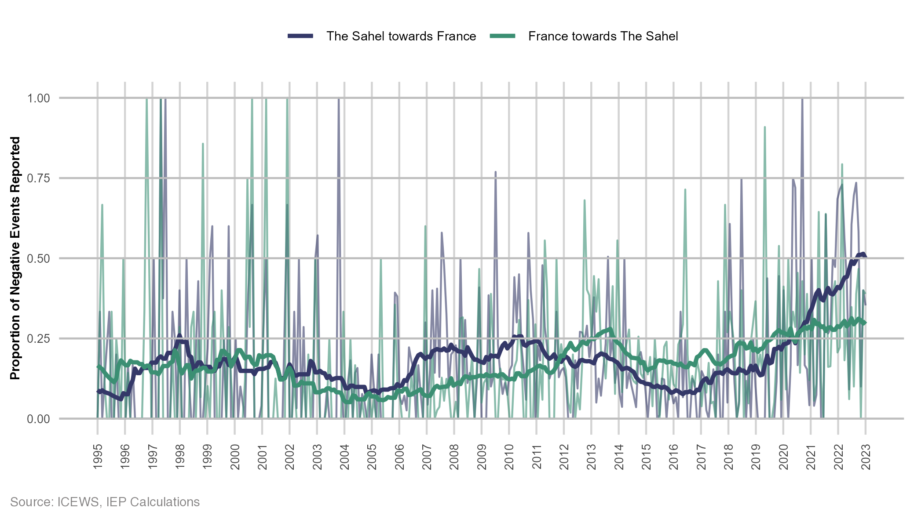
Tensions between the Sahel Countries and France
Negative sentiment from Mali and Burkina Faso drives up overall regional proportions of negative sentiment

Slide 42
Islamic State
06.

Slide 43
The Islamic State
IS Most deadly terrorist group – 1,805, likely much higher because of unattributed deaths.
Islamic State operates decentralised network of affiliate. Each group acts independently.
IS conducted attacks in 22 countries, one more than in 2023.
Syria and the DRC recorded the most IS-related fatalities, with Syria alone accounting for 280 of 469 attacks.
ISK has grown rapidly from one country in 2021 to five in 2024. Active in Afghanistan, Pakistan, Iran, Russia, and Central Asia.
In 2024, 24 IS plots foiled – Israel, Iran, Turkey, Germany, France, Sweden, Russia.

Slide 44
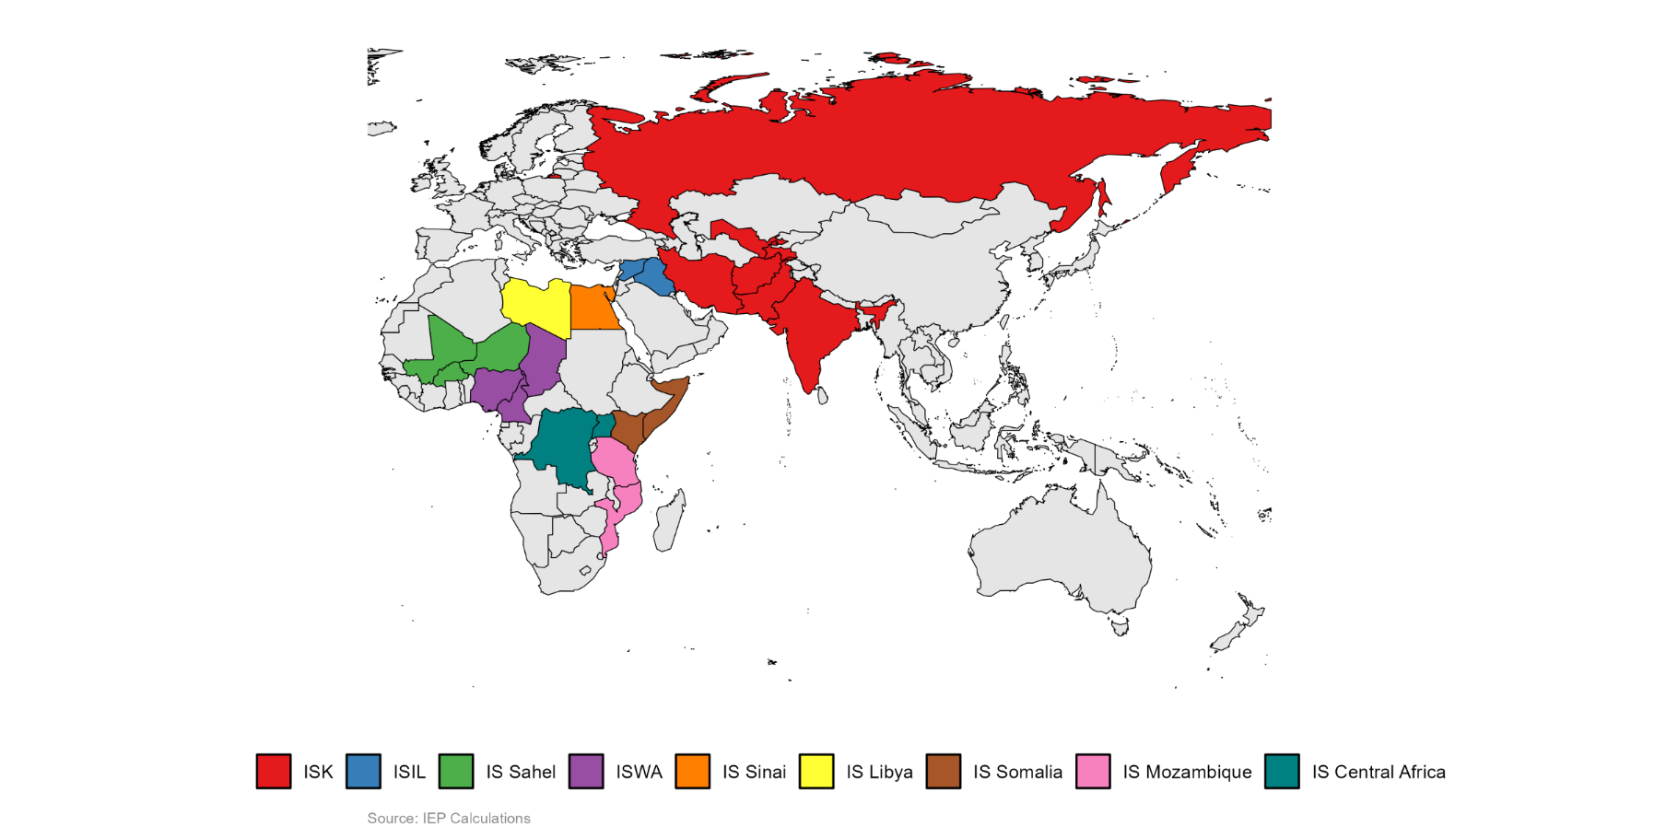
Islamic State Affiliate Locations and Attacks, 2024
In 2024, Islamic State affiliates were active across Asia, Europe, the Middle East, and Africa.

Slide 45
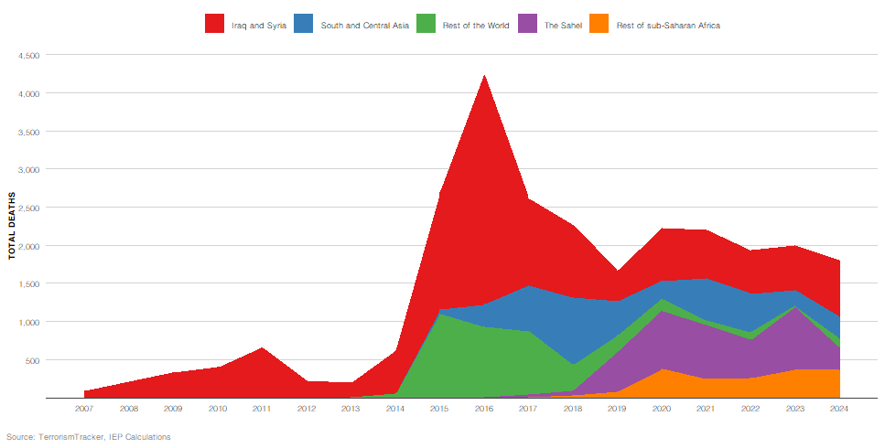
Deaths Attributed to the Islamic State, by Country and Regional Groupings, 2007- 2024
Of the IS affiliate groups, ISIL, ISWA and ISK have been the deadliest in the past decade.

Slide 46
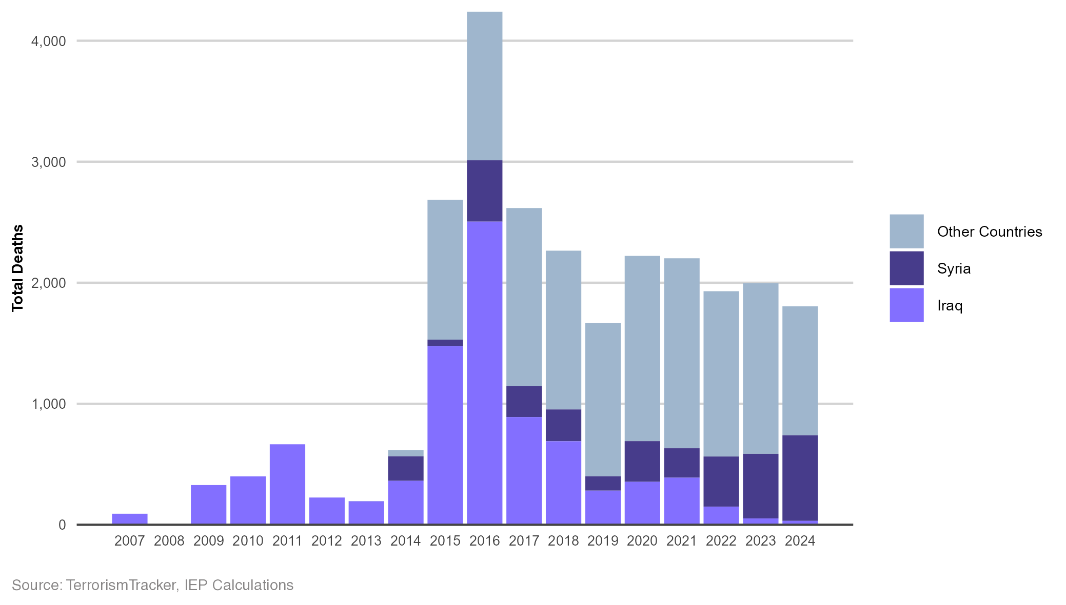
Deaths Attributed to Islamic State, 2007- 2024
Since 2017, the majority of deaths caused by IS have occurred outside of Iraq and Syria.

Slide 47
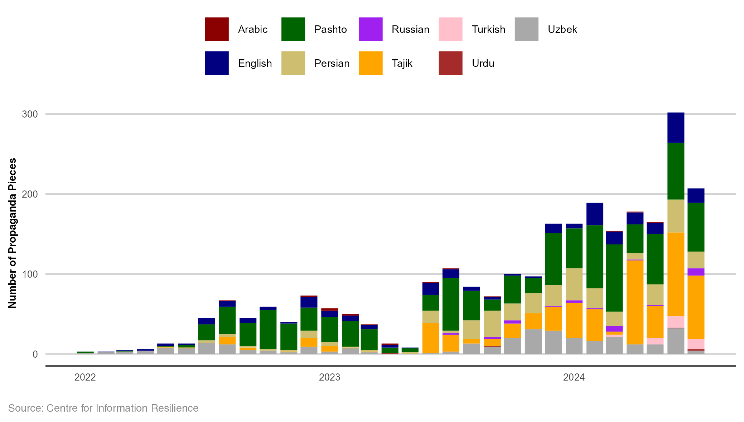
ISK Propaganda by Language, 2022-2024
In the past two years, there has been a notable increase in reported ISK propaganda pieces.

