Slide 1
GLOBAL TERRORISM INDEX 2024
Measuring the impact of terrorism

Slide 2
The Institute for Economics and Peace is an independent, not-for-profit think tank dedicated to understanding the intersection between business, peace and economics. It places a special emphasis on metrics to measure peace, operational programs to improve peace, and the economic benefits of peace.

Slide 3
Our international offices
Brussels
The Hague
New York
Sydney Head Office
Mexico City
Harare

Slide 4
Institute for Economics and Peace
Research used extensively by organisations, including the OECD, Commonwealth Secretariat, World Bank and the United Nations
40BN
1.4BN
152
MEDIA REACH
SOCIAL REACH
COUNTRY AUDIENCE
Work is included in 1,000s of university courses
Activities in over 150 countries last 12 months – training, education and consulting
10
6,000
2M
PUBLISHED REPORTS
BOOK REFERENCES
WEB VISITORS

Slide 5
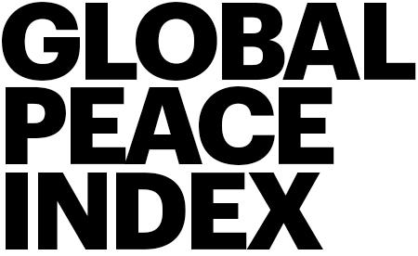
IEP Products

Slide 6
01.
What is the Global Terrorism Index?

Slide 7
The Global Terrorism Index
Now in its
Ranks
163
According to the relative impact of terrorism
^{12th}
year
countries
Includes contributions from International Experts
Used as an indicator in the Global Peace Index
Developed by the Institute for Economics and Peace

Slide 8
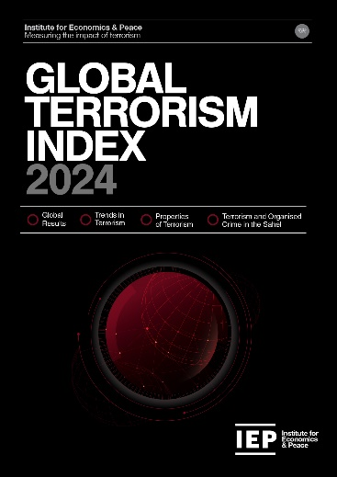
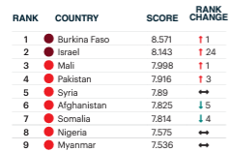
Global Terrorism Index: Methodology
Definition of terrorism: the systematic threat or use of violence, by non-state actors, whether for or in opposition to established authority, with the intention of communicating a political, religious or ideological message to a group larger than the victim group, by generating fear and so altering (or attempting to alter) the behaviour of the larger group.
Over 5 years to measure long term impact
Indicator | Weight
Incidents | 1
Injuries | 0.5
Deaths | 3
Hostages | 0.5
Year | Year minus 1 | Year minus 2 | Year minus 3 | Year minus 4
52% | 26% | 13% | 6% | 3%
Socio-economic indicators
Logarithmic banding scores (1-10)

Slide 9
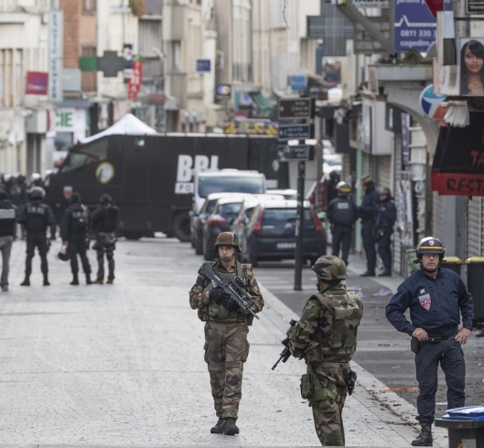
02.
GTI 2024 Results

Slide 10
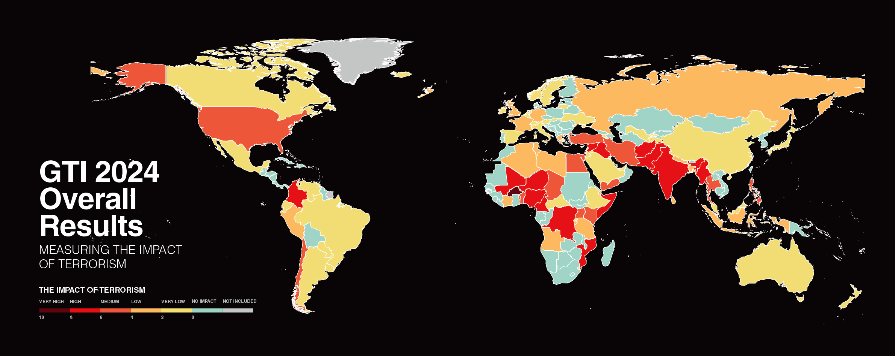
Notes:
Needs map

Slide 11
Key Findings 2024
In 2023 terrorism had its highest impact since 2017
High risk that it will be worse in 2024 than 2023
Without Hamas October 7th attack deaths would still have risen 5%
The epicenter of terrorism has firmly moved from MENA to the Sahel
By contrast, terrorism in western democracies is at a 15 year low

Slide 12
Key Findings 2024
Deaths from terrorism rose to 8,352 in 2023, a 22% increase
Attacks decreased to 3,350, a 23% fall
Terrorism is becoming more lethal and more concentrated. Deadliness of attacks increased by 22% to 2.5 deaths per attack, compared to 1.6 in 2022.
The number of countries recording at least one attack fell from 60 to 50, number of countries recording at least one death fell from 44 to 41

Slide 13
Key Findings 2024…con’t
Hamas-led attack of October 7th was the deadliest terrorist attack since 9/11. Latest estimates suggest 30,000+ Palestinians killed by Israeli military action.
Burkina Faso is the country most impacted by terrorism, with deaths rising by 68% to 1,907. Israel is second.
This is the first time that a country other than Iraq or Afghanistan has been ranked first on the index.

Slide 14
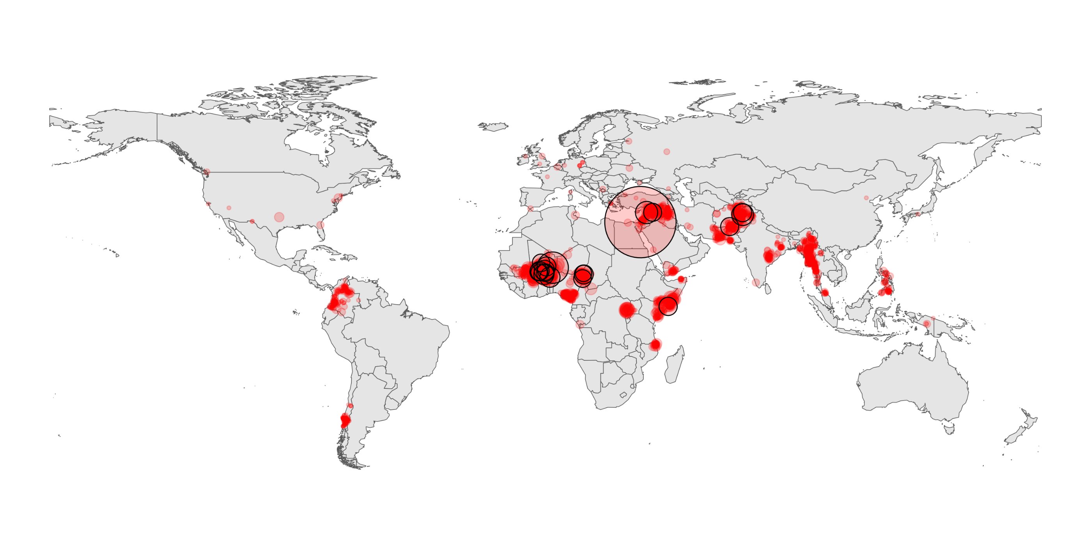
Terrorist attacks in 2023

Slide 15
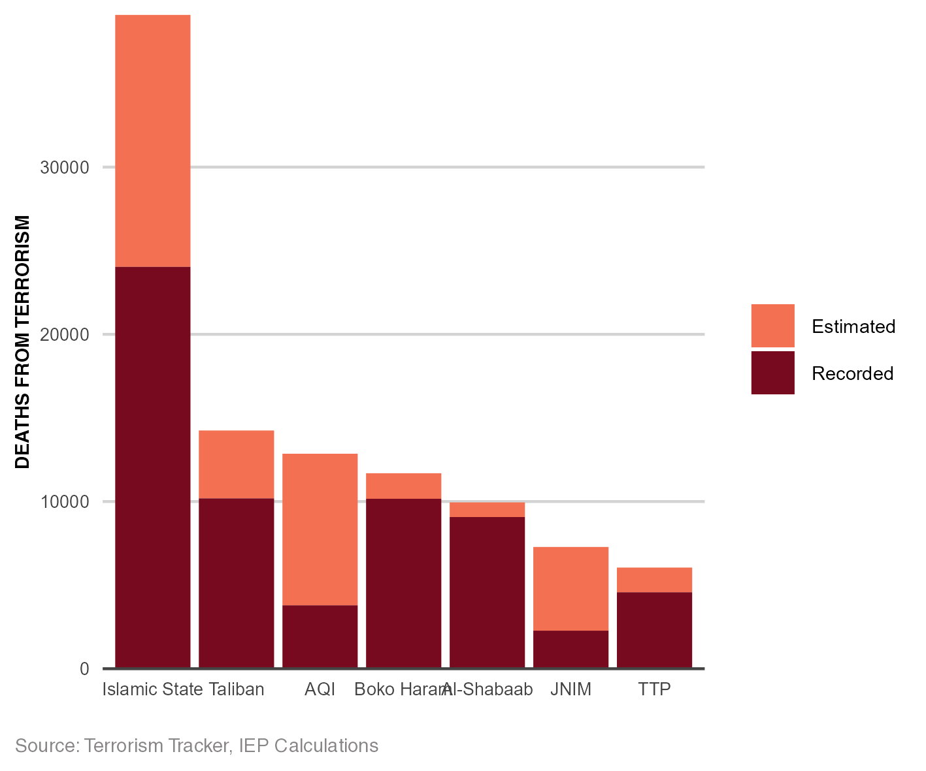
Most active terrorist groups
Two fundamental considerations:
Taliban no longer classified as terrorist organisation, leading to large drop in deaths in Afghanistan
Fall in the number of active groups and an increase in unattributed attacks.
Using Machine Learning, unattributed deaths can be attributed to existing groups.
IS deaths would have been 60% higher
Period 2007-2023

Slide 16
The countries most impacted by terrorism, 2024
First time Iraq or Afghanistan have not been on the top of the index
1
BURKINA FASO
Rank change:
6
AFGHANISTAN
Rank change: 5
2
ISRAEL
Rank change: 24
7
SOMALIA
Rank change: 4
3
MALI
Rank change: 1
8
NIGERIA
Rank change:
4
PAKISTAN
Rank change: 3
9
MYANMAR
Rank change:
5
SYRIA
Rank change:
10
NIGER
Rank change:

Slide 17
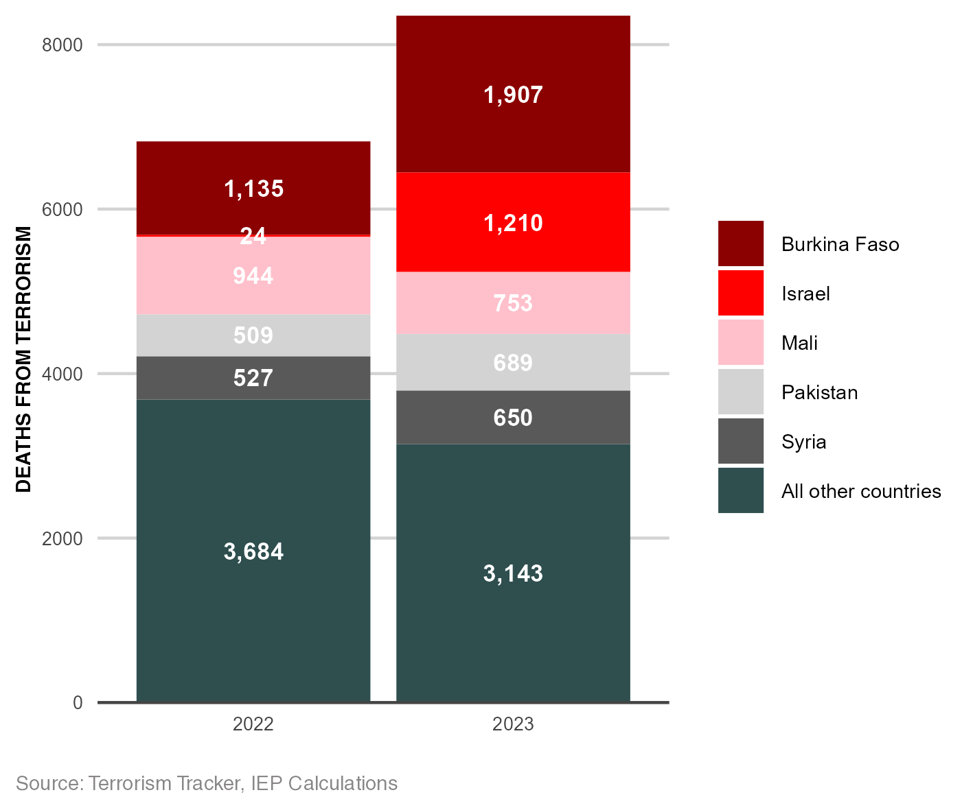
Five countries account for bulk of terrorism
Deaths in 5 most impacted countries increased by 66%
Deaths fall 13.5% for all other countries
Terrorism becoming more geographically concentrated

Slide 18
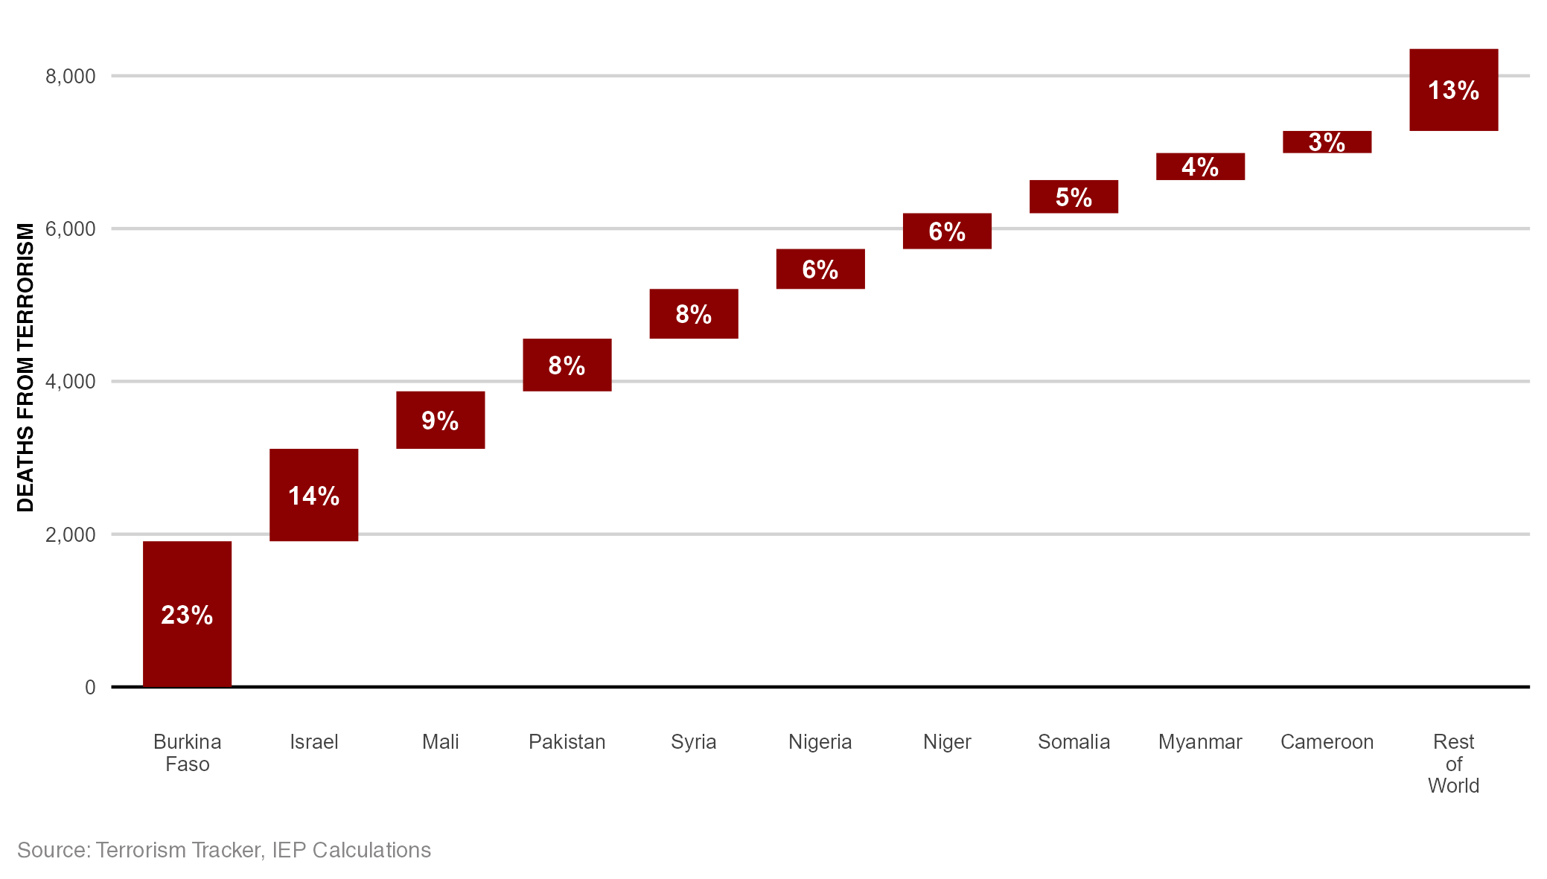
Deaths from terrorism by country, 2023
Ten countries accounted for 87% of all deaths from terrorism in 2023

Slide 19
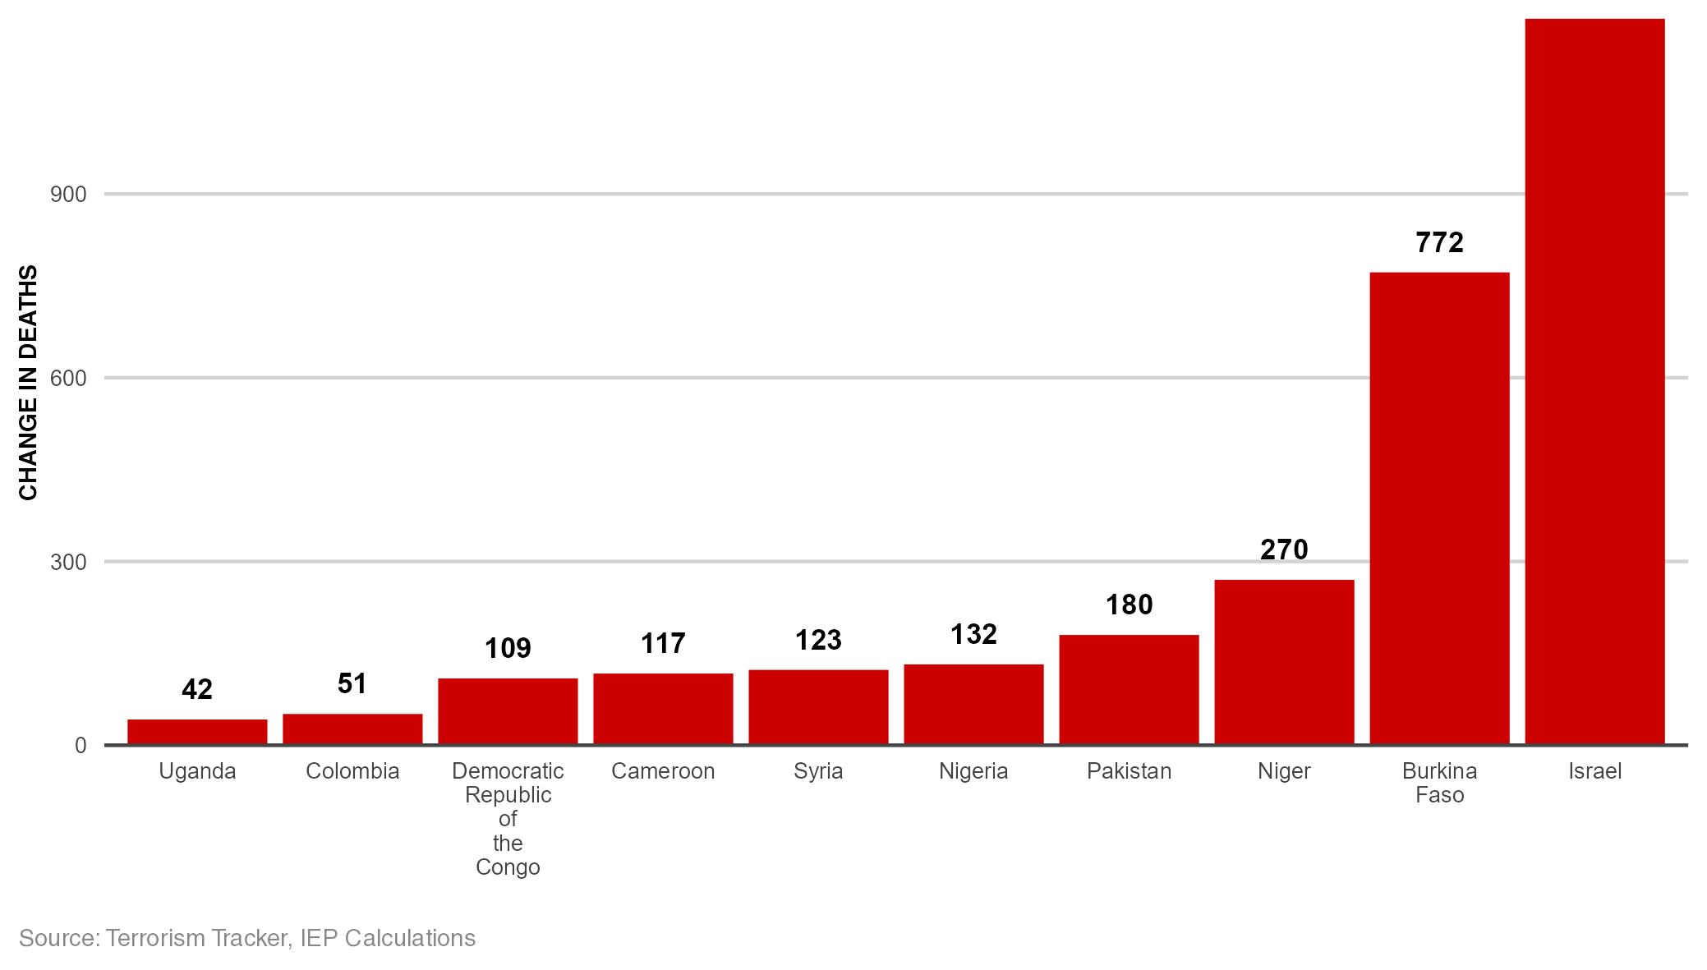
Increases, deaths from terrorism, 2022-2023
Israel had the largest increase in deaths from terrorism between 2022 and 2023
1186

Slide 20
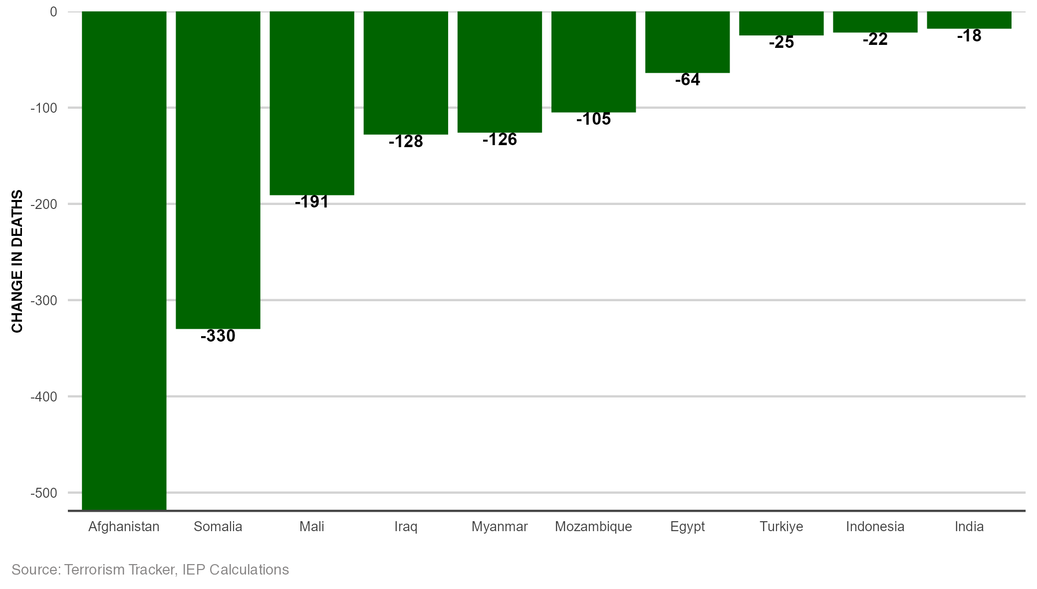
Decreases, deaths from terrorism, 2022-2023
Afghanistan had the largest decrease in the number of deaths from terrorism since 2022

Slide 21
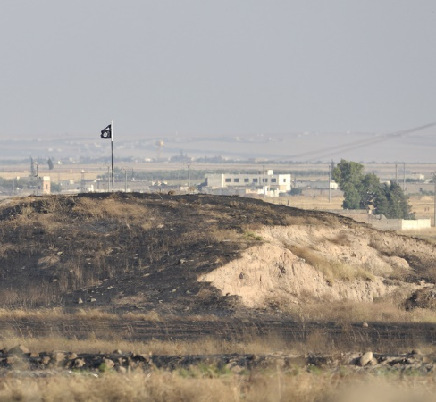
03.
Trends in terrorism

Slide 22
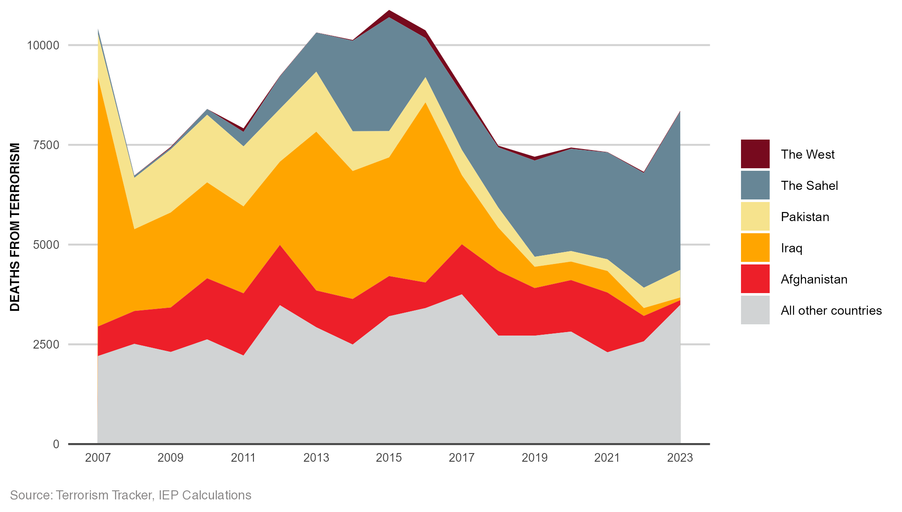
Deaths from terrorism, 2007-2023
Deaths from terrorism have decreased 23% since peaking in 2015

Slide 23
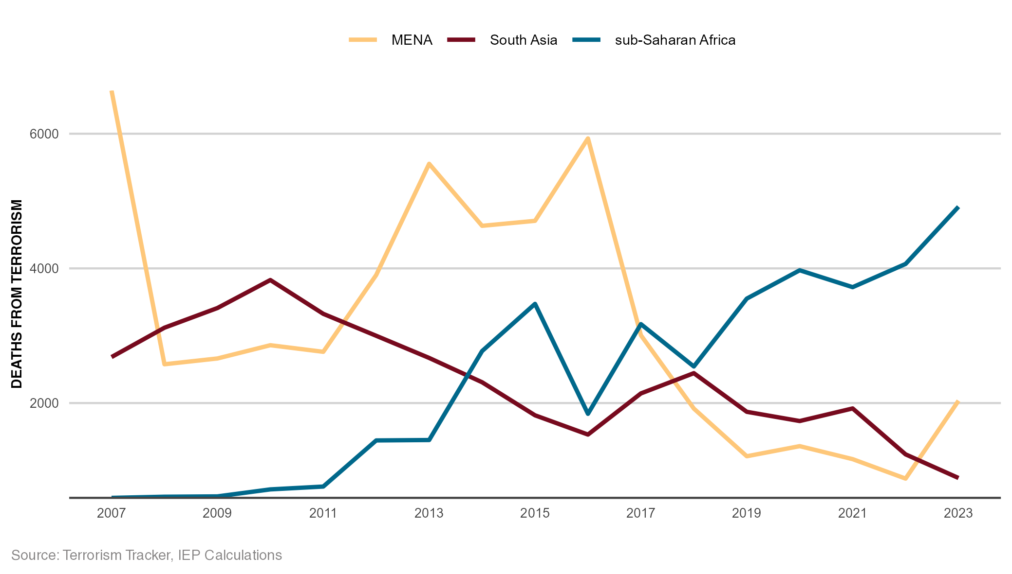
Trend in terrorism deaths by region, 2007-2023
Sub-Saharan Africa now suffers from more terrorism than South Asia and MENA combined

Slide 24
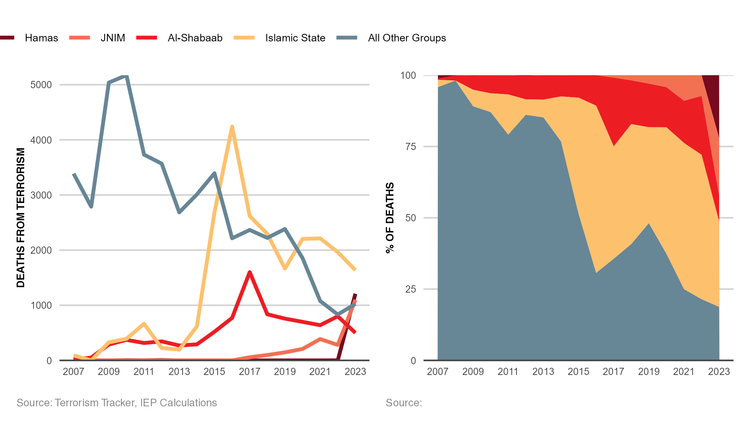
Deadliest terrorist groups, 2007-2023
Islamic State remains the deadliest terrorist group

Slide 25
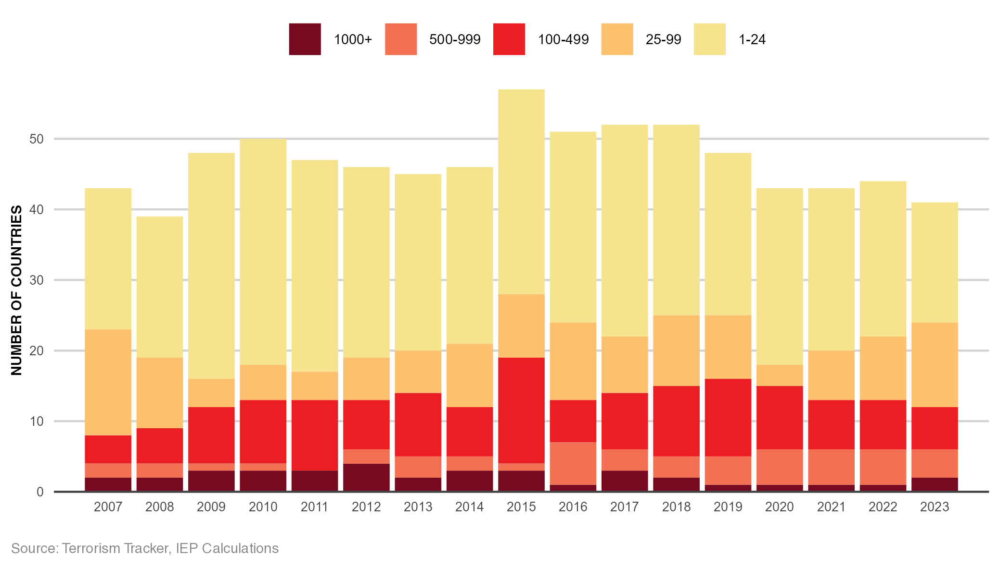
Distribution of deaths from terrorism, 2007-2023
The number of countries experiencing terrorism deaths is at its lowest level since 2008.

Slide 26
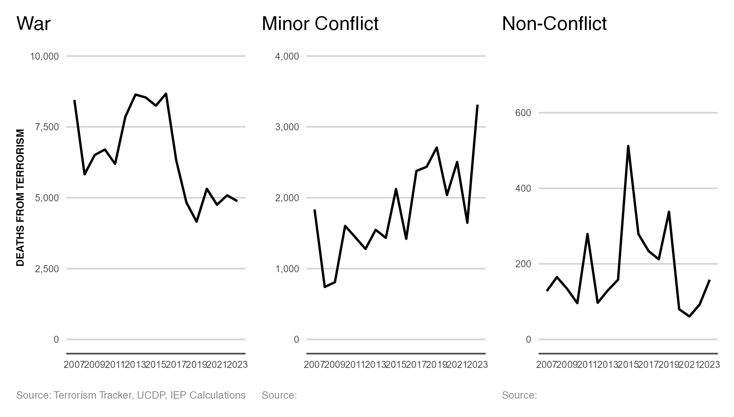
Deaths from terrorism by conflict type, 2007-2023
Over 98 per cent of deaths from terrorism in 2023 occurred in countries currently experiencing a conflict

Slide 27
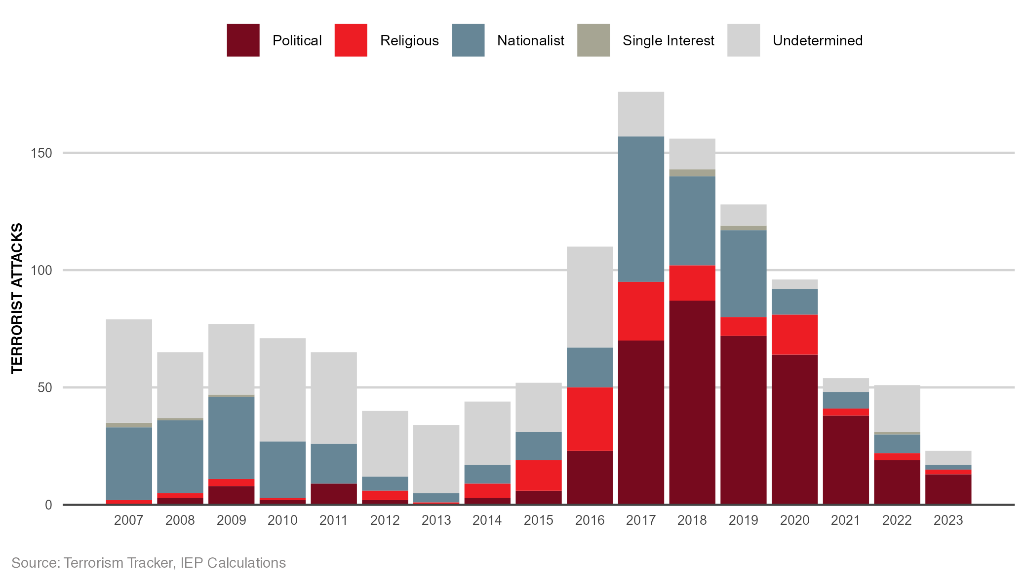
Terror attacks in the west by motivation, 2007-2023
Both politically and religiously motivated attacks have fallen over the past five years

Slide 28
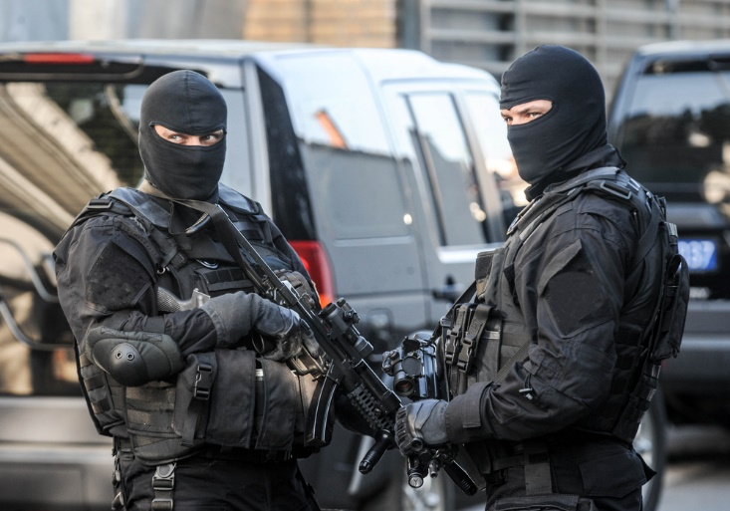
03.
The Properties of Terrorism

Slide 29
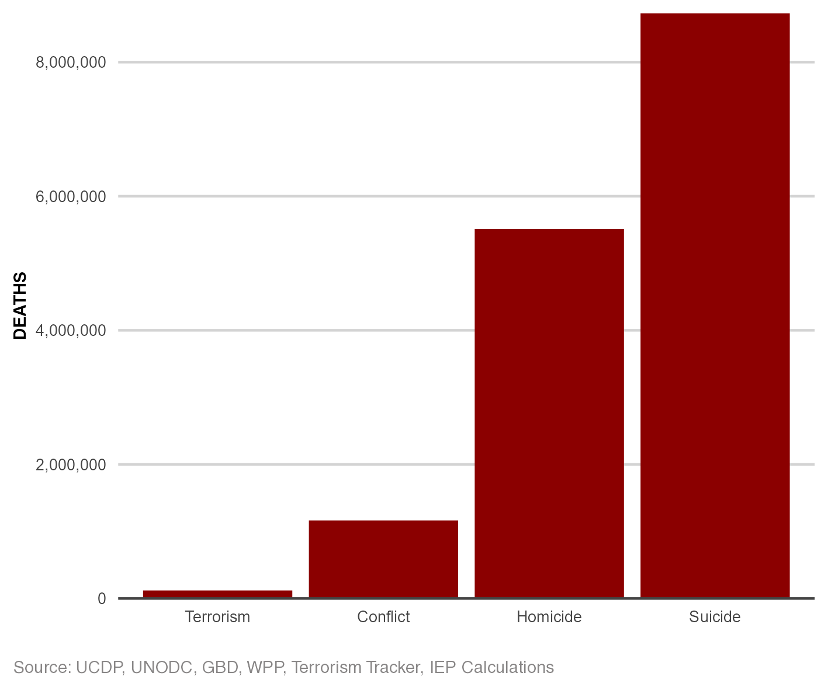
Terrorism compared to other forms of violence
Total deaths from terrorism are much lower than other forms of violence

Slide 30
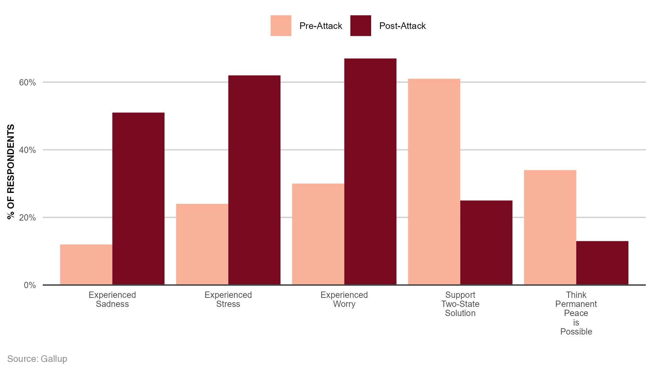
Impact of the October 7th attacks on the Israeli Public
Support for peace fell dramatically, while feelings of sadness, stress, and worry increased

Slide 31
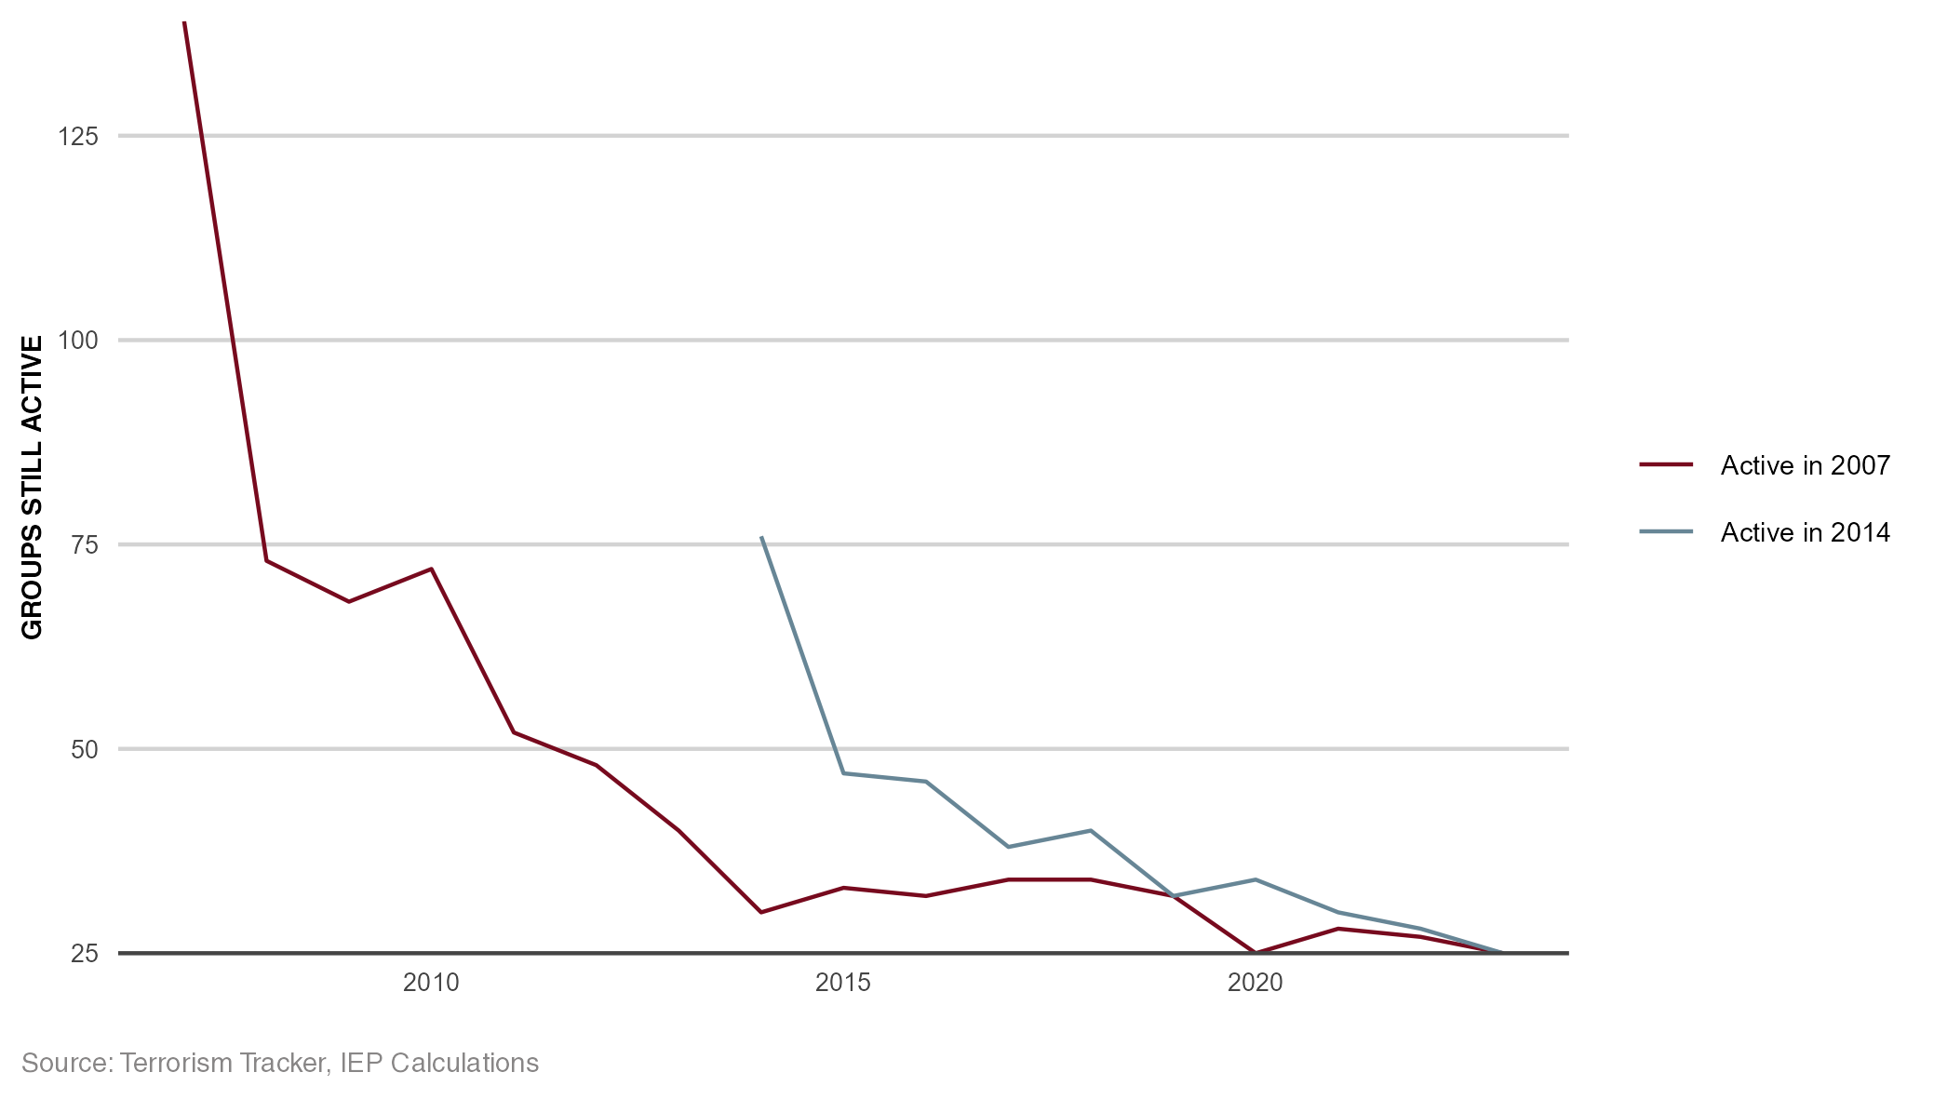
Terrorist group survival rate, 2007 and 2014
Most terrorist groups last two years or fewer.

Slide 32
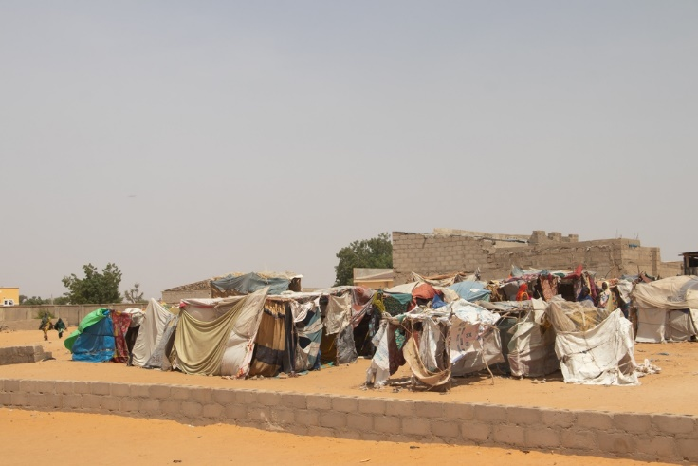
04.
Terrorism in The Sahel

Slide 33
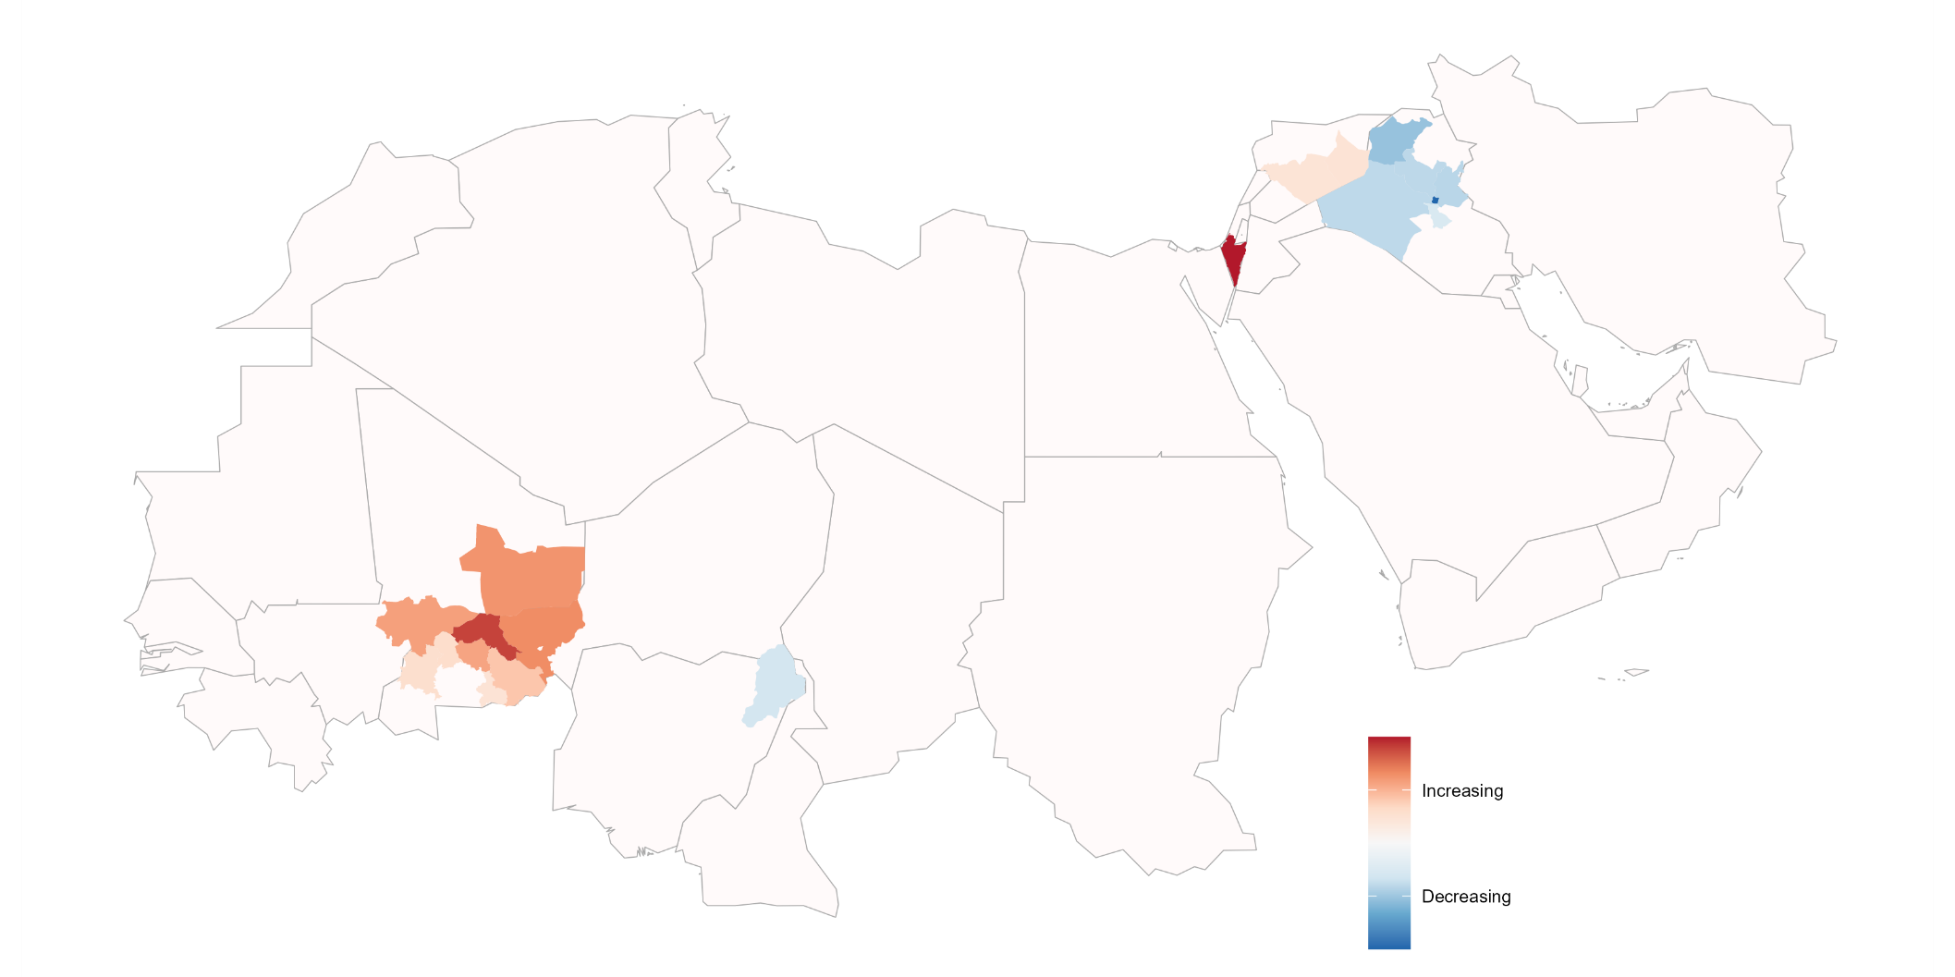
Most significant changes in deaths from terrorism, 2020-2023
Since 2020, terrorism has shifted from MENA to the Sahel.
Source: Dragonfly TerrorismTracker, IEP Calculations

Slide 34
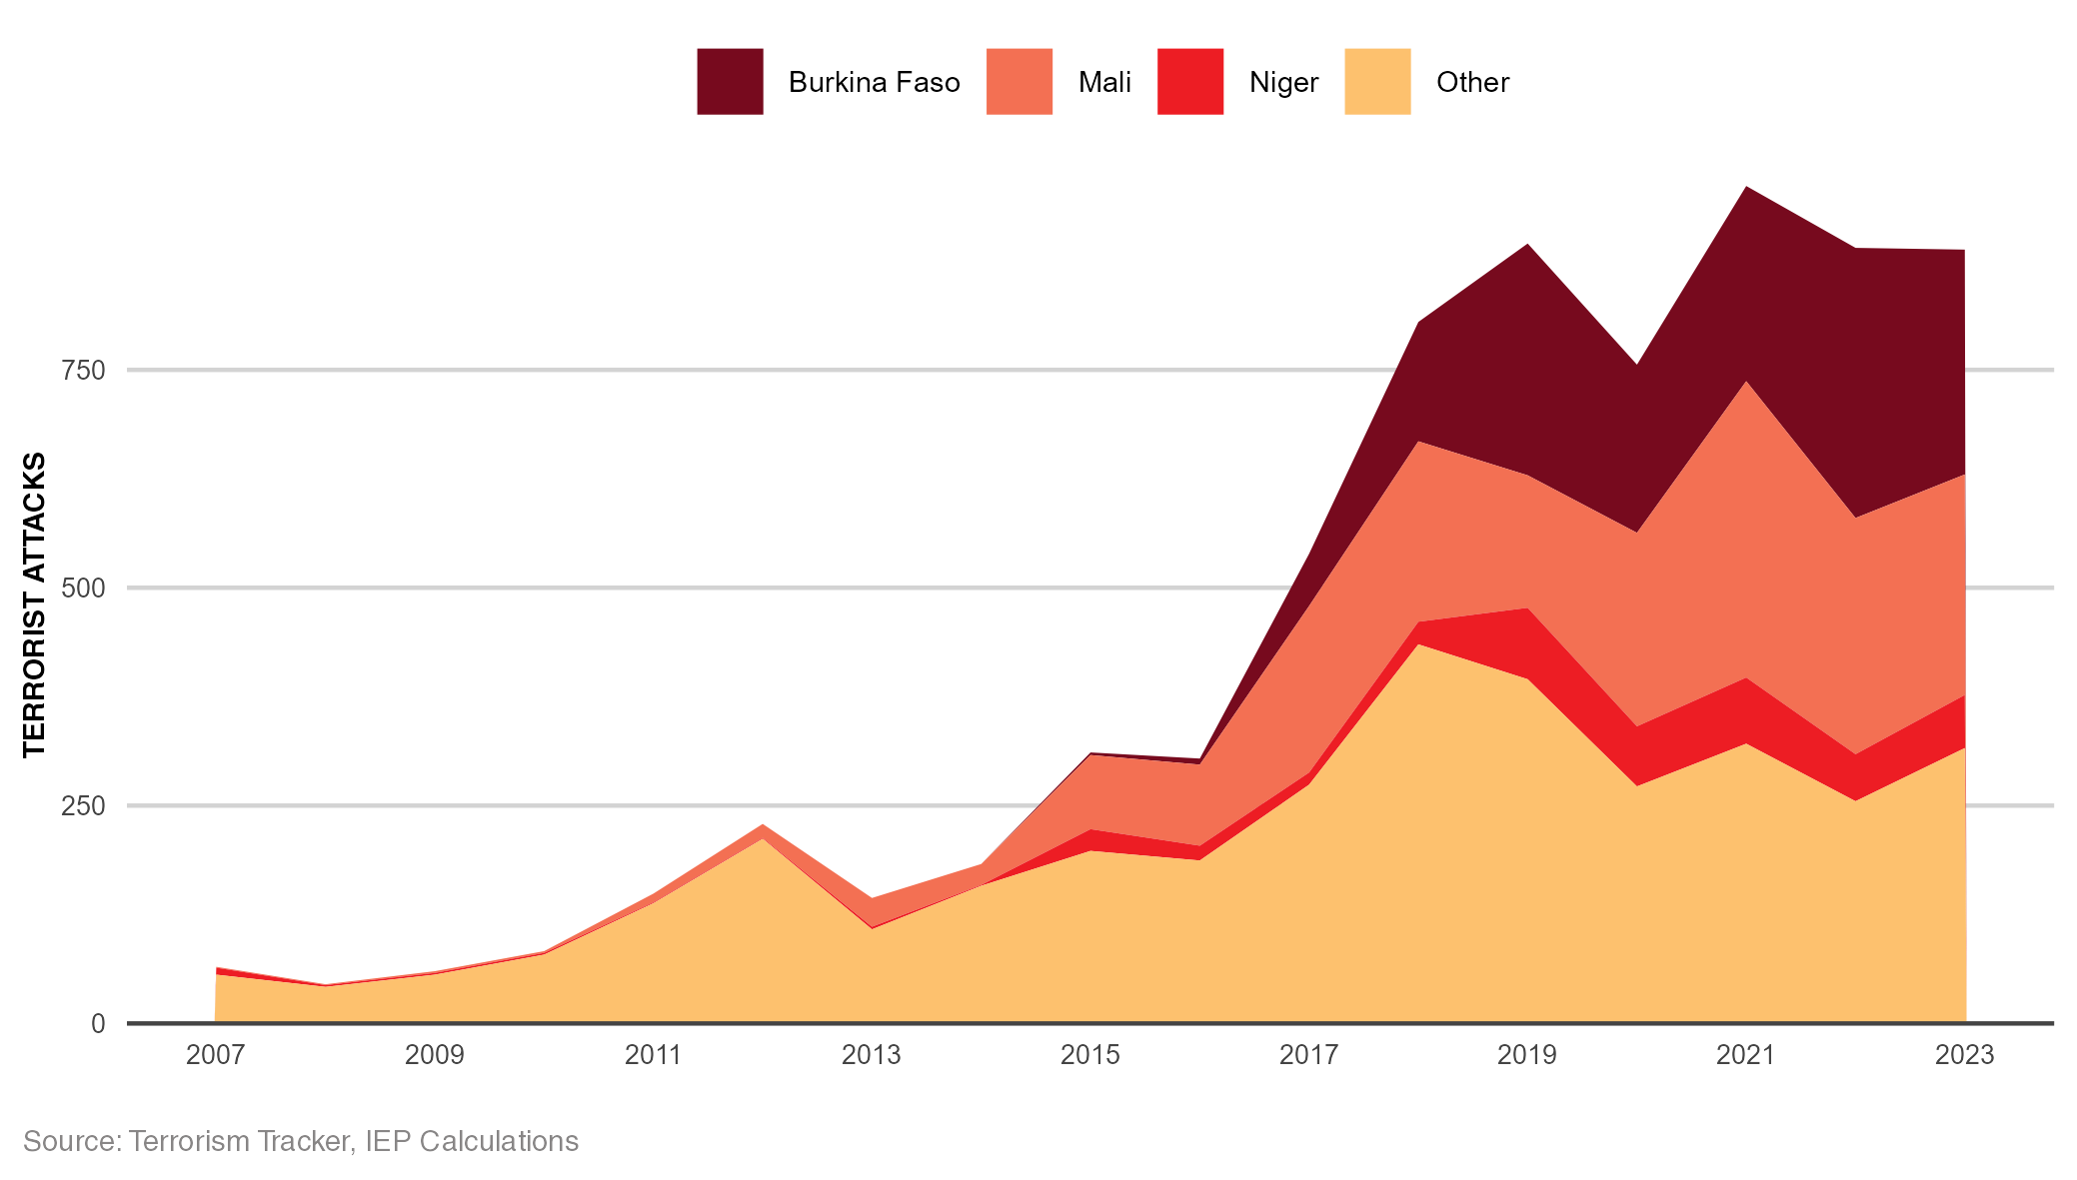
Terrorist attacks in the Sahel, 2007-2023
Since 2017 most of the terrorist activity in the Sahel has been in the Central Sahel region.

Slide 35
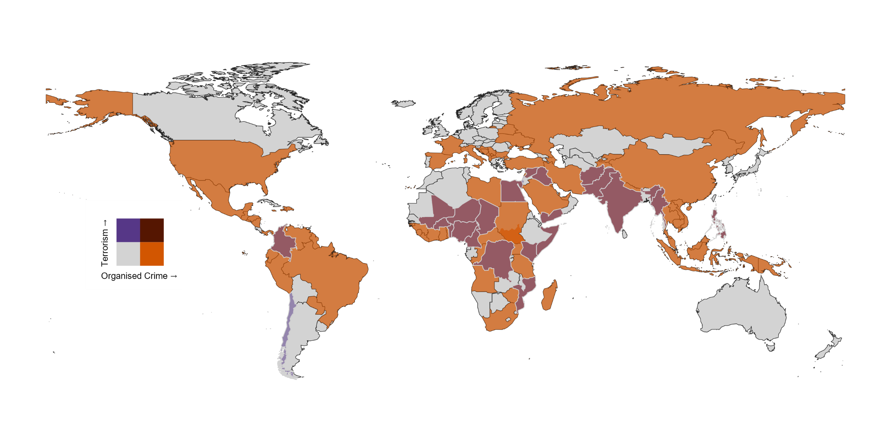
Organised crime and terrorism across the world
Both terrorism and organized crime are high in the Sahel region

Slide 36
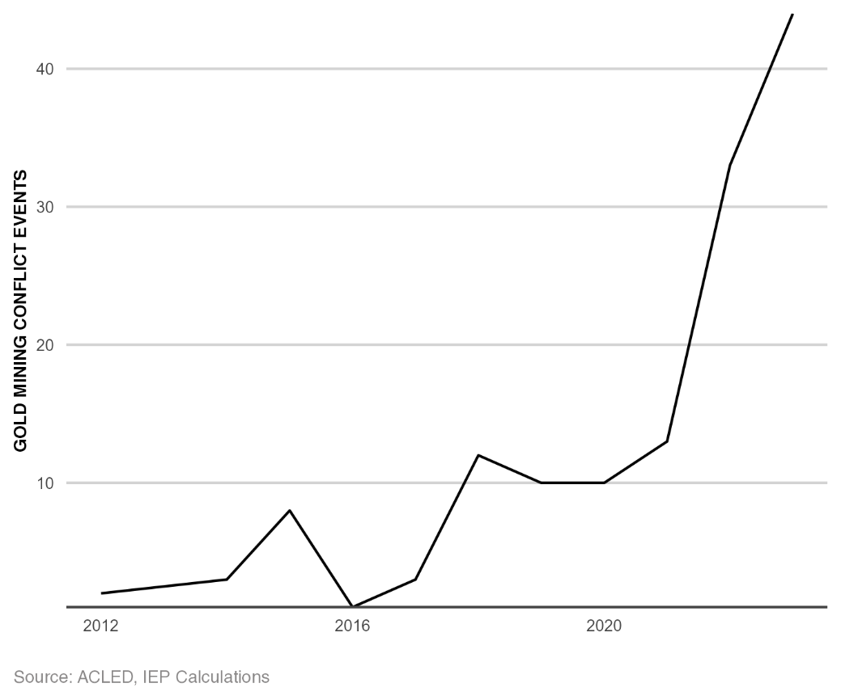
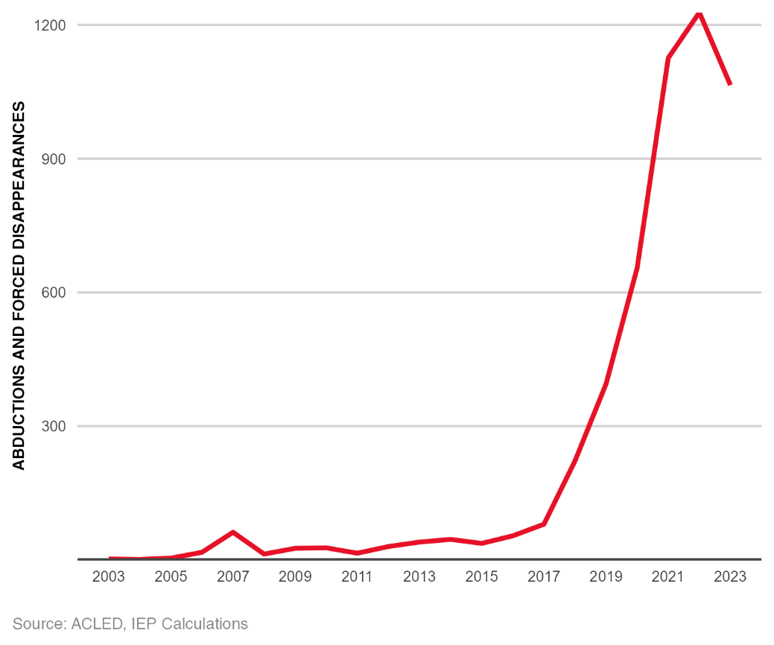
Impact of organised crime in the Sahel region
Kidnappings and armed events at gold mining operations have both risen dramatically in the last five years
Gold Mining Conflict Events
Kidnappings

Slide 37
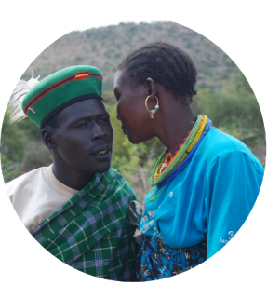
Get involved with IEP
@GlobPeaceIndex
GlobalPeaceIndex
Ambassador Program
Positive Peace Workshops
@GlobalPeaceIndex
Online
Strategic Partnerships
IEP Peace Academy
visionofhumanity.org

