Slide 1


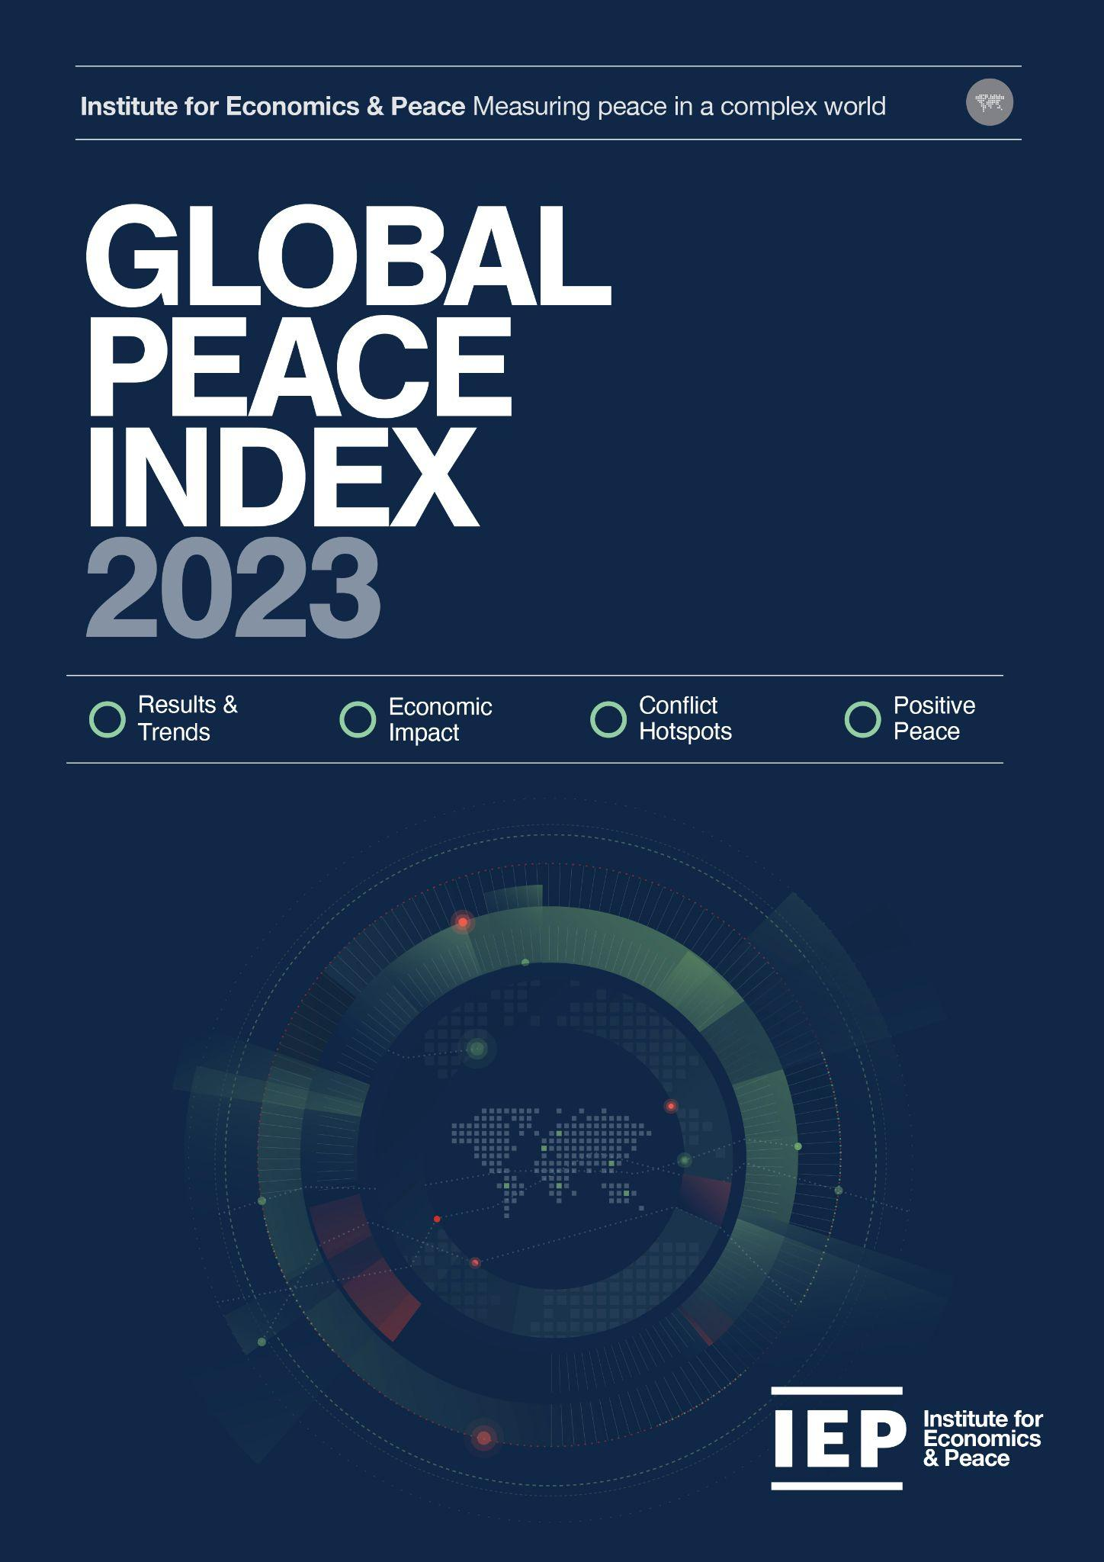
GLOBAL PEACE
INDEX 2023
Measuring peace in a complex world
OVERVIEW:
Key Findings
Trends in Peace
Economic Value of Peace
Ukraine & Europe
Conflict Hotspots

Slide 2
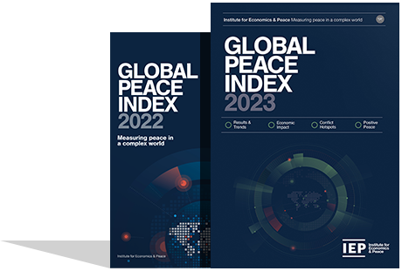
ABOUT US
Pioneering research & insight
The Institute for Economics and Peace is an independent, not-for-profit think tank dedicated to building a greater understanding of the key drivers of peace, as well as identifying the economic benefits that increased peacefulness can deliver.

Slide 3
IEP by the numbers
40BN
1.4BN
152
Media impressions
Social media impressions
Country audience
10
8000
2M
Published reports
Book references
Unique website visitors
Research used extensively by organisations, including the OECD, Commonwealth Secretariat, World Bank and the United Nations
IEP’s research and insight is included in 1,000s of university courses around the world
Over 500,000 downloads of IEP reports in the last 12 months

Slide 4
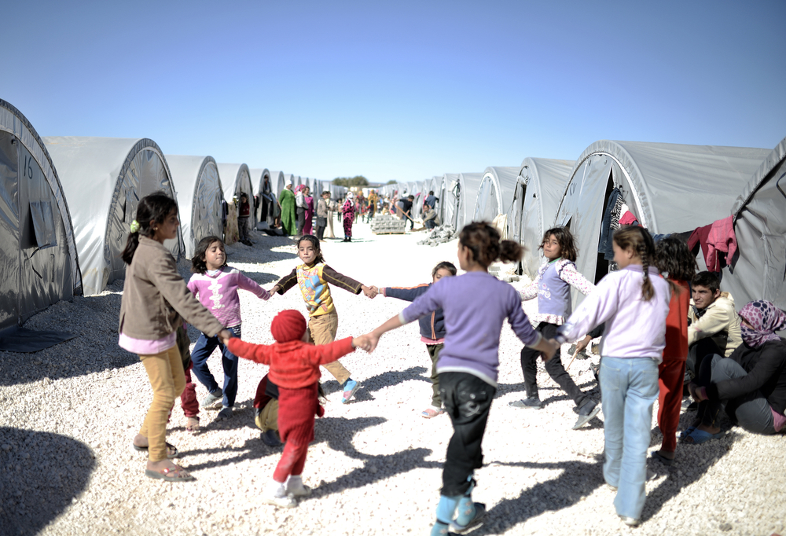

KEY FINDINGS
Key indicators
GPI highlights
Results & trends

Slide 5
The Global Peace Index Indicators
6
measures of ongoing domestic and international conflict
10
measures of societal safety
and security
7
measures of militarisation
Including: intensity of organised internal conflicts, relations with neighbouring countries and number of deaths from conflict
Including: number of refugees and IDPs, impact of terrorism, homicide and incarceration rates
Including: military expenditure, number of armed service personnel, ease of access to small weapons
17th edition, covers 99.7% world’s population

Slide 6
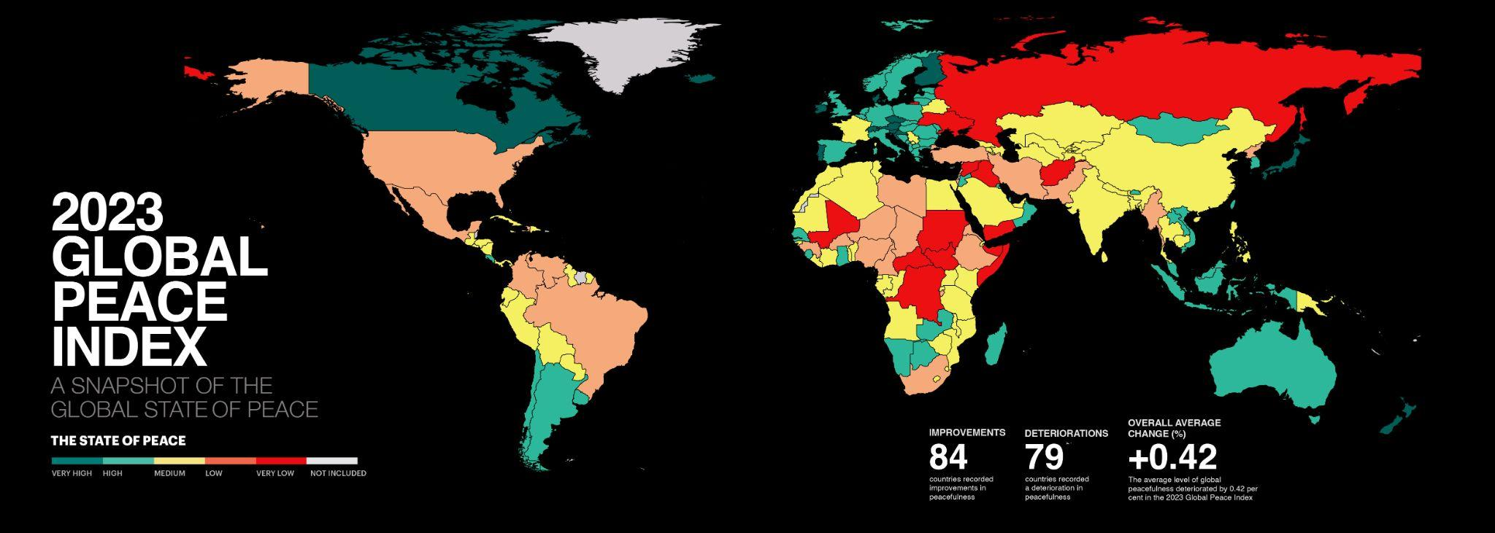
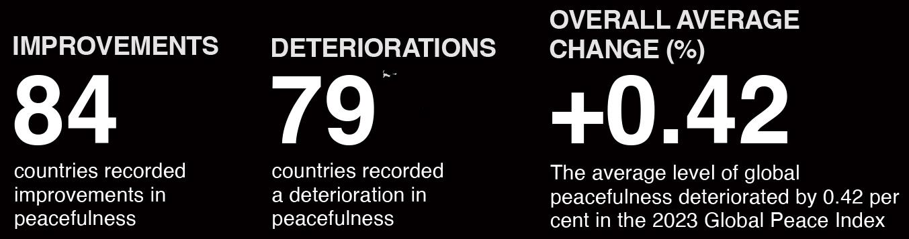

Slide 7


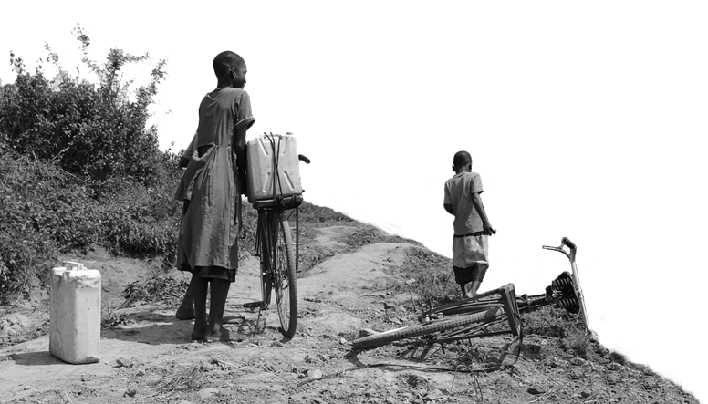
2023 key highlights
    The average level of global country peacefulness has deteriorated by
    84
    countries became more peaceful
0.42%
    79
    countries deteriorated
    This is the 13th deterioration in the last 15 years.
    Improvements were driven by changes in:
    Terrorism Impact
    Political Terror Scale
    Military expenditure (% of GDP)
    Deteriorations primarily driven by changes in:
        External Conflicts Fought
        Political Instability
    Deaths from Internal Conflict

Slide 8
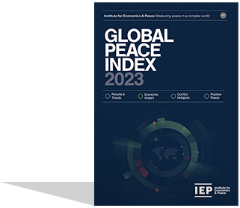
2023 key highlights
Iceland remains as the most peaceful country in the world
Libya and Burundi had the largest improvements
Middle East and North Africa (MENA) improved significantly for the last three consecutive years
Europe remains the most peaceful region, and recorded a slight improvement in the past year

Slide 9
2023 key highlights - continued
Afghanistan remains the world’s least peaceful nation. However, it recorded one of the largest increases in peacefulness
Conflict deaths increased by 96%
Russia and Eurasia recorded the steepest regional deterioration
Six of the nine GPI regions recorded deteriorations

Slide 10
10 most peaceful countries
1
ICELAND
Rank change:
6
SINGAPORE
Rank change: 4
2
DENMARK
Rank change: 1
7
PORTUGAL
Rank change: 1
3
IRELAND
Rank change: 1
8
SLOVENIA
Rank change: 4
4
NEW ZEALAND
Rank change: 2
9
JAPAN
Rank change:
5
AUSTRIA
Rank change:
10
SWITZERLAND
Rank change: 1

Slide 11
10 least peaceful countries
163
AFGHANISTAN
Rank change:
158
RUSSIA
Rank change: 2
162
YEMEN
Rank change:
157
UKRAINE
Rank change: 14
161
SYRIA
Rank change:
156
SOMALIA
Rank change: 2
160
SOUTH SUDAN
Rank change:
155
SUDAN
Rank change:
159
CONGO, DRC
Rank change:
154
IRAQ
Rank change: 3

Slide 12
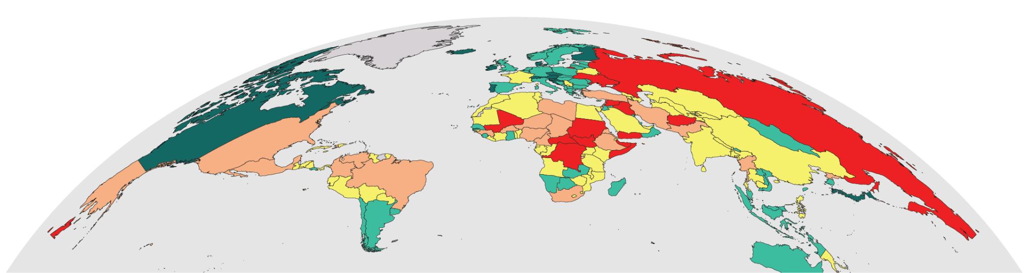
5 most improved countries
BURUNDI
LIBYA
Rank: 128
Rank: 137
Rose 6 places
Rose 14 places
OMAN
COTE D’IVOIRE
Rank: 48
Rank: 90
Rose 18 places
Rose 18 places
AFGHANISTAN
Rank: 163
No Change in Rank

Slide 13
5 most deteriorated countries
UKRAINE
Rank:157
Fell 14 places
MALI
Rank:153
Fell 4 places
ISRAEL
Rank:143
Fell 8 places
HAITI
Rank:129
Fell 17 places
RUSSIA
Rank:158
Fell 2 places

Slide 14
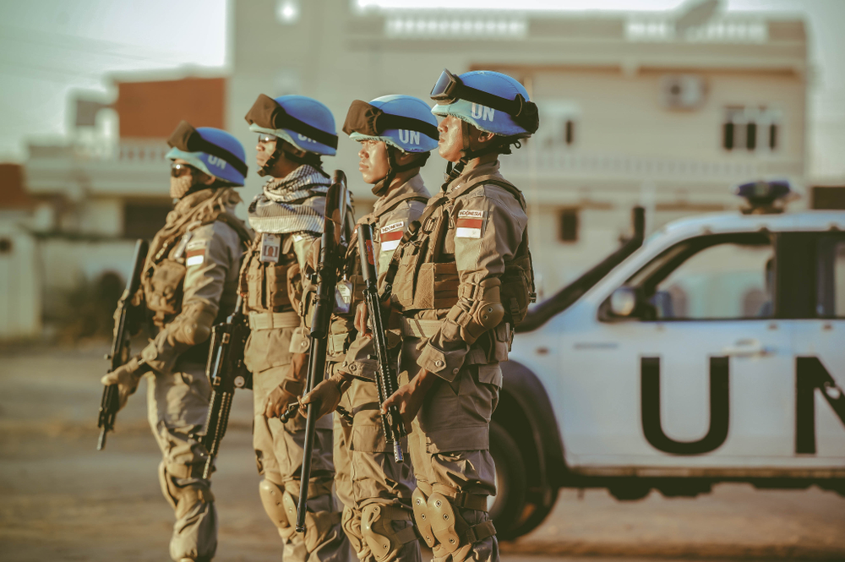
TRENDS IN
PEACE
15 year trends
Improvements & deterorations
Conflict & militarisation trends

Slide 15
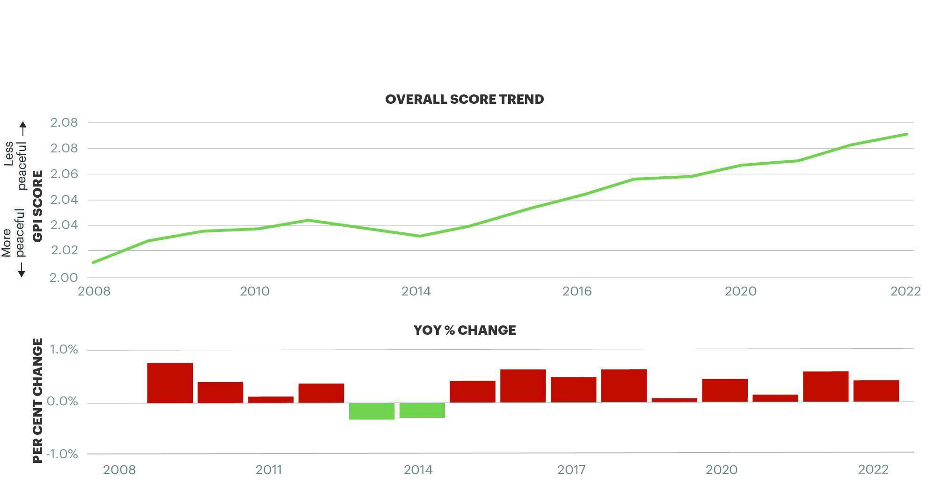
Peacefulness since 2008
    Peacefulness has declined year on year for 13 of the last 15 years.
    Source: IEP
97 countries deteriorated while 66 improved

Slide 16
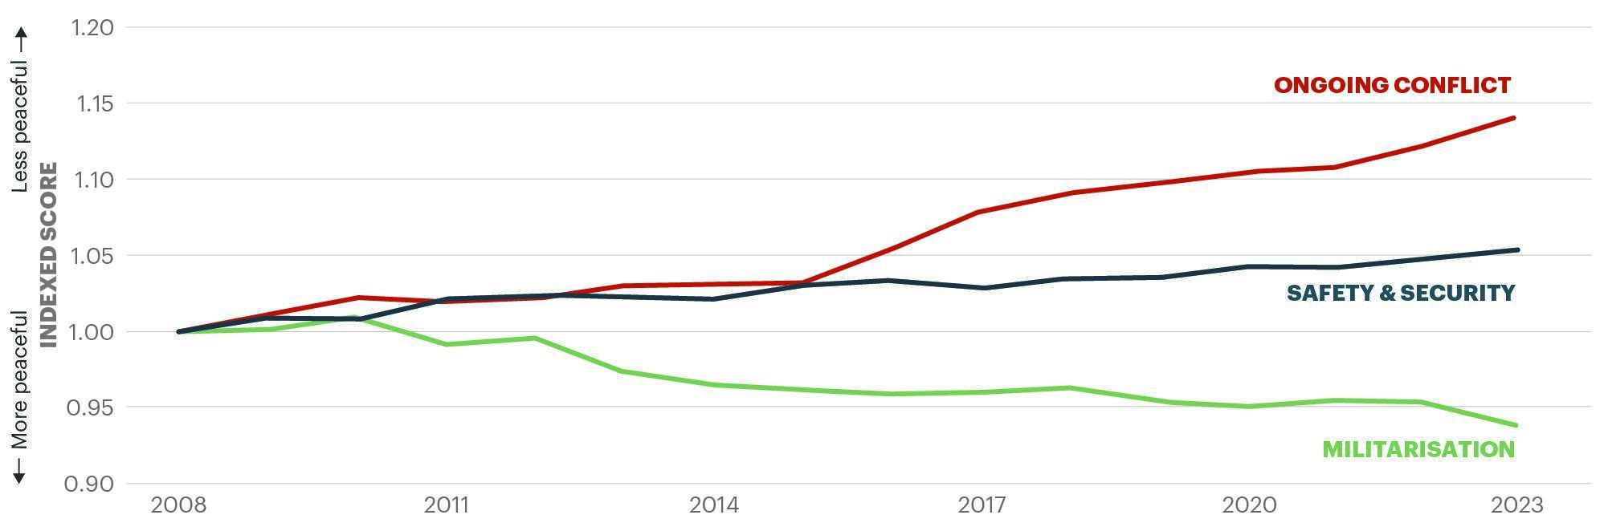
Peace over the last 15 years
Militarisation was the only domain to improve since 2008. Ongoing conflict deteriorated substantially since the mid 2010s.
    Source: IEP

Slide 17
Changes in indicator scores, 2008 - 2023
    The Violent Demonstrations and External Conflicts fought indicators both deteriorated by more than 50 per cent since 2008
←More Peaceful
Less Peaceful→

Slide 18
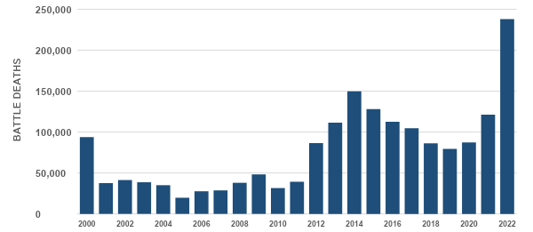
Total battle deaths, 2000 - 2022
Over 180,000 of the battlefield deaths occurred in Ethiopia and the Ukraine
Source: UCDP
Total Battle Deaths, 2000 - 2022

Slide 19
Trends in Internal & External Conflict indicators
More countries are involved in external conflicts than at any other time
Average level of internal conflict has risen steadily over the past 15 years
Source: UCDP; IEP calculations
Source: EIU

Slide 20
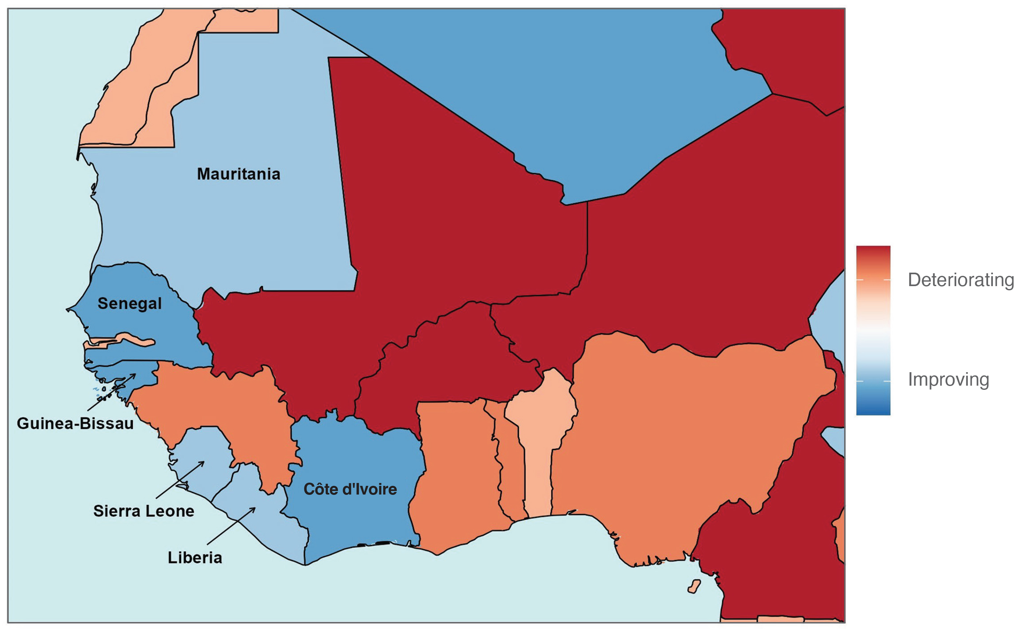
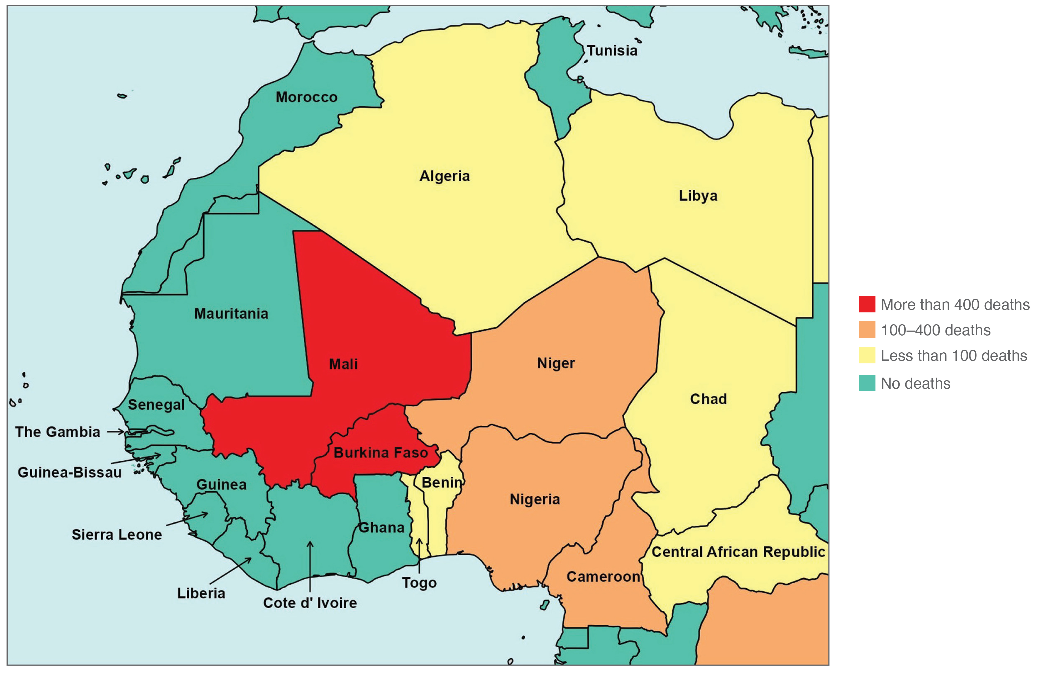
Coastal West Africa
Change in GPI score, 2008-2023
Almost every coastal West African country recorded an improvement in overall GPI score
Deaths from terrorism, 2022
Not a single death from terrorism was recorded from Morocco to Ghana in 2022, despite high levels of terrorism in the Sahel
Source: IEP
Source: Terrorism Tracker, IEP Calculations

Slide 21
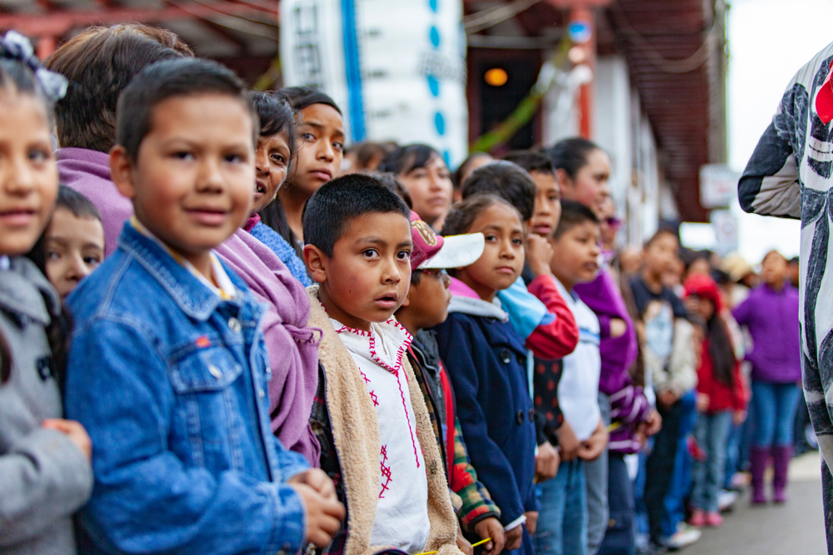
ECONOMIC
VALUE OF
PEACE
Economic impacts
Impact breakdown
Ten year trends

Slide 22
Economic impact of violence, 2022
$17.5
trillion
Which is equivalent to
12.9%
of total world GDP
OR
$2,200
per person
If the world decreased
violence by 10%
$1.75tr
Could be directed to
other economic activities

Slide 23
Economic impact of violence, continued
The economic impact of violence was $17.5 trillion PPP in 2022, equivalent to 12.9 per cent of global GDP or $2,200 per person.
The economic impact increased by 6.6 per cent, owing to increases in military expenditure. The economic impact of military expenditure rose by 16.8 per cent in PPP terms.
Ukraine, Afghanistan and Sudan incurred the highest relative economic cost of violence in 2022, equivalent to 63.1, 46.5 and 39.7 per cent of GDP, respectively.
In the ten countries most economically affected by violence, the average economic cost was equivalent to 34 per cent of GDP. In the ten most peaceful countries the average economic cost was 2.9 per cent of GDP.

Slide 24
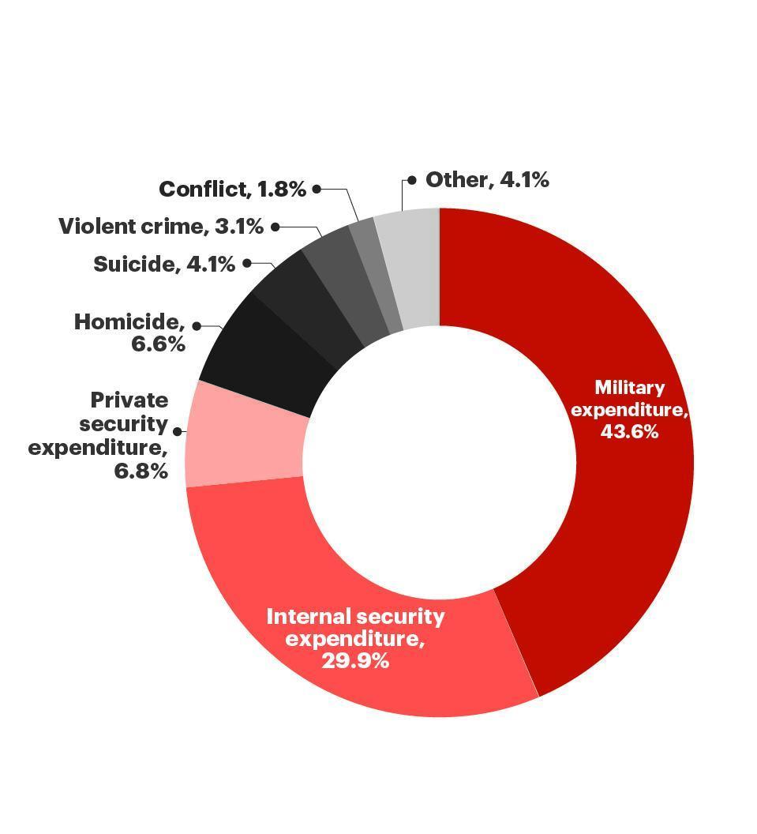
Breakdown of the economic impact of violence
Military and internal security expenditure combined account for almost 75 per cent of the economic impact of violence.
10 most affected countries average GDP loss 34%
10 most affected countries average GDP loss 2.9%
    Source: IEP

Slide 25
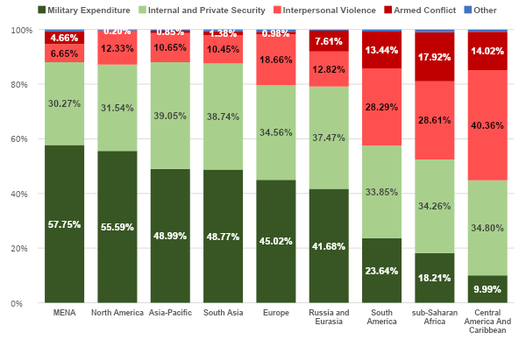
Composition of economic impact, by region
Security spending has the largest relative economic impact in most regions

Slide 26
The economic impact of a blockade of Taiwan
Chinese blockade of Taiwan would lead to a drop in global economic output of 2.7 trillion in the first year or 2.8% global GDP.
Almost double the loss that occurred as the result of the 2008 Global Financial Crisis.
The Chinese economy would shrink by seven per cent, while Taiwan’s economy would shrink by almost 40 per cent.
Taiwan produces 92 per cent of the world’s advanced logic semiconductor chips

Slide 27
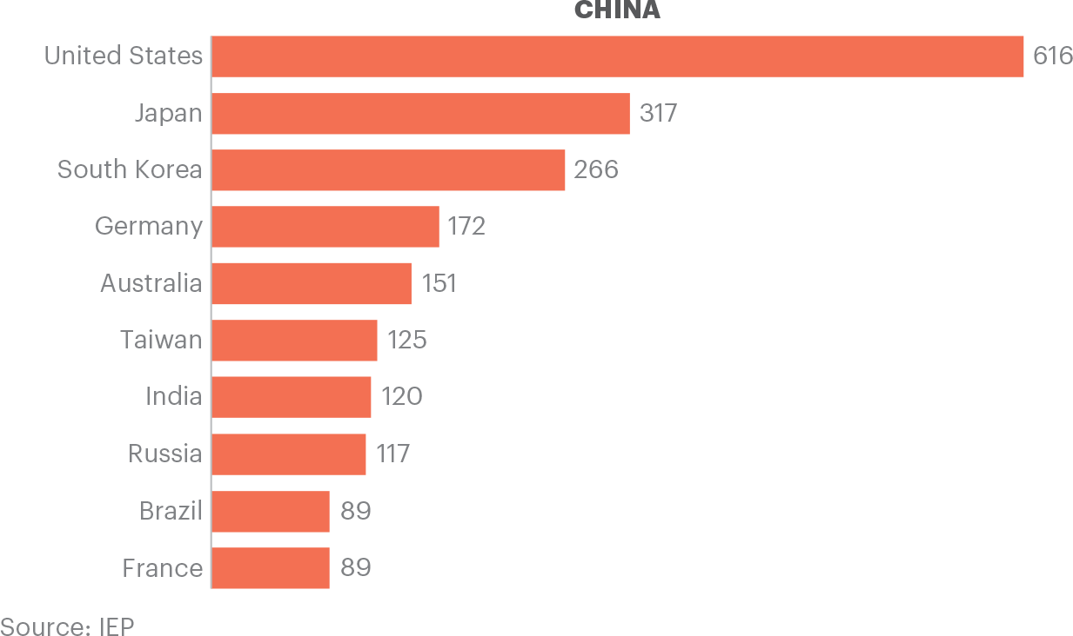
China’s largest trading partners
China’s five biggest trading partners are advanced democracies, and are highly integrated economically and militarily

Slide 28

UKRAINE
Conflict deaths
Economic impact
Eastern Europe

Slide 29
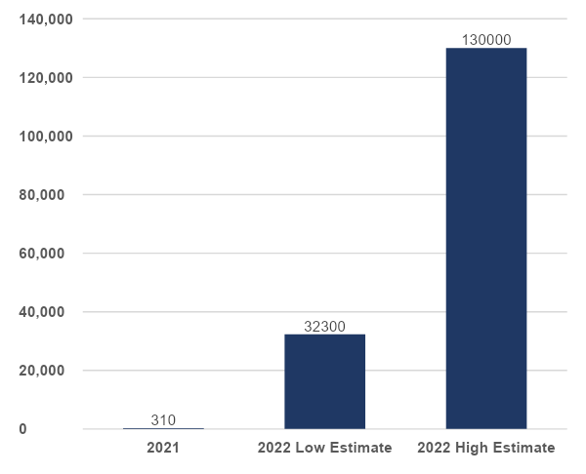
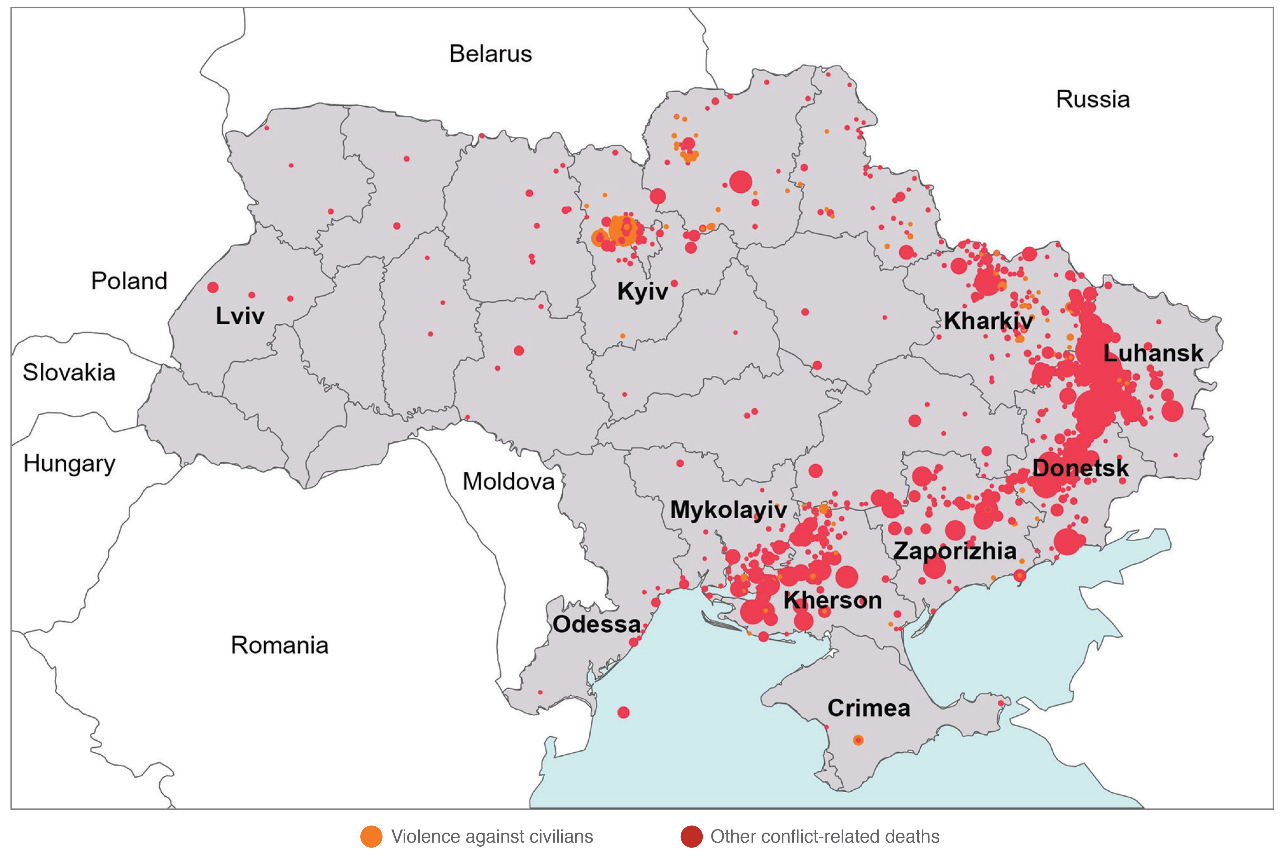
The war in Ukraine
Most recent estimates suggest 83,000 people were killed in the conflict in 2022
WPP projections suggest that 65% of Ukrainian men ages 19-24 fled the country or were killed
Conflict Deaths in Ukraine, 2021 to 2022
Geographic Distribution of Conflict Deaths, 2022
Source: IEP Calculations
Source: ACLED

Slide 30
The economic impact of violence to Ukraine
Increased by
$449
billion
Which is equivalent to
63%
of total GDP
That’s an increase of
479%
compared to the prior year

Slide 31
Population leaving Ukraine
Males
Age Group | % Change 2021–2023
15-19 | -25.72%
20-24 | -64.73%
25-29 | -53.90%
30-34 | -34.86%
35-39 | -14.28%
40-44 | -10.40%
45-49 | -9.31%
Females
Age Group | % Change 2021–2023
15-19 | -31.05%
20-24 | -72.26%
25-29 | -57.70%
30-34 | -35.85%
35-39 | -14.00%
40-44 | -9.98%
45-49 | -7.81%

Slide 32
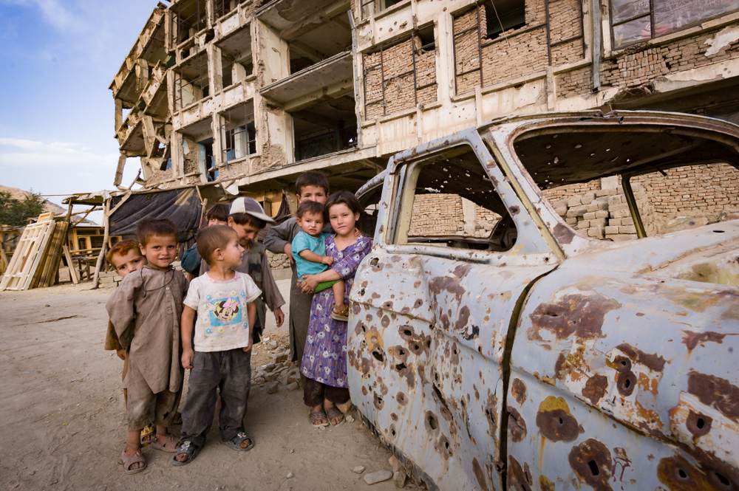
CONFLICT
TRENDS &
HOTSPOTS
Battle deaths
Country focus
Drone usage

Slide 33
Conflict trends
Violence increased significantly in Ethiopia, Mali, Myanmar, and Ukraine in 2022. Drops significantly in Afghanistan and Yemen.
Conflict was increasing even prior to the Russian invasion of Ukraine. Total conflict-related deaths rose by 45 per cent between 2020 and 2021, and 96% between 2021 and 2022.
More conflict deaths in Ethiopia at 100,000 than Ukraine at 83,000 in 2022.
Internationalised conflicts have increased 9 fold since 2004 to 27.

Slide 34
Internationalised intrastate conflicts
Internationalised intrastate conflicts are now just as common as intrastate conflicts.
Number of Conflicts by Type, 1976 - 2021
Source: UCDP

Slide 35
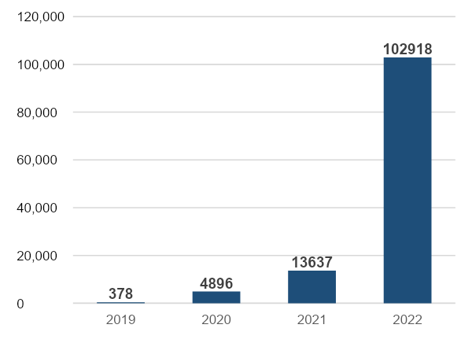
Ethiopia
Near total media blackout has made verifying conflict deaths extremely difficult.
Some estimates suggest that over half a million people may have died owing to a lack of humanitarian aid.
Conflict-related Deaths in Ethiopia, 2019 - 2022
Source: UCDP

Slide 36
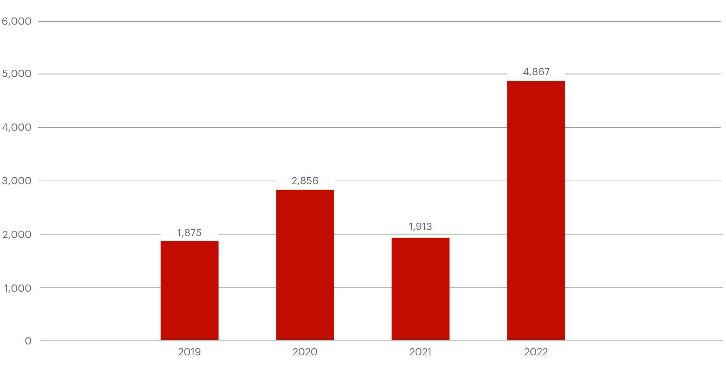
Mali
The surge in violence in 2022 has led to a large increase in violence targeted at civilians, much of it committed by government forces.
Conflict Related Deaths in Mali, 2019 - 2022
Source: ACLED

Slide 37
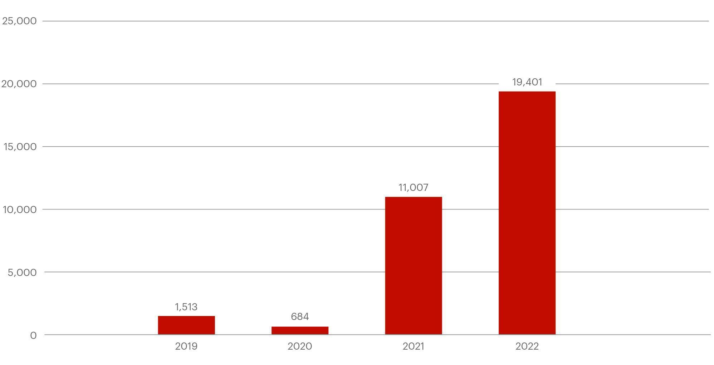
Myanmar
As the conflict in Myanmar intensified, opposition to the military government shifted from protest to open violent conflict.
Conflict Related Deaths in Myanmar, 2019 - 2022
Source: ACLED

Slide 38
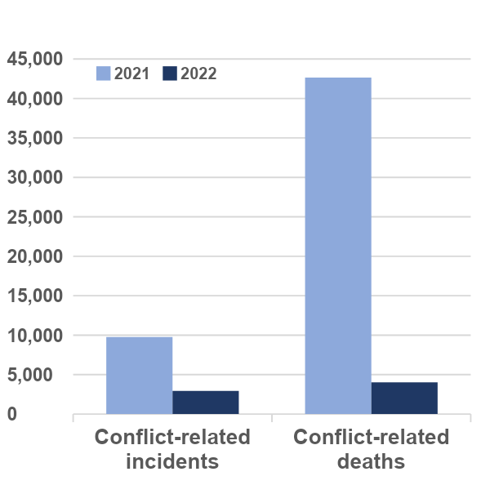
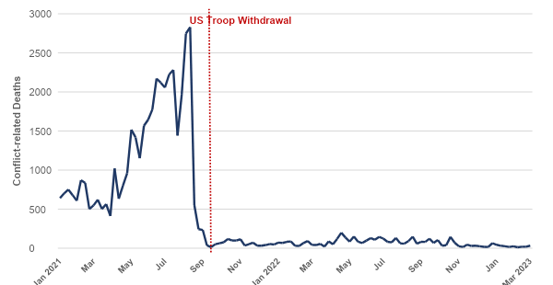
Afghanistan
The number of conflict-related deaths and incidents has fallen dramatically since the US troop withdrawal in August 2021.
Conflict in Afghanistan, 2021 - 2022
Monthly Conflict-related deaths, Jan 2021 – Mar 2023
Source: ACLED

Slide 39





Get involved with IEP
@GlobPeaceIndex
GlobalPeaceIndex
Ambassador Program
Positive Peace Workshops
@GlobalPeaceIndex
Online
Strategic Partnerships
IEP Peace Academy
visionofhumanity.org

