Slide 1
GLOBAL TERRORISM INDEX 2023
Measuring the impact of terrorism

Slide 2
“
The Institute for Economics & Peace aims to create a paradigm shift in the way the world thinks about peace.
Mission & About us
We are an independent, not-for-profit think tank dedicated to building a greater understanding of the key drivers of peace, as well as identifying the economic benefits that increased peacefulness can deliver.

Slide 3
Our international offices
SYDNEY
NEW YORK
BRUSSELS
THE HAGUE
MEXICO CITY
HARARE
Australia
USA
Belgium
The Netherlands
Mexico
Zimbabwe

Slide 4
Institute for Economics & Peace
Research used extensively by organisations, including the OECD, Commonwealth Secretariat, World Bank and the United Nations
28BN
1.4BN
152
MEDIA REACH
SOCIAL REACH
COUNTRY REACH
Work is included in thousands of university courses
Over 350,000 downloads of IEP reports
10
3000
1.3M
PUBLISHED REPORTS
BOOK REFERENCES
UNIQUE VISITORS

Slide 5
IEP Products

Slide 6
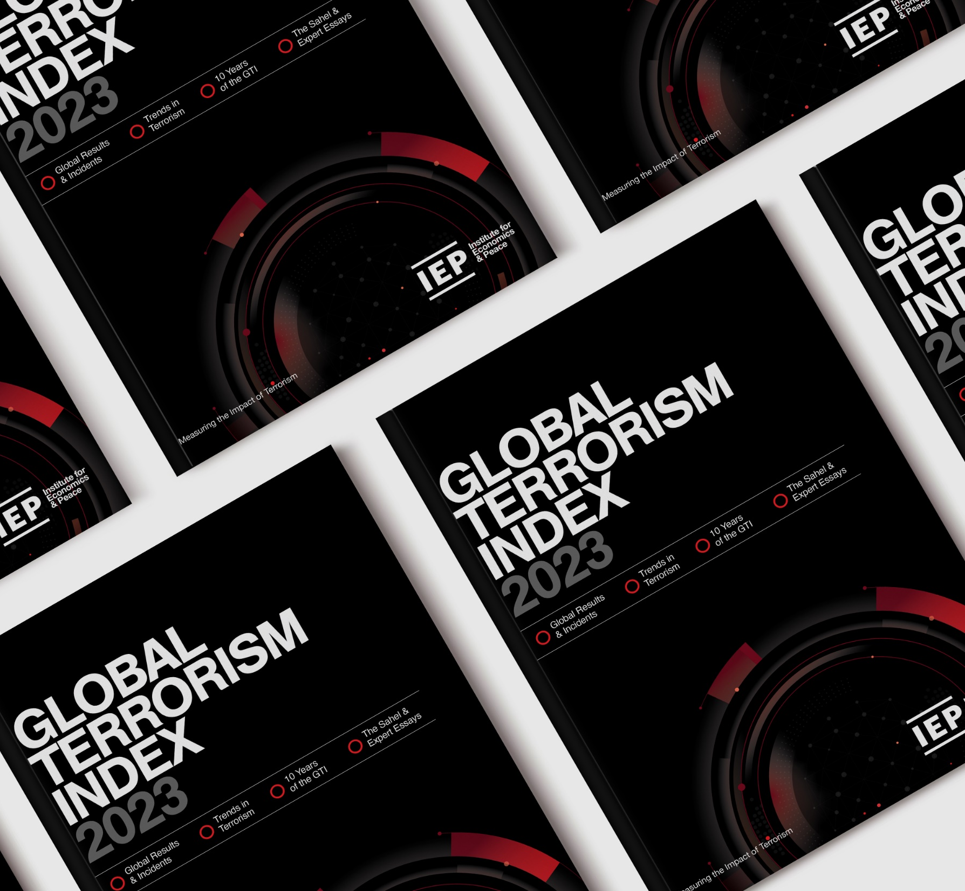
01.
What is the Global Terrorism Index?

Slide 7
The Global Terrorism Index
Now in its
Ranks
163
According to the relative impact of terrorism
^{10th}
year
countries
Includes contributions from International Experts
Used as an indicator in the Global Peace Index
Developed by the Institute for Economics and Peace

Slide 8
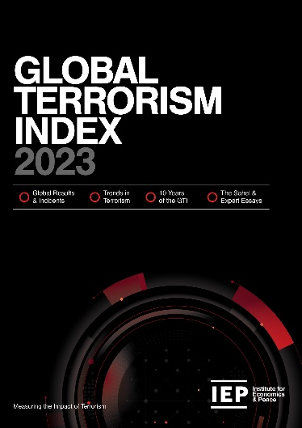
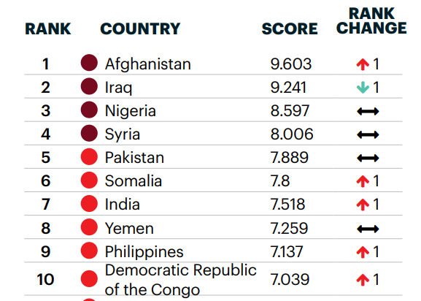
Global Terrorism Index: Methodology
Definition of terrorism: the systematic threat or use of violence, by non-state actors, whether for or in opposition to established authority, with the intention of communicating a political, religious or ideological message to a group larger than the victim group, by generating fear and so altering (or attempting to alter) the behaviour of the larger group.
Over 5 years to measure long term impact
Indicator | Weight
Incidents | 1
Injuries | 0.5
Deaths | 3
Hostages | 0.5
Year | Year minus 1 | Year minus 2 | Year minus 3 | Year minus 4
52% | 26% | 13% | 6% | 3%
Socio-economic indicators
Logarithmic banding scores (1-10)

Slide 9
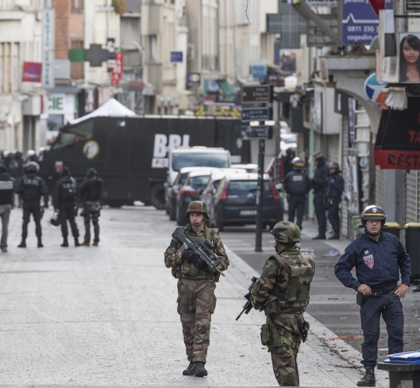
02.
GTI 2023 Results

Slide 10
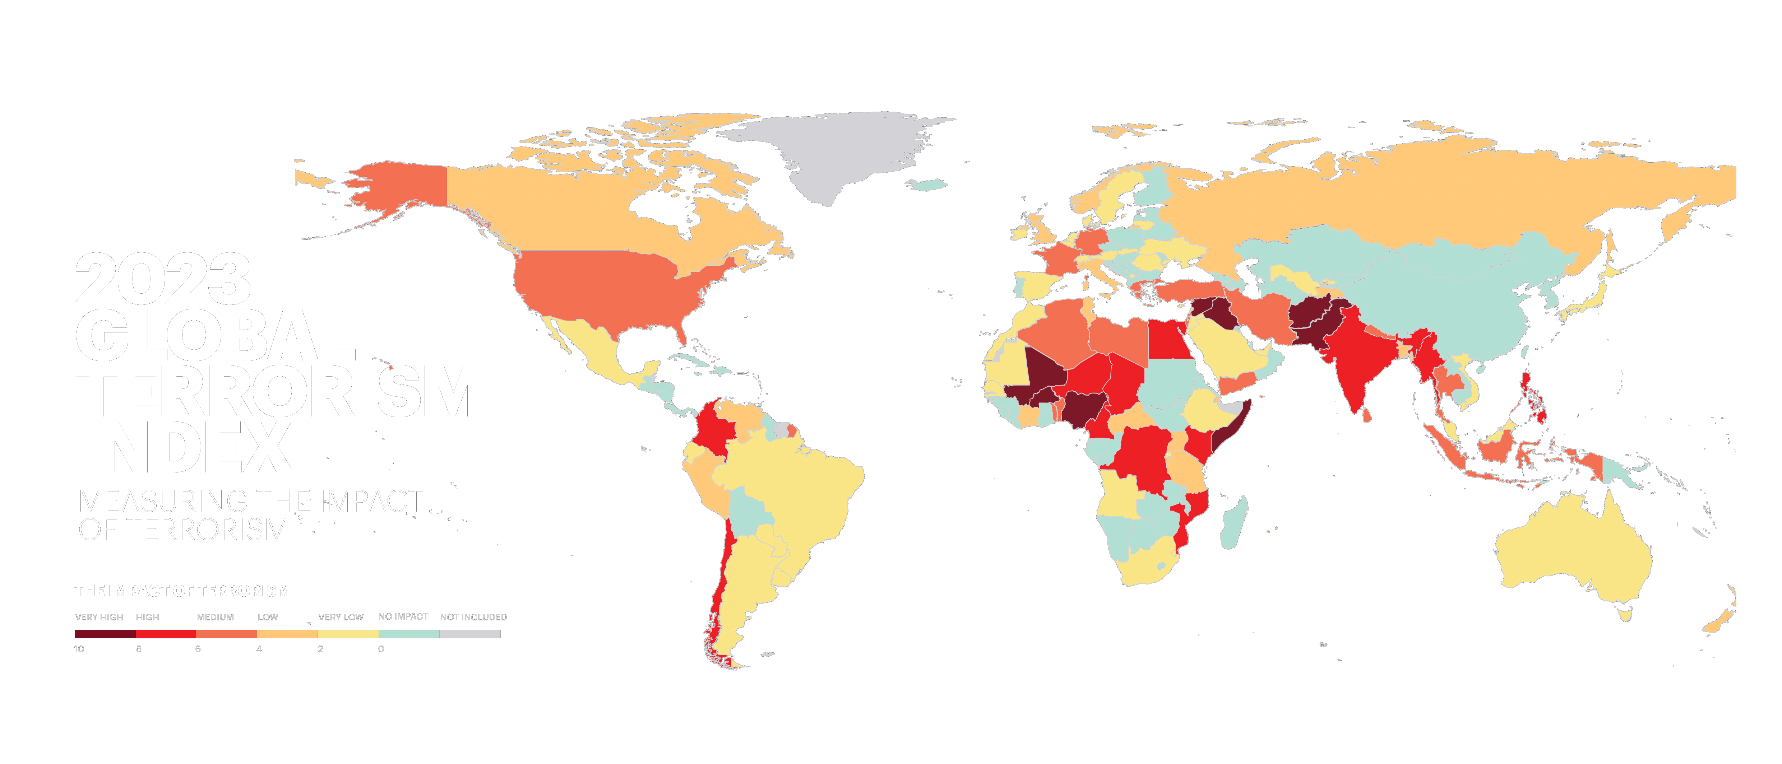
Notes:
Needs map

Slide 11
Highlights 2023
No improvement in terrorism last three years
Number of countries recording terrorism deaths unchanged - range from 43 in 2020 to 42 in 2022
25 countries improved compared to 24 that deteriorated in 2022
Sub-Saharan Africa recorded largest increase in deaths – rose by 8%
Sahel the epicenter of terrorism – 43% of global terrorism deaths occur in the region
Deaths in MENA continues to decline – down 32% to 791 deaths in 2022

Slide 12
Highlights 2023…con’t
Terrorism is becoming more effective killing 26% more people per attack. Both IS and al-Shabaab have become more lethal.
Suicide deaths in MENA have decreased dramatically – down from 1,947 in 2016 to six in 2022
Islamic State and affiliates most deadly group – 1,833 deaths in 21 countries
Balochistan Liberation Army (BLA) in Pakistan is the fastest growing group – 233 deaths, ninefold increase since 2021.

Slide 13
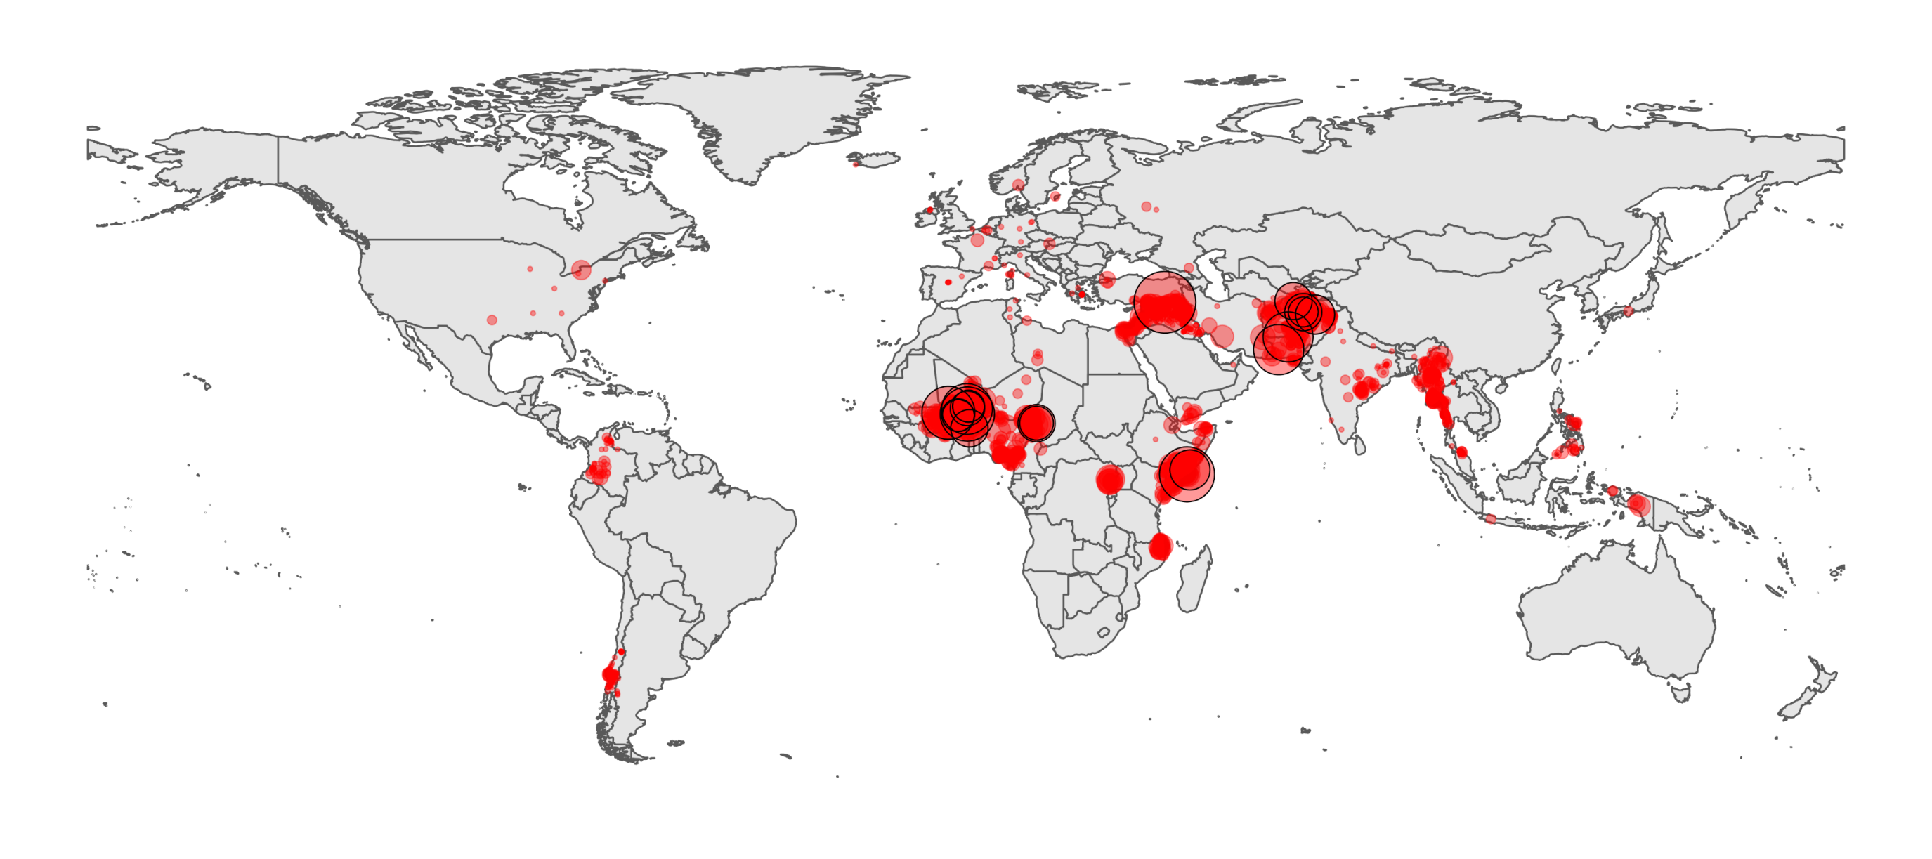
Terrorist attacks in 2022

Slide 14
Highlights 2023…con’t
Two fundamental considerations
Taliban no longer classified as terrorist organisation
Terrorism deaths down 9% - excluding Afghanistan up 4%
IS claiming less attacks - especially Sahel
IS deaths down 16% - if the rise in unknown jihadists were included, then deaths increased

Slide 15
Change in GTI Score 2021-2022
Sub-Saharan Africa was the only region to deteriorate in 2022
Source: IEP Calculations, Terrorism Tracker

Slide 16
The countries most impacted by terrorism, 2023
Afghanistan recorded the highest impact of terrorism for the fourth consecutive year.
1
AFGHANISTAN
Rank change:
6
PAKISTAN
Rank change: 3
2
BURKINA FASO
Rank change: 2
7
IRAQ
Rank change: 5
3
SOMALIA
Rank change:
8
NIGERIA
Rank change: 3
4
MALI
Rank change: 3
9
MYANMAR
Rank change:
5
SYRIA
Rank change: 1
10
NIGER
Rank change: 2

Slide 17
Five countries account for bulk of terrorism
Deaths in 5 most impacted countries increased by 8%
Deaths fall 26% for all other countries
Terrorism becoming more geographically concentrated

Slide 18
Deaths from terrorism by country, 2022
Ten countries accounted for 85% of all deaths from terrorism in 2022
Source: Terrorism Tracker, IEP Calculations

Slide 19
Increases, deaths from terrorism, 2021 - 2022
Burkina Faso had the largest increase in deaths from terrorism between 2021 and 2022
Source: Terrorism Tracker, IEP Calculations

Slide 20
Decreases, deaths from terrorism, 2021 - 2022
Afghanistan had the largest decrease in the number of deaths from terrorism since 2021
Source: IEP Calculations, Terrorism Tracker

Slide 21
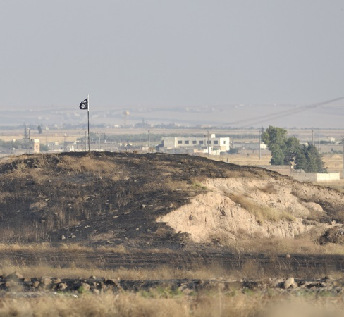
03.
Trends in terrorism

Slide 22
Deaths from terrorism, 2007-2022
Deaths from terrorism have decreased 38% since peaking in 2015

Slide 23
Deadliest terrorist groups, 2007-2022
Islamic State was the deadliest known terrorist group for the eighth consecutive year
Source: IEP Calculations, Terrorism Tracker

Slide 24
Distribution of deaths from terrorism, 2007-2022
The number of countries experiencing terrorism deaths has remained constant since 2020.
Source: IEP Calculations, Terrorism Tracker

Slide 25
Deaths from terrorism by conflict type, 2007-2022
Over 98 per cent of deaths from terrorism occur in countries currently experiencing a conflict
WAR
MINOR ARMED CONFLICT
NON-CONFLICT
Source: UCDP, IEP Calculations, Terrorism Tracker

Slide 26
Trend in terrorism deaths by region, 2007-2022
Sub-Saharan Africa suffers from more terrorism than South Asia and MENA combined
Source: IEP Calculations, Terrorism Tracker

Slide 27
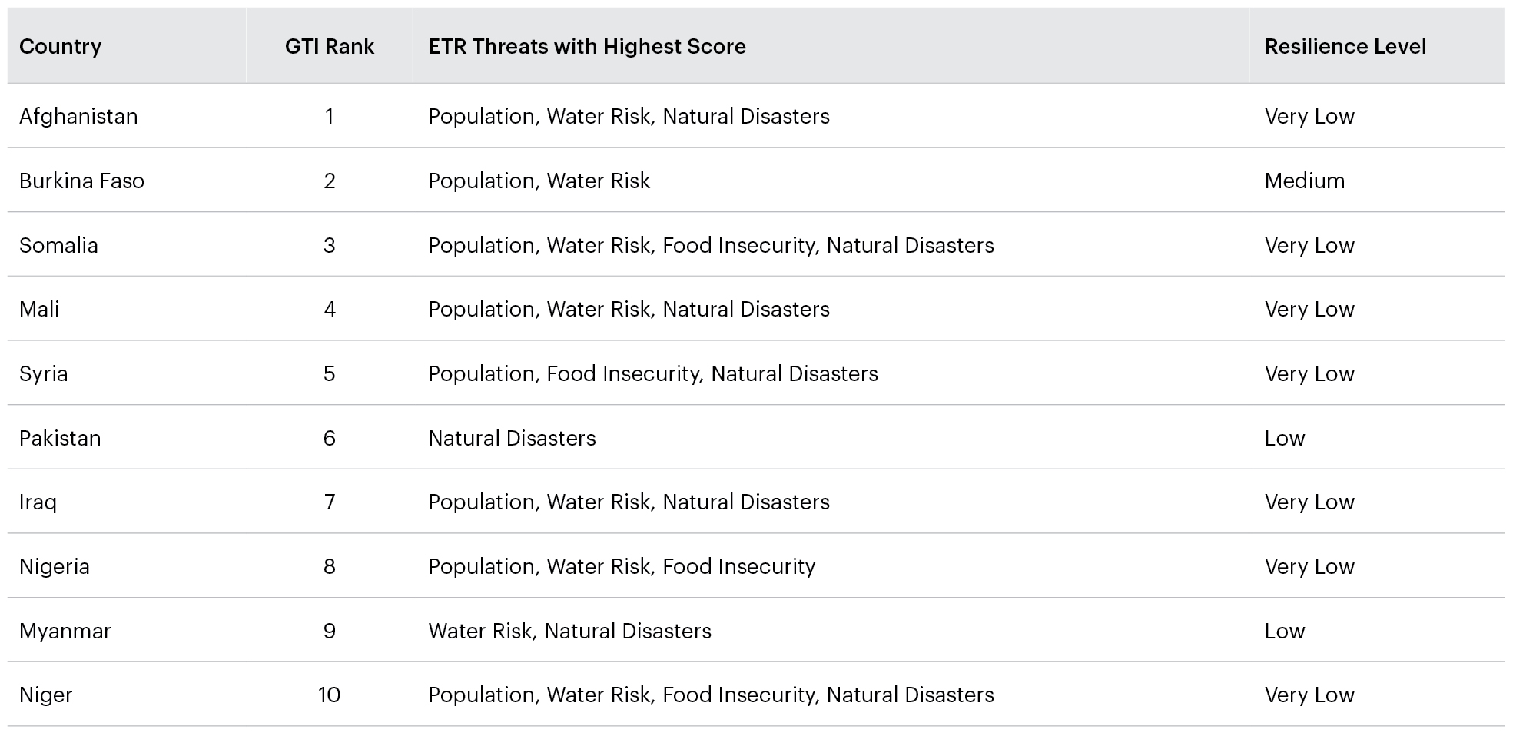
GTI Worst Ten, Ecological Threats and Resilience Levels, 2022
Eight of the ten countries suffering the worst from terrorism also face extreme water shortages and high population growth

Slide 28
Percentage of population by region that ranked war and terrorism as their top concern, 2021
12% of the citizens of countries in South Asia perceived war and terrorism to be the biggest threat to their daily safety, compared to just 0.28% in Central America and Caribbean

Slide 29
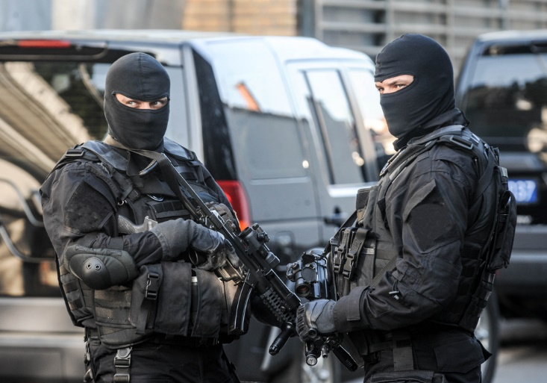
04.
Terrorism in The West

Slide 30
Terrorist Fatalities in the West by Motivation, 2007 - 2022
Since 2007, over half the fatalities from terrorism have been from religiously motivated groups. This is followed by deaths from ideologically motivated attacks which accounts for 31 per cent.
Source: IEP Calculations, Terrorism Tracker

Slide 31
Terror Attacks in the West by Motivation, 2007-2022
Since 2015, there have been more ideological terror attacks then religious attacks.
Source: IEP Calculations, Terrorism Tracker

Slide 32
Terrorism in the West
Ideology continues to be the most prominent motivation behind terrorism in the West.
15 ideologically motivated attacks, 3 religiously motivated attacks in 2022
Since 2012, there have been over three times more ideologically motivated attacks than religiously motivated terrorist attacks.
Only 8 attacks in the US – none tied to a group
4 attacks in UK - no deaths for the first year since 2008

Slide 33
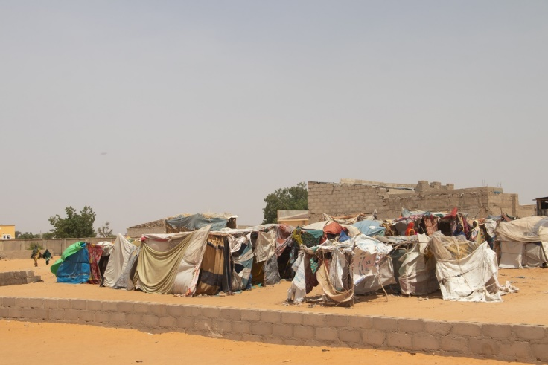
05.
Terrorism in The Sahel

Slide 34
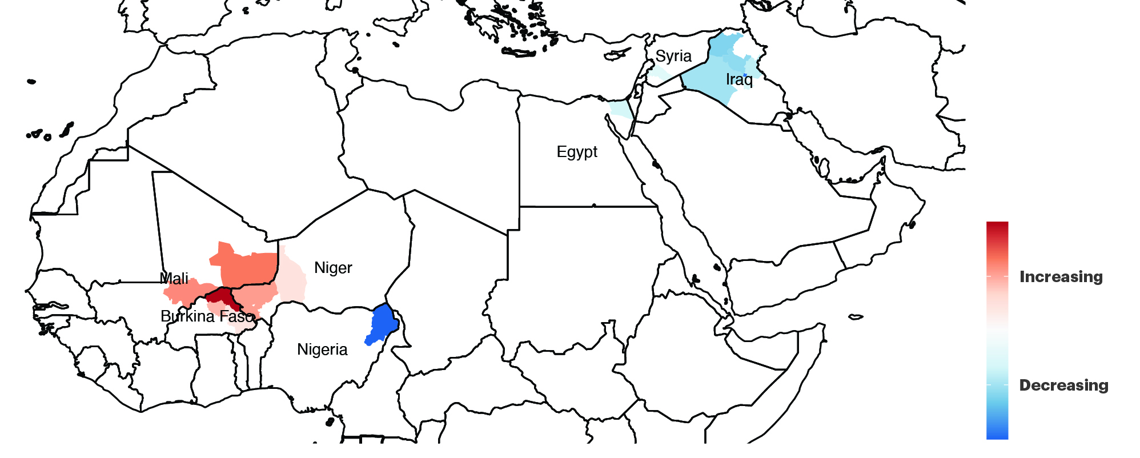
Most Significant Changes in Deaths from Terrorism, 2020-2022
Terrorism has shifted from MENA to the Sahel within the last two years.
Source: Dragonfly TerrorismTracker, IEP Calculations

Slide 35
Deaths from terrorism in sub-Saharan Africa 2007-2022
Since 2012, the Sahel has comprised most deaths from terrorism in sub-Saharan Africa.
Source: IEP Calculations, Terrorism Tracker

Slide 36
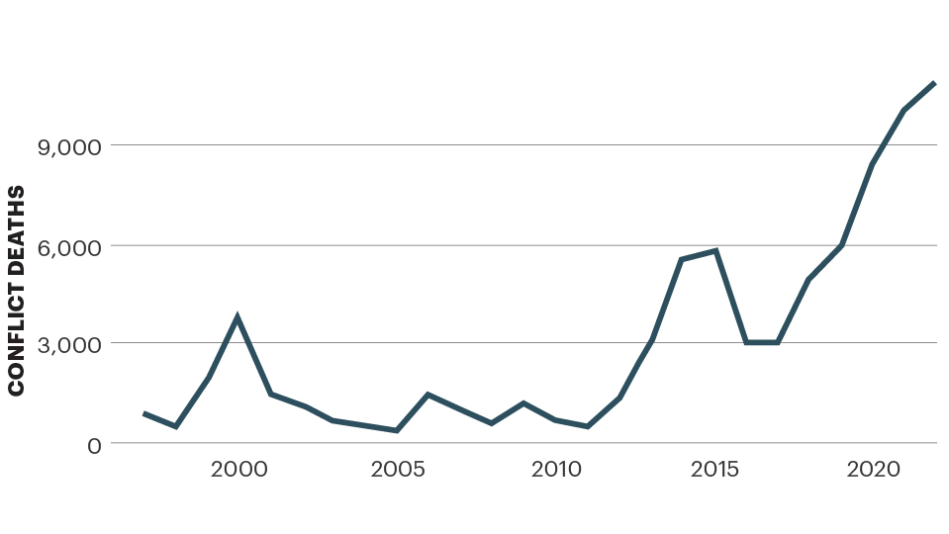
Deaths from Conflict in the Sahel, 1995-2022
The Sahel has seen steadily increasing deaths from conflict since 2011, with a severe spike from 2017 onwards.
2022
Source: ACLED, IEP Calculations

Slide 37
Coups and coup attempts in Sub-Saharan Africa, 2017-2022
Coup attempts and successes have surged since 2021 mainly in the Sahel.

Slide 38
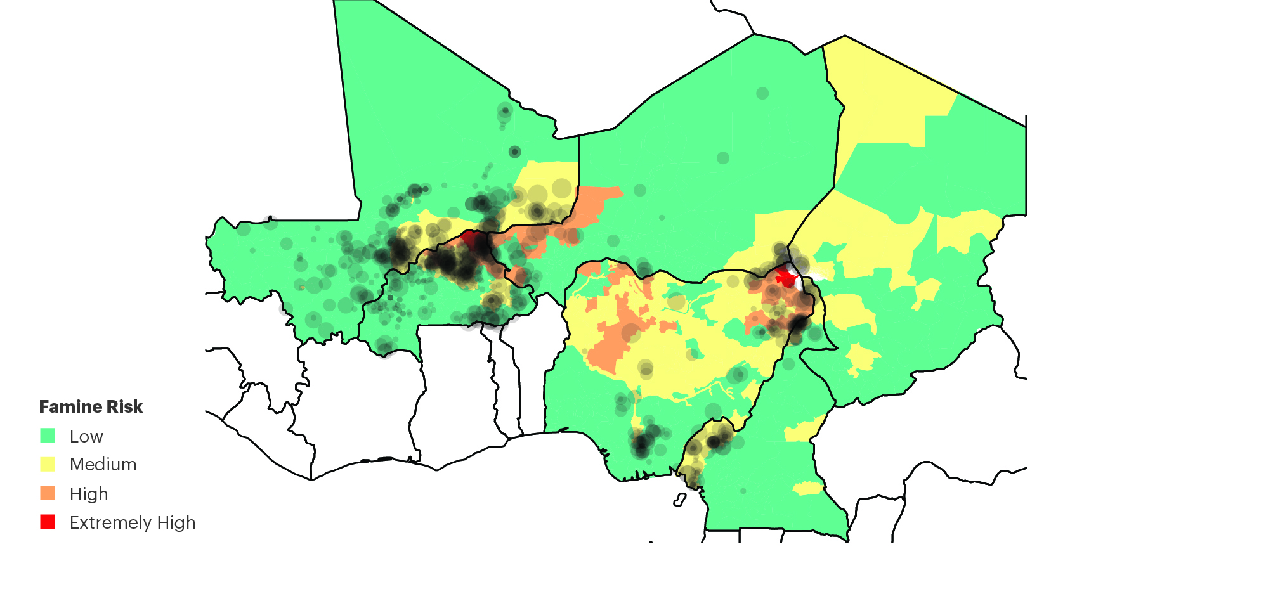
Deaths from Terrorism and Ecological Threats in the Sahel
Most deaths from terrorism occurred in states and regions ranked as having high famine risk.
Source: TerrorismTracker, FEWS, IEP Calculations

Slide 39
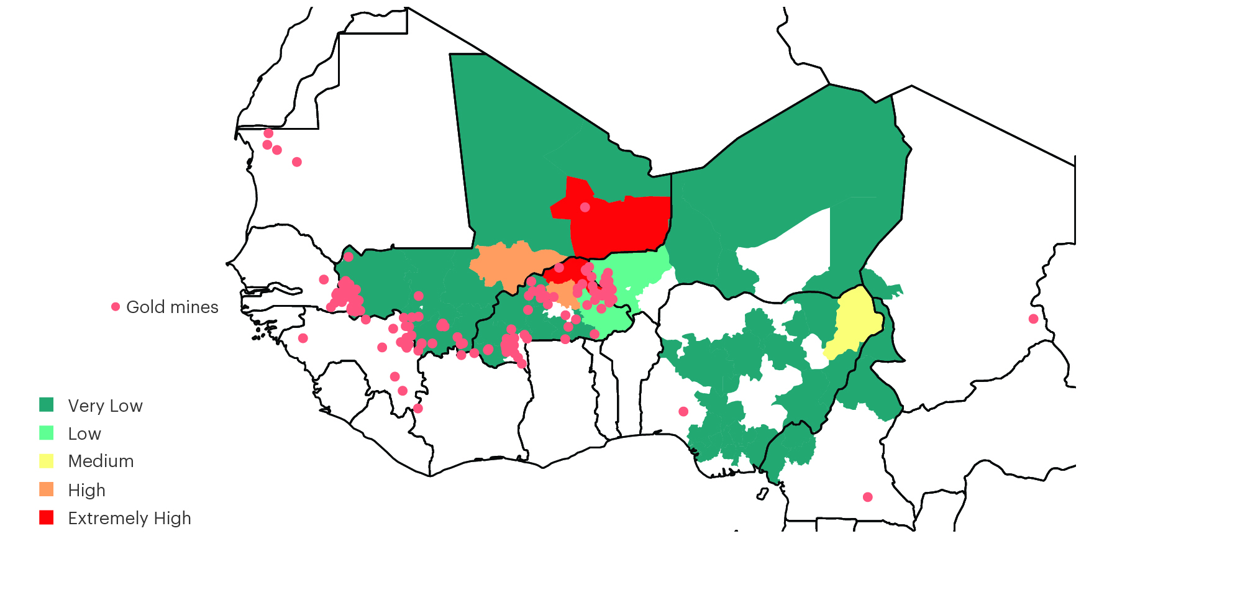
Deaths from Terrorism and Gold Mines
Terrorism deaths in the Sahel are more likely in areas with established gold mines
Source: TerrorismTracker, US Geological Survey

Slide 40
Change in the approval of the US and Russia in the Sahel
Approval ratings for both Russia and the US are high – over 50% in most countries and improving.

Slide 41
Sentiment in the Sahel Towards Former Colonial Power
Approval of France is net negative across most of the Sahel

Slide 42
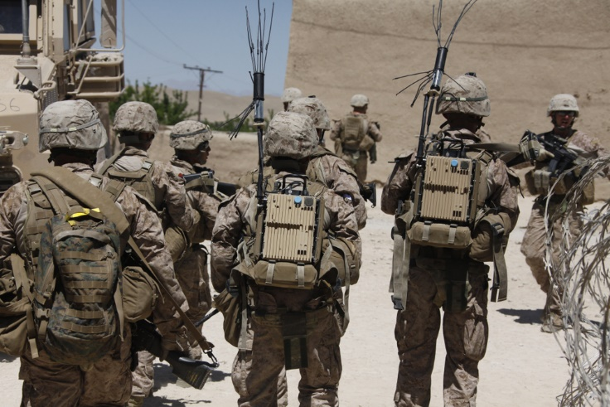
06.
MENA

Slide 43
Terrorism Deaths in MENA & Rest of the World, 2012-2022
Deaths in MENA have fallen from 57% of all deaths globally in 2016 to 12% in 2022.
Source: IEP Calculations, TerrorismTracker

Slide 44
Terrorism Deaths by Terrorist Group in MENA, 2012-2022
Almost a third of all terrorism deaths in MENA over the last decade were claimed by Islamic State

Slide 45
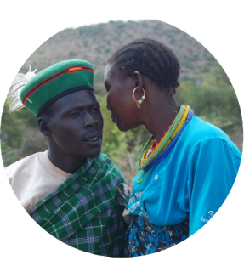
Get involved with IEP
@GlobPeaceIndex
GlobalPeaceIndex
Ambassador Program
Positive Peace Workshops
@GlobalPeaceIndex
Online
Strategic Partnerships
IEP Peace Academy
visionofhumanity.org

