Slide 1
Safety Perceptions Index 2023

Slide 2
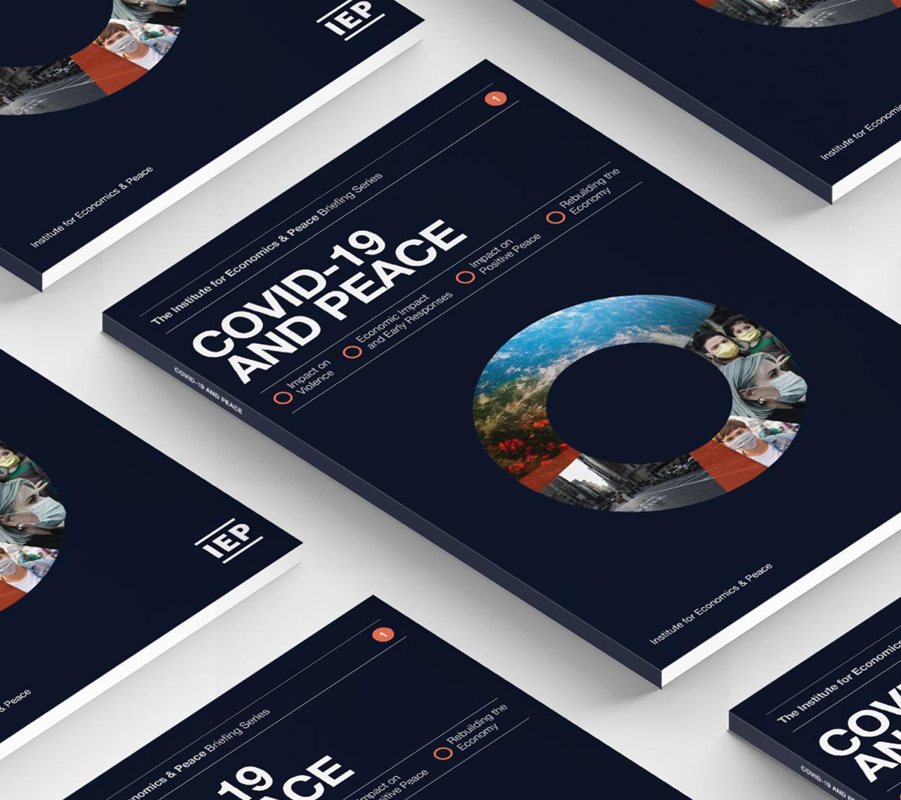
The Institute for Economics and Peace is an independent, not-for-profit think tank dedicated to building a greater understanding of the key drivers of peace, as well as identifying the economic benefits that increased peacefulness can deliver.

Slide 3
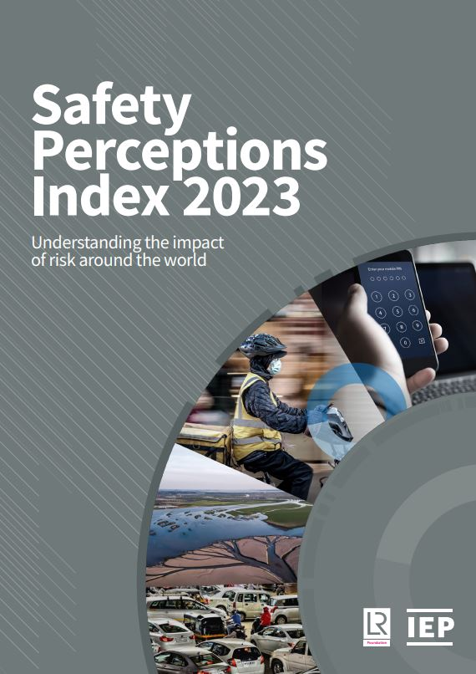
Index Overview
Source: The Safety Perceptions Index (SPI) draws on responses to 12 key questions in the 2021 World Risk Poll
Over 125,000 respondents from 121 surveyed countries
Comparisons drawn from the 2019 World Risk Poll
Two themes:
Experience of serious harm in the past two years
Worry about harm
Five domains: Food and Water, Violent Crime, Severe Weather, Mental Health, Workplace Safety
For each domain, the rates of experience and worry are averaged to create the SPI scores by domain
These scores are then averaged for each country to measure the overall SPI score by country
That is, the overall level of risk impact a country faces

Slide 4
Results Overview – 2021 vs 2019
Domain results
Cross-domain results
Food and Water (experience and worry about harm both declined)
On average, experience of harm increased slightly
Violent Crime (experience and worry about harm both declined)
On average, worry declined slightly
Severe Weather (experience of harm increased, while worry declined)
In 2021, people worried about different things than they did in 2019
Mental Health (experience and worry about harm both increased)
Workplace Safety (N/A)
There was a rise in fears related to unknown threats

Slide 5
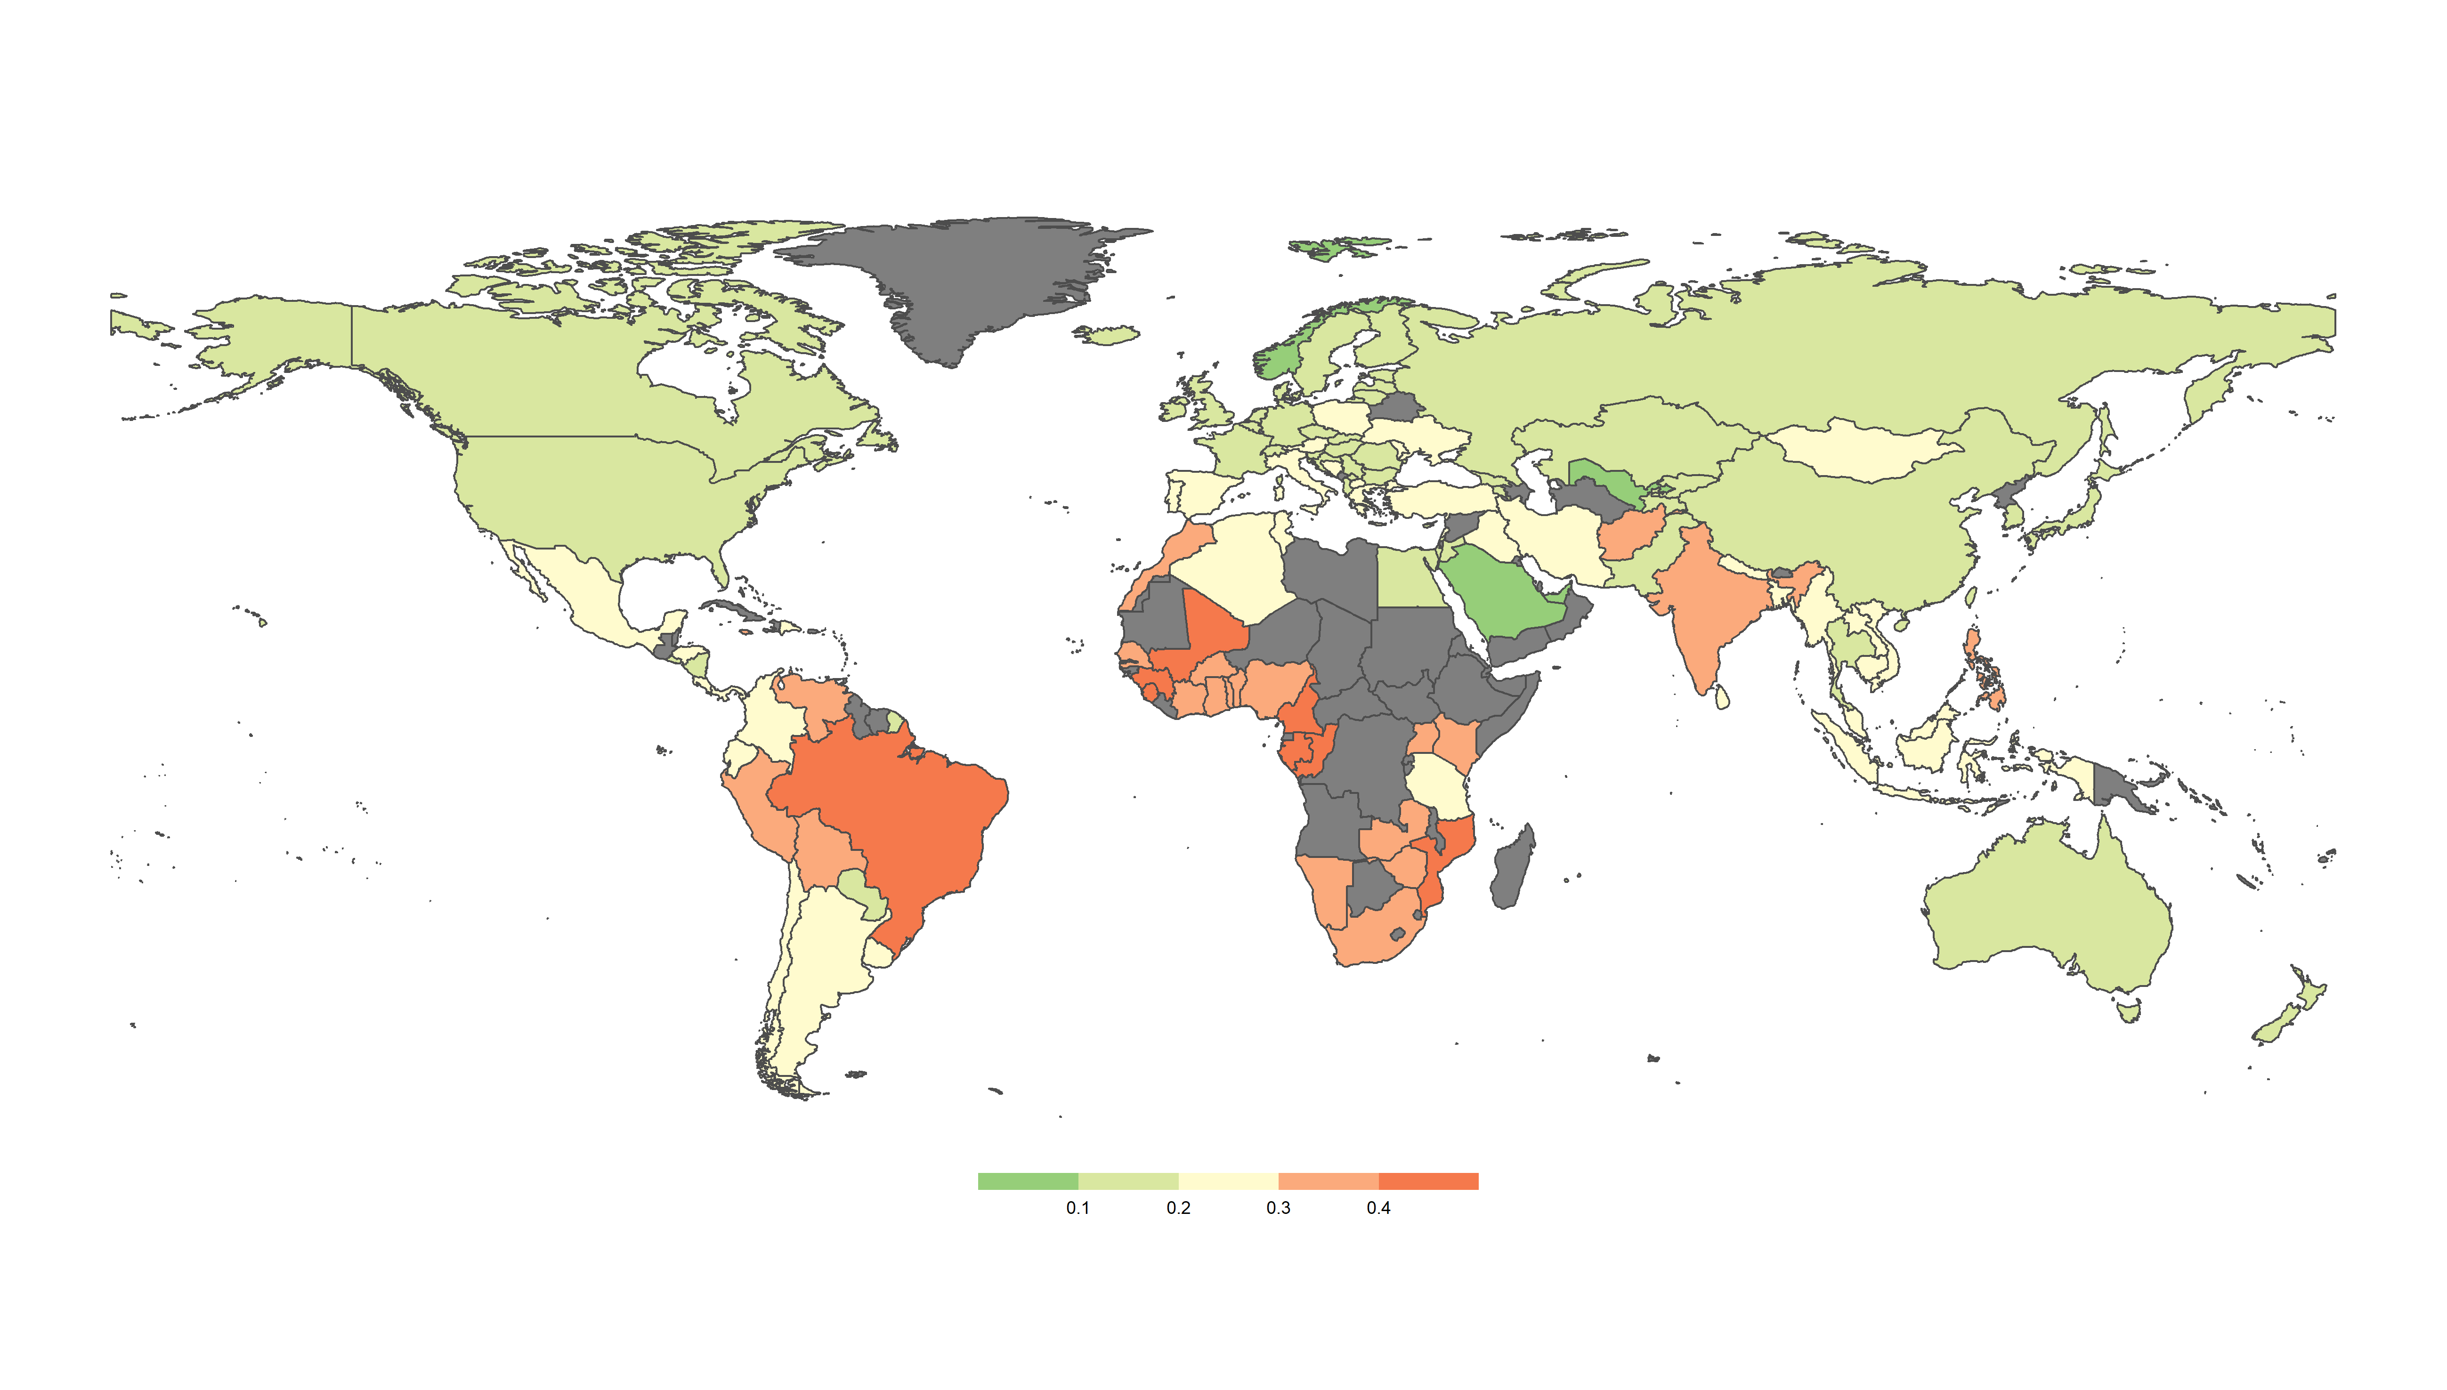
Country-level and Regional Results
Uzbekistan ranked as the least risk-impacted country in the world
The Russia and Eurasia region ranked as the least risk-impacted region
*These results are based on data from before the Russian invasion of Ukraine
Mali ranked as the most risk-impacted country in the world
Sub-Saharan Africa ranked as the most risk-impacted region

Slide 6
The Shifting Risk Landscape
Changes in “top risk” responses
Only 7% of people identified Covid-19 as the top threat to their everyday safety in 2021
Fifth most common response overall
Other rate changes were more substantial than the rise in new worries about Covid-19
Suggests that the pandemic’s impact on the risk landscape was more indirect than direct
Largest changes were in relation to the “don’t know” and “nothing/no risks” categories…

Slide 7
Rise of ‘Ambiguous Risk’
Significant swing in response rates:
The rate of people reporting no great threat in their daily lives fell by half
The rate of people being unsure of their greatest threat nearly doubled
This swing occurred in two-thirds of countries
Held true across all demographic categories (including age, gender and education level)
This swing comes against the backdrop of a rise in feelings of relative unsafety
In 2021, 35% of people felt less safe than five years prior, compared to 30% in 2019
Noteworthy given that the SPI showed an overall decline in worries about many “conventional” risks

Slide 8
Relationships Between Experience and Worry
Violent crime and severe weather are associated with the highest levels of worry
They also exceed levels of first-hand and overall experience by the largest margins
In contrast, workplace safety shows the lowest level of worry, both in absolute terms and relative to first-hand and overall experience
Workplace safety and mental health are the only risk domains for which levels of overall experience exceed levels of worry
These findings align with research on the relationship between perceived “controllability” and worry

Slide 9
Employment Status and the Rise in Economic Anxieties
Amid the downturns associated with the pandemic, economic and financial worries rose between 2019 and 2021.
Perceptions of relative unsafety rose for all employment groups.
Unexpectedly, people employed full time experienced the largest increases in rates of feeling less safe, with self-employed people experiencing the biggest uptick.

Slide 10
Road Safety Risks
In both 2019 and 2021, road safety concerns were the most commonly identified specific risk to daily life.
The SPI 2023 report highlights the significant improvements that have been made in recent decades in road safety, even as the number of cars on the road globally has soared.
However, harm from road incidents remain common, and they impact certain groups – particularly young men – more frequently than others.
However, with the declines in mobility associated with Covid-19, the percentage of people naming road safety as their top threat dropped by 5 points.

Slide 11
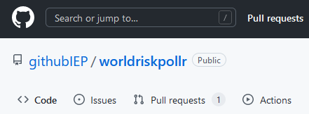
World Risk Poll R Package
R package worldriskpollr developed.
For those interested in accessing and exploring the World Risk Poll data, IEP has released an R package to provide easy access to it. This package can be installed using this link: https://github.com/githubIEP/worldriskpollr.
Allows users to select a World Risk Poll question and access the results by:
Country
Age
Education
Gender
Employment
Income
Household income
Package has passed all CRAN tests and will be published soon.

