Slide 1
GLOBAL TERRORISM INDEX 2022
Measuring the impact of terrorism

Slide 2
“
The Institute for Economics & Peace aims to create a paradigm shift in the way the world thinks about peace.
Mission & About us
We are an independent, not-for-profit think tank dedicated to building a greater understanding of the key drivers of peace, as well as identifying the economic benefits that increased peacefulness can deliver.

Slide 3
Our international offices
SYDNEY
NEW YORK
BRUSSELS
THE HAGUE
MEXICO CITY
HARARE
Australia
USA
Belgium
The Netherlands
Mexico
Zimbabwe

Slide 4
Institute for Economics & Peace
Research used extensively by organisations, including the OECD, Commonwealth Secretariat, World Bank and the United Nations
28BN
1.4BN
152
MEDIA REACH
SOCIAL REACH
COUNTRY REACH
Work is included in thousands of university courses
Over 350,000 downloads of IEP reports
10
3000
1.3M
PUBLISHED REPORTS
BOOK REFERENCES
UNIQUE VISITORS

Slide 5
IEP Products

Slide 6
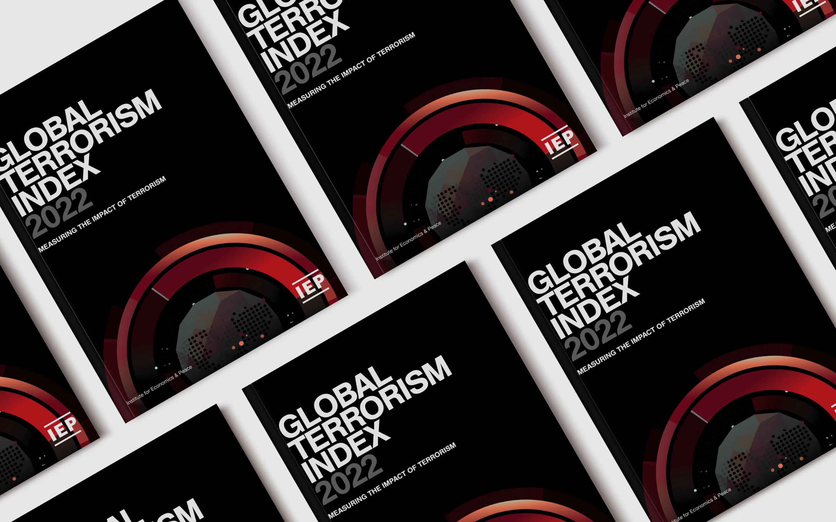
01.
What is the Global Terrorism Index?

Slide 7
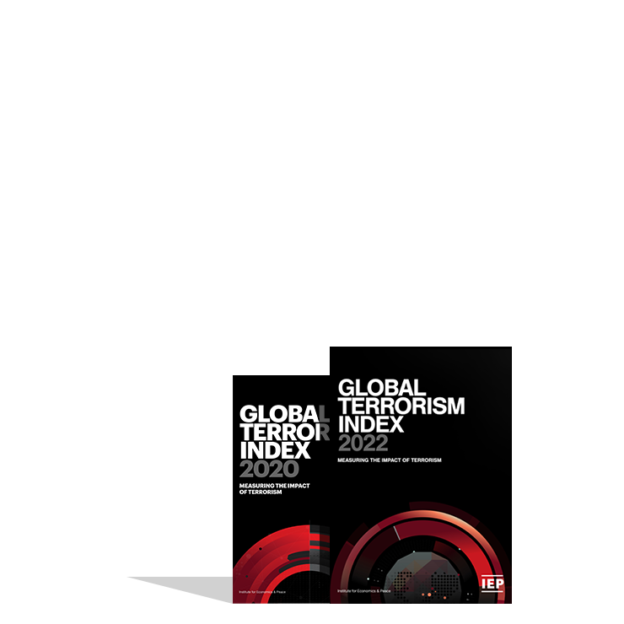
The Global Terrorism Index
Now in its
Ranks
8th
163
According to the relative impact of terrorism
year
countries
Includes contributions from International Experts
Used as an indicator in the Global Peace Index
Developed by the Institute for Economics and Peace

Slide 8
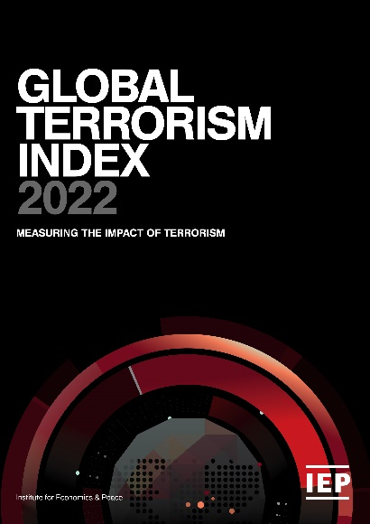
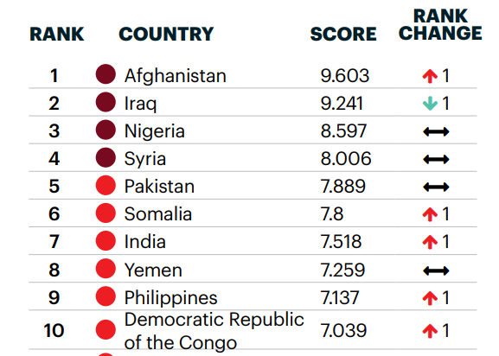
Global Terrorism Index: Methodology
Definition of terrorism: The systemic threat or use of violence, whether for or in opposition to established authority, with the intention of communicating a political, religious or ideological message to a group larger than the victim group by generating fear and altering the behaviour of the larger group.
Over 5 years to measure long term impact
Indicator | Weight
Incidents | 1
Injuries | 0.5
Deaths | 3
Hostages | 0.5
Year | Year minus 1 | Year minus 2 | Year minus 3 | Year minus 4
52% | 26% | 13% | 6% | 3%
Socio-economic indicators
Logarithmic banding scores (1-10)

Slide 9
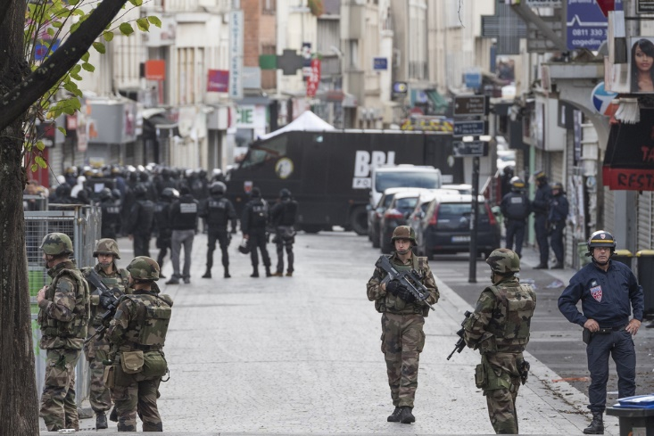
02.
GTI 2022 Results

Slide 10
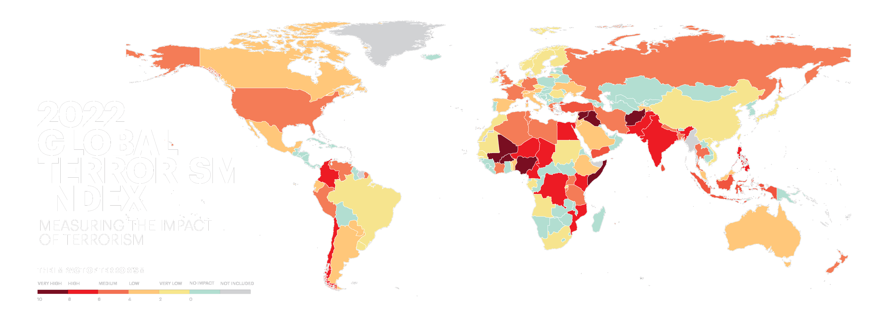
Notes:
Needs map

Slide 11
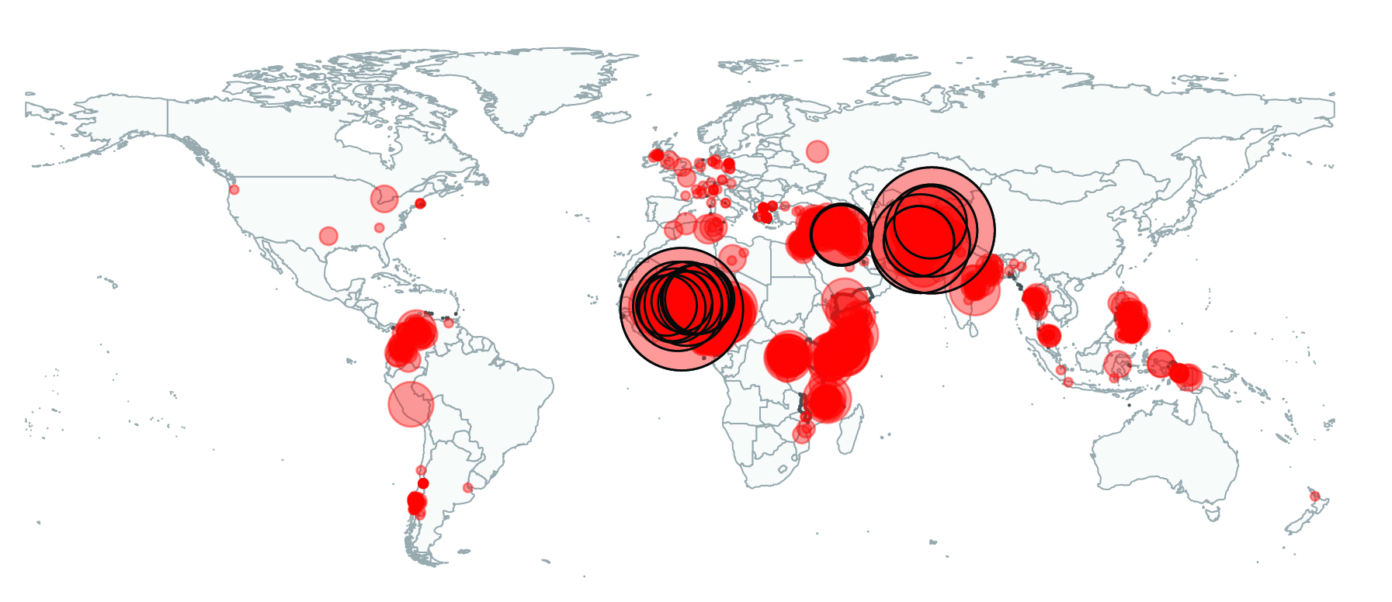
Terrorism attacks

Slide 12
Highlights 2022
Deaths from terrorism down 1.2% - last four years similar, range between 7,100 and 7,3000
Number of attacks up by 17% to 5,226 – less lethal than 2020
86 countries improved compared to 19 that deteriorated
Terrorism is becoming more concentrated into conflict zones – 97% and attacks and 6 times deadlier than elsewhere
Sahel now new epicenter of terrorism – deaths up 10 times since 2007

Slide 13
Highlights 2022…con’t
Deaths decrease by 10% in sub-Saharan Africa – due to success against Boko Haram
Deaths in MENA continue to decline – down 14% to 1,139
Islamic State and affiliates most deadly group – deaths 2,066 in 20 countries
JNIM is the fastest growing group – 352 deaths, an increase of 69%
ISWA is the most lethal – 23 attacks with 15 deaths average per attack

Slide 14
Highlights 2022…con’t
52% of all attacks not ascribed to a particular terrorist group
Attacks in the West fallen substantially for last 4 years – 59 attacks, ten deaths in 2021, down 70%
Politically motivated terrorism overtakes religious terrorism – 5 times higher in last 5 years
Mozambique recorded the largest drop – 90 deaths down 82%

Slide 15
The countries most impacted by terrorism, 2022
Afghanistan recorded the highest impact of terrorism for the third consecutive year.
1
AFGHANISTAN
Rank change:
6
NIGERIA
Rank change: 2
2
IRAQ
Rank change:
7
MALI
Rank change:
3
SOMALIA
Rank change:
8
NIGER
Rank change: 4
4
BURKINA FASO
Rank change: 2
9
-
5
SYRIA
Rank change:
10
PAKISTAN
Rank change: 2

Slide 16
Key findings, 2022
Deaths in 5 most impacted countries increase by 21%
Deaths fall 19% for all other countries
Terrorism becoming more concentrated

Slide 17
Change in GTI Score 2020-2021
Sub-Saharan Africa was the only region to deteriorate in 2021
Source: IEP Calculations, Terrorism Tracker

Slide 18
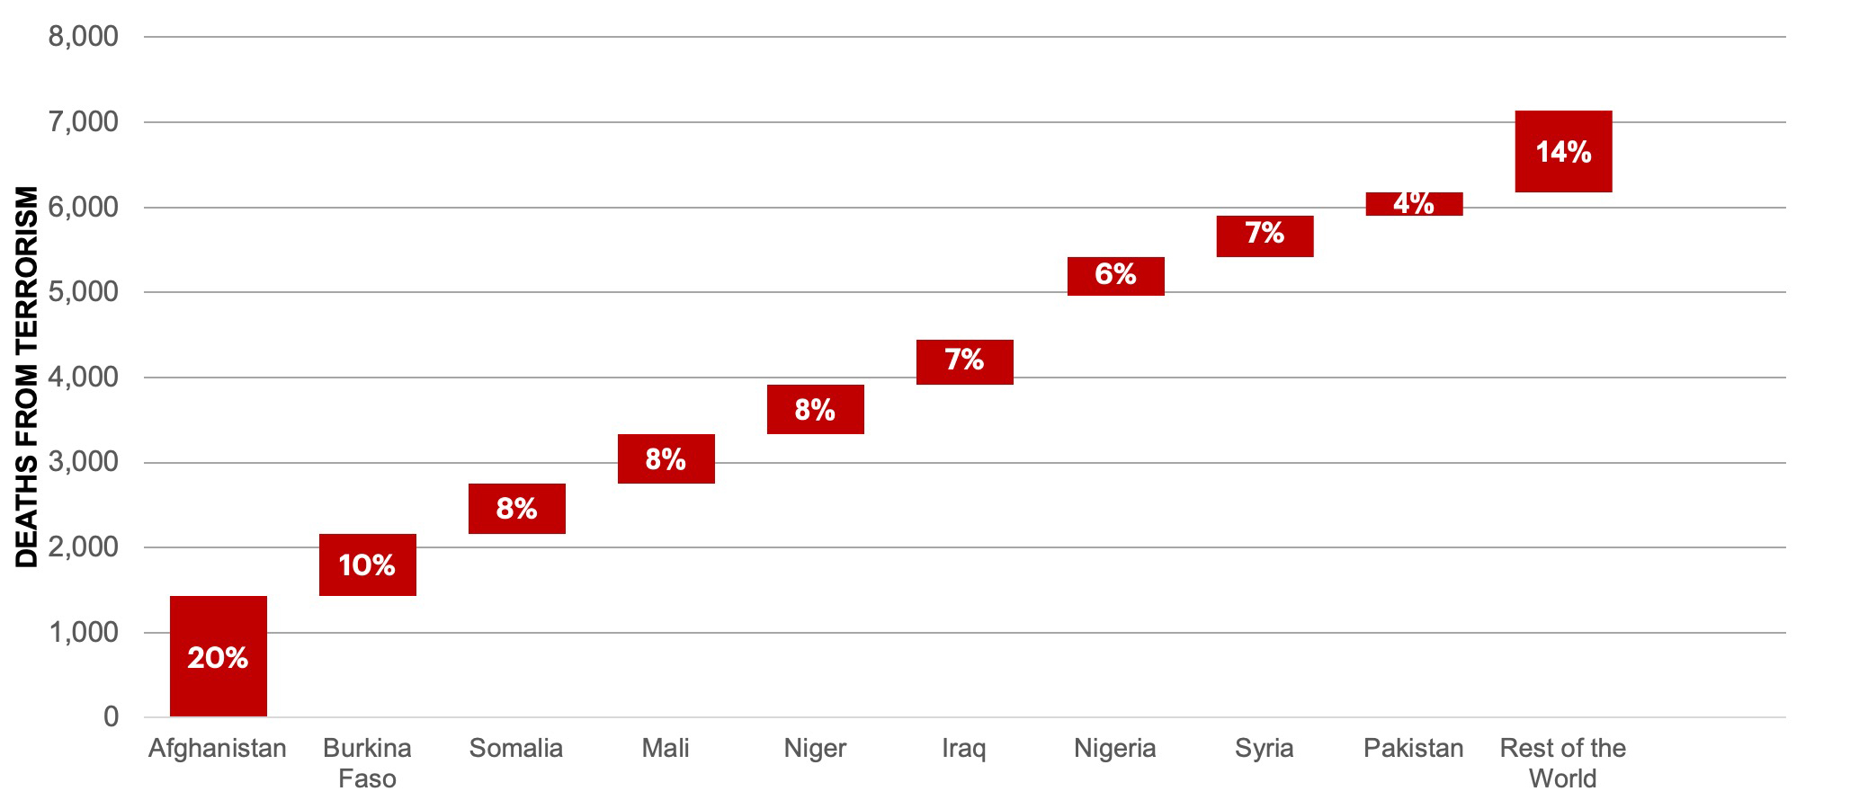
Deaths from terrorism by country, 2021
Ten countries accounted for 85% of all deaths from terrorism in 2021
Source: IEP Calculations, Terrorism Tracker

Slide 19
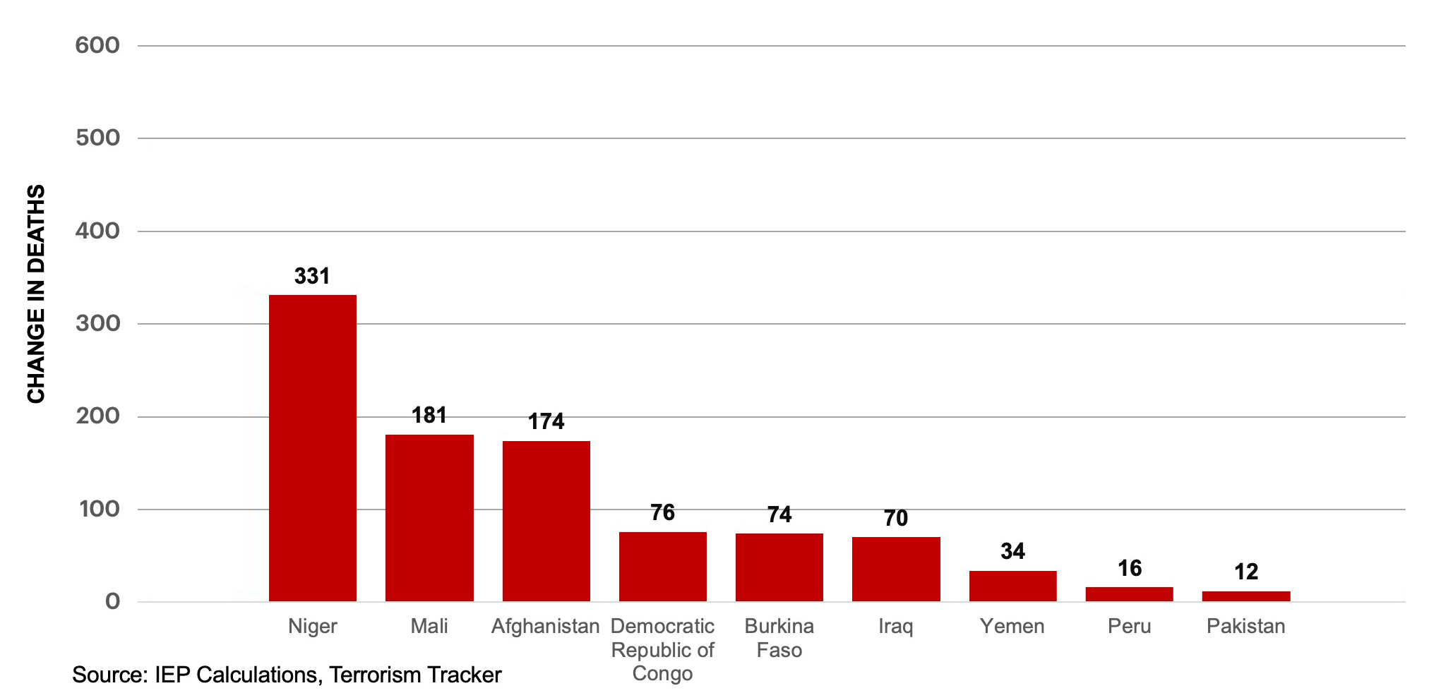
Deteriorations, deaths from terrorism, 2020 - 2021
Source: IEP Calculations, Terrorism Tracker

Slide 20
Improvements, deaths from terrorism, 2020 - 2021
Mozambique had the largest decrease in the number of deaths from terrorism since 2020
Source: IEP Calculations, Terrorism Tracker

Slide 21
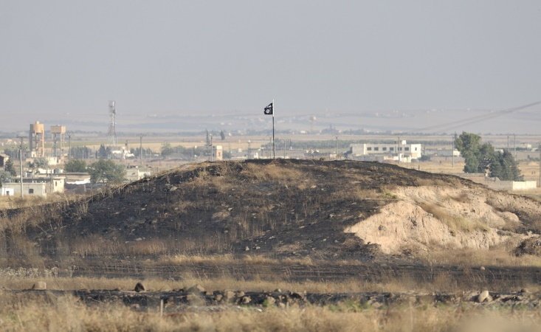
03.
Trends in terrorism

Slide 22
Deaths from terrorism, 2007-2021
Deaths from terrorism have decreased 33% since peaking in 2015

Slide 23
Deadliest terrorist groups, 2007-2021
Islamic State was the deadliest known terrorist group for the fourth consecutive year
Source: IEP Calculations, Terrorism Tracker

Slide 24
Distribution of deaths from terrorism, 2007-2021
In 2021, 105 countries recorded no deaths from terrorism, the highest number for the second consecutive year
Source: IEP Calculations, Terrorism Tracker

Slide 25
Deaths from terrorism by conflict type, 2002-2019
Over 97 per cent of deaths from terrorism occur in countries currently experiencing a conflict
WAR
NON-CONFLICT
MINOR ARMED CONFLICT
Source: IEP Calculations, Terrorism Tracker

Slide 26
Trend in terrorism deaths by region, 2007-2021
South Asia and sub-Saharan Africa suffer from more terrorism than MENA
Source: IEP Calculations, Terrorism Tracker

Slide 27
04.
A shifting landscape

Slide 28
Deaths from terrorism by decade, 2000-2019
The last decade was the deadliest on record with over 182,000 terrorism deaths, compared to 72,000 in the 2000s

Slide 29
Trend in ISIL-related terrorism deaths, 2007-2021
Since 2007, ISIL and affiliated groups have caused over 19,000 terrorism deaths
Source: IEP Calculations, Terrorism Tracker

Slide 30
Countries recording at least one death from ISIS-related attacks, 2007-2021
The number of countries recording at least one death from terror attacks by IS and affiliates has risen from 2 in 2013 to 20 in 2021
Source: IEP Calculations, Terrorism Tracker

Slide 31
Regional distribution of ISIL-related terrorism deaths, 2007-2021
By 2019, nearly a third of ISIL deaths from terrorism occurred in the MENA region
Source: IEP Calculations, Terrorism Tracker

Slide 32
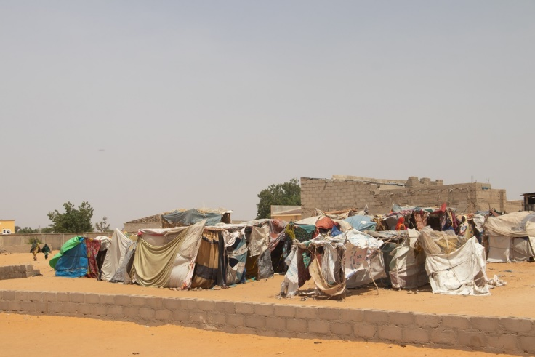
05.
Terrorism in the Sahel

Slide 33
Terrorism in the Sahel, 2007-2021
Incidents and deaths in the Sahel have significantly increased since 2007
Source: IEP Calculations, Terrorism Tracker
Notes:
It is difficult to say with certainty, but the drop is most likely the result of effective CT/ counterinsurgency operations, particularly by the French. These saw some success in that the terrorists fled across the region, but within a year or two they reorganised (JNIM emerged in 2017) and the terror returned

Slide 34
Kidnappings in the Sahel, 1997-2021
Kidnappings in the Sahel have increased exponentially since 2010
Source: IEP Calculations ACLED

Slide 35
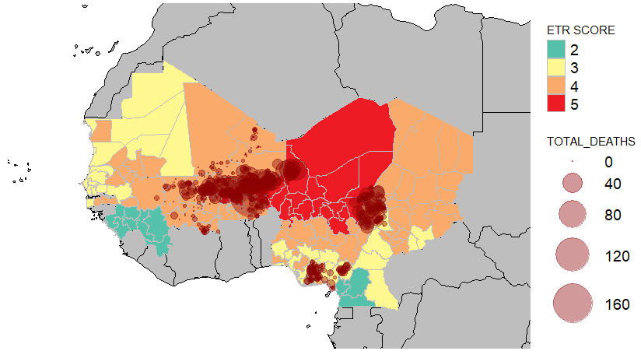
Terrorism in the Sahel coincides with Ecological Threats
Levels of terrorism is strongly associated with food and water scarcity
Source: IEP Calculations, Terrorism Tracker

Slide 36
Overview of ETR scores, Sahel region, 2021
Eight of the ten countries in the Sahel region rank in the bottom half of the ETR
Country | ETR Score | ETR Rank | Projected population change (2021 – 2050) |  | Max Threat
Niger | 5 | 177 | 161% | Rapid Population Growth
Burkina Faso | 4 | 165 | 102% | Water Risk
Nigeria | 4 | 156 | 90% | Water Risk
Mali | 4 | 153 | 109% | Water Risk
Chad | 4 | 148 | 101% | Food Risk
Mauritania | 4 | 137 | 89% | Water Risk
Gambia | 3 | 129 | 96% | Water Risk
Senegal | 3 | 124 | 93% | Water Risk
Guinea | 3 | 87 | 92% | Food Risk
Cameroon | 3 | 85 | 86% | Food Risk
Source: IEP Calculations

Slide 37
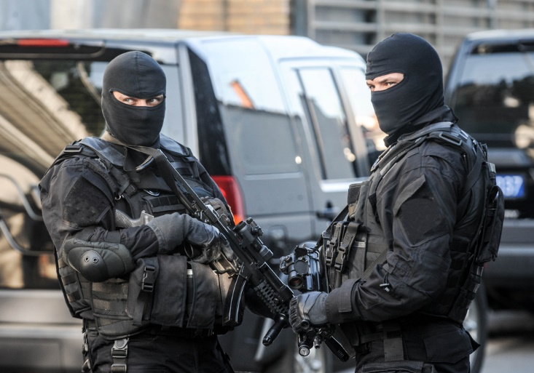
06.
Terrorism in the west

Slide 38
Attacks in the West by ideology
Far-left attacks are less deadly than far-right or religious attacks
Source: IEP Calculations, Terrorism Tracker

Slide 39
Fatalities by ideology, 2007-2021
Religious attacks have caused the most fatalities followed by the far right
Source: IEP Calculations, Terrorism Tracker

Slide 40
Terrorism in the west
Politically terrorism has overtaken religious terrorism – political attacks 5 times higher
Only 3 Islamist attacks in Europe in 2021 – 2 deaths
Only 7 attacks in the US – none tied to a group
Similarities between far-left and far-right terrorists
Both target government – 17% of attacks
Similar motivations – alienated from system
Political terror, access to weapons and militarization associated with level of terrorism and social inequity

Slide 41
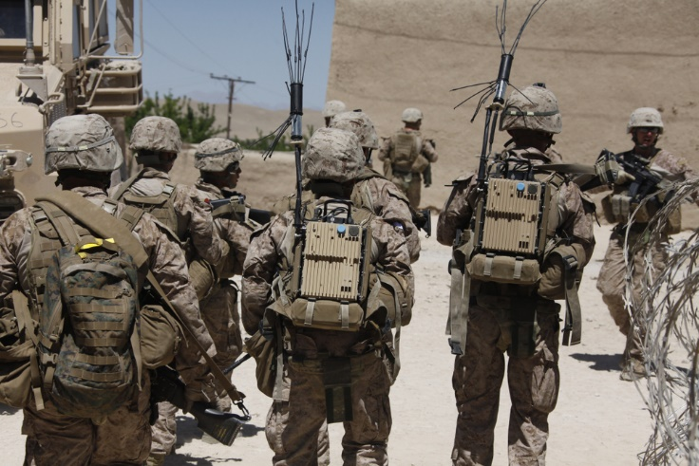
07.
Terrorism and conflict

Slide 42
Terrorist attacks by conflict type, 2021
97 per cent of terrorist attacks occur in countries embroiled in conflict
Source: IEP Calculations, Terrorism Tracker, UCDP

Slide 43
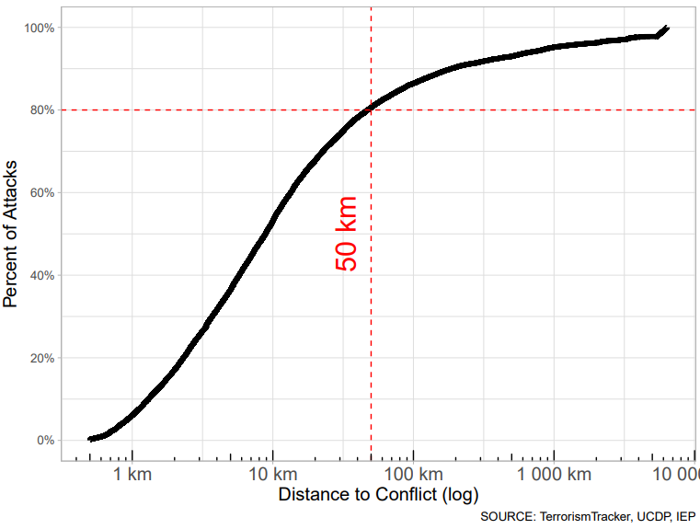
Proximity of terrorist attacks to conflict
80 per cent of terrorist attacks occur within 50 km of an ongoing conflict

Slide 44
Most important terrorist groups since 2007
Most insurgent groups have been operating since 2007 and are in sub-Saharan Africa and MENA
Group | Country | Region | Years of Operation | Ideology | Sub-Ideology | Terrorist Deaths | Victims Deaths | Total Deaths
Taliban | Afghanistan | South Asia | 2007 – current | Religious | Islamic | 2156 | 9473 | 11629
Islamic State (IS) | Iraq | MENA | 2007 – current | Religious | Islamic | 390 | 8418 | 8808
Boko Haram | Nigeria | sub-Saharan Africa | 2007 – current | Religious | Islamic | 1049 | 7401 | 8450
Al-Shabaab | Somalia | sub-Saharan Africa | 2007 – current | Religious | Islamic | 1213 | 6649 | 7862
Tehrik-e-Taliban Pakistan (TTP) | Pakistan | South Asia | 2007 – current | Religious | Islamic | 1037 | 3939 | 4976
* Al-Qaeda in Iraq (AQI) | Iraq | MENA | 2007 – 2013 | Religious | Islamic | 124 | 3691 | 3815
Communist Party of India - Maoist (CPI-M) | India | South Asia | 2007 – current | Separatist/ Ethno-national | Separatist | 134 | 2006 | 2140
* Islamic State - Sinai Province | Egypt | MENA | 2013 – current | Religious | Islamic | 227 | 1490 | 1717
Al-Qaeda in the Arabian Peninsula (AQAP) | Yemen | MENA | 2009 – current | Religious | Islamic | 247 | 1344 | 1591
Boko Haram | Cameroon | sub-Saharan Africa | 2014 – current | Religious | Islamic | 326 | 1224 | 1550
Kurdistan Workers' Party (PKK) | Turkey | Europe | 2009 – current | Separatist/ Ethno-Nationalist | Separatist | 309 | 1041 | 1350
Revolutionary Armed Forces of Colombia (FARC) | Colombia | South America | 2007 – current | Political | Far-Left | 153 | 1097 | 1250
Islamic State West Africa (ISWA) | Nigeria | sub-Saharan Africa | 2017 – current | Religious | Islamic | 269 | 954 | 1223

Slide 45
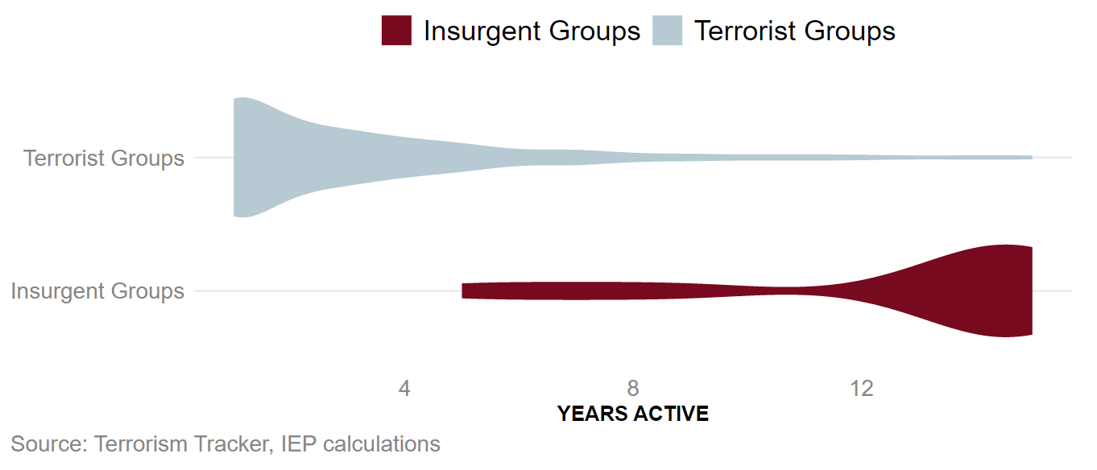
Distribution of insurgent and terrorist group survival
Insurgent groups are active for significantly longer than terrorist groups

Slide 46
Terrorist group survival, 2007-2021
Most terrorist groups disband, merge with other groups, or are destroyed within a year of being formed

Slide 47
Terrorism in Ukraine
Ukraine and Georgia experienced major spikes in terrorism during their wars in 2008 and 2014
Ukraine suffered 78 attacks, Georgia 41 attacks
Number of attacks will increase with the intensity of the war
Cyber attacks were building in lead-up to war - 397,000 in 2020, 285,000 first 10 months 2021
Cyber attacks have spillover effects to other countries
Need for better definitions for cyberattacks, cyber warfare, cyber terrorism – what level of severity constitutes cyber warfare

Slide 48
Feedback loops supporting terrorist organisations
The diagram shows the nodes and linkages of a terrorist support system
Support by Sympathizers
Financial and Material Resources
Recruitment
of Terrorists
Density of Terrorist Network
Influence of Network
Impact of Attacks
Feedback loops
Recruitment
Funding
Media
Motivation
Negative Perception of Countries
Media
Reports
Source: Adapted from Schoenenberger et al., (2014) and IEP

Slide 49
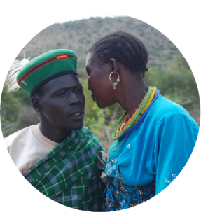
Get involved with IEP
@GlobPeaceIndex
GlobalPeaceIndex
Ambassador Program
Positive Peace Workshops
@GlobalPeaceIndex
Online
Strategic Partnerships
IEP Peace Academy
visionofhumanity.org

