Slide 1


October 2022
Ecological Threat Report
2022
Overview & Key Findings

Slide 2

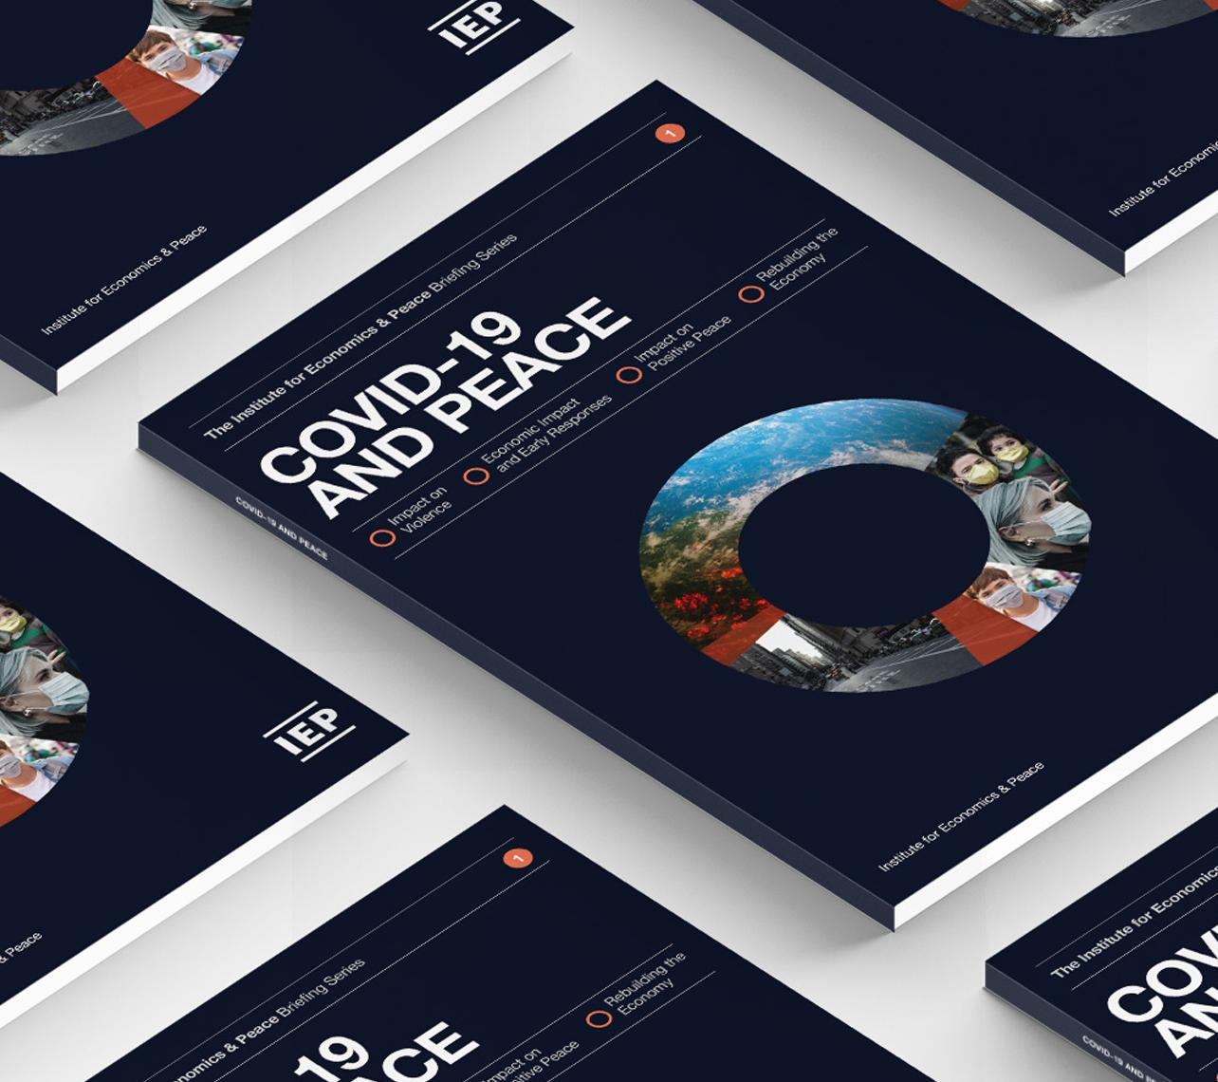
The Institute for Economics and Peace is an independent, not-for-profit think tank dedicated to understanding the intersection between business, peace and economics. It places a special emphasis on metrics to measure peace, operational programs to improve peace, and the economic benefits of peace.

Slide 3
Our international offices
Brussels
The Hague
New York
Sydney Head Office
Mexico City
Harare

Slide 4

Institute for Economics and Peace
Research used extensively by organisations, including the OECD, Commonwealth Secretariat, World Bank and the United Nations
28BN
1.4BN
152
MEDIA REACH
SOCIAL REACH
COUNTRY AUDIENCE
Work is included in 1,000s of university courses
Activities in over 30 countries last 12 months – training, workshops, consulting
10
6000
2M
PUBLISHED REPORTS
BOOK REFERENCES
WEB VISITORS

Slide 5
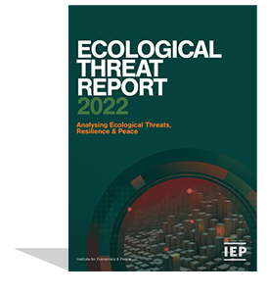
The Ecological Threat Report
Ranks
Ranks
Analyses
228
3638
250
Countries and Independent States
Local Administrative Areas
Cities
Using
Sources thousands of datasets to assess ecological vulnerability, resilience and risk
99.99% of world’s population covered
9
Indicators on a 1-5 scale

Slide 6
The Ecological Threat Report
4
domains
2
measures of ecological threat
27
hotspot countries
Food Security
Water Stress
Population Growth
Natural Disasters
Countries with the highest ecological threats and lowest resilience
The ETR score
The Catastrophic Score

Slide 7
01.
Key
Findings

Slide 8
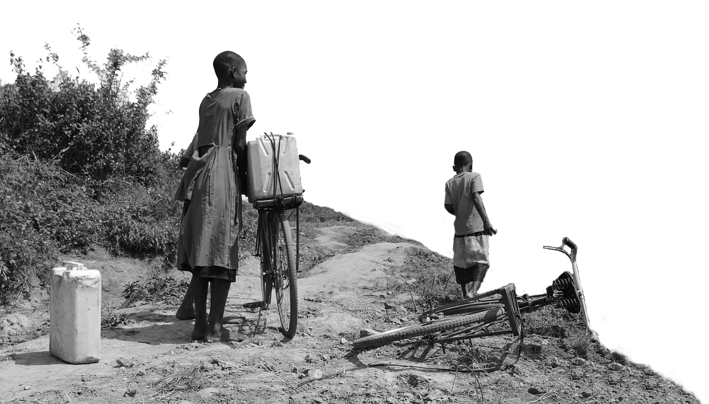

2022 key highlights
    In 2022, 127 countries home to
2.05bn
    By 2050, same 127 countries will have
    people face catastrophic ecological threats.
    3.4 bn
    66%
From today

Slide 9

2022 highlights
    Ecological threats, violence and conflict are closely associated, forming vicious cycles of violence
    As ETR scores worsen peacefulness deteriorates – without societal resilience.
    The world’s 40 least peaceful countries will increase their population by 1.3 billion by 2050, representing 49% of the world’s population.
    They also have the worst ecological threats.
    750 million suffering from undernourishment and will only get worse.
    Since 2019, the world’s concern over climate change has decreased by 1.5%. Citizens in three of the four biggest emitters have a low level of concern – China, India, and Russia.
    The world’s fastest growing megacities are the lest capable of managing growth.
    Countries with high societal resilience are likely to meet their ecological challenges.

Slide 10
2022 highlights…cont’d
    Sub Saharan Africa facing the biggest challenges
    All bar one country are facing severe water stress.
    89% of all people facing food insecurity are in sub-Saharan Africa.
    The population of sub-Saharan Africa is projected to increase by 95% by 2050. 15 countries will more than double.
    The five megacities with the largest population growth are in sub-Saharan Africa.
    Six of the 10 least peaceful countries in the world are in sub-Saharan Africa.
    2 out of 3 hotspot countries are in sub-Saharan Africa.
    7 of 8 countries with worst risk score are in sub-Saharan Africa.

Slide 11
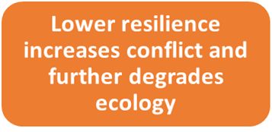
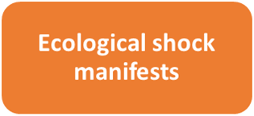

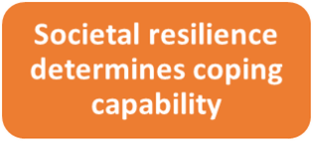
Resilience at Risk
Reoccurring, compounding, or high impact threats have the potential to disrupt or break down a country's level of resilience.
Ecological health

Slide 12
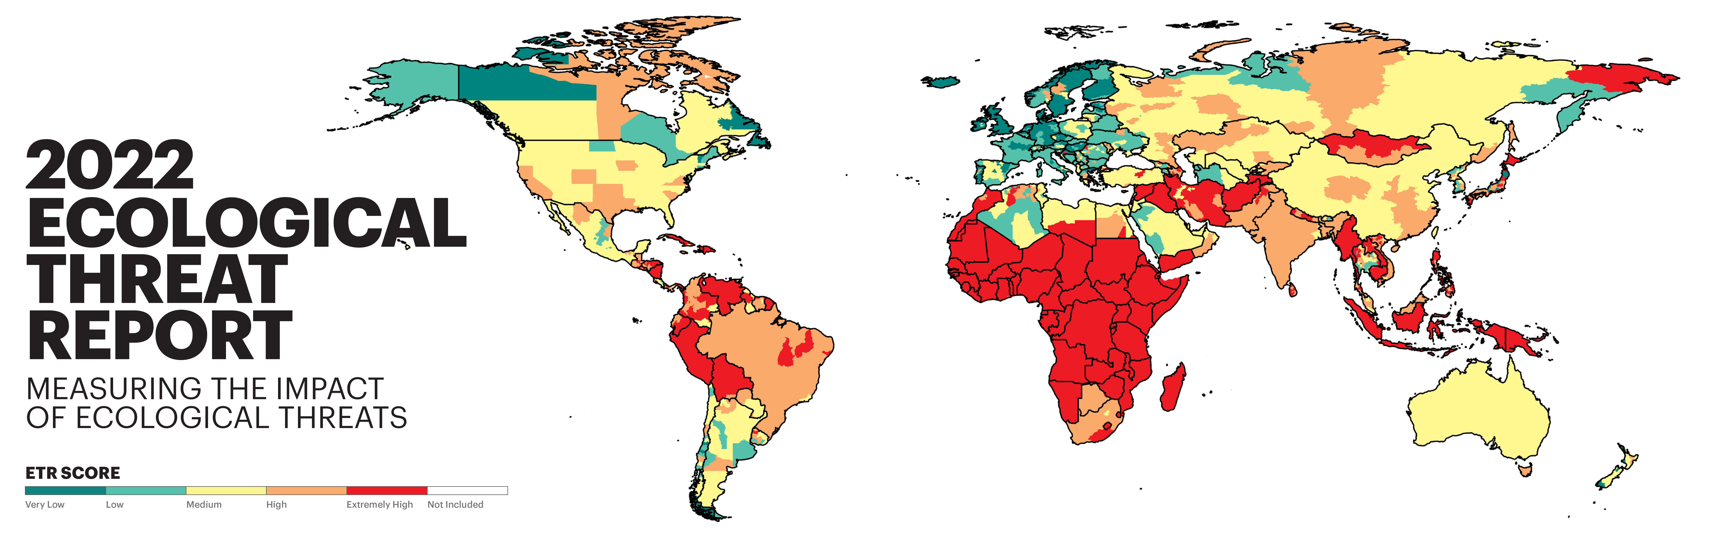
Source: IEP

Slide 13
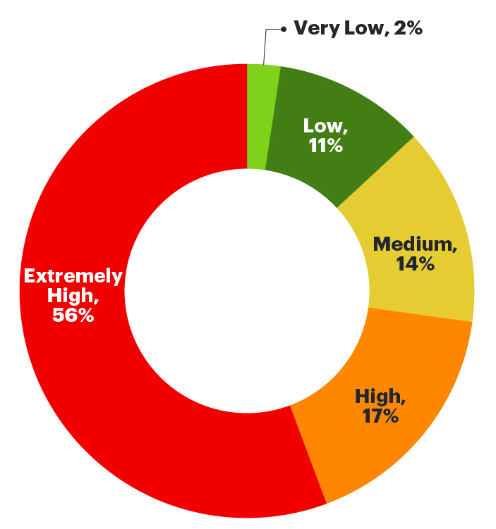
2022 highlights – continued
    The severity of ecological threats.
    127 countries score extremely high
    39 countries score high
    32 countries score medium
    25 countries score low
    5 countries score very low
Source: IEP

Slide 14
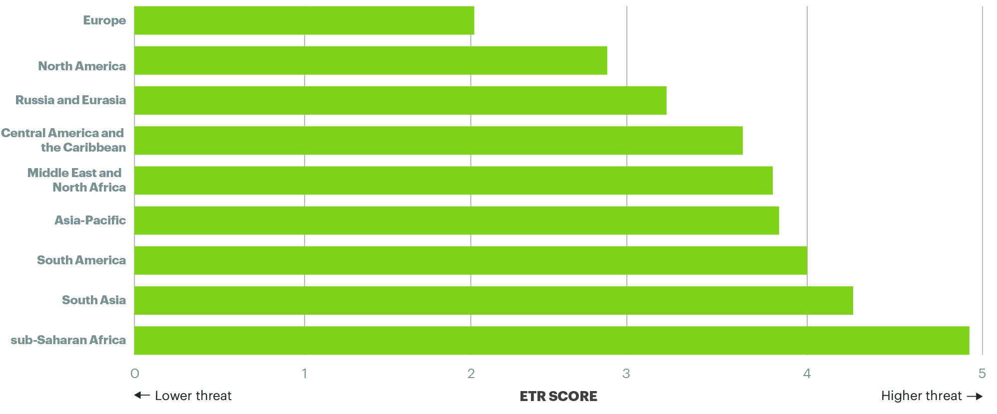
ETR SCORE – Average by region
Source: IEP Calculations

Slide 15
2022 regional overview
+
+
_
_
_
North America recorded the second best ETR score.
North America
South Asia
South Asia recorded the second worst ETR score. It is the second least peaceful region as measured by the GPI
Europe
Europe recorded the best ETR score.
Sub-Saharan Africa
MENA
SSA recorded the worst ETR score. It is the third least peaceful region as measured by the GPI
MENA recorded the fifth worst ETR score. It is the least peaceful region as measured by the GPI

Slide 16
02.
Country Hotspots

Slide 17
Resilience and Hotspot Countries
    The 30 countries with the lowest Positive Peace and worst ecological threats are home to 768 million people
    Positive Peace shows high statistical associations with improved levels of food security, water security and the ability to manage natural disasters.
    The ETR uses Positive Peace and the worst ETR scores to identify countries where resilience is unlikely to be strong enough to adapt to shocks – hotspot countries.
    27 hotspots countries face extreme ecological threats and low societal resilience – home to 738 million people.

Slide 18
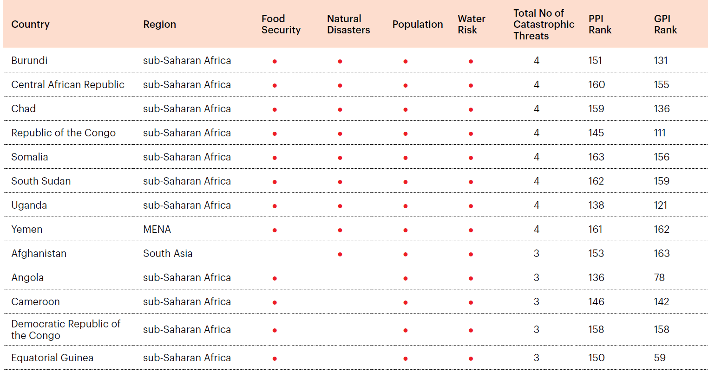
Hotspot countries, 2022
Two thirds of hotspot countries are in sub-Saharan Africa
Source: IEP

Slide 19
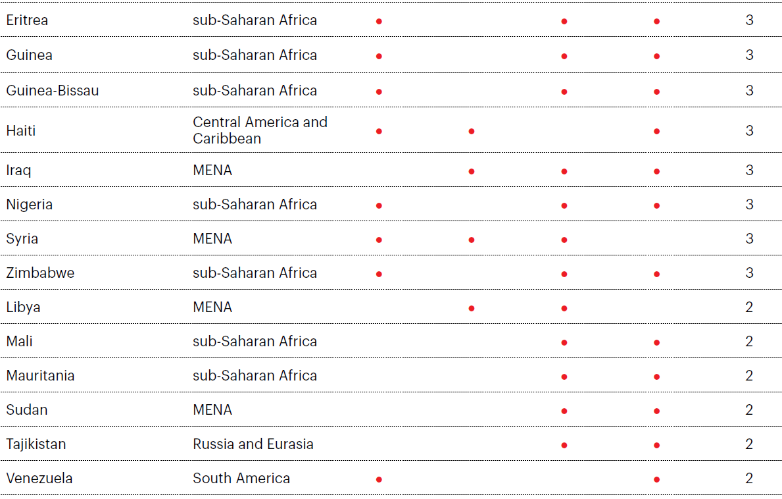
Hotspot countries, 2022….cont’d
Two thirds of hotspot countries are in sub-Saharan Africa
Source: IEP

Slide 20
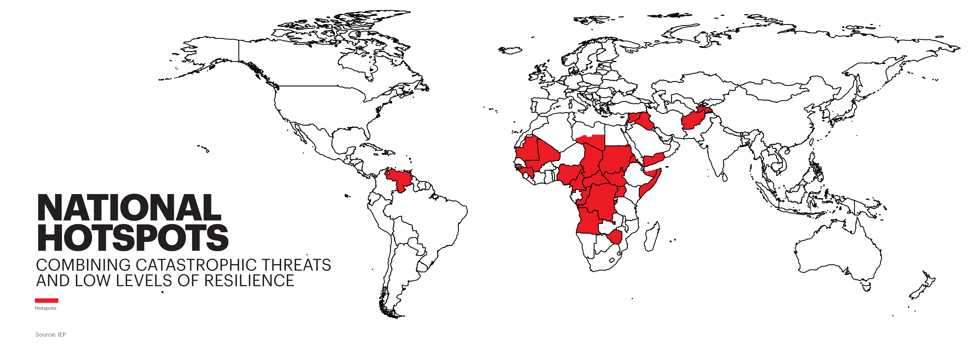
Source: IEP

Slide 21
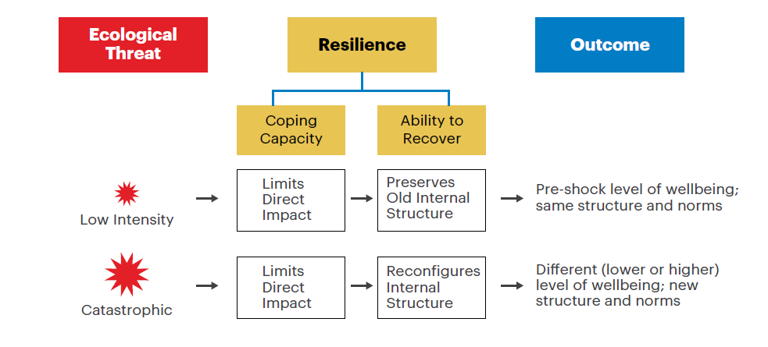
Resilience involves coping with and recovering from shocks
Resilience societies can cope with higher level shocks, learning from the shocks to improve future outcomes.
A catastrophic ecological threat may prompt the system to change its internal structures and norms.
Source: IEP

Slide 22
2022 highlights – Hotspots
    The 37 sub-national districts face catastrophic threats in all four domains. They are home to 37 Million people
    Eight worst districts by population
Country | Region | Sub-national Areas | Location | Description | 2020 Population
Somalia | sub-Saharan Africa | Banaadir | South East | Administrative region of Somalia. | 5,788,490
South Sudan | sub-Saharan Africa | Jonglei State | East | Most populous state in South Sudan. | 2,934,960
Central African Republic | sub-Saharan Africa | Bangui | South | Capital and largest city of the Central African Republic. | 2,337,446
Mozambique | sub-Saharan Africa | Inhambane | South East | One of the oldest settlements on the eastern coast of Mozambique. | 2,060,850
South Sudan | sub-Saharan Africa | Warrap State | North | Located on the border with Sudan. | 2,029,098
Somalia | sub-Saharan Africa | Jubbada Hoose | South | Southernmost state of Somalia, bordered by Kenya. | 1,748,136
South Sudan | sub-Saharan Africa | Upper Nile | North East | Fourth most populated state in South Sudan. | 1,669,730
Uganda | sub-Saharan Africa | Mbale District | East | Located close to the Kenyan border. | 1,508,451
Source: IEP

Slide 23
03.
Ecological Threats

Slide 24
Food Security – Key Findings
    Forty-one countries face extreme food insecurity
    830M live in countries with severe food insecurity – more than 65% of the population were unable to afford food at least once last year.
    Sub-Saharan Africa has the largest proportion of its population living with catastrophic food insecurity, 14 times higher than the next region MENA.
    92% of food insecure people low peace countries.
    The largest deteriorations since 2019 occurred in Colombia, Syria, Ethiopia and Mozambique.

Slide 25
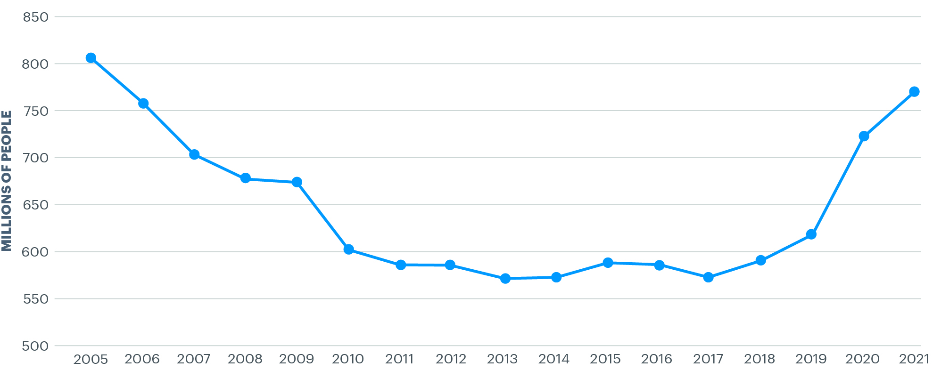
Number of undernourished globally, 2005-2021
In 2021, the number of undernourished people rose by an estimated 46 million to 760 million.
Source: FAO; IEP Calculations

Slide 26
Water Security
    Water and food are intrinsically related. Lack of water leads to lack of food
    More than 1.4 billion people globally are exposed to extreme levels of water stress in 83 countries.
    Sub-Saharan Africa, South Asia and Latin America suffer from the worst water stress.
    Without planning many European countries will suffer water stress – Greece, Italy, Portugal, Netherlands
    Conflict with water as a trigger has tripled since 2000. Iraq, Somalia and Yemen have had the most water-related conflicts in the last 20 years.
    Damming is a major issue for downstream countries – 300M dependent on Mekong, 200M dependent on the Nile.

Slide 27
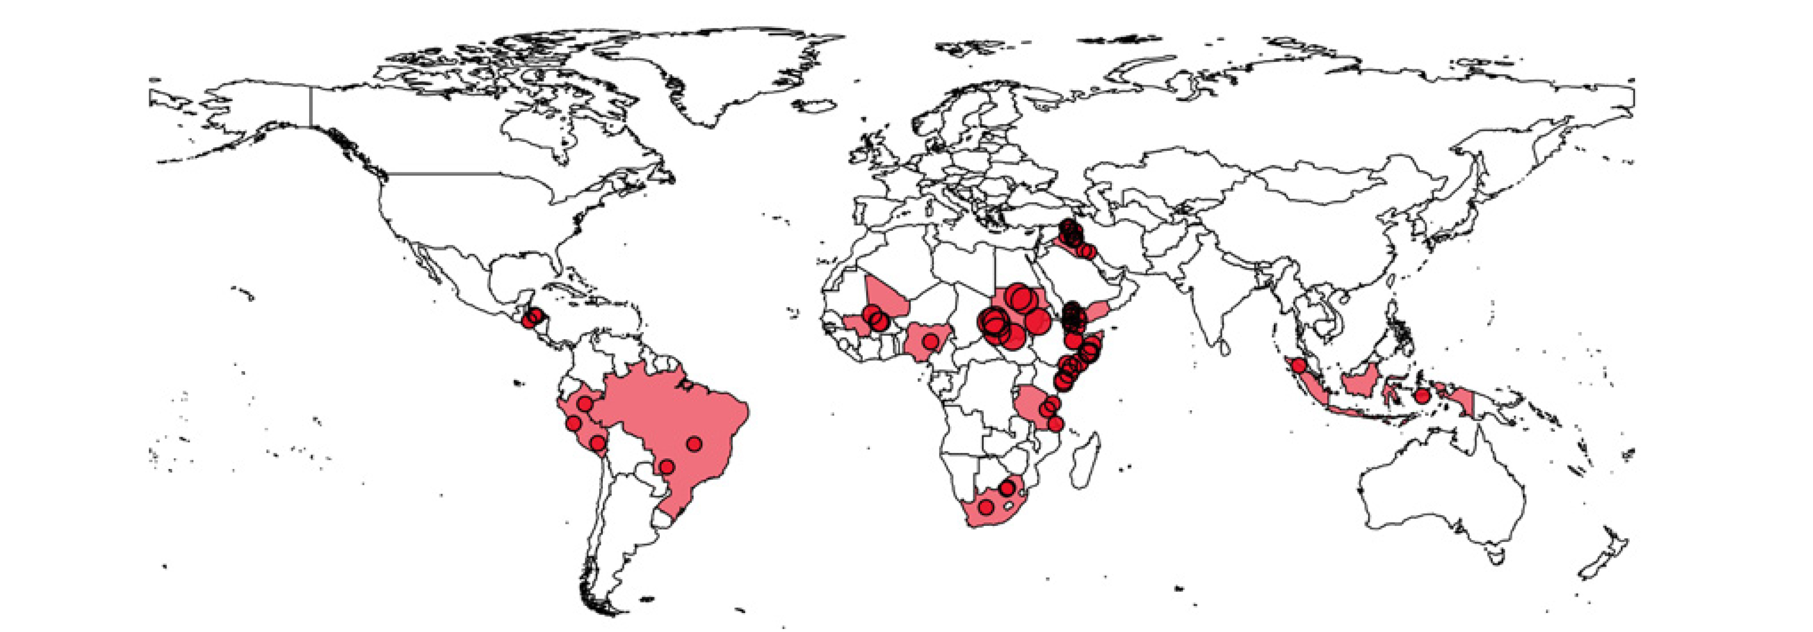
Historical water conflicts in countries that are expected to have increasing water stress to 2040
Iraq, Somalia, Yemen and Sudan are most likely to have continued conflicts over water.
Source: Pacific Institute; WRI

Slide 28
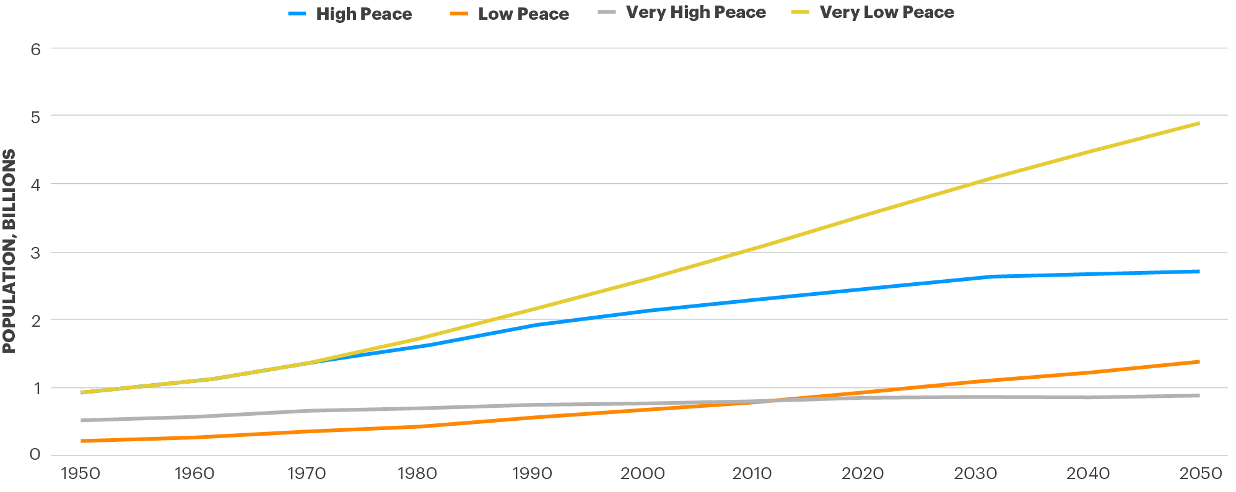
Projection of global population, by peace level, 1960–2050
The population is projected to increase by 37 per cent by 2050 in very low peace countries compared to an increase of less than one per cent in very high peace countries.
Source: IHME

Slide 29
The fifteen countries predicted to double their population by 2050
All fifteen countries predicted to double their population by 2050 are located in sub-Saharan Africa.
Country | 2020 Population (millions) | 2050 Population (millions) | Percentage Increase
Niger | 24.1 | 68.5 | 184%
Angola | 32.8 | 76.0 | 132%
Uganda | 47.2 | 105.7 | 124%
Somalia | 16.1 | 35.9 | 123%
Democratic Republic of the Congo | 89.5 | 197.4 | 121%
Tanzania | 62.8 | 138.1 | 120%
Zambia | 18.7 | 41.0 | 120%
Mali | 20.3 | 44.0 | 117%
Burundi | 11.9 | 25.8 | 116%
Mozambique | 32.3 | 67.8 | 110%
Burkina Faso | 20.9 | 43.2 | 107%
Chad | 16.3 | 33.6 | 107%
Malawi | 20.3 | 41.7 | 106%
Republic of the Congo | 5.7 | 11.5 | 102%
Equitorial Guinea | 1.4 | 2.8 | 102%
Source: UNDESA

Slide 30
Natural Disasters
    Asia-Pacific is the most impacted region by natural disasters, followed by sub-Saharan Africa and Central America and the Caribbean.
    The cost of natural disasters has also risen from $50 billion per year in the 1980s to $200 billion per year in the last decade.
    Flooding is the most common natural disaster since 1981 with 5,079 incidents recorded over the period.
    Of the 27 ETR hotspot countries Afghanistan, Haiti, Tajikistan, Nigeria and Mali were the countries with the biggest increases in natural disasters since 1981.

Slide 31
Disaster and Conflict Displacement
    The number of people displaced by conflict keeps increasing
    89 million currently displaced because of conflict - up 3.5% from last and doesn’t include Ukraine.
    Displacements from natural disasters are usually short term.
    The five countries with the largest conflict displacements in 2021 - Syria, Ethiopia, DRC, Afghanistan and South Sudan.
    In 2021, the countries that received the most refugees included Lebanon, Jordan, Turkey, and Uganda – over 6.5 million in 2021.
    In Europe, the countries that received the most included Sweden, Austria, Greece and Germany – over 1 million in 2021.

Slide 32
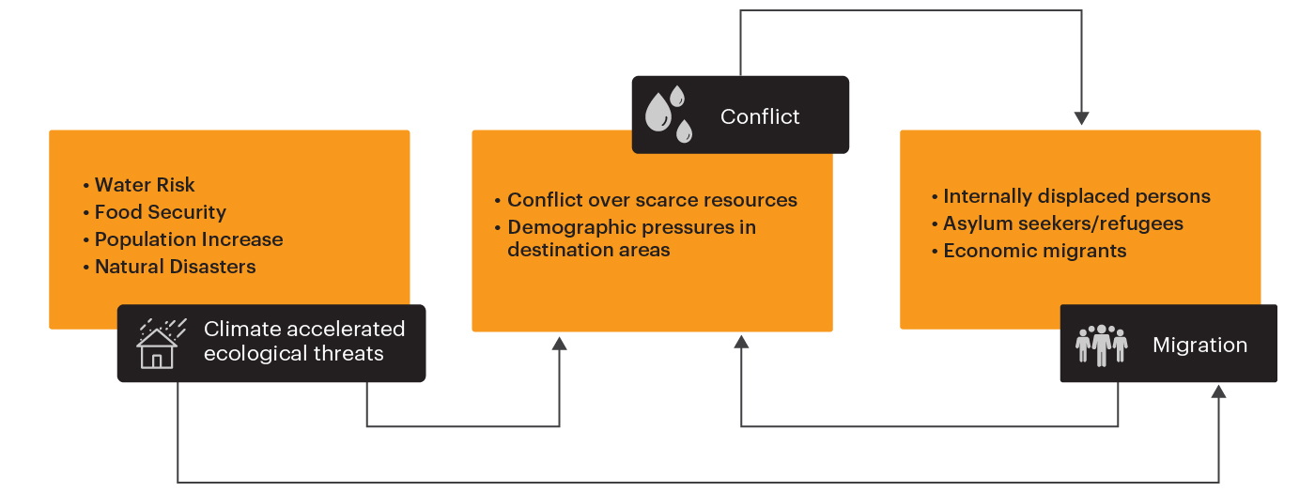
Relationships between ecology, climate, conflict and migration
Potential causal pathways between ecological threats, conflict and migration.
Source: Abel at al. 2019

Slide 33
04.
Climate Survey

Slide 34
Global concern over climate change
    IEP analysed Lloyd's Register risk data for public perceptions on serious concerns for climate change in next 20 years.
    Concern has declined globally by 1.5 per cent to 48 per cent since 2019.
    South Americans had the highest score at 65%.
    MENA had the lowest score at 27%.
    Sub-Saharan Africa and South Asia ranked war, terrorism, crime and violence as greater concerns than climate change.

Slide 35
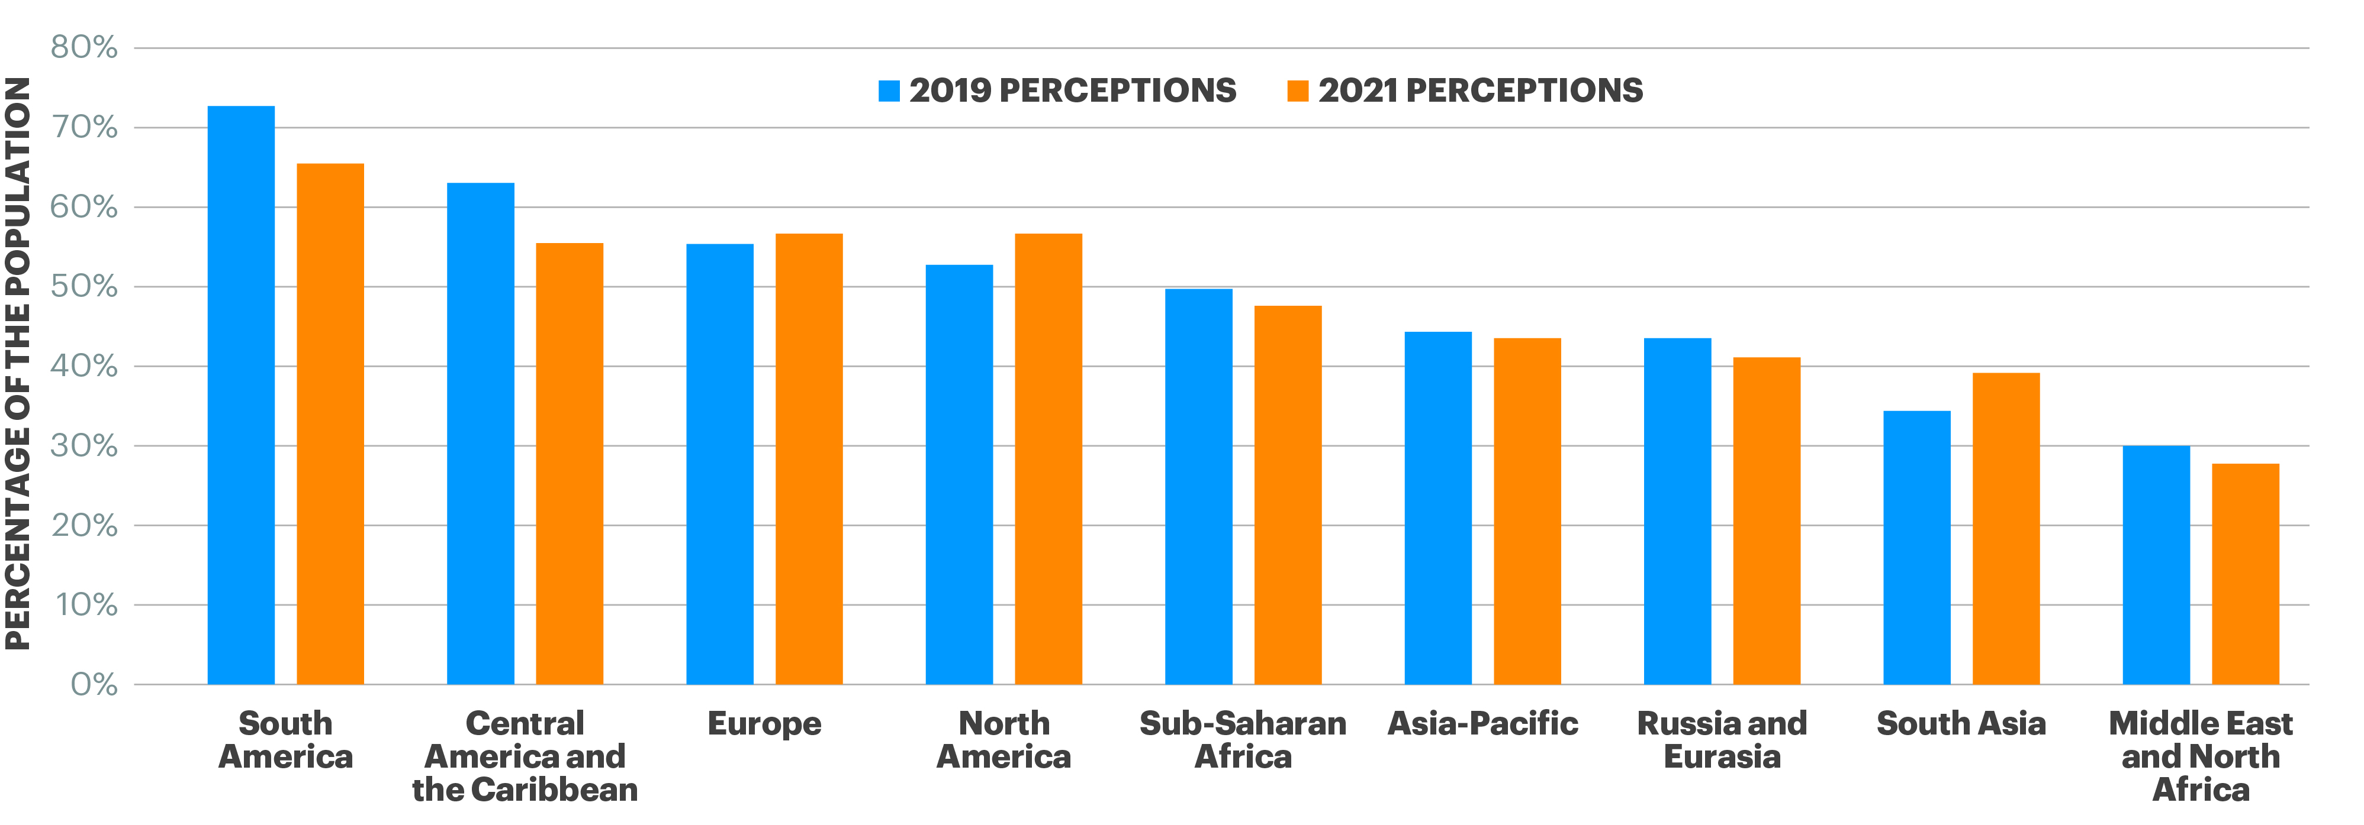
Percentage of population that believes climate change will be a very serious threat over the next 20 years, regional average, 2019 and 2021
In 2021, 65 per cent of the citizens of countries in South America perceived climate change to be a very serious threat over the next 20 years compared to just 27 per cent in the MENA region.
Source: Gallup; IEP Calculations

Slide 36
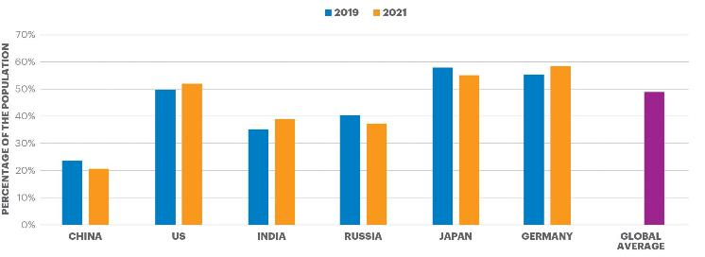
Percentage of population of largest C02 emitters that believes climate change will be a serious threat over the next 20 years,
Three of the four countries who are largest emitter have low levels of concern with concern falling substantially in two.
Source: Gallup; IEP Calculations

Slide 37
05.
Temperature and Climate Change

Slide 38
Accelerating Ecological Threats
    Climate change will act as an accelerator for ecological degradation, raising many security implications both at the micro and macro levels.
    A temperature rise of one degree Celsius means that the air can hold around seven per cent more moisture, with the implications being:
      An increase in the magnitude and frequency of natural disasters
      Irregular and intense rainfall as well as longer dry spells putting pressure on agriculture, impacting food security.
      Limiting the availability of freshwater, increasing water stress

Slide 39
06.
Ecological Changes and Megacities

Slide 40
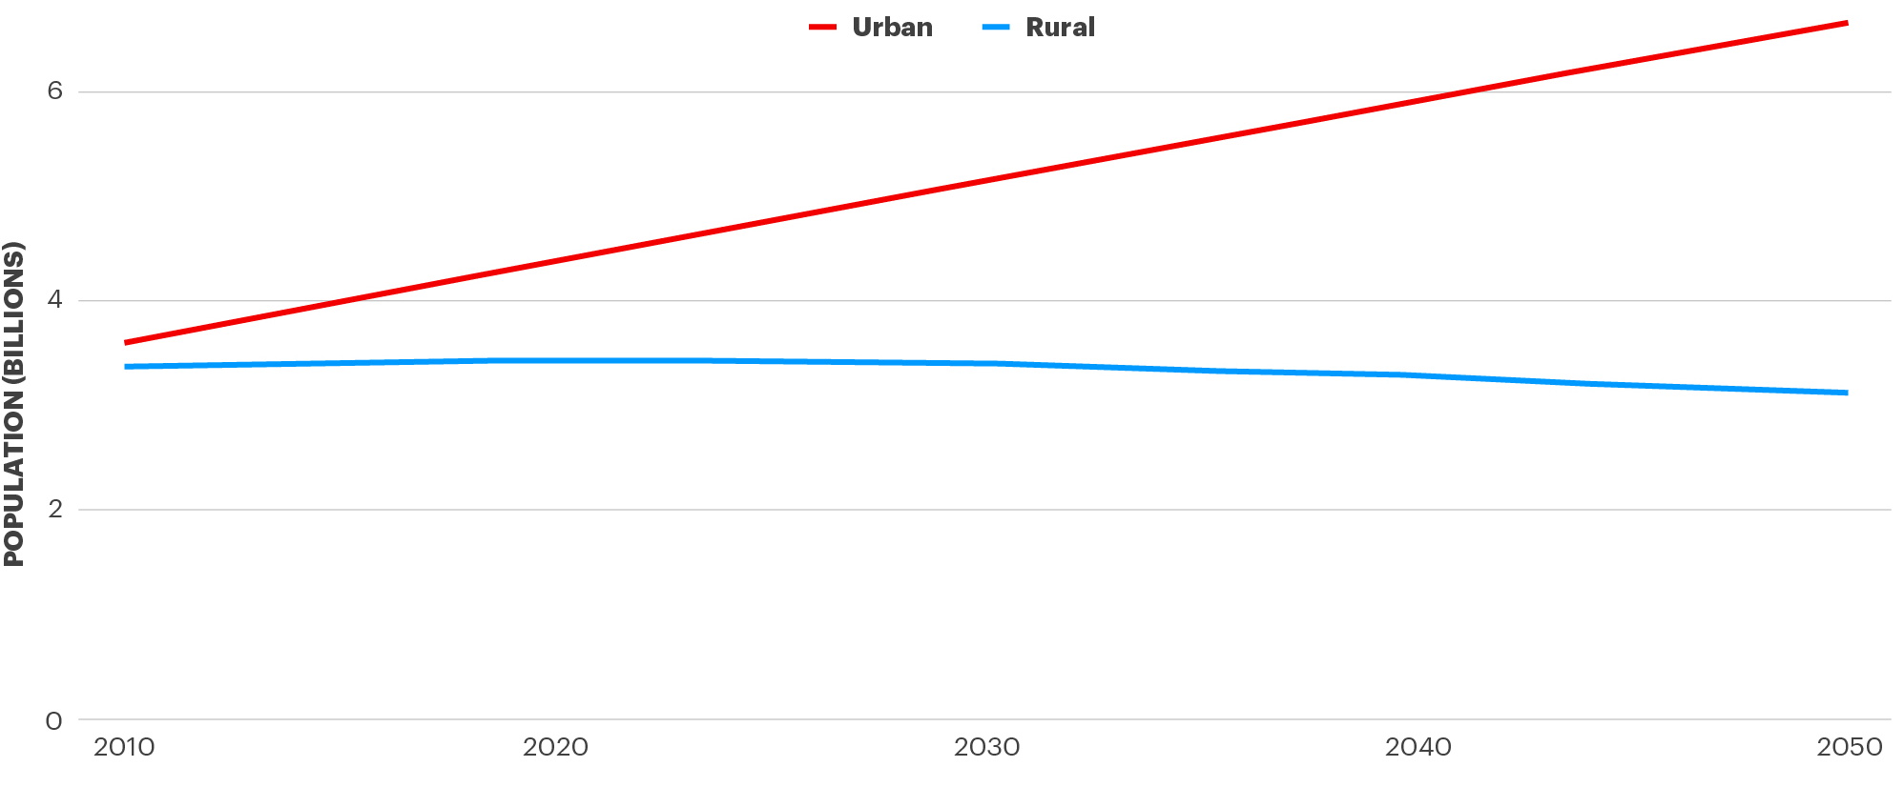
Projected population growth 2010-2050, urban versus rural
The world’s population is projected to continue to rise, with the growth occurring in cities, while rural areas will marginally decline.
Source: IEP; OWID; Masanobu Kii 2021

Slide 41
Megacities – currently 34, increasing to at least 47 by 2050
    The fastest growing cities face similar challenges – lack financial capacity, high rates of violence, civil unrest, pervasive pollution, poor sanitation, high population growth.
    The least resilient cities are Kinshasa, Nairobi, Lagos, Dhaka, Baghdad, Lahore, Kolkata, Delphi.
    Nine cities have more than 20 times the WHO recommended maximum air pollution level – most in India and China.
    By 2050, 60% of cities will be in low peace countries and will be the fastest growing.

Slide 42
07.
Policy Recommendations

Slide 43
Policy recommendations
    Current policies will not be enough to reverse the deteriorating environments of the poorest and least peaceful countries.
    The countries with the highest resilience will manage their way through current and emerging ecological shocks.
    Better analysis of the societal systems would enable better environmental outcomes.
    For the countries with the fastest population growth culturally appropriate family planning is urgently needed.
    Micro water capture projects aid the poorest. Enable food production, allowing micro value added businesses – cooperatives work well.
    Micro projects need stronger community design.
    Substantial improvements in bio-mass needed – FMNR cheap, successful and highly scalable.

Slide 44
Energy Dependency On Low Peace Countries
    Reliable energy sources is imperative for national security, especially true in a changing climate as patterns of energy will change to adapt to new seasonal trends.
    Dependency on exports from Low Peace countries therefore exposes importing countries to supply disruptions from instability caused by conflict.
    As highlighted by the Ukraine War, many middle and high income countries are dependent on Russian energy exports.
    The developed countries with the highest dependency on energy imports from Low Peace countries are:
      Japan – 84 per cent
      South Korea – 74 per cent
      Italy – 72 per cent
      Belgium – 73 per cent

Slide 45
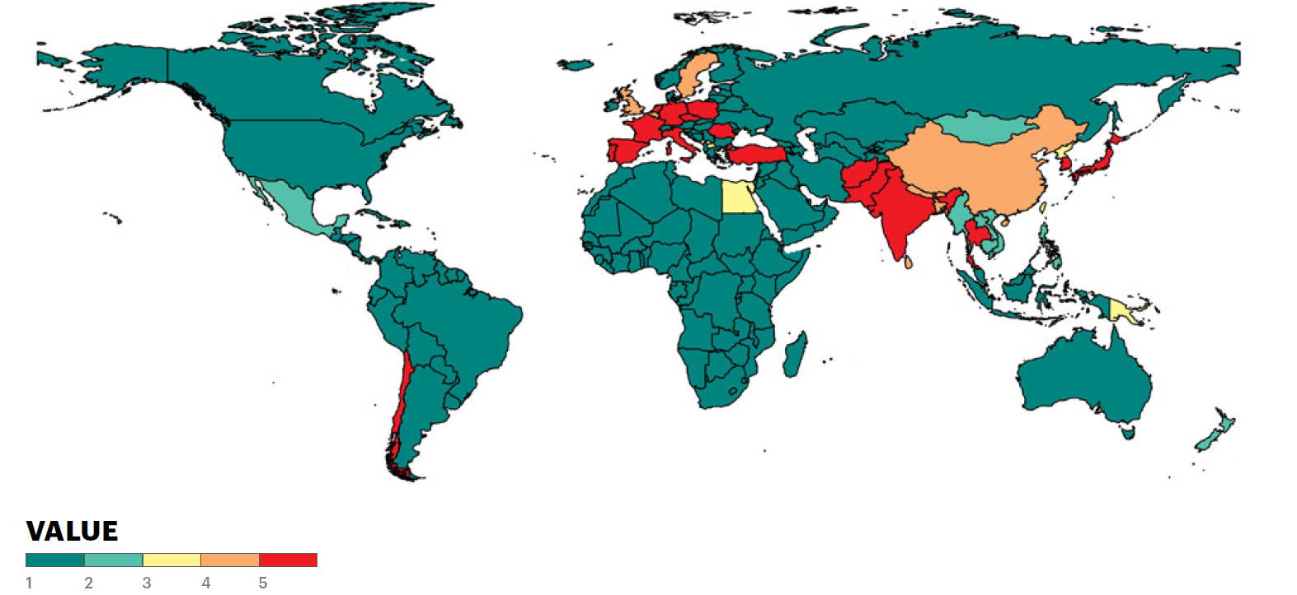
Countries dependent on energy imports from low peace countries
    Europe and South Asia are highly dependent on energy imports from low peace countries.

Slide 46





Get involved with IEP
@GlobPeaceIndex
GlobalPeaceIndex
Ambassador Program
Positive Peace Workshops
@GlobalPeaceIndex
Online
Strategic Partnerships
IEP Peace Academy
visionofhumanity.org

Slide 47

Peace in the Age of Chaos
Peace in the Age of Chaos is the debut
book by the Founder & Executive Chairman
of IEP, Steve Killelea A.M.
The book pushes the reader to rethink peace,
as something that is pivotal to the development of successful societies
Includes many personal experiences and the journey behind the founding of IEP and the Global Peace Index
Endorsed by prominent politicians,
peacebuilders and professors
Buy and more info: peaceintheageofchaos.org

