Slide 1
POSITIVE
PEACE
2022
Analysing the factors that sustain peace

Slide 2


The Institute for Economics and Peace is an independent, not-for-profit think tank dedicated to building a greater understanding of the key drivers of peace, as well as identifying the economic benefits that increased peacefulness can deliver.

Slide 3
Our international offices
Brussels
The Hague
New York
Sydney Head Office
Mexico City
Harare

Slide 4

About the Institute
Research used extensively by organisations including the OECD, Commonwealth Secretariat, World Bank and the United Nations.
27BN
1.3BN
152
Work is included in 1,000s of university courses and trained over 1,500 IEP ambassadors.
GLOBAL MEDIA REACH
SOCIAL REACH
COUNTRY REACH
Over 200,000 downloads of IEP reports in the last 12 months.
20,000
3000
1.5M
NEWS ARTICLES
BOOK REFERENCES
UNIQUE VISITORS

Slide 5
01.
Understanding Systems Thinking

Slide 6

What is a system?
No generally agreed definition
An approach:
Has more internal controls than external controls
Can be defined by its boundaries
Operates with a high degree of complexity
A nation is a system, so is a judicial system
Is a soccer team or loose social network a system?

Slide 7
Why systemic thinking is different
Government and most organisations think in cause and effect
Modern science is based on cause and effect
The sum of the parts is more than the whole – therefore cannot be broken down into its parts to fully understand
Systems thinking is a radial transformation in understanding how societies operate

Slide 8
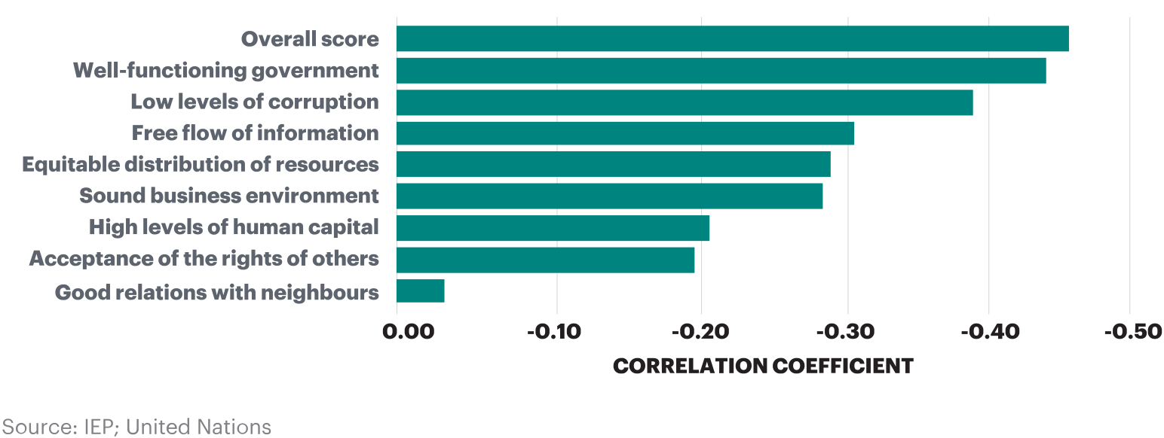
The sum is more than the parts
Changes in Positive Peace and Changes in GDP

Slide 9
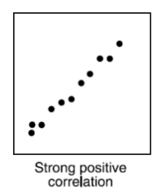
Cause and Effect
Scientific Reasoning: Repeatability
In repeatable scientific experiments
same input = same output
Input
Output
Experiment
Effect does not influence the cause

Slide 10
Effects are not clearly defined
Elements mutually interact making causality difficult to imply.
Well Functioning Government
Low Levels of Corruption
Free Flow of Information

Slide 11
Systems lie within systems
The smallest subsystem can interact with the largest super system.
Eco systems
International Community
Parliament
Police
Schools
Nations
Atmosphere

Slide 12
Properties of systems
Self-regulating and seeking homeostasis
Systems are path dependent
Encoded norms regulate the system to maintain homeostasis
Systems self-modify when there are persistent mismatches with inputs
Form virtuous or vicious cycles
Systems are be understood through mathematics

Slide 13
Systems are responsive
Understanding the system response requires understanding the systems and their relationship to the input.
System
Encoded Norms
System Response
Input to System
System Interacts with input
Intent
Notes:
In systems thinking the input comes into the system, interacts with the systems intent and encoded norm, thereby determining an action which may then attempt to alter the input
This is known as a mutual feedback loop. The system is constantly modifying inputs to match its encoded norms

Slide 14
Systems are path dependent
Historical path
Best approach to change is to continuously nudge the system in the right direction.
Virtuous cycle
System
Many small changes from many directions is the optimum way to change the system
Vicious cycle

Slide 15
Homeostasis & self-modification
Persistent mismatch
Process assessment
System modification
Feedback loop
New homeostasis
New
encoded norm
Encoded norms

Slide 16
Tipping points
An input can occur for a lengthy period with little effect
After certain point a small input can cause radical changes
Think of Mercury or Lead in the body
A bird drops a new seed in a forest
A new invention or idea such as the mobile phone
Once changed the system cannot revert back to what it was

Slide 17

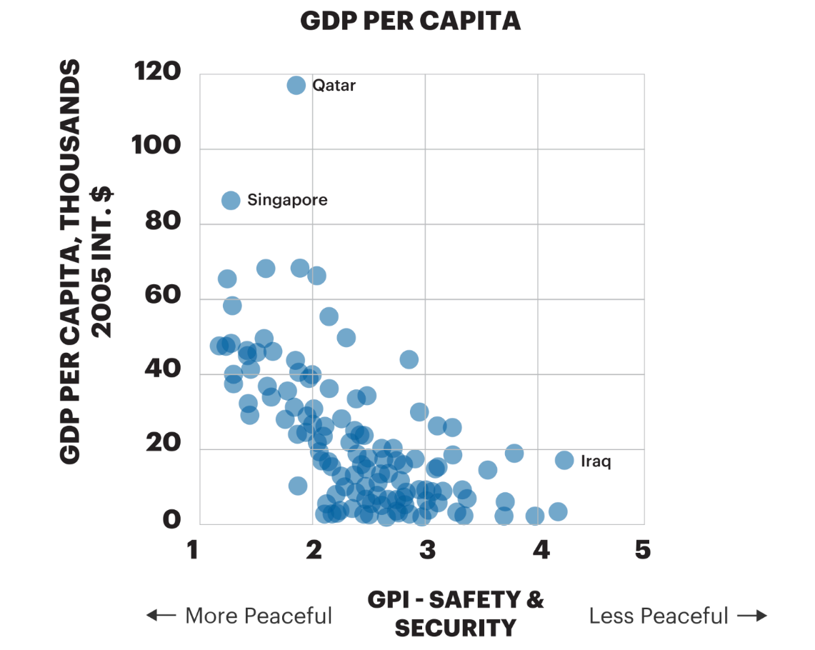
Tipping points
GDP Per Capita
Source: IEP; United Nations

Slide 18

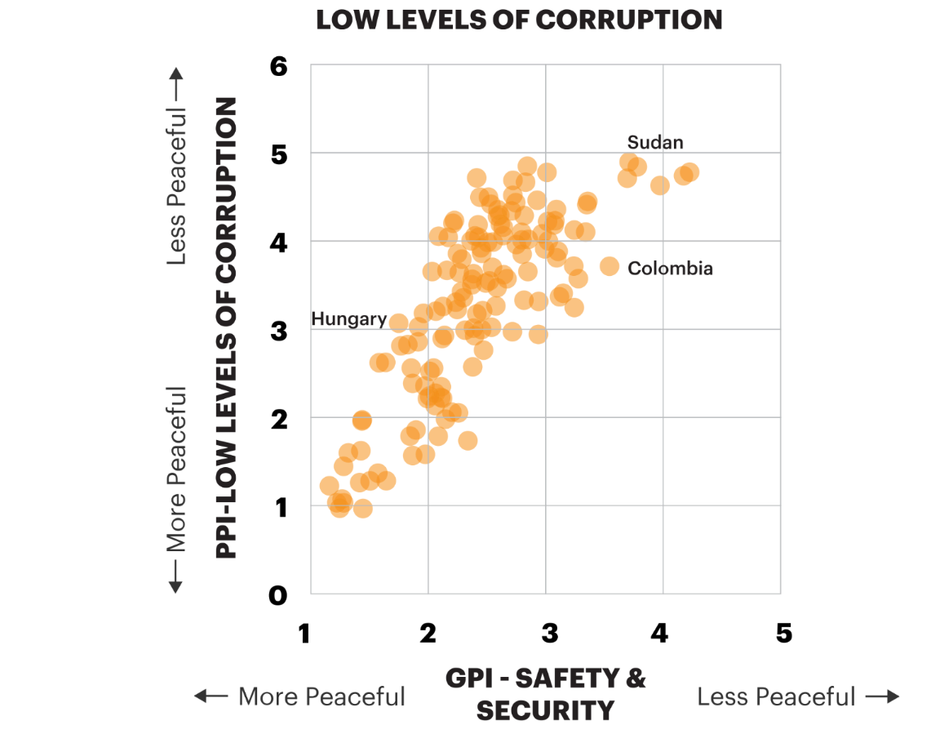
Tipping points
Corruption and Peace
Source: IEP; United Nations

Slide 19

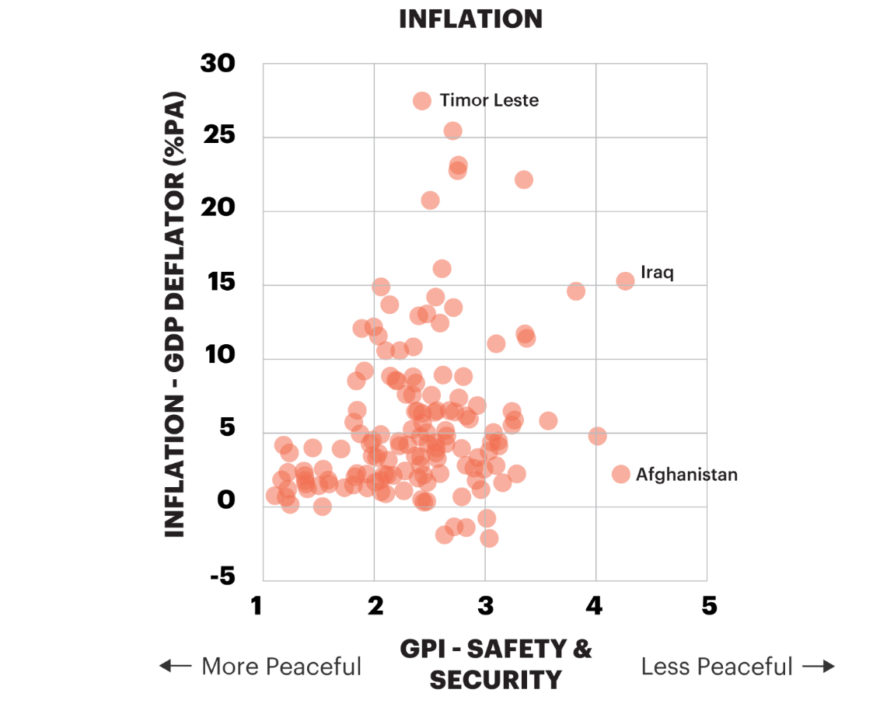
Tipping points
Inflation and Peace
Source: IEP; United Nations

Slide 20

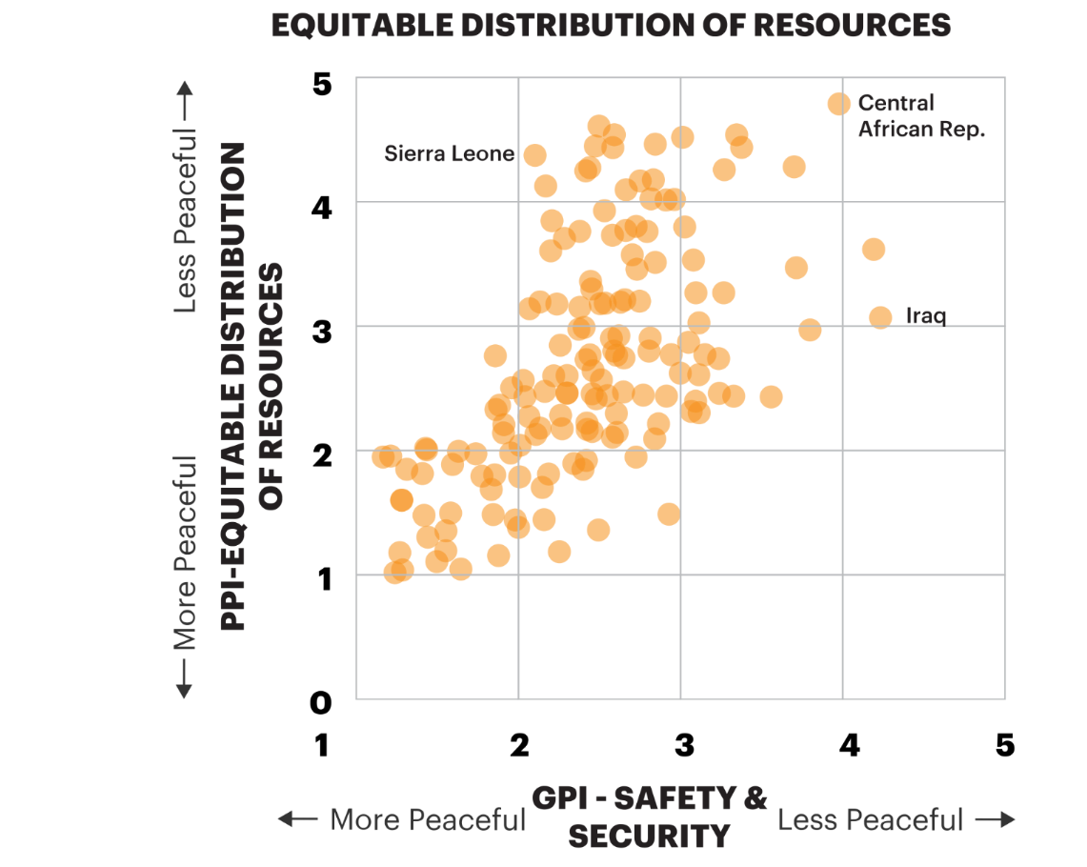
Tipping points
Inequality and Peace
Source: IEP; United Nations

Slide 21
Systems are cyclic and changing
Momentum more important than position
Virtuous cycle
Vicious cycle

Slide 22

Adaptation and resilience
Adaptation – the ability to adapt to a changed environment
Resilience – ability to absorb shocks to the system and to successfully adapt to a changed environment
Positive Peace can be used to measure resilience and adaptability
Well-functioning democracies are highest in Positive Peace and wealth because of their ability to adapt and recover from shocks

Slide 23
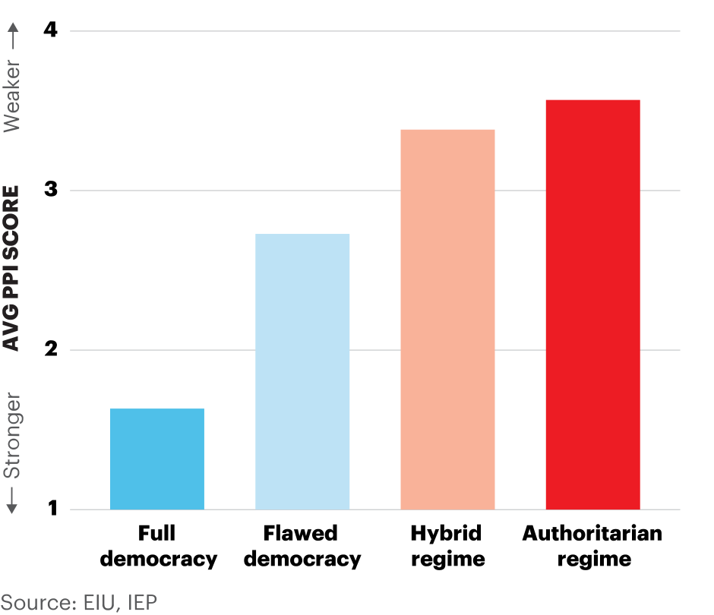
Positive Peace by government type
Full democracies have the strongest average levels of Positive Peace.

Slide 24
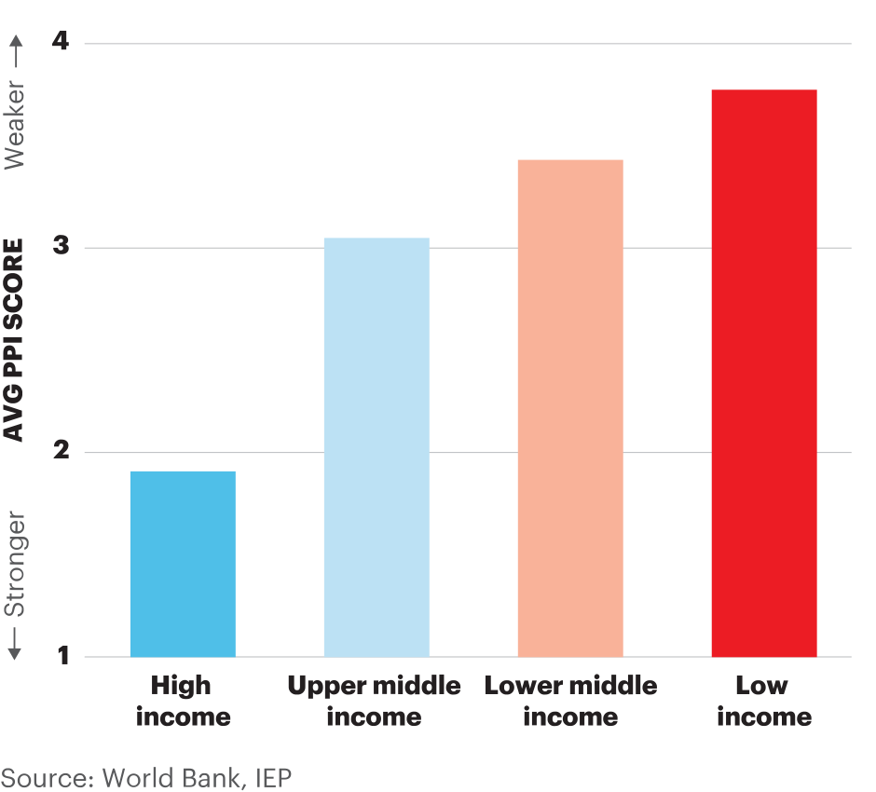

Positive Peace by income group
High income countries have the strongest average levels of Positive Peace.

Slide 25
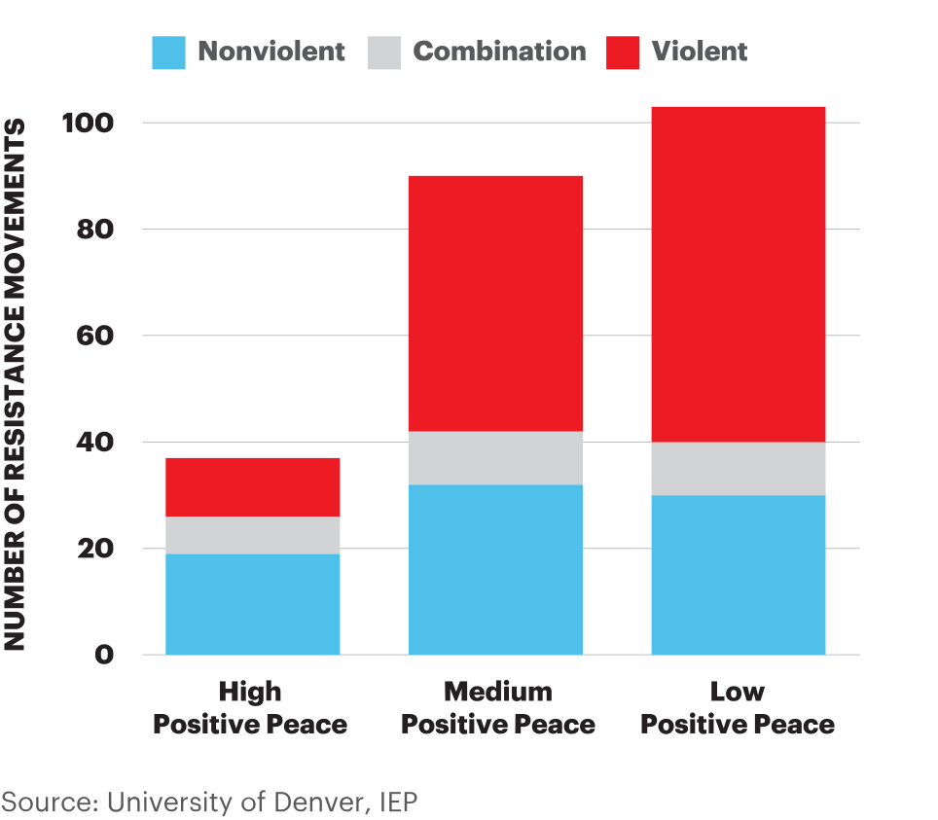
Prevalence and nature of resistance campaigns
Between 1945 and 2006, 91 per cent of violent resistance campaigns have occurred in countries with weaker Positive Peace.

Slide 26
02.
Halo - Systemic Process Analysis

Slide 27
Halo - Systemic Process Analysis
Halo
systems are difficult to directly perceive, they can only be understood by what they emanate – data, surveys, participants impressions
They can never be fully understood because they are constantly changing

Slide 28
Halo - Systemic Process Analysis
Unique approach to defining a system
Especially designed for understanding societal systems – starting point was biological systems
Building block approach where attributes can be mixed according to knowledge and needs
Consists of 28 unique attributes that describe a system, also known as building blocks
Reiterative and reusable approach for systemic analysis
The analysis can be as short as a day or as long as a year

Slide 29
Halo – Systemic process analysis
The 28 building blocks can be divided into three categories
Defining the content of the system
The dynamics of the system
Analysing the system

Slide 30
Halo – Examples of defining the contents of the system
Define the boundaries of the system
What are the sub-systems contained within the system?
Understand the Intent of the system and sub-systems
What measurements exist for the system?
What is the path dependencies of the systems – best understood through history and values

Slide 31
Halo – Examples understanding the dynamics of the system
Understand momentum – for the system, subsystems, stocks and flows
Understand the emergent qualities in the system, including through changes in stocks and flows
Develop the feedback loops based on the flows
Identify the main encoded norms within the system through values, intent, legal frameworks and more
Follow the money to understand flows

Slide 32
Halo – Examples of analysing the system
How resilient and adaptable is the system?
Does the system conform to any known architypes
Subsystems – what are their functions, purpose and potential
Use static and dynamic modelling
Analysis the results through the lens of Positive Peace for verification

Slide 33
Halo – 12 step example of how to use
Step 1 – Defining the System and its Bounds
Geographical area
Social grouping – ethnicity, religion etc
Coverage of legal frameworks
Nature and types of sub-systems
Step 2 – What are the Major Sub-Systems?
Not necessary to consider all sub-systems

Slide 34
Halo - Approaches to analysing the attributes of a system
Step 3 – What is the Intent of the System?
There may be multiple intents, select the most important ones
Difference between stated intent and actual intent
Intent of nations may be determined in the political, economic, international relations and social areas
Step 4 – What is the Purpose, Function and Potential of Sub-Systems?
There may be multiple purposes for a sub-system
There will be multiple functions
Potential may also be ‘negative’

Slide 35
Halo - Approaches to analysing the attributes of a system
Step 5 – Identifying the Stocks, Flows and Transformations within the System
Some stocks and flows are more important

Slide 36
Halo - Approaches to analysing the attributes of a system
Step 6 – Finding the encoded Norms
Encoded norms regulate the flows between stocks
But encoded norms may also be cultural values
Others are established by legal or regulatory frameworks

Slide 37
Halo - Approaches to analysing the attributes of a system
Step 7 – Developing System Diagrams

Slide 38
Halo - Approaches to analysing the attributes of a system
Step 8 – Performing a Static Analysis
Depicts a system at one point in time
Step 9 – Performing a Dynamic Analysis
Requires time series data
‘Emergence’ happens when flows are increasing or new systemic properties appear
‘Sun-setting’ is the opposite of emergence and may occur due to obsolescence or other factors

Slide 39
Halo - Approaches to analysing the attributes of a system
Example of static and dynamic analyses
Arrows show how indicators changed from 2009 to 2020 in Zimbabwe. Green arrows represent improvements; red arrows, deteriorations.
Bars represent the average level of the indicator in 2020 for the sub-Saharan region in 2020
Source: IEP and others

Slide 40
Halo - Approaches to analysing the attributes of a system
Step 10 – Identify the System Archetypes
Basic patterns that keep emerging in different systems.
Limits to growth
Exponential success
Seeking the wrong goal
Rule breaking
Escalation
The tragedy of the commons
Step 11 – Path Dependency
Cultural and historical reasons will influence the future path of the system

Slide 41
Halo - Approaches to analysing the attributes of a system
Step 12 – Finding the Cultural Values
Cultural values affect the limits of what the system can do
Step 13 – Bring it together
Overall analysis and revision
Step 14 – Analyse through the lens of Positive Peace
Group the interventions under the Positive Peace pillars

Slide 42


Peace in the Age of Chaos
Peace in the Age of Chaos is the debut
book by the Founder & Executive Chairman
of IEP, Steve Killelea A.M.
The book pushes the reader to rethink peace,
as something that is pivotal to the development of successful societies
Includes many personal experiences and the journey behind the founding of IEP and the Global Peace Index
Endorsed by prominent politicians,
peacebuilders and professors

Slide 43



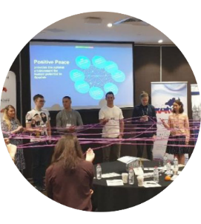

Get involved with IEP
@GlobPeaceIndex
GlobalPeaceIndex
Ambassador Program
Positive Peace Workshops
@GlobalPeaceIndex
Online
Strategic Partnerships
IEP Peace Academy
visionofhumanity.org

