Slide 1
Positive Peace 2022
Analysing the factors that build, predict and sustain peace.

Slide 2

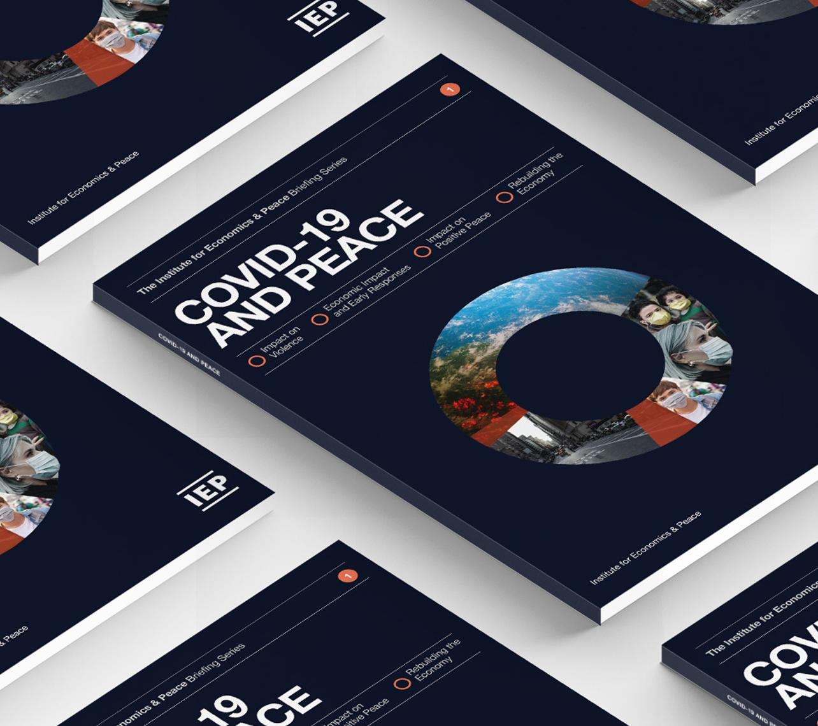
The Institute for Economics and Peace is an independent, not-for-profit think tank dedicated to building a greater understanding of the key drivers of peace, as well as identifying the economic benefits that increased peacefulness can deliver.

Slide 3
Our international offices
Brussels
The Hague
New York
Sydney Head Office
Mexico City
Harare

Slide 4

About the Institute
Research used extensively by organisations including the OECD, Commonwealth Secretariat, World Bank and the United Nations.
27BN
980M
152
Work is included in 1,000s of university courses and trained over 1,500 IEP ambassadors.
GLOBAL MEDIA REACH
SOCIAL REACH
COUNTRY REACH
Over 200,000 downloads of IEP reports last 12 months.
20,000
3000
1.5M
NEWS ARTICLES
BOOK REFERENCES
UNIQUE VISITORS

Slide 5
01.
What is Positive Peace?

Slide 6
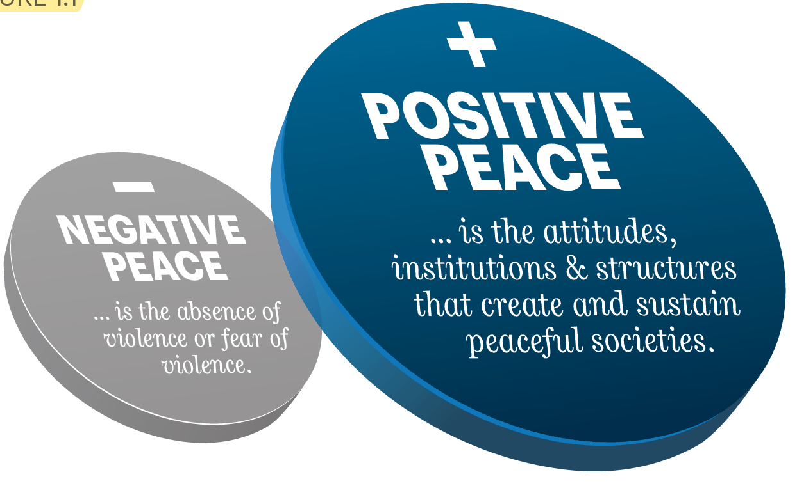
What is Positive Peace?
Notes:
Ask Darren if more intro slides are available/needed

Slide 7
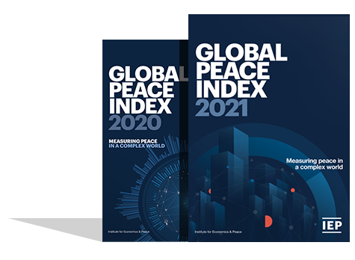
The Global Peace Index
Now in its
Ranks
According to their relative states of peace
15th
163
year
countries
Using
Developed by the Institute for Economics and Peace
Guided and overseen by a panel of International Experts
23
Indicators weighed on a 1-5 scale

Slide 8
Global Peace Index indicators
6
measures of ongoing domestic and international conflict
10
measures of societal safety
and security
7
measures of militarisation
Including: intensity of organized internal conflicts, relations with neighbouring countries and number of deaths from conflict
Including: number of refugees and IDPs, impact of terrorism, homicide and incarceration rates
Including: military expenditure, number of armed service personnel, ease of access to small weapons

Slide 9

Defining and measuring peace
The perfect state would have no police, jails or crime.
Actual Peace
Crime
Suppression
Military
Armed Conflict
Positive Peace
Derived through statistical analysis of datasets, indices and attitudes with the GPI
GPI
Positive Peace Index
Notes:
There are two types of peace. Negative and positive.
Starting point for the GPI is to image a state with no need for jails, crime and therefore no peace.
The definition in the Global Peace Index is ‘absence of violence’ and ‘absence of fear of violence’
But negative peace doesn’t tell you anything about what is necessary for a peaceful society
Positive peace index is derived through statistical analysis of over 9,000 datasets, indexes and attitudinal surveys
This is first empiric attempt to derive positive peace, this enables one to imagine how a world can become more peaceful.

Slide 10
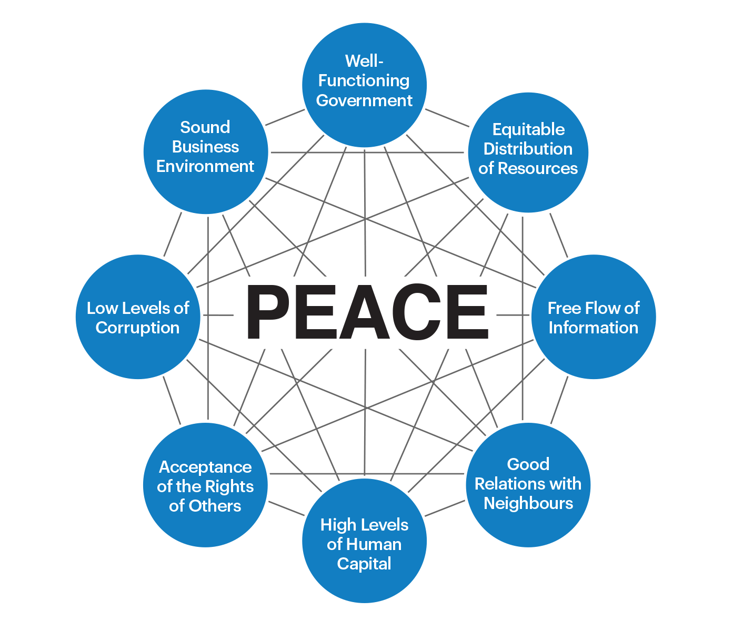
Positive Peace
Positive Peace creates the optimum environment for human potential to flourish.
    High levels of Positive Peace are associated with:
    Higher per capita income
    Resilience
    Better environmental outcomes
    Higher measures of wellbeing
    Better performance on SDGs

Slide 11
Countries that improve in Positive Peace outperform the global average
Growth in real GDP of a portfolio of countries that improve in Positive Peace exceeds an equally weighted global average by 33 per cent over 10 year period.

Slide 12
Social Wellbeing and Positive Peace
There is a close correlation between the SPI Foundations of Wellbeing scores and PPI scores.

Slide 13
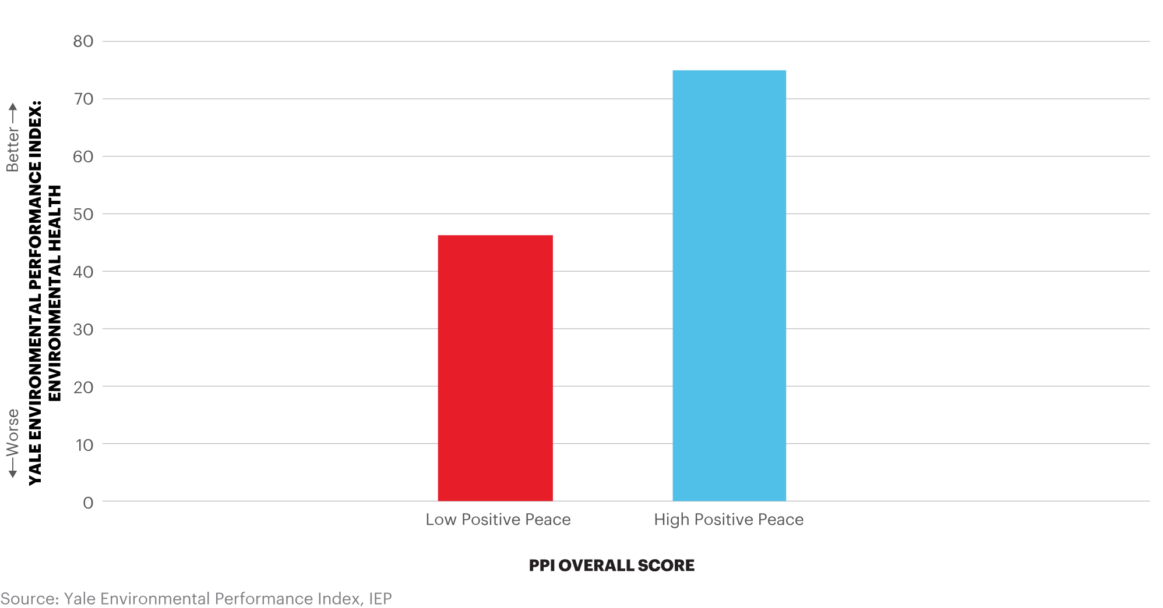
Environmental scores and Positive Peace, 2019
Countries with high Positive Peace also record stronger environmental performance.

Slide 14
02.
Systems

Slide 15

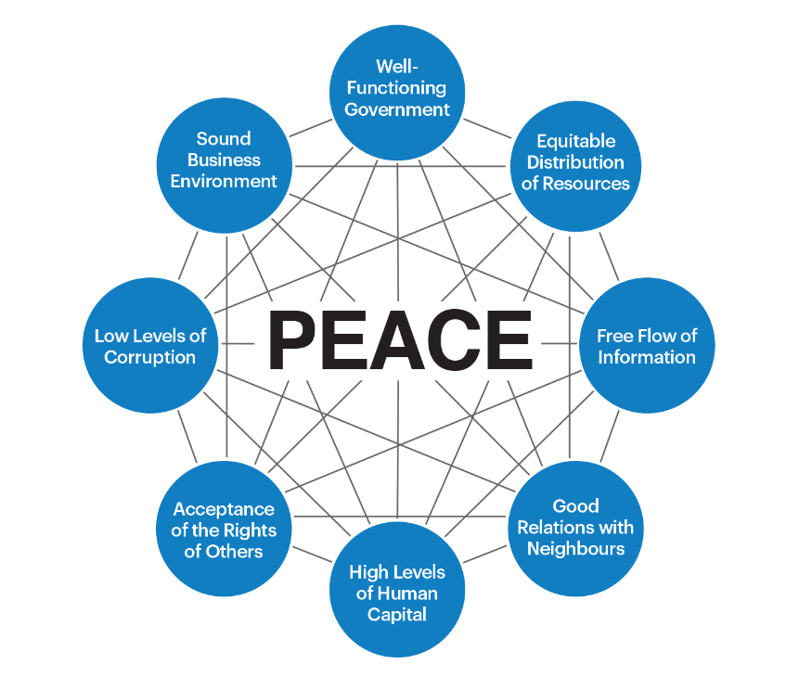
Positive Peace operates systemically
The Pillars of Positive Peace provide entry points into a system
Through stimulating each of the Pillars the whole of the system is stimulated
Systems operate through feedback loops, encoded norms and steady state – not through causality
Positive Peace can be used to measure emergent qualities of a system as well as sun-setting qualities
Systems are not static, they have momentum. Positive Peace measures the momentum.
Positive Peace is an excellent measure of the resilience of a system.

Slide 16
System – simple expression
Changes in stocks and flows
Emergence
Purpose
Functions
Stocks/flows
subsystems
Path dependency
Adaptation
Steady state
Encoded
Norms
* Values
* Legal structures
* Policies
History and culture
Positive Peace
vision into a
system
Systems seek a steady state but are always adjusting became of a changing environment

Slide 17
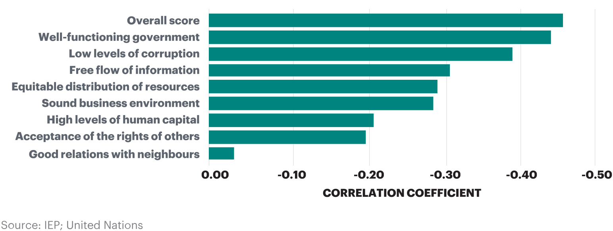
The sum is more than the parts
CHANGES IN POSITIVE PEACE AND CHANGES IN GDP

Slide 18
03.
Rankings and Changes

Slide 19
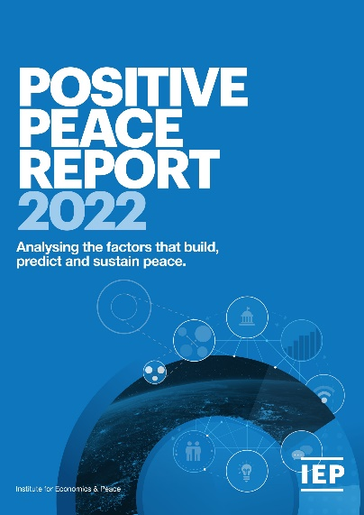
The Positive Peace Index
Now in its
Ranks
Using
8th
163
24
year
countries
Indicators weighed on a 1-5 scale
Developed by the Institute for Economics and Peace
Uses over 25,000 datasets, indexes and surveys
Empirically derived

Slide 20
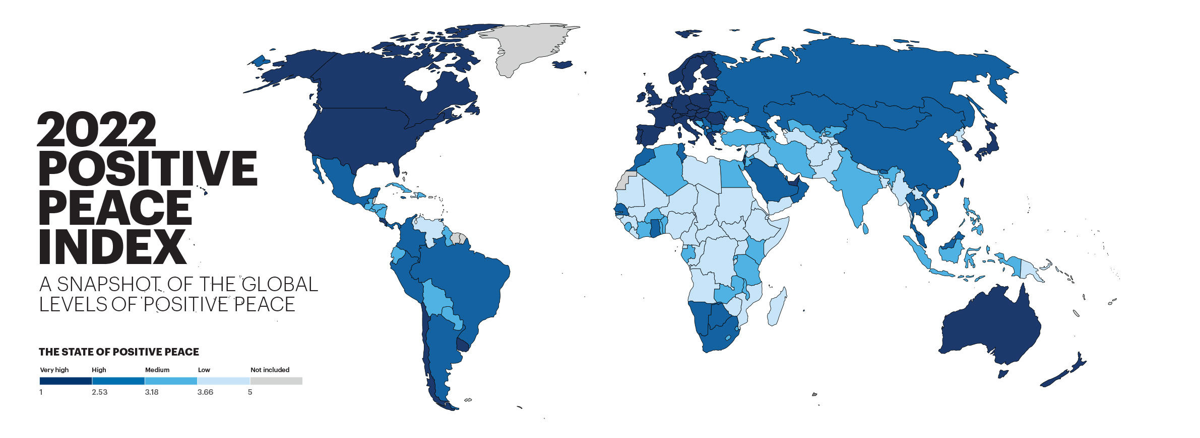

Slide 21
Key findings – 10 years
Positive Peace improved
globally in the past decade
126
2.4%
countries became more peaceful, 37 deteriorated
Improvements were driven by:
Free-Flow of Information
Good Relations with Neighbours
Equitable Distribution of Resources
Deteriorations were driven by:
Changes in the ‘Attitudes’ domain
Low Levels of Corruption Pillar

Slide 22

Key findings 10 years
Syria and Libya had the largest deteriorations
North America was the only region to deteriorate
Uzbekistan and Georgia had the largest improvements
Asia Pacific had the largest regional improvement
Europe remains the most peaceful region, but deteriorated on four Pillars

Slide 23
Positive Peace Index – Top Ten Nations
(and Rank Changes over the Past Decade)
1
SWEDEN
Rank change: 1
6
NETHERLANDS
Rank change:
2
DENMARK
Rank change: 1
7
CANADA
Rank change:
3
FINLAND
Rank change:
8
AUSTRALIA
Rank change:
4
NORWAY
Rank change:
9
GERMANY
Rank change:
5
SWITZERLAND
Rank change:
10
IRELAND
Rank change:
Notes:
Germany and Iceland are tied for 9th in rankings; Australia, Canada and UK are tied for 11th

Slide 24
Positive Peace Index – Bottom Ten Nations
(and Rank Changes over the Past Decade)
163
SOMALIA
Rank change:
158
DEMOCRATIC REPUBLIC OF THE CONGO
Rank change: 3
162
SOUTH SUDAN
Rank change: 5
157
SYRIA
Rank change: 40
161
YEMEN
Rank change: 7
156
ERITREA
Rank change:
160
CENTRAL AFRICAN REPUBLIC
Rank change: 2
155
SUDAN
Rank change: 5
159
CHAD
Rank change: 3
154
IRAQ
Rank change: 1
Notes:
Sudan, Iraq, and Democratic Republic of the Congo are tied for 152nd

Slide 25
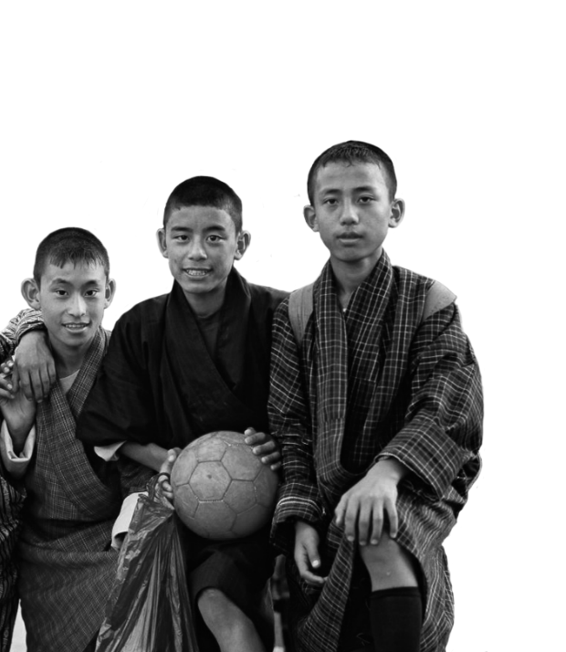
Changes in the Attitudes, Institutions and Structures of Positive Peace, 2009–2020
The improvement in the PPI since 2009 was largely driven by structural improvements. Institutional functioning has remained broadly the same over the period while attitudes have deteriorated.

Slide 26
Percentage Change in Positive Peace, 2009–2020
Seven of the eight Pillars have improved since 2009, with Low Levels of Corruption showing a deterioration over the period.

Slide 27
Percentage Change in PPI Indicators, 2009–2020
The individuals using the Internet indicator recorded the largest improvement, while the quality of information and factionalised elites indicators recorded the largest deteriorations.

Slide 28
Percentage Change in Average Regional Scores, 2009-2020
North America is the only region that did not improve in Positive Peace between 2009 and 2020, driven by a deterioration in Positive Peace in the United States.

Slide 29
Changes in Attitudes, Institutions and Structures in the PPI, United States, 2009–2020
Positive Peace deteriorated in the US from 2009 on the back of poorer scores for institutional and attitude indicators.

Slide 30
Percentage Change in Positive Peace Indicators, United States, 2009–2020
The quality of information and factionalised elites indicators deteriorated substantially since 2009 in the US.

Slide 31
Change in Attitudes, Institutions and Structures in the PPI, Europe, 2009–2020
Improvements in the economy of southern and eastern European nations have contributed to benign structural outcomes for the region. In contrast, attitudes deteriorated markedly.

Slide 32
Change in Positive Peace Indicators, Europe, 2009-2020
Substantial improvements in economic and health indicators were partially offset by worsening political radicalisation and quality of informed debate.

Slide 33
Change in Attitudes, Institutions and Structures in the PPI, China, 2009–2020
Improvements in indicators of social structures have offset deteriorations caused by worsening attitudes.

Slide 34
Change in Attitudes, Institutions and Structures in the PPI, United Kingdom, 2009–2020
Since 2015, the Attitudes and Institutions Domains recorded substantial deteriorations in the UK.

Slide 35
Change in Attitudes, Institutions and Structures in the PPI, Russia, 2009–2020
A large deterioration in Russia’s Attitudes Domain from 2010 to 2014 was offset by improvements in Structures.

Slide 36
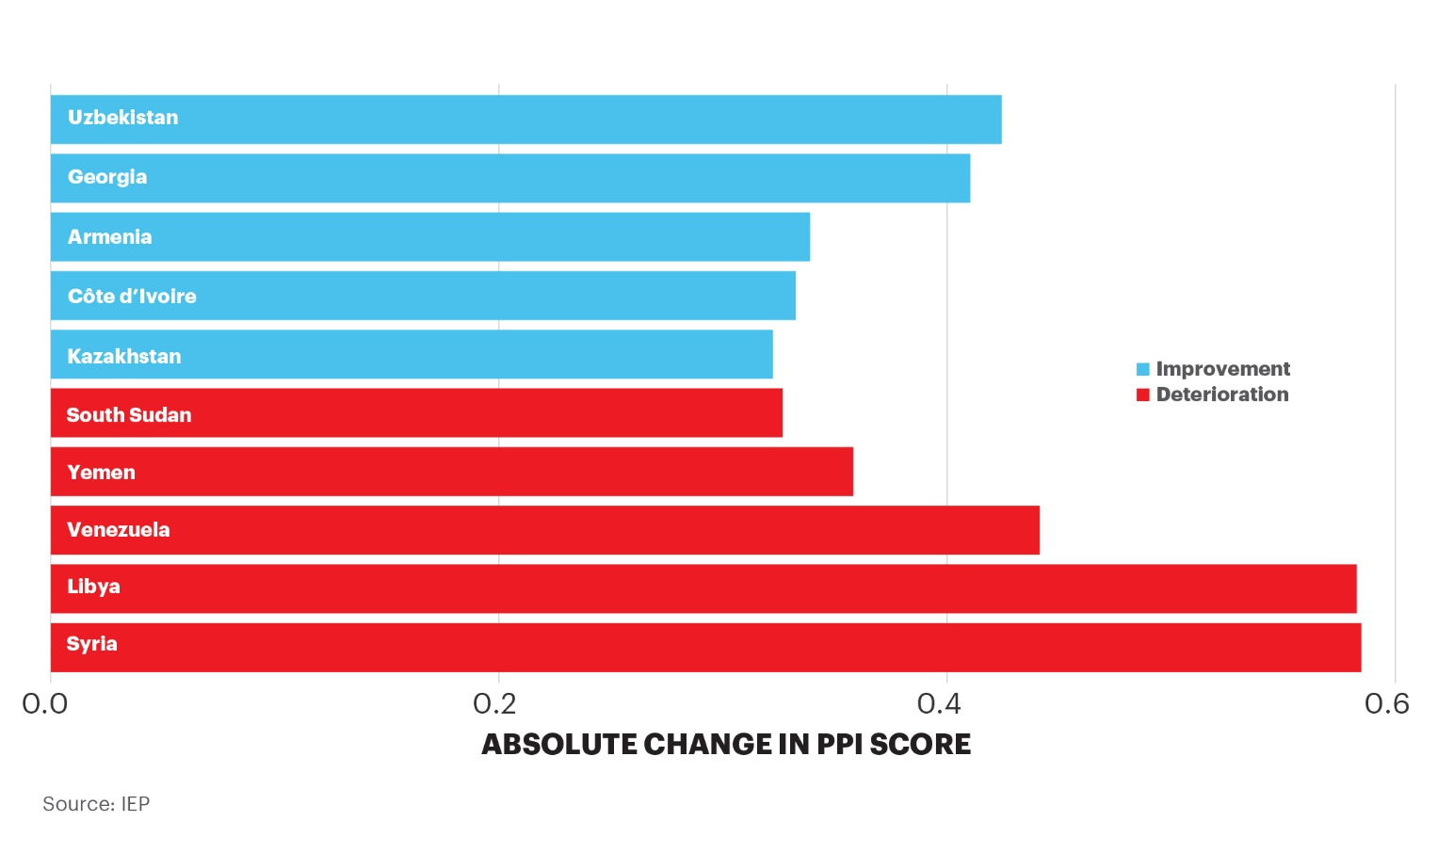
Largest Changes in Positive Peace, 2009–2020
Uzbekistan and Georgia recorded the largest improvements in Positive Peace, while Syria and Libya recorded the largest declines.

Slide 37
04.
Benefits of Positive Peace

Slide 38
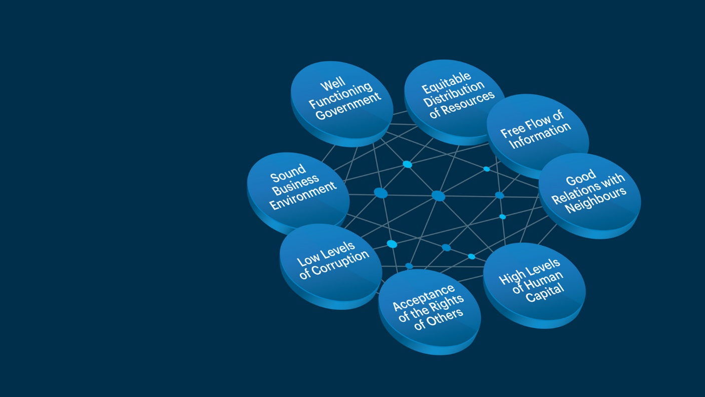

Positive Peace
provides the optimal environment for human potential to flourish.

Slide 39
High levels of Positive Peace lead to:
Higher measures of wellbeing
Stronger resilience & adaptability
Better environmental outcomes
3
1
2
Better business environment
Better performance on development goals
Higher per capita income
6
4
5

Slide 40

Positive Peace & financial metrics
Every one index point of improvement in the PPI is associated with a ten-fold rise in GDP.
Household consumption in countries improving in Positive Peace grows at twice the rate relative to countries where Positive Peace deteriorates.
Growth in business activity in countries where Positive Peace improved was two times higher than in countries where the PPI deteriorated in the last decade.
Inflation rates in countries where Positive Peace deteriorated were three times more
volatile when compared to countries where Positive Peace improved.
Among PPI improvers, Foreign Direct Investment grew by more than two percentage points per year faster than in countries where the PPI deteriorated.

Slide 41
Positive Peace and GDP per capita, 2020
On average, across all levels of country income, every one index point improvement in the Positive Peace Index is associated with a tenfold rise in GDP per capita.

Slide 42
Volatility of Inflation by Positive Peace Outcome, 2009 - 2020
Countries in which Positive Peace deteriorated recorded a standard deviation of inflation rates much greater than those countries where PPI improved.

Slide 43
Changes in Household Consumption by Positive Peace, 2009–2020
Among countries where Positive Peace improved, household consumption rose from 2009 to 2020 at a rate much higher than in countries where the PPI deteriorated.

Slide 44
Changes in FDI and Trade by Positive Peace Outcome, 2009-2020
FDI flows towards PPI improvers grew strongly over the decade, while countries where Positive Peace deteriorated became less attractive in global capital markets. Trade is also stronger among countries improving in the PPI.

Slide 45
Positive Peace and OECD Life Satisfaction
Among OECD nations, those with higher levels of Positive Peace enjoy higher levels of life satisfaction.

Slide 46
Negative Emotions and Social Attitudes, 2020
The deterioration in the Attitudes Domain of Positive Peace is corroborated by an increase in the proportion of Gallup’s respondents reporting to have felt negative emotions prior to taking the survey.

Slide 47
Positive Peace and COVID-19: Tests
Higher resilience countries were able to provide far more COVID-19 tests per capita than their counterparts.

Slide 48
Positive Peace and COVID-19: Hospital Beds
Higher resilience countries have superior medical resources for the management of the pandemic.
The systemic nature of Positive Peace means the overall functioning of society is better

Slide 49
Positive Peace and COVID-19: Cumulative Excess Mortality
Countries with lower levels of Positive Peace reported higher excess mortality rates. At least in part this may be due to COVID-19 infections, as the pandemic was the only major public health differential between 2019 and 2020.

Slide 50
05.
Predictive Capabilities of Positive Peace

Slide 51
Positive Peace – Predictive Capabilities
The Positive Peace deficit model predicts future deteriorations in the GPI
Countries that rank higher in the GPI than in the PPI have a Positive Peace deficit. History shows that peace in these countries deteriorate over time.
79% of the countries with a Positive Peace deficit of more than 20 places in 2009 recorded deteriorated in peacefulness from 2009 to 2020.
Eighty-five percent of countries with a Positive Peace deficit of more than 50 places, deteriorated from 2009 to 2020.
The level of socio-economic resilience in such countries is not developed enough to sustain the country’s existing level of negative peace.
Countries that had a Positive Peace surplus improved by 3.1% in the GPI over the subsequent decade.
Those with a deficit recorded an average deterioration of almost 12% in their GPI scores

Slide 52
Positive Peace Deficit Model - Deteriorations in the GPI
Of the 39 countries in Positive Peace deficit in 2009, 31 (79%) deteriorated in the GPI within the following ten years.
 | Country | PPI Rank 2009 (A) | GPI Internal Peace Rank 2009 (B) | Positive Peace Deficit 2009 (A) – (B) | Change in GPI Internal Peace 2009-2020 (%) | Change in GPI Internal Peace 2009-2019
1 | Equatorial Guinea | 150 | 59 | 91 | 5.1 | Deterioration
2 | Timor-Leste | 129 | 52 | 77 | 6.1 | Deterioration
3 | Angola | 148 | 77 | 71 | 6.4 | Deterioration
4 | Syria | 116 | 53 | 63 | 88.6 | Deterioration
5 | Djibouti | 134 | 74 | 60 | 12.7 | Deterioration
6 | Burkina Faso | 104 | 47 | 57 | 37.0 | Deterioration
7 | The Gambia | 130 | 75 | 55 | -2.8 | Improvement
8 | Rwanda | 120 | 66 | 54 | 5.1 | Deterioration
9 | Laos | 133 | 80 | 53 | -8.9 | Improvement
10 | Sierra Leone | 110 | 57 | 53 | 3.2 | Deterioration
11 | Viet Nam | 86 | 33 | 53 | 10.0 | Deterioration
12 | Egypt | 113 | 63 | 50 | 28.4 | Deterioration
13 | Eritrea | 156 | 106 | 50 | 0.3 | Deterioration
14 | Cameroon | 146 | 97 | 49 | 32.1 | Deterioration
15 | Liberia | 125 | 79 | 46 | 1.1 | Deterioration
16 | Bhutan | 77 | 32 | 45 | -11.2 | Improvement
17 | Malawi | 114 | 72 | 42 | 6.8 | Deterioration
18 | Indonesia | 99 | 58 | 41 | 0.1 | Deterioration
19 | Turkmenistan | 147 | 107 | 40 | -4.1 | Improvement
20 | Nicaragua | 101 | 62 | 39 | 52.5 | Deterioration
 | Country | PPI Rank 2009 (A) | GPI Internal Peace Rank 2009 (B) | Positive Peace Deficit 2009 (A) – (B) | Change in GPI Internal Peace 2009-2020 (%) | Change in GPI Internal Peace 2009-2019
21 | Zambia | 106 | 67 | 39 | 6.2 | Deterioration
22 | Swaziland | 126 | 88 | 38 | 2.8 | Deterioration
23 | Tajikistan | 142 | 104 | 38 | 0.1 | Deterioration
24 | Togo | 128 | 91 | 37 | 4.8 | Deterioration
25 | Azerbaijan | 118 | 86 | 32 | 1.4 | Deterioration
26 | Bangladesh | 135 | 103 | 32 | -1.5 | Improvement
27 | Myanmar | 151 | 121 | 30 | 6.2 | Deterioration
28 | Libya | 97 | 68 | 29 | 73.1 | Deterioration
29 | Madagascar | 127 | 98 | 29 | -2.7 | Improvement
30 | Mozambique | 107 | 78 | 29 | 16.0 | Deterioration
31 | Qatar | 44 | 15 | 29 | 4.0 | Deterioration
32 | Bosnia & Herzegovina | 75 | 48 | 27 | 9.6 | Deterioration
33 | Republic of the Congo | 143 | 116 | 27 | 4.5 | Deterioration
34 | Tanzania | 94 | 68 | 26 | 1.3 | Deterioration
35 | Haiti | 149 | 124 | 25 | -2.6 | Improvement
36 | Jordan | 67 | 42 | 25 | 8.4 | Deterioration
37 | Centr. African Republic | 158 | 135 | 23 | 28.5 | Deterioration
38 | Cambodia | 131 | 109 | 22 | -10.8 | Improvement
39 | Yemen | 154 | 132 | 22 | 34.7 | Deterioration
Source: IEP

Slide 53
Positive Peace Deficit Model - Deteriorations in the GPI
Seventy-nine per cent of countries with a Positive Peace deficit in 2009 recorded higher levels of violence in the subsequent decade. This compares with 32 per cent for nations with a surplus.

Slide 54
Positive Peace Deficit Model - Deteriorations in the GPI
Countries in deficit in 2009 had an average GPI score deterioration of 11.6% in the subsequent decade. In contrast, nations with Positive Peace surpluses saw their peacefulness improve by 3.1%.

Slide 55
Countries with large Positive Peace deficits in 2020
Countries in this list are more likely to experience increasing levels of violence over the next decade.
 | Country | PPI Rank 2020 (A) | GPI Internal Peace Rank 2020 (B) | Positive Peace Deficit 2020 (A) – (B)
1 | Equatorial Guinea | 150 | 63 | 87
2 | Laos | 124 | 52 | 72
3 | Sierra Leone | 110 | 56 | 54
4 | Liberia | 129 | 76 | 53
5 | Angola | 136 | 86 | 50
6 | Timor-Leste | 111 | 61 | 50
7 | Nepal | 126 | 78 | 48
8 | Turkmenistan | 140 | 92 | 48
9 | The Gambia | 104 | 57 | 47
10 | Eritrea | 156 | 111 | 45
11 | Rwanda | 115 | 70 | 45
12 | Bhutan | 65 | 22 | 43
13 | Cambodia | 116 | 73 | 43
14 | Bangladesh | 134 | 94 | 40
15 | Tajikistan | 143 | 104 | 39
16 | Tanzania | 102 | 64 | 38
17 | Uganda | 138 | 100 | 38
 | Country | PPI Rank 2020 (A) | GPI Internal Peace Rank 2020 (B) | Positive Peace Deficit 2020 (A) – (B)
18 | Zambia | 112 | 74 | 38
19 | Indonesia | 87 | 50 | 37
20 | Madagascar | 123 | 87 | 36
21 | Guinea | 141 | 106 | 35
22 | Djibouti | 132 | 98 | 34
23 | Malawi | 117 | 83 | 34
24 | Swaziland | 122 | 91 | 31
25 | Uzbekistan | 100 | 69 | 31
26 | Guinea-Bissau | 142 | 112 | 30
27 | Jordan | 83 | 53 | 30
28 | Qatar | 49 | 19 | 30
29 | Haiti | 148 | 119 | 29
30 | Azerbaijan | 112 | 84 | 28
31 | Viet Nam | 70 | 47 | 23
32 | Croatia | 38 | 17 | 21
33 | Senegal | 78 | 57 | 21
34 | Chad | 159 | 139 | 20
Source: IEP

Slide 56
06.
Using and Creating Positive Peace

Slide 57

Global Positive Peace activities
Positive Peace 17 partners implementing workshops
Workshops in Uganda, Kenya, Columbia, Libya, Thailand, Mexico, Cambodia, United States, Australia… more
Training a million people on Positive Peace
Created over 3,000 IEP ambassadors in 106 countries
Offering free Online Peace Academy
Notes:
Large scale workshops.
Such as those that are currently underway in Colombia. Funded by Rotary Global grant
An example is the workshop in Mexico in 2017 – with 304 participants.

Slide 58
Project example of Positive Peace
Peace 911, Philippines
Decades-long violence in Paquiabato District of Davao City
Equitable Distribution of Resources – provision of services to the community
High levels of Human Capital and Sound Business Environment – training and setting up businesses in organic gardening growing
Free Flow of Information – setting up a telephone hotline that insurgents used to surrender to authorities.
After 9 months of Peace 911, the Paquiabato District was declared free from insurgent violence

Slide 59
Project example of Positive Peace
Matavai, Australia
Need to foster social harmony and youth agency among Pacific Island communities in Western Sydney
Partnership between IEP and the University of Western Sydney
Three-day workshop with Matavai youth to develop community-led Positive Peace projects
Numerous projects were developed including a documentary film on the Matavai culture, which will be finalised and exhibited in the first half of 2022.

Slide 60
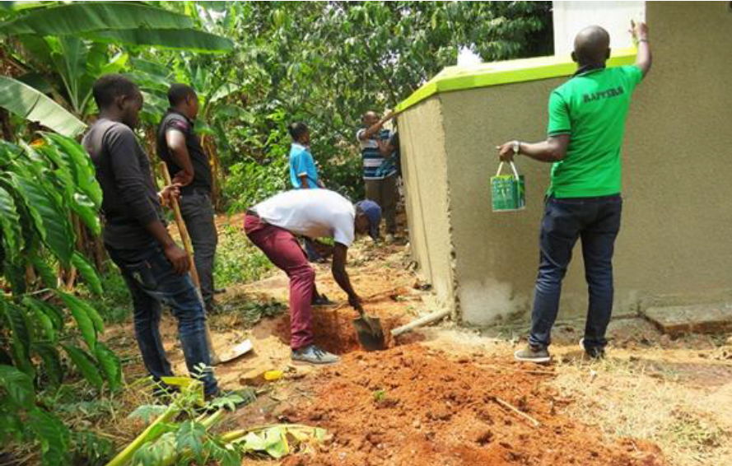
Positive Peace in practice – Kakuba Literacy Project, Uganda
Water & sanitation project, Luubu, Uganda
Where: Luubu, Mayuge District, Uganda
Objective: Improving sanitation in the Luubu community of the blind
When: 2018
Examples of initiatives:
Sound Business Environment: Employing local youths in the building of latrines and sourcing construction materials from local providers
Low Levels of Corruption: Involving community in the allocation and monitoring of funding and construction materials
Equitable Distribution of Resources: Multiple and better latrines offered a fairer distribution of sanitation facilities in the area
Notes:
Large scale workshops.
Such as those that are currently underway in Colombia. Funded by Rotary Global grant
An example is the workshop in Mexico in 2017 – with 304 participants.

Slide 61
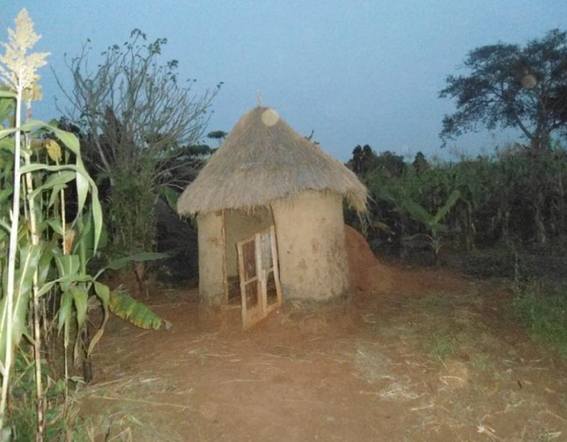
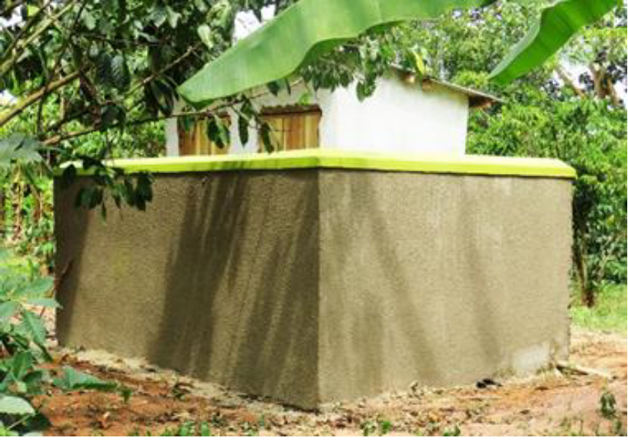
Positive Peace in practice – Kakuba Literacy Project, Uganda
Water & sanitation project, Luubu, Uganda
Where: Luubu, Mayuge District, Uganda
Objective: Improving sanitation in the Luubu community of the blind
When: 2018
BEFORE
AFTER
Notes:
Large scale workshops.
Such as those that are currently underway in Colombia. Funded by Rotary Global grant
An example is the workshop in Mexico in 2017 – with 304 participants.

Slide 62
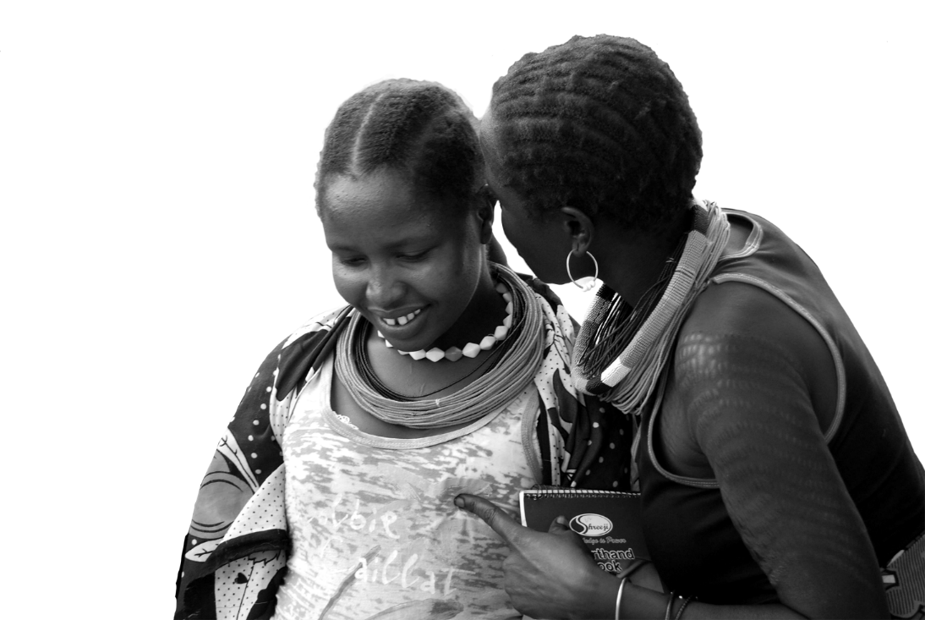
Project example of Positive Peace
Literacy project post Rotary workshop in Uganda
Jude Kakuba – Rotaract Club of Kampala Ssese Islands
Where: Kakuba Primary School, Busedde, Uganda
Objective: Improving student conditions, enrolment rates and academic performance
When: 2016 – 2018
Outcome:
  Before implementation of the project, 70% achieved low grades
  After implementation of the project, only 38% achieved low grades
  Number of students enrolled jumped by 146%.

Slide 63
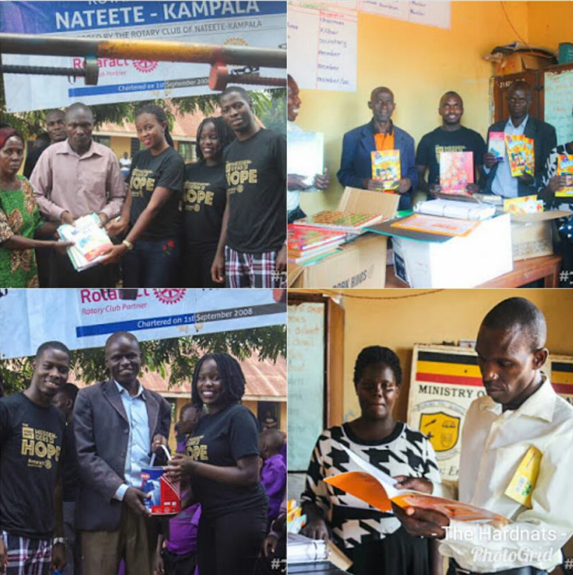
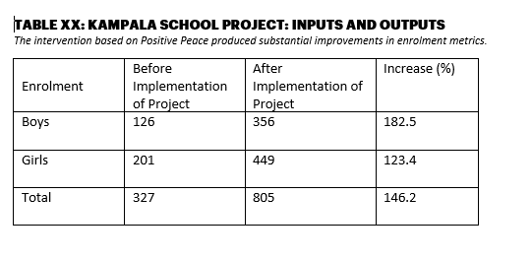
Positive Peace in practice – Kakuba Literacy Project, Uganda
Kakuba Literacy Project, Uganda
Pupil enrolment
Pupil performance
Lower grades
Grades
1 & 2
Lower grades
Grades
1 & 2
70%
62%
30%
38%
Before project
After project
Notes:
Large scale workshops.
Such as those that are currently underway in Colombia. Funded by Rotary Global grant
An example is the workshop in Mexico in 2017 – with 304 participants.

Slide 64
Ugandan school example
Well-functioning government – including local community leaders on the planning and implementation committee
Sound business environment -Has been addressed through construction of classroom blocks
Equitable distribution - provision of scholastic material for all
Acceptance of the rights of others – provision of sanitary pads for girls
Good relations with neighbours – planting fruit trees and porridge lunch
Free flow of information – partnered with local radio station
High level of human capital – provided medical checks and class room construction
Low levels of corruption – branding donated items and setting up committee to monitor
Notes:
Large scale workshops.
Such as those that are currently underway in Colombia. Funded by Rotary Global grant
An example is the workshop in Mexico in 2017 – with 304 participants.

Slide 65
Ugandan school example
Well-functioning government – including local community leaders on the planning and implementation committee
Sound business environment - Has been addressed through construction of classroom blocks
Equitable distribution - provision of scholastic material for all
Acceptance of the rights of others – provision of sanitary pads for girls
Good relations with neighbours – planting fruit trees and porridge lunch
Free flow of information – partnered with local radio station
High level of human capital – provided medical checks and class room construction
Low levels of corruption – branding donated items and setting up committee to monitor
Notes:
Large scale workshops.
Such as those that are currently underway in Colombia. Funded by Rotary Global grant
An example is the workshop in Mexico in 2017 – with 304 participants.

Slide 66
Ugandan school example
Well-functioning government – including local community leaders on the planning and implementation committee.
Sound business environment -Has been addressed through construction of classroom blocks.
Equitable distribution - provision of scholastic material for all
Acceptance of the rights of others – provision of sanitary pads for girls
Good relations with neighbours – planting fruit trees and porridge lunch
Free flow of information – partnered with local radio station
High level of human capital – provided medical checks and class room construction
Low levels of corruption – branding donated items and setting up committee to monitor
Notes:
Large scale workshops.
Such as those that are currently underway in Colombia. Funded by Rotary Global grant
An example is the workshop in Mexico in 2017 – with 304 participants.

Slide 67
Ugandan school example
Well-functioning government – including local community leaders on the planning and implementation committee
Sound business environment -Has been addressed through construction of classroom blocks
Equitable distribution - provision of scholastic material for all
Acceptance of the rights of others – provision of sanitary pads for girls
Good relations with neighbours – planting fruit trees and porridge lunch
Free flow of information – partnered with local radio station
High level of human capital – provided medical checks and class room construction
Low levels of corruption – branding donated items and setting up committee to monitor
Notes:
Large scale workshops.
Such as those that are currently underway in Colombia. Funded by Rotary Global grant
An example is the workshop in Mexico in 2017 – with 304 participants.

Slide 68
Ugandan school example
Well-functioning government – including local community leaders on the planning and implementation committee
Sound business environment -Has been addressed through construction of classroom blocks
Equitable distribution - provision of scholastic material for all
Acceptance of the rights of others – provision of sanitary pads for girls
Good relations with neighbours – planting fruit trees and porridge lunch
Free flow of information – partnered with local radio station
High level of human capital – provided medical checks and class room construction
Low levels of corruption – branding donated items and setting up committee to monitor
Notes:
Large scale workshops.
Such as those that are currently underway in Colombia. Funded by Rotary Global grant
An example is the workshop in Mexico in 2017 – with 304 participants.

Slide 69
Ugandan school example
Well-functioning government – including local community leaders on the planning and implementation committee
Sound business environment -Has been addressed through construction of classroom blocks
Equitable distribution - provision of scholastic material for all
Acceptance of the rights of others – provision of sanitary pads for girls
Good relations with neighbours – planting fruit trees and porridge lunch
Free flow of information – partnered with local radio station
High level of human capital – provided medical checks and class room construction
Low levels of corruption – branding donated items and setting up committee to monitor
Notes:
Large scale workshops.
Such as those that are currently underway in Colombia. Funded by Rotary Global grant
An example is the workshop in Mexico in 2017 – with 304 participants.

Slide 70
Ugandan school example
Well-functioning government – including local community leaders on the planning and implementation committee
Sound business environment -Has been addressed through construction of classroom blocks
Equitable distribution - provision of scholastic material for all
Acceptance of the rights of others – provision of sanitary pads for girls
Good relations with neighbours – planting fruit trees and porridge lunch
Free flow of information – partnered with local radio station
High level of human capital – provided medical checks and class room construction
Low levels of corruption – branding donated items and setting up committee to monitor
Notes:
Large scale workshops.
Such as those that are currently underway in Colombia. Funded by Rotary Global grant
An example is the workshop in Mexico in 2017 – with 304 participants.

Slide 71
Ugandan school example
Well-functioning government – including local community leaders on the planning and implementation committee
Sound business environment -Has been addressed through construction of classroom blocks
Equitable distribution - provision of scholastic material for all
Acceptance of the rights of others – provision of sanitary pads for girls
Good relations with neighbours – planting fruit trees and porridge lunch
Free flow of information – partnered with local radio station
High level of human capital – provided medical checks and class room construction
Low levels of corruption – branding donated items and setting up committee to monitor
Notes:
Large scale workshops.
Such as those that are currently underway in Colombia. Funded by Rotary Global grant
An example is the workshop in Mexico in 2017 – with 304 participants.

Slide 72
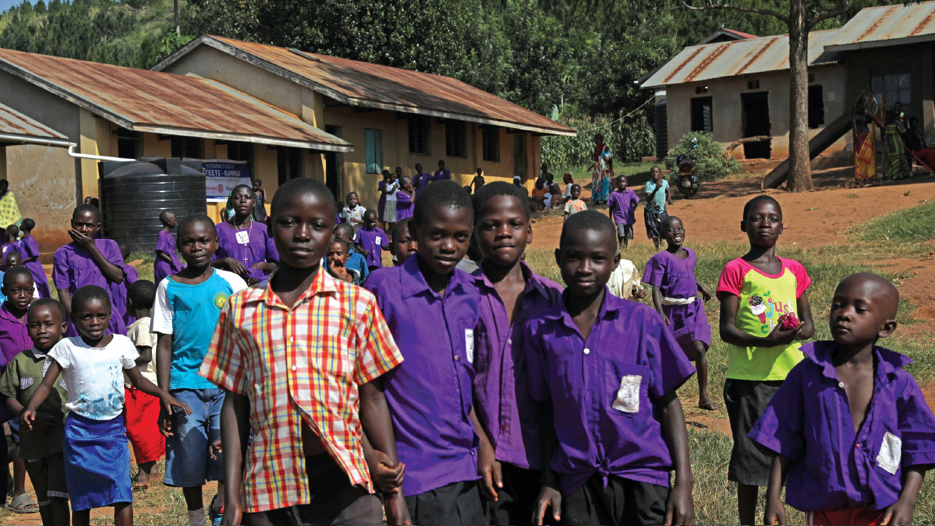
Notes:
Jude Kakuba – Rotaract Club of Kampala Ssese Islands.
Literacy project post Rotary workshop in Uganda
Acceptance of the rights of others – women's hygiene
Before implementation of the project, 48.5% of the candidates achieved the first 3 Divisions while 51.5% (the majority) achieved the other (undesirable) divisions. After implementation of the project, 67.8% of the candidates achieved the first 3 (desirable) divisions while 32.2% (the minority) achieved the other 3 (undesirable) divisions. The teachers confirmed that this improvement is a result of the scholastic materials such as study charts, teacher guides, mathematical sets and exercise books that were donated to the pupils.
There has been a percentage increment of 38.5% in pupil enrolment since implementation of the first phase of the project due to the improved learning environment.

Slide 73
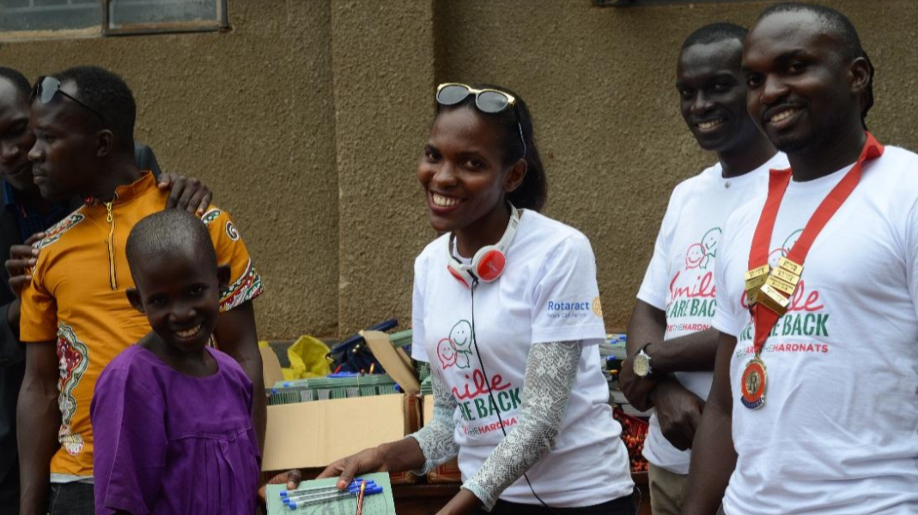
Notes:
Jude Kakuba – Rotaract Club of Kampala Ssese Islands.
Literacy project post Rotary workshop in Uganda
Acceptance of the rights of others – women's hygiene
Before implementation of the project, 48.5% of the candidates achieved the first 3 Divisions while 51.5% (the majority) achieved the other (undesirable) divisions. After implementation of the project, 67.8% of the candidates achieved the first 3 (desirable) divisions while 32.2% (the minority) achieved the other 3 (undesirable) divisions. The teachers confirmed that this improvement is a result of the scholastic materials such as study charts, teacher guides, mathematical sets and exercise books that were donated to the pupils.
There has been a percentage increment of 38.5% in pupil enrolment since implementation of the first phase of the project due to the improved learning environment.

Slide 74
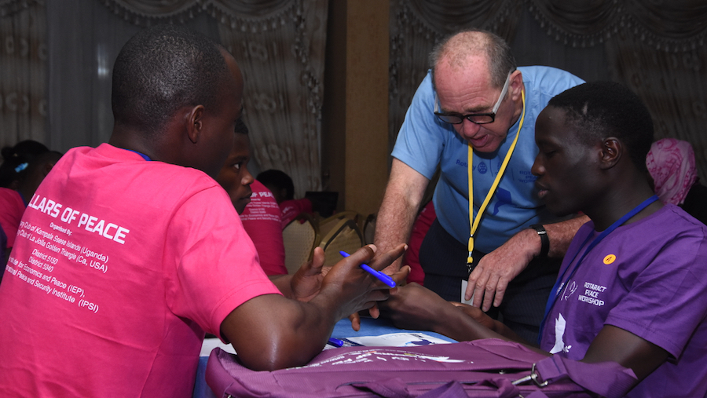
Notes:
Jude Kakuba – Rotaract Club of Kampala Ssese Islands.
Literacy project post Rotary workshop in Uganda
Acceptance of the rights of others – women's hygiene
Before implementation of the project, 48.5% of the candidates achieved the first 3 Divisions while 51.5% (the majority) achieved the other (undesirable) divisions. After implementation of the project, 67.8% of the candidates achieved the first 3 (desirable) divisions while 32.2% (the minority) achieved the other 3 (undesirable) divisions. The teachers confirmed that this improvement is a result of the scholastic materials such as study charts, teacher guides, mathematical sets and exercise books that were donated to the pupils.
There has been a percentage increment of 38.5% in pupil enrolment since implementation of the first phase of the project due to the improved learning environment.

Slide 75
Positive Peace Index - Summary
Measure and analyse peace
Measure and analyse peace
163
ACTION
Better predictions
$
Lost opportunity cost
Factors that create peace
Better cost/benefit analysis
Better program outcomes

Slide 76


Peace in the Age of Chaos
Peace in the Age of Chaos is the debut
book by the Founder & Executive Chairman
of IEP, Steve Killelea A.M.
The book pushes the reader to rethink peace,
as something that is pivotal to the development of successful societies
Includes many personal experiences and the journey behind the founding of IEP and the Global Peace Index
Endorsed by prominent politicians,
peacebuilders and professors

Slide 77

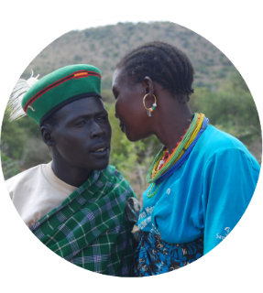

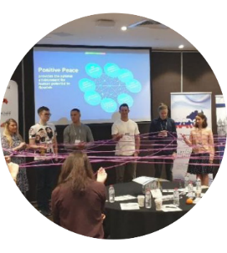

Get involved with IEP
@GlobPeaceIndex
GlobalPeaceIndex
Ambassador Program
Positive Peace Workshops
@GlobalPeaceIndex
Online
Strategic Partnerships
IEP Peace Academy
visionofhumanity.org

