Slide 1
Ecological Threat Report
2021
Overview & key findings

Slide 2

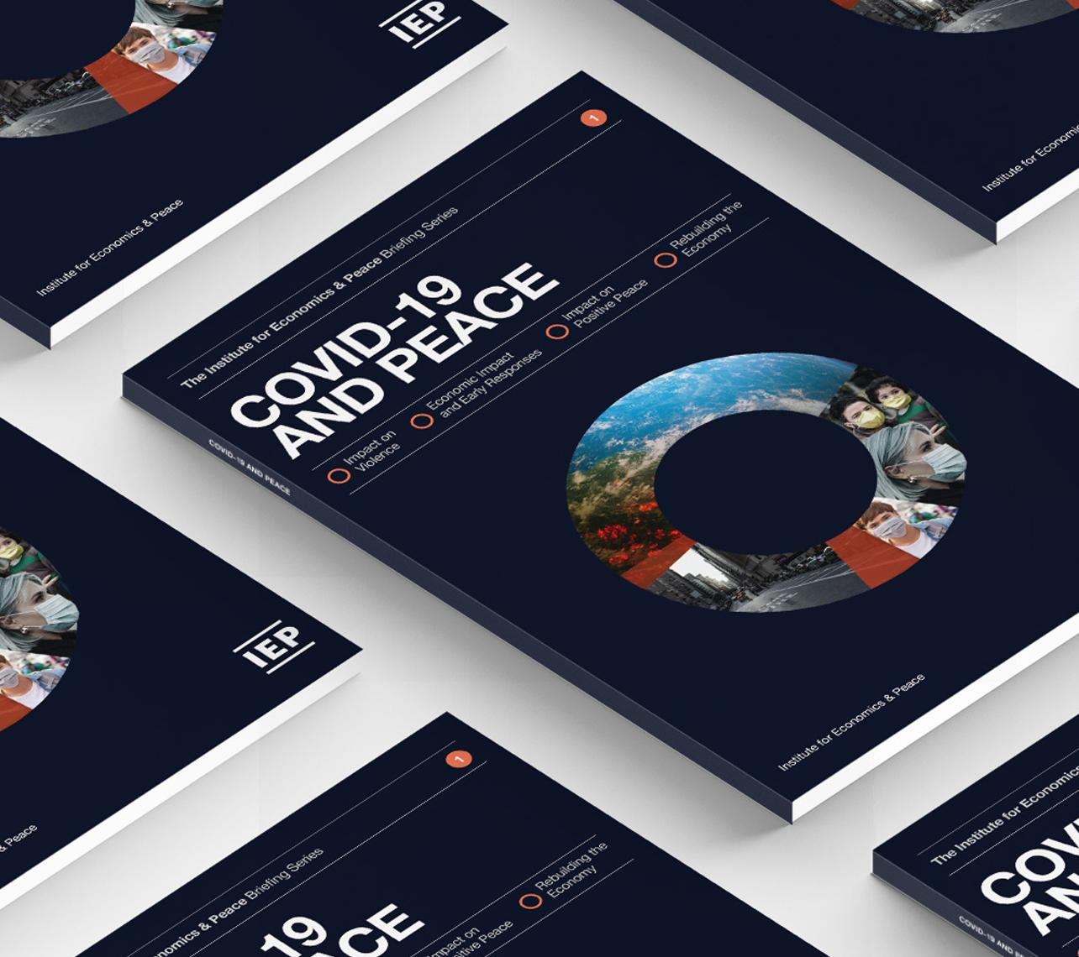
The Institute for Economics and Peace is an independent, not-for-profit think tank dedicated to building a greater understanding of the key drivers of peace, as well as identifying the economic benefits that increased peacefulness can deliver.

Slide 3
Our international offices
Brussels
The Hague
New York
Sydney Head Office
Mexico City
Harare

Slide 4

Institute for Economics and Peace
Research used extensively by organisations, including the OECD, Commonwealth Secretariat, World Bank and the United Nations
27BN
1.4BN
152
MEDIA REACH
SOCIAL REACH
COUNTRY AUDIENCE
Work is included in 1,000s of university courses
Over 500,000 downloads of IEP reports in the last 12 months
10
6000
1.4M
PUBLISHED REPORTS
BOOK REFERENCES
WEB VISITORS

Slide 5
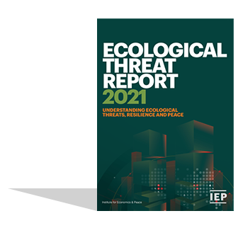
The Ecological Threat Report
Ranks
^{2nd}
Now in its
178
99.9%
year
of world’s population covered
Countries and Independent States
Using
Developed by the Institute for Economics and Peace
Combines ecological threats and societal resilience to forecast major falls in peace
7
Indicators on a 1-5 scale

Slide 6
The Ecological Threat Report Indicators
3
2
2
measures of resource scarcity
measures of natural disasters and temperature rise
measures of ecological threat
Including: rapid population growth, water risk, food risk
The ETR score
The Catastrophic Score
Including: weighted frequency natural disasters and temperature anomalies,

Slide 7
01.
Key
Findings

Slide 8

Major Findings
    Ecological damage and conflict work as a vicious cycle
    Ecological damage is a major driver of conflict and its getting worse.
    Conflict and resource degradation and strongly connected – 11 of the 15 countries with the worst ETI scores are in conflict.
    Key drivers of future conflict are deteriorating – malnutrition, food insecurity and population growth in the most stressed counties are all rising.
    28 of 30 countries with worst ETR scores are in the bottom half of the GPI.
    Sub-Saharan Africa has the most countries at risk.
    30 countries with lowest resilience and worst ETR scores are home to 1.26 Billion people – hotspot countries.

Slide 9
Global food insecurity, 2014-2020
The number of food-insecure people rose by over 300 million people in 2020 from the previous year, the largest annual increase on record.
Indicator | 2014 | 2015 | 2016 | 2017 | 2018 | 2019 | 2020
Total population in moderate or severe food insecurity (billions of people) | 1.65 | 1.68 | 1.76 | 1.88 | 1.98 | 2.05 | 2.37
Prevalence of moderate or severe food insecurity in the adult population | 22.6% | 22.8% | 23.6% | 24.9% | 25.9% | 26.6% | 30.4%
Source: UN, IEP
The vast majority of this 2020 increase occurred in three regions: South Asia, sub-Saharan Africa and South America.

Slide 10
Major Findings
    Reversing the systemic cycles requires new thinking
    The problems are systemic – Therefore the solutions need to be implemented systemically.
    Multi-lateral organisations are currently in siloes – better if they were integrated around areas of interest.
    Currently refugees, food, security, family planning, business development, health are separated – recommend integration around an areas of interest.
    Projects implemented at the community level, provide better buy-in, more efficient and more targeted - scaling up.
    Business development at the meso level is missing - $5,000 - $50,000 investments.
    Most surprising result
    Males 5-19 have three times malnutrition rates in Africa compared to females.

Slide 11
The ETR and societal resilience
    The 30 countries with the lowest resilience and highest ETR score are home to 1.26 billion people
    18 of the 20 countries with the highest ETR score are among the world's least peaceful countries.
    Positive Peace is used to measure resilience.
    Statistically associated with better food security, water security, population growth and the ability to manage natural disasters.
    No country with high Positive Peace has very poor ETR scores.
    As Positive Peace improves the management of water, food and population improve creating resilience.

Slide 12
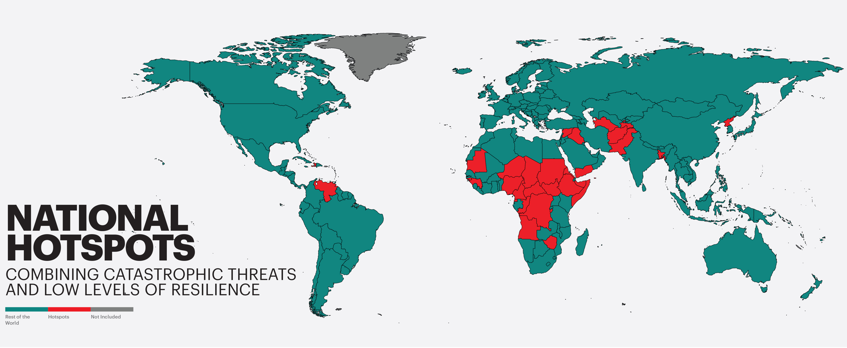

Slide 13
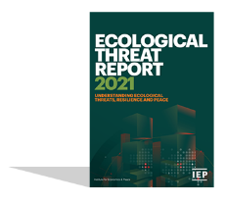
Resilience at Risk
Reoccurring, compounding, or high impact threats have the potential to disrupt or break down a country's level of resilience.
Ecological Threats
Ecological shock deterioates resilience
Lower resilience to adapt or prevent future threats

Slide 14
2021 highlights – Hotspots
    Three clusters of ecological hotspots are susceptible to collapse:
    The Sahel-Horn belt of Africa, from Mauritania to Somalia;
    The Southern African belt, from Angola to Madagascar;
    The Middle East and Central Asian belt, from Syria to Pakistan.

Slide 15
Hotspot countries, 2021
18 of the 30 hotspot countries are in sub-Saharan Africa
Country | Catastrophic score | Greatest Threat | PPI Rank | GPI Rank |  | Country | Catastrophic score | Greatest Threat | PPI Rank | GPI Rank
Afghanistan | 5 | Food Risk | 151 | 163 |  | Mauritania | 5 | Water Risk | 141 | 118
Angola | 5 | Food Risk | 145 | 80 |  | Niger | 5 | Population Risk | 137 | 137
Bangladesh | 5 | Natural Disaster risk | 139 | 91 |  | Nigeria | 5 | Water Risk | 146 | 146
Burundi | 5 | Food Risk | 147 | 129 |  | North Korea | 5 | Natural Disaster risk | 138 | 151
Cameroon | 5 | Food Risk | 142 | 145 |  | Pakistan | 5 | Natural Disaster risk | 148 | 150
Central African Republic | 5 | Food Risk | 159 | 155 |  | Republic of Congo | 3 | Water Risk | 150 | 119
Chad | 5 | Food Risk | 158 | 132 |  | Somalia | 5 | Natural Disaster risk | 163 | 158
Democratic Republic of the Congo | 5 | Food Risk | 156 | 157 |  | South Sudan | 5 | Food Risk | 161 | 160
Equatorial Guinea | 5 | Water Risk | 155 | 62 |  | Sudan | 5 | Food Risk | 154 | 153
Eritrea | 5 | Food Risk | 160 | 136 |  | Syria | 5 | Water Risk | 157 | 161
Ethiopia | 5 | Food Risk | 134 | 139 |  | Tajikistan | 5 | Water Risk | 140 | 97
Guinea | 5 | Food Risk | 143 | 92 |  | Turkmenistan | 5 | Temperature Rise Risk | 135 | 109
Guinea-Bissau | 5 | Water Risk | 152 | 99 |  | Venezuela | 3 | Water Risk | 136 | 152
Haiti | 5 | Natural Disaster risk | 149 | 108 |  | Yemen | 5 | Food Risk | 162 | 162
Iraq | 5 | Temperature Rise Risk | 144 | 159 |  | Zimbabwe | 5 | Natural Disaster risk | 153 | 133

Slide 16
Ecological Threat Index

Slide 17
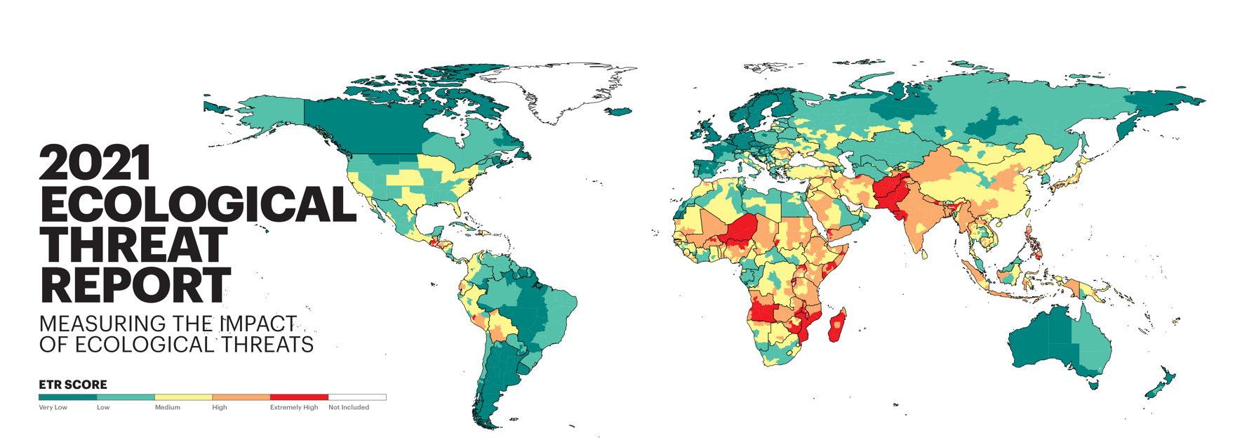

Slide 18
2021 highlights – continued
    The severity of ecological threats.
    13 countries score extremely high
    34 countries score high
    50 countries score medium
    46 countries score low
    35 countries score very low
Source: IEP

Slide 19
10 countries with the lowest ETR score
1
ICELAND
6
NETHERLANDS
2
SINGAPORE
7
FINLAND
3
IRELAND
8
URAGUAY
4
UNITED KINGDOM
9
SWEDEN
5
NORWAY
10
HONG KONG

Slide 20
10 countries with the highest ETR score
178
AFGHANISTAN
173
BURUNDI
NIGER
GUATEMALA
177
172
176
MADAGASCAR
171
MOZAMBIQUE
175
MALAWI
170
PAKISTAN
174
RWANDA
169
ANGOLA

Slide 21
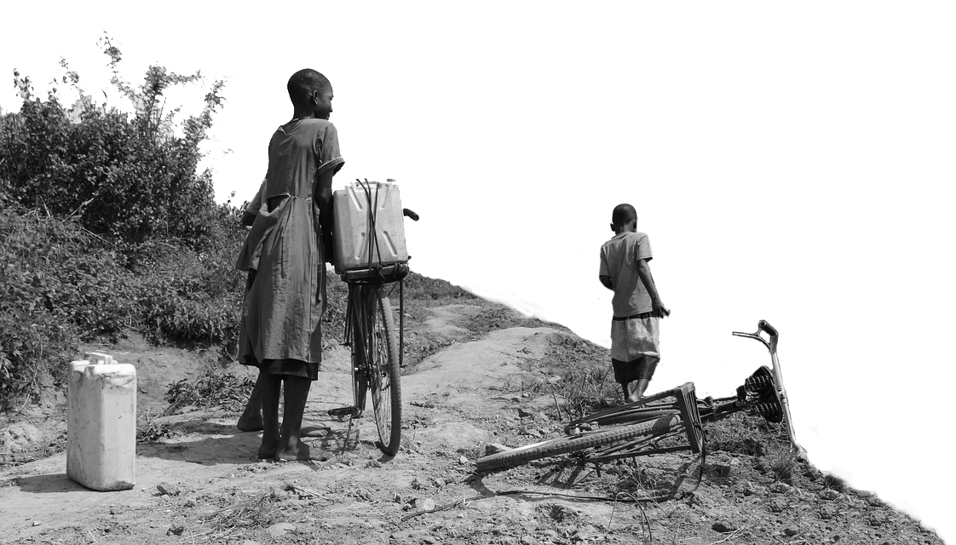

2021 key highlights
    In 2021, 47 countries home to
3.3 bn
    By 2050
    people face high to extreme ecological threats.
    4.7 billion people will reside in these countries by 2050 accounting for 48.7 per cent of the world's total population. An increase of
    42%
    From today

Slide 22
ETI SCORE – Average by region

Slide 23
2021 regional overview
+
+
_
_
_
North America
North America recorded the best ETR score.
South Asia
South Asia recorded the worst ETR score. It is the second least peaceful region as measured by the GPI
Europe
Europe recorded the second best ETR score.
MENA
Sub-Saharan Africa
MENA recorded the third worst ETR score. It is the least peaceful region as measured by the GPI
SSA recorded the second worst ETR score. It is the third least peaceful region as measured by the GPI

Slide 24
Regional composition by ecological threat score, percentage of region's countries, 2021

Slide 25
ETR Score by Peacefulness – ETR score versus GPI score, 2021

Slide 26
04.
Resource Scarcity

Slide 27
Projection of global population, by peace level, 1960–2050
No high or very high peace countries suffer from an extremely high ETR score.

Slide 28
The eleven countries predicted to double their population by 2050
All eleven countries predicted to double their population by 2050 are located in sub-Saharan Africa.
Country | 2021 Population (millions) | 2050 Population (millions) | Percentage Increase
Niger | 25.1 | 65.6 | 161.0%
Angola | 33.9 | 77.4 | 128.2%
Somalia | 16.4 | 34.9 | 113.5%
Democratic Republic of the Congo | 92.4 | 194.5 | 110.5%
Tanzania | 61.5 | 129.4 | 110.4%
Mali | 20.9 | 43.6 | 109.0%
Zambia | 18.9 | 39.1 | 106.8%
Burundi | 12.3 | 25.3 | 106.6%
Mozambique | 32.2 | 65.3 | 103.1%
Burkina Faso | 21.5 | 43.4 | 102.0%
Chad | 16.9 | 34.0 | 101.2%
Source: UN, IEP

Slide 29
Food Security – Key Findings
    The number and percentage of food-insecure people globally has risen every year since 2014.
    By 2050, the number of food insecure is expected to increase by 43 per cent to 3.4 billion people, up from 2.4 billion.
    By 2050, the global demand for food will increase by 50 per cent from current levels.
    Two-thirds of people in sub-Saharan Africa currently face food insecurity.
    By 2050, 4.8 billion people will reside in the 40 least peaceful countries, a increase of 1.3 billion or 27%.
    The ten countries with the highest Resource Scarcity score are all projected to increase their population by over 55 per cent.

Slide 30
Number of undernourished globally, 2005-2020
Under-nourishment has been steadily rising since 2017, increasing by 19%

Slide 31
Food Security – Key Findings continued
    2020 recorded the largest increase undernourishment in decades an additional 118 million from undernourishment.
    Under-nourishment is getting worse, reversing decades long trend of improvement.
    The number of undernourished people is projected to rise by 343 million people by 2050, a 45 per cent increase.
    The five most undernourished countries are Somalia, the Central African Republic, Haiti, Yemen and Madagascar.
    In the first half of 2021, the Food Price Index recorded a 26.8 per cent rise compared to 2019.

Slide 32
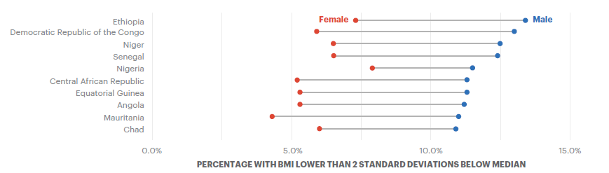

Gender differentials in thinness, sub-Saharan Africa, 2016
In some countries in sub-Saharan Africa, thinness is three times as prevalent in males as in females in the 5-19 age bracket.

Slide 33
05.
Forced Displacement

Slide 34
2021 ETR findings
    82.4 million people were forcibly displaced by conflict and violence at the end of 2020 — the highest number on record.
    The number of forcibly displaced people has increased each year for the last nine years.
    The number of people forcibly displaced has doubled in the last 20 years
    1 in 94 people globally are forcibly displaced
    Low and very low peace countries account for 91 per cent of the people displaced from conflict and violence worldwide.
    One in three people displaced move beyond their home country
    170 countries closed their borders either partially or completely during 2020
    Refugees returning home were a third of pre-COVID levels – 250,000 returnees

Slide 35
Total number of refugees, 1995-2020
The number of forcibly displaced people has increased each year for the last nine years.
Source: UNHCR; IDMC

Slide 36
People forcibly displaced from conflict and violence by category at the end of 2020
The total number of people forcibly displaced internally is more than the other categories of forcible displacement combined.

Slide 37
Refugees from conflict, by peaceful level, 2020
Low and very low peace countries account for 91 per cent of the people forcibly displaced from conflict and violence.
Source: UNCHR, IDMC, IEP

Slide 38
New annual displacements due to conflict and natural disasters, 2008-2020
New disaster displacements reached 30.7 million in 2020, while armed conflict accounted for 9.8 million displacements.

Slide 39
The countries with the largest number of displaced people from conflict and natural disasters, end of 2020
In 2020, 78.4 per cent of the total displacements worldwide are from these 15 countries.
Country | Displaced Internally | Displaced Abroad | Total Displaced | Percentage Displaced Internally
Syria | 6,568,000 | 6,796,720 | 13,364,720 | 49%
Afghanistan | 4,664,000 | 2,833,565 | 7,497,565 | 62%
Dem. Rep. of the Congo | 5,332,000 | 985,799 | 6,317,799 | 84%
Palestine | 131,010 | 5,816,140 | 5,947,150 | 2%
Colombia | 4,943,000 | 260,770 | 5,203,770 | 95%
Venezuela | 0 | 4878573 | 4,878,573 | 0%
Yemen | 3,858,000 | 54,906 | 3,912,906 | 99%
Somalia | 2,968,000 | 868,365 | 3,836,365 | 77%
South Sudan | 1,542,000 | 2,193,678 | 3,735,678 | 41%
Sudan | 2,730,000 | 857,426 | 3,587,426 | 76%
Nigeria | 2,873,000 | 426,013 | 3,299,013 | 87%
Ethiopia | 2,693,000 | 276,402 | 2,969,402 | 91%
Iraq | 1,224,000 | 574,113 | 1,798,113 | 68%
Myanmar | 509,600 | 1,143,506 | 1,653,106 | 31%
India | 1,402,000 | 82,369 | 1,484,369 | 94%
TOTALS | 41,437,610 | 28,048,345 | 69,485,955 | 60%
Source: UNHCR, IDMC, IEP

Slide 40
Regional distribution of displacements, internal and abroad, origin and destination, by region, 2020
At the end of 2020, the largest number of displacements originated from MENA and sub-Saharan Africa.

Slide 41
06.
Perceptions of Climate change

Slide 42
2021 ETR findings
    Public perception of climate risk in 142 countries
    Question - "Do you think that climate change is a very serious threat to the people in this country in the next 20 years?”
    Half the world answered yes.
    12 of the 20 countries with the highest rating spoke Portuguese or Spanish, Chile best at 89%.
    28.9 per cent of respondents in MENA perceive climate change as a serious threat — the lowest of all regions.
    23.3% in China was 6th lowest, India 35% - hard to meet targets without citizens on-board.

Slide 43
Percentage of population that believes climate change will be a serious or very serious threat over the next 20 years, regional average, 2019
On average, 73 per cent of the citizens of countries in South America perceive climate change to be a very serious threat over the next 20 years compared to just 28.9 per cent in the MENA region.

Slide 44





Get involved with IEP
@GlobPeaceIndex
GlobalPeaceIndex
Ambassador Program
Positive Peace Workshops
@GlobalPeaceIndex
Online
Strategic Partnerships
IEP Peace Academy
visionofhumanity.org

Slide 45

Peace in the Age of Chaos
Peace in the Age of Chaos is the debut
book by the Founder & Executive Chairman
of IEP, Steve Killelea A.M.
The book pushes the reader to rethink peace,
as something that is pivotal to the development of successful societies
Includes many personal experiences and the journey behind the founding of IEP and the Global Peace Index
Endorsed by prominent politicians,
peacebuilders and professors
Buy and more info: peaceintheageofchaos.org

