Slide 1
Oxford May 2019
SYSTEMS THINKING & POSITIVE PEACE
Analysing the factors that sustain peace

Slide 2
“
The Institute for Economics and Peace is an independent, not-for-profit think tank dedicated to building a greater understanding of the key drivers of peace, as well as identifying the economic benefits that increased peacefulness can deliver.

Slide 3
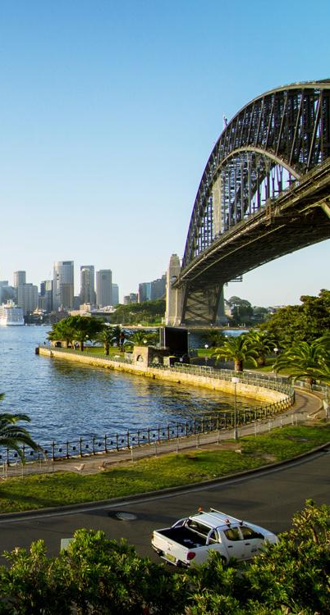
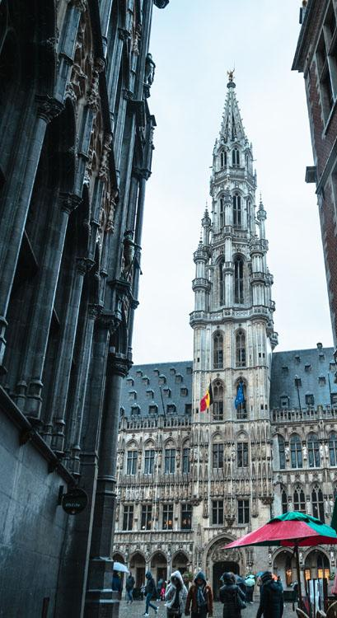
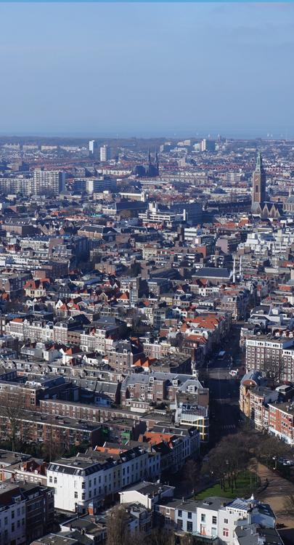
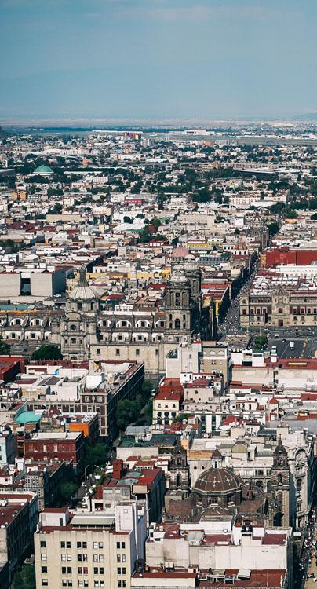
IEP International Offices
SYDNEY
NEW YORK
BRUSSELS
THE HAGUE
MEXICO CITY
HARARE
Australia
USA
Belgium
The Netherlands
Mexico
Zimbabwe

Slide 4
About the institute
Research used extensively by organisations including the OECD, Commonwealth Secretariat, World Bank and the United Nations.
7BN
825M
140
GLOBAL MEDIA REACH
SOCIAL REACH
COUNTRY REACH
Work is included in 1,000s of university courses and trained over 1,100 IEP ambassadors.
Over 100,000 downloads of IEP reports last 12 months.
10
3000
1M
PUBLISHED REPORTS
BOOK REFERENCES
UNIQUE VISITORS

Slide 5
01.
Understanding Systems Thinking

Slide 6
What is a system?
No generally agreed definition
An approach:
Has more internal controls than external controls
Can be defined by its boundaries
Operates with a high degree of complexity
A nation is a system, so is a judicial system
Is a soccer team or loose social network a system?

Slide 7
What is systems thinking?
Government and most organisations think in cause and effect
Modern science is based on cause and effect
The sum of the parts is more than the whole – therefore cannot be broken down into its parts to fully understand
Systems thinking is a radial transformation in understanding how societies operate

Slide 8
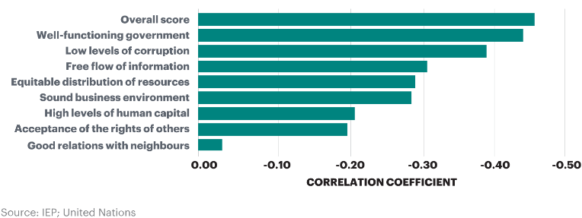
The sum is more than the parts
Changes in Positive Peace and Changes in GDP

Slide 9
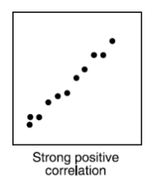
Systems thinking - causal
Scientific Reasoning: Repeatability
In repeatable scientific experiments
same input = same output
Input
Output
Experiment
Effect is contained in the cause

Slide 10
Effects are not clearly defined
Elements mutually interact making causality difficult to imply
Well Functioning Government
Low Levels of Corruption
Free Flow of Information

Slide 11
Systems lie within systems
The smallest subsystem can interact with the largest super system
Eco systems
International Community
Parliament
Police
Schools
Nations
Atmosphere

Slide 12
Properties of systems
Self-regulating and seeking homeostasis
Systems are path dependent
Encoded norms regulate the system to maintain homeostasis
Systems self-modify when there are persistent mismatches with inputs
Form virtuous or vicious cycles
Systems are be understood through mathematics

Slide 13
Systems are responsive
Understanding the system response requires understanding the systems and their relationship to the input
System
Encoded Norms
System Response
Input to System
System Interacts with input
Intent
Notes:
In systems thinking the input comes into the system, interacts with the systems intent and encoded norm, thereby determining an action which may then attempt to alter the input
This is known as a mutual feedback loop. The system is constantly modifying inputs to match its encoded norms

Slide 14
Systems are path dependent
Historical path
Best approach to change is to continuously nudge the system in the right direction
Virtuous cycle
System
Many small changes from many directions is the optimum way to change the system
Vicious cycle

Slide 15
Homeostasis & self-modification
Persistent mismatch
Process assessment
System modification
Feedback loop
New homeostasis
New
encoded norm
Encoded norms

Slide 16
Tipping points
An input can occur for a lengthy period with little effect
After certain point a small input can cause radical changes
Think of Mercury or Lead in the body
A bird drops a new seed in a forest
A new invention or idea such as the mobile phone
Once changed the system cannot revert back to what it was

Slide 17
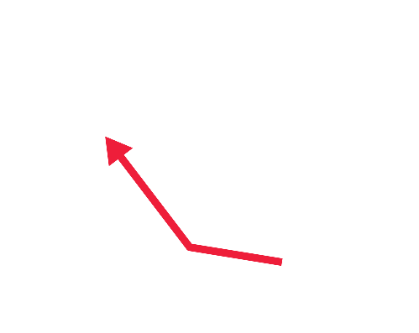
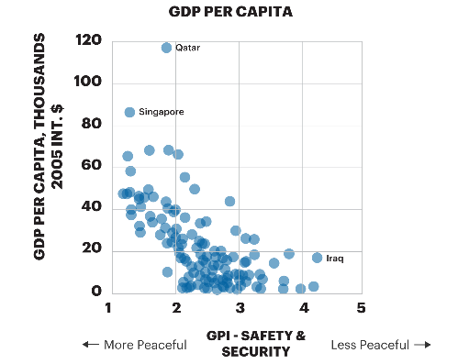
Tipping points
GDP Per Capita
Source: IEP; United Nations

Slide 18
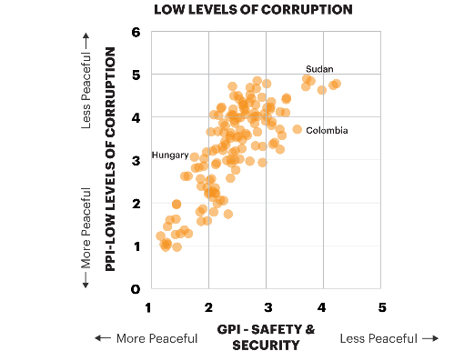
Tipping points
Corruption and Peace
Source: IEP; United Nations

Slide 19
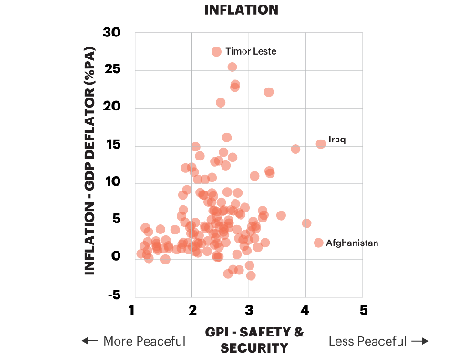
Tipping points
Inflation and Peace
Source: IEP; United Nations

Slide 20
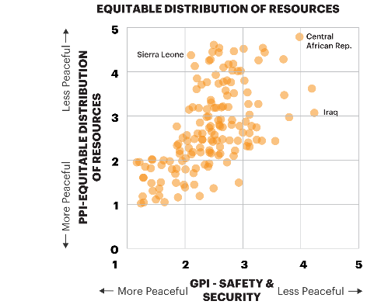
Tipping points
Inequality and Peace
Source: IEP; United Nations

Slide 21
Systems are cyclic and changing
Momentum more important than position
Virtuous cycle
Vicious cycle

Slide 22
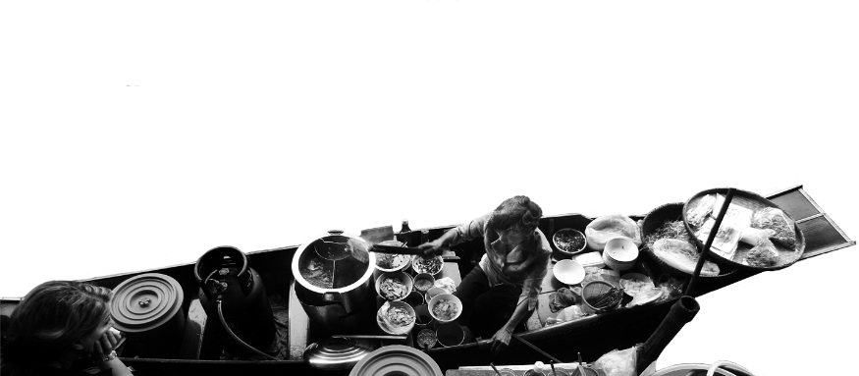
Adaptation and resilience
Adaptation – the ability to adapt to a changed environment
Resilience – ability to absorb shocks to the system and to successfully adapt to a changed environment
Positive Peace can be used to measure resilience and adaptability
Democracies are highest in Positive Peace and wealth because of their ability to adapt and recover from shocks

Slide 23
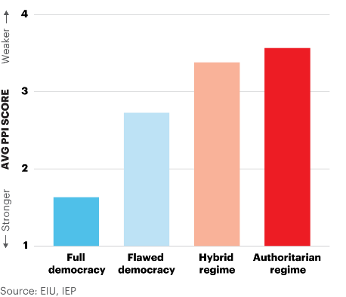
Positive Peace by government type
Full democracies have the strongest average levels of Positive Peace

Slide 24
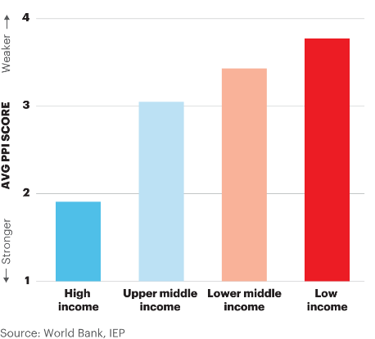
Positive Peace by income group
High income countries have the strongest average levels of Positive Peace

Slide 25
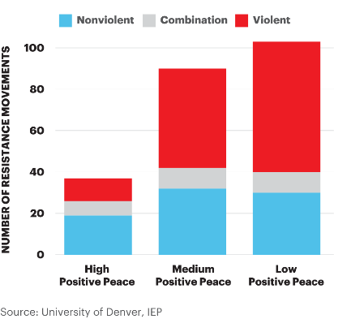
Prevalence and nature of resistance campaigns
Between 1945 and 2006, 91 per cent of violent resistance campaigns have occurred in countries with weaker Positive Peace

Slide 26
Future adaptability
Major changes facing humanity are global in nature
These challenges are systemic in nature
Most of humanity’s thinking is causal and Darwinian
Viewing societies systems more easily aligns with the challenges of our age
Therefore – systemic changes at all levels should become easier

Slide 27
02.
What is Positive Peace

Slide 28
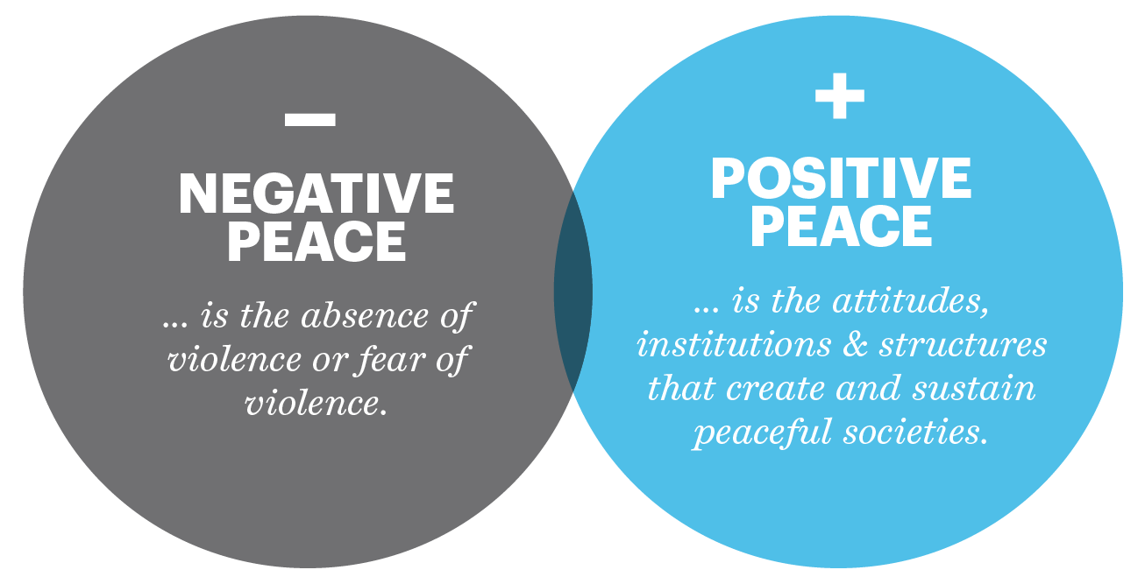
What is Positive Peace?
Notes:
Ask Darren if more intro slides are available/needed

Slide 29
The Global Peace Index
Ranks
Now in its
11th
163
According to their relative states of peace
year
countries
Using
Guided and overseen by a panel of International Experts
23
Developed by the Institute for Economics and Peace
Indicators weighed on a 1-5 scales

Slide 30
Global Peace Index indicators
6
measures of ongoing domestic and international conflict
10
measures of societal safety
and security
7
measures of militarisation
Including: intensity of organized internal conflicts, relations with neighbouring countries and number of deaths from conflict
Including: number of refugees and IDPs, impact of terrorism, homicide and incarceration rates
Including: military expenditure, number of armed service personnel, ease of access to small weapons

Slide 31
Defining and measuring peace
The perfect state would have no police, jails or crime.
Actual Peace
Measures:
Crime
Suppression
Military
Armed Conflict
Positive Peace
Derived through statistical analysis of datasets, indices and attitudes with the GPI
GPI
Positive Peace Index
Notes:
There are two types of peace. Negative and positive.
Starting point for the GPI is to image a state with no need for jails, crime and therefore no peace.
The definition in the Global Peace Index is ‘absence of violence’ and ‘absence of fear of violence’
But negative peace doesn’t tell you anything about what is necessary for a peaceful society
Positive peace index is derived through statistical analysis of over 9,000 datasets, indexes and attitudinal surveys
This is first empiric attempt to derive positive peace, this enables one to imagine how a world can become more peaceful.

Slide 32
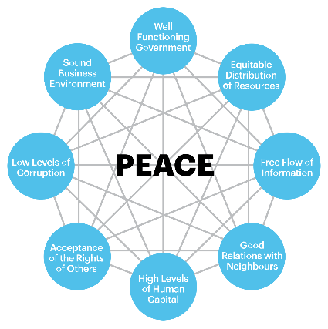
Positive Peace
Positive Peace creates the optimum environment for human potential to flourish.
High levels of Positive Peace are associated with:
Higher per capita income
Resilience
Better environmental outcomes
Higher measure of wellbeing
Better performance on MDGs

Slide 33
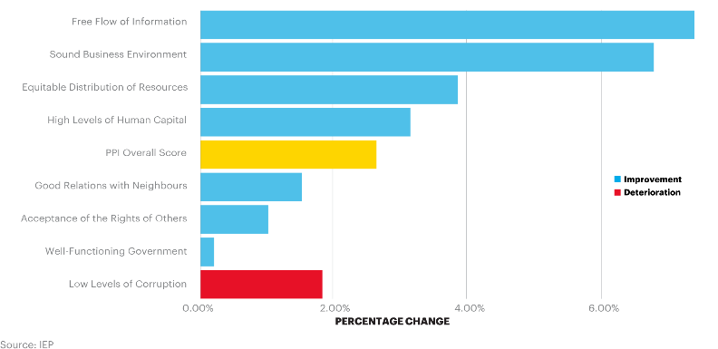
Changes in the pillars of peace, 2009-2018
Seven of the eight Pillars have improved since 2009. Low Levels of Corruption, however deteriorated 1.9 per cent over the period.

Slide 34
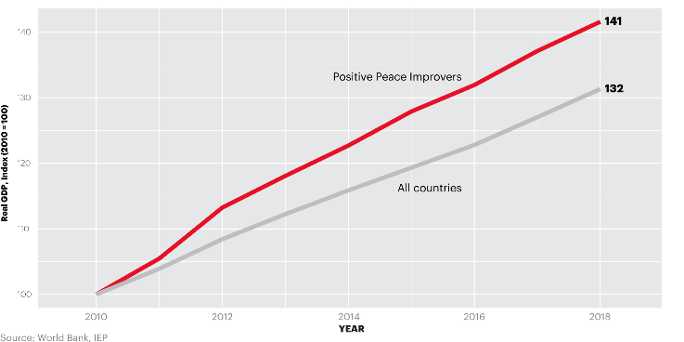
Countries that improve in Positive Peace outperform the global average
Growth in real GDP of a portfolio of countries that improve in Positive Peace exceeds an equally weighted global average by one percentage point per year.

Slide 35
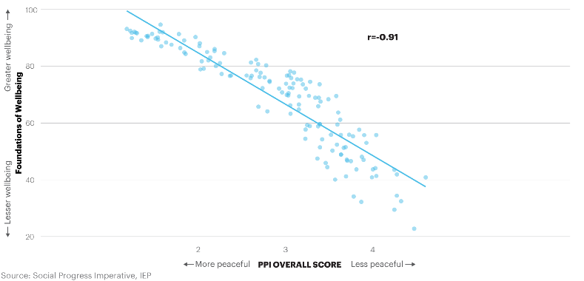
Social and wellbeing and Positive Peace, 2018
There is a close correlation between the SPI Foundations of Wellbeing scores and PPI scores.

Slide 36
03.
Positive Peace
Platform for Change

Slide 37
The Positive Peace Index
Ranks
Using
Now in its
8th
163
24
year
countries
Indicators weighed on a 1-5 scales
Developed by the Institute for Economics and Peace
Uses over 5,000 datasets, indexes and surveys
Empirically derived

Slide 38
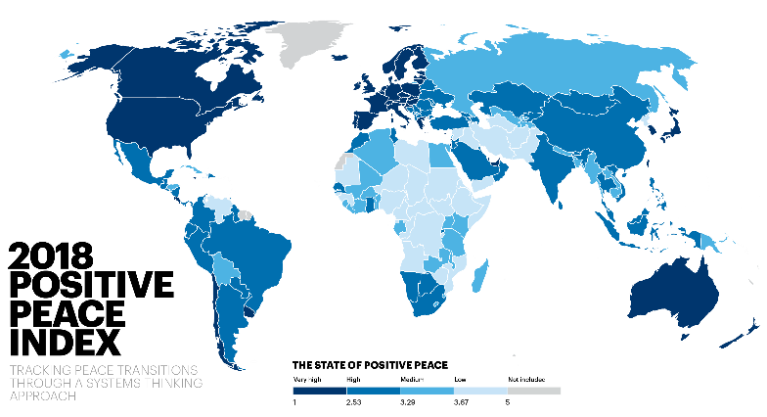
Notes:
Needs map

Slide 39
Key findings – 12 years
Positive Peace improved
per cent globally over the last 12 years
111
2.4
countries became more peaceful, 52 deteriorated
Improvements were driven by changes in:
Sound Business Environment
Free Flow of Information
Deteriorations in Low Levels of Corruption partly offset improvements

Slide 40
Key findings 12 years - continued
Syria and Yemen had the largest deteriorations
North America had the largest regional deterioration
Cote d’Ivoire and Georgia had the largest improvements
Russia and Eurasia had the largest regional improvement
Europe remains the most peaceful region, but deteriorated on three Pillars

Slide 41
Positive Peace Index – Top ten
1
SWEDEN
Rank change:
6
IRELAND
Rank change: 1
2
FINLAND
Rank change: 1
7
DENMARK
Rank change: 2
3
NORWAY
Rank change: 1
8
NEW ZEALAND
Rank change:
4
SWITZERLAND
Rank change: 2
9
GERMANY
Rank change:
5
NETHERLANDS
Rank change: 2
9
ICELAND
Rank change:
Notes:
Germany and Iceland are tied for 9th in rankings; Australia, Canada and UK are tied for 11th

Slide 42
Positive Peace Index – Bottom ten
163
SOMALIA
Rank change:
158
NORTH KOREA
Rank change: 1
162
157
CENTRAL AFRICAN REPUBLIC
Rank change:
EQUATORIAL GUINEA
Rank change: 5
161
YEMEN
Rank change:
156
CHAD
Rank change: 1
160
ERITHREA
Rank change:
155
SYRIA
Rank change: 4
159
SOUTH SUDAN
Rank change: 3
152
SUDAN
Rank change:
Notes:
Sudan, Iraq, and Democratic Republic of the Congo are tied for 152nd

Slide 43
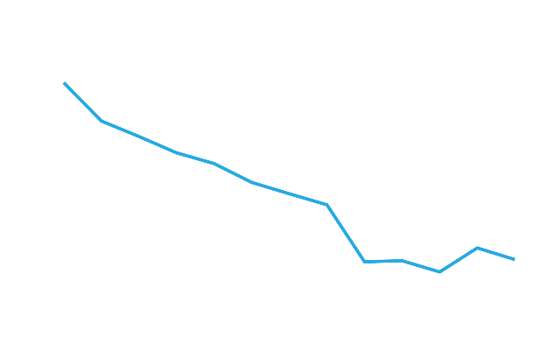
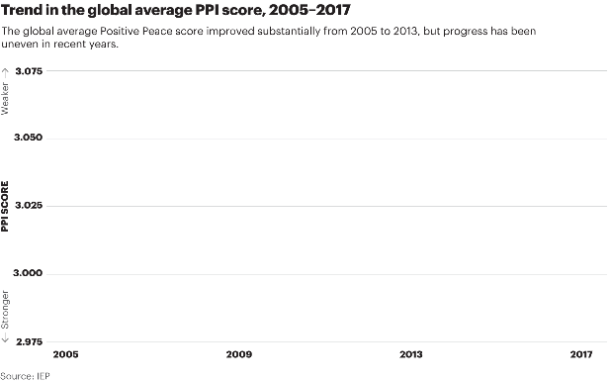
Trends in Positive Peace, 2005-2017
Positive Peace score improved steadily between 2005 and 2013, but progress has been uneven in the last four years.

Slide 44
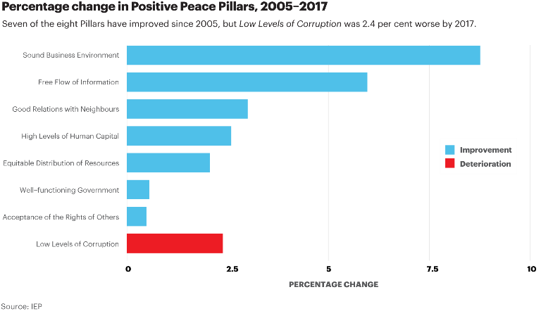
Percentage change in Positive Peace, 2005 - 2017
Seven of the eight pillars have improved since 2005

Slide 45
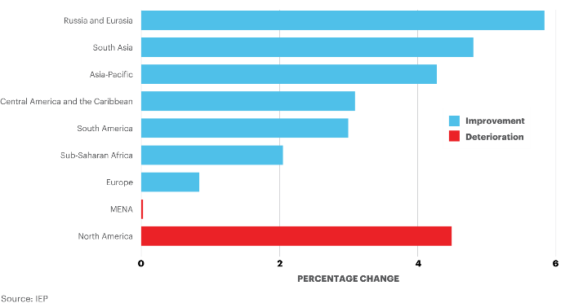
Changes in regional scores, 2005 - 2017
North America and MENA are the only regions that did not improve in Positive Peace between 2005 and 2017

Slide 46
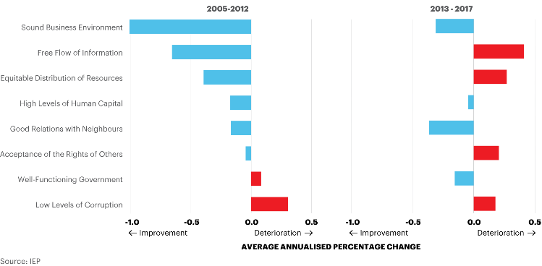
Global Percentage Change in Positive Peace
Sound Business Environment, Free Flow of Information, and Equitable Distribution of Resources improved significantly between 2005 and 2012

Slide 47
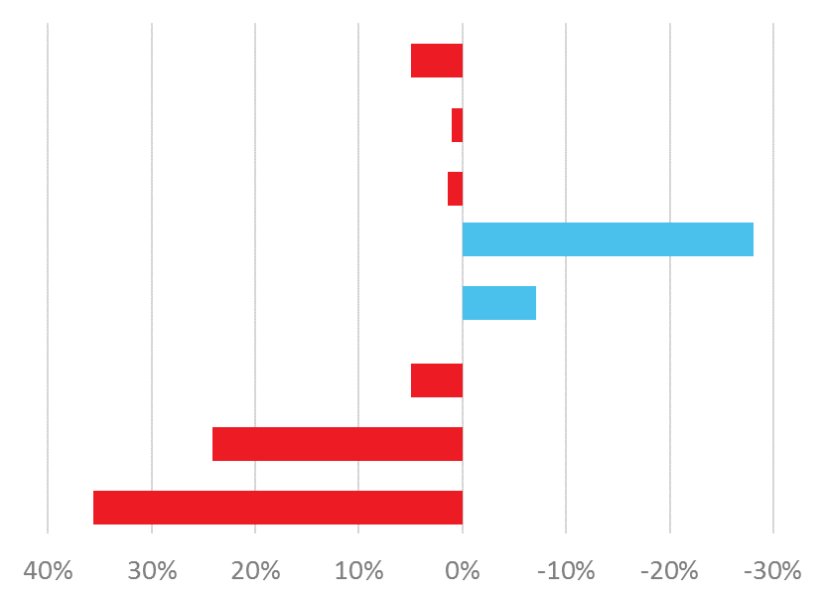
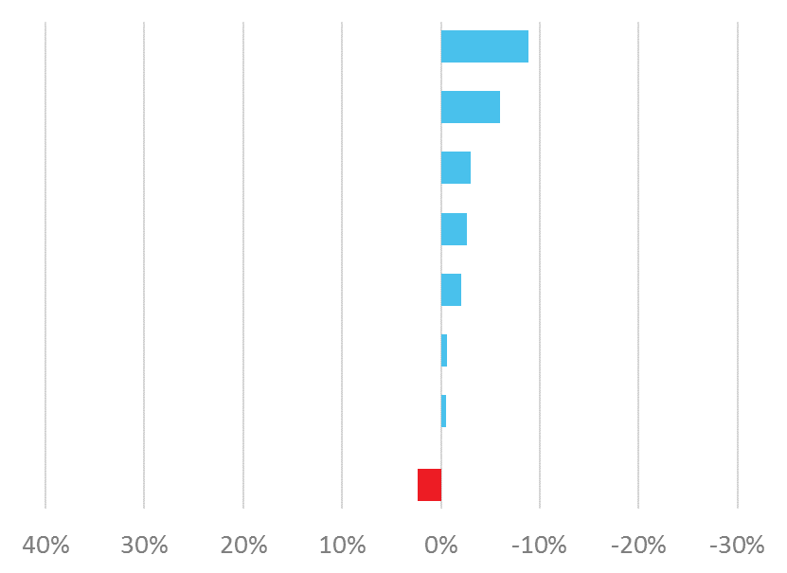
US and the World Percentage Score Changes
In the USA, six of the eight Pillars have deteriorated since 2005
United States
World
Sound Business Environment
Good Relations with Neighbours
Well-Functioning Government
High Levels of Human Capital
Equitable Distribution of Resources
Acceptance of the Rights of Others
Low Levels of Corruption
Free Flow of Information
Deterioration
Improvement
Deterioration
Improvement
PERCENTAGE CHANGE, 2005 - 2017
Source: IEP

Slide 48
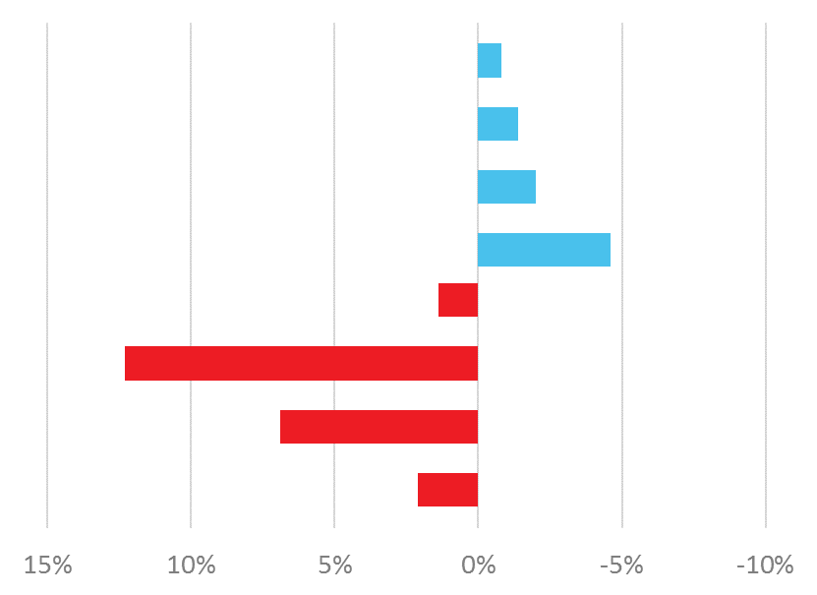
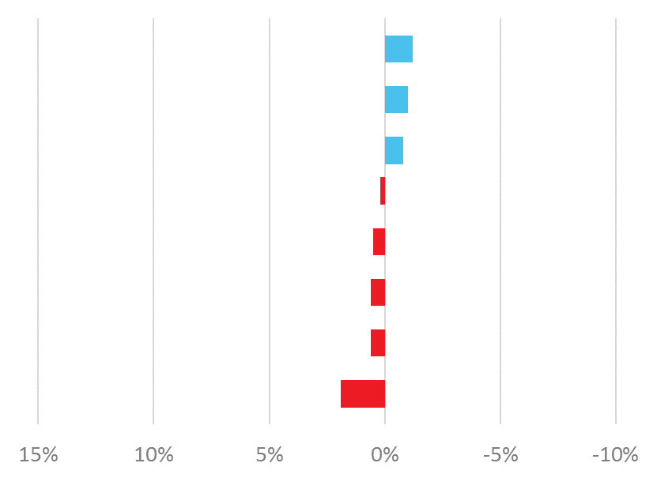
US and the World Percentage Score Changes
Acceptance of the Rights of Others has experienced the largest deterioration
United States
World
Sound Business Environment
Good Relations with Neighbours
Well-Functioning Government
High Levels of Human Capital
Equitable Distribution of Resources
Acceptance of the Rights of Others
Low Levels of Corruption
Free Flow of Information
Deterioration
Improvement
Deterioration
Improvement
PERCENTAGE CHANGE, 2013 - 2017
Source: IEP

Slide 49
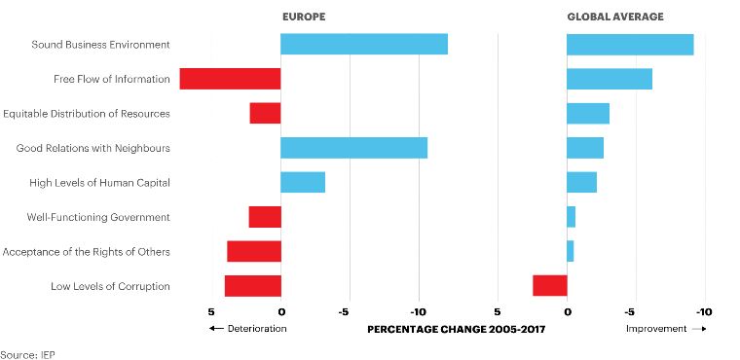
Europe and the World Percentage Score Changes
In Europe, five of the eight Pillars have deteriorated since 2005

Slide 50
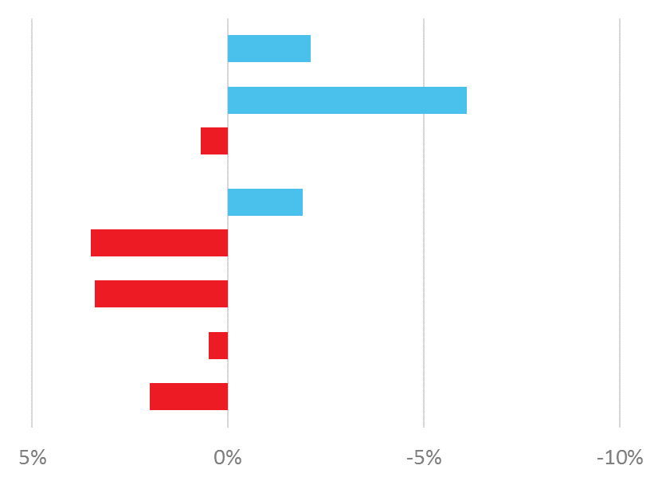
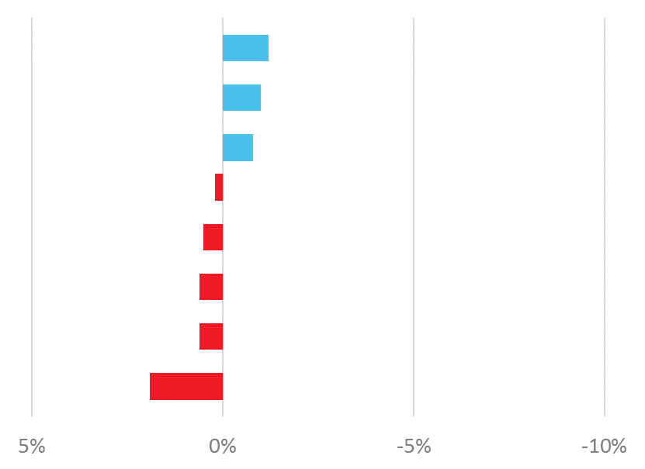
Europe and the World Percentage Score Changes
Europe deteriorated on Equitable distribution of resources and Acceptance of the rights of others more than the global average
Europe
Global Average
Sound Business Environment
Good Relations with Neighbours
Well-Functioning Government
High Levels of Human Capital
Equitable Distribution of Resources
Acceptance of the Rights of Others
Low Levels of Corruption
Free Flow of Information
Deterioration
Improvement
Deterioration
Improvement
PERCENTAGE CHANGE, 2013 - 2017
Source: IEP

Slide 51
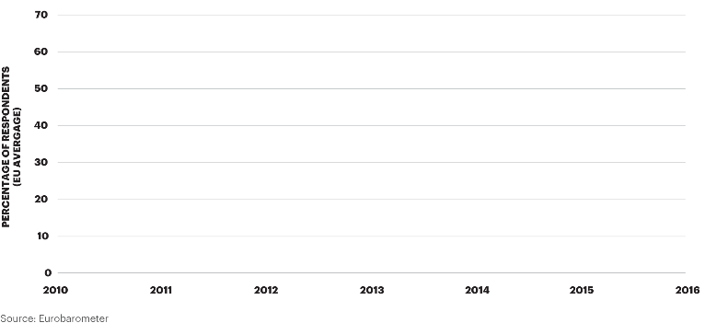
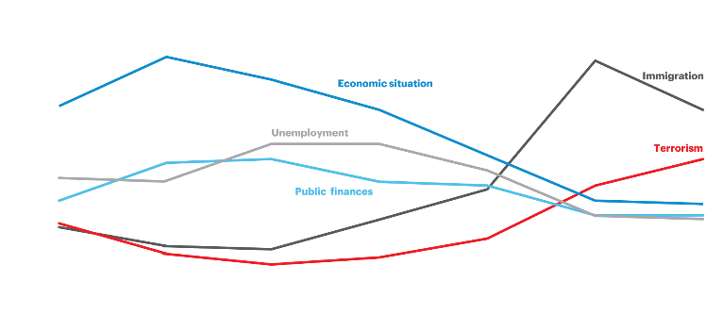
Perceptions of the Most Important Issues in the EU
Between 2010 and 2016, the percentage of people reporting immigration as the most important issue more than tripled

Slide 52
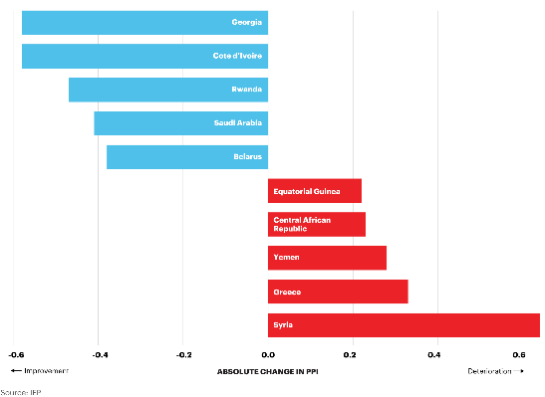
Largest Changes in Positive Peace, 2005 - 2017
Cote d’Ivoire and Georgia recorded the largest improvements while Syria experienced the largest deterioration

Slide 53
04.
Positive Peace Index
Benefits of Positive Peace

Slide 54
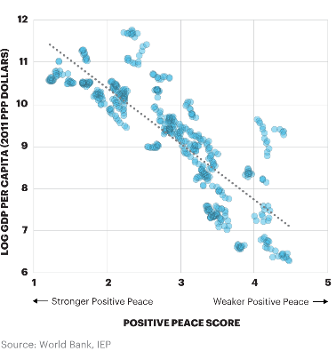
Positive Peace and GDP per Capita, 2005-2016
Every one per cent improvement in Positive Peace is associated with a 2.9 per cent growth in GDP per capita

Slide 55
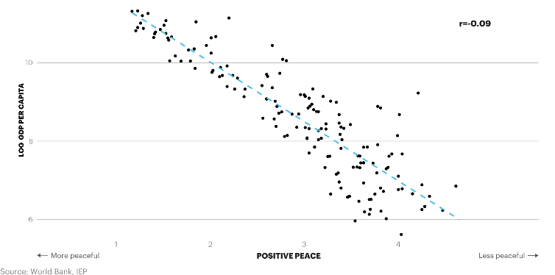
Positive Peace and GDP per capita, 2018
On average, across all levels of country income, every one index point improvement in the Positive Peace Index is associated with a 2.54 percentage point rise in GDP per capita.

Slide 56
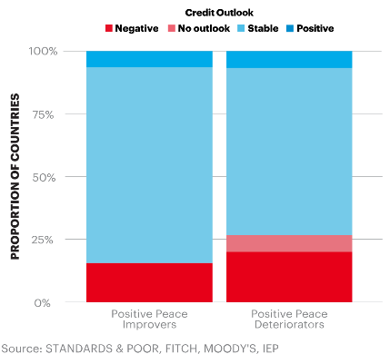
Credit Ratings and Positive Peace, 2009-2018
Credit ratings for countries improving in Positive Peace are more likely to change positively or remain stable than for countries in which the PPI deteriorates.

Slide 57
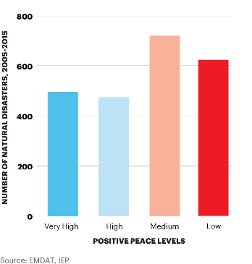
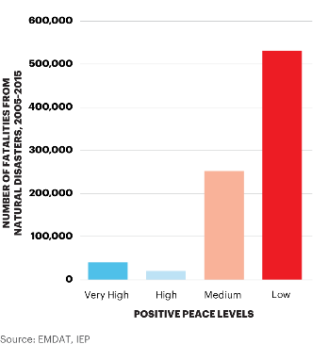
Frequency of Natural Disasters, 2005 - 2015
Low Positive Peace countries experience 13 times more fatalities from natural disasters compared to high Positive Peace countries

Slide 58
Distribution of Endogenous Shocks, 2005 - 2015
High Peace
High
Medium
Low Peace
POSITIVE PEACE

Slide 59
05.
Positive Peace Index
Economic Impact of Peace

Slide 60
The global cost of violence, 2017
Deaths from conflict and terrorism peaked in 2014
$14.1
TRILLION
Which is equivalent to
11.2%
of total world GDP
OR
$1853
per person
If the world decreased
violence by 10%...
$1.41 TRILLION
could be directed to
other economic activities

Slide 61
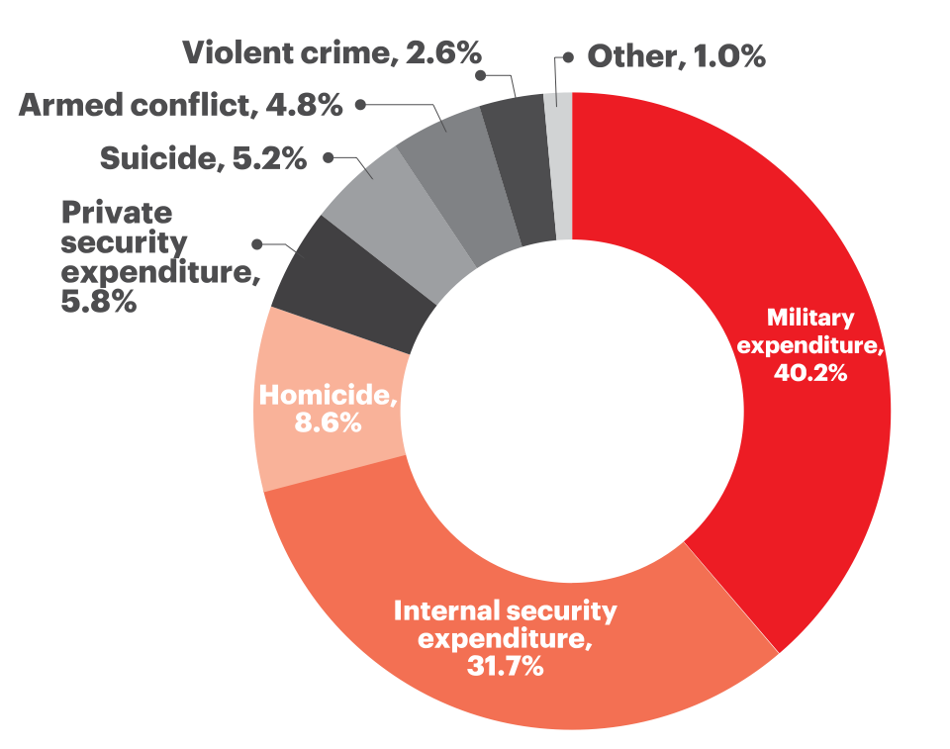
The global cost of violence, 2017
A 1% reduction in the cost of violence is the equivalent to:
1%
total global Official Development Assistance in 2017
A 10% reduction in the cost of violence is the equivalent to:
10%
The global total Foreign Direct Investment in 2018
The size the combined economies of Switzerland, Ireland and Denmark

Slide 62
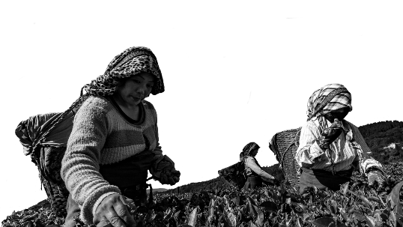
Global economic impact of violence
“
In the last 70 years, annual GDP growth has been three times higher in highly peaceful countries compared to those with low levels of peace.

Slide 63
GPI and GDP per capita growth
Countries with very high level of peace, on average achieved nearly three times higher GDP per capita growth compared to the least peaceful countries since 1960.

Slide 64
GPI and lower levels of inflation
Historically, inflation levels have been three times lower in highly peaceful countries.
Long-term median inflation in very high peace countries was 3.5% compared to 9.7% in very low peace countries.

Slide 65
GPI and lower interest rates
Historically interest rates have been twice as high in the least peaceful countries.
The average interest rate in the most peaceful countries was 8.7%, compared to 20% in very low peace countries.

Slide 66
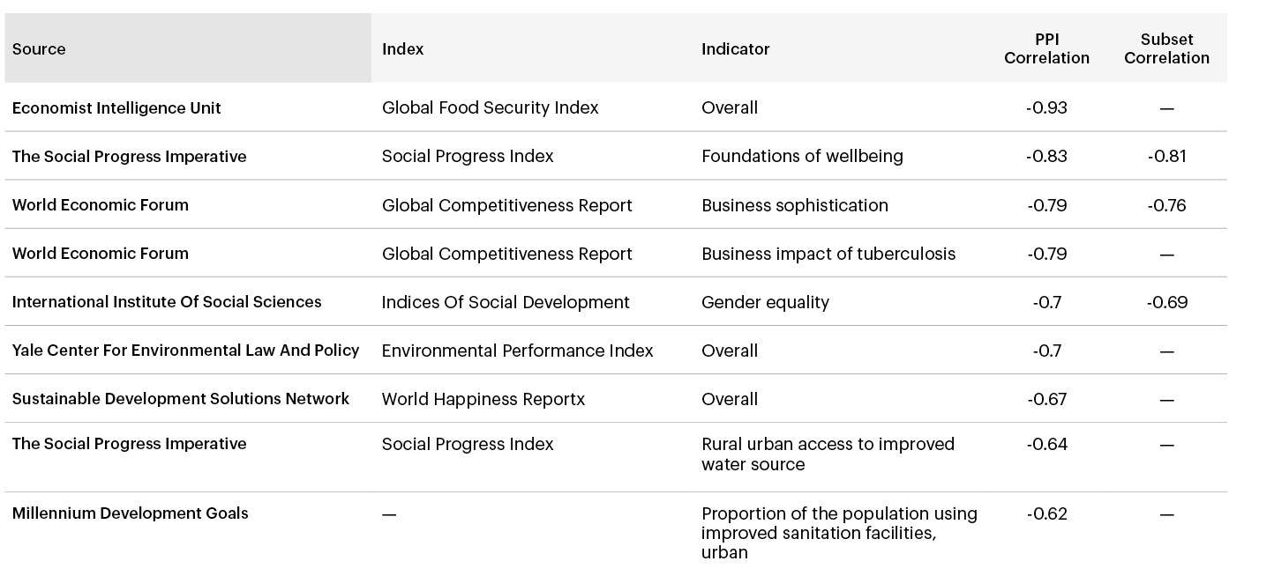
Correlation to Common Development Goals
There are strong correlations between the PPI and other measures of development

Slide 67
05.
Positive Peace Index
Positive Peace & GPI Score

Slide 68
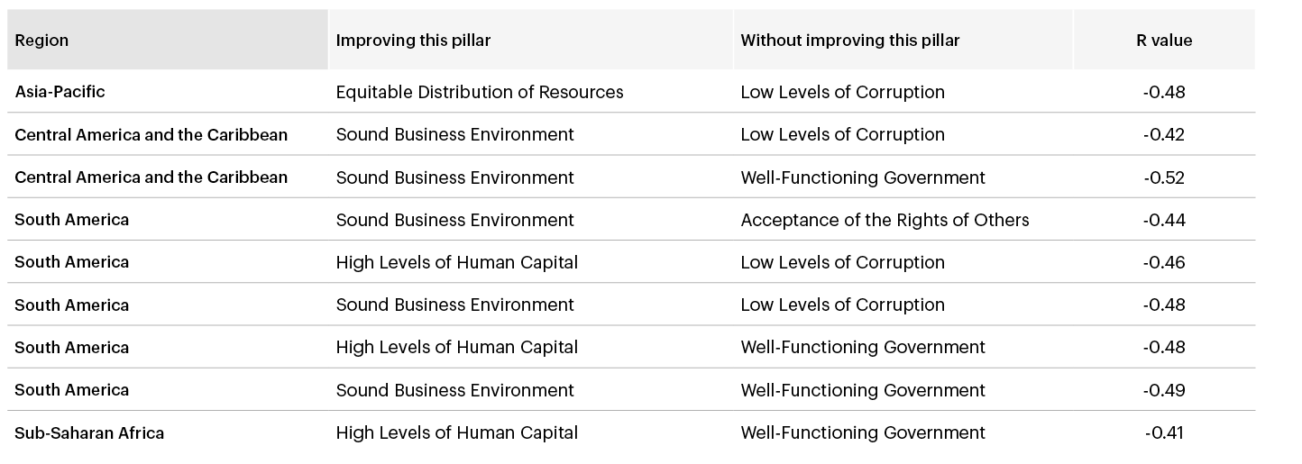
Improvements in one Pillar only
Improvements in one Pillar only results in a higher likelihood of deteriorations in peace

Slide 69
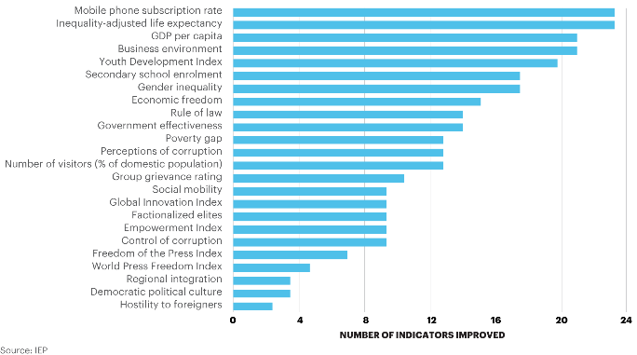
Indicators associated with improvements in GPI
Improvements in connectivity, material well-being, the economy, gender equality and youth development are common leading indicators of improvements in Positive Peace

Slide 70
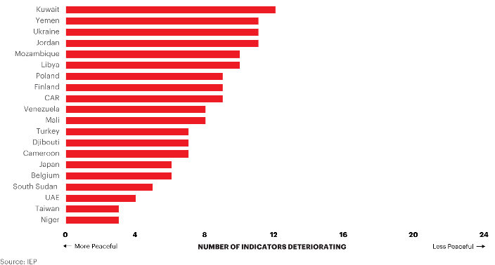
Indicators associated with deteriorations in GPI
Deteriorations in press freedom, tensions between groups, social mobility and corruption are leading indicators of deteriorations in peace

Slide 71
06.
Positive Peace Index
Using and Creating Positive Peace

Slide 72
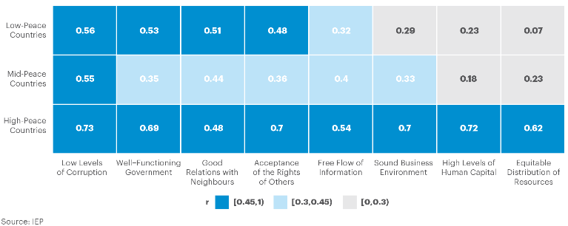
Correlation between Positive Peace and GPI Score
Low Levels of Corruption is the only Pillar that is strongly significant across all three levels of peacefulness

Slide 73
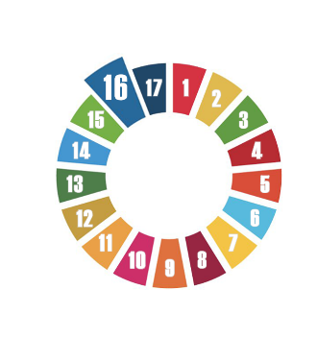
Correlation to Common Development Goals
Positive Peace – Predicting changes in peace and economic performance 2007 to 2014
SDG16
Falls in Positive peace preceded falls in GPI score
Falls in Positive Peace precede falls in many macro economic indicators
Improvements in Positive Peace precede improvements in GPI score
Improvements in Positive Peace precede improvements in many macro economic indicators.

Slide 74
Correlation to Common Development Goals
Positive Peace - Predicting changes in peace and economic performance 2007 to 2014
SDG16
Countries that improve in Positive Peace since 1996 have 2% higher GDP growth than countries that deteriorate in Positive Peace
Countries that improved in Positive Peace saw exchange rates improve by 1.9% compared to -0.2% for countries that deteriorated in Positive Peace.
Countries that deteriorated significantly in Positive Peace had a fall in their credit rating of 4.5 points on average – Non OECD
Every 1% improvement in Positive Peace is associated with 2.9% per cent growth in real GDP per capita from 2005 to 2016.

Slide 75
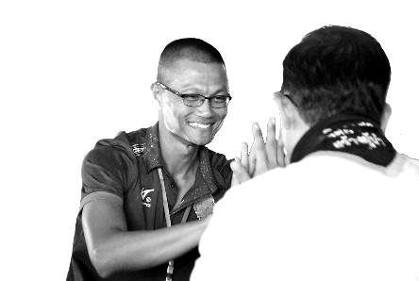
Global Positive Peace activities
Positive Peace Workshops with 17 partners
Workshops in Uganda, Kenya, Columbia, Libya, Thailand, Mexico, Cambodia, Australia… more
Training a million people on Positive Peace
Created over 1500 IEP ambassadors in 106 countries
Developing masters course with Blanquerna
Notes:
Large scale workshops.
Such as those that are currently underway in Colombia. Funded by Rotary Global grant
An example is the workshop in Mexico in 2017 – with 304 participants.

Slide 76
Project example of Positive Peace
Literacy project post Rotary workshop in Uganda
Jude Kakuba – Rotaract Club of Kampala Ssese Islands.
Outcome:
Before implementation of the project, 51.5% achieved poor results
After implementation of the project, 67.8% of the candidates achieved desirable results.
Number of students enrolled jumped by 38.5%.

Slide 77
Ugandan school example
Well-functioning government – including local community leaders on the planning and implementation committee.
Sound business environment -Has been addressed through construction of classroom blocks.
Equitable distribution - provision of scholastic material for all
Acceptance of the rights of others – provision of sanitary pads for girls
Good relations with neighbours – planting fruit trees and porridge lunch
Free flow of information – partnered with local radio station
High level of human capital – provided medical checks and class room construction
Low levels of corruption – branding donated items and setting up committee to monitor
Notes:
Large scale workshops.
Such as those that are currently underway in Colombia. Funded by Rotary Global grant
An example is the workshop in Mexico in 2017 – with 304 participants.

Slide 78
Ugandan school example
Well-functioning government – including local community leaders on the planning and implementation committee.
Sound business environment - Has been addressed through construction of classroom blocks.
Equitable distribution - provision of scholastic material for all
Acceptance of the rights of others – provision of sanitary pads for girls
Good relations with neighbours – planting fruit trees and porridge lunch
Free flow of information – partnered with local radio station
High level of human capital – provided medical checks and class room construction
Low levels of corruption – branding donated items and setting up committee to monitor
Notes:
Large scale workshops.
Such as those that are currently underway in Colombia. Funded by Rotary Global grant
An example is the workshop in Mexico in 2017 – with 304 participants.

Slide 79
Ugandan school example
Well-functioning government – including local community leaders on the planning and implementation committee.
Sound business environment -Has been addressed through construction of classroom blocks.
Equitable distribution - provision of scholastic material for all
Acceptance of the rights of others – provision of sanitary pads for girls
Good relations with neighbours – planting fruit trees and porridge lunch
Free flow of information – partnered with local radio station
High level of human capital – provided medical checks and class room construction
Low levels of corruption – branding donated items and setting up committee to monitor
Notes:
Large scale workshops.
Such as those that are currently underway in Colombia. Funded by Rotary Global grant
An example is the workshop in Mexico in 2017 – with 304 participants.

Slide 80
Ugandan school example
Well-functioning government – including local community leaders on the planning and implementation committee.
Sound business environment -Has been addressed through construction of classroom blocks.
Equitable distribution - provision of scholastic material for all
Acceptance of the rights of others – provision of sanitary pads for girls
Good relations with neighbours – planting fruit trees and porridge lunch
Free flow of information – partnered with local radio station
High level of human capital – provided medical checks and class room construction
Low levels of corruption – branding donated items and setting up committee to monitor
Notes:
Large scale workshops.
Such as those that are currently underway in Colombia. Funded by Rotary Global grant
An example is the workshop in Mexico in 2017 – with 304 participants.

Slide 81
Ugandan school example
Well-functioning government – including local community leaders on the planning and implementation committee.
Sound business environment -Has been addressed through construction of classroom blocks.
Equitable distribution - provision of scholastic material for all
Acceptance of the rights of others – provision of sanitary pads for girls
Good relations with neighbours – planting fruit trees and porridge lunch
Free flow of information – partnered with local radio station
High level of human capital – provided medical checks and class room construction
Low levels of corruption – branding donated items and setting up committee to monitor
Notes:
Large scale workshops.
Such as those that are currently underway in Colombia. Funded by Rotary Global grant
An example is the workshop in Mexico in 2017 – with 304 participants.

Slide 82
Ugandan school example
Well-functioning government – including local community leaders on the planning and implementation committee.
Sound business environment -Has been addressed through construction of classroom blocks.
Equitable distribution - provision of scholastic material for all
Acceptance of the rights of others – provision of sanitary pads for girls
Good relations with neighbours – planting fruit trees and porridge lunch
Free flow of information – partnered with local radio station
High level of human capital – provided medical checks and class room construction
Low levels of corruption – branding donated items and setting up committee to monitor
Notes:
Large scale workshops.
Such as those that are currently underway in Colombia. Funded by Rotary Global grant
An example is the workshop in Mexico in 2017 – with 304 participants.

Slide 83
Ugandan school example
Well-functioning government – including local community leaders on the planning and implementation committee.
Sound business environment -Has been addressed through construction of classroom blocks.
Equitable distribution - provision of scholastic material for all
Acceptance of the rights of others – provision of sanitary pads for girls
Good relations with neighbours – planting fruit trees and porridge lunch
Free flow of information – partnered with local radio station
High level of human capital – provided medical checks and class room construction
Low levels of corruption – branding donated items and setting up committee to monitor
Notes:
Large scale workshops.
Such as those that are currently underway in Colombia. Funded by Rotary Global grant
An example is the workshop in Mexico in 2017 – with 304 participants.

Slide 84
Ugandan school example
Well-functioning government – including local community leaders on the planning and implementation committee.
Sound business environment -Has been addressed through construction of classroom blocks.
Equitable distribution - provision of scholastic material for all
Acceptance of the rights of others – provision of sanitary pads for girls
Good relations with neighbours – planting fruit trees and porridge lunch
Free flow of information – partnered with local radio station
High level of human capital – provided medical checks and class room construction
Low levels of corruption – branding donated items and setting up committee to monitor
Notes:
Large scale workshops.
Such as those that are currently underway in Colombia. Funded by Rotary Global grant
An example is the workshop in Mexico in 2017 – with 304 participants.

Slide 85
Notes:
Jude Kakuba – Rotaract Club of Kampala Ssese Islands.
Literacy project post Rotary workshop in Uganda
Acceptance of the rights of others – women's hygiene
Before implementation of the project, 48.5% of the candidates achieved the first 3 Divisions while 51.5% (the majority) achieved the other (undesirable) divisions. After implementation of the project, 67.8% of the candidates achieved the first 3 (desirable) divisions while 32.2% (the minority) achieved the other 3 (undesirable) divisions. The teachers confirmed that this improvement is a result of the scholastic materials such as study charts, teacher guides, mathematical sets and exercise books that were donated to the pupils.
There has been a percentage increment of 38.5% in pupil enrolment since implementation of the first phase of the project due to the improved learning environment.

Slide 86
Notes:
Jude Kakuba – Rotaract Club of Kampala Ssese Islands.
Literacy project post Rotary workshop in Uganda
Acceptance of the rights of others – women's hygiene
Before implementation of the project, 48.5% of the candidates achieved the first 3 Divisions while 51.5% (the majority) achieved the other (undesirable) divisions. After implementation of the project, 67.8% of the candidates achieved the first 3 (desirable) divisions while 32.2% (the minority) achieved the other 3 (undesirable) divisions. The teachers confirmed that this improvement is a result of the scholastic materials such as study charts, teacher guides, mathematical sets and exercise books that were donated to the pupils.
There has been a percentage increment of 38.5% in pupil enrolment since implementation of the first phase of the project due to the improved learning environment.

Slide 87
Notes:
Jude Kakuba – Rotaract Club of Kampala Ssese Islands.
Literacy project post Rotary workshop in Uganda
Acceptance of the rights of others – women's hygiene
Before implementation of the project, 48.5% of the candidates achieved the first 3 Divisions while 51.5% (the majority) achieved the other (undesirable) divisions. After implementation of the project, 67.8% of the candidates achieved the first 3 (desirable) divisions while 32.2% (the minority) achieved the other 3 (undesirable) divisions. The teachers confirmed that this improvement is a result of the scholastic materials such as study charts, teacher guides, mathematical sets and exercise books that were donated to the pupils.
There has been a percentage increment of 38.5% in pupil enrolment since implementation of the first phase of the project due to the improved learning environment.

Slide 88
Positive Peace Index - Summary
Measure and analyse peace
Measure and analyse peace
163
ACTION
Better predictions
$
Lost opportunity cost
Factors that create peace
Better cost/benefit analysis
Better program outcomes

Slide 89
Connect with us
visionofhumanity.org
GlobalPeaceIndex
@GlobPeaceIndex
@GlobalPeaceIndex

