Slide 1

GLOBAL
TERRORISM
INDEX 2019
Measuring the Impact of Terrorism

Slide 2
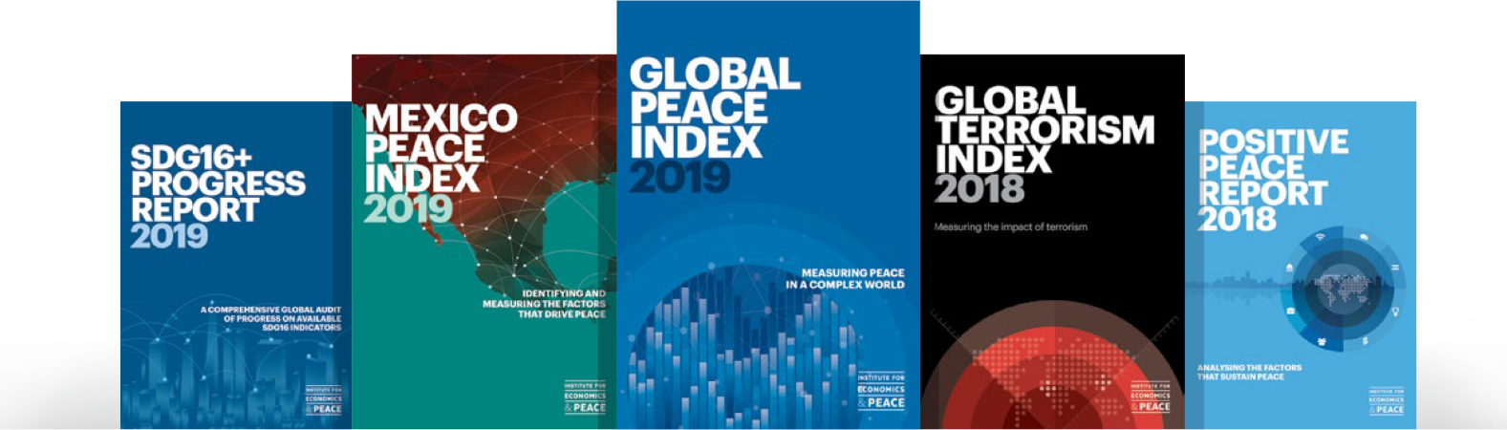
“
The Institute for Economics and Peace is an independent, not-for-profit think tank dedicated to building a greater understanding of the key drivers of peace, as well as identifying the economic benefits that increased peacefulness can deliver.

Slide 3



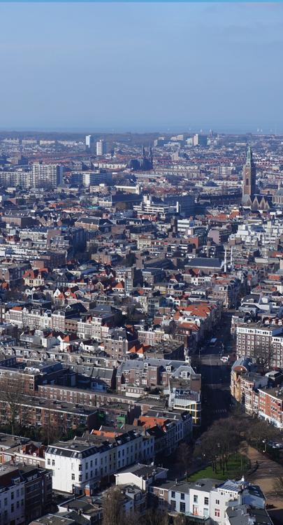
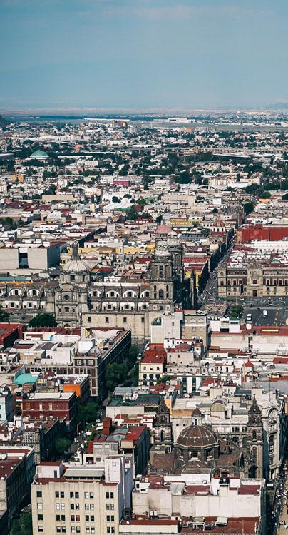
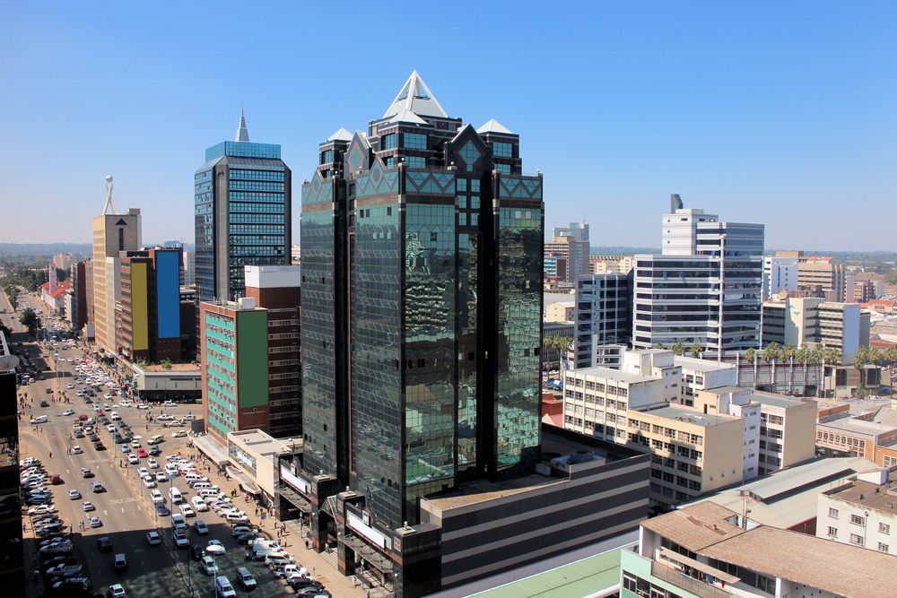
IEP International Offices
SYDNEY
NEW YORK
BRUSSELS
THE HAGUE
MEXICO CITY
HARARE
Australia
USA
Belgium
The Netherlands
Mexico
Zimbabwe

Slide 4

About the Institute
Research used extensively by organisations including the OECD, Commonwealth Secretariat, World Bank and the United Nations.
16BN
968M
150
GLOBAL MEDIA REACH
SOCIAL REACH
COUNTRY REACH
Work is included in 1,000s of university courses and trained over 1,500 IEP ambassadors.
Over 200,000 downloads of IEP reports last 12 months.
1500
3000
1.5M
IEP AMBASSADORS
BOOK REFERENCES
UNIQUE VISITORS

Slide 5
01.
What is the Global Terrorism Index?

Slide 6
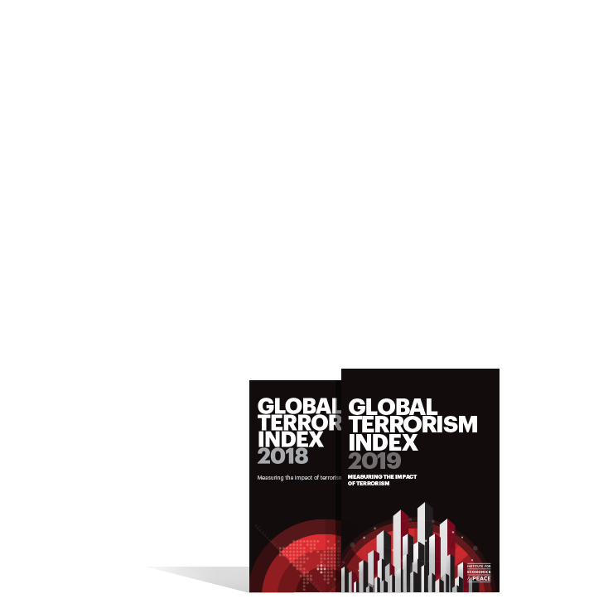
The Global Terrorism Index
Now in its
Ranks
6th
163
According to the relative impact of terrorism
year
countries
Guided and overseen by a panel of International Experts
Used as an indicator in the Global Peace index
Developed by the Institute for Economics and Peace

Slide 7


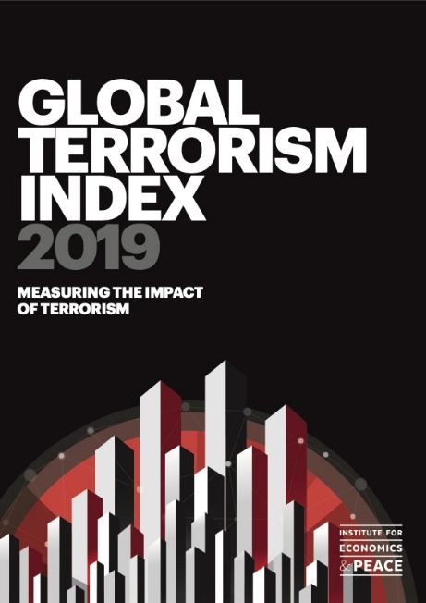
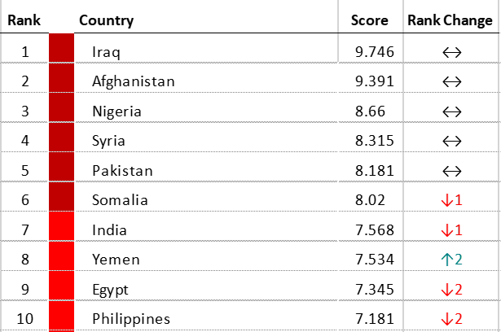



Global Terrorism Index: Methodology
Definition: the use of illegal force and violence by a non‐state actor to attain a political, economic, religious, or social goal through fear, coercion, or intimidation
    Over 5 years to measure long term impact
Indicator | Weight
Incidents | 1
Injuries | 0.5
Deaths | 3
Property Damage | 1 to 3
Year | Year minus 1 | Year minus 2 | Year minus 3 | Year minus 4
52% | 26% | 13% | 6% | 3%
    Logarithmic banding scores (1-10)
    Socio-economic indicators
Notes:
There are two types of peace. Negative and positive.
Starting point for the GPI is to image a state with no need for jails, crime and therefore no peace.
The definition in the Global Peace Index is ‘absence of violence’ and ‘absence of fear of violence’
But negative peace doesn’t tell you anything about what is necessary for a peaceful society
Positive peace index is derived through statistical analysis of over 9,000 datasets, indexes and attitudinal surveys
This is first empiric attempt to derive positive peace, this enables one to imagine how a world can become more peaceful.

Slide 8
02.
Results

Slide 9

Notes:
Needs map

Slide 10
The Countries Most Impacted by Terrorism, 2019 GTI
For the first time since 2003, Iraq is not ranked first on the index.
1
AFGHANISTAN
Rank change: 1
6
SOMALIA
Rank change: 1
2
7
INDIA
Rank change: 1
IRAQ
Rank change: 1
3
NIGERIA
Rank change:
8
YEMEN
Rank change:
4
SYRIA
Rank change:
9
PHILIPPINES
Rank change: 1
5
PAKISTAN
Rank change:
10
CONGO, DRC
Rank change: 1

Slide 11
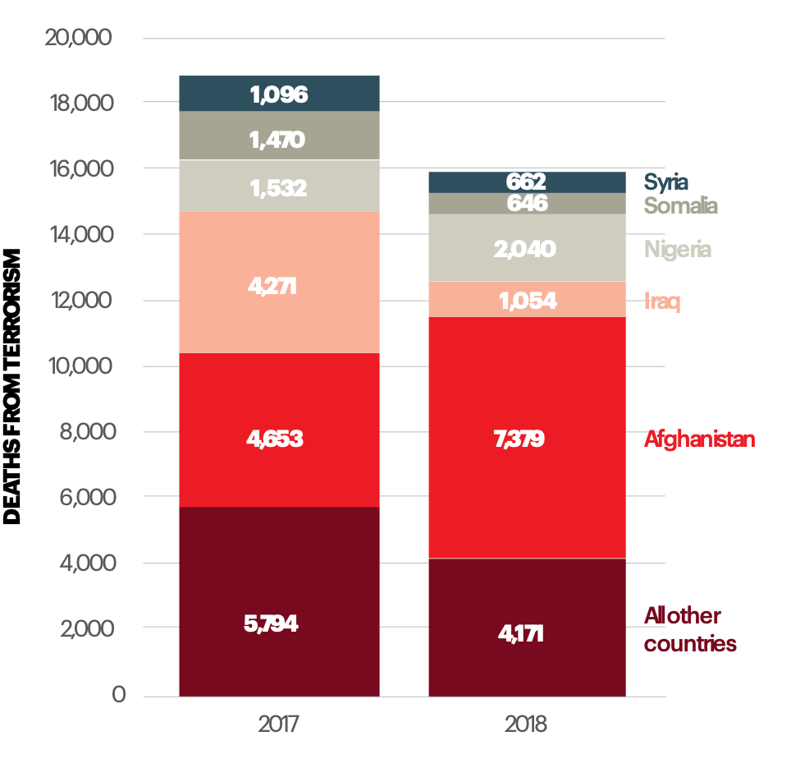
Key Findings, 2019 GTI
Terrorism has been on a downward trend since its peak in 2014
Terrorism deaths decreased by 15.2% between 2017 and 2018

Slide 12
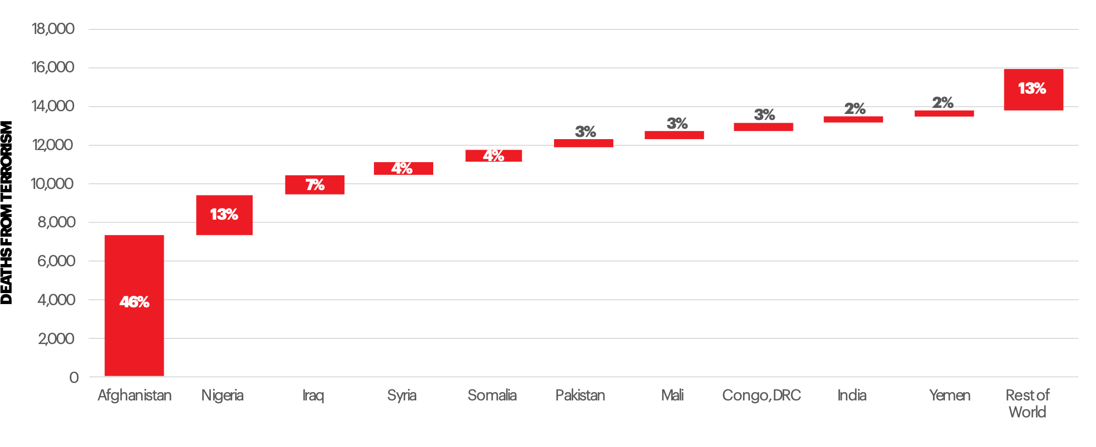
Deaths from Terrorism by Country, 2018
Ten countries accounted for 87% of all deaths from terrorism in 2018

Slide 13
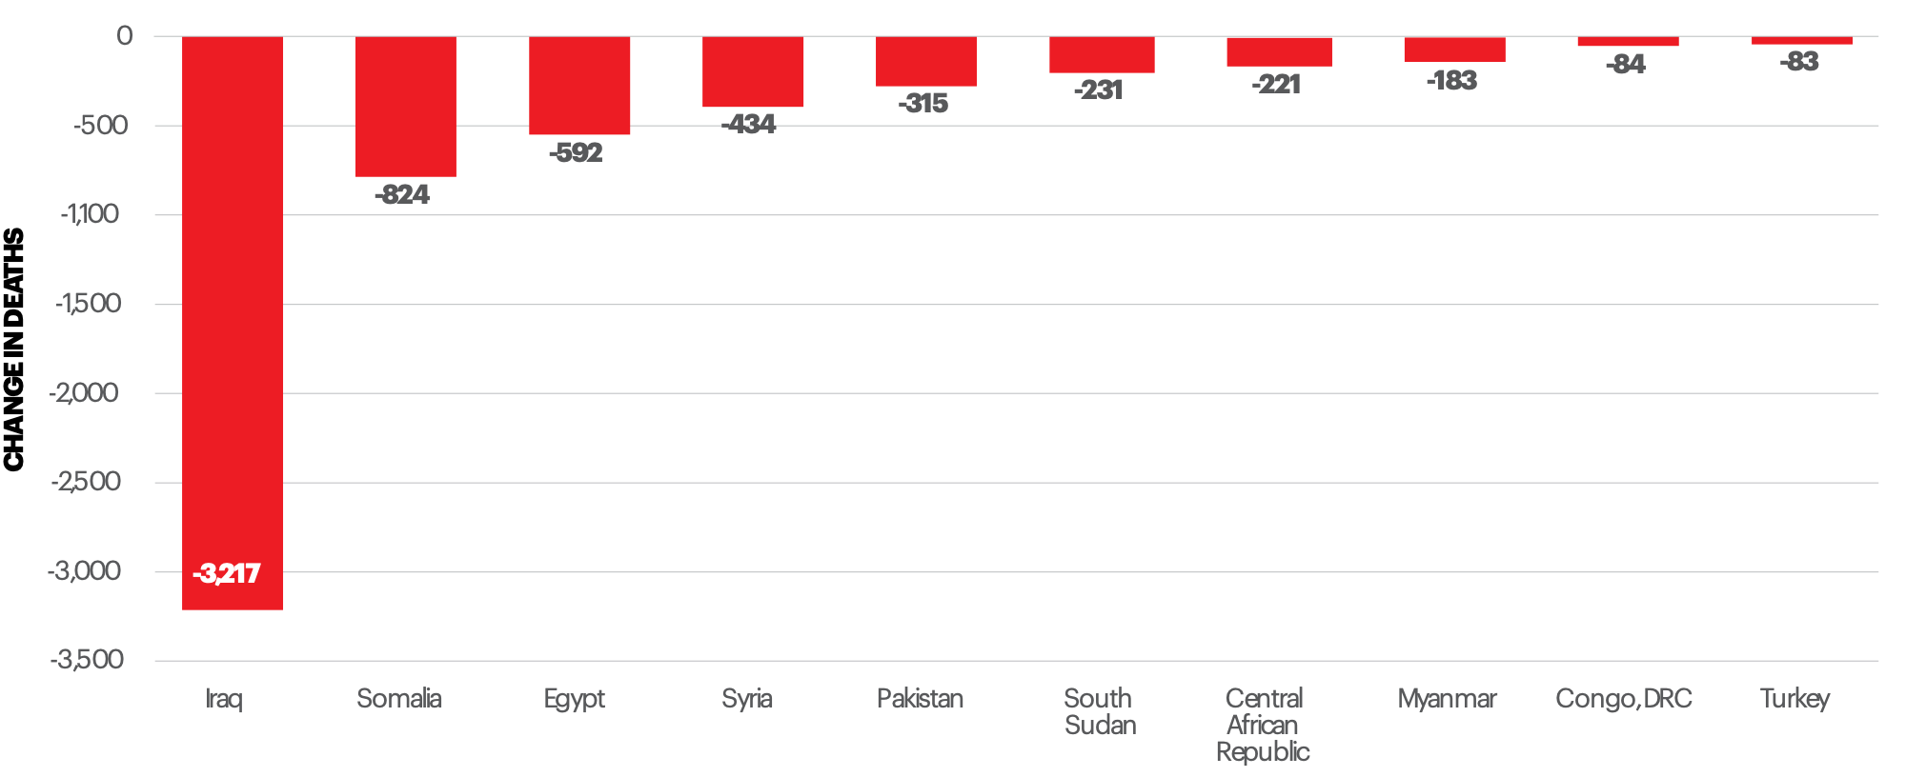
Risers and Fallers, Deaths from Terrorism, 2017 to 2018
Deaths from terrorism in Iraq have fallen over 90% since the peak in 2014

Slide 14
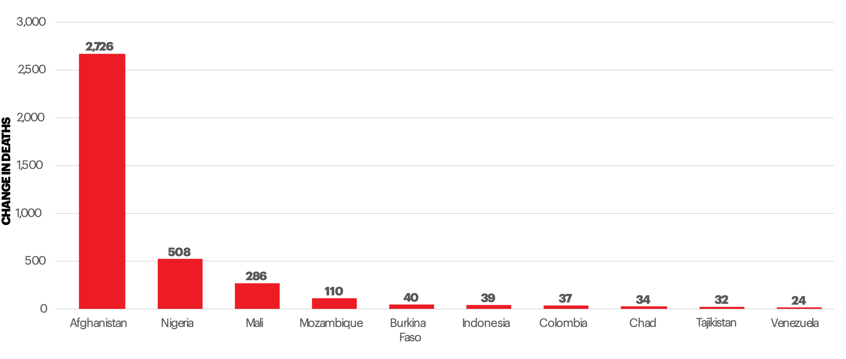
Risers and Fallers, Deaths from Terrorism, 2017 to 2018
Deaths from terrorism in Iraq have fallen over 90% since the peak in 2014

Slide 15

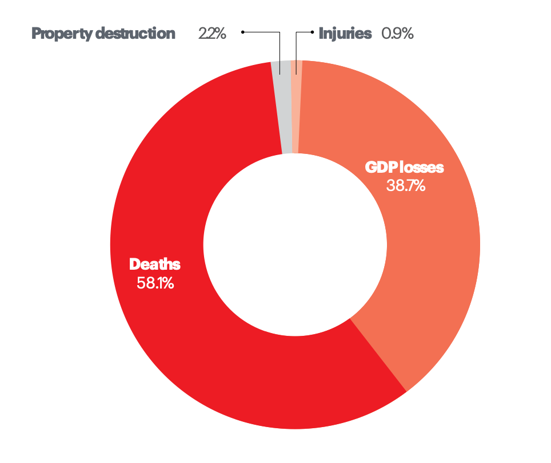
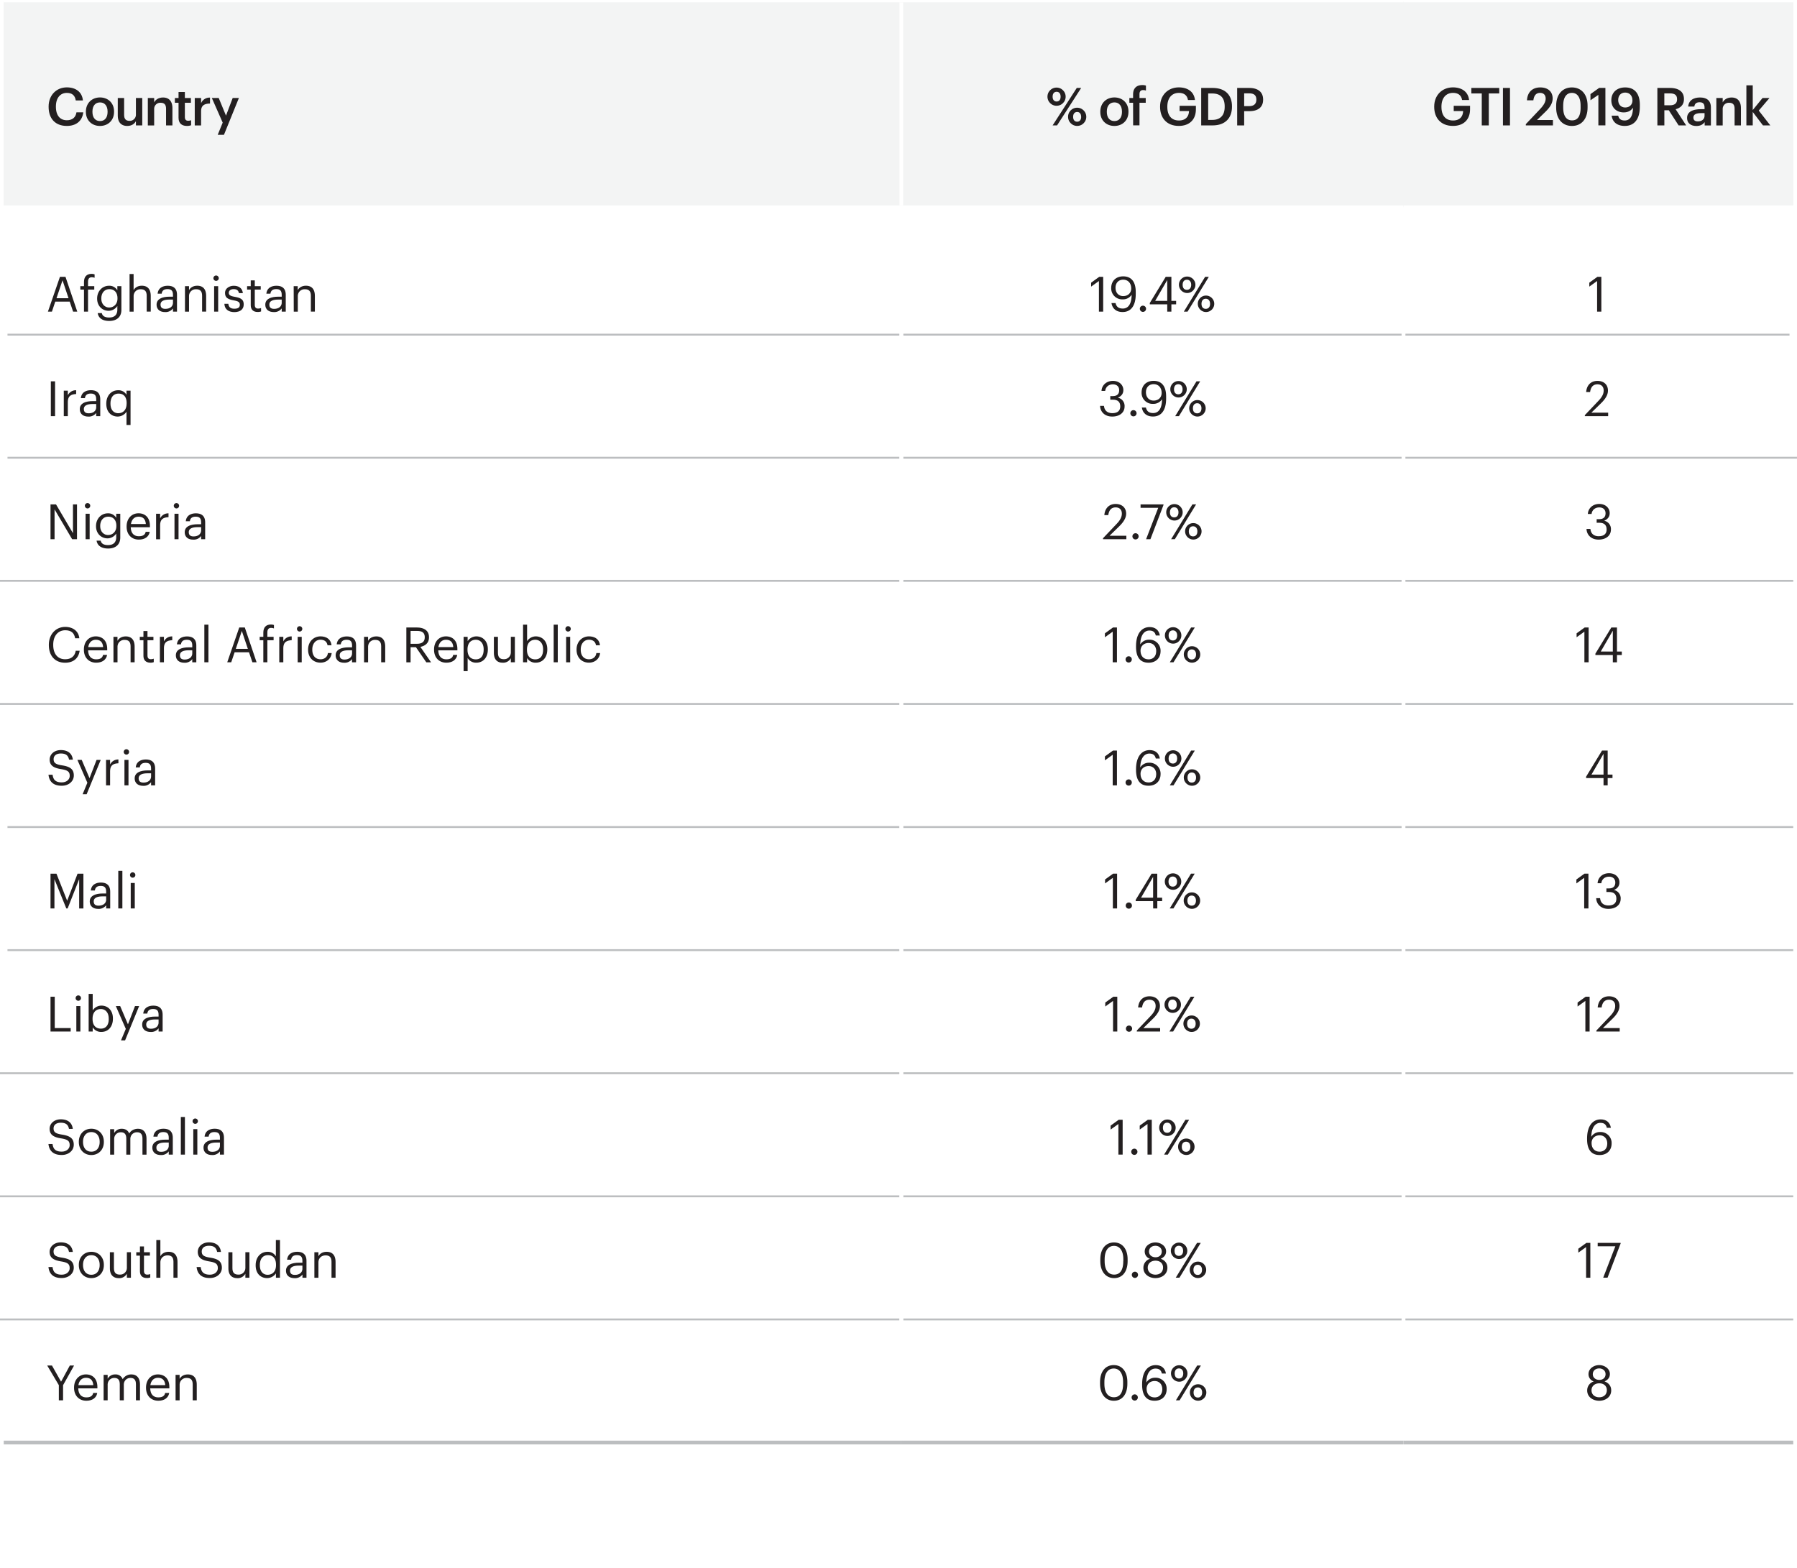
The economic impact of terrorism, 2018
The total economic impact of terrorism in 2018 was over 33 billion dollars

Slide 16
03.
Trends in Terrorism

Slide 17
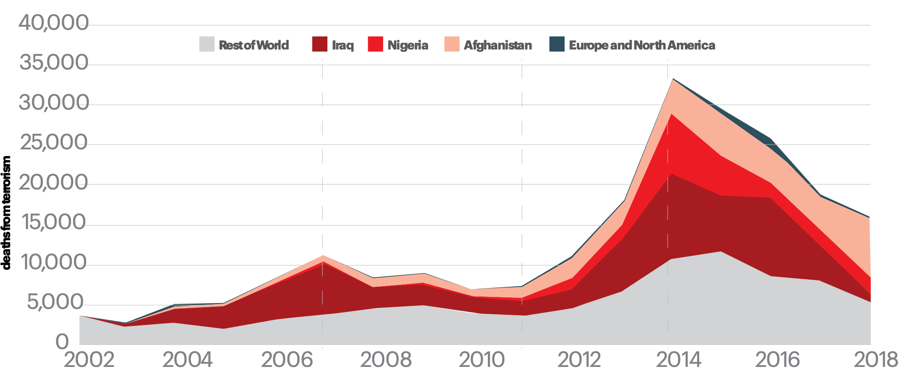
Deaths from terrorism, 1998-2018
Deaths from terrorism have decreased 52% since peaking in 2014

Slide 18
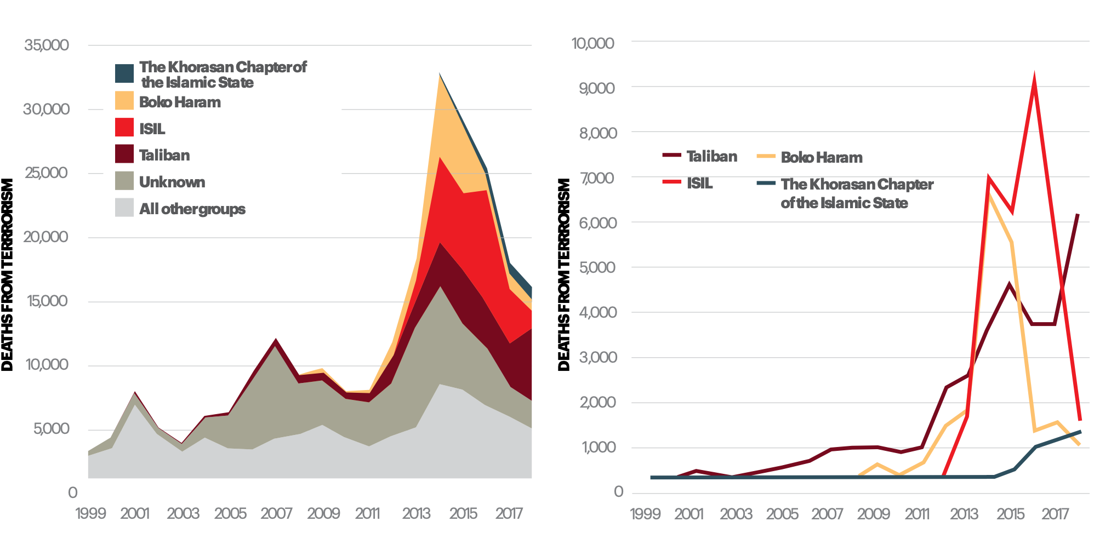
Deadliest Terrorist Groups, 1999-2018
For the first time since 2013, ISIL was not the deadliest terrorist group

Slide 19
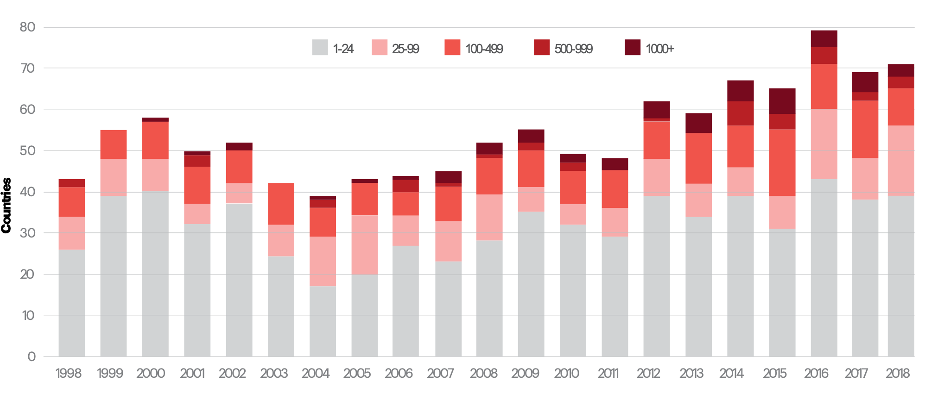
Distribution of deaths from terrorism, 1998-2018
The distribution of terrorism peaked in 2016, when 79 countries experienced at least one death from terrorism

Slide 20
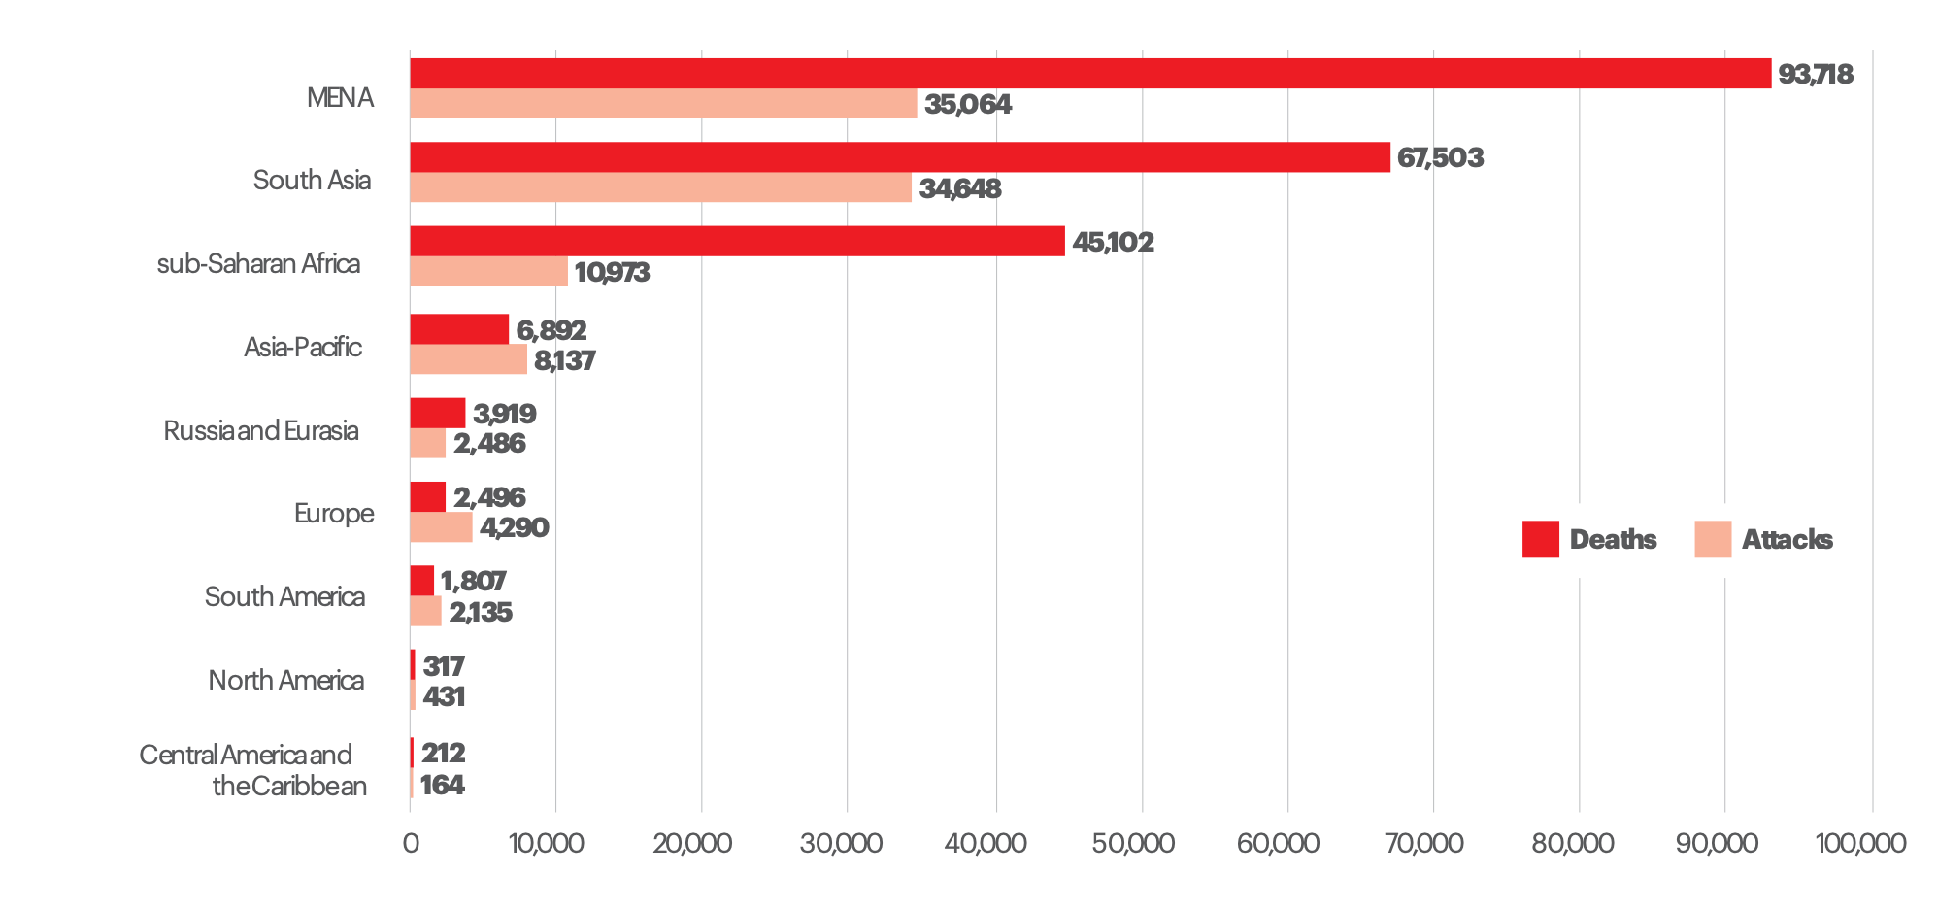
Deaths from terrorism by region, 2002-2018
There have been over 93,000 deaths from terrorism in the MENA region since 2002

Slide 21
04.
Far-right Terrorism and
Political Violence

Slide 22
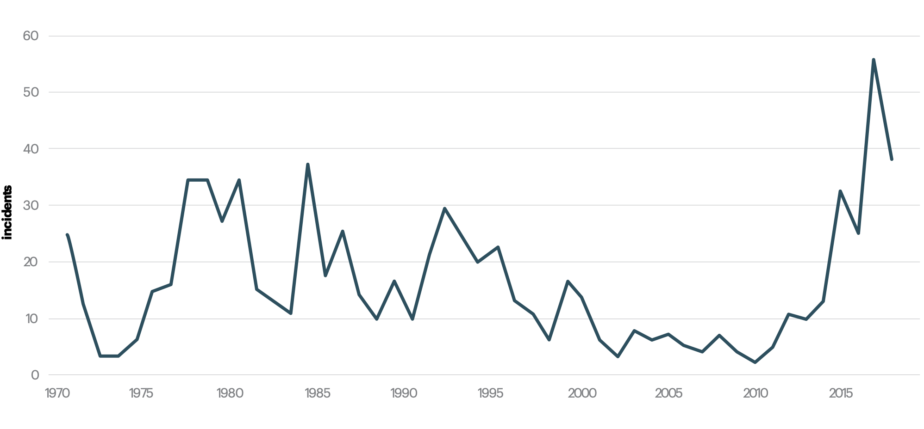
Far-right terrorist incidents in the west, 1970-2018
There has been a 320% increase in far-right terrorism in the past five years

Slide 23
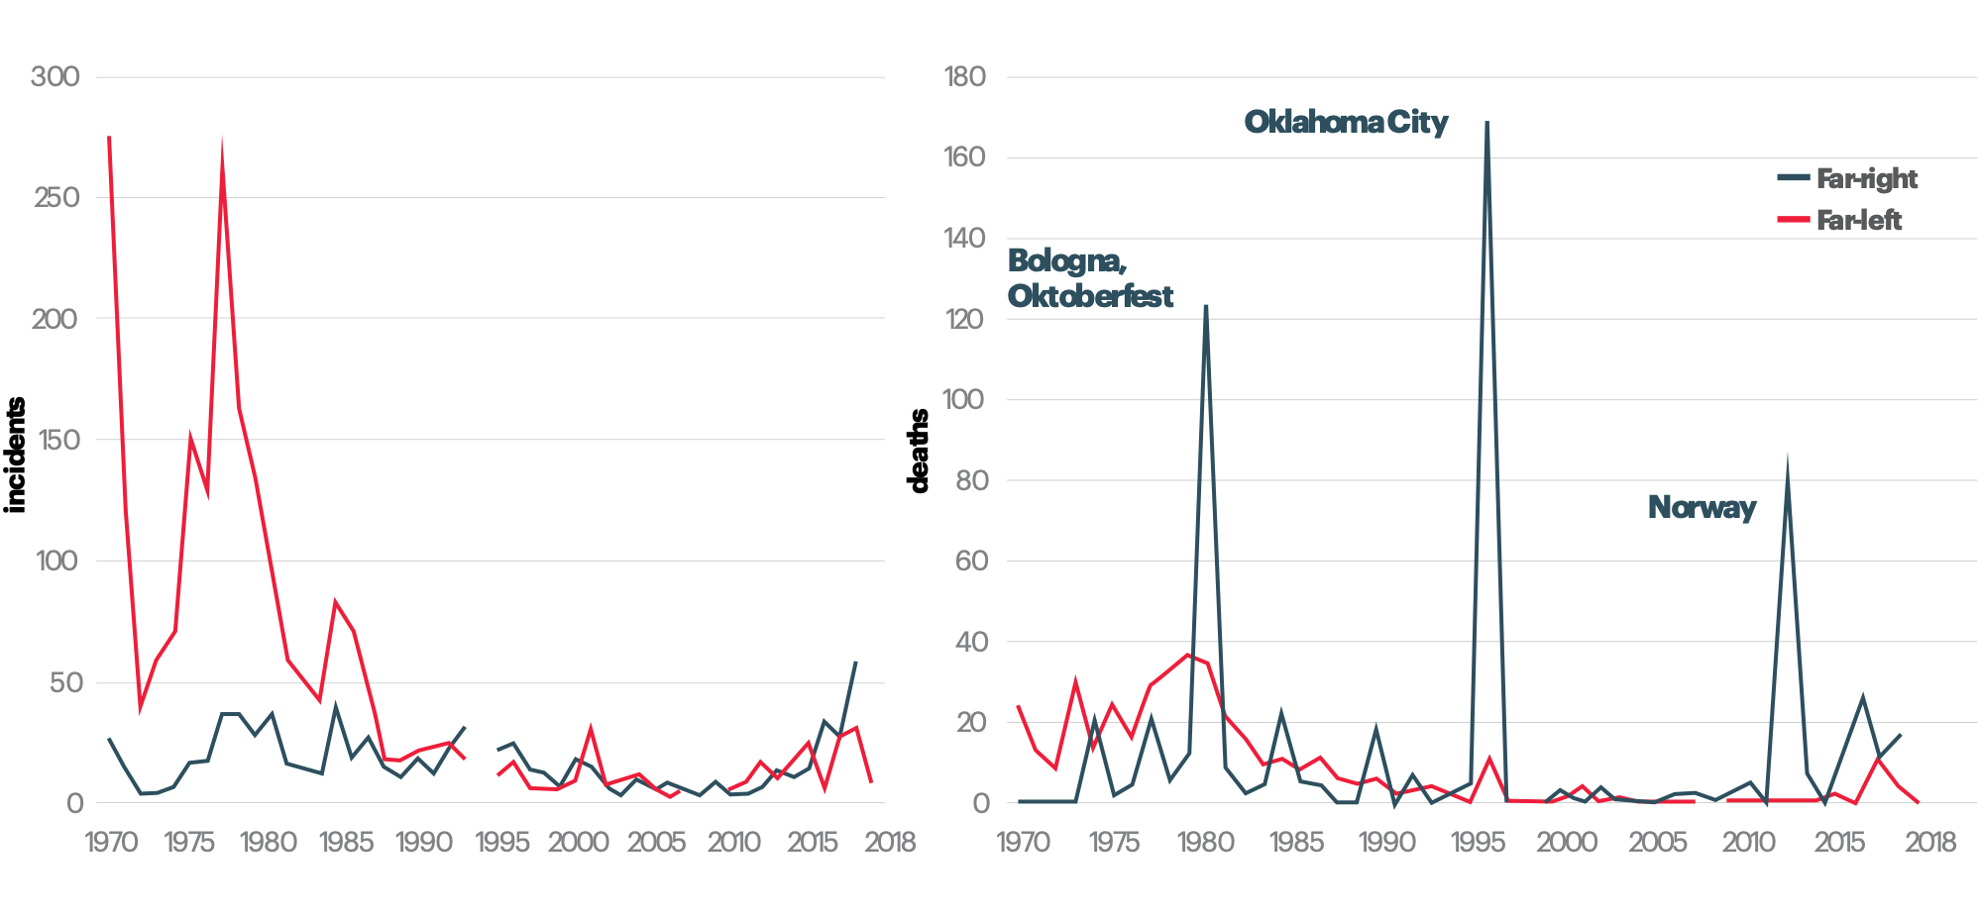
Political terrorism in the west, far-left vs far-right, 1970-2018
Far-left terrorism was more common over the past fifty years, but far-right terrorism was deadlier

Slide 24
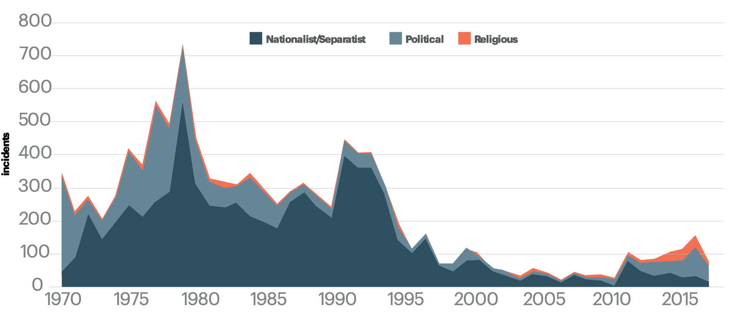
Terrorism by ideology in the west, 1970-2018
Political terrorism has increased significantly in the past decade

Slide 25
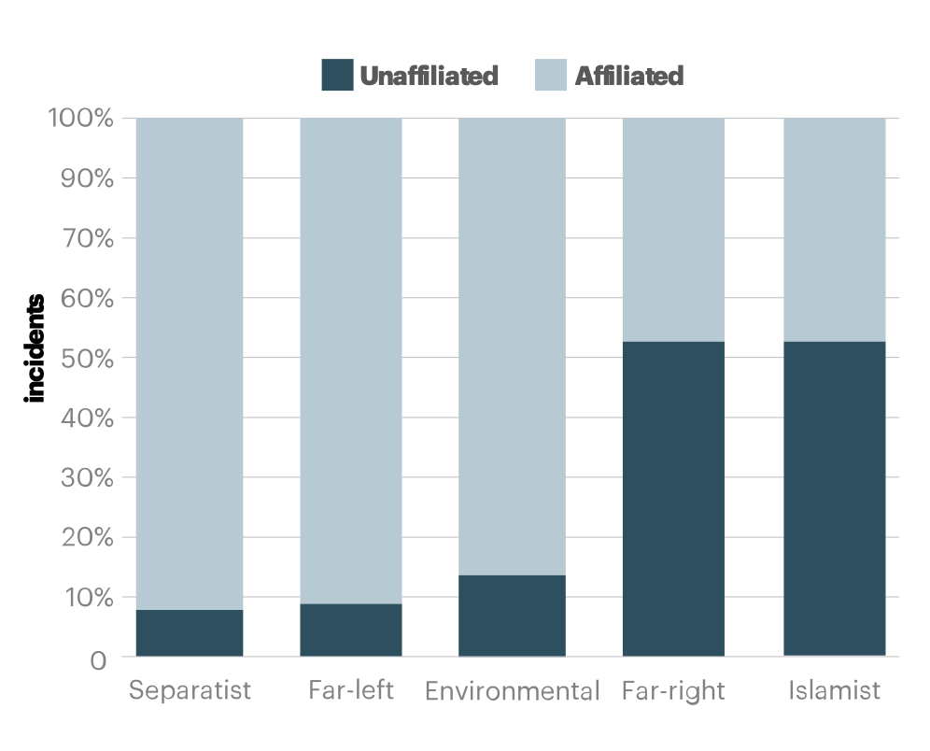
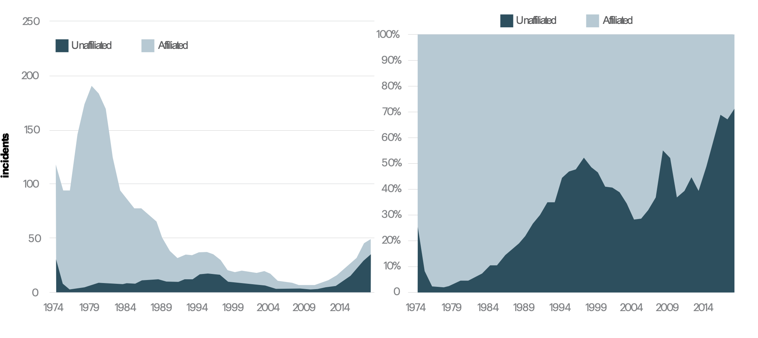
Unaffiliated and affiliated attacks
Far-right terrorists are less likely to be affiliated with a group, and this proportion has been increasing

Slide 26
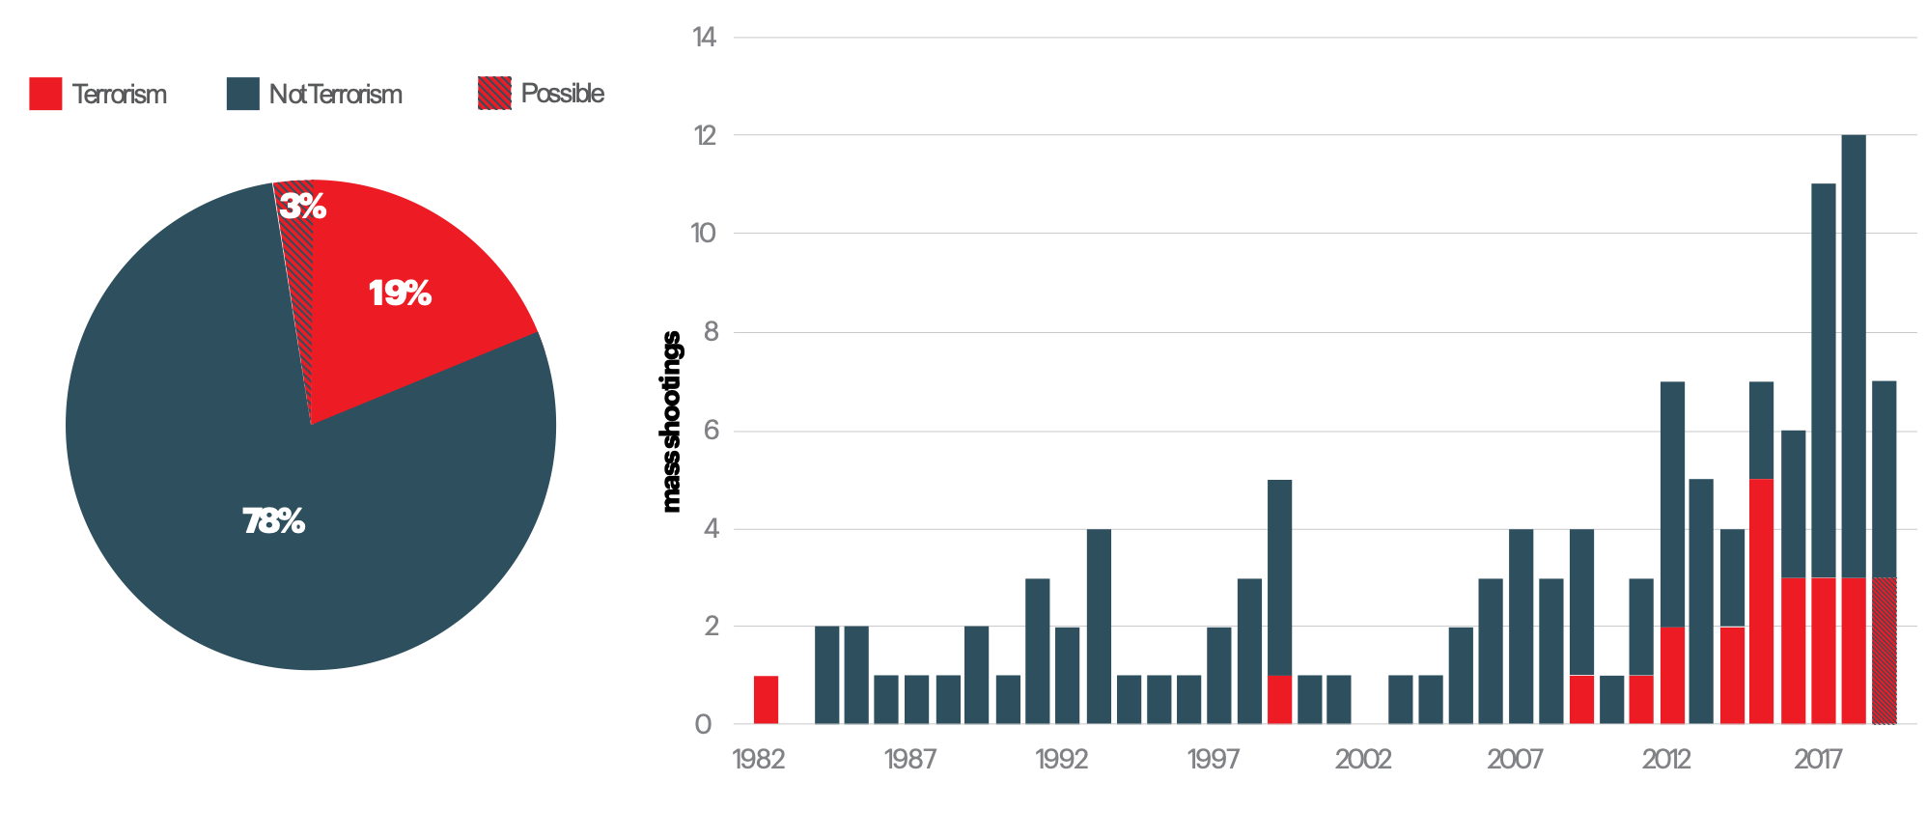
Terrorism and mass shootings
The proportion of mass shootings classified as terrorist attacks has been increasing

Slide 27
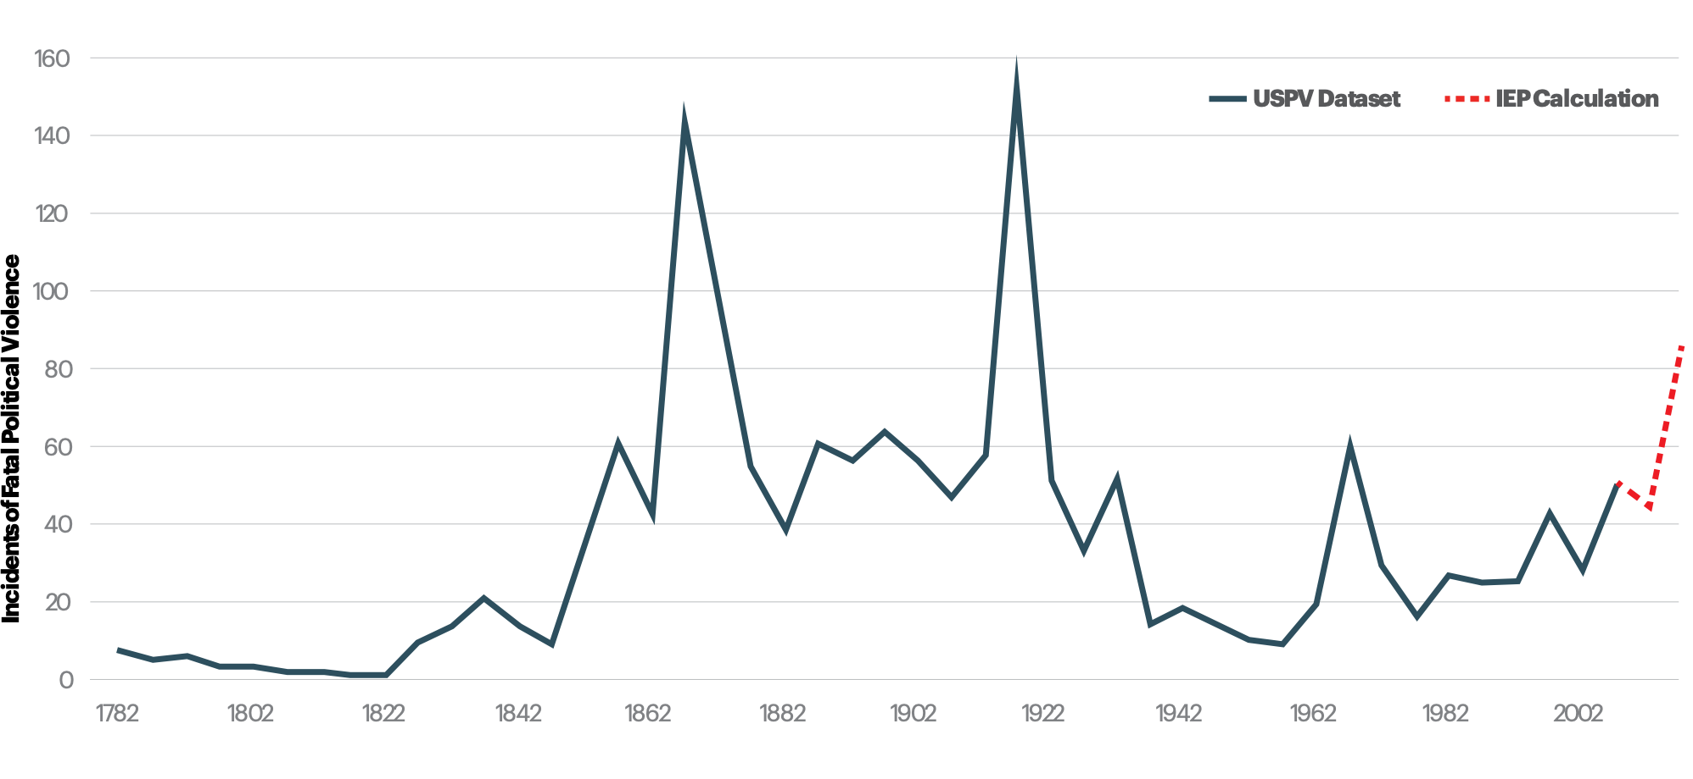
Terrorism and trends in political wave
The increase in far-right terror is part of a broader wave of increased instability, and lower Positive Peace

Slide 28
05.
Conflict and
Terrorism

Slide 29
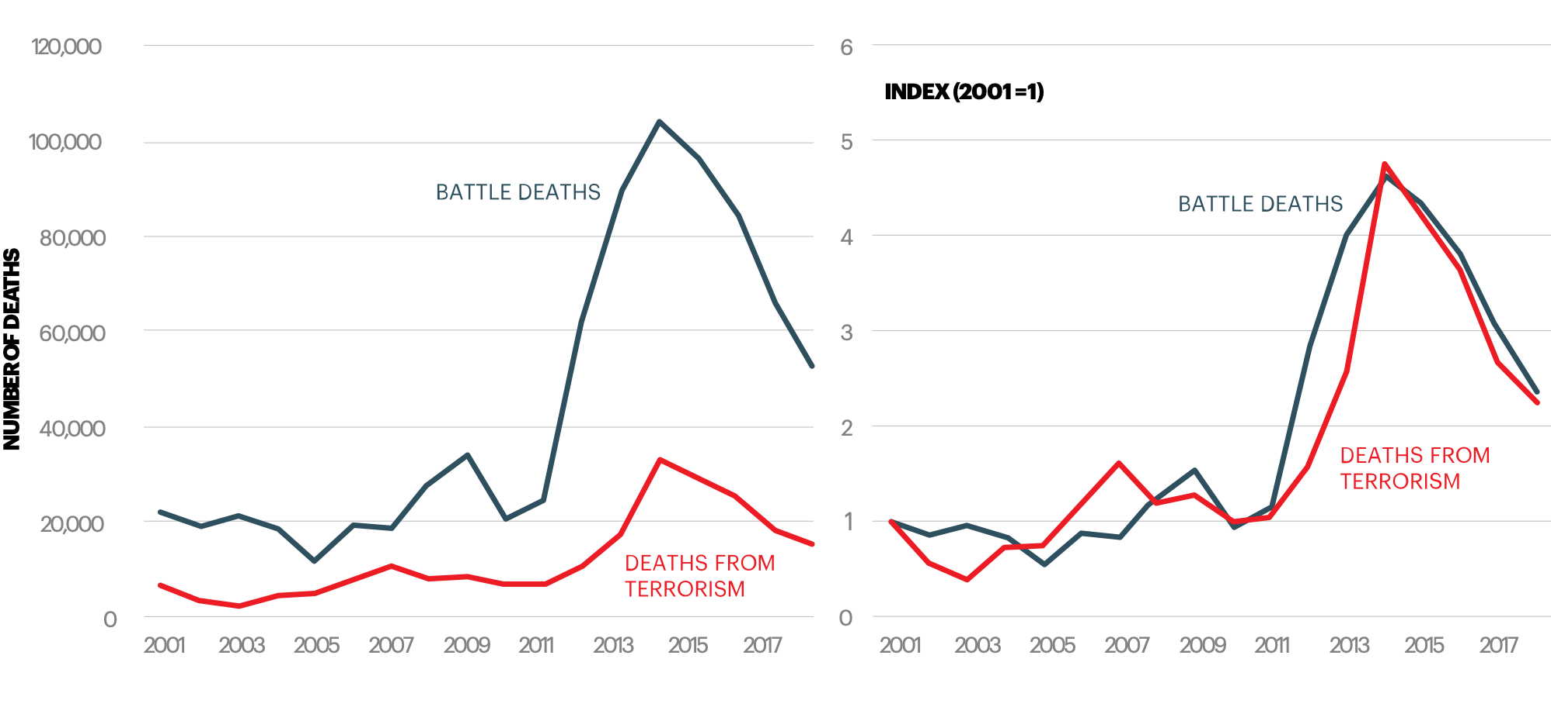
Deaths from terrorism and conflict, 2001-2018
Conflict remains the primary driver of terrorism worldwide.

Slide 30
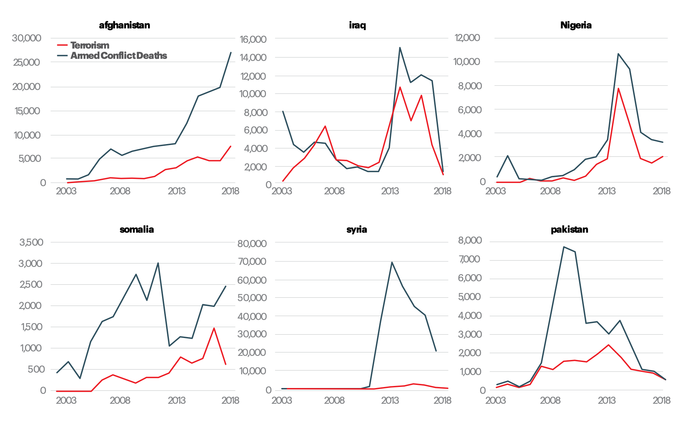
Deaths from terrorism and conflict by country, 2003-2018
All ten of the countries most impacted by terrorism were involved in at least one conflict

Slide 31
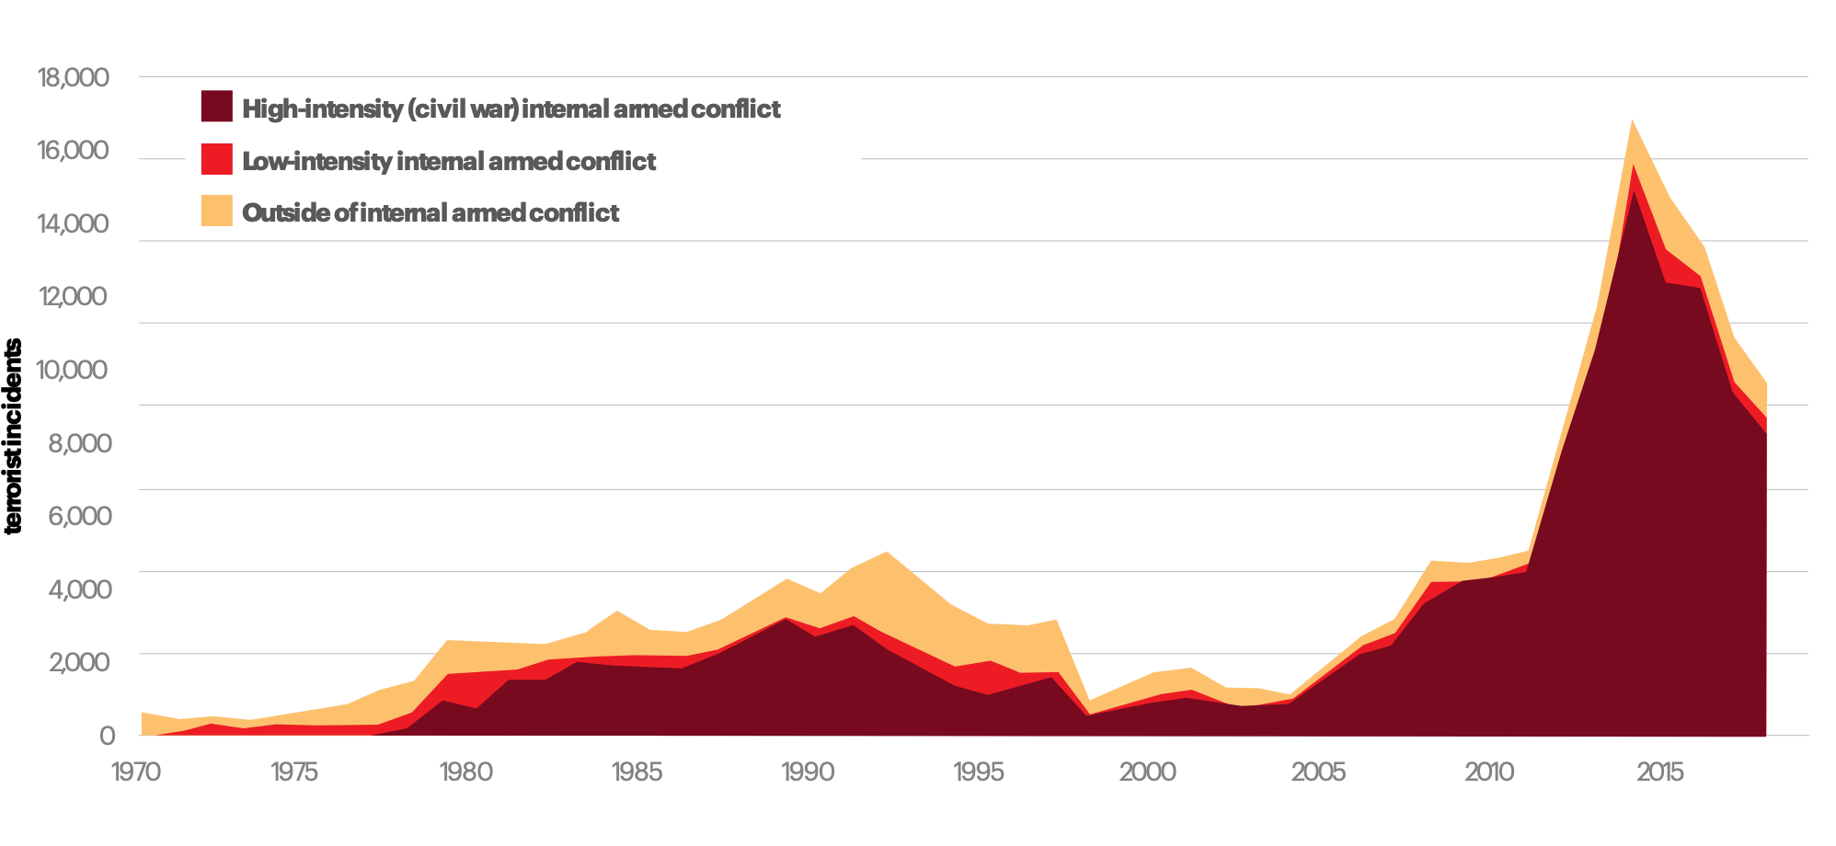
Terrorist attacks by conflict type, 1970-2018
Most terrorist incidents occur in countries in high-intensity internal armed conflicy

Slide 32
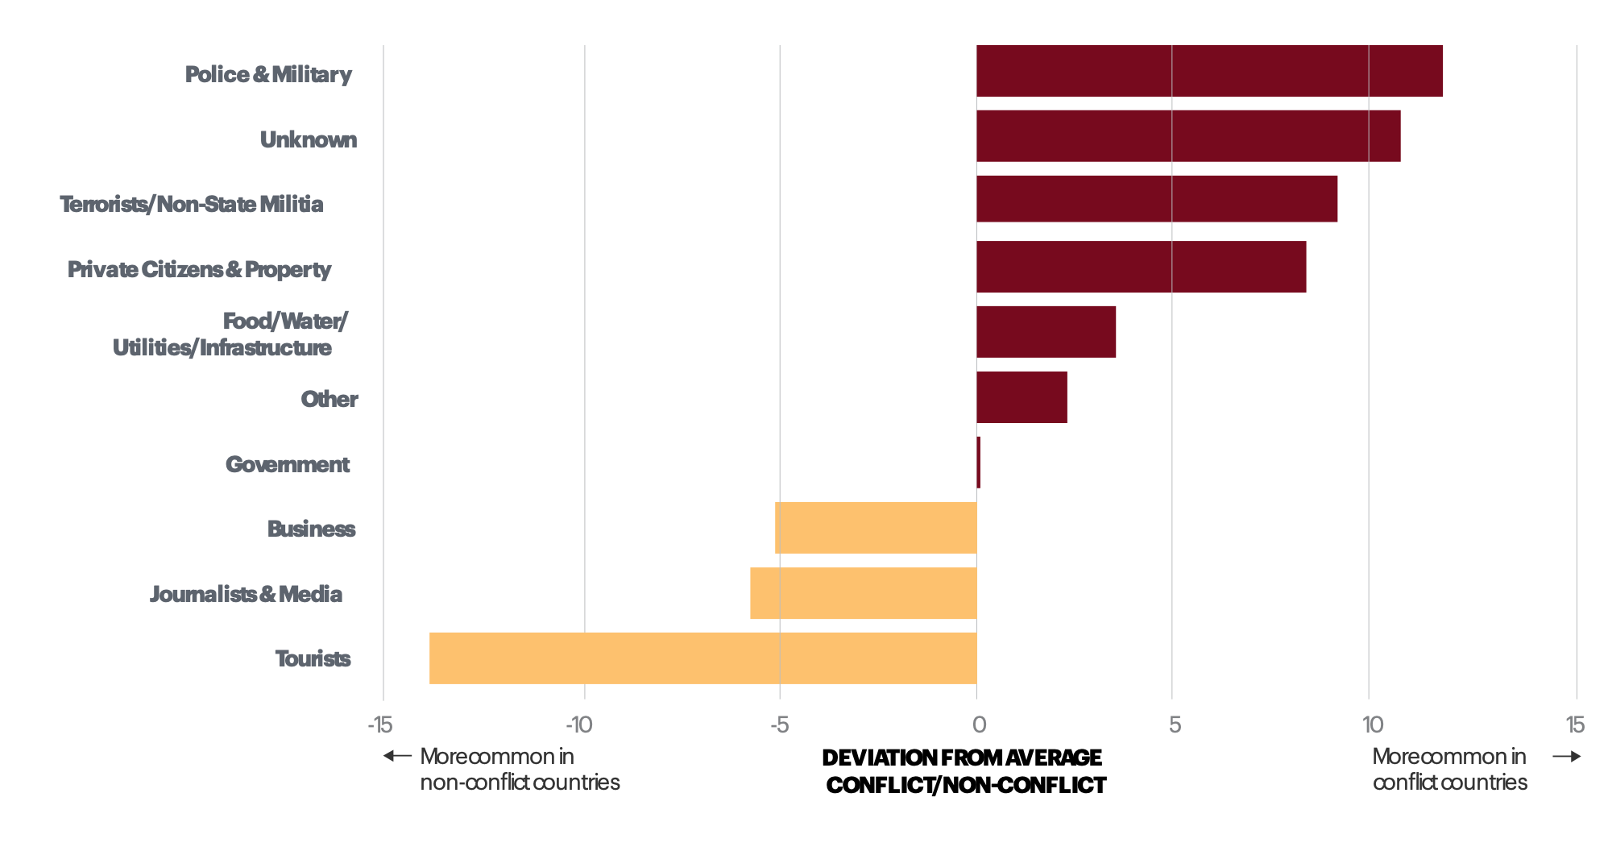
Targets of terrorism, conflict and non-conflict countries
Terrorist groups in conflict countries are much more likely to select traditional military targets

Slide 33
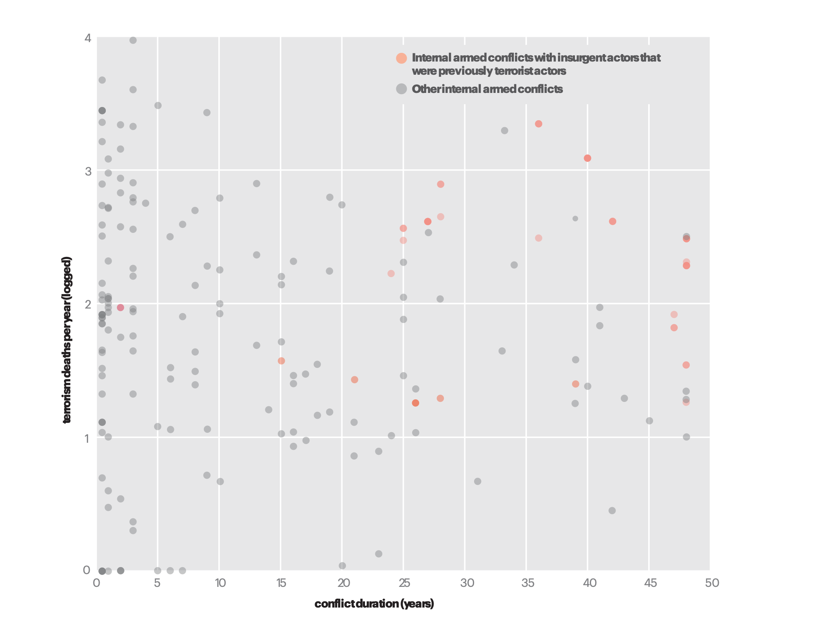
Conflict duration and intensity with terrorist group involvement, 1989-2018
The involvement of terrorist groups increases the intensity and duration of conflicts

Slide 34
06.
Gender and
Terrorism

Slide 35
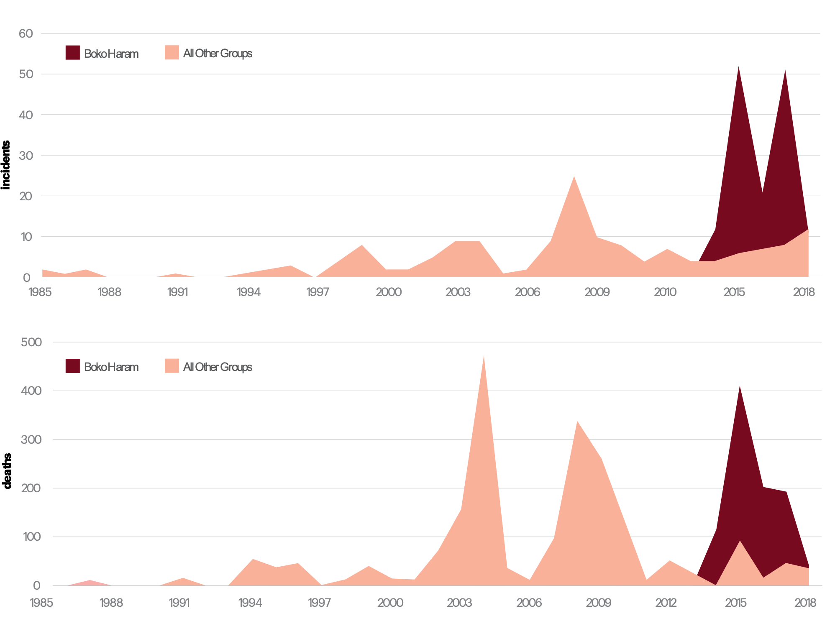
Female suicide attacks as a percentage of the total, by country, 1985-2018
Female suicide attacks were more than 30% of total suicide attacks in Cameroon, Nigeria, and Russia

Slide 36
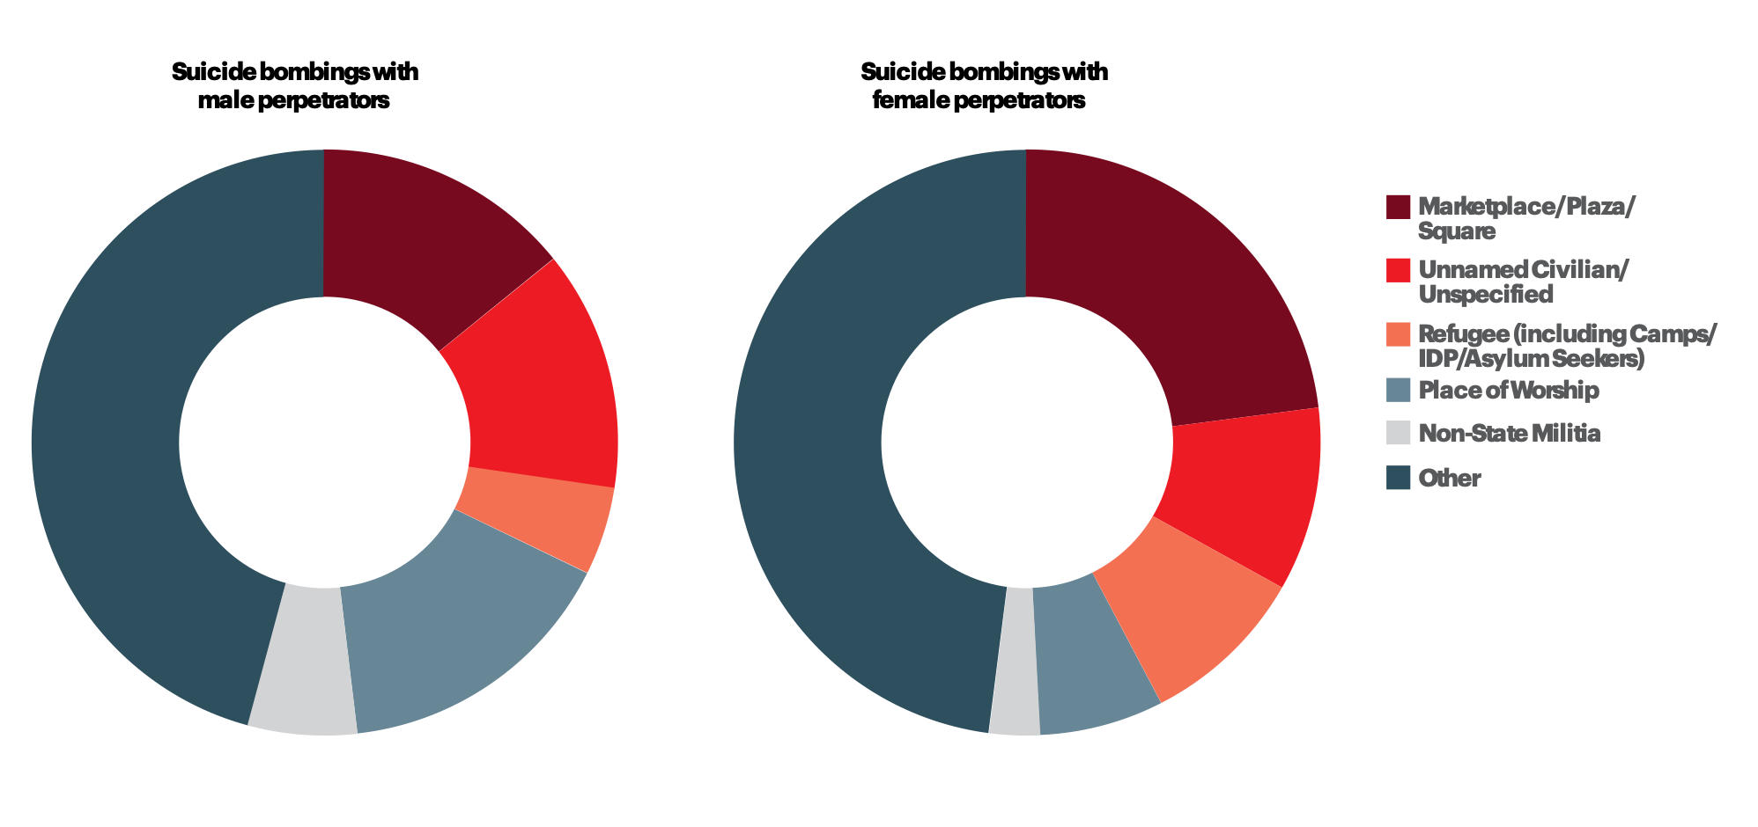
Suicide attacks by target, male and female, Boko Haram, 2014-2018
Female suicide bombers were much more likely to attack public gatherings

Slide 37
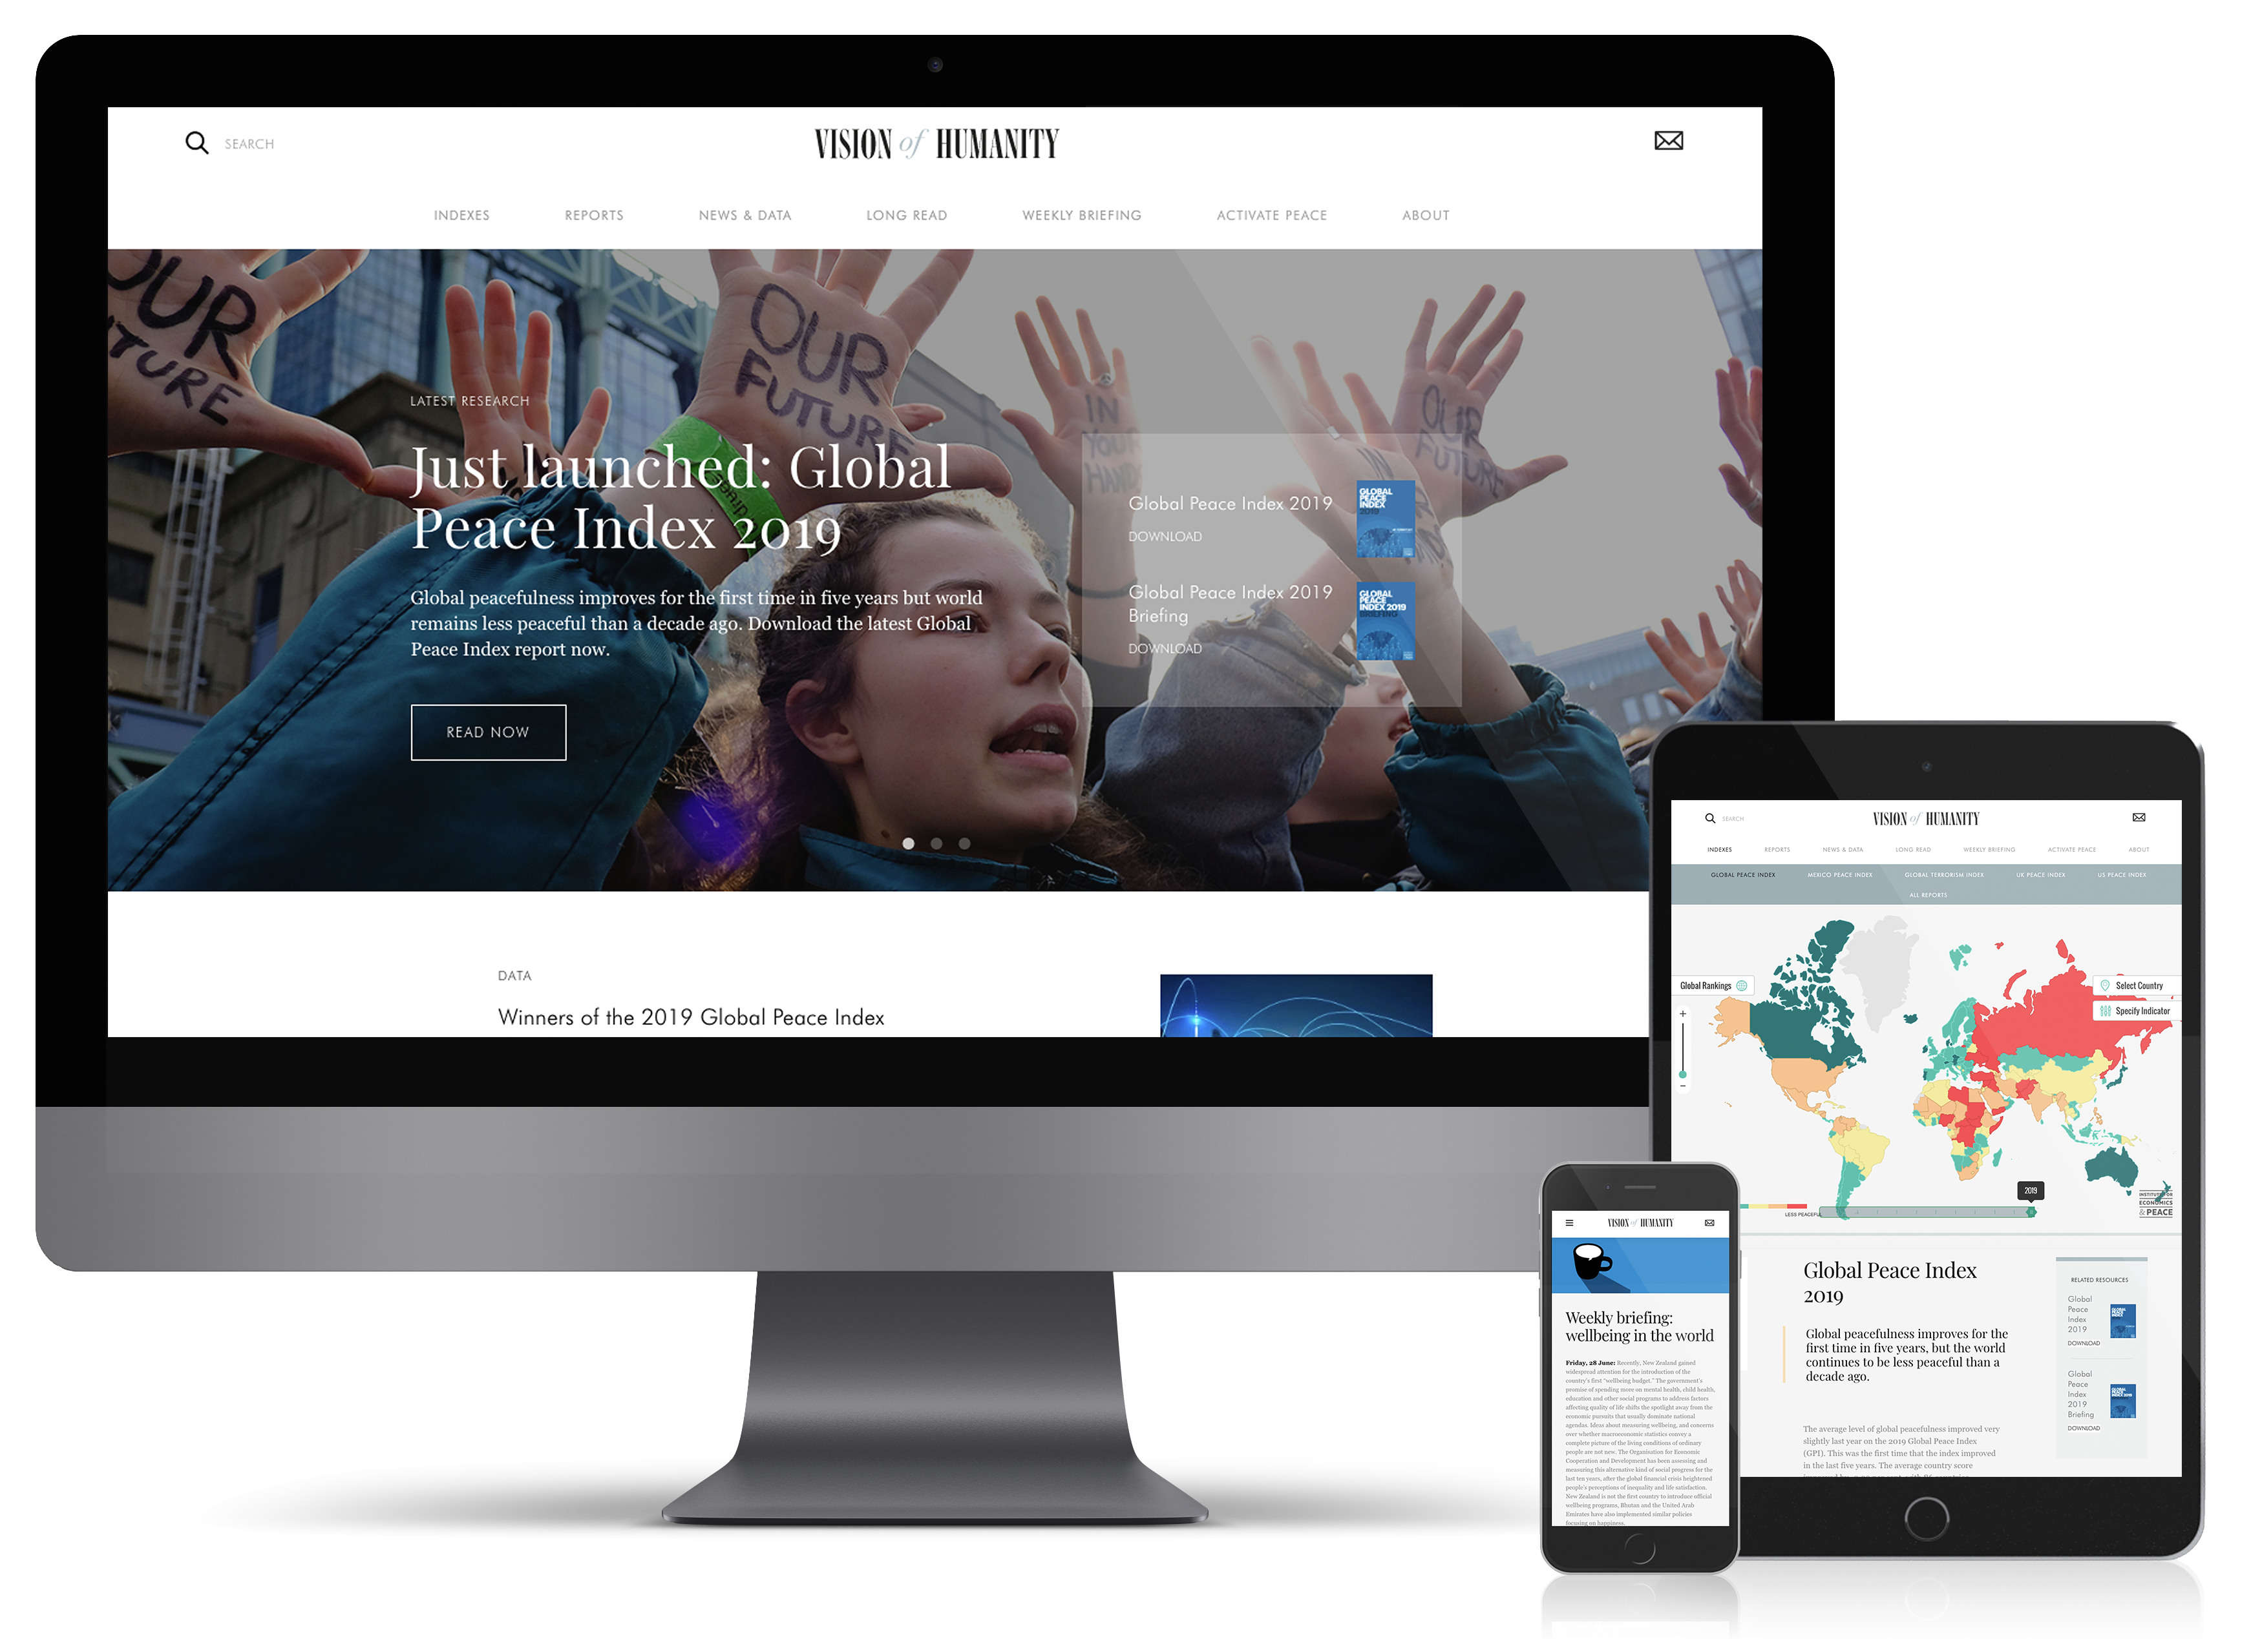
Connect with us
visionofhumanity.org
GlobalPeaceIndex
@GlobPeaceIndex
@GlobalPeaceIndex

