Slide 1
June 2020
GLOBAL PEACE INDEX 2020
Measuring peace in a complex world

Slide 2

Institute for Economics and Peace
Research used extensively by organisations, including the OECD, Commonwealth Secretariat, World Bank and the United Nations.
16BN
900M
150
2019 MEDIA REACH
SOCIAL REACH
COUNTRY REACH
Work is included in 1,000s of university courses
Over 500,000 downloads of IEP reports in the last 12 months
10
3000
1.3M
PUBLISHED REPORTS
BOOK REFERENCES
UNIQUE VISITORS

Slide 3
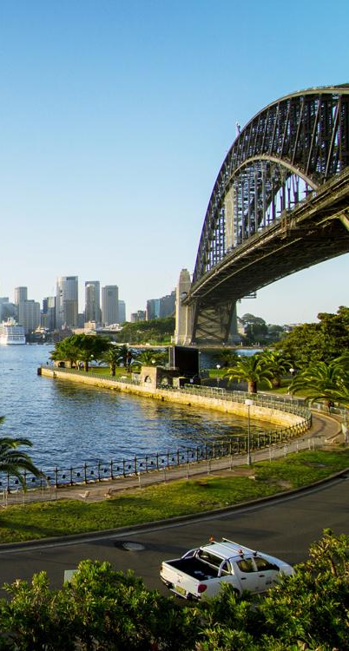
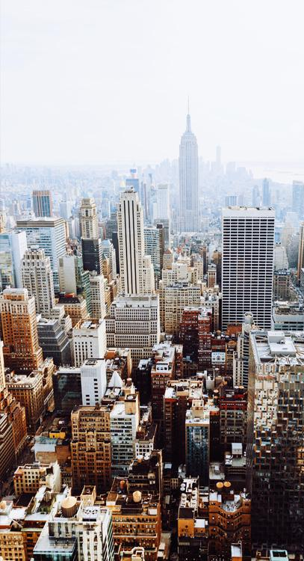
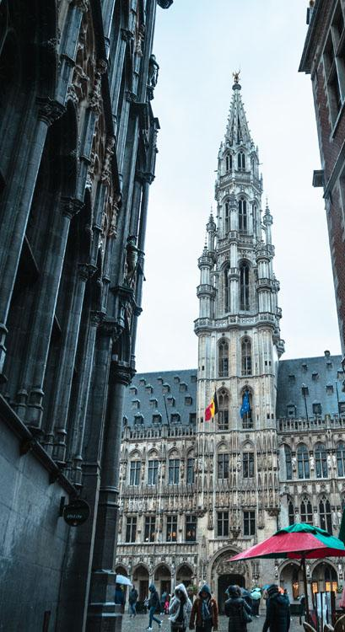
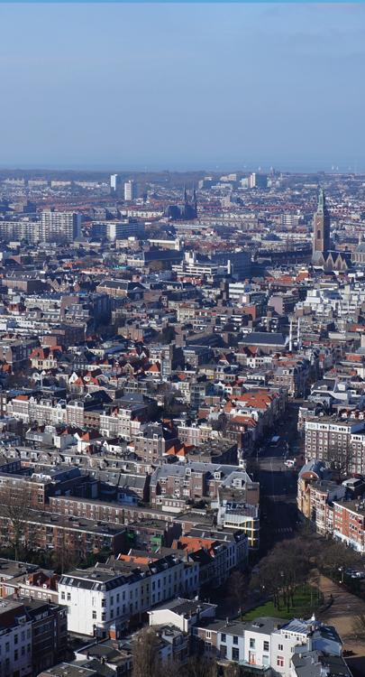
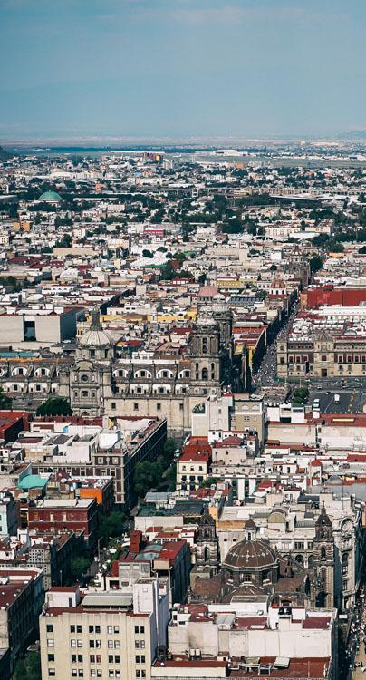
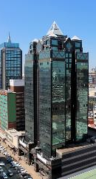
IEP International Offices
SYDNEY
NEW YORK
BRUSSELS
THE HAGUE
MEXICO CITY
HARARE
Australia
USA
Belgium
The Netherlands
Mexico
Zimbabwe

Slide 4
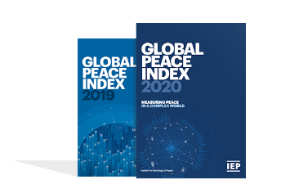
The Global Peace Index
Ranks
Now in its
99.7% of world’s population covered
14th
163
year
countries
Using
Guided and overseen by a panel of International Experts
23
Developed by the Institute for Economics and Peace
Indicators weighed on a 1-5 scale

Slide 5
The Global Peace Index Indicators
6
measures of ongoing domestic and international conflict
10
measures of societal safety
and security
7
measures of militarisation
Including: intensity of organized internal conflicts, relations with neighbouring countries and number of deaths from conflict
Including: number of refugees and IDPs, impact of terrorism, homicide and incarceration rates
Including: military expenditure, number of armed service personnel, ease of access to small weapons

Slide 6
01.
Key
Findings

Slide 7
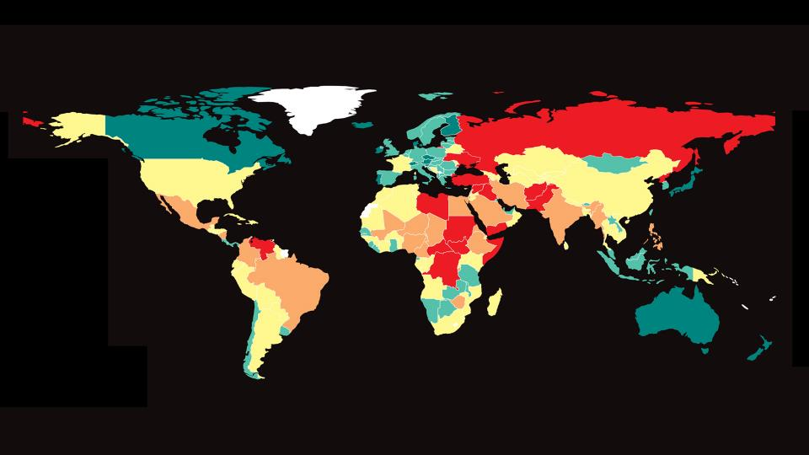
The Global Peac Index Indicators
GLOBAL PEACE INDEX 2020

Slide 8


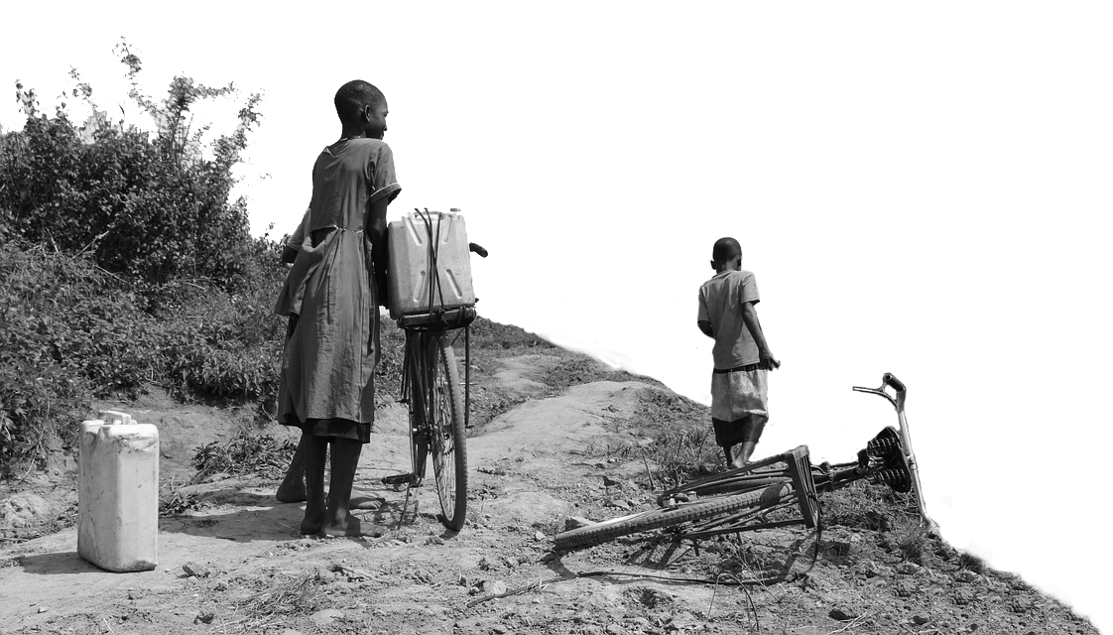
2020 Key Highlights
The average level of global country peacefulness has deteriorated by
81
countries became more peaceful
0.34%
80
countries deteriorated
This is the ninth deterioration in the last 12 years.
Improvements were driven by changes in:
Terrorism Impact
Homicides
Weapons Imports and Exports
Deteriorations primarily driven by changes in:
Political Terror Scale
Refugees and IDPs
Intensity of Internal Conflict

Slide 9
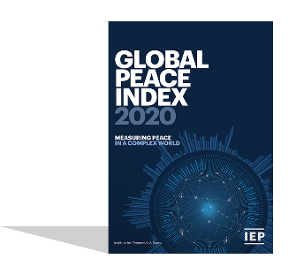

2020 highlights
Iceland is the most peaceful country in the world
Azerbaijan and Armenia had the largest improvement
Russia and Eurasia had the largest regional improvement
Europe remains the most peaceful region, despite ongoing political instability and a small deterioration in peacefulness

Slide 10

2020 highlights - continued
Afghanistan remains the world’s least peaceful nation. It has now been deteriorating for over a decade
Benin and Nicaragua had the largest deteriorations
South America and Central America had the largest
regional deteriorations
Middle East and North Africa remains the least peaceful region. However, it did improve on deaths from terrorism and internal conflict

Slide 11
10 most peaceful countries
1
ICELAND
Rank change:
6
CANADA
Rank change:
2
NEW ZEALAND
Rank change:
7
SINGAPORE
Rank change:
3
PORTUGAL
Rank change:
8
CZECH REPUBLIC
Rank change: 1
4
AUSTRIA
Rank change:
9
JAPAN
Rank change: 2
5
DENMARK
Rank change:
10
SWITZERLAND
Rank change:

Slide 12
10 least peaceful countries
163
AFGHANISTAN
Rank change:
158
SOMALIA
Rank change: 3
162
SYRIA
Rank change:
157
LIBYA
Rank change:
161
IRAQ
Rank change: 1
156
CONGO, DRC
Rank change:
160
SOUTH SUDAN
Rank change: 1
155
CENTRAL AFRICAN REPUBLIC
Rank change: 3
159
YEMEN
Rank change:
154
RUSSIA
Rank change:

Slide 13
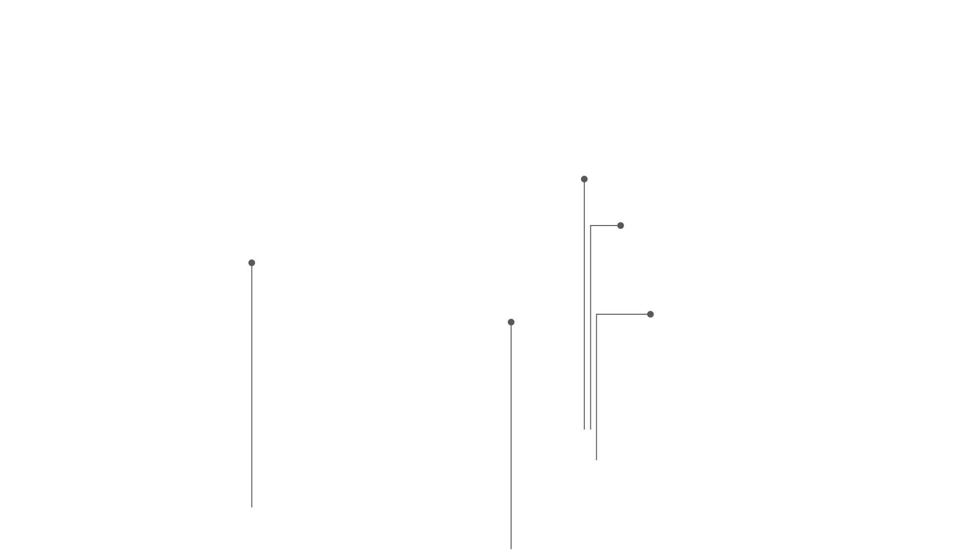

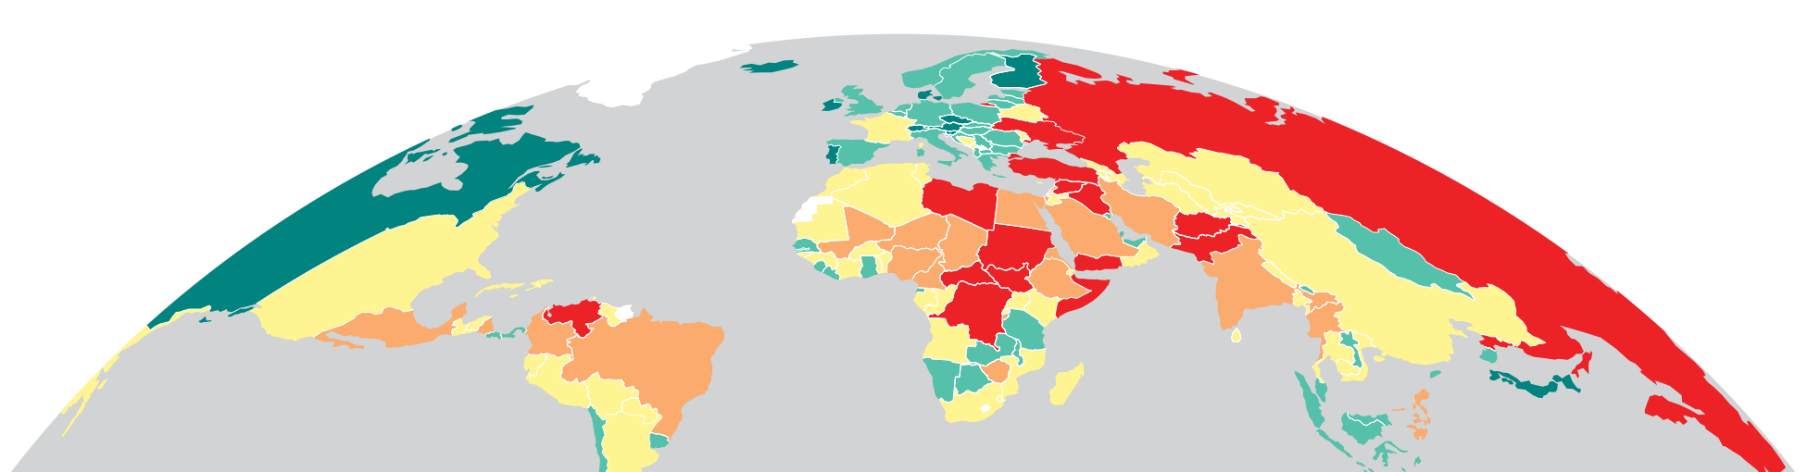
5 most improved countries
ARMENIA
RANK: 99
Rose 15 places
AZERBAJIAN
RANK: 120
Rose 12 places
SOUTH AFRICA
BAHRAIN
RANK: 123
RANK: 110
HONDURAS
Rose 3 places
Rose 9 places
RANK: 119
Rose 4 places

Slide 14
5 most deteriorated countries
BENIN
RANK: 106
Fell 35 places
CHILE
RANK: 45
NICARAGUA
Fell 17 places
RANK: 135
NIGER
Fell 15 places
RANK: 138
VENEZUELA
Fell 11 places
RANK: 149
Fell 4 places

Slide 15
02.
Trends in
Peace

Slide 16
Peace since 2008
Peacefulness has declined year on year for nine of the last 12 years.

Slide 17
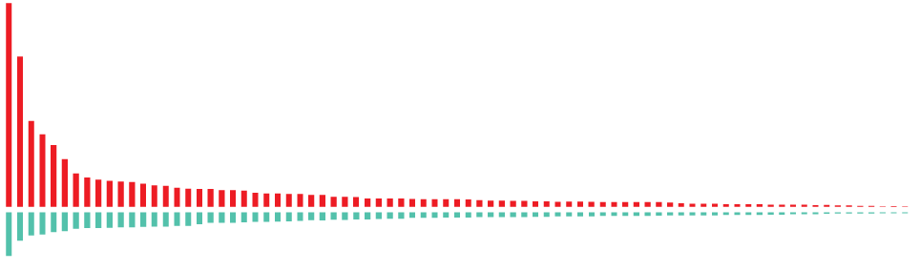
Improvements and deteriorations, 2008-2020
81
countries became less peaceful
Peace declined
2.49%
Over the last decade
79
countries became more peaceful

Slide 18
Rising inequality in Global Peace
The gap between the least and most peaceful countries continues to grow.

Slide 19
Trends in key Safety and Security indicators
After peaking in 2014, deaths from terrorism are now at the lowest level in a decade
Almost 70 million people have now been displaced by violence
The average global homicide rate continues to fall

Slide 20
Trends in key Ongoing Conflict indicators
Battle Deaths continue to fall after peak in 2014
However, the total number of active conflicts has not fallen
The average intensity of internal conflict is still rising

Slide 21
Trends in key Militarisation indicators
The fall in the size of armed forces now appears to be levelling off
Despite high spending by global superpowers, average military expenditure has declined
Weapons imports and exports have had a moderate but sustained increase

Slide 22
Civil Unrest- Highlights
From 2011 to 2019, the number of riots, general strikes and anti-government demonstrations increased by 244 per cent globally.
The number of riots around the world increased by 282 per cent from 2011 to 2019 while general strikes increased by 821 per cent.
96 countries recorded a violent demonstration in 2019, as citizens protest against a range of issues - economic hardship, race, police brutality and corruption.
Europe had the largest number of protests 1,600 events from 2011 to 2018. Sixty-five per cent of the demonstrations in Europe were nonviolent.
The impending economic recession will increase the likelihood of demonstrations and riots.

Slide 23
03.
The Economic
Value of Peace

Slide 24
The economic impact of violence 2020
$14.5
trillion
Which is equivalent to
10.6%
of total world GDP
OR
$1909
per person
If the world decreased
violence by 10%...
$1.45 TRILLION
Could be directed to
other economic activities

Slide 25
Breakdown of the economic impact of violence
Military expenditure accounts for over 40% of the total economic impact of violence.

Slide 26
04.
COVID-19 and Peace

Slide 27
COVID-19 and Peace - Key Findings
Level of air travel strongly correlated with the take up of COVID-19.
Most indicators in the Global Peace Index are expected to deteriorate. The one area that may improve is military expenditure, as countries redirect resources to propping up their economies.
Drug dealing and other types of crime have seen a temporary reduction as a result of social isolation. However, reports of domestic violence, suicide and mental illness increased.
US and Europe are expected to see an increase in political instability.

Slide 28
COVID-19 and Peace - Key Findings
US and China relations are deteriorating, affecting many multilateral organisations – WHO, WTO, UN Security Council.
Support of UN Peacekeeping operations is likely to decrease.
Overseas Developmental Aid is likely to decrease as funds are used to support domestic economies. Further stressing fragile countries, such as Liberia, Afghanistan, Burundi and South Sudan.
Countries with low credit ratings, such as Brazil, Pakistan, Argentina and Venezuela may not be able to borrow enough to sustain their economic recoveries, potentially leading to greater social unrest.

Slide 29




Positive Peace and pandemic recovery.
Countries with better financial conditions and higher Positive Peace are most likely to have the best outcomes through the crisis.
Finland
Spain
Italy
Sweden
Belgium
Greece
Denmark
France
Latvia
Ireland
Portugal
Poland
Netherlands
Slovenia
Slovakia
Canada
Hungary
UK
Brazil
Austria
South Africa
Higher Lower
Economic Strength
-
Israel
Switzerland
US
Indonesia
Australia
South Korea
Turkey
New Zealand
Czech Republic
Colombia
Norway
Lithuania
India
Iceland
Chile
Germany
Russia
Japan
China
Estonia
Mexico
Higher Positive Peace
Lower Positive Peace
PPI RANK
Source: IEP

Slide 30
Interest rate responses to US recessions
Past US recessions required cuts in the Fed Funds rates of five per cent. At 1.5 per cent, there is little room for large interest rate cuts.

Slide 31
05.
Peace and
Ecological Threat

Slide 32
Water-related risk by region
Water-related risks are highest in the Middle East and North Africa.

Slide 33
Food security vs. Positive Peace
Countries with low levels of Positive Peace have higher levels of food insecurity.

Slide 34
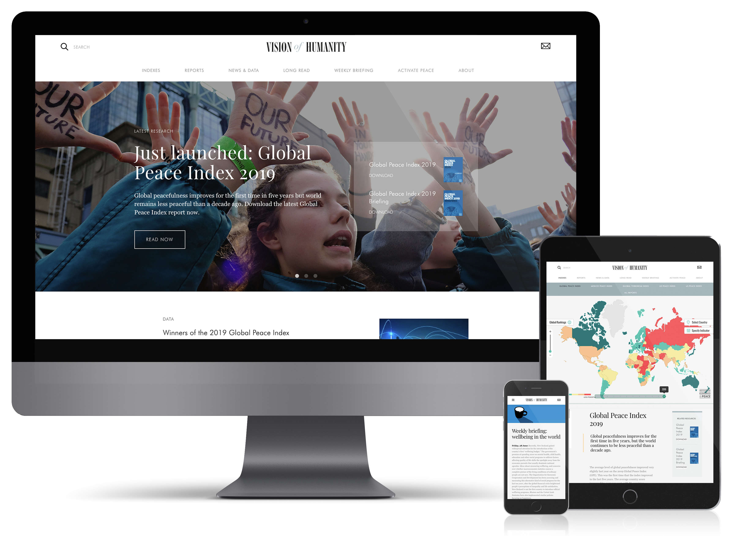
Connect with us
visionofhumanity.org
GlobalPeaceIndex
@GlobPeaceIndex
@GlobalPeaceIndex

