Slide 1
September 2020
Ecological
Threat
Register
Understanding Ecological Threats,
Resilience and Peace

Slide 2
Institute for Economics and Peace
Research used extensively by organisations, including the OECD, Commonwealth Secretariat, World Bank and the United Nations.
16BN
900M
150
2019 MEDIA REACH
SOCIAL REACH
COUNTRY REACH
Work is included in 1,000s of university courses
Over 500,000 downloads of IEP reports in the last 12 months
10
3000
1.3M
PUBLISHED REPORTS
BOOK REFERENCES
UNIQUE VISITORS

Slide 3
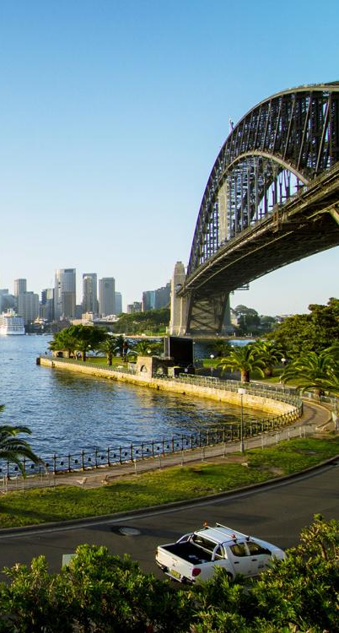
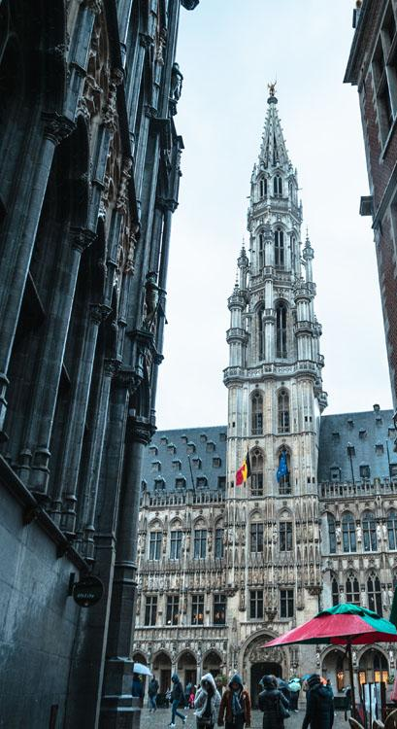
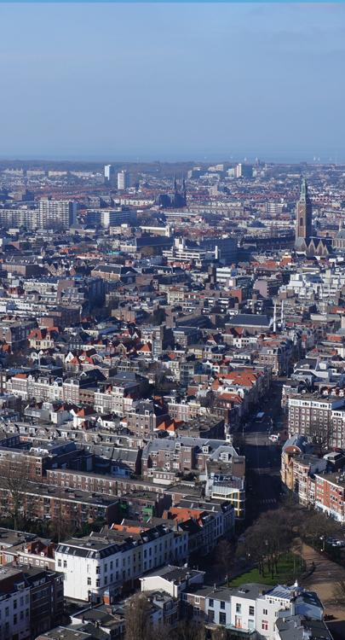
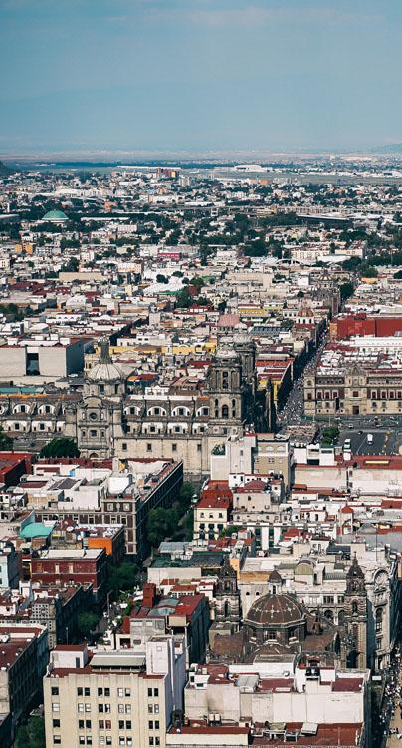
IEP International Offices
SYDNEY
NEW YORK
BRUSSELS
THE HAGUE
MEXICO CITY
HARARE
Australia
USA
Belgium
The Netherlands
Mexico
Zimbabwe

Slide 4
Ecological Threat Register 2020 (ETR)
This is the inaugural edition of the Ecological Threat Register
Covers 157 countries and 97% of the world’s population
Report covers eight areas of ecological threats
Food, water, population growth, droughts, floods, sea levels, cyclones, rising temperatures
Developed by the Institute for Economics and Peace
Measures resilience using IEP’s Positive Peace framework
The ETR projects out to 2050

Slide 5
01.
Key
Findings

Slide 6
Key Highlights
141 countries are exposed to at least one ecological threat between now and 2050.
19 of the countries with the most threats are home to 2.1 billion people.
Ten of these are in the 40 least peaceful countries on the GPI.
6.4 billion people live in countries which are exposed to medium to high ecological threats.
Three clusters of ecological hotspots are susceptible to collapse:
The Sahel-Horn belt of Africa, from Mauritania to Somalia;
The Southern African belt, from Angola to Madagascar;
The Middle East and Central Asian belt, from Syria to Pakistan.

Slide 7
Key Highlights.. Cont’d
Only 2 of the countries most at risk are amongst the 10 largest recipient of climate aid
Three major immigration routes due to ecological threat are:
Latin America to US and Canada
Sahel and sub-Saharan Africa to Europe
South Asia and Middle East to Europe
1.2 billion in high risk, low resilience countries face displacement by 2050.
Even without climate change ecological threats will lead to failed states
Notes:
Iraq and Uganda are the two countries receiving large climate related aid. Major countries with the highest risk that are not getting climate related aid are Pakistan and Ethiopia.

Slide 8
Key Highlights.. Calculating countries least likely to cope
Biggest shocks, very low resilience
Resource Risks
Water
Food
Population
740 million people
Natural Disasters
Floods
Cyclones
Droughts
Temperature
1 billion people
43 Countries
Drop Duplicates
32 countries - 1.2 billion at risk of being displaced by 2050
Notes:
Iraq and Uganda are the two countries receiving large climate related aid. Major countries with the highest risk that are not getting climate related aid are Pakistan and Ethiopia.

Slide 9
Key Highlights.. Conflict and risk
Resource Degradation
Vicious cycle
Conflict
10 of the 19 countries facing most shocks are in conflict or very low peace
4 of the 5 least peaceful countries face the most risks
Notes:
Iraq and Uganda are the two countries receiving large climate related aid. Major countries with the highest risk that are not getting climate related aid are Pakistan and Ethiopia.

Slide 10
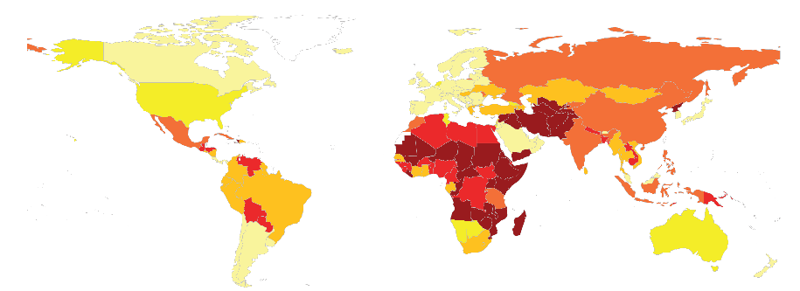
Ecological Threat Register and Resilience
Countries with low resilience and severe shocks are most at threat
Notes:
There are likely to be three major migration routes because of ecological collapse. The first is Central America to US and a lesser degree to Canada. Africa to Europe and South Asia and MENA to Europe

Slide 11
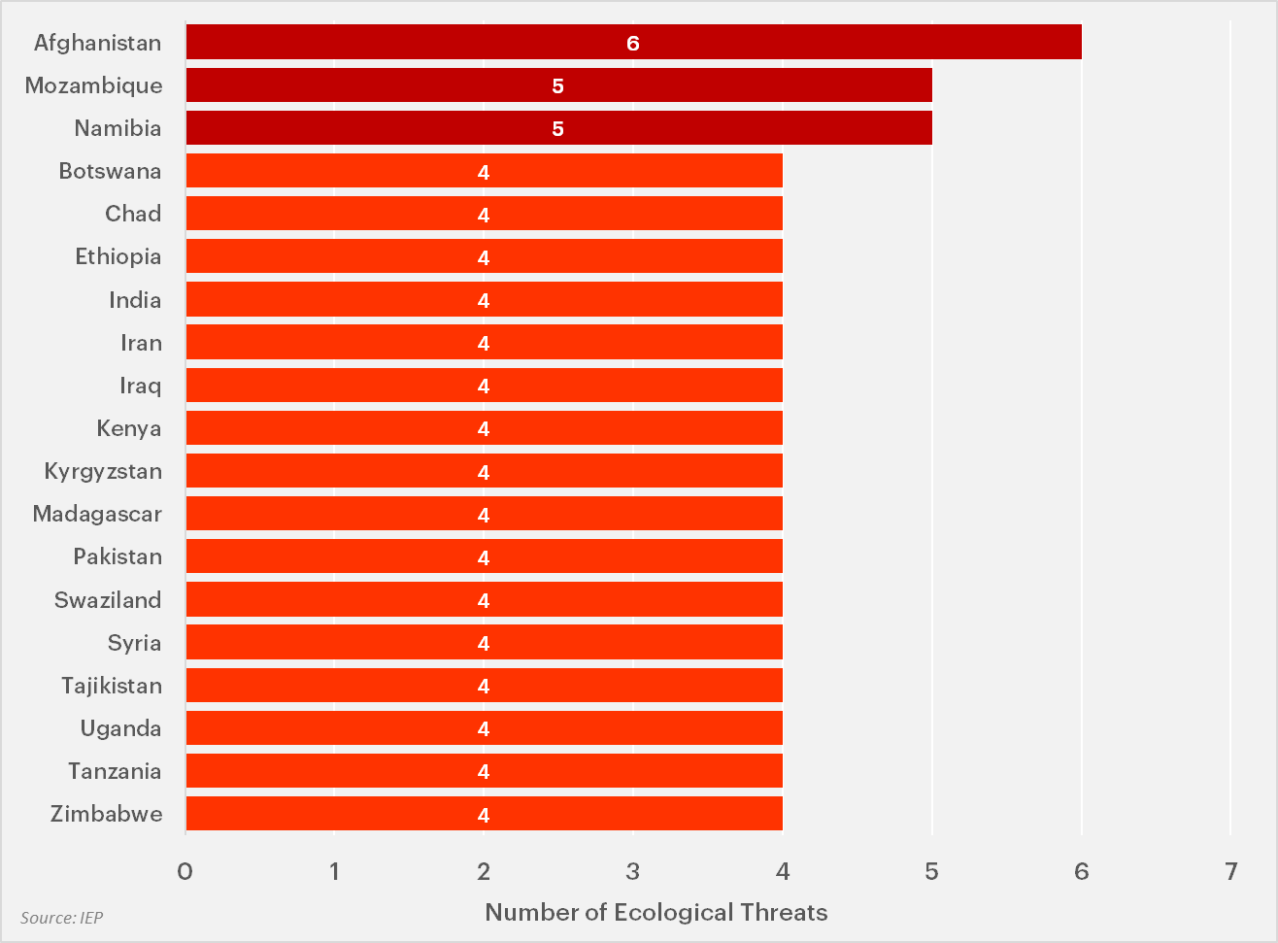
2.1 billion people live in countries facing four or more threats.
Ten of the 19 most exposed countries to ecological threats are among the world’s 40 least peaceful countries.
Notes:
Iraq, Afghanistan and Syria are amongst the five least peaceful countries and in conflict.
14 countries are likely to double their population in the next 30 years, Niger will have the biggest increase at 171%

Slide 12
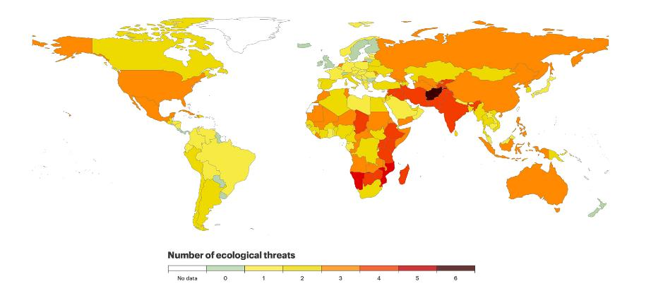
The Global Distribution of Ecological Threats
Map
Notes:
There are three areas of the world facing the most ecological threats
The Sahel-Horn belt of Africa, from Mauritania to Somalia;
The Southern African belt, from Angola to Madagascar;
The Middle East and Central Asian belt, from Syria to Pakistan.
Mention multiple threats are not good but the likely intensity of a single threat is more important, especially with low resilience – covered later in presentation

Slide 13
02.
Resilience &
Positive Peace

Slide 14
Resilience & Positive Peace – Key Findings
Positive Peace is used as the measure of resilience.
Roughly three out of every four countries has improved its Positive Peace in the last decade.
Positive Peace is associated with other highly desirable qualities:
Higher per capita income,
better ecological performance,
higher measures of well being.
Better inclusion
Positive Peace deficits good predictor of substantial falls in peace

Slide 15
Resource scarcity hotspots
746 million people live in countries with very low capacity to deal with resource depletion threats such as rapid population growth, water stress and food insecurity.
Country | Resource Depletion Count | Highest Threat | Positive Peace Status in 2018 | Change in | Population
 |  |  |  | Positive Peace | (Millions)
 |  |  |  | from 2009 to 2018
Afghanistan | 3 | Water Stress | Very Low | Marginal Improvement | 38.9
Iraq | 3 | Water Stress | Very Low | Marginal Improvement | 40.2
Eswatini | 3 | Food Security | Low | Moderate Improvement | 1.2
Yemen | 3 | Water Stress | Very Low | Deterioration | 29.8
Mozambique | 2 | Population Growth | Low | Deterioration | 31.3
Angola | 2 | Population Growth | Very Low | Marginal Improvement | 32.9
Central African Republic | 2 | Food Security | Very Low | Deterioration | 4.8
Eritrea | 2 | Population Growth | Very Low | Deterioration | 3.5
Chad | 2 | Population Growth | Very Low | Marginal Improvement | 16.4
Haiti | 2 | Food Security | Very Low | Deterioration | 11.4
Ethiopia | 2 | Population Growth | Low | Broadly Stable | 115.0
Liberia | 2 | Population Growth | Low | Broadly Stable | 5.1
Kenya | 2 | Population Growth | Low | Moderate Improvement | 53.8
Madagascar | 2 | Population Growth | Low | Broadly Stable | 27.7
Pakistan | 2 | Water Stress | Very Low | Marginal Improvement | 220.9
Republic of the Congo | 2 | Population Growth | Very Low | Broadly Stable | 5.5
Syria | 2 | Water Stress | Very Low | Deterioration | 17.5
Tajikistan | 2 | Population Growth | Very Low | Marginal Improvement | 9.5
Timor-Leste | 2 | Water Stress | Low | Marginal Improvement | 1.3
Uganda | 2 | Population Growth | Low | Broadly Stable | 45.7
Zambia | 2 | Population Growth | Low | Broadly Stable | 18.4
Zimbabwe | 2 | Population Growth | Very Low | Moderate Improvement | 14.9
Total |  |  |  |  | 745.7
Notes:
The countries most at threat are ones with very low and deteriorating Positive Peace.
The countries in this table are the ones which are likely to have the worst shocks with poor resilience 6 face water shocks, 13 population growth ( all greater than 100% in next 30 years) and 3 food security.

Slide 16
Natural distater hotspots
More than one billion people live in countries with high exposure to natural disasters and very low resilience.
Country | Natural Disaster Count | Highest Threat | Positive Peace Status in 2018 | Change in | Population
 |  |  |  | Positive Peace | (Millions)
 |  |  |  | from 2009 to 2018
Mozambique | 3 | Droughts | Low | Deterioration | 31.3
Afghanistan | 2 | Droughts | Very Low | Marginal Improvement | 38.9
Bangladesh | 2 | Floods | Low | Marginal Improvement | 164.7
Chad | 2 | Floods | Very Low | Marginal Improvement | 16.4
Ethiopia | 2 | Droughts | Low | Broadly Stable | 115.0
Iran | 2 | Floods | Low | Deterioration | 84.0
Kenya | 2 | Droughts | Low | Moderate Improvement | 53.8
Madagascar | 2 | Cyclone | Low | Broadly Stable | 27.7
Malawi | 2 | Droughts | Low | Broadly Stable | 19.1
Mali | 2 | Floods | Very Low | Deterioration | 20.3
Mauritania | 2 | Droughts | Very Low | Deterioration | 4.6
Niger | 2 | Floods | Very Low | Marginal Improvement | 24.2
North Korea | 2 | Floods | Very Low | Broadly Stable | 25.8
Pakistan | 2 | Floods | Very Low | Marginal Improvement | 220.9
Somalia | 2 | Droughts | Very Low | Broadly Stable | 15.9
Sudan | 2 | Floods | Very Low | Broadly Stable | 43.8
Syria | 2 | Droughts | Very Low | Deterioration | 17.5
Tajikistan | 2 | Droughts | Very Low | Marginal Improvement | 9.5
Uganda | 2 | Droughts | Low | Broadly Stable | 45.7
Uzbekistan | 2 | Droughts | Low | Moderate Improvement | 33.5
Zimbabwe | 2 | Droughts | Very Low | Moderate Improvement | 14.9
Total |  |  |  |  | 1,027.5
Notes:
Droughts are the most common future natural disaster (12) followed by floods (8). 11 countries are in both tables with six at least doubling their population in the next 30 years.

Slide 17
03.
Resource
scarcity

Slide 18
Population growth – Key Findings
Global population is projected to reach 10 billion by 2050.
By 2050, the 40 least peaceful countries will have an additional 1.3 billion people and will be home to more than half of the world’s population.
17 countries in sub-Saharan Africa are projected to double their population by 2050, making it the fastest growing region globally.

Slide 19
By 2050, the 40 least peaceful countries will have an additional 1.3 billion people.
Notes:
The largest increases in population are in the low peace countries highlighting the relationship between peace and sustainability

Slide 20
Water Stress – Key Findings
2.6 billion people live in 46 countries experiencing high or extreme water stress.
There is now 60 per cent less freshwater available per person
today than there was in the early 1960s.
By 2040, 5.4 billion people will live in the 59 countries experiencing high or extreme water stress, including India and China.
The number of water-related conflict and violent incidents increased by 270 per cent worldwide in the last decade. Yemen and Iraq had most incidents.
The combined effects of rising temperatures, population growth and increased rainfall variability will reduce future water availability.

Slide 21
Global fresh water use, 1900-2050
Global fresh water use will increase by 50 per cent by 2050
Source: Flörke et al. 2013, World Bank, IEP calculations
Notes:
There is now 60 per cent less freshwater available per person today than there was in the early 1960s.
The population is increasing faster than water availability.

Slide 22
Food Security – Key Finding
Food insecurity means not having enough food for a healthy life – can be intermittent or irregular.
An estimated 2 billion people currently face food insecurity.
By 2050, this figure is expected to increase to 3.5 billion people.
58 per cent of the people in sub-Saharan Africa face food insecurity – the highest of any region.
65 per cent of the population in each of the world’s least peaceful and low income countries (13 countries) experience food affordability problems.

Slide 23
Global food insecurity is on the rise
Hunger and food insecurity have increased since 2014, with an additional 300 million people facing food insecurity. COVID-19 will only increase this figure in 2020.
Indicator | 2014 | 2015 | 2016 | 2017 | 2018
Total food insecure population (billions of people) | 1.7 | 1.7 | 1.8 | 1.9 | 2.0
Prevalence of food insecurity in the adult population | 23% | 23% | 24% | 26% | 26%

Slide 24
04.
Natural
Disasters

Slide 25
Natural disasters – Key Findings
One billion people live in areas that combine high frequency and intensity of natural disasters with low and stagnant levels of Positive Peace.
Floods and storms account for 72 per cent of the natural disasters between 1990 and 2019.
Natural disasters displaced 25 million people in 2019. This is three times higher than the 8.6 million displaced by armed conflict.
A 2.1-metre rise in sea levels would permanently cover land that is currently home to 200 million people around the world.

Slide 26
05.
Development Assistance and Resilience

Slide 27
COUNTRIES receiving the most CLIMATE-RELATED AID
India received significantly more climate-related aid than any other country in 2018 at US $6.5 billion.
Country | Total climate-related development finance | Positive Peace Status in 2018 | ETR count
 | US$(millions)
India | $6,533 | Medium | 4
Bangladesh | $1,800 | Low | 2
Indonesia | $1,626 | Medium | 3
Uganda | $1,164 | Low | 4
Philippines | $993 | Low | 3
Morocco | $918 | Medium | 3
Colombia | $535 | Medium | 1
Ethiopia | $526 | Low | 4
Iraq | $439 | Very Low | 4
Mexico | $428 | Medium | 3
Only three of the 22 most vulnerable countries are in this list

Slide 28
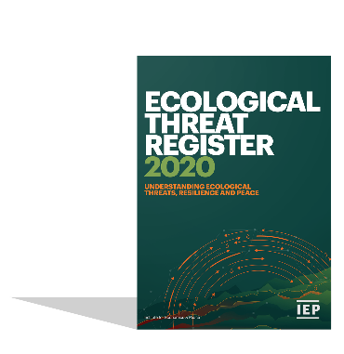
Download our research
Download the Ecological Threat Register 2020 report plus our other research at:
visionofhumanity.org/reports

