Slide 1
POSITIVE
PEACE 2019
CONFERENCE
Analysing the factors that sustain peace

Slide 2
“
The Institute for Economics and Peace is an independent, not-for-profit think tank dedicated to building a greater understanding of the key drivers of peace, as well as identifying the economic benefits that increased peacefulness can deliver.

Slide 3
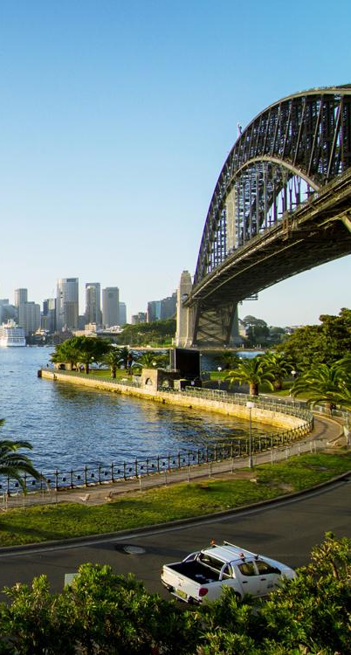
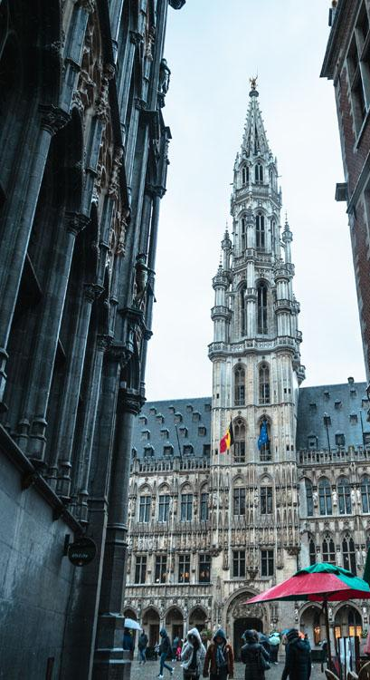
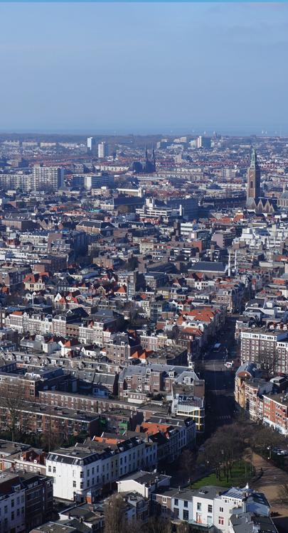
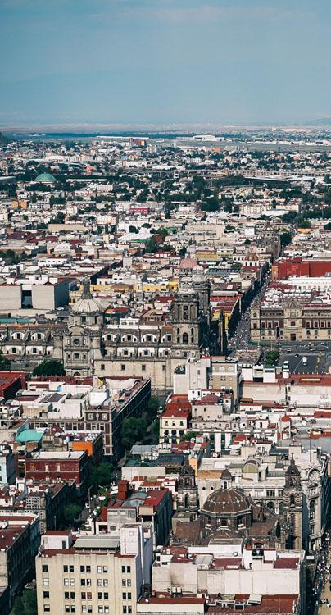
IEP International Offices
SYDNEY
NEW YORK
BRUSSELS
THE HAGUE
MEXICO CITY
HARARE
Australia
USA
Belgium
The Netherlands
Mexico
Zimbabwe

Slide 4
About the Institute
Research used extensively by organisations including the OECD, Commonwealth Secretariat, World Bank and the United Nations.
16BN
968M
150
GLOBAL MEDIA REACH
SOCIAL REACH
COUNTRY REACH
Work is included in 1,000s of university courses and trained over 1,500 IEP ambassadors.
Over 200,000 downloads of IEP reports last 12 months.
8,600
3000
1.5M
NEWS ARTICLES
BOOK REFERENCES
UNIQUE VISITORS

Slide 5
01.
What is Positive Peace?

Slide 6
What is Positive Peace?
Notes:
Ask Darren if more intro slides are available/needed

Slide 7
The Global Peace Index
Now in its
Ranks
11th
163
According to their relative states of peace
year
countries
Using
Guided and overseen by a panel of International Experts
23
Developed by the Institute for Economics and Peace
Indicators weighed on a 1-5 scale

Slide 8
Global Peace Index indicators
6
measures of ongoing domestic and international conflict
10
measures of societal safety
and security
7
measures of militarisation
Including: intensity of organized internal conflicts, relations with neighbouring countries and number of deaths from conflict
Including: number of refugees and IDPs, impact of terrorism, homicide and incarceration rates
Including: military expenditure, number of armed service personnel, ease of access to small weapons

Slide 9
Defining and measuring peace
The perfect state would have no police, jails or crime.
Actual Peace
Measures:
Crime
Suppression
Military
Armed Conflict
Positive Peace
Derived through statistical analysis of datasets, indices and attitudes with the GPI
GPI
Positive Peace Index
Notes:
There are two types of peace. Negative and positive.
Starting point for the GPI is to image a state with no need for jails, crime and therefore no peace.
The definition in the Global Peace Index is ‘absence of violence’ and ‘absence of fear of violence’
But negative peace doesn’t tell you anything about what is necessary for a peaceful society
Positive peace index is derived through statistical analysis of over 9,000 datasets, indexes and attitudinal surveys
This is first empiric attempt to derive positive peace, this enables one to imagine how a world can become more peaceful.

Slide 10
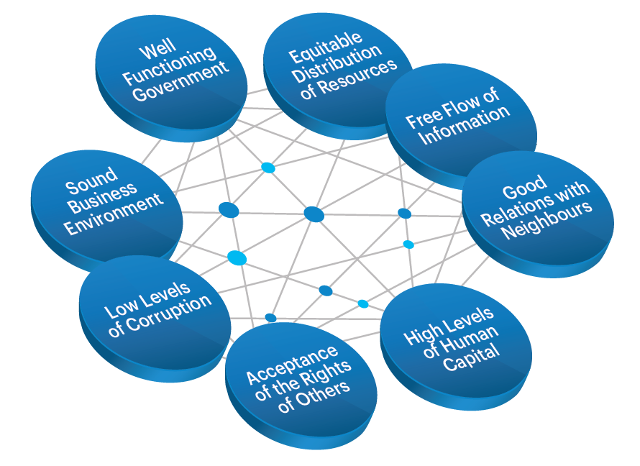
Positive Peace
Positive Peace creates the optimum environment for human potential to flourish.
High levels of Positive Peace are associated with:
Higher per capita income
Resilience
Better environmental outcomes
Higher measure of wellbeing
Better performance on MDGs

Slide 11
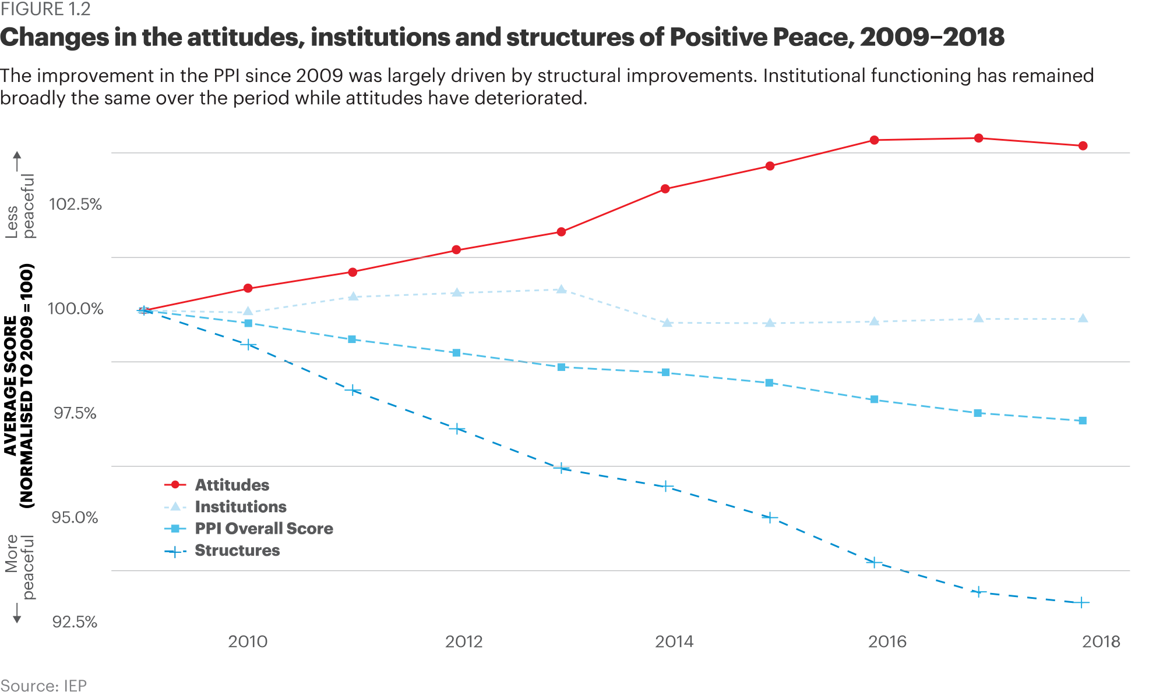
Changes in the Attitudes, Institutions & Structures of Positive Peace, 2009 -2018
Improvement in the PPI since 2009 was largely driven by structural improvements.

Slide 12
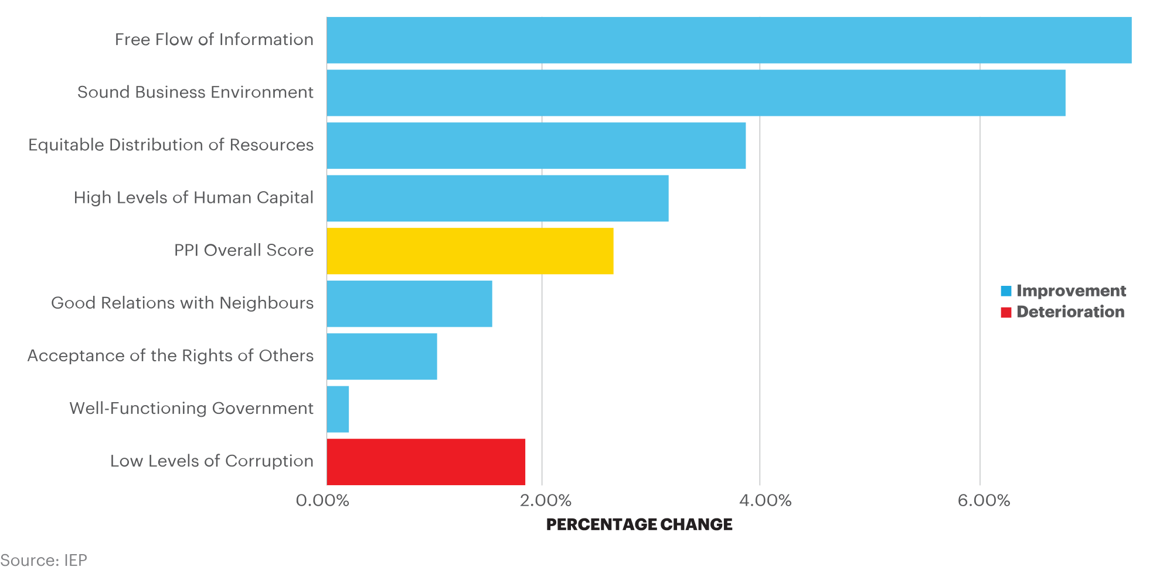
Changes in the pillars of peace, 2009-2018
Seven of the eight Pillars have improved since 2009. Low Levels of Corruption, however deteriorated 1.9 per cent over the period.

Slide 13
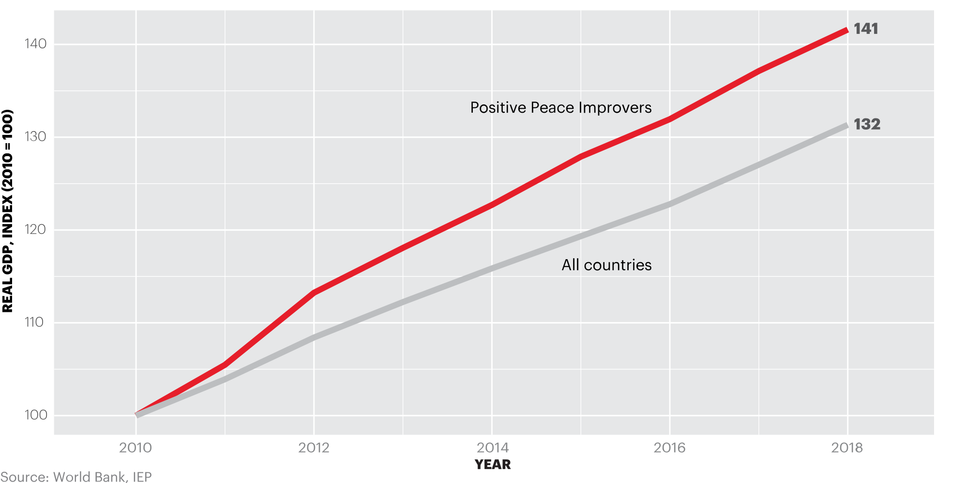
Countries that improve in Positive Peace outperform the global average
Growth in real GDP of a portfolio of countries that improve in Positive Peace exceeds an equally weighted global average by one percentage point per year.

Slide 14
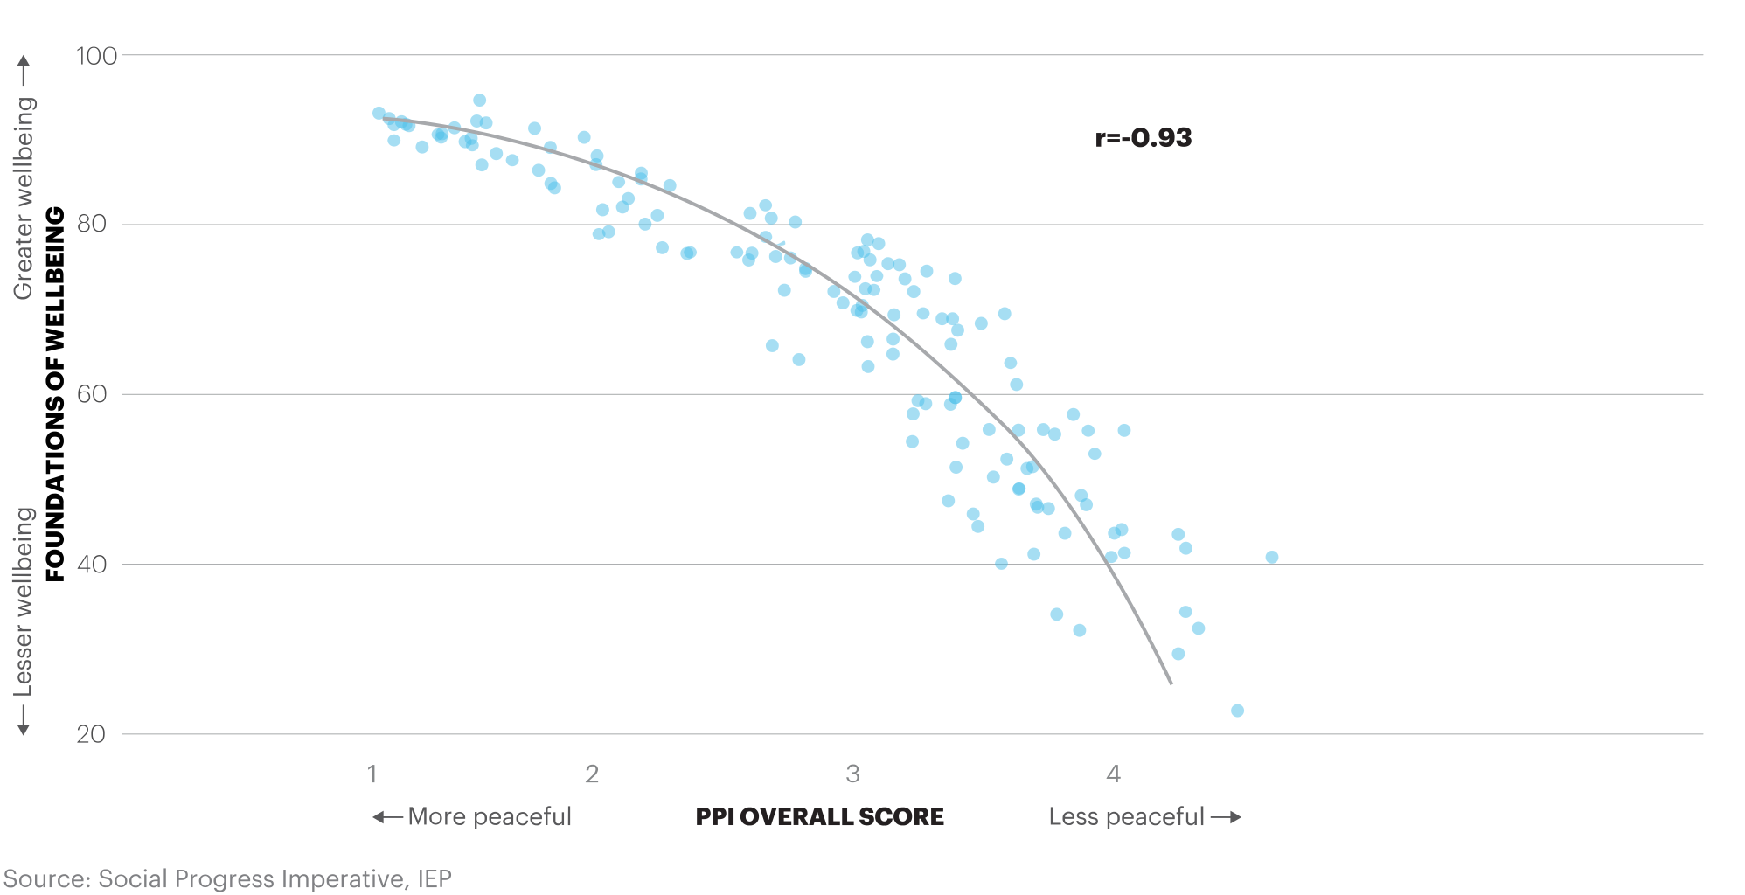
Social and wellbeing and Positive Peace, 2018
There is a close correlation between the SPI Foundations of Wellbeing scores and PPI scores.

Slide 15
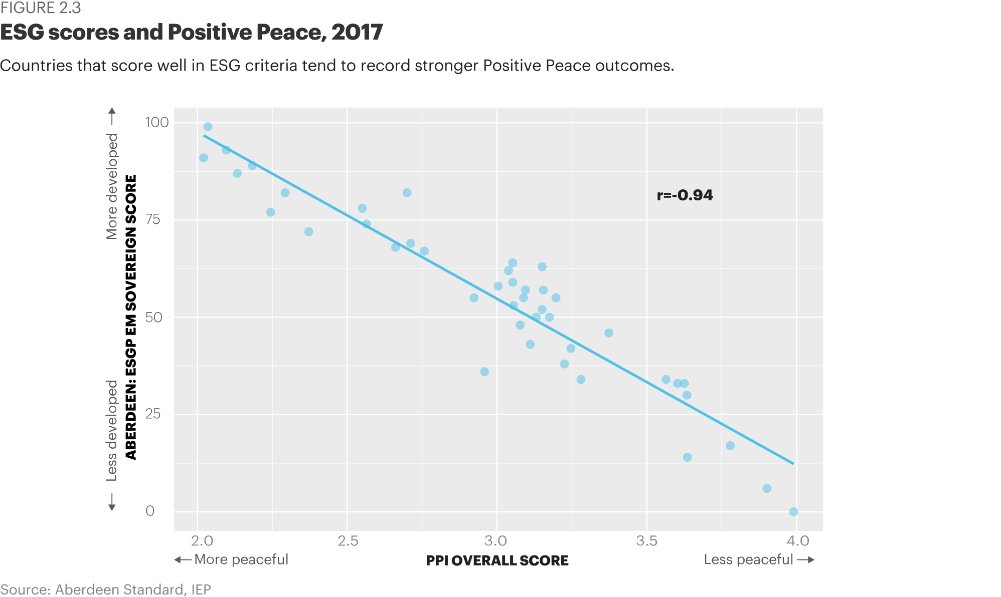
ESG scores and Positive Peace, 2017
Countries that score well in ESG criteria tend to record stronger Positive Peace outcomes.

Slide 16
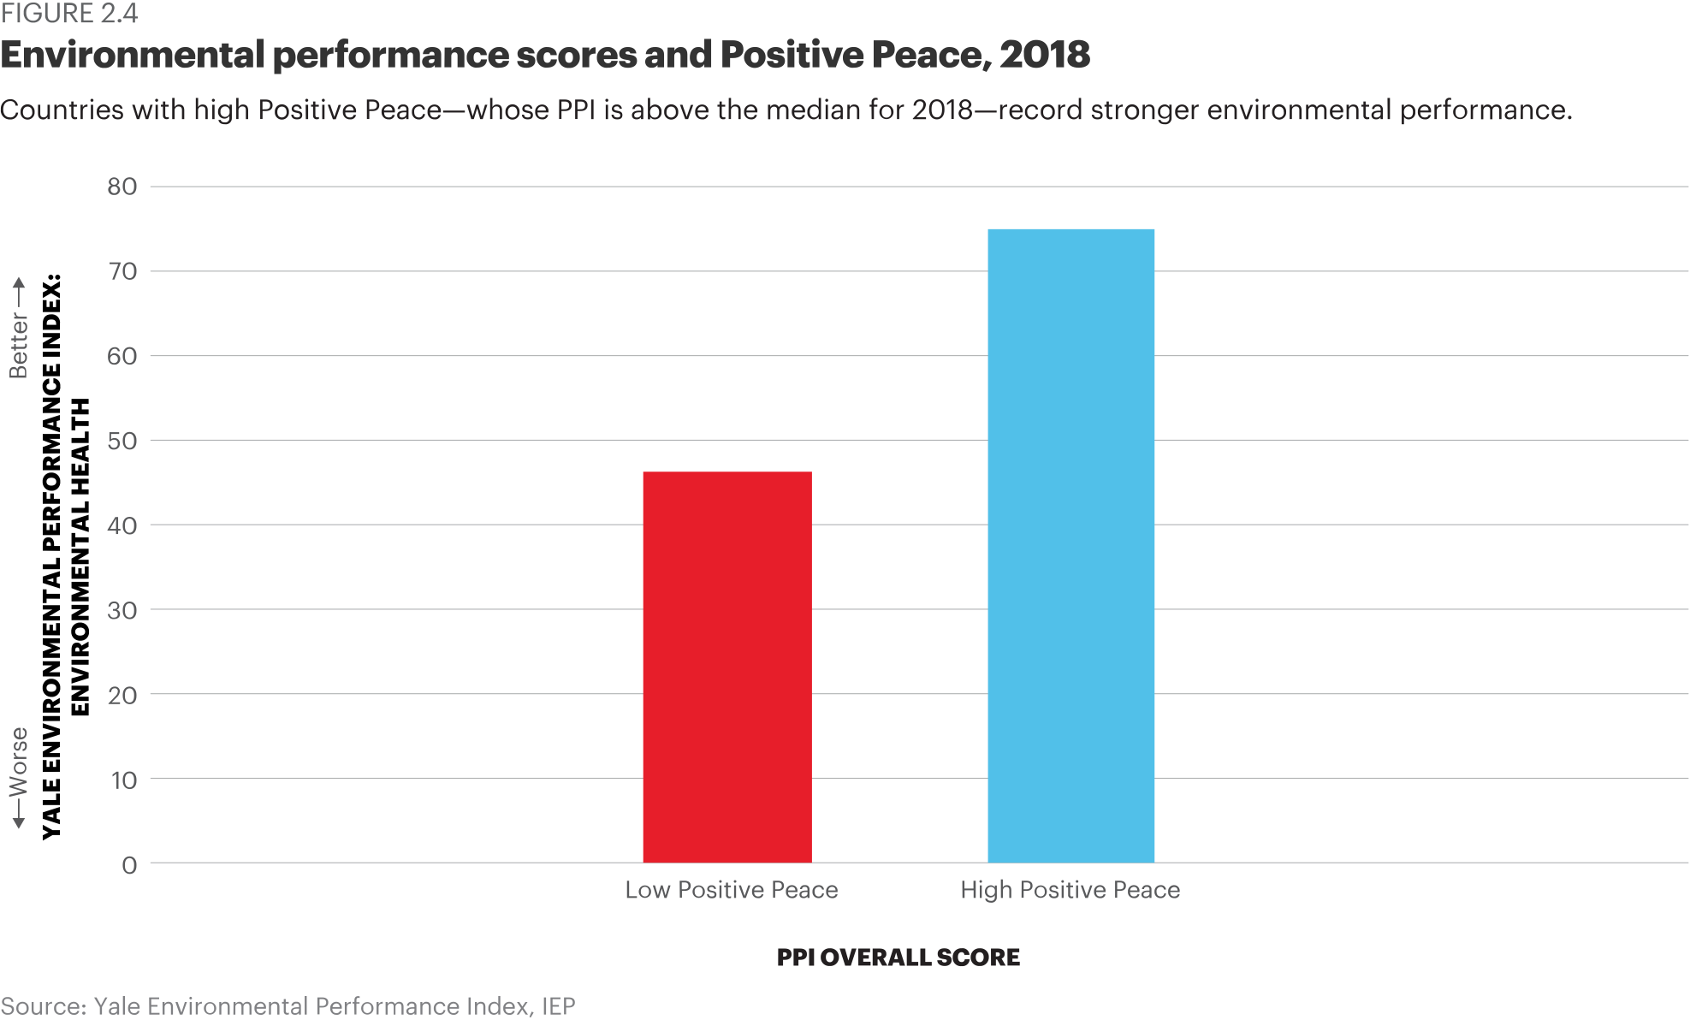
Environmental scores and Positive Peace, 2018
Countries with high Positive Peace – whose PPI is above the median for 2018 – record stronger environmental performance.

Slide 17
02.
A platform for Change

Slide 18
The Positive Peace Index
Now in its
Ranks
Using
8th
163
24
year
countries
Indicators weighed on a 1-5 scale
Developed by the Institute for Economics and Peace
Uses over 25,000 datasets, indexes and surveys
Empirically derived

Slide 19
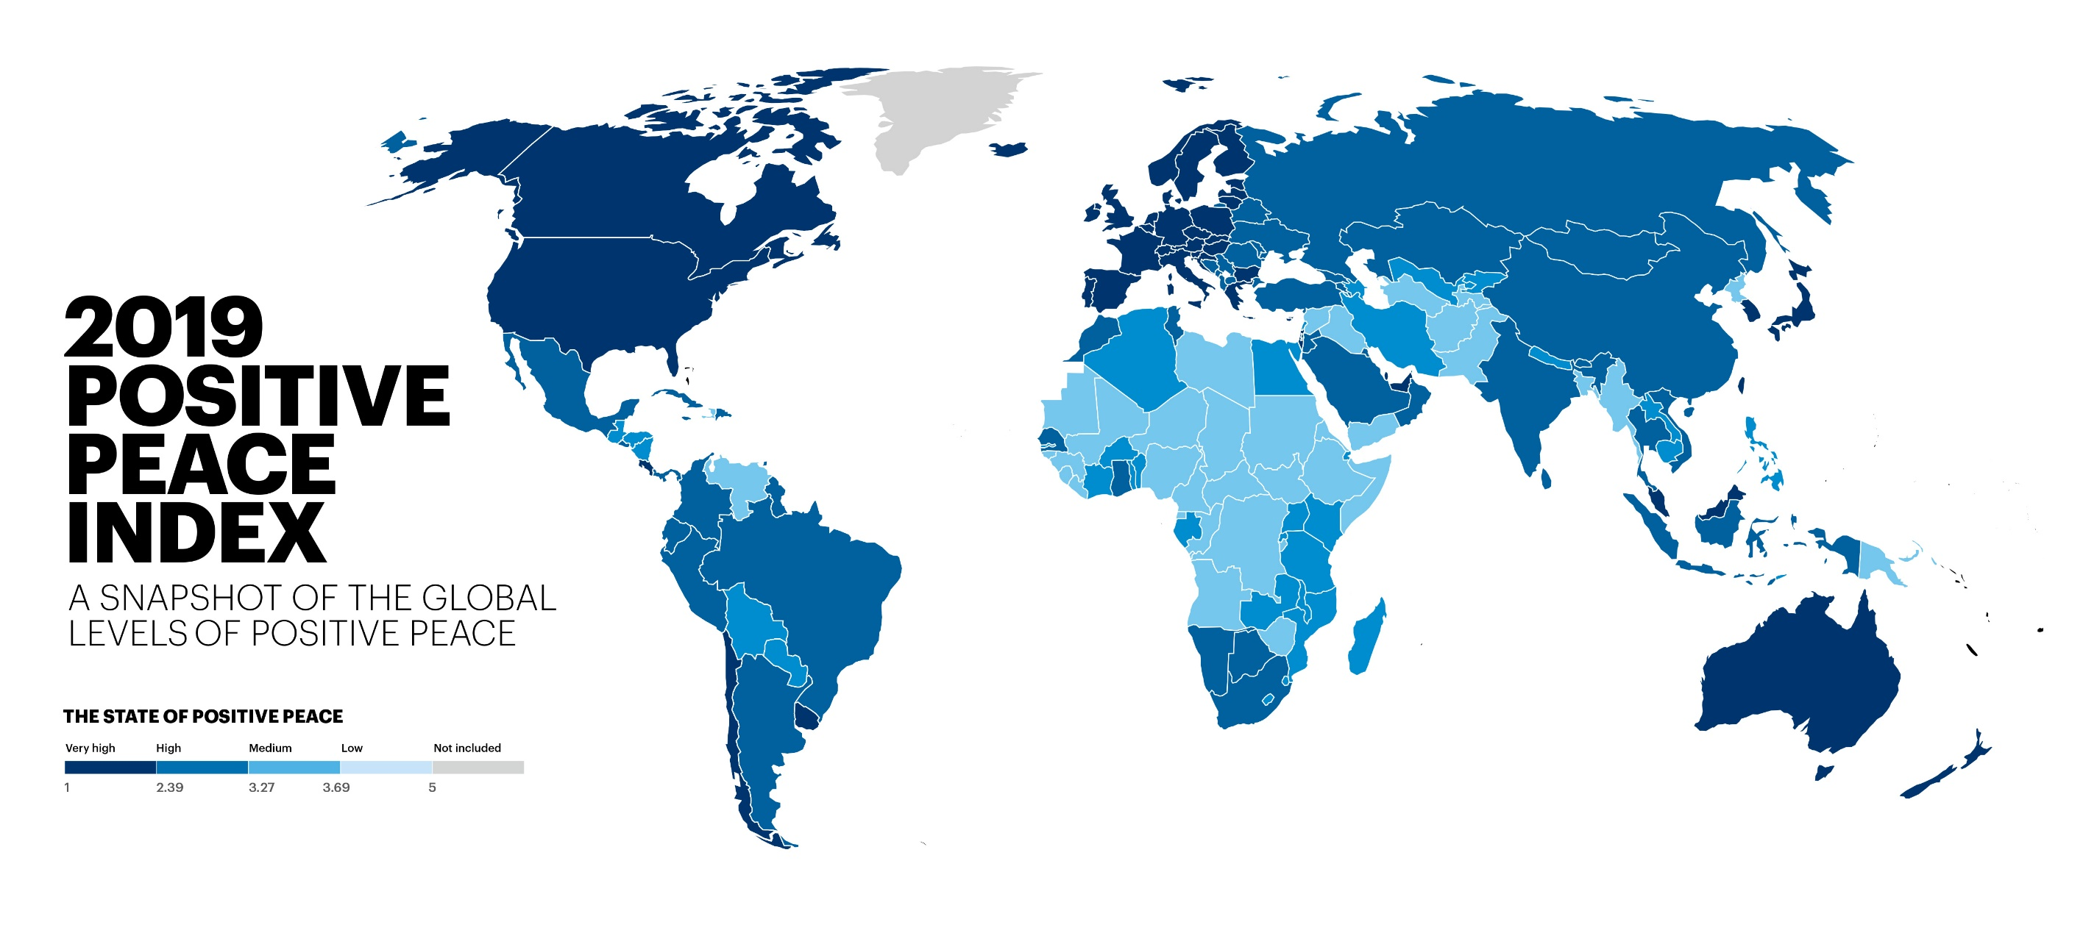
Notes:
Needs map

Slide 20
Key findings – 12 years
Positive Peace improved
globally in the past decade
2.6%
128
countries became more peaceful, 35 deteriorated
Improvements were driven by:
Free-Flow of Information
Sound Business Environment
Equitable distribution of resources
Deteriorations were driven by:
Changes in the ‘Attitudes’ domain
Low Levels of Corruption Pillar

Slide 21
Key findings 12 years - continued
Syria and Libya had the largest deteriorations
North America had the largest regional deterioration
Cote d’Ivoire and Georgia had the largest improvements
Russia and Eurasia had the largest regional improvement
Europe remains the most peaceful region, but deteriorated on three Pillars

Slide 22
Positive Peace Index – Top ten
1
NORWAY
Rank change:
6
ICELAND
Rank change:
2
FINLAND
Rank change:
7
NETHERLANDS
Rank change:
3
SWITZERLAND
Rank change: 1
8
IRELAND
Rank change:
3
SWEDEN
Rank change:
9
NEW ZEALAND
Rank change:
5
DENMARK
Rank change:
10
CANADA
Rank change: 1
Notes:
Germany and Iceland are tied for 9th in rankings; Australia, Canada and UK are tied for 11th

Slide 23
Positive Peace Index – Bottom ten
163
SOMALIA
Rank change:
157
ERITREA
Rank change: 4
162
157
YEMEN
Rank change:
CONGO - KINSHASA
Rank change: 1
161
SOUTH SUDAN
Rank change:
154
SYRIA
Rank change:
160
CENTRAL AFRICAN
REPUBLIC
Rank change:
154
SUDAN
Rank change: 3
159
CHAD
Rank change:
154
AFGHANISTAN
Rank change:
Notes:
Sudan, Iraq, and Democratic Republic of the Congo are tied for 152nd

Slide 24
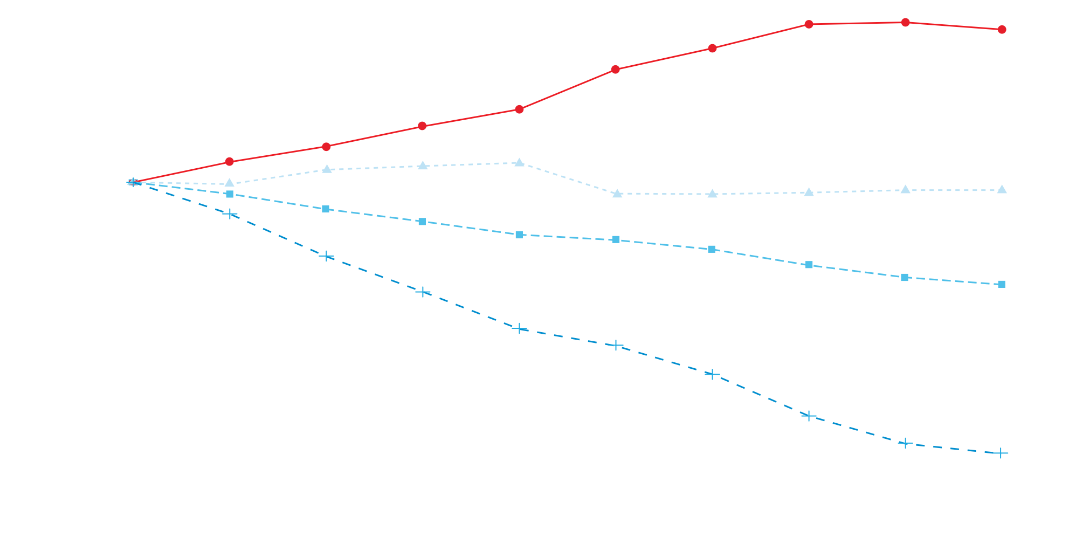
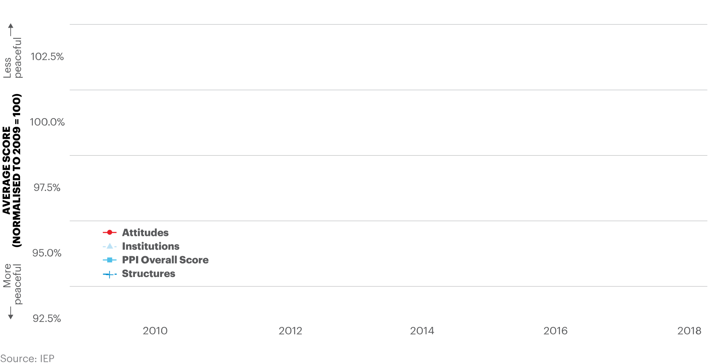
Changes in the attitudes, institutions and structures of Positive Peace, 2009–2018
The improvement in the PPI since 2009 was largely driven by structural improvements. Institutional functioning has remained broadly the same over the period while attitudes have deteriorated.

Slide 25
Percentage change in Positive Peace, 2009–2018
Seven of the eight Pillars have improved since 2009, with Low Levels of Corruption showing a 1.9 per cent deterioration over the period.

Slide 26
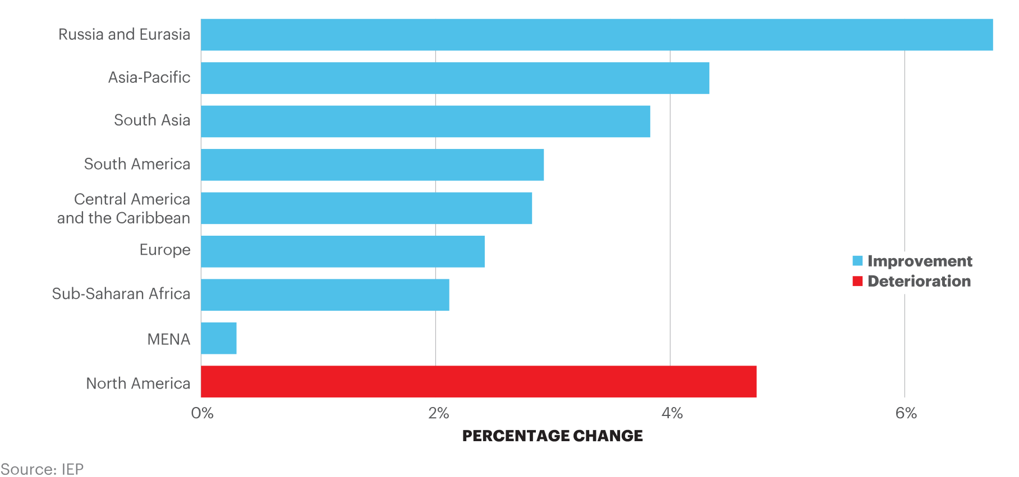
Percentage change in average regional scores, 2009-2018
North America is the only region that did not improve in Positive Peace between 2009 and 2018, driven by a deterioration in Positive Peace in the United States.

Slide 27
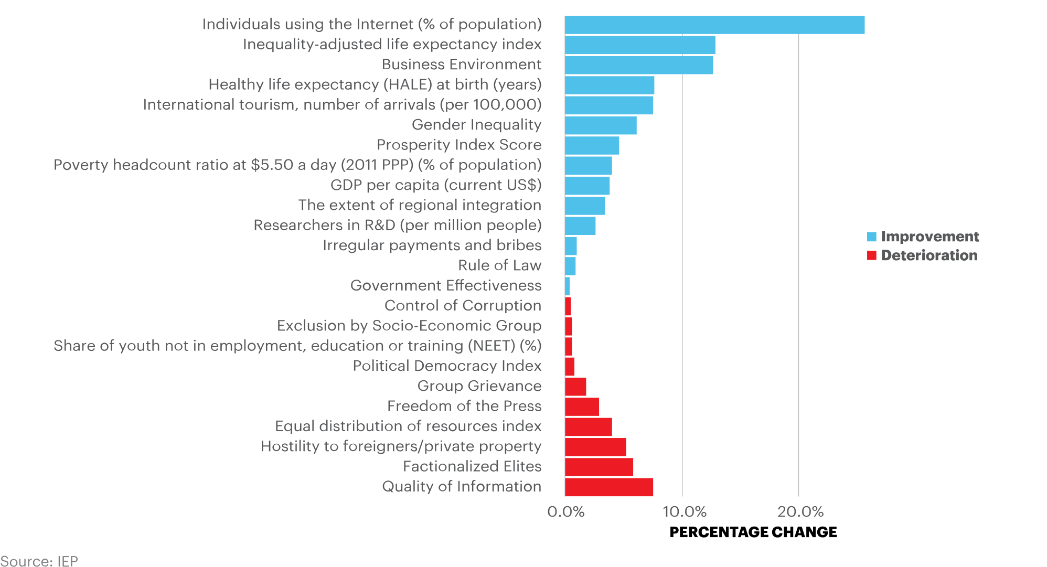
Percentage change in PPI indicators, 2009–2018
The Individuals using the Internet indicator recorded the largest improvement, while the Quality of Information and Factionalised Elites indicators recorded the largest deteriorations.

Slide 28
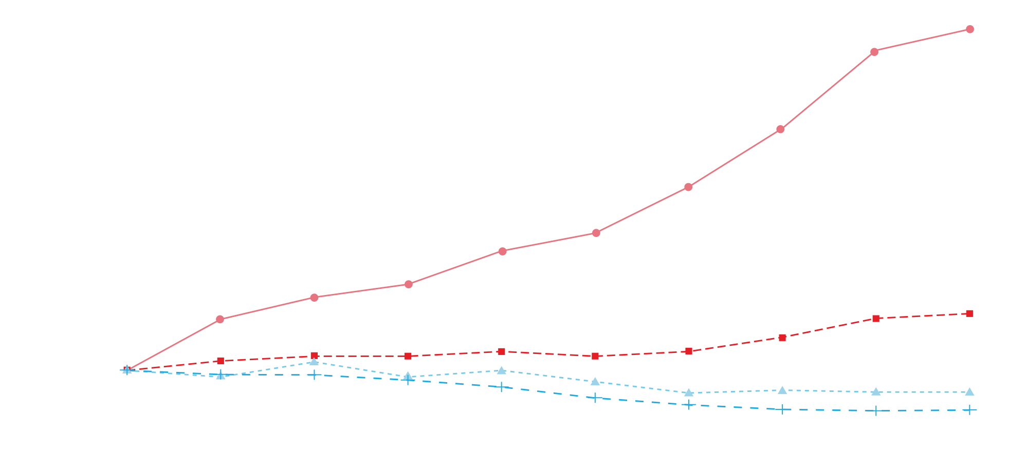
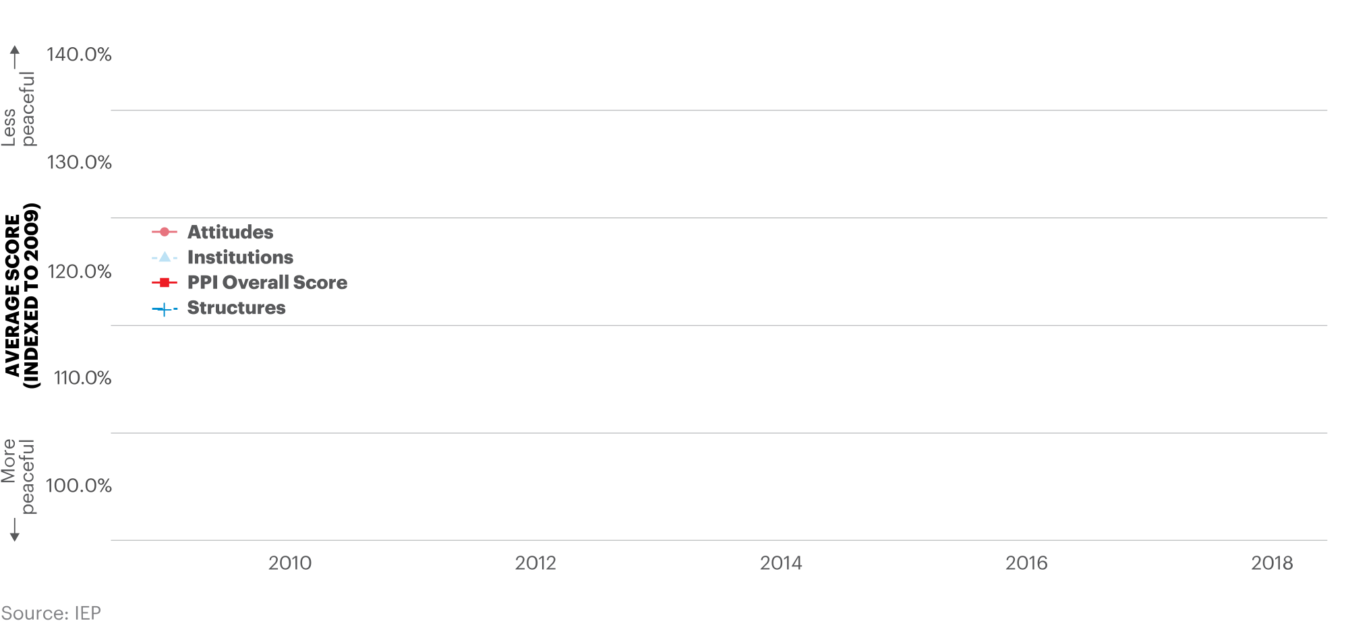
Changes in attitudes, institutions and structures in the PPI, United States, 2009–2018
Positive Peace deteriorated in the US from 2015 on the back of poorer scores for institutional and attitude indicators.

Slide 29
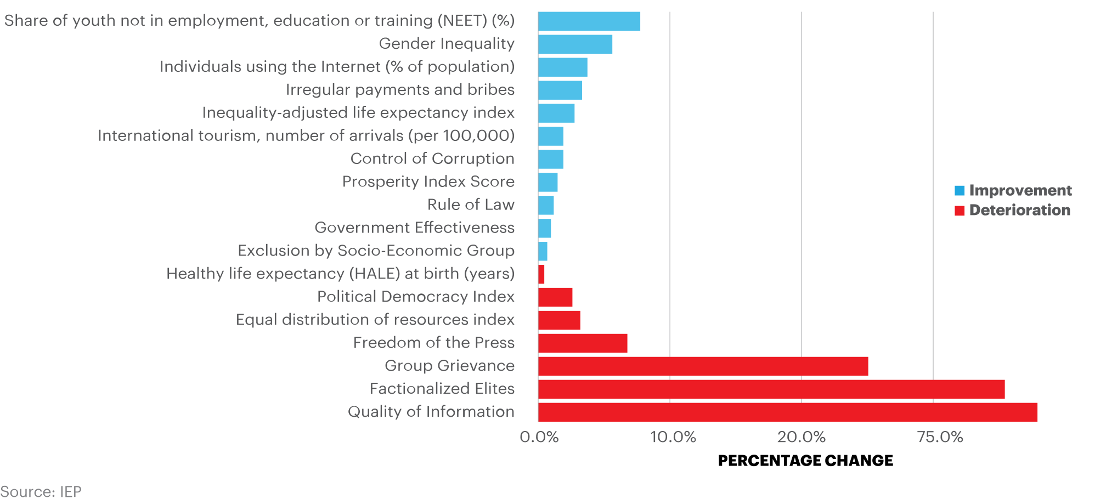
Percentage change in Positive Peace indicators, United States, 2009–2018
Positive Peace deteriorated in the US from 2015 because of worsening indicators in the Attitudes and Institutions domains.

Slide 30
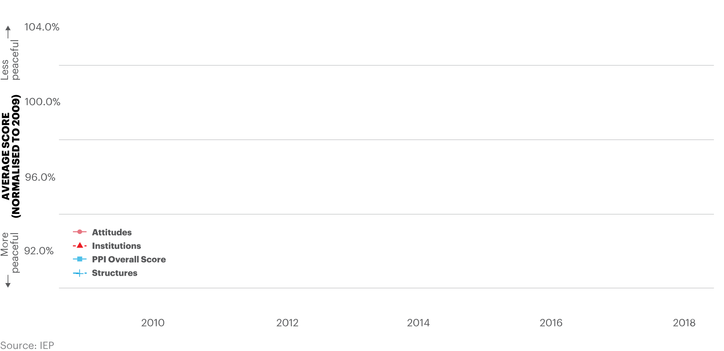
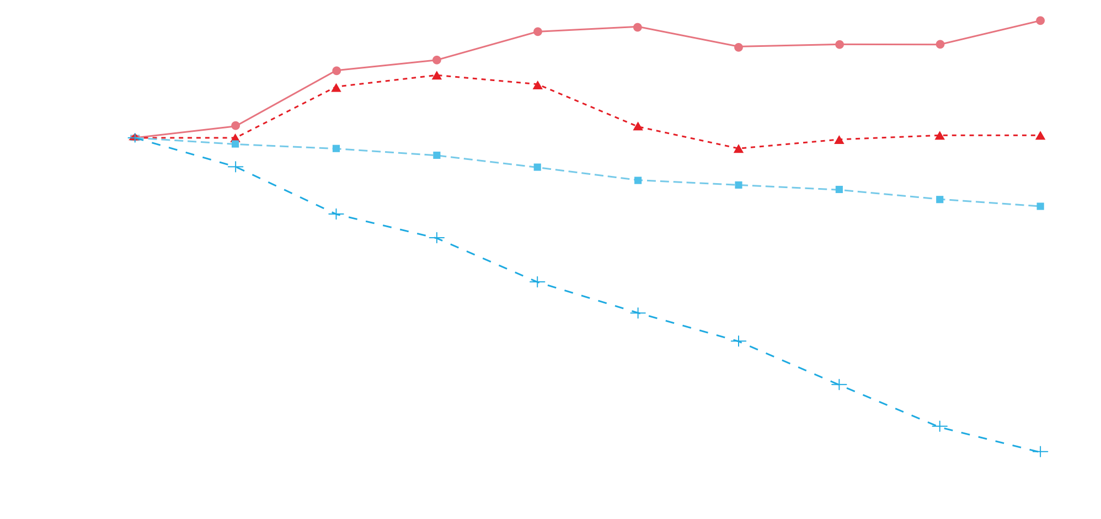
Change in attitudes, institutions and structures in the PPI, Europe, 2009–2018
Improvements in the economy of southern and eastern European nations have contributed to benign structural outcomes for the region. In contrast, attitudes deteriorated markedly.

Slide 31
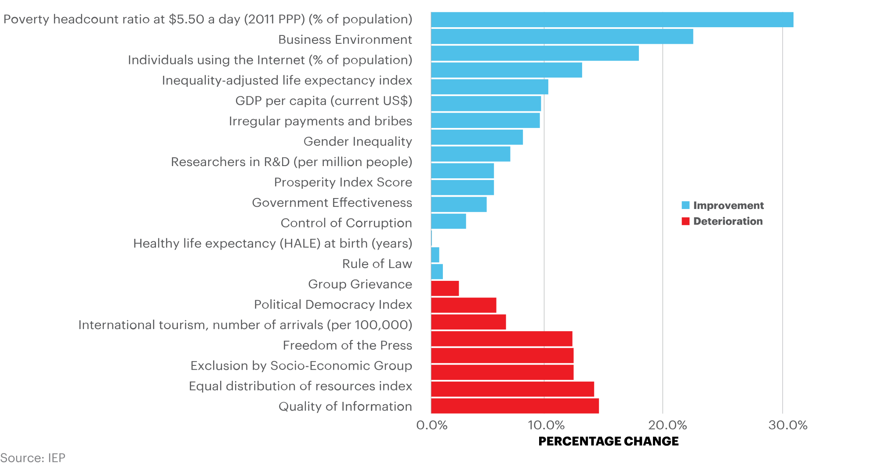
Percentage change in Positive Peace indicators, Europe, 2009–2018
Substantial improvements in economic and health indicators were partially offset by worsening political radicalisation and quality of informed debate.

Slide 32
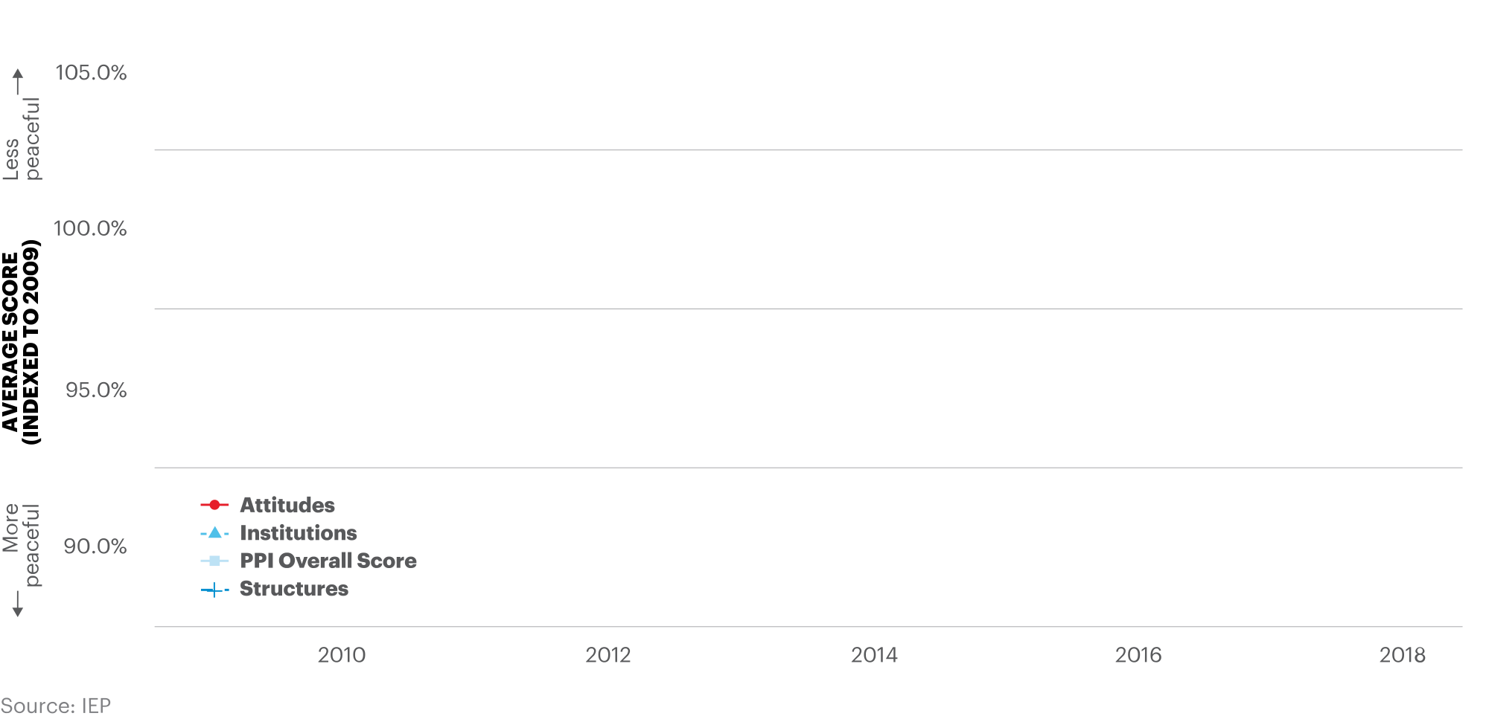
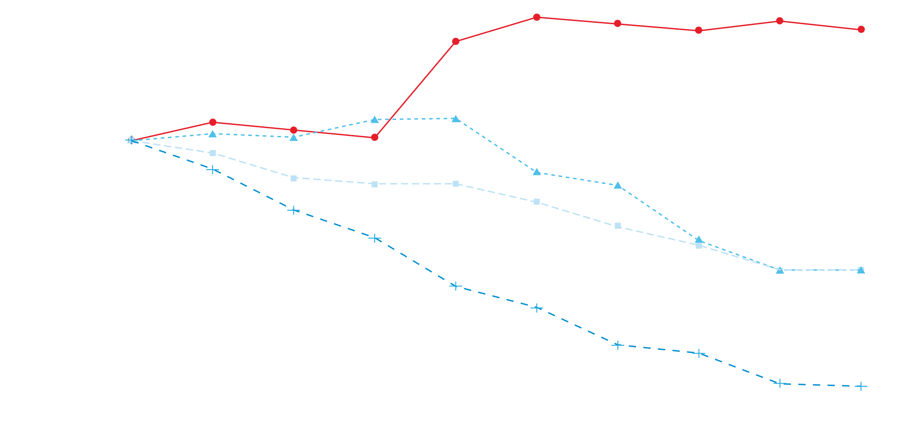
Change in attitudes, institutions and structures in the PPI, China, 2009–2018
Improvements in indicators of social structures – economic, health and physical infrastructure gauges – have offset deteriorations caused by worsening scores for exclusion by socio-economic group and hostility to foreigners/private property.

Slide 33
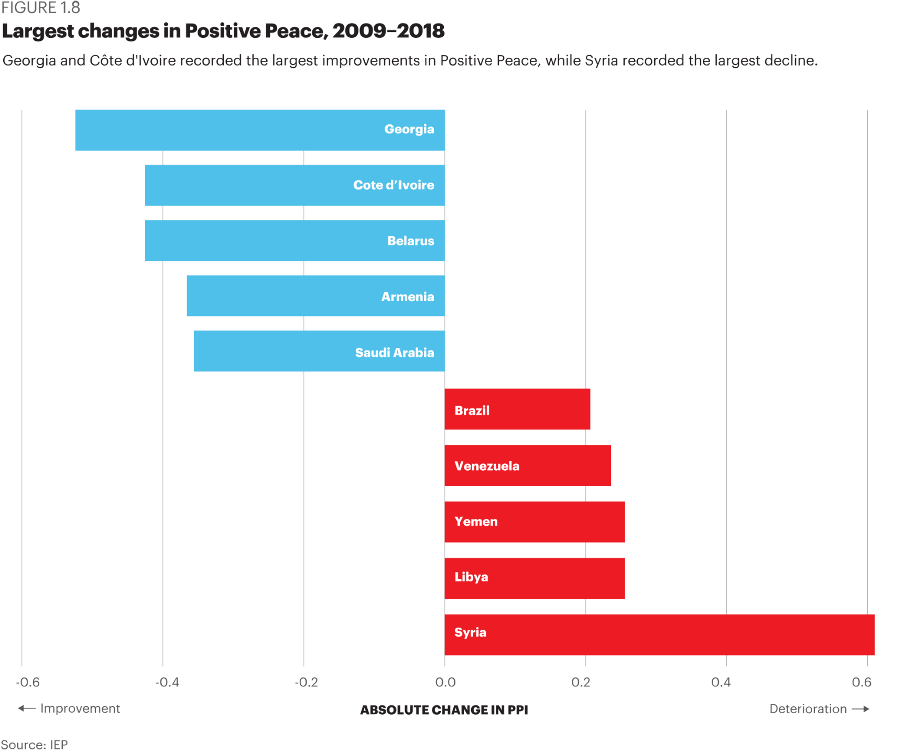
Largest Changes in Positive Peace, 2009–2018
Georgia and Côte d'Ivoire recorded the largest improvements in Positive Peace, while Syria recorded the largest decline.

Slide 34
03.
Benefits of Positive Peace

Slide 35
Positive Peace
provides the optimal environment for human potential to flourish.

Slide 36
High levels of Positive Peace lead to:
Higher measures of wellbeing
Stronger resilience
Better environmental outcomes
3
1
2
Better performance on development goals
Higher per capita income
4
5

Slide 37
Positive Peace & financial metrics
Every one index point of improvement in the PPI is associated with a two percentage point rise in GDP.
Household consumption in countries improving in Positive Peace grows at twice the rate relative to countries where Positive Peace deteriorates.
Growth in business activity in countries where Positive Peace improved was six times higher than in countries where the PPI deteriorated in the last decade.
Domestic currency in countries where Positive Peace improved appreciated by 1.3 percentage points per year more than countries where it deteriorated.
Inflation rates in countries where Positive Peace deteriorated were four times more
volatile when compared to countries where Positive Peace improved.
Among PPI improvers, Foreign Direct Investment grew by seven per cent per year in the past decade. This compares with a decline in investment where Positive Peace deteriorated.

Slide 38
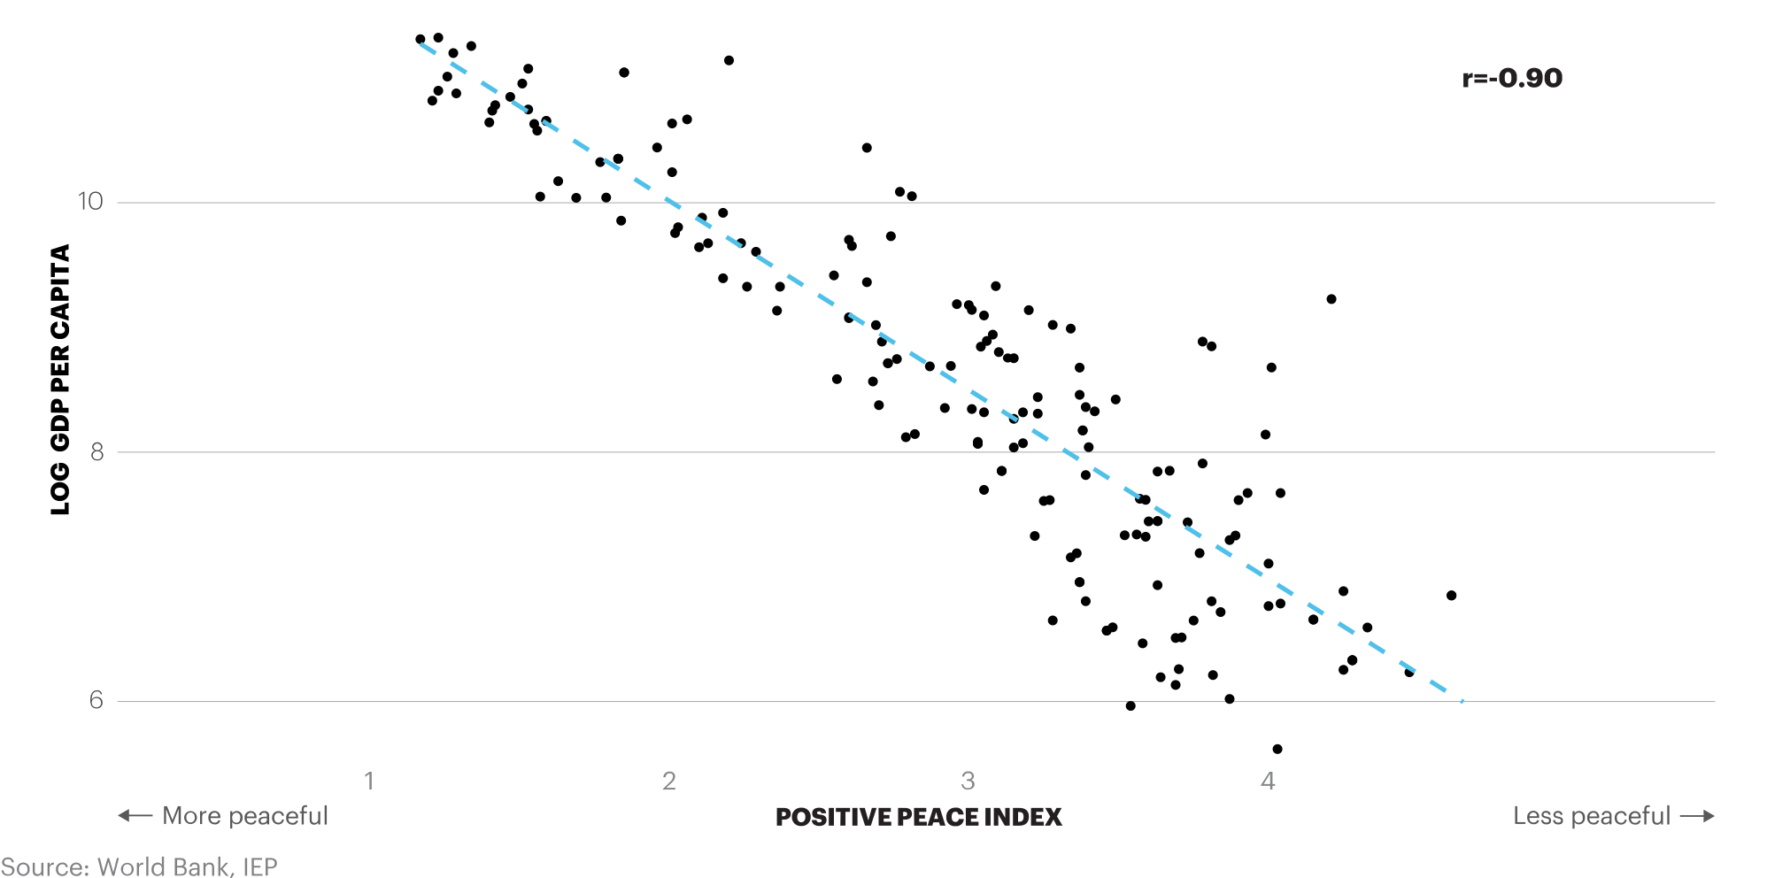
Positive Peace and GDP per capita, 2018
On average, across all levels of country income, every one index point improvement in the Positive Peace Index is associated with a two percentage point rise in GDP per capita.

Slide 39
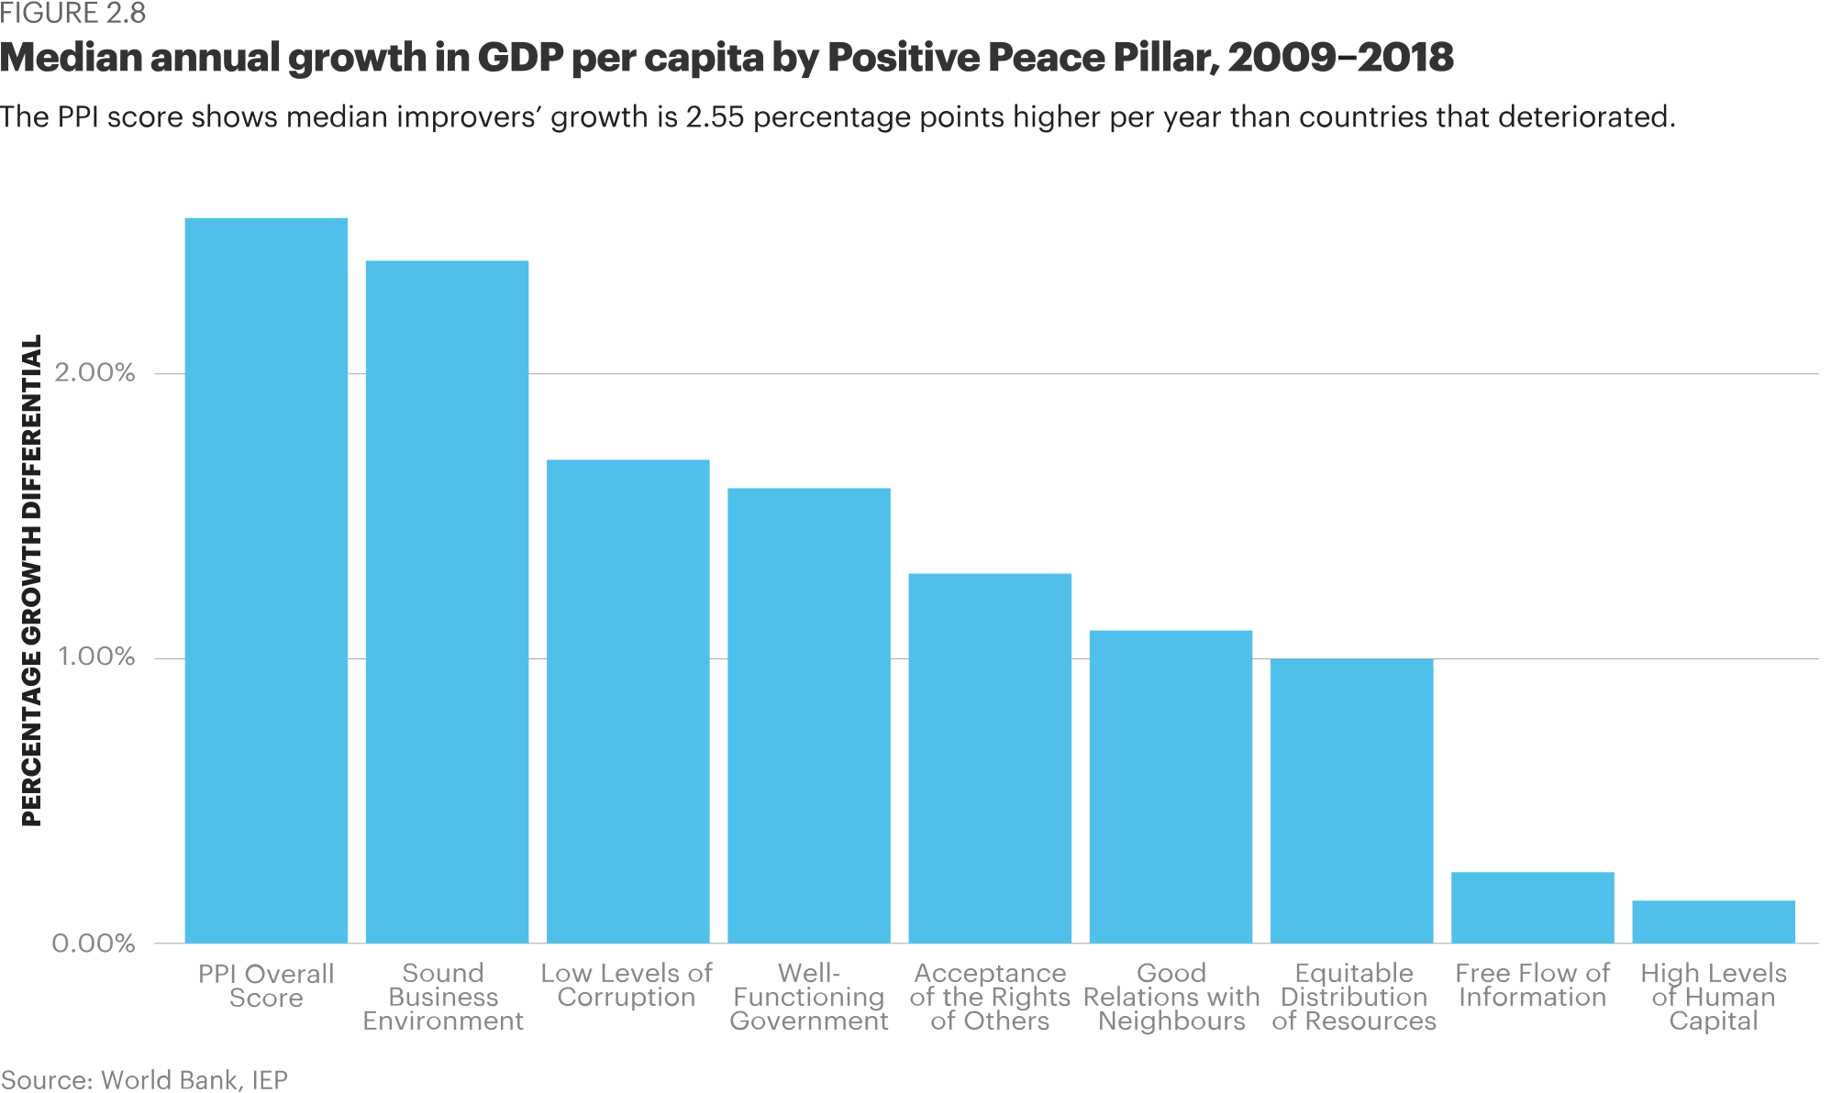
Median annual growth in GDP per capita by Positive Peace Pillar, 2009 - 2018
The PPI score shows median improvers’ growth is 2.55 percentage points higher per year than in countries that deteriorated.

Slide 40
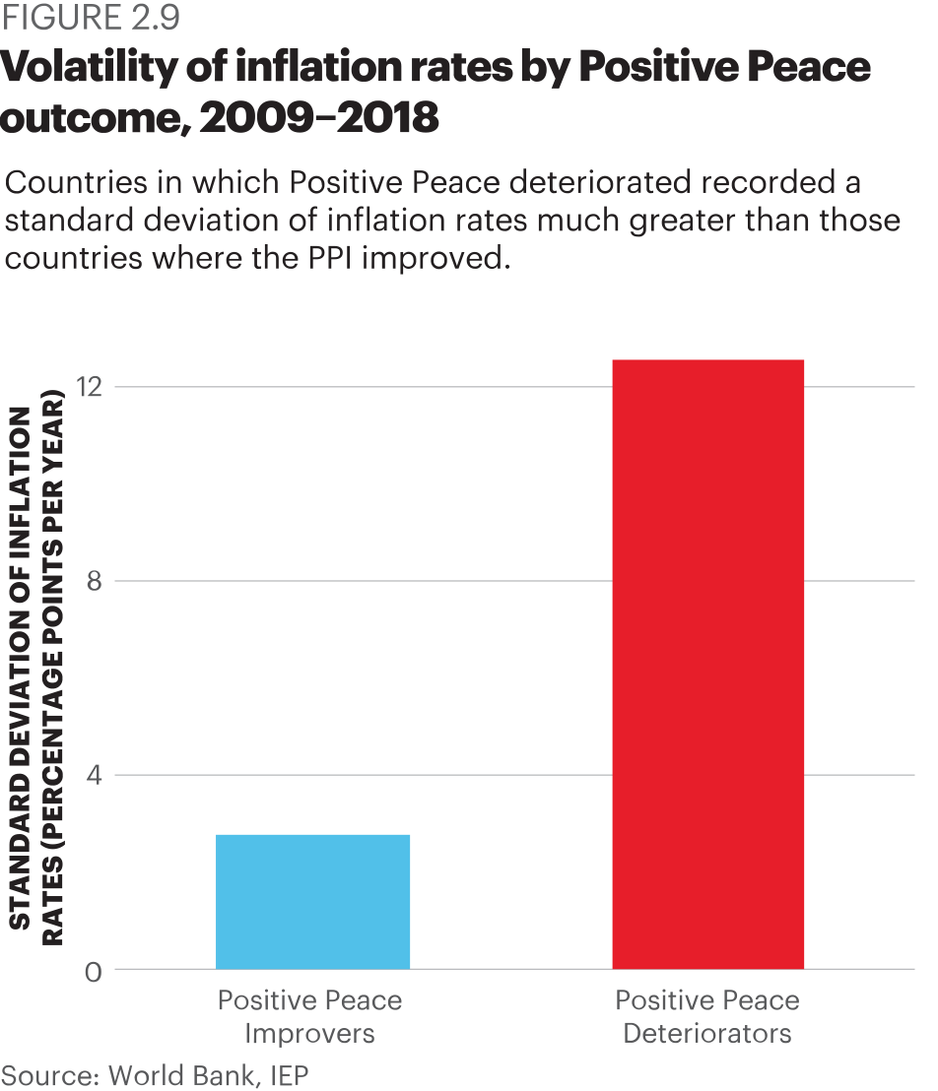
Volatility of inflation rates by Positive Peace outcome, 2009 - 2018
Countries in which Positive Peace deteriorated recorded a standard deviation of inflation rates much greater than those countries where PPI improved.

Slide 41
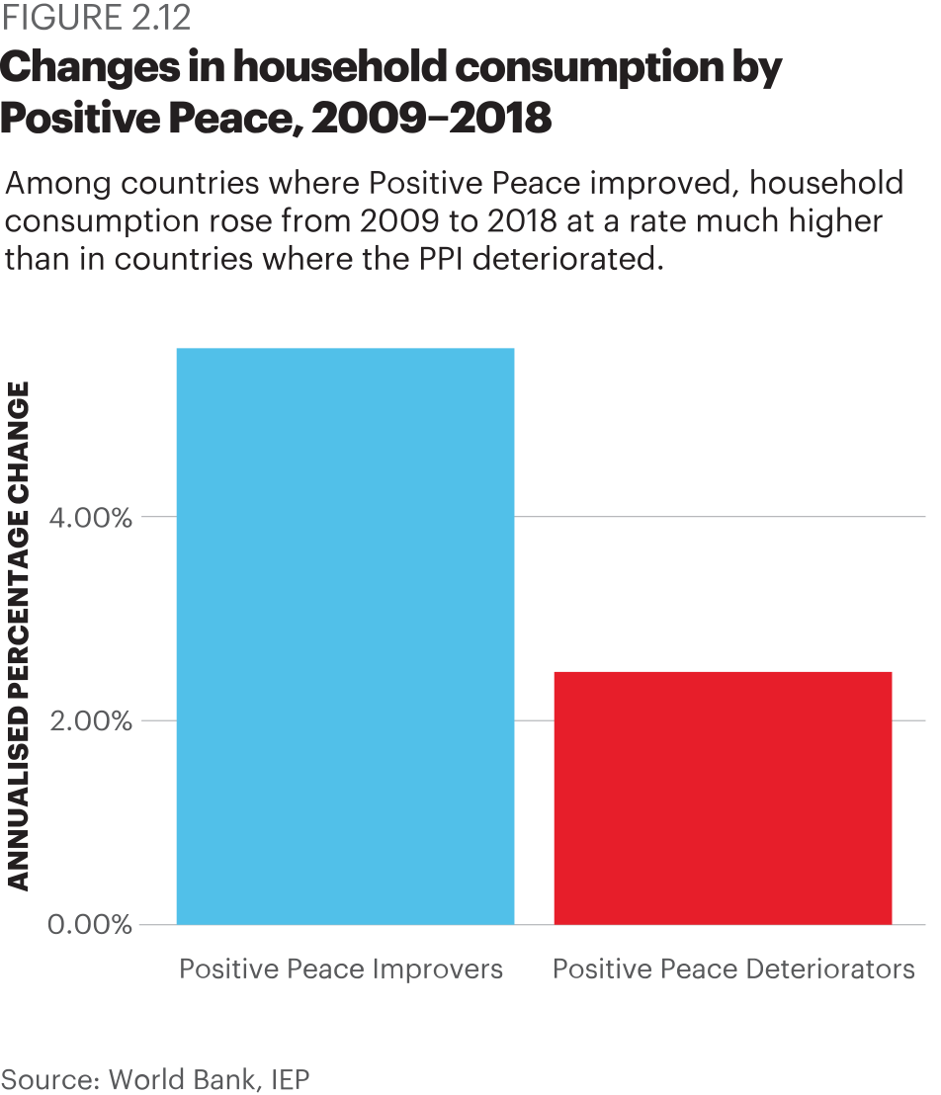
Changes in household consumption by Positive Peace, 2009 – 2018
Among countries where Positive Peace improved, household consumption rose from 2009 to 2018 at a rate much higher than in countries where the PPI deteriorated.

Slide 42
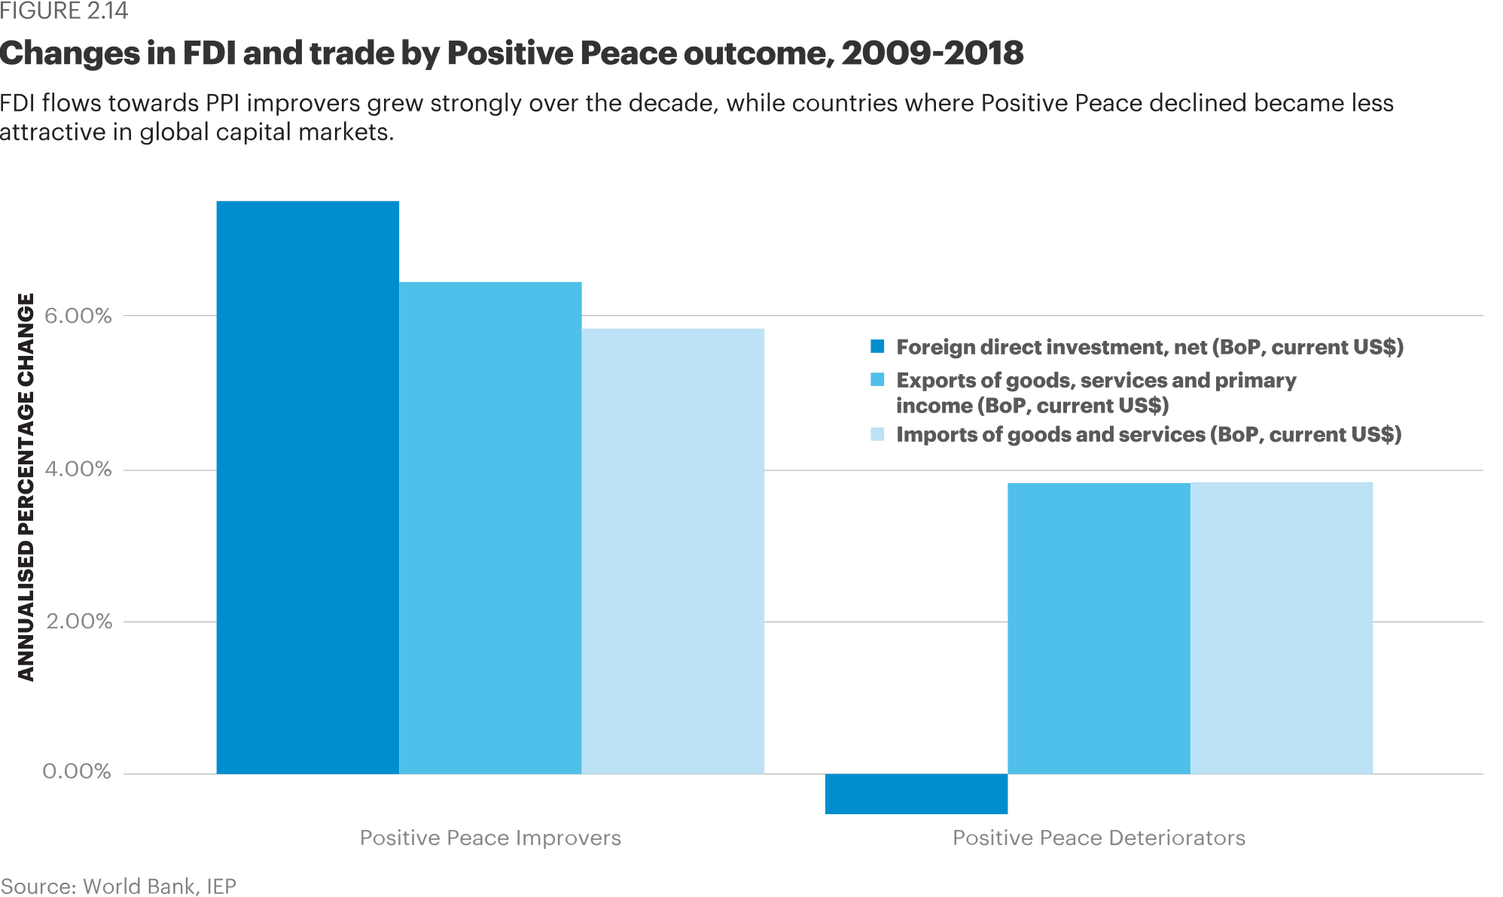
Changes in FDI and trade by Positive Peace outcome, 2009 -2018
FDI flows towards PPI improvers grew strongly over the decade, while countries where Positive Peace declined became less attractive in global capital markets.

Slide 43
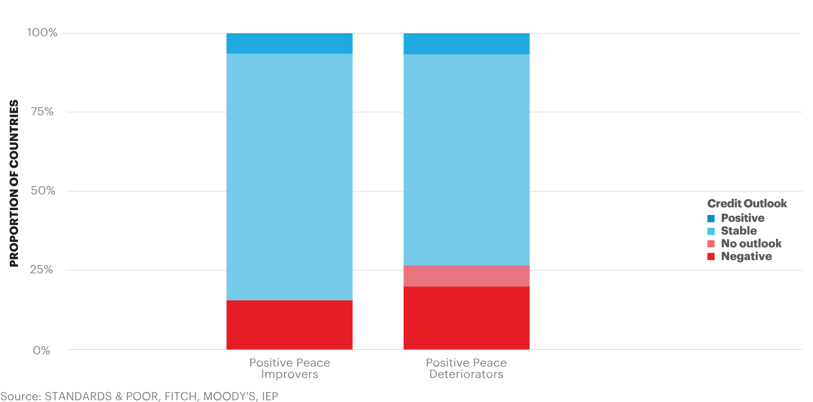
Credit Ratings and Positive Peace, 2009-2018
Credit ratings for countries improving in Positive Peace are more likely to change positively or remain stable than for countries in which the PPI deteriorates.

Slide 44
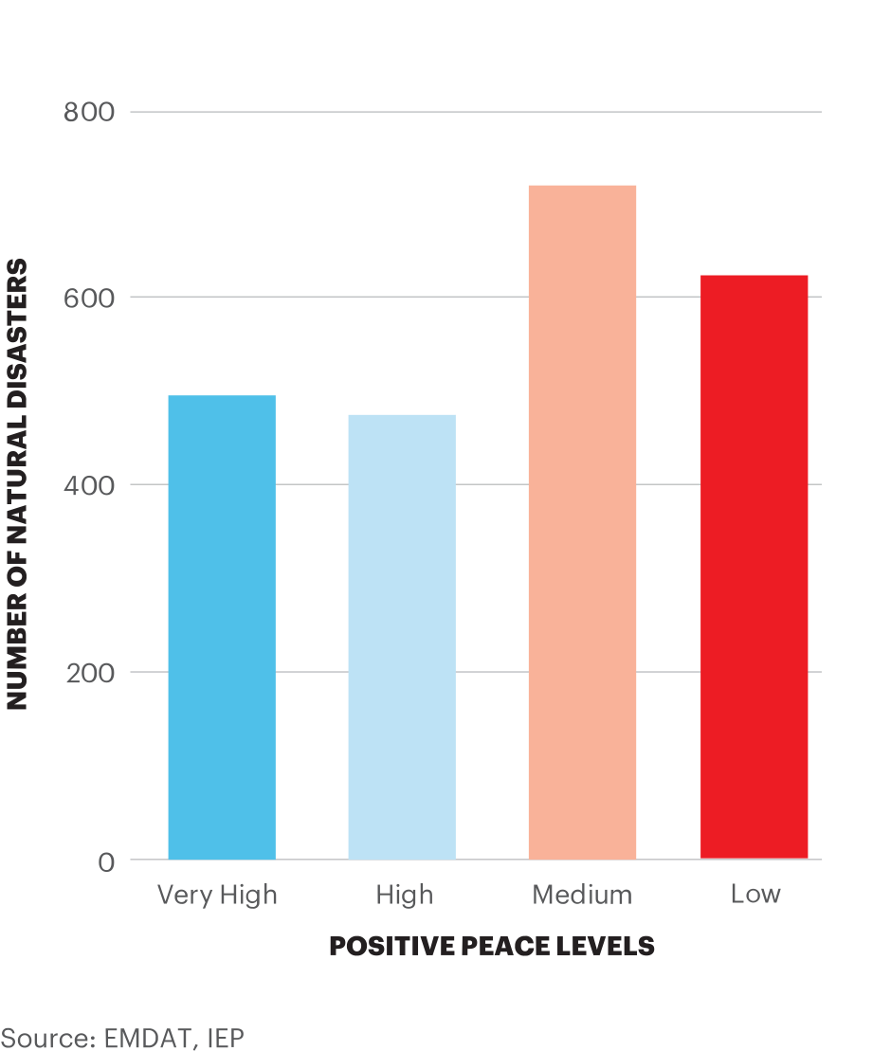
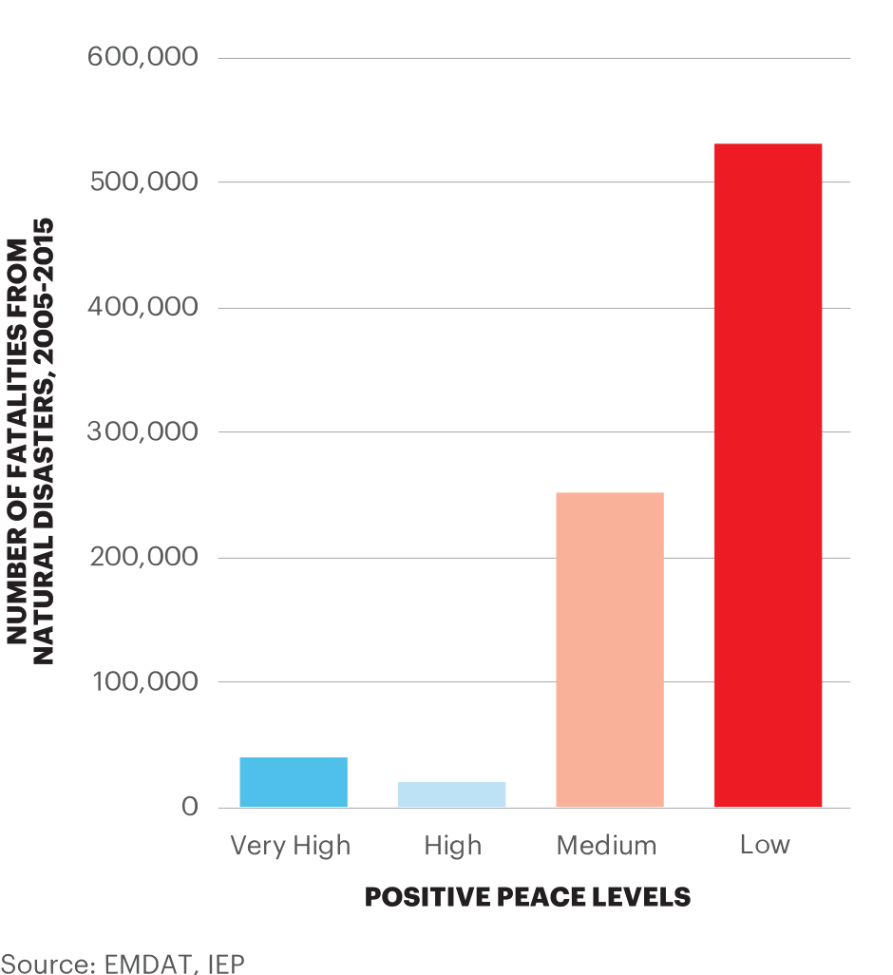
Frequency of Natural Disasters, 2009-2018
Natural disasters occur almost as often in low Positive Peace countries as in high Positive Peace ones, but cause far more fatalities.

Slide 45
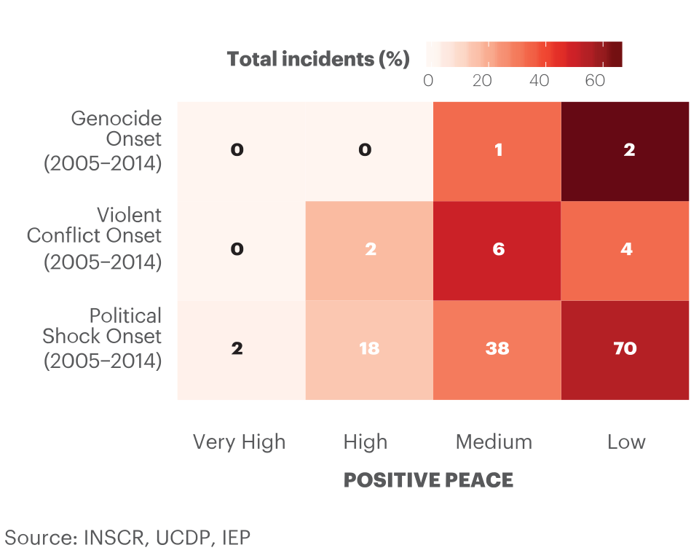
Distribution of Endogenous Shocks, 2009-2018
Lower Positive Peace countries experience more shocks.

Slide 46
04.
Economic Impact
of Peace

Slide 47
The global cost of violence, 2018
Deaths from conflict and terrorism peaked in 2014
$14.1
TRILLION
Which is equivalent to
11.2%
of total world GDP
OR
$1853
per person
If the world decreased
violence by 10%...
$1.41 TRILLION
could be directed to
other economic activities

Slide 48
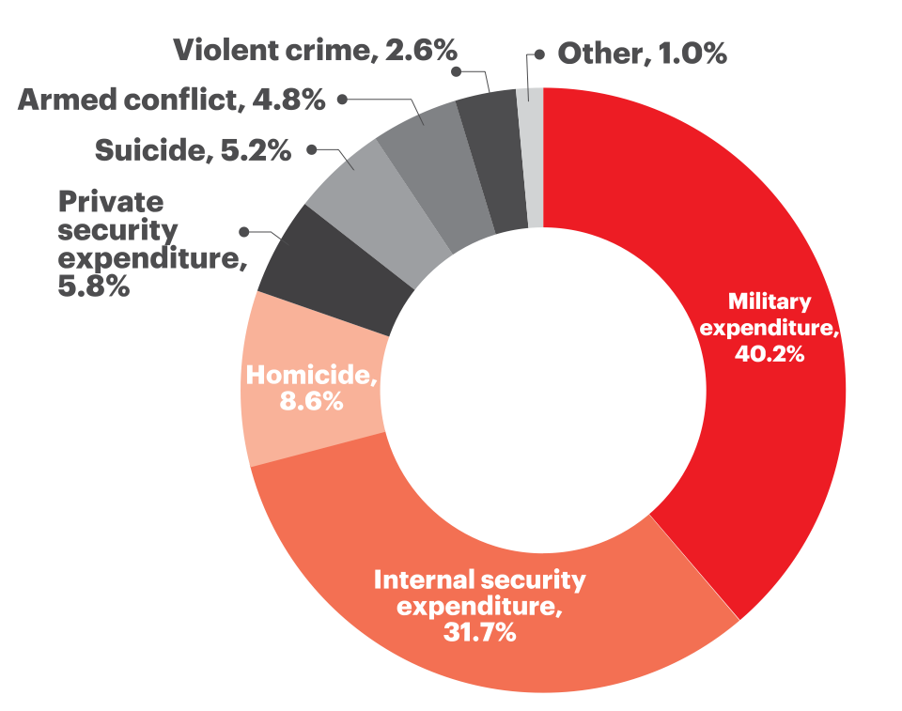
The global cost of violence, 2018
A 1% reduction in the cost of violence is the equivalent to:
1%
total global Official Development Assistance in 2017
A 10% reduction in the cost of violence is the equivalent to:
10%
The global total Foreign Direct Investment in 2018
The size the combined economies of Switzerland, Ireland and Denmark

Slide 49
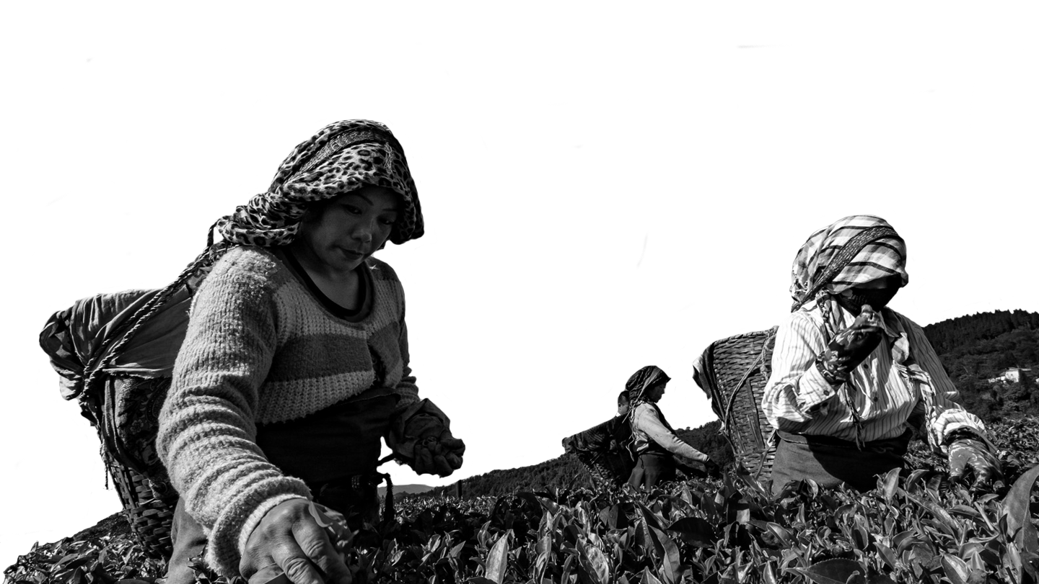
Global economic impact of violence
“
In the last 70 years, annual GDP growth has been three times higher in highly peaceful countries compared to those with low levels of peace.

Slide 50
GPI and GDP per capita growth
Countries with very high level of peace, on average achieved nearly three times higher GDP per capita growth compared to the least peaceful countries since 1960.

Slide 51
GPI and lower levels of inflation
Historically, inflation levels have been three times lower in highly peaceful countries.
Long-term median inflation in very high peace countries was 3.5% compared to 9.7% in very low peace countries.

Slide 52
GPI and lower interest rates
Historically interest rates have been twice as high in the least peaceful countries.
The average interest rate in the most peaceful countries was 8.7%, compared to 20% in very low peace countries.

Slide 53
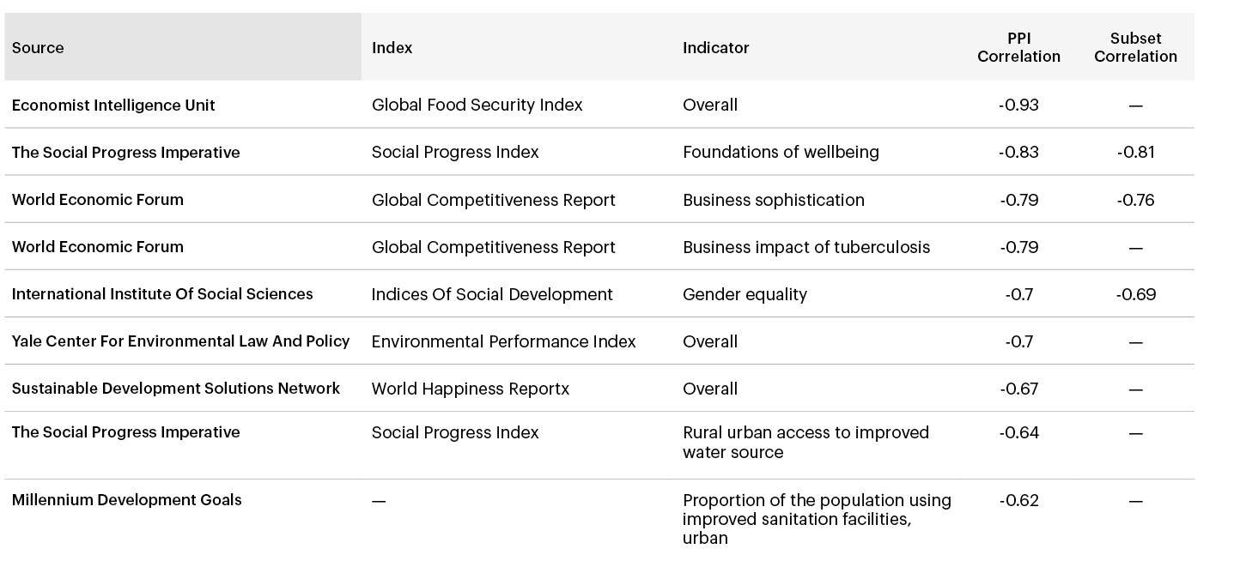
Correlation to Common Development Goals
There are strong correlations between the PPI and other measures of development

Slide 54
05.
Positive Peace & GPI Score

Slide 55
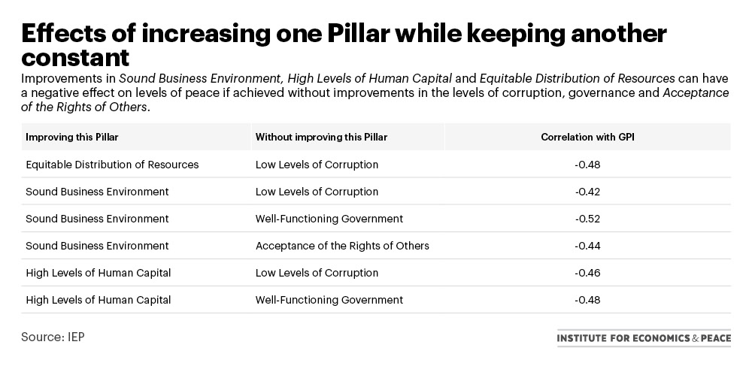
Effects of increasing one Pillar while keeping another constant
Improvements in Sound Business Environment, High Levels of Human Capital and Equitable Distribution of Resources can have a negative effect on levels of peace if achieved without improvements in the levels of corruption, governance and Acceptance of the Rights of Others.

Slide 56
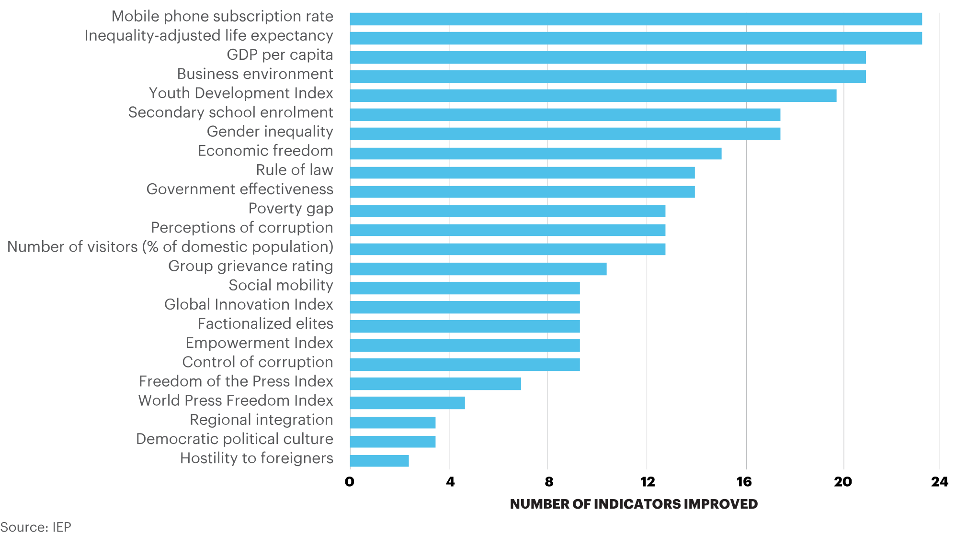
Indicators associated with improvements in GPI
Improvements in connectivity, material well-being, the economy, gender equality and youth development are common leading indicators of improvements in Positive Peace

Slide 57
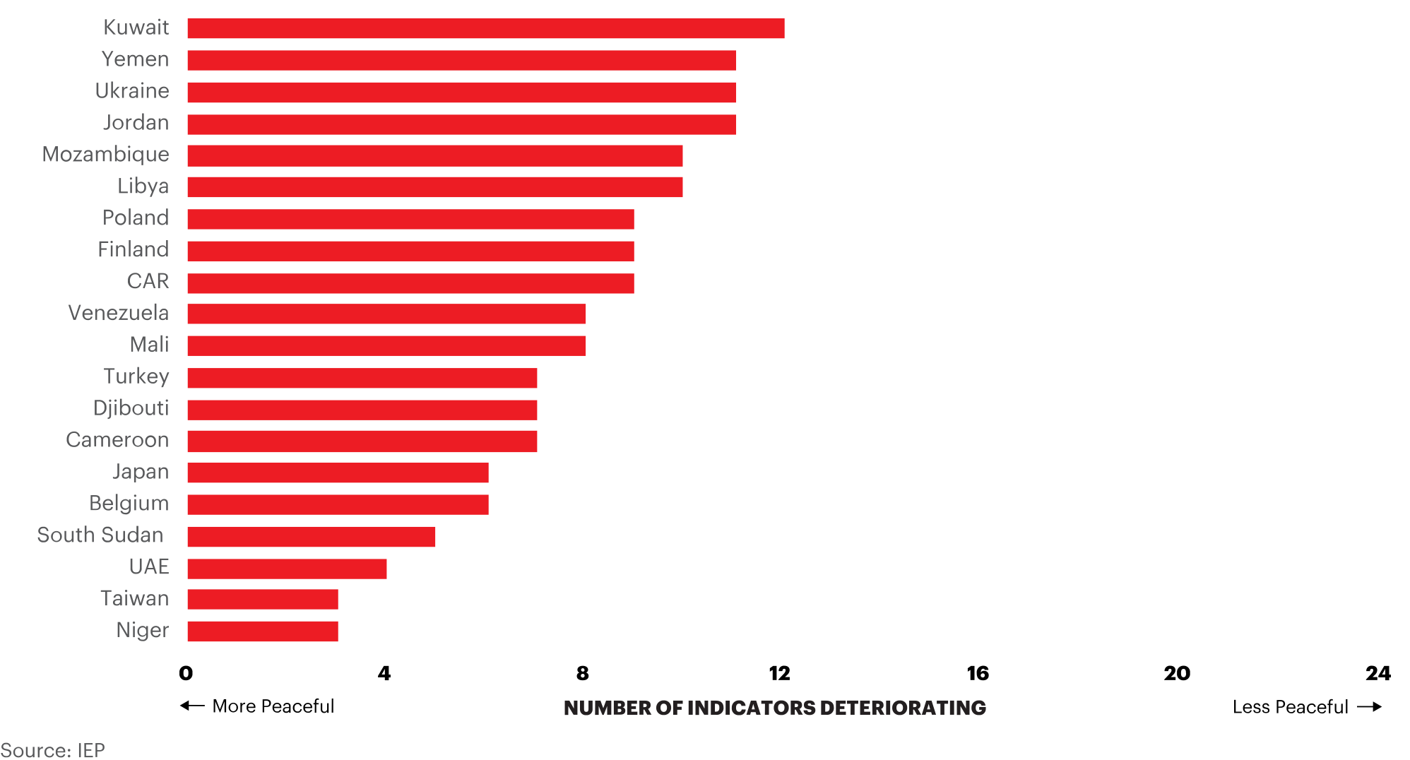
Indicators associated with deteriorations in GPI
Deteriorations in press freedom, tensions between groups, social mobility and corruption are leading indicators of deteriorations in peace

Slide 58
06.
Understanding Systems Thinking

Slide 59
What is a system?
No generally agreed definition
An approach:
Has more internal controls than external controls
Can be defined by its boundaries
Operates with a high degree of complexity
A nation is a system, so is a judicial system
Is a soccer team or loose social network a system?

Slide 60
What is systems thinking?
Government and most organisations think in cause and effect
Modern science is based on cause and effect
The sum of the parts is more than the whole – therefore cannot be broken down into its parts to fully understand
Systems thinking is a radial transformation in understanding how societies operate

Slide 61
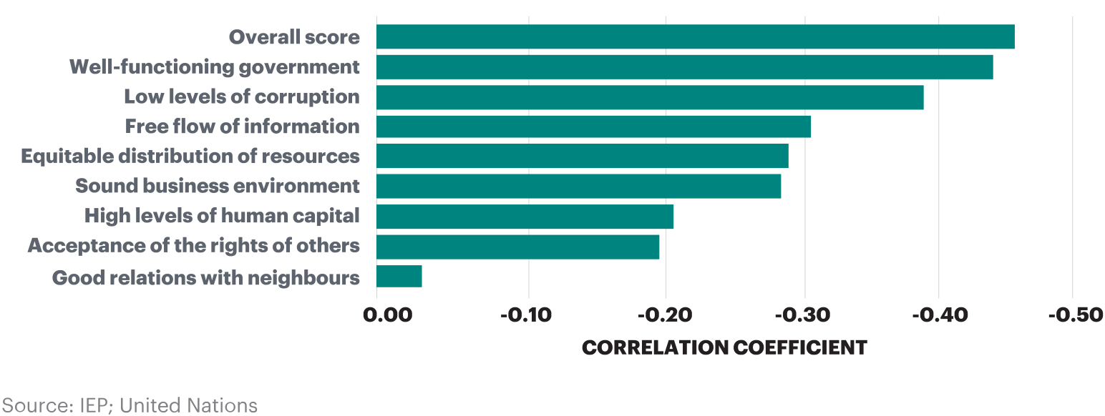
The sum is more than the parts
Changes in Positive Peace and Changes in GDP

Slide 62
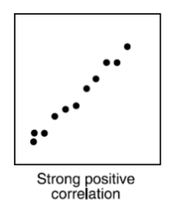
Systems thinking - causal
Scientific Reasoning: Repeatability
In repeatable scientific experiments
same input = same output
Input
Output
Experiment
Effect is contained in the cause

Slide 63
Effects are not clearly defined
Elements mutually interact making causality difficult to imply
Well Functioning Government
Low Levels of Corruption
Free Flow of Information

Slide 64
Systems lie within systems
The smallest subsystem can interact with the largest super system
Eco systems
International Community
Parliament
Police
Schools
Nations
Atmosphere

Slide 65
Properties of systems
Self-regulating and seeking homeostasis
Systems are path dependent
Encoded norms regulate the system to maintain homeostasis
Systems self-modify when there are persistent mismatches with inputs
Form virtuous or vicious cycles
Systems are be understood through mathematics

Slide 66
Systems are responsive
Understanding the system response requires understanding the systems and their relationship to the input
System
Encoded Norms
System Response
Input to System
System Interacts with input
Intent
Notes:
In systems thinking the input comes into the system, interacts with the systems intent and encoded norm, thereby determining an action which may then attempt to alter the input
This is known as a mutual feedback loop. The system is constantly modifying inputs to match its encoded norms

Slide 67
Systems are path dependent
Historical path
Best approach to change is to continuously nudge the system in the right direction
Virtuous cycle
System
Many small changes from many directions is the optimum way to change the system
Vicious cycle

Slide 68
Homeostasis & self-modification
Persistent mismatch
Process assessment
System modification
Feedback loop
New homeostasis
New
encoded norm
Encoded norms

Slide 69
Tipping points
An input can occur for a lengthy period with little effect
After certain point a small input can cause radical changes
Think of Mercury or Lead in the body
A bird drops a new seed in a forest
A new invention or idea such as the mobile phone
Once changed the system cannot revert back to what it was

Slide 70
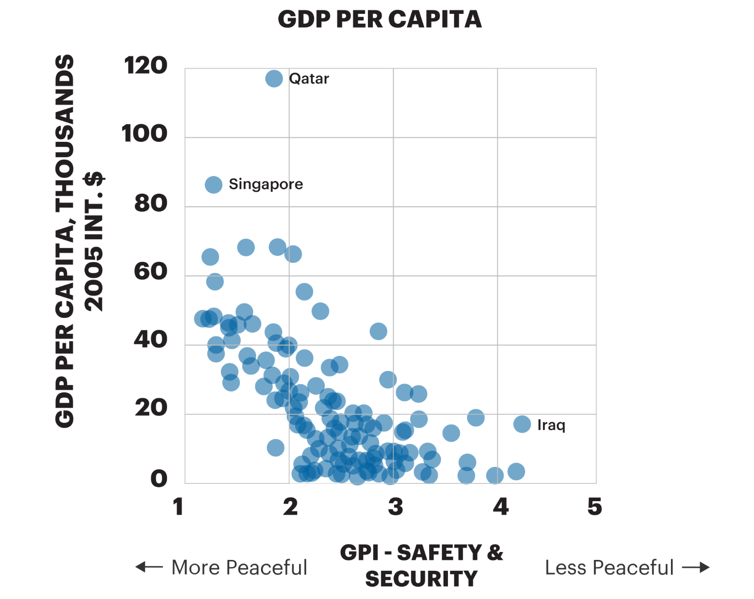
Tipping points
GDP Per Capita
Source: IEP; United Nations

Slide 71
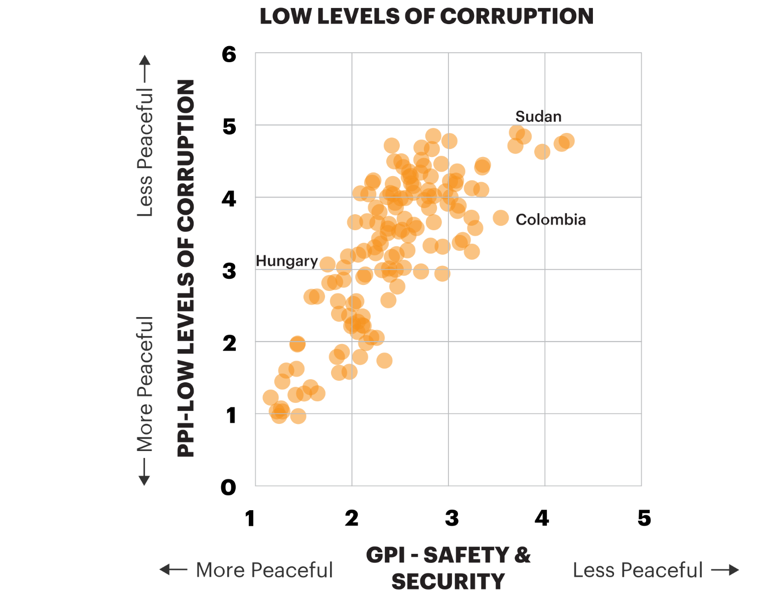
Tipping points
Corruption and Peace
Source: IEP; United Nations

Slide 72
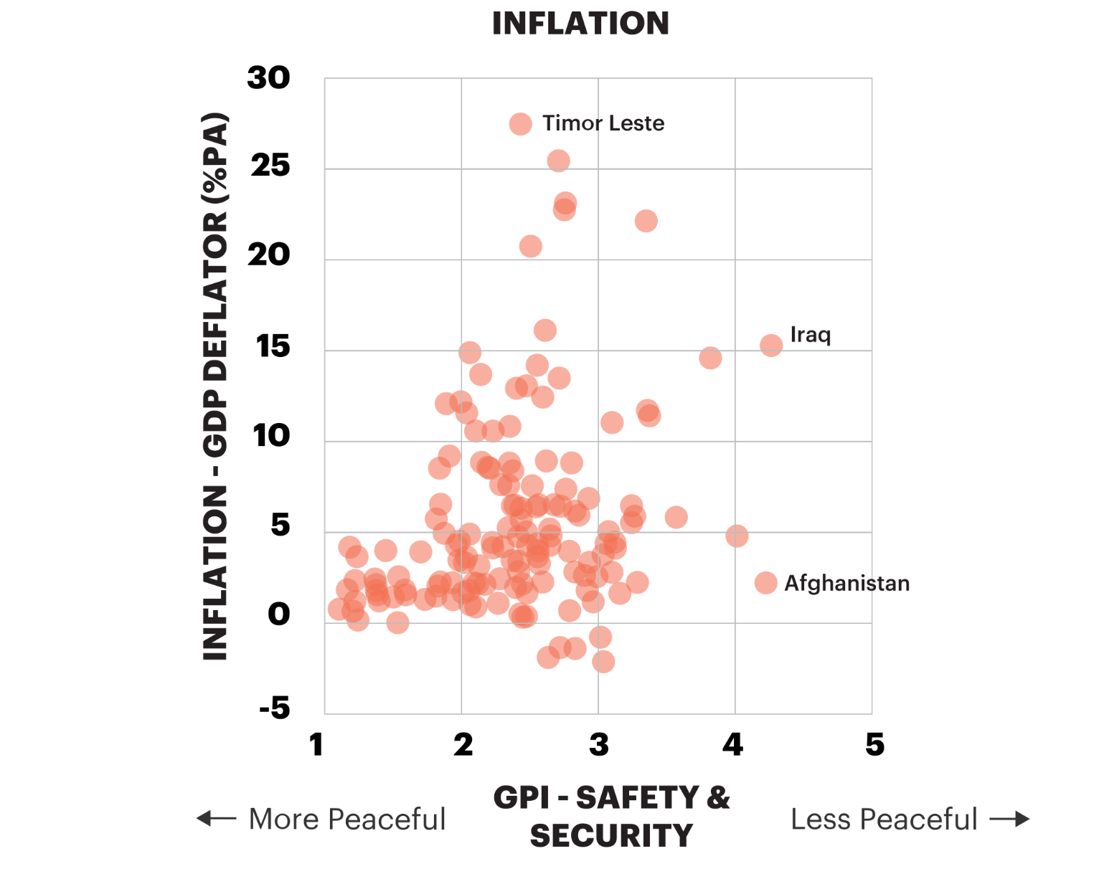
Tipping points
Inflation and Peace
Source: IEP; United Nations

Slide 73
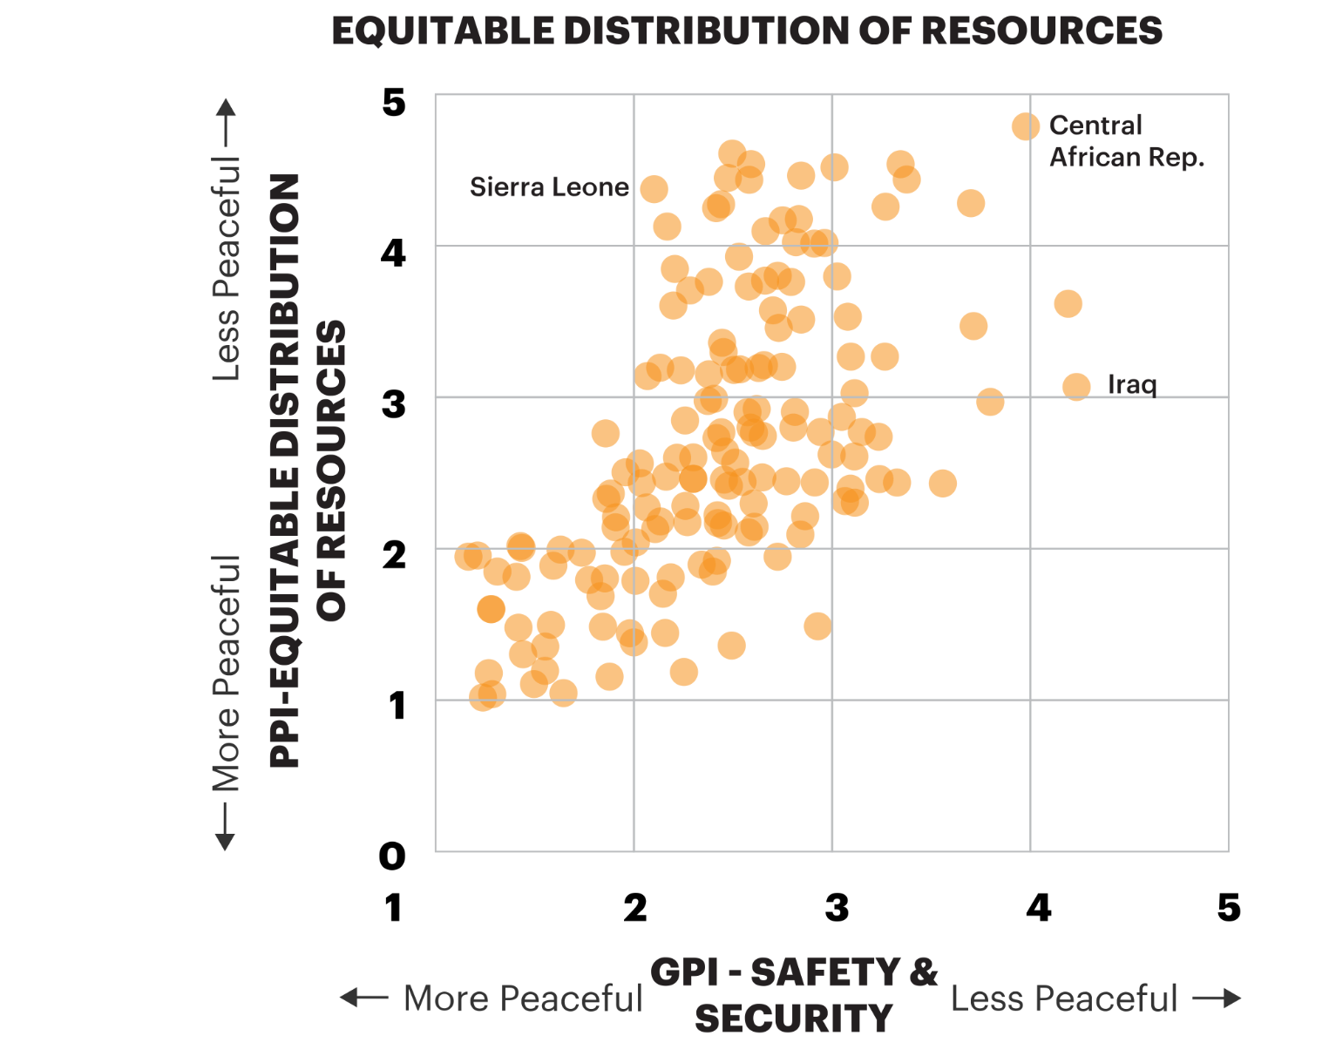
Tipping points
Inequality and Peace
Source: IEP; United Nations

Slide 74
Systems are cyclic and changing
Momentum more important than position
Virtuous cycle
Vicious cycle

Slide 75
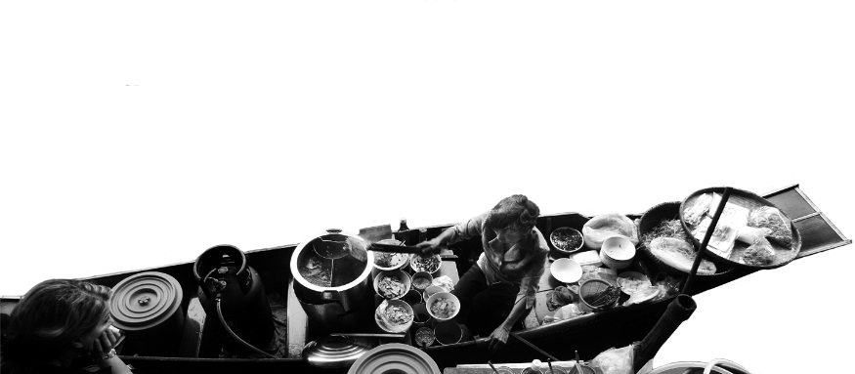
Adaptation and resilience
Adaptation – the ability to adapt to a changed environment
Resilience – ability to absorb shocks to the system and to successfully adapt to a changed environment
Positive Peace can be used to measure resilience and adaptability
Democracies are highest in Positive Peace and wealth because of their ability to adapt and recover from shocks

Slide 76
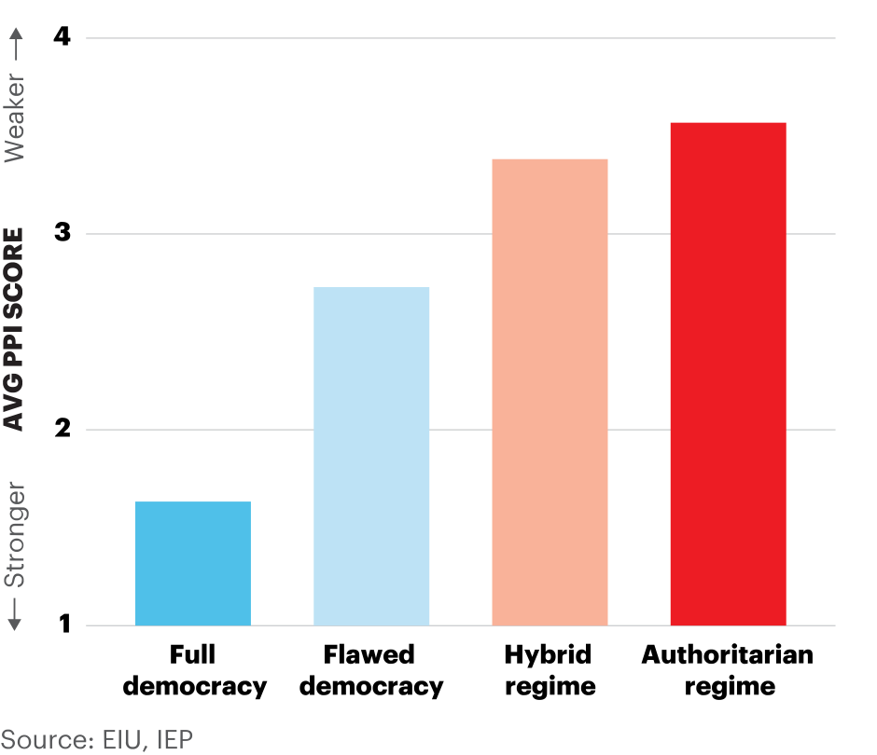
Positive Peace by government type
Full democracies have the strongest average levels of Positive Peace

Slide 77
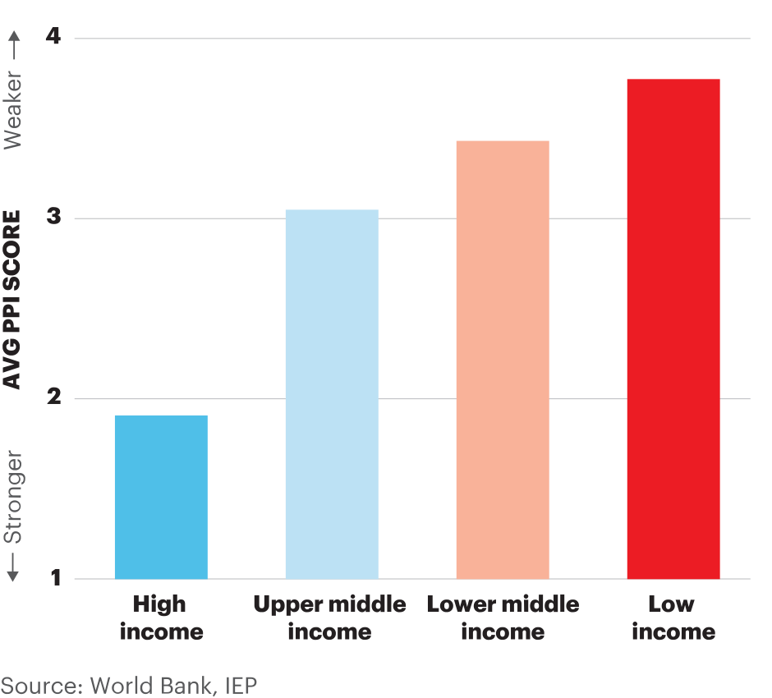
Positive Peace by income group
High income countries have the strongest average levels of Positive Peace

Slide 78
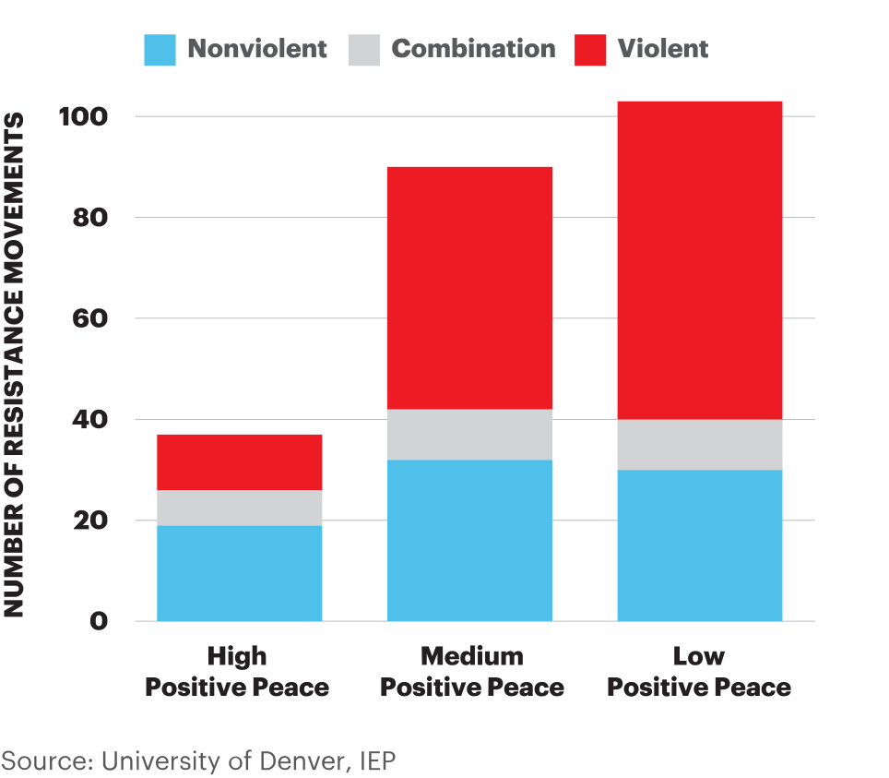
Prevalence and nature of resistance campaigns
Between 1945 and 2006, 91 per cent of violent resistance campaigns have occurred in countries with weaker Positive Peace

Slide 79
Future adaptability
Major changes facing humanity are global in nature
These challenges are systemic in nature
Most of humanity’s thinking is causal and Darwinian
Viewing societies systems more easily aligns with the challenges of our age
Therefore – systemic changes at all levels should become easier

Slide 80
Positive Peace Index - Summary
Measure and analyse peace
Measure and analyse peace
163
ACTION
Better predictions
$
Lost opportunity cost
Factors that create peace
Better cost/benefit analysis
Better program outcomes

Slide 81
06.
Using and Creating Positive Peace

Slide 82
Correlation between Positive Peace and GPI Score
Low Levels of Corruption is the only Pillar that is strongly significant across all three levels of peacefulness

Slide 83
Correlation to Common Development Goals
Positive Peace – Predicting changes in peace and economic performance 2007 to 2014
SDG16
Falls in Positive peace preceded falls in GPI score
Falls in Positive Peace precede falls in many macro economic indicators
Improvements in Positive Peace precede improvements in GPI score
Improvements in Positive Peace precede improvements in many macro economic indicators.

Slide 84
Correlation to Common Development Goals
Positive Peace - Predicting changes in peace and economic performance 2007 to 2014
SDG16
Countries that improve in Positive Peace since 1996 have 2% higher GDP growth than countries that deteriorate in Positive Peace
Countries that improved in Positive Peace saw exchange rates improve by 1.9% compared to -0.2% for countries that deteriorated in Positive Peace.
Countries that deteriorated significantly in Positive Peace had a fall in their credit rating of 4.5 points on average – Non OECD
Every 1% improvement in Positive Peace is associated with 2.9% per cent growth in real GDP per capita from 2005 to 2016.

Slide 85
Global Positive Peace activities
Positive Peace Workshops with 17 partners
Workshops in Uganda, Kenya, Columbia, Libya, Thailand, Mexico, Cambodia, Australia… more
Training a million people on Positive Peace
Created over 1500 IEP ambassadors in 106 countries
Developing masters course with Blanquerna
Notes:
Large scale workshops.
Such as those that are currently underway in Colombia. Funded by Rotary Global grant
An example is the workshop in Mexico in 2017 – with 304 participants.

Slide 86
Project example of Positive Peace
Literacy project post Rotary workshop in Uganda
Jude Kakuba – Rotaract Club of Kampala Ssese Islands.
Outcome:
Before implementation of the project, 51.5% achieved poor results
After implementation of the project, 67.8% of the candidates achieved desirable results.
Number of students enrolled jumped by 38.5%.

Slide 87
Kakuba Literacy Project, Uganda
Where: Kakuba Primary School, Busedde, Uganda.
Objective: Improving student conditions, enrolment rates and academic performance.
When: 2016 – 2018.
Examples of initiatives:
High Levels of Human Capital: Training community members in vocational skills
Low Levels of Corruption: Labelling and monitoring school materials and resources. Shared responsibility, students, parents, teachers
Equitable Distribution of resources: Implementing lunch at school (porridge program), planting fruit trees, shared learning aids
Acceptance of the Rights of Others: Distribution of female hygiene products reduced absenteeism among girls
Free Flow of Information: Partnering with local radio station Busoga 90.6 FM to update community members each stage of the project
Notes:
Large scale workshops.
Such as those that are currently underway in Colombia. Funded by Rotary Global grant
An example is the workshop in Mexico in 2017 – with 304 participants.

Slide 88
Positive Peace in practice – Kakuba Literacy Project, Uganda
Kakuba Literacy Project, Uganda
Pupil enrollment
 | Before implementation 2016 | After implementation 2019
Boys | 126 | 356
Girls | 201 | 449
Total | 327 | 805
Pupil performance
Lower grades
Grades 1 & 2
Lower grades
Grades 1 & 2
70%
62%
30%
38%
2016
2018
Notes:
Large scale workshops.
Such as those that are currently underway in Colombia. Funded by Rotary Global grant
An example is the workshop in Mexico in 2017 – with 304 participants.

Slide 89
Positive Peace in practice – Kakuba Literacy Project, Uganda
Water & sanitation project, Luubu, Uganda
Where: Luubu, Mayuge District, Uganda.
Objective: Improving sanitation in the Luubu community of the blind.
When: 2018.
Examples of initiatives:
Sound Business Environment: Employing local youths in the building of latrines and sourcing construction materials from local providers
Low Levels of Corruption: Involving community in the allocation and monitoring of funding and construction materials
Equitable Distribution of Resources: Multiple and better latrines offered a fairer distribution of sanitation facilities in the area
Notes:
Large scale workshops.
Such as those that are currently underway in Colombia. Funded by Rotary Global grant
An example is the workshop in Mexico in 2017 – with 304 participants.

Slide 90
Positive Peace in practice – Kakuba Literacy Project, Uganda
Water & sanitation project, Luubu, Uganda
Where: Luubu, Mayuge District, Uganda.
Objective: Improving sanitation in the Luubu community of the blind.
When: 2018.
BEFORE
AFTER
Notes:
Large scale workshops.
Such as those that are currently underway in Colombia. Funded by Rotary Global grant
An example is the workshop in Mexico in 2017 – with 304 participants.

Slide 91
Ugandan school example
Well-functioning government – including local community leaders on the planning and implementation committee.
Sound business environment -Has been addressed through construction of classroom blocks.
Equitable distribution - provision of scholastic material for all
Acceptance of the rights of others – provision of sanitary pads for girls
Good relations with neighbours – planting fruit trees and porridge lunch
Free flow of information – partnered with local radio station
High level of human capital – provided medical checks and class room construction
Low levels of corruption – branding donated items and setting up committee to monitor
Notes:
Large scale workshops.
Such as those that are currently underway in Colombia. Funded by Rotary Global grant
An example is the workshop in Mexico in 2017 – with 304 participants.

Slide 92
Ugandan school example
Well-functioning government – including local community leaders on the planning and implementation committee.
Sound business environment - Has been addressed through construction of classroom blocks.
Equitable distribution - provision of scholastic material for all
Acceptance of the rights of others – provision of sanitary pads for girls
Good relations with neighbours – planting fruit trees and porridge lunch
Free flow of information – partnered with local radio station
High level of human capital – provided medical checks and class room construction
Low levels of corruption – branding donated items and setting up committee to monitor
Notes:
Large scale workshops.
Such as those that are currently underway in Colombia. Funded by Rotary Global grant
An example is the workshop in Mexico in 2017 – with 304 participants.

Slide 93
Ugandan school example
Well-functioning government – including local community leaders on the planning and implementation committee.
Sound business environment -Has been addressed through construction of classroom blocks.
Equitable distribution - provision of scholastic material for all
Acceptance of the rights of others – provision of sanitary pads for girls
Good relations with neighbours – planting fruit trees and porridge lunch
Free flow of information – partnered with local radio station
High level of human capital – provided medical checks and class room construction
Low levels of corruption – branding donated items and setting up committee to monitor
Notes:
Large scale workshops.
Such as those that are currently underway in Colombia. Funded by Rotary Global grant
An example is the workshop in Mexico in 2017 – with 304 participants.

Slide 94
Ugandan school example
Well-functioning government – including local community leaders on the planning and implementation committee.
Sound business environment -Has been addressed through construction of classroom blocks.
Equitable distribution - provision of scholastic material for all
Acceptance of the rights of others – provision of sanitary pads for girls
Good relations with neighbours – planting fruit trees and porridge lunch
Free flow of information – partnered with local radio station
High level of human capital – provided medical checks and class room construction
Low levels of corruption – branding donated items and setting up committee to monitor
Notes:
Large scale workshops.
Such as those that are currently underway in Colombia. Funded by Rotary Global grant
An example is the workshop in Mexico in 2017 – with 304 participants.

Slide 95
Ugandan school example
Well-functioning government – including local community leaders on the planning and implementation committee.
Sound business environment -Has been addressed through construction of classroom blocks.
Equitable distribution - provision of scholastic material for all
Acceptance of the rights of others – provision of sanitary pads for girls
Good relations with neighbours – planting fruit trees and porridge lunch
Free flow of information – partnered with local radio station
High level of human capital – provided medical checks and class room construction
Low levels of corruption – branding donated items and setting up committee to monitor
Notes:
Large scale workshops.
Such as those that are currently underway in Colombia. Funded by Rotary Global grant
An example is the workshop in Mexico in 2017 – with 304 participants.

Slide 96
Ugandan school example
Well-functioning government – including local community leaders on the planning and implementation committee.
Sound business environment -Has been addressed through construction of classroom blocks.
Equitable distribution - provision of scholastic material for all
Acceptance of the rights of others – provision of sanitary pads for girls
Good relations with neighbours – planting fruit trees and porridge lunch
Free flow of information – partnered with local radio station
High level of human capital – provided medical checks and class room construction
Low levels of corruption – branding donated items and setting up committee to monitor
Notes:
Large scale workshops.
Such as those that are currently underway in Colombia. Funded by Rotary Global grant
An example is the workshop in Mexico in 2017 – with 304 participants.

Slide 97
Ugandan school example
Well-functioning government – including local community leaders on the planning and implementation committee.
Sound business environment -Has been addressed through construction of classroom blocks.
Equitable distribution - provision of scholastic material for all
Acceptance of the rights of others – provision of sanitary pads for girls
Good relations with neighbours – planting fruit trees and porridge lunch
Free flow of information – partnered with local radio station
High level of human capital – provided medical checks and class room construction
Low levels of corruption – branding donated items and setting up committee to monitor
Notes:
Large scale workshops.
Such as those that are currently underway in Colombia. Funded by Rotary Global grant
An example is the workshop in Mexico in 2017 – with 304 participants.

Slide 98
Ugandan school example
Well-functioning government – including local community leaders on the planning and implementation committee.
Sound business environment -Has been addressed through construction of classroom blocks.
Equitable distribution - provision of scholastic material for all
Acceptance of the rights of others – provision of sanitary pads for girls
Good relations with neighbours – planting fruit trees and porridge lunch
Free flow of information – partnered with local radio station
High level of human capital – provided medical checks and class room construction
Low levels of corruption – branding donated items and setting up committee to monitor
Notes:
Large scale workshops.
Such as those that are currently underway in Colombia. Funded by Rotary Global grant
An example is the workshop in Mexico in 2017 – with 304 participants.

Slide 99
Notes:
Jude Kakuba – Rotaract Club of Kampala Ssese Islands.
Literacy project post Rotary workshop in Uganda
Acceptance of the rights of others – women's hygiene
Before implementation of the project, 48.5% of the candidates achieved the first 3 Divisions while 51.5% (the majority) achieved the other (undesirable) divisions. After implementation of the project, 67.8% of the candidates achieved the first 3 (desirable) divisions while 32.2% (the minority) achieved the other 3 (undesirable) divisions. The teachers confirmed that this improvement is a result of the scholastic materials such as study charts, teacher guides, mathematical sets and exercise books that were donated to the pupils.
There has been a percentage increment of 38.5% in pupil enrolment since implementation of the first phase of the project due to the improved learning environment.

Slide 100
Notes:
Jude Kakuba – Rotaract Club of Kampala Ssese Islands.
Literacy project post Rotary workshop in Uganda
Acceptance of the rights of others – women's hygiene
Before implementation of the project, 48.5% of the candidates achieved the first 3 Divisions while 51.5% (the majority) achieved the other (undesirable) divisions. After implementation of the project, 67.8% of the candidates achieved the first 3 (desirable) divisions while 32.2% (the minority) achieved the other 3 (undesirable) divisions. The teachers confirmed that this improvement is a result of the scholastic materials such as study charts, teacher guides, mathematical sets and exercise books that were donated to the pupils.
There has been a percentage increment of 38.5% in pupil enrolment since implementation of the first phase of the project due to the improved learning environment.

Slide 101
Notes:
Jude Kakuba – Rotaract Club of Kampala Ssese Islands.
Literacy project post Rotary workshop in Uganda
Acceptance of the rights of others – women's hygiene
Before implementation of the project, 48.5% of the candidates achieved the first 3 Divisions while 51.5% (the majority) achieved the other (undesirable) divisions. After implementation of the project, 67.8% of the candidates achieved the first 3 (desirable) divisions while 32.2% (the minority) achieved the other 3 (undesirable) divisions. The teachers confirmed that this improvement is a result of the scholastic materials such as study charts, teacher guides, mathematical sets and exercise books that were donated to the pupils.
There has been a percentage increment of 38.5% in pupil enrolment since implementation of the first phase of the project due to the improved learning environment.

Slide 102
Connect with us
visionofhumanity.org
GlobalPeaceIndex
@GlobPeaceIndex
@GlobalPeaceIndex

