Slide 1
Global Peace Index 2021
Overview & key findings

Slide 2

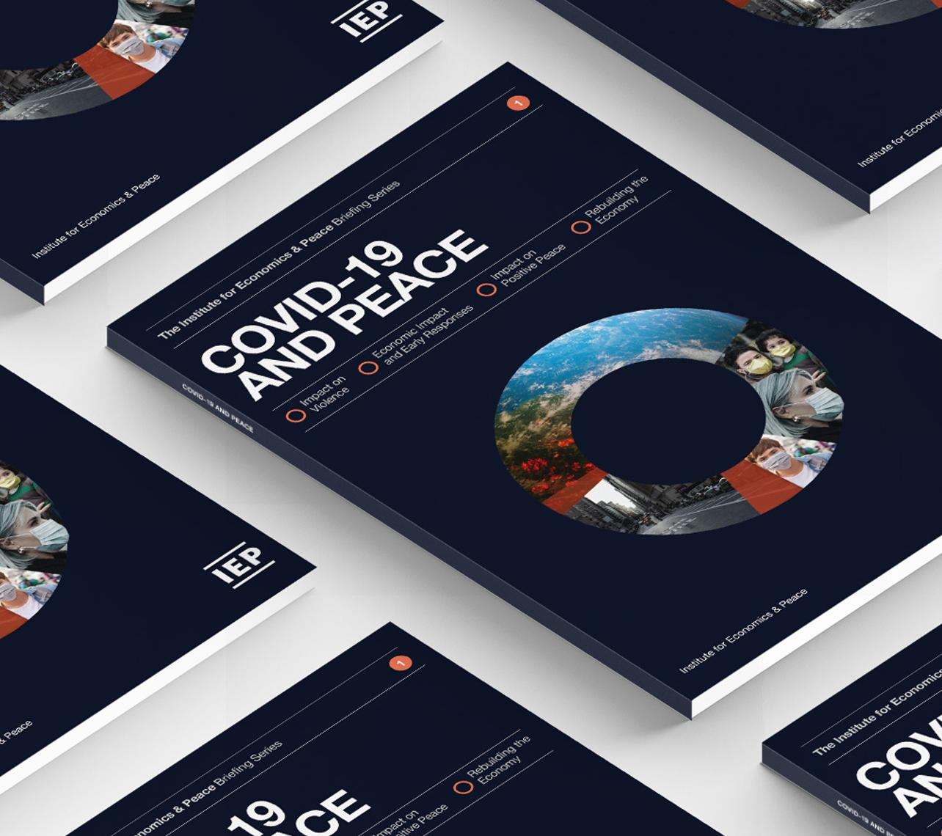
The Institute for Economics and Peace is an independent, not-for-profit think tank dedicated to building a greater understanding of the key drivers of peace, as well as identifying the economic benefits that increased peacefulness can deliver.

Slide 3
Our international offices
Brussels
The Hague
New York
Sydney Head Office
Mexico City
Harare

Slide 4

Institute for Economics and Peace
Research used extensively by organisations, including the OECD, Commonwealth Secretariat, World Bank and the United Nations
24BN
1.2BN
152
MEDIA REACH
SOCIAL REACH
COUNTRY AUDIENCE
Work is included in 1,000s of university courses
Over 500,000 downloads of IEP reports in the last 12 months
10
6000
1.4M
PUBLISHED REPORTS
BOOK REFERENCES
WEB VISITORS

Slide 5
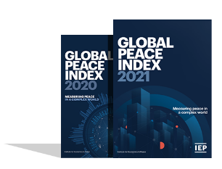
The Global Peace Index
Ranks
Now in its
99.7% of world’s population covered
15th
163
year
countries
Using
Guided and overseen by a panel of International Experts
23
Developed by the Institute for Economics and Peace
Indicators weighed on a 1-5 scale

Slide 6
The Global Peace Index Indicators
6
measures of ongoing domestic and international conflict
10
measures of societal safety
and security
7
measures of militarisation
Including: intensity of organized internal conflicts, relations with neighbouring countries and number of deaths from conflict
Including: number of refugees and IDPs, impact of terrorism, homicide and incarceration rates
Including: military expenditure, number of armed service personnel, ease of access to small weapons

Slide 7
01.
Key
Findings

Slide 8
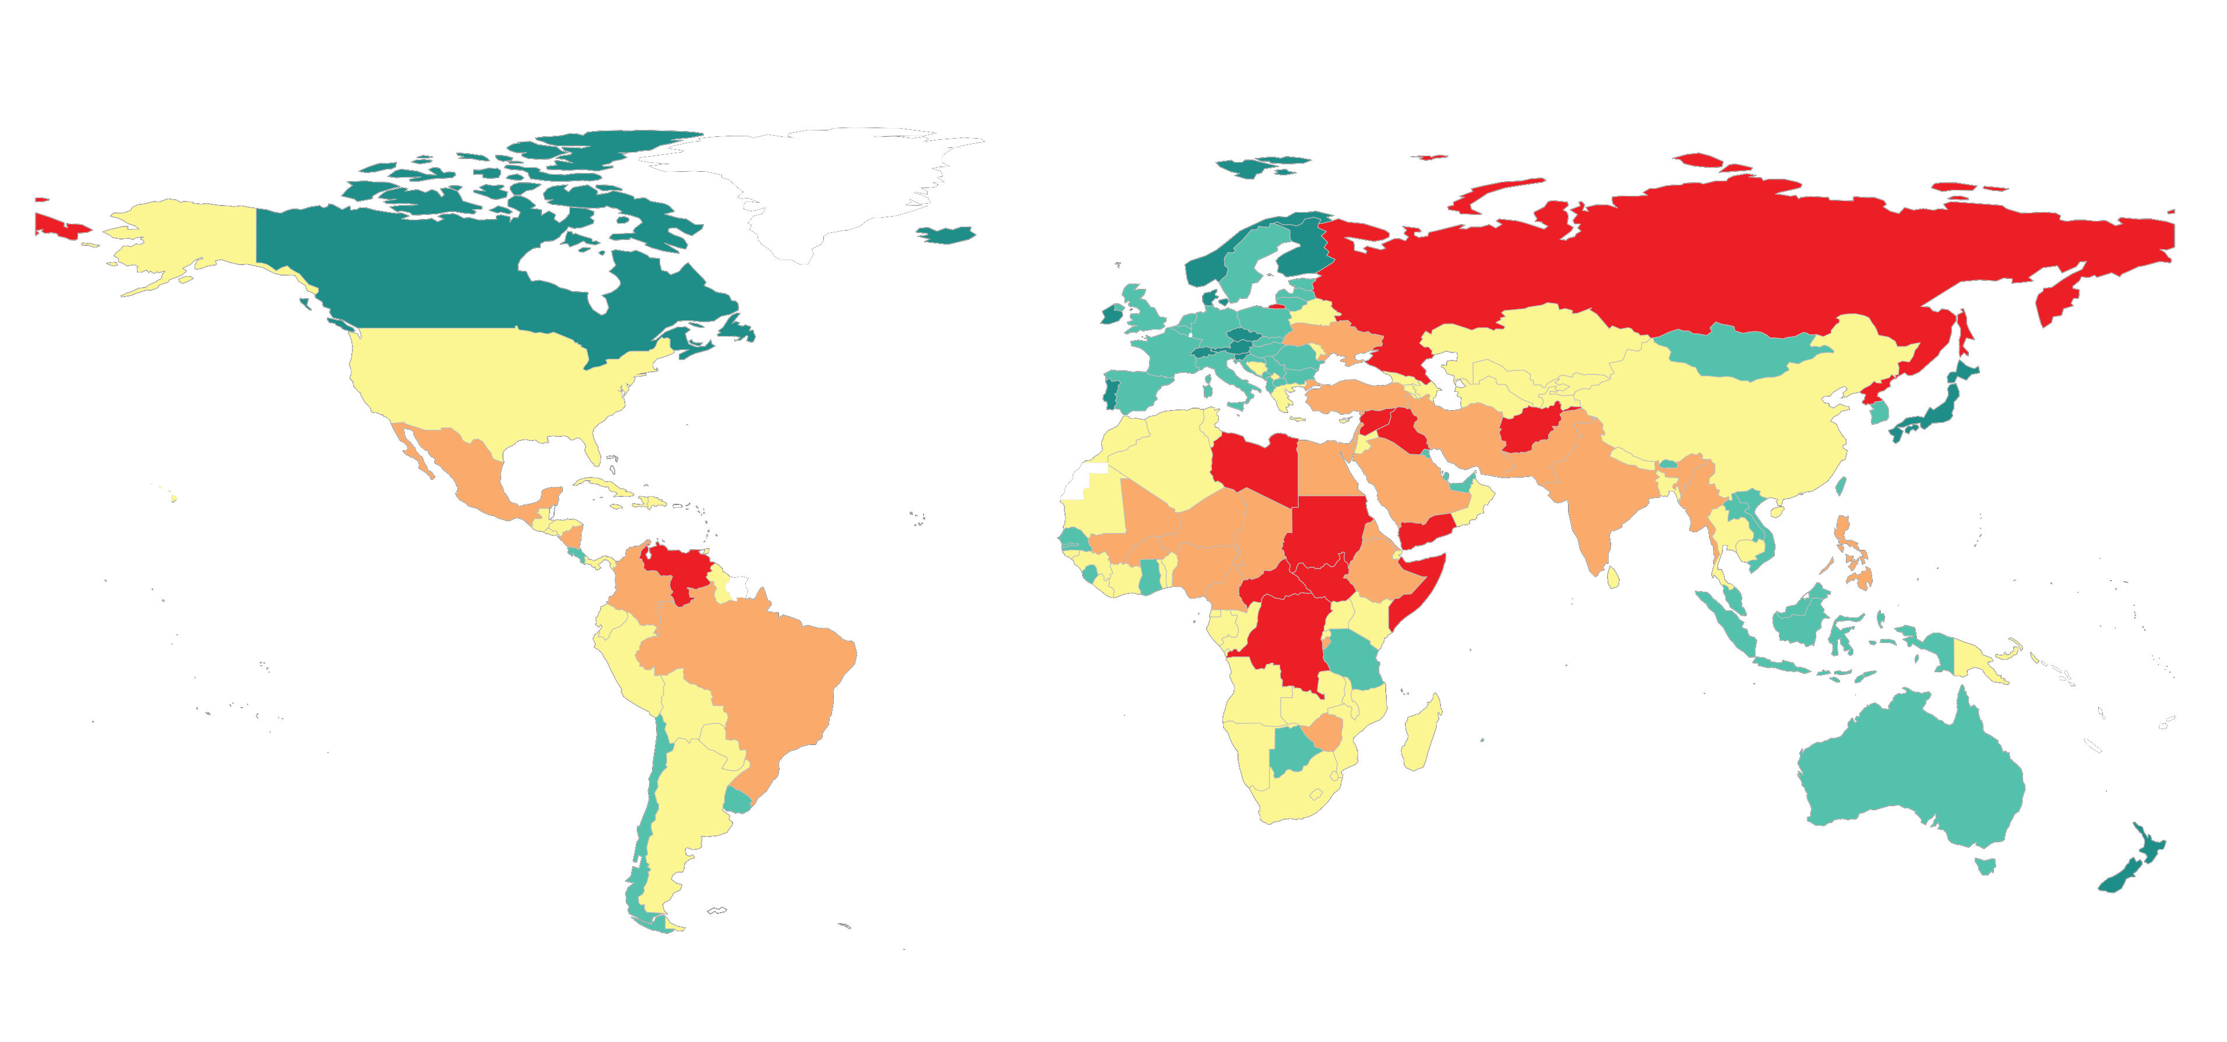
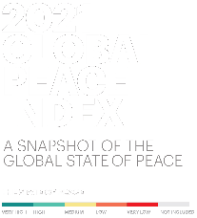
The Global Peac Index Indicators

Slide 9


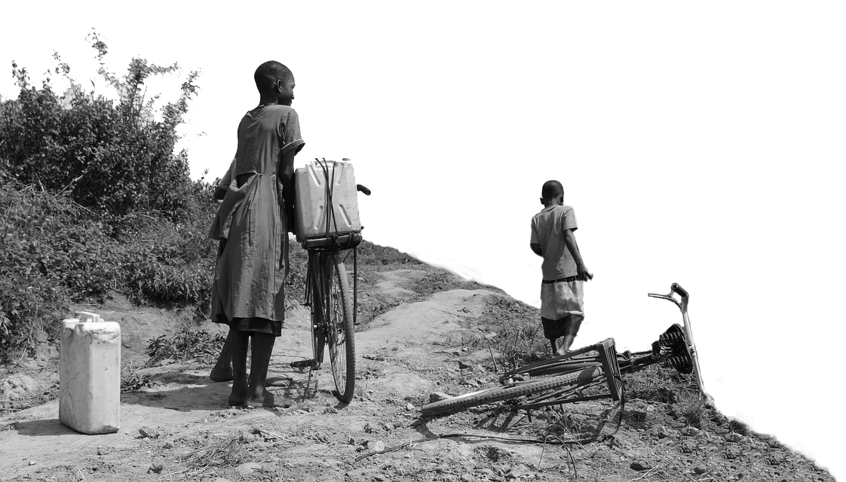
2021 key highlights
    The average level of global country peacefulness has deteriorated by
    87
    countries became more peaceful
0.07%
    73
    countries deteriorated
    This is the ninth deterioration in the last 13 years.
    Improvements were driven by changes in:
    Ongoing conflict
    Internal conflict
    Terrorism impact
    Deteriorations primarily driven by changes in:
        Militarisation
    Military expenditure
    Safety and Security

Slide 10
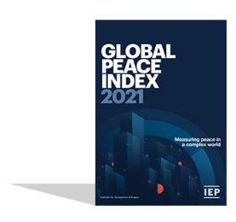


2021 highlights
    Indicators with the largest deterorations in 2021 GPI
    Violent demonstrations – 3 times more countries fell as improved
    Political instability – twice as many countries fell as improved
    Militarization – 97 countries deteriorated
    Indicators with the largest improvements in the 2021 GPI
    Deaths from internal conflict
    Number and intensity of internal conflicts
    Deaths from terrorism – 6th consecutive year of improvements

Slide 11
2021 highlights – continued
    Iceland is the most peaceful country in the world
    Ukraine and Iraq had the largest improvement
    Middle East and North Africa had the largest regional improvement.
    However, it remains the least peaceful region
    Europe remains the most peaceful region, despite a deterioration in political instability, mainly because of improvements in terrorism

Slide 12
2021 highlights - continued
    Afghanistan remains the world’s least peaceful nation. However, it recorded a small increase in peacefulness
    Burkina Faso and Belarus recorded the largest deteriorations
    North America had the largest regional deterioration, owing to
    increases in violent demonstrations
    Six of the nine GPI regions recorded deteriorations

Slide 13
10 most peaceful countries
1
ICELAND
Rank change:
6
AUSTRIA
Rank change: 2
2
NEW ZEALAND
Rank change: 1
7
SWITZERLAND
Rank change: 2
3
DENMARK
Rank change: 2
8
IRELAND
Rank change: 3
4
PORTUGAL
Rank change: 2
9
CZECH REPUBLIC
Rank change: 1
5
SLOVENIA
Rank change: 5
10
CANADA
Rank change: 3

Slide 14
10 least peaceful countries
163
AFGHANISTAN
Rank change:
158
SOMALIA
Rank change: 1
YEMEN
Rank change: 3
DEMOCRATIC REPUBLIC OF THE CONGO
Rank change: 1
162
157
161
SYRIA
Rank change: 1
156
LIBYA
Rank change: 1
160
SOUTH SUDAN
Rank change:
155
CENTRAL AFRICA REPUBLIC
Rank change: 1
159
IRAQ
Rank change: 2
154
RUSSIA
Rank change:

Slide 15
2021 regional overview
North America
North America recorded the largest deterioration in 2021, with the average level of peacefulness in the region falling by 1.8 per cent
South Asia
One of three regions to record an improvement in peacefulness, but it remains the second least peaceful region overall
Europe
MENA
Despite recording the largest
improvement in peacefulness in 2021, MENA remains the least peaceful region in the world
Europe remains the most peaceful region in the world and is home to eight of the ten most peaceful countries

Slide 16
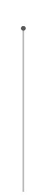
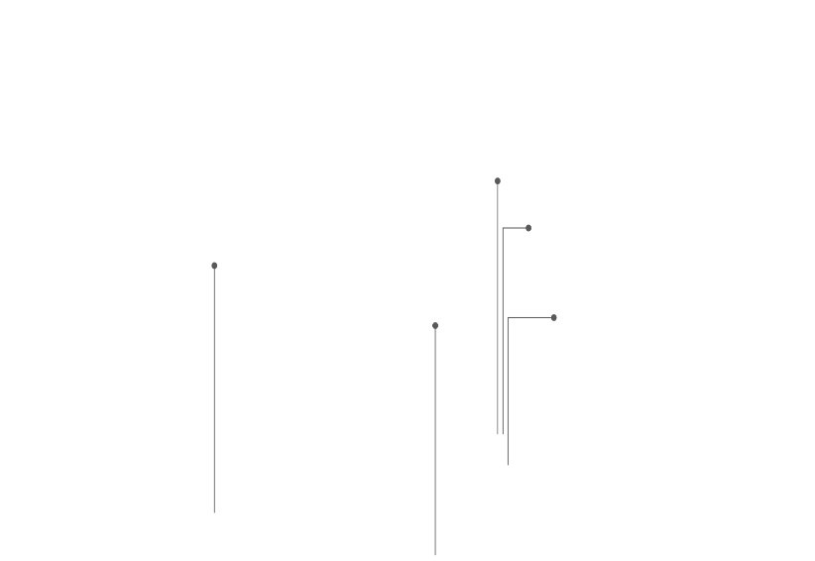
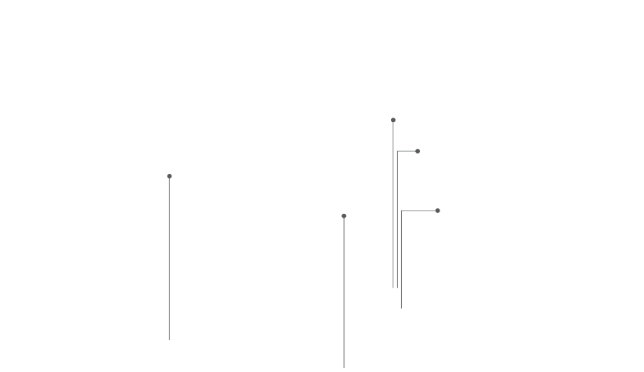
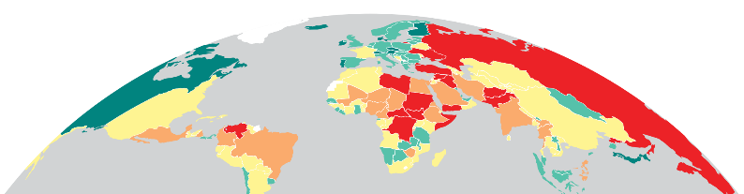
5 most improved countries
POLAND
RANK: 24
Rose 9 places
NORTH MACEDONIA
RANK: 40
Rose 11 places
UKRAINE
IRAQ
RANK: 142
RANK: 159
Rose 5 places
Rose 2 places
VIETNAM
RANK: 50
Rose 19 places

Slide 17
5 most deteriorated countries
BELARUS
BURKINA FASO
RANK: 117
RANK: 134
Fell 19 places
Fell 13 places
HONDURAS
AZERBAIJAN
RANK: 124
RANK: 121
Fell 8 places
Fell 6 places
ZAMBIA
RANK: 71
Fell 24 places

Slide 18
02.
COVID-19 &
Peace

Slide 19
Impact of COVID-19 on Peacefulness
While levels of violence fell in the early stages of the pandemic, most forms of violence returned to pre-COVID levels
Civil unrest increased considerably after an initial drop. There was a ten per cent increase in violent demonstrations in 2020
There were 5,000 COVID related violent incidents in 2020
Political instability deteriorated in 46 countries. COVID-19 exacerbated existing tensions in many countries
Long-term impact of the pandemic on homicide, violent crime, suicide is unclear.
If poor economic conditions persist, likelihood of future civil unrest will increase

Slide 20
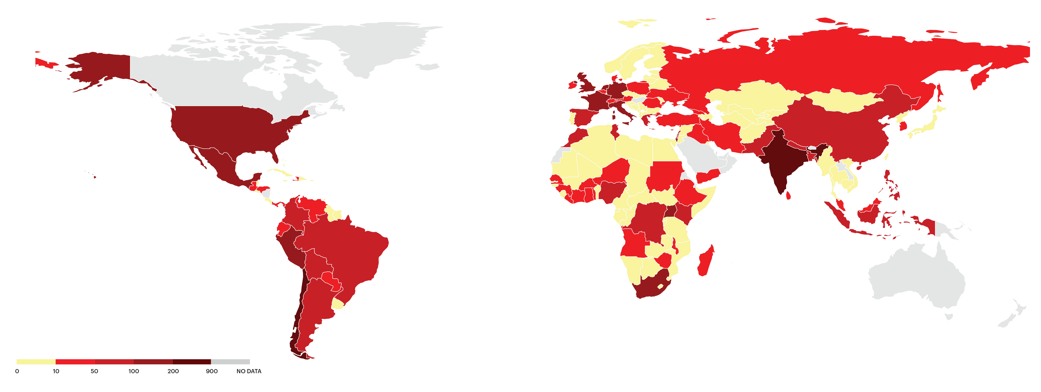
COVID-19 related violent incidents, January 2020 to April 2021
There were over 5,000 pandemic-related incidents during this period that involved
some form of violence.

Slide 21
COVID-19 and economic recovery
Economic recovery will be the key factor in whether civil unrest continues to grow
Countries with higher levels of Positive Peace are better placed to recover quicker from the pandemic
OECD Countries – Countries with high Positive Peace achieved unemployment rates of under 7% in 2020 compared to rates of up to 23% in low Positive Peace countries
The Czech Republic, Estonia, Germany, Lithuania, the Netherlands, Norway, Singapore, Slovenia, and Switzerland are best placed for a post-COVID-19 recovery

Slide 22
03.
Trends in
Peace

Slide 23
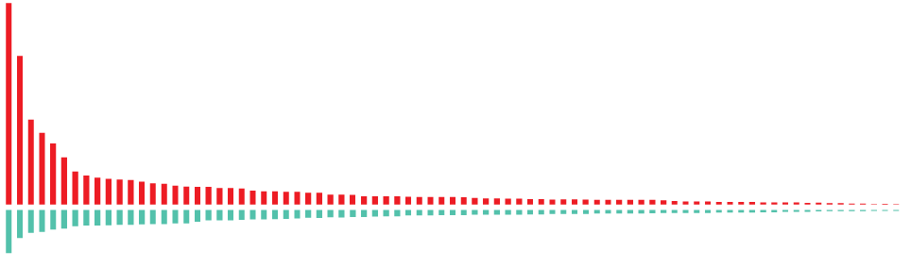
Improvements and deteriorations, 2008-2021
    75
    countries became less peaceful
Peace declined
2.00%
Since 2008
    86
    countries became more peaceful

Slide 24
Peace since 2008
    Peacefulness has declined year on year for nine of the last 13 years.

Slide 25
Peace over the last decade
    Militarisation was the only domain to improve over the last decade.
Ongoing conflict
The Ongoing Conflict domain improved for the first time since 2015
Militarisation
Largest increases in military expenditure in 2020 were the US, China, Germany and South Korea

Slide 26
Rising inequality in Global Peace
    The gap between the least and most peaceful countries continues to grow.

Slide 27
Trends in key Safety and Security indicators
Violent Demonstrations now at their highest level since the beginning of the index
Over 80 million people have now been forcibly displaced by violence
The average global homicide rate continues to fall

Slide 28
Civil Unrest, 2011 - 2019
    Major unrest events increased by 251% between 2011 and 2019

Slide 29
Trends in key Ongoing Conflict indicators
Battle Deaths continue to fall after peaking in 2014
Total conflicts fell in the past two years, but are 88% higher than 2010
The average intensity of internal conflict is still rising

Slide 30
Trends in key Militarisation indicators
The fall in the size of armed forces now appears to be levelling off
Despite high spending by global superpowers, average military expenditure has declined
Weapons imports and exports have had a moderate but sustained increase

Slide 31
04.
The Economic
Value of Peace

Slide 32
The economic impact of violence 2020
$14.96
trillion
Which is equivalent to
11.6%
of total world GDP
OR
$1942
per person
If the world decreased
violence by 10%...
$1.496 TRILLION
Could be directed to
other economic activities
10% reduction is equivalent to size of Switzerland, Denmark and Ireland’s economies

Slide 33
Economic impact of violence - Highlights
The global economic impact of violence was $14.96 trillion PPP in 2020, equivalent to 11.6 per cent of global GDP or $1,942 per person.
The economic impact increased by 0.2 per cent, owing to increases in military expenditure.
Syria, South Sudan and Afghanistan suffered the largest economic impact at 81%, 42% and 40% respectively of GDP
The ten countries most economically affected by violence averaged 36% of GDP, while ten most peaceful countries averaged 4 %.

Slide 34
Breakdown of the economic impact of violence
    Military expenditure accounts for over 40% of the total economic impact of violence.
Source: IEP

Slide 35
Composition of Economic Impact by Region
    Security spending has the largest economic impact in most regions

Slide 36
05.
Peace and Perceptions of Risk

Slide 37
Global perceptions of safety & risk
The five countries with the largest experience of violence are in sub-Saharan Africa.
50%
60%
75%
5%
Risks to safety
Fear of violent crime
Feeling safe
Male & female
50% of people in Afghanistan, Brazil, South Africa, Mexico and the Dominican Republic report violence as the greatest risk to safety in their daily lives
60% of people globally are worried about sustaining serious harm from violent crime
75% of people feel as safe or more safe than 5 years ago
5% more women fear violence than men globally
Source IEP/ Lloyds Register Foundation World Risk Poll

Slide 38
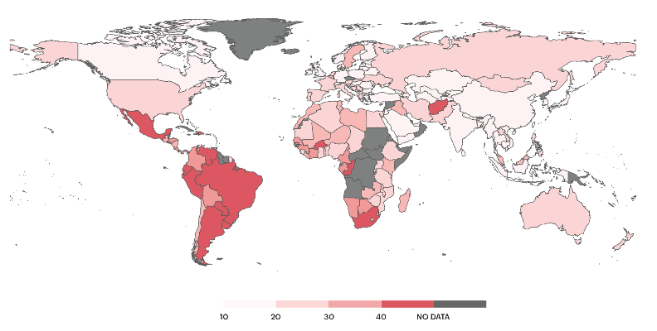
Proportion of people who cite crime, violence or terrorism as their greatest threat to safety
    The fear of violence is highest in South America and Southern Africa.

Slide 39
What is the greatest risk to your safety?
    Violence was the second most cited risk globally
Source IEP/ Lloyds Register Foundation World Risk Poll

Slide 40
Feelings of safety over time
    Only 25% of people feel that the world was less safe in 2019 compared to 2014
Source IEP/ Lloyds Register Foundation World Risk Poll

Slide 41
Experience and fear of violence – Top 5 and Bottom 5 Countries
Source IEP/ Lloyds Register World Foundation Risk Poll

Slide 42
Feelings of safety & risk– Top 5 and Bottom 5 Countries
Source IEP/ Lloyds Register Foundation World Risk Poll

Slide 43
Perceptions of Risk by Region

Slide 44
Predicting Changes in Peacefulness
The gap between Positive Peace and Negative Peace is a strong predictor of future changes in peacefulness
Countries with a Positive Peace ‘deficit’ are more likely to have falls in peacefulness in future
However, they do need a shock to unsettle their current level of peace
Of the ten countries with the largest deteriorations in peacefulness between 2009 and 2019, seven had large Positive Peace deficits in 2009
90 per cent of countries with Positive Peace deficits of more than 50 places in 2009 recorded substantial deteriorations by 2019
Equatorial Guinea, Sierra Leone, Laos, Timor-Leste, Malawi and Liberia have the largest Positive Peace Deficits in 2020

Slide 45





Get involved with IEP
@GlobPeaceIndex
GlobalPeaceIndex
Ambassador Program
Positive Peace Workshops
@GlobalPeaceIndex
Online
Strategic Partnerships
IEP Peace Academy
visionofhumanity.org

Slide 46
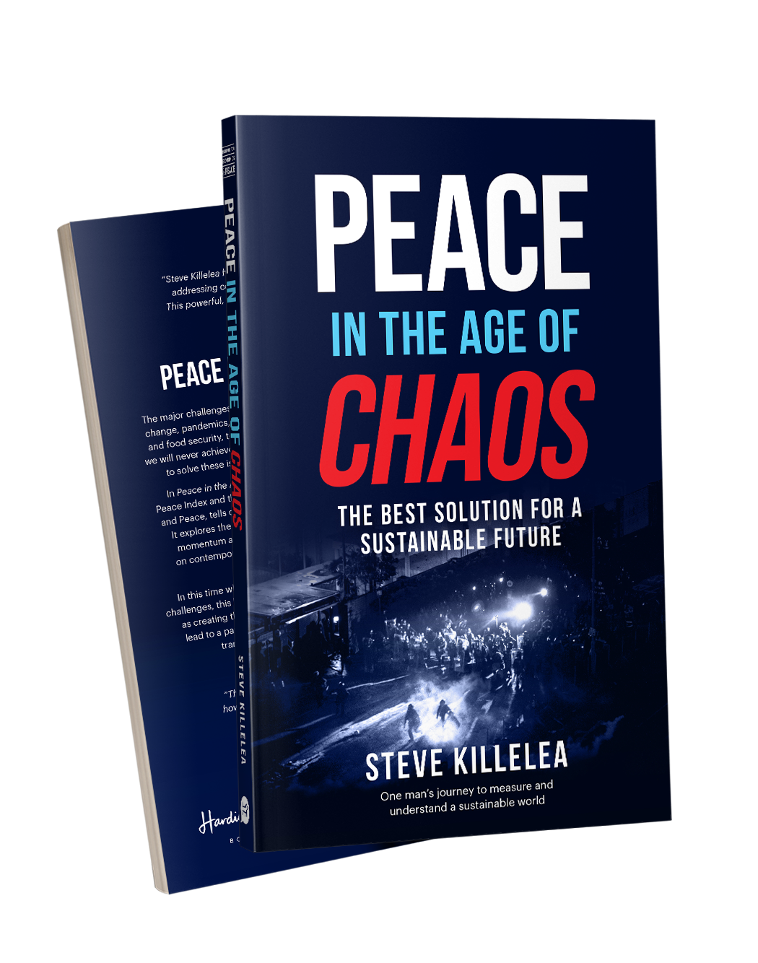
Peace in the Age of Chaos
Peace in the Age of Chaos is the debut
book by the Founder & Executive Chairman
of IEP, Steve Killelea A.M.
The book pushes the reader to rethink peace,
as something that is pivotal to the development of successful societies
Includes many personal experiences and the journey behind the founding of IEP and the Global Peace Index
Endorsed by prominent politicians,
peacebuilders and professors
Buy and more info: peaceintheageofchaos.org

