Slide 2
Institute for Economics & Peace
Research used extensively by organisations including the OECD, Commonwealth Secretariat, World Bank and the United Nations.
16BN
968M
150
MEDIA REACH
SOCIAL REACH
COUNTRY REACH
Work is included in 1,000s of university courses and trained over 1,100 IEP ambassadors.
Over 100,000 downloads of IEP reports last 12 months.
10
3000
1.5M
PUBLISHED REPORTS
BOOK REFERENCES
UNIQUE VISITORS

Slide 3
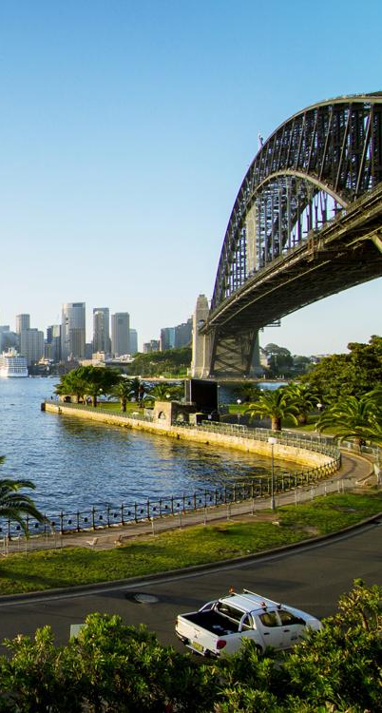
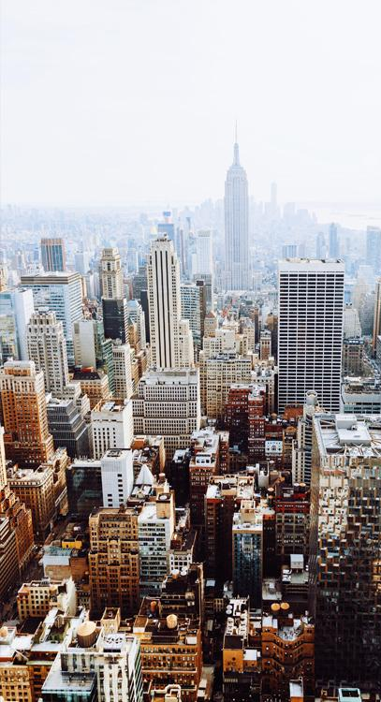
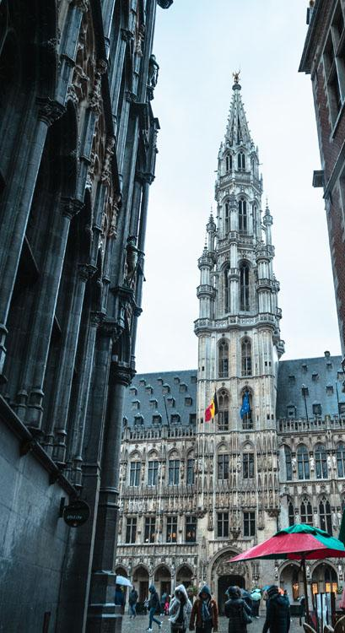
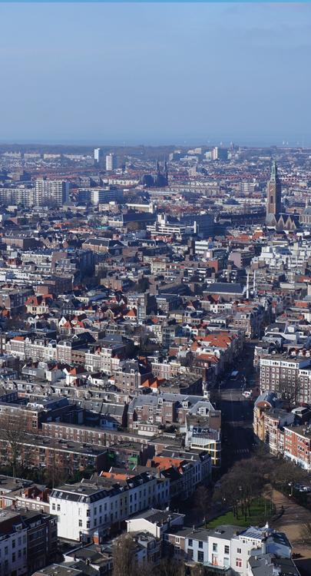
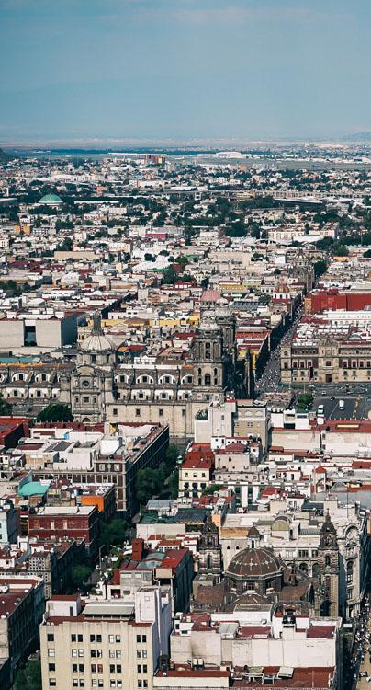
IEP International Offices
SYDNEY
NEW YORK
BRUSSELS
THE HAGUE
MEXICO CITY
HARARE
Australia
USA
Belgium
The Netherlands
Mexico
Zimbabwe

Slide 4
The Global Peace Index
Ranks
Now in its
13th
163
According to their relative states of peace
year
countries
Using
Guided and overseen by a panel of International Experts
23
Developed by the Institute for Economics and Peace
Indicators weighed on a 1-5 scales

Slide 5
The Global Peace Index Indicators
6
measures of ongoing domestic and international conflict
10
10 measures of societal safety
and security
7
measures of militarisation
Including: intensity of organized internal conflicts, relations with neighbouring countries and number of deaths from conflict
Including: number of refugees and IDPs, impact of terrorism, homicide and incarceration rates
Including: military expenditure, number of armed service personnel, ease of access to small weapons

Slide 6
01.
Key Findings

Slide 7
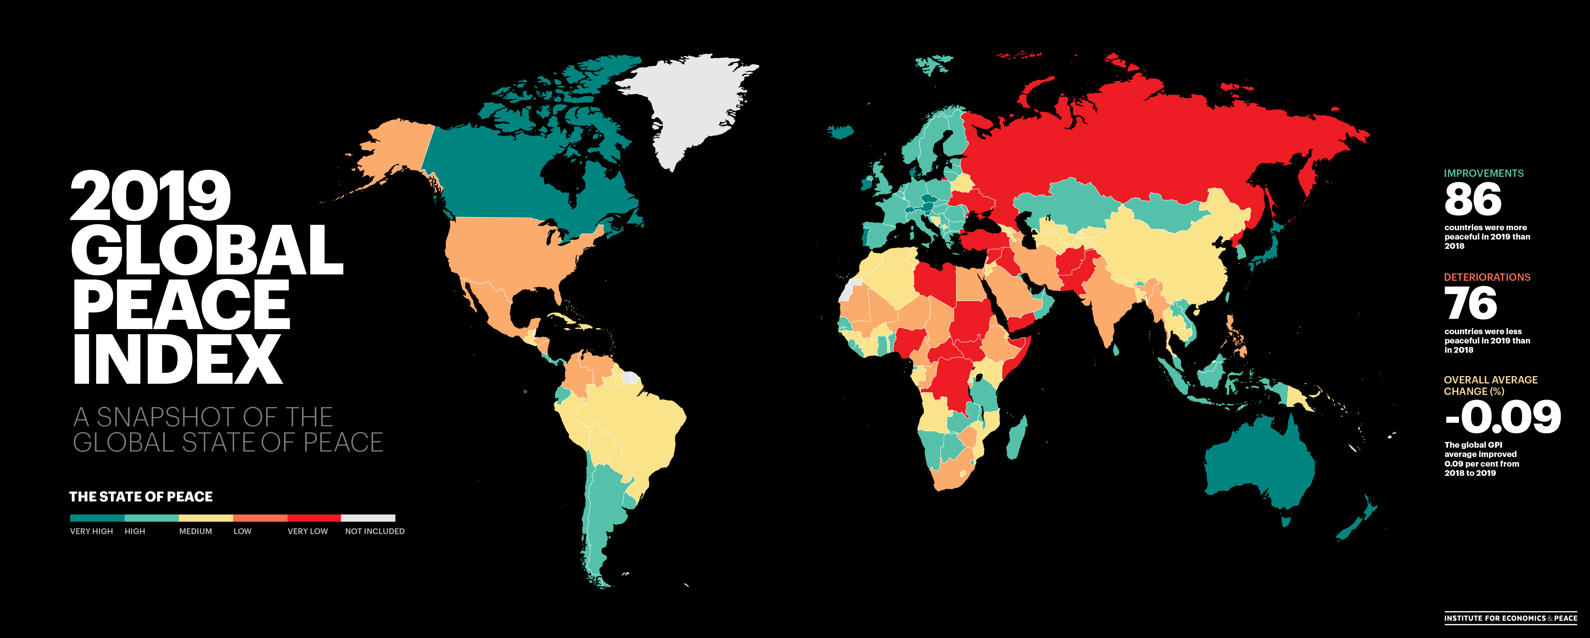

Slide 8
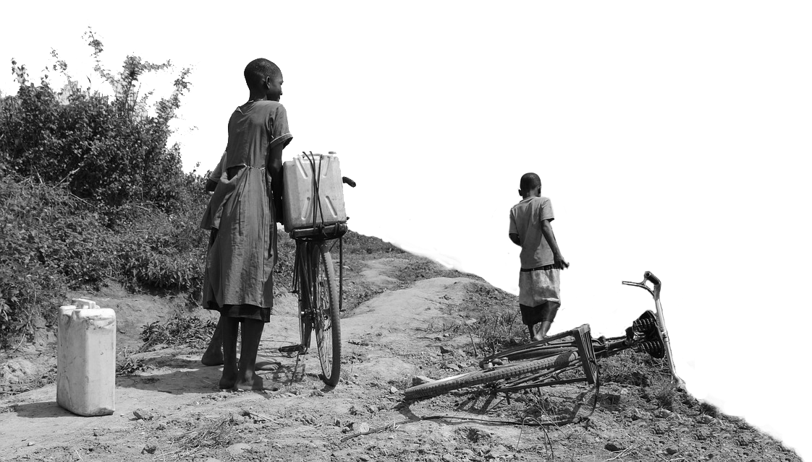
2019 highlights
The average level of country peacefilness has improved by
from last year.
86
countries became more peaceful,
0.09%
76
deteriorated.
This was the first improvement in the last five years.
Deteriorations primarily driven by changes in:
Perceptions of Criminality
Internal and External Conflicts Fought
Incarceration
Improvements were driven by changes in:
Deaths from Internal Conflict
Military Expenditure

Slide 9
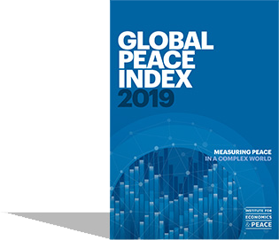
2019 highlights
Iceland is, again, the most peaceful country in the world
Ukraine and Sudan had the largest improvement
Russia and Eurasia had the largest regional improvement
Europe remains the most peaceful region, improving for the first time since 2014, despite ongoing political instability
Bhutan rises to 15 - largest improvement of any country in top 20 - risen 43 places in 12 years

Slide 10
2019 highlights - continued
Afghanistan is now the world’s least peaceful nation, followed by Syria
Nicaragua and Burkina Faso had the largest deteriorations
Central America and North America had the largest regional deteriorations
Iran drops 9 places to 139
US drops 4 places to 128 – Homicide, Violent crime, Milex, Weapons Exports

Slide 11
10 most peaceful countries
1
ICELAND
Rank change:
6
CANADA
Rank change:
2
NEW ZEALAND
Rank change:
7
SINGAPORE
Rank change: 2
3
PORTUGAL
Rank change: 2
8
SLOVENIA
Rank change: 2
4
AUSTRIA
Rank change: 1
9
JAPAN
Rank change: 1
5
DENMARK
Rank change: 1
10
CZECH REPUBLIC
Rank change: 3

Slide 12
10 least peaceful countries
163
AFGHANISTAN
Rank change: 1
158
SOMALIA
Rank change: 1
162
SYRIA
Rank change: 1
157
CENTRAL AFRICAN REPUBLIC
Rank change: 1
161
SOUTH SUDAN
Rank change:
156
LIBYA
Rank change: 1
160
YEMEN
Rank change: 2
155
CONGO, DEM. REP.
Rank change:
159
IRAQ
Rank change: 1
154
RUSSIA
Rank change: 1

Slide 13
5 most improved countries
Rose 2 places
Rose 3 places
Rose 7 places
Rose 24 places
Rose 23 places

Slide 14
5 most deteriorated countries
Fell 26 places
Fell 54 places
Fell 6 places
Fell 10 places
Fell 9 places

Slide 15
02.
Trends & Peace

Slide 16
Peace in the last decade
Peacefulness has declined year on year for eight of the last eleven years.
OVERALL SCORE TREND
YOY% CHANGE
Source: IEP

Slide 17
Changes in peace, 2008-2019
81
countries became less peaceful
Peace declined
3.78%
Over the last decade
81
countries became more peaceful

Slide 18
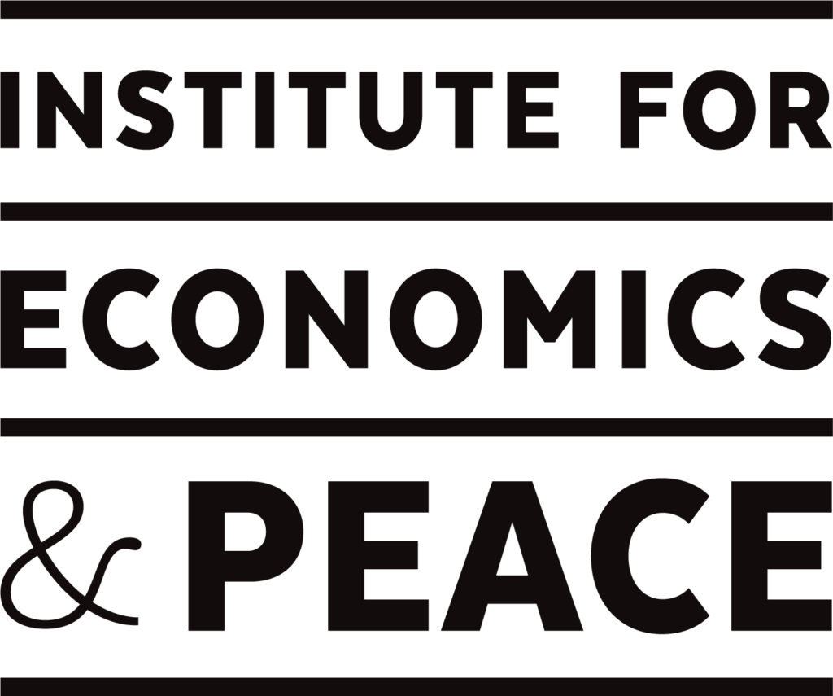
Deteriorations in peace-10 years
60
This number of
DISPLACED PEOPLE
has doubled
million in 2017
2008
2018
251%
Increase in battle deaths
203%
Increase in deaths from terrorism

Slide 19
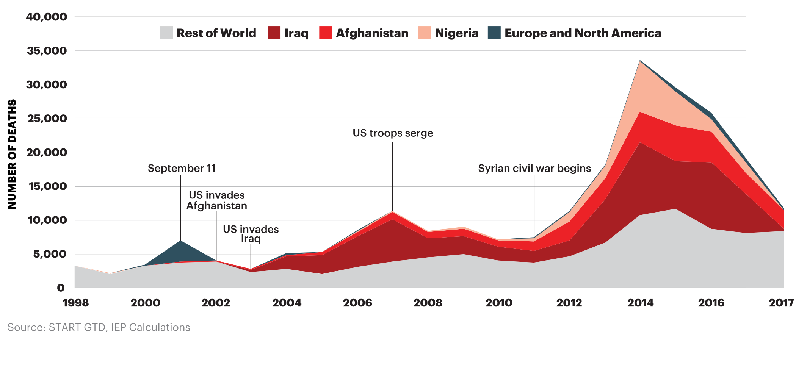
Deaths from terrorism by country, 2018

Slide 20
Improvements in peace-10 years
72%
61%
39%
39% more countries
improved than deteriorated in political terror
61% of countries reduced military expenditure as a % of GDP
72% of countries had a drop in the homicide rate

Slide 21
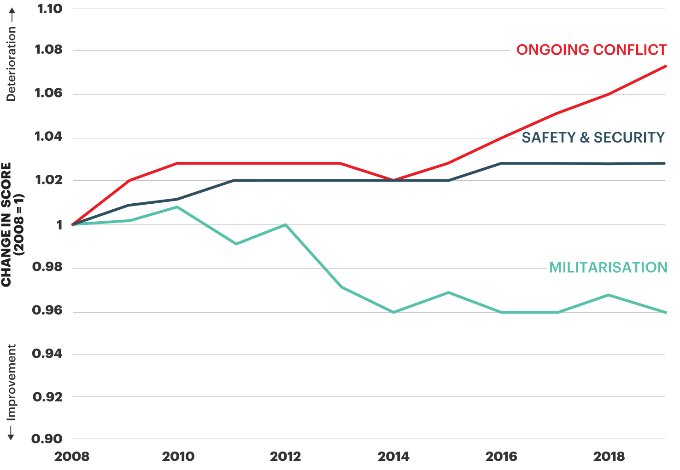
Peace in the last decade
Militarisation was the only domain to improve.
Source: IEP

Slide 22
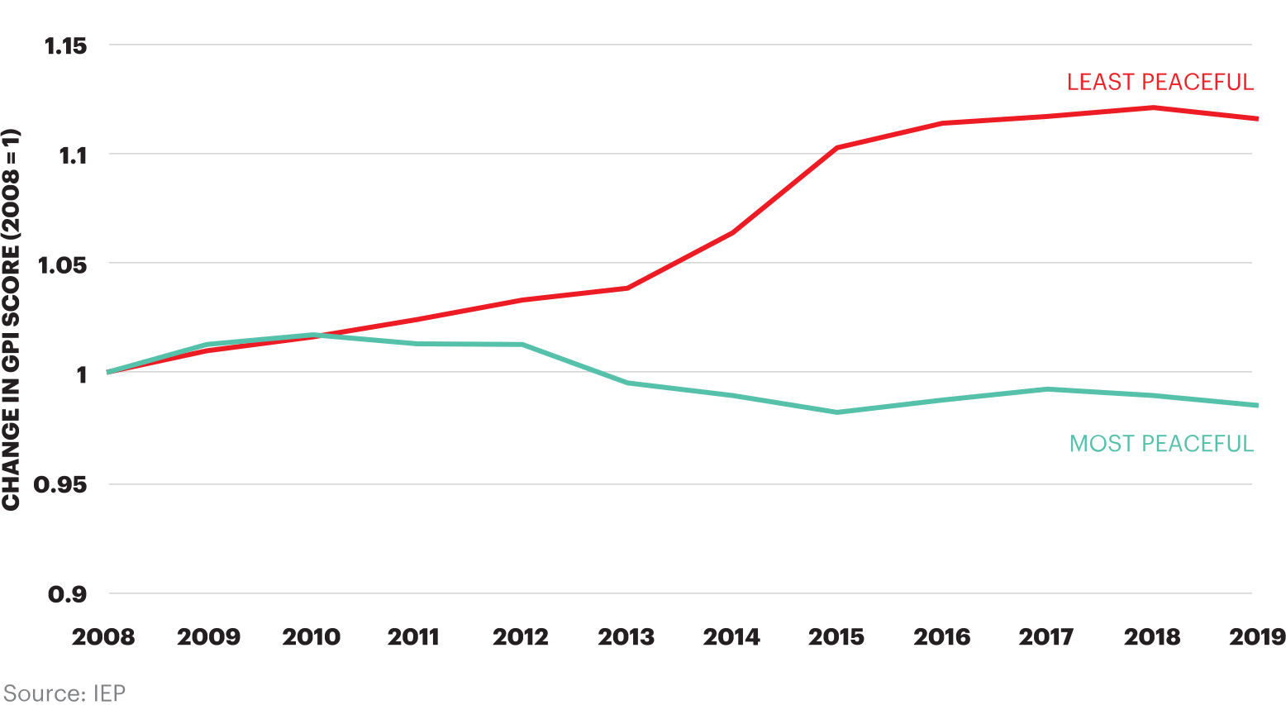
The stickiness of peace
Gap between the least and most peaceful countries continues to grow.

Slide 23
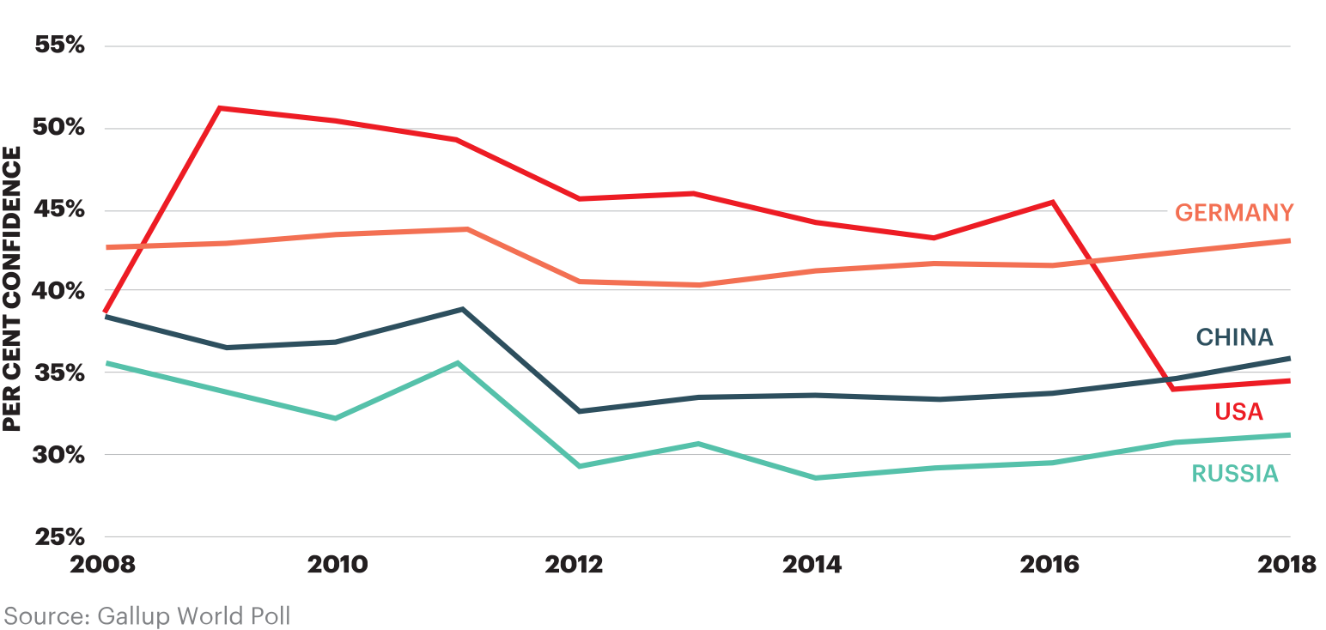
Perceptions of global leadership in 2018
Approval of Chinese leadership overtook approval of American leadership.

Slide 24
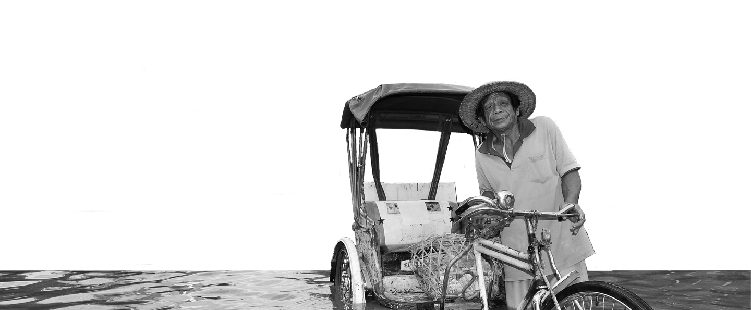
Climate change and peace
971 million people live in areas with high or very high climate change exposure. 400 million reside in countries with low levels of peacefulness.
Climate change can increase the likelihood of violent conflict through its impact on resource availability, livelihood security and migration.
Countries with high levels of Positive Peace are better able to manage climate-induced shocks and tend to have higher environmental performance.

Slide 25
03.
Economic Impact of Violence

Slide 26
The global cost of violence, 2019
Deaths from conflict and terrorism peaked in 2014.
$14.1
trillion
Which is equivalent to
11.2%
of total world GDP
OR
$1853
per person
If the world decreased
violence by 10%...
$1.41 TRILLION
Could be directed to
other economic activities

Slide 27
Global economic impact of violence
The average economic cost of violence was equivalent to 45% of GDP in the ten countries most impacted by violence, compared to only 2% in the ten least affected.
In the last 70 years, per capita GDP growth has been three times higher in highly peaceful countries compared to those with low levels of peace
Peace is positively related to changes six macro economic indicators
GDP growth, exchange rate, inflation rate, interest rate, FDI and sovereign credit ratings

Slide 28
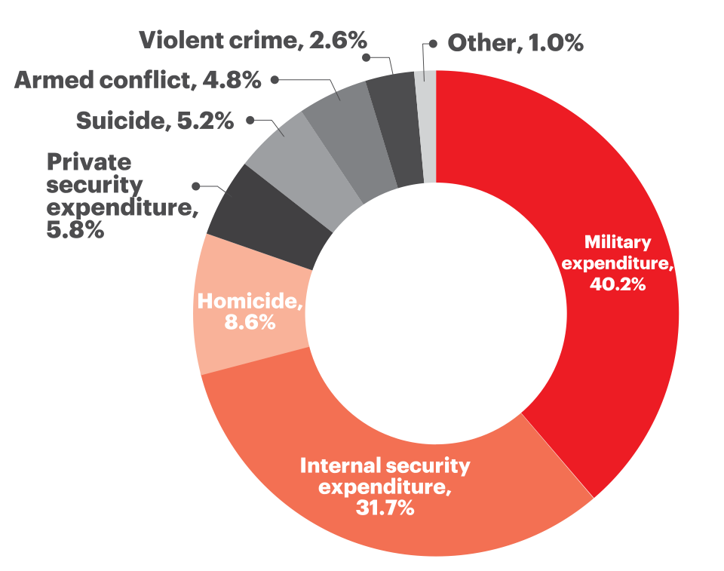
Breakdown of the economic impact of violence
Military expenditure accounts for over 40% of the total economic impact of violence.
A 1% reduction in the cost of violence is the equivalent to:
1%
total global Official Development Assistance in 2017
A 10% reduction in the cost of violence is the equivalent to:
10%
The global total Foreign Direct Investment in 2018
The size the combined economies of Switzerland, Ireland and Denmark
Source: IEP

Slide 29
03.
Positive Peace

Slide 30
Defining and measuring peace
The perfect state would have no police, jails or crime.
Actual Peace
Measures:
Crime
Suppression
Military
Armed Conflict
Positive Peace
Derived through statistical analysis of datasets, indices and attitudes with the GPI
GPI
Positive Peace Index
Notes:
There are two types of peace. Negative and positive.
Starting point for the GPI is to image a state with no need for jails, crime and therefore no peace.
The definition in the Global Peace Index is ‘absence of violence’ and ‘absence of fear of violence’
But negative peace doesn’t tell you anything about what is necessary for a peaceful society
Positive peace index is derived through statistical analysis of over 9,000 datasets, indexes and attitudinal surveys
This is first empiric attempt to derive positive peace, this enables one to imagine how a world can become more peaceful.

Slide 31
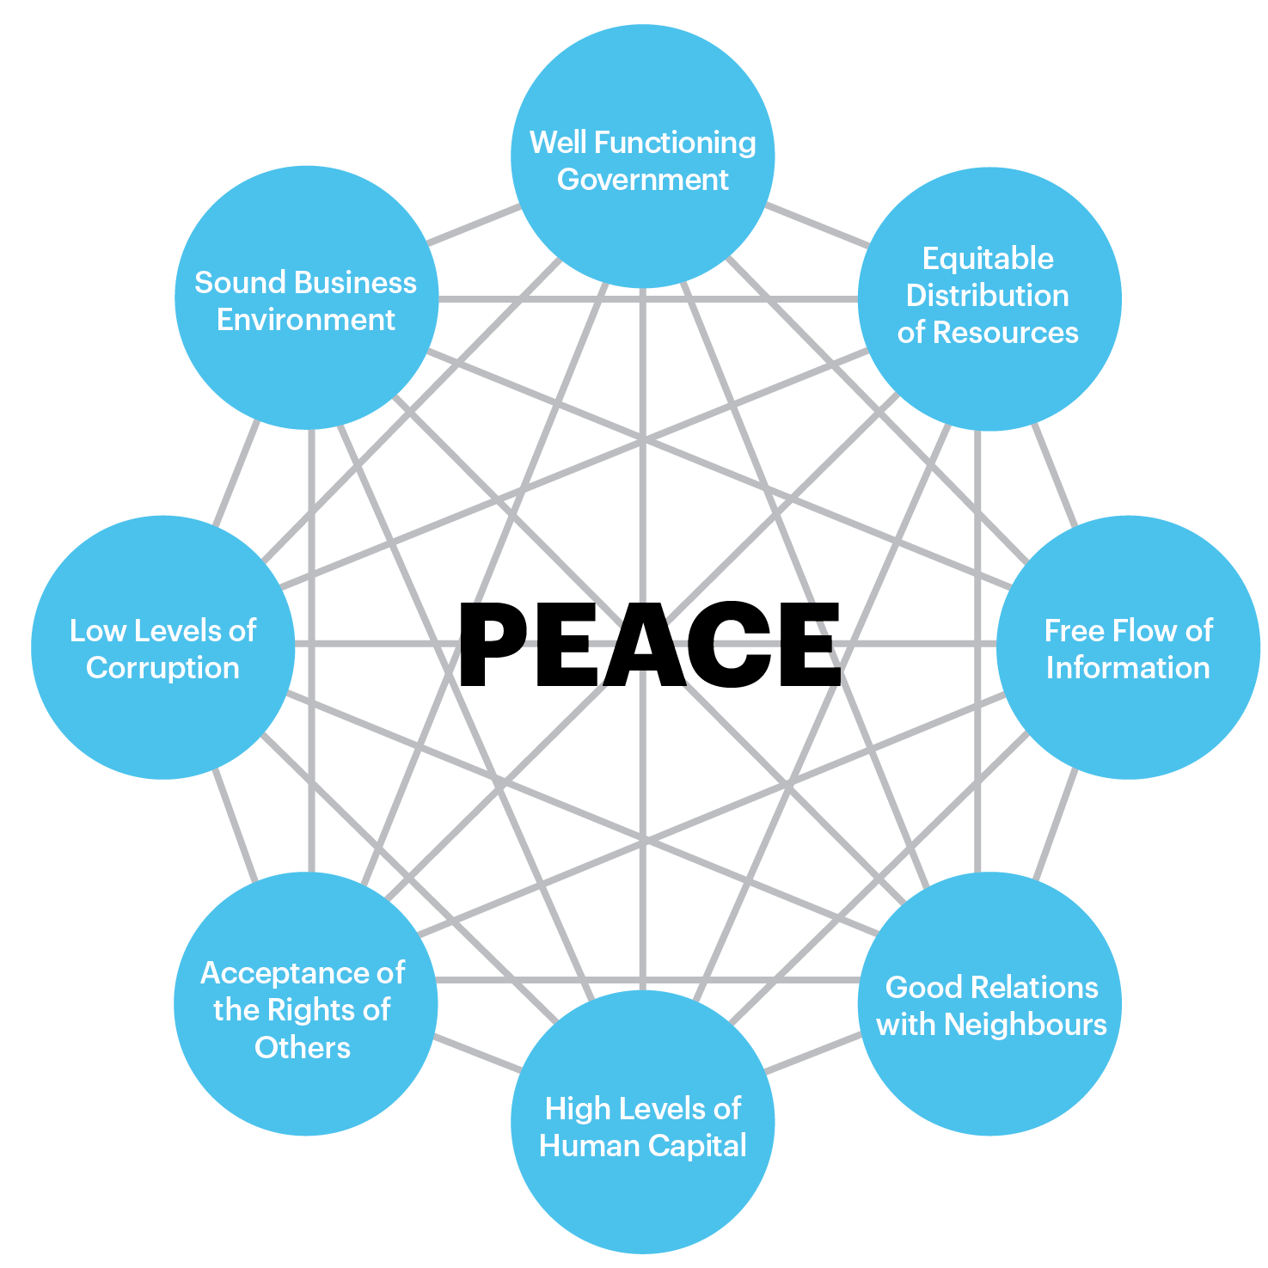
Positive Peace
Positive Peace creates the optimum environment for human potential to flourish.
High levels of Positive Peace are associated with:
Higher per capita income
Resilience
Better environmental outcomes
Higher GDP growth per annum
Better performance on MDGs

Slide 32
Connect with us
visionofhumanity.org
GlobalPeaceIndex
@GlobPeaceIndex
@GlobalPeaceIndex

